Slide 1









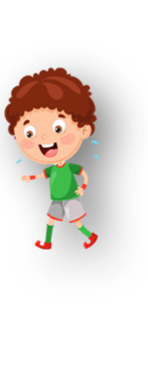











Unit 1 My family Lesson 2 – Task 4,5,6
Notes:
Để nguyên trang bìa như này, chỉ thay đổi tên bài trong quá trình làm. Logo của sách Wonderful World

Slide 2



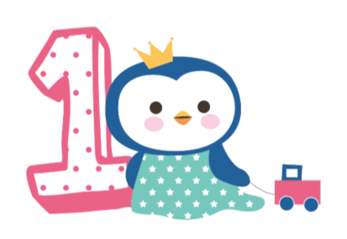



Warm up
Song: I love my family.

Slide 3


I love my family!
Notes:
https://www.youtube.com/watch?v=b5jVOrR0J28

Slide 4
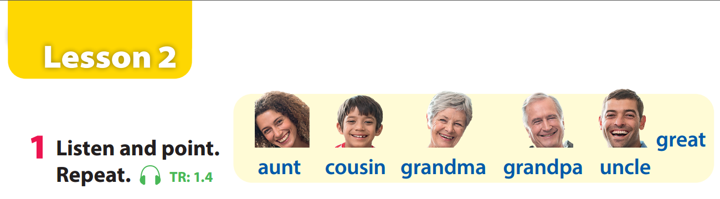

Review
Notes:
- Revise and practice functional language from lesson 2 with the flashcards.
- Then ask volunteers to stand at the front of the class and
ask and answer questions. (E.g: Who is this? – This is my ...)

Slide 5
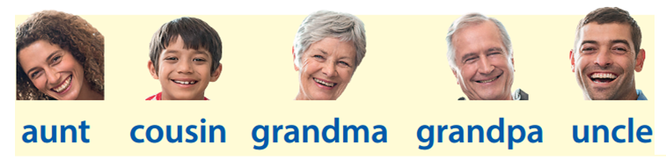
Review
Who’s missing?
Who’s missing?
Who’s missing?
Who’s missing?
Who’s missing?
Notes:
Game: Who’s missing?
Divide the class into 4 groups.
Teacher shows the cards of family members on the board/screen.
Teacher hides a flashcard of a family member.
Ask each member to stand and say which picture is missing.
Who says it fast will get points for the teams.

Slide 6

Presentation
Task 4: Listen and repeat.

Slide 7
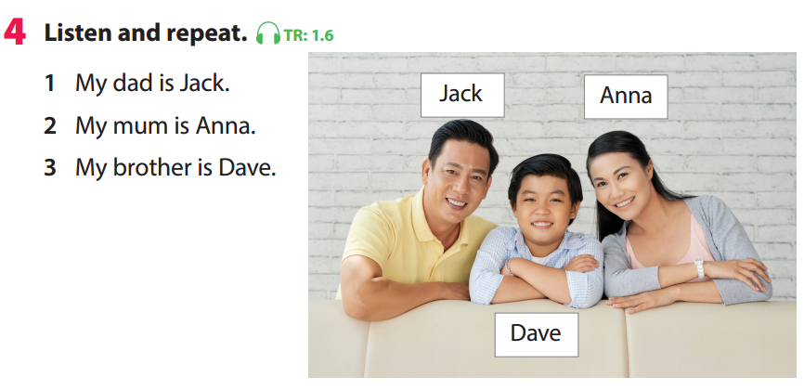


Notes:
Task 4: Listen and repeat. (Track 1.6)
- Point to the pictures. Ask students to notice the people and their names. Tell students that this structure can be used to introduce the names of the members in a family.
- Play the recording. Tell students to look at the pictures and follow the sentences with their fingers.
- Play the recording again. Ask students to repeat.

Slide 8

Practice
Task 5: Look and say.

Slide 9
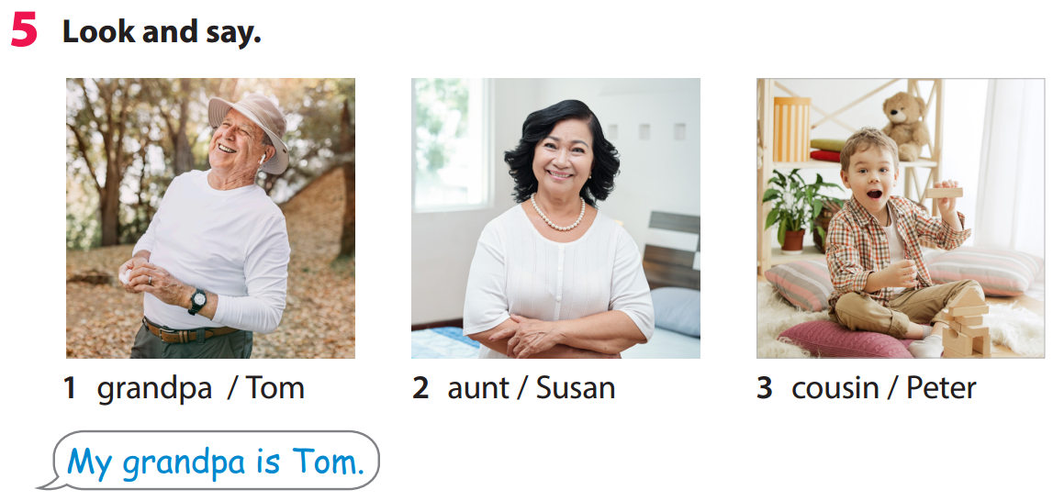
My grandpa is Tom
Notes:
Task 5: Look and say. Nhấn mạnh cấu trúc ngữ pháp & phần bôi đỏ hs có thể thay thế
Tell students to look at the pictures and ask them
Ask students to practice saying the sentences individually and then in pairs.
Ask volunteers to read out their answers. Correct any mistakes.
Suggested sentences:
2. My aunt is Susan.
3. My cousin is Peter

Slide 10

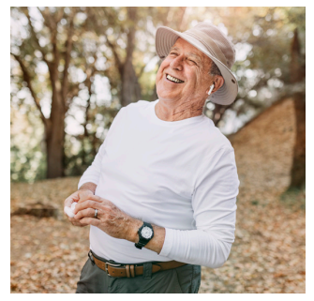



Slide 11
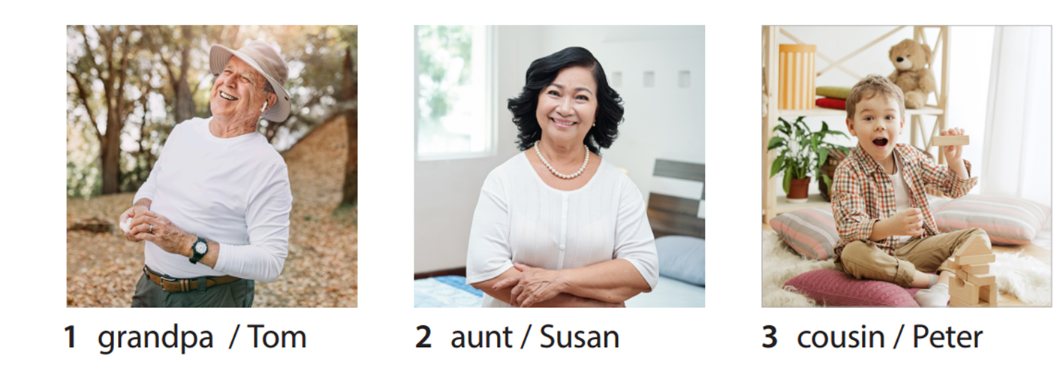
My aunt is Susan.

Slide 12
My cousin is Peter.

Slide 13






Slide 14



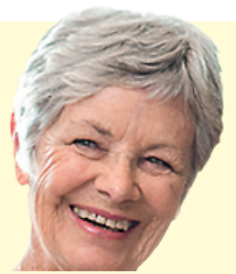
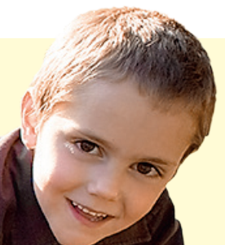
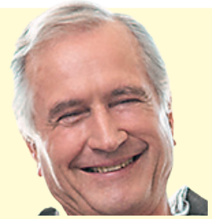
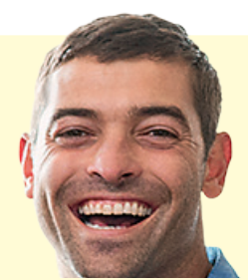

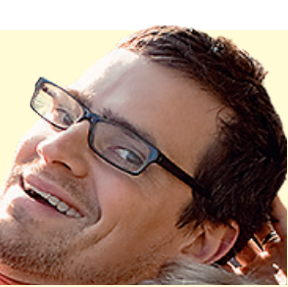
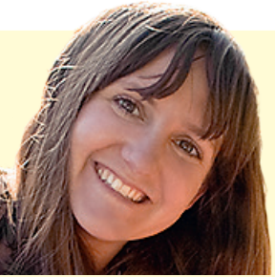

Go
Notes:
Mini game: Lucky memeber
- Divide class into 3 groups.
- Ask each group to choose one member they like, then say a structure to introduce the names of the members in their family.
E.g: My mum is Nga.
- The game will give students a random point if they answer correctly.
- Group has a most points is the winner

Slide 15




My aunt is
............

Slide 16

My cousin is ..........

Slide 17

My grandma is .........

Slide 18

My brother is .........

Slide 19

My grandpa is .........

Slide 20

My uncle is .........

Slide 21

My dad is .........

Slide 22
My mum is .........

Slide 23
My sister is .........

Slide 24
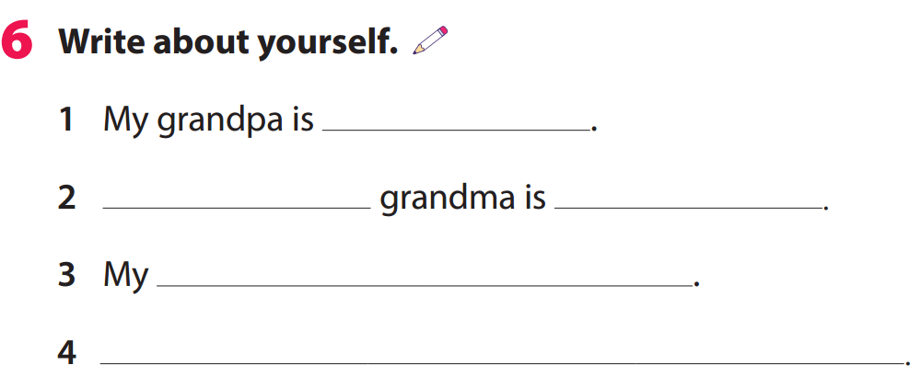

Mike
My
Maria
sister is Nina
My uncle is Jack
Notes:
Task 6: Write about yourself! GV yêu cầu hs viết về bản thân mình dựa theo đáp án bôi đỏ
- Tell them to look at the prompt. Elicit which information is missing in each sentence.
- Explain to students that they have to fill in the blanks with information about their family members.
- Ask volunteers to read out their sentences to the whole class.

Slide 25

Production
My family book

Slide 26



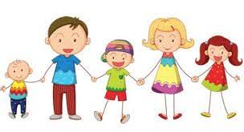
Notes:
My Family book.
- Tell students they’re going to make a family story book together.
- Ask student to draw/ glue a picture of member in this book. Then write the information about him/her.
E.g.: This is my ______
He is__________
Age: __________

Slide 27

Assessment

Slide 28
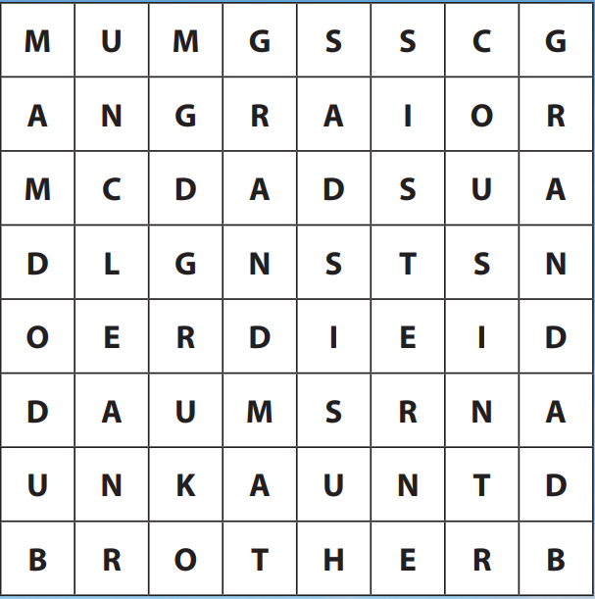

Slide 29



Good bye.
See you again!
Notes:
Để nguyên trang goodbye như này.

