Slide 1













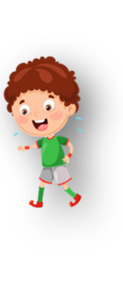








Unit 1 My family Lesson 1 – Task 4,5,6
Notes:
Để nguyên trang bìa như này, chỉ thay đổi tên bài trong quá trình làm. Logo của sách Wonderful World

Slide 2





Warm up
Spin! Up and down.

Slide 3

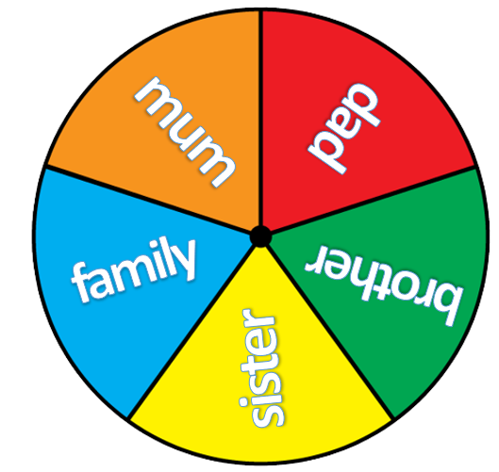


spin
Notes:
Bấm vào nút Spin để quay tròn, sau đó bấm spin để dừng lại. Sau đó click chuột bên ngoài ảnh sang slide tiếp theo
Mini game: Spin! Up and down
- Tell students to make groups of 5. Each student in group holds a different flashcard/ tag name of a member in family. Spin the wheel until it stops. Call a student say the word.
- If the student listen to the word that matches their flashcard ( e.g: mum – up, sister – down, ...) they must stand up/ sit down and say out loud.

Slide 4
spin
Notes:
Bấm vào nút Spin để quay tròn, sau đó bấm spin để dừng lại. Sau đó click chuột bên ngoài ảnh sang slide tiếp theo
Mini game: Spin! Up and down
- Tell students to make groups of 5. Each student in group holds a different flashcard/ tag name of a member in family. Spin the wheel until it stops. Call a student say the word.
- If the student listen to the word that matches their flashcard ( e.g: mum – up, sister – down, ...) they must stand up/ sit down and say out loud.

Slide 5
spin
Notes:
Bấm vào nút Spin để quay tròn, sau đó bấm spin để dừng lại. Sau đó click chuột bên ngoài ảnh sang slide tiếp theo
Mini game: Spin! Up and down
- Tell students to make groups of 5. Each student in group holds a different flashcard/ tag name of a member in family. Spin the wheel until it stops. Call a student say the word.
- If the student listen to the word that matches their flashcard ( e.g: mum – up, sister – down, ...) they must stand up/ sit down and say out loud.

Slide 6
spin
Notes:
Bấm vào nút Spin để quay tròn, sau đó bấm spin để dừng lại. Sau đó click chuột bên ngoài ảnh sang slide tiếp theo
Mini game: Spin! Up and down
- Tell students to make groups of 5. Each student in group holds a different flashcard/ tag name of a member in family. Spin the wheel until it stops. Call a student say the word.
- If the student listen to the word that matches their flashcard ( e.g: mum – up, sister – down, ...) they must stand up/ sit down and say out loud.

Slide 7
spin
Notes:
Bấm vào nút Spin để quay tròn, sau đó bấm spin để dừng lại. Sau đó click chuột bên ngoài ảnh sang slide tiếp theo
Mini game: Spin! Up and down
- Tell students to make groups of 5. Each student in group holds a different flashcard/ tag name of a member in family. Spin the wheel until it stops. Call a student say the word.
- If the student listen to the word that matches their flashcard ( e.g: mum – up, sister – down, ...) they must stand up/ sit down and say out loud.

Slide 8




This is my family.
Notes:
Lead in
- Teacher asks 1 group to come and say in front of the class. Each student introduces him/herself:
dad
mum
brother
sister
- Then teacher introduces a family by saying: This is my mum/dad/brother/sister/ family (with hand gestures).
- Tell that students are going to learn more about how to introduce their family members.

Slide 9

Notes:
finger family song
https://www.youtube.com/results?search_query=finger+family+song

Slide 10




Presentation
Task 4: Listen and repeat.

Slide 11
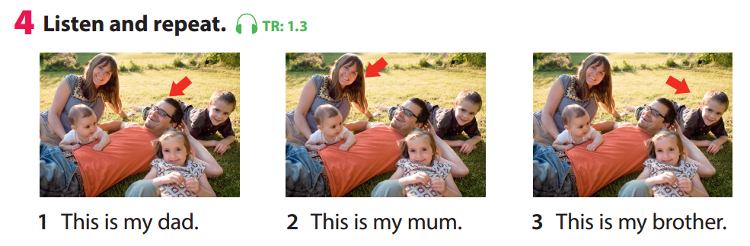

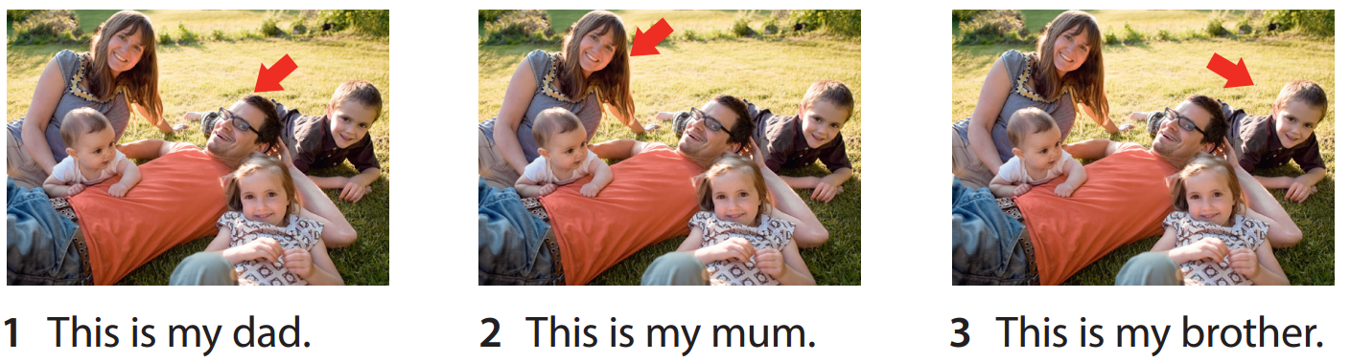

Notes:
GV click audio trước nghe tới đâu thì click point vào.

Slide 12
This is my dad
A
B
Notes:
Bấm chuột lần 1 sẽ xuất hiện hình ảnh & âm thanh. Click lần 2 chọn A. Click lần 3 sẽ hiện cụm câu.
Mini game: Listen and choose the correct picture
Key: A

Slide 13
Listen and choose
This is my brother
A
B
Notes:
Bấm chuột lần 1 sẽ xuất hiện hình ảnh & âm thanh. Click lần 2 chọn A. Click lần 3 sẽ hiện cụm câu.
Mini game: Listen and choose the correct picture
Key: B

Slide 14
Listen and choose
This is my mum
A
B
Notes:
Bấm chuột lần 1 sẽ xuất hiện hình ảnh & âm thanh. Click lần 2 chọn A. Click lần 3 sẽ hiện cụm câu.
Mini game: Listen and choose the correct picture.
Key: A

Slide 15

Practice
Task 5: Look and say.

Slide 16
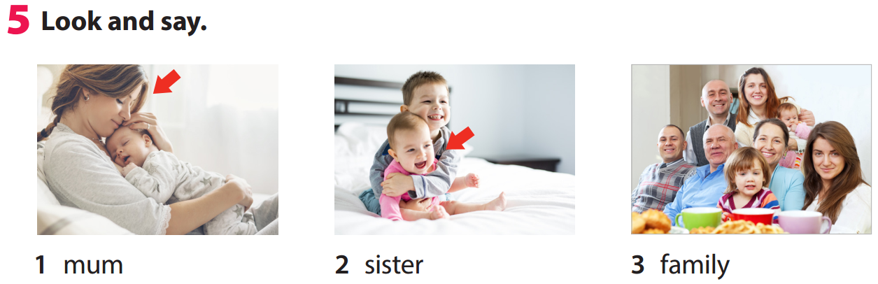
mum
This is my
Notes:
Trọng tâm vào mẫu câu “This is my……..” nên khi click chuôt sẽ hiện từ mum. Sau đó GV yêu câu hs tự đặt theo mẫu câu tương tự cho hình 2 và 3
- Tell students to look at the picture for question 1 and ask them whom the arrow points to. Elicit “mum”. Read out the example and ask students to repeat it.
- Explain the rest of the task to students. Allow them enough time to practise saying the sentences individually and then in pairs. Go round the class helping students if necessary.
- Ask volunteers to read out their answers. Correct any mistakes.

Slide 17


7
1
5
2
3
6
8
4
LUCKY STAR
GO
Notes:
THIẾT KẾ HOẠT ĐỘNG TƯƠNG TÁC: câu trả lời ở cuối mỗi slide từ slide 18-
Mini game: A lucky star
Divide class into 2 big groups. (Boys and Girls)
There are 2 lucky numbers in this game. If students choose a lucky one, they will get 5 points without answering question. If their number is not lucky one, they must read a sentence and get points if it is right, otherwise other groups will take their turn. The group which has more points will win the game.

Slide 18




You are given 3 points
Notes:
This is my sister.

Slide 19
You are given 1 point
Notes:
This is my dad.

Slide 20

You are given 5 points
Notes:
Lucky star. Ko cần trả lời vẫn được 5 điểm

Slide 21
You are given 3 points
Notes:
This is my mum.

Slide 22
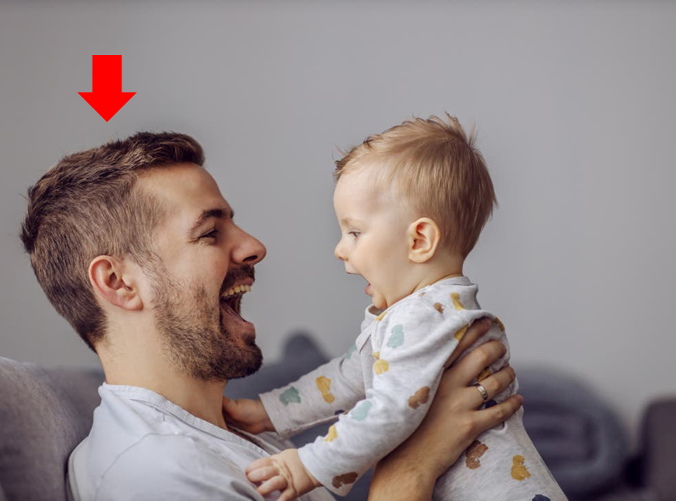
You are given 2 points
Notes:
This is my dad.

Slide 23
You are given 4 point
Notes:
This is my family.

Slide 24
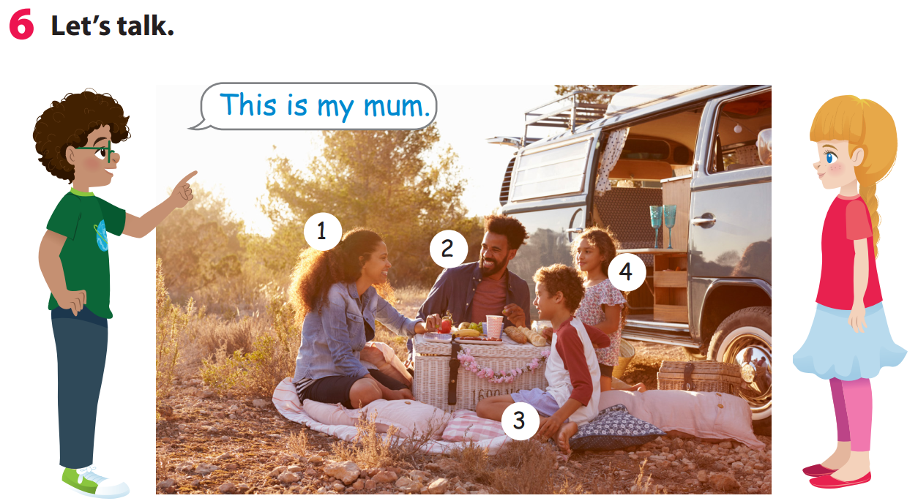
Notes:
Let’s talk!
- Tell students to look at the picture. Then talk about the members of the family in the picture.
- Ask students to work in pairs to talk about the other people in the photo.
- Ask some volunteers to speak in front of the class.

Slide 25

Production
Task 6: Let’s talk

Slide 26

Speaking about your family
Notes:
Yêu cầu học sinh mang theo ảnh gia đình để luyện tập Speaking about your family.
- Ask students to work in group of 6.
- Ask student to write their own question about topic family on a card.
- Each student is allowed to ask one question to their friend.
Suggested questions:
1. How many people in your family?
Student: numbers/ there are _(number)_
2. How many brothers/sisters do you have?
3. Who are they?
4. How old is your ...?

Slide 27


1. How many people are there in your family?
There are 3.

Slide 28
2. Who are they?
My mum, my dad and me.

Slide 29
3. How many brother/sister
do you have?
1 brother and 2 sisters.

Slide 30
4. How old is your sister?
She’s 10

Slide 31

Assessment
Time bomb game
Notes:
Mỗi hs phải mang ảnh gia đình để chơi game này.
Game: Time bomb
- Ask your class to form a circle (if possible)
- Choose one student to stand in the middle of the circle/ or in front of the class. (a leader)
- Then, throw a tennis ball/ ball to one of students.
- Each student has only 5 seconds to point any member in their family photo and say: This is my ... And throw the ball to one another friend.
- If the ball is dropped, that student must be pass it around the circle/ the class as fast as they can. The leader count down from 10.
- The last student has the ball when it “explodes” is out of the game.

Slide 32

Notes:
Mỗi hs phải mang ảnh gia đình để chơi game này.
Game: Time bomb
- Ask your class to form a circle (if possible)
- Choose one student to stand in the middle of the circle/ or in front of the class. (a leader)
- Then, throw a tennis ball/ ball to one of students.
- Each student has only 5 seconds to point any member in their family photo and say: This is my ... And throw the ball to one another friend.
- If the ball is dropped, that student must be pass it around the circle/ the class as fast as they can. The leader count down from 10.
- The last student has the ball when it “explodes” is out of the game.

Slide 33



Good bye.
See you again!

