Slide 1









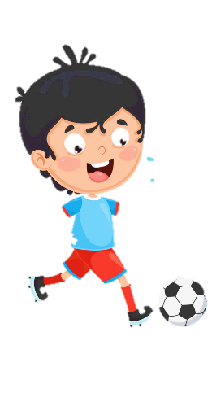











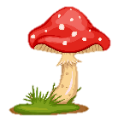
Unit 11
My day
Lesson 2 – Task 1,2,3

Slide 2

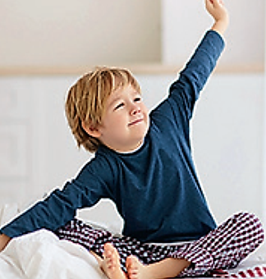
get up

Slide 3
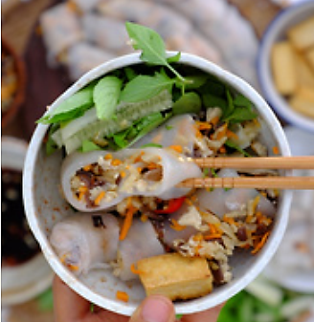
have breakfast

Slide 4
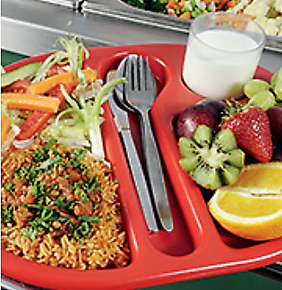
have lunch

Slide 5
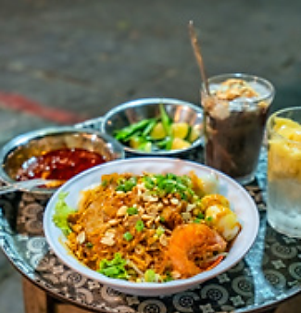
have dinner

Slide 6
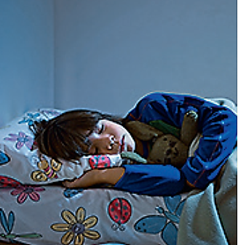
go to bed

Slide 7
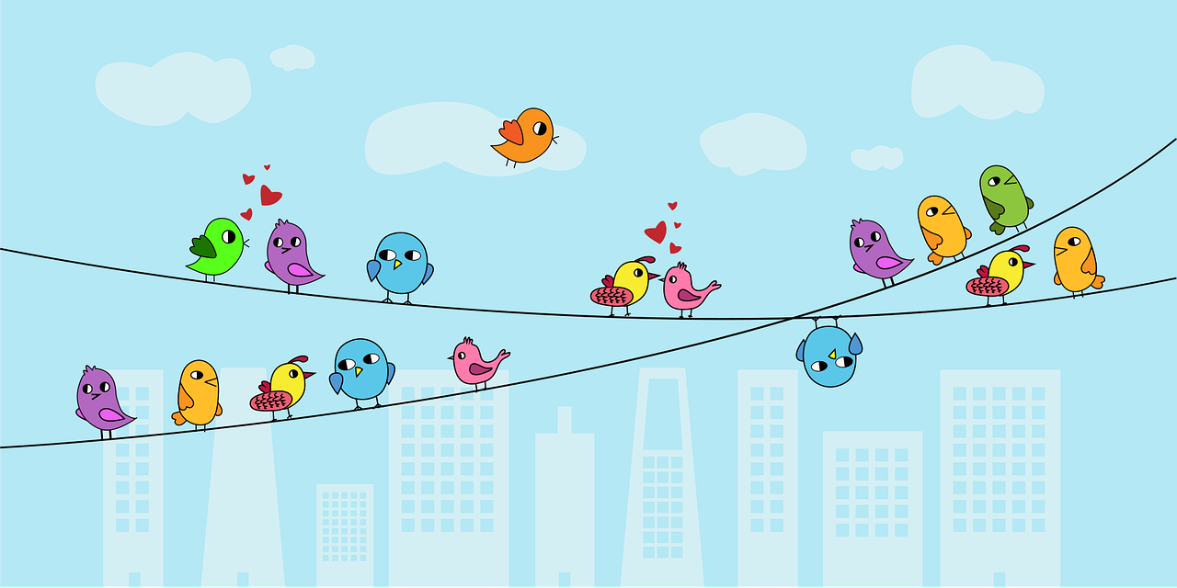
What is it?
have breakfast

Slide 8
What is it?
go to bed

Slide 9
What is it?
have dinner

Slide 10

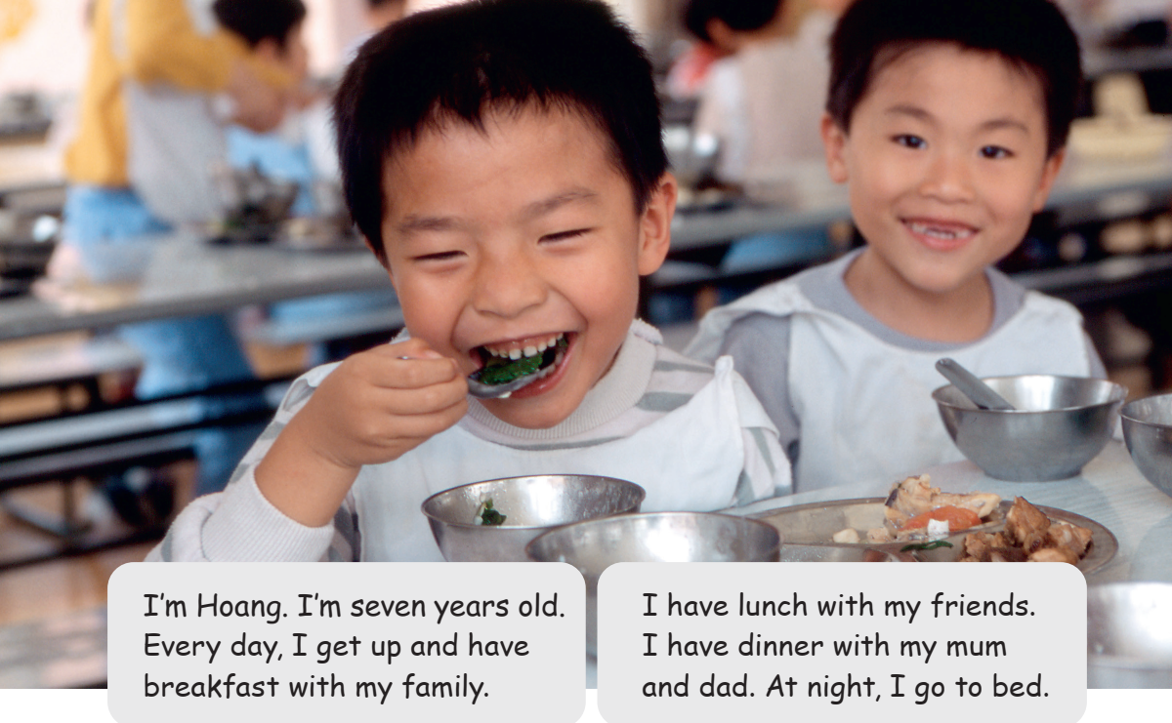

Task 2 Listen and number in order.
3
4
5
2

