Slide 1



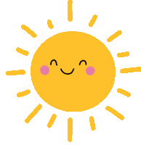


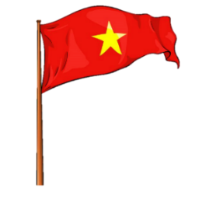


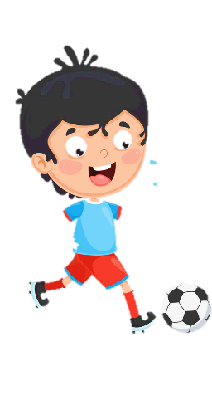




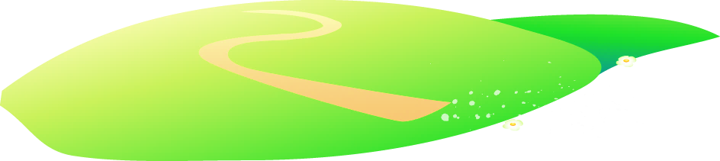


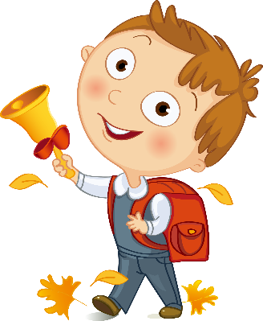



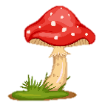
Unit 11
My day
Lesson 1 – Task 4,5,6

Slide 2
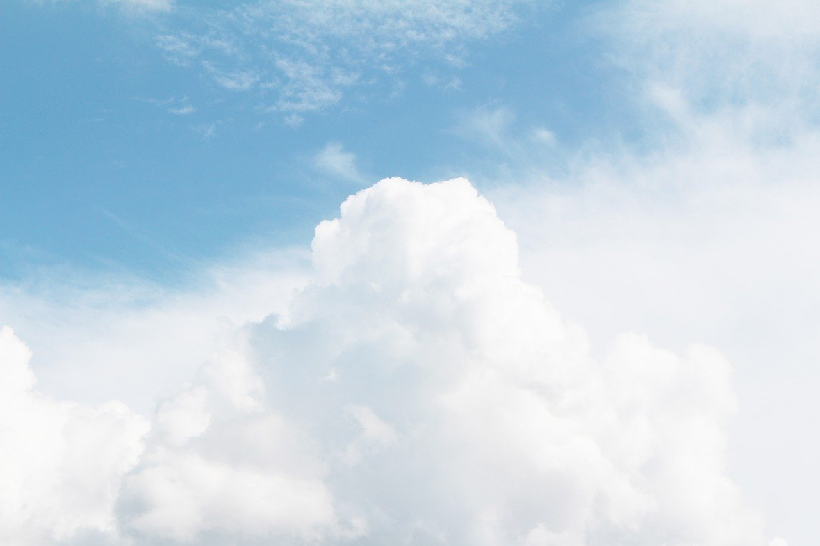
1. The day after Thursday is ________.
2. The last day of the week is ________.
3. The beginning of the week is ________.
4. The day with the letters w-y-e-a-n-d-e-s is ________.
5. The day before Sunday is _________.
6. The day between Monday and Wednesday is _________.
7. The day before Friday is _________.
Fill in the blank
Monday
Sunday
Friday
Wednesday
Tuesday
Thursday
Saturday

Slide 3

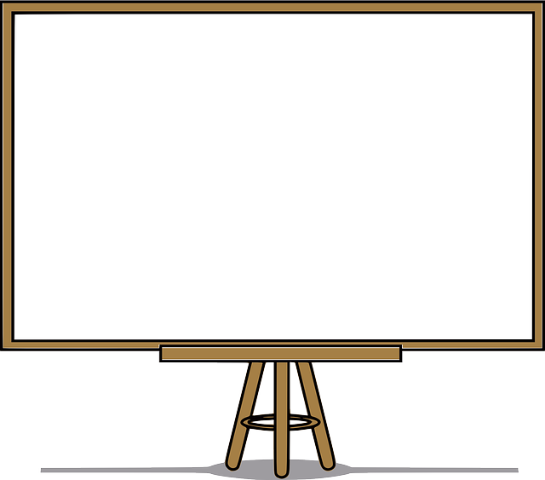
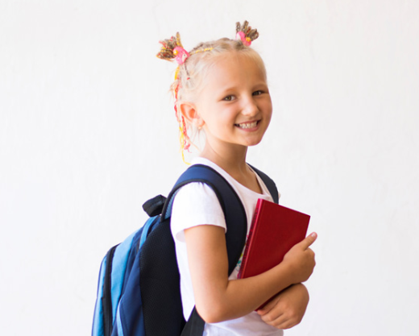
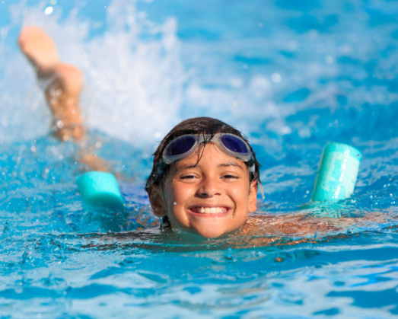
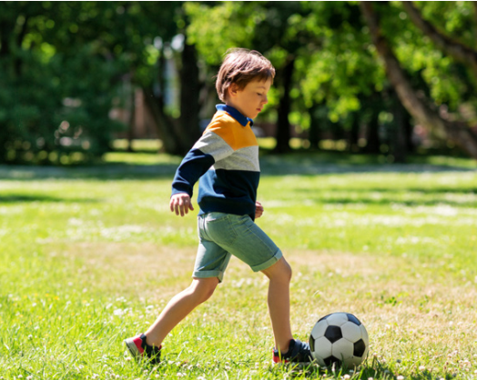
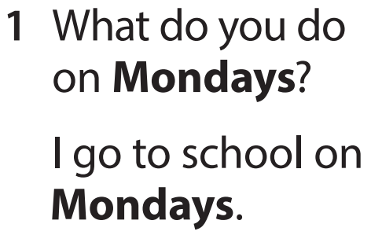
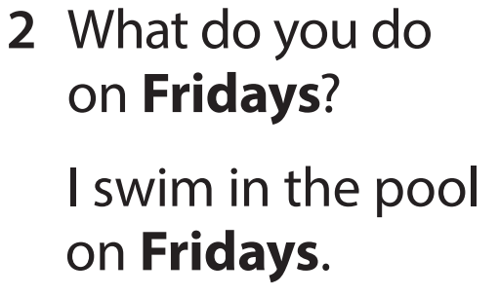
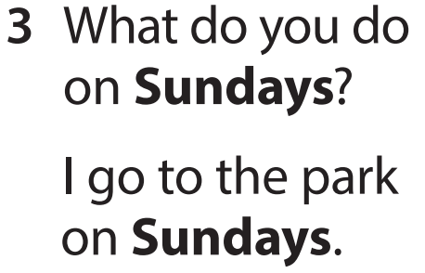
Task 4 Listen and repeat.

Slide 4
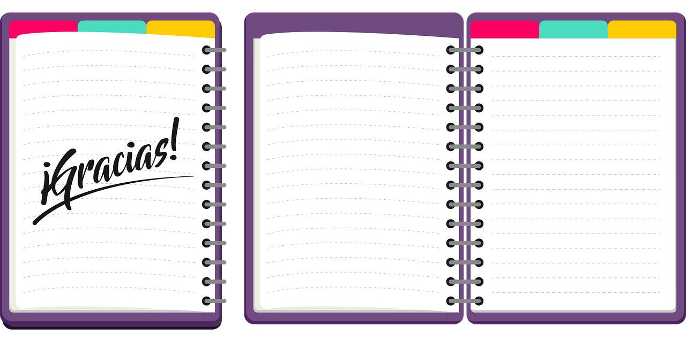
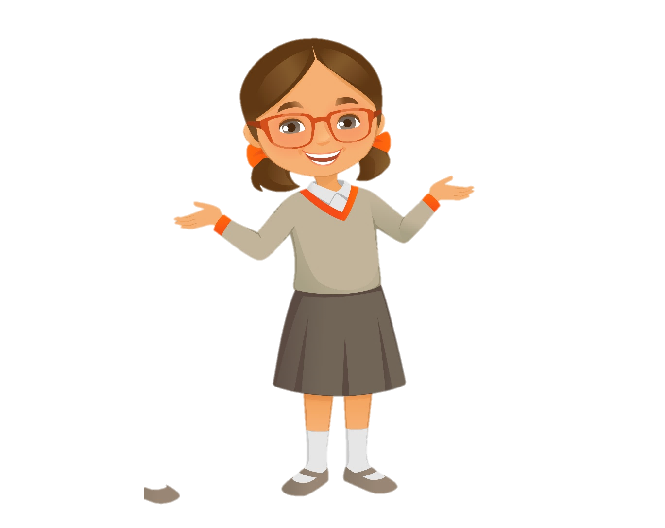
Mondays
Wednesdays
What do you do on _______?
I _______ on _______.
Saturdays
Fridays
Tuesdays
Sundays
Thursdays

Slide 5

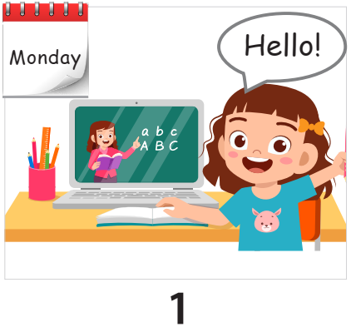
Task 5 Look and say.
What do you do on Mondays?
I go to English class on Mondays.

Slide 6
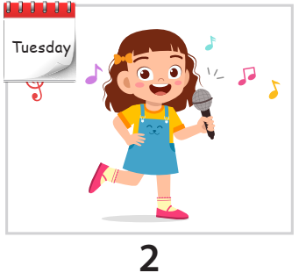
Task 5 Look and say.
What do you do on Tuesdays?
I sing on Tuesdays.

Slide 7
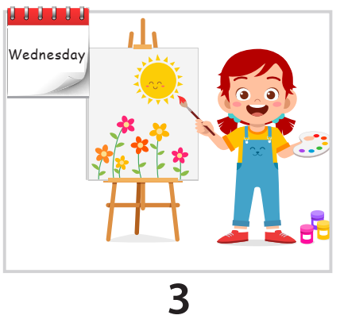
Task 5 Look and say.
What do you do on Wednesdays?
I paint on Wednesdays.

Slide 8
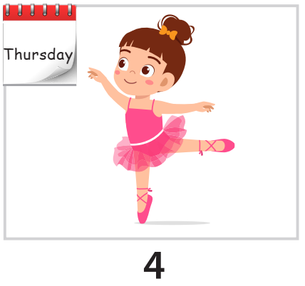
Task 5 Look and say.
What do you do on Thursdays?
I dance on Thursdays.

Slide 9
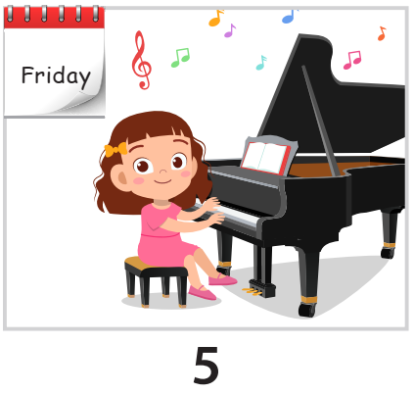
Task 5 Look and say.
What do you do on Fridays?
I play the piano on Fridays.

Slide 10
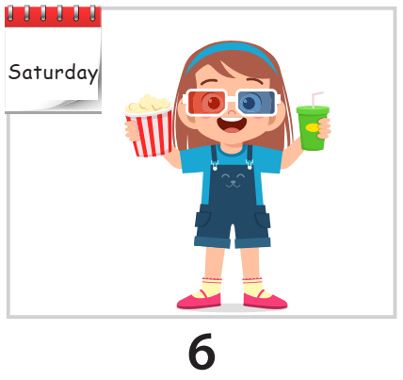
Task 5 Look and say.
What do you do on Saturdays?
I go to the cinema on Saturdays.

Slide 11
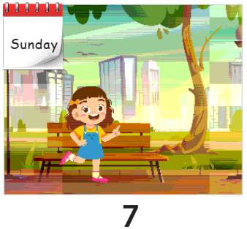
Task 5 Look and say.
What do you do on Sundays?
I go to the park on Sundays.

