Slide 1








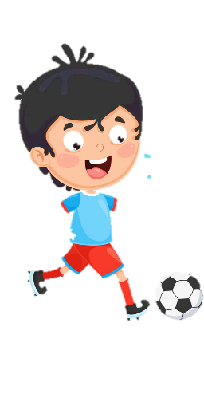












Notes:
Để nguyên trang bìa như này, chỉ thay đổi tên bài trong quá trình làm. Logo của sách Wonderful World

Slide 2
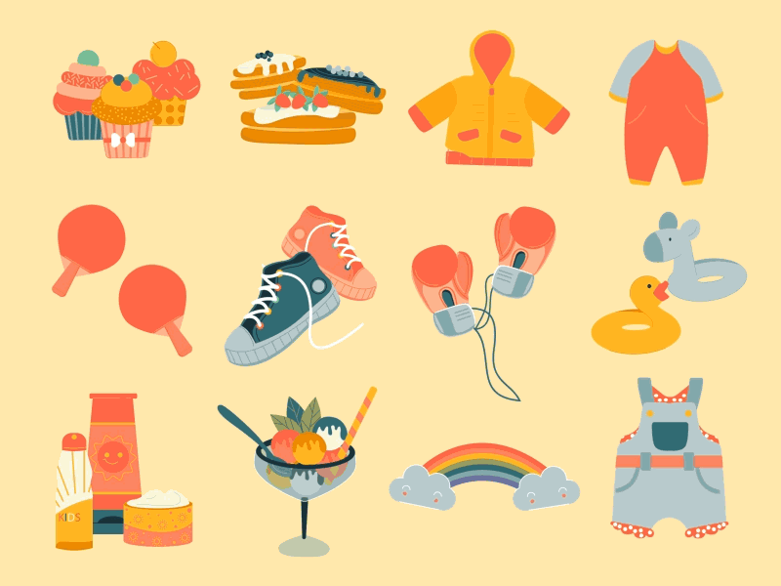

Unit 5
My Clothes
LESSON 1: task 1,2,3

Slide 3
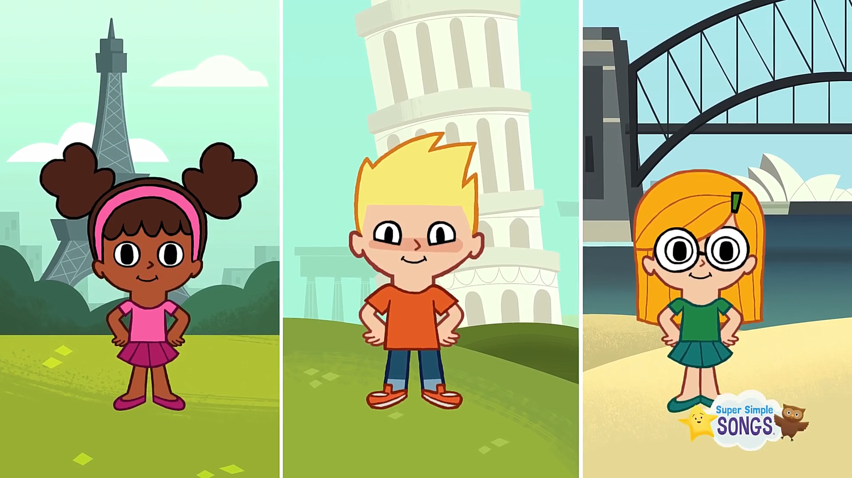

Hello everyone!
1 WARM UP

Slide 4
1
2
3
GUESSING GAME
4
5
6

Slide 5
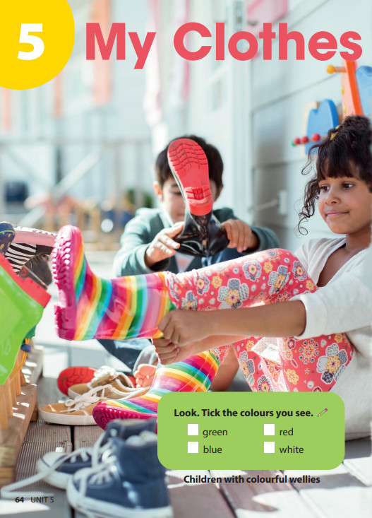
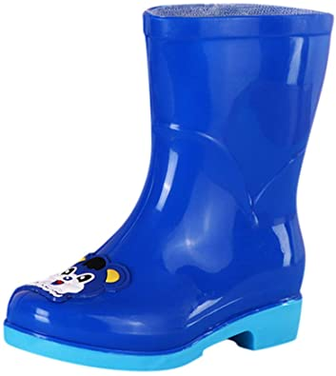
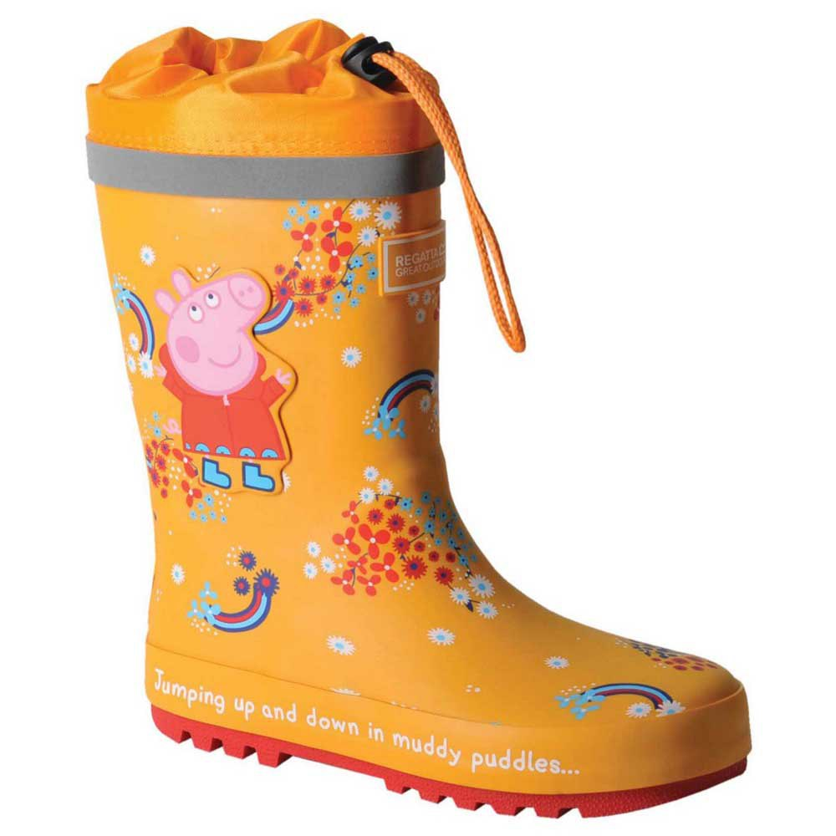
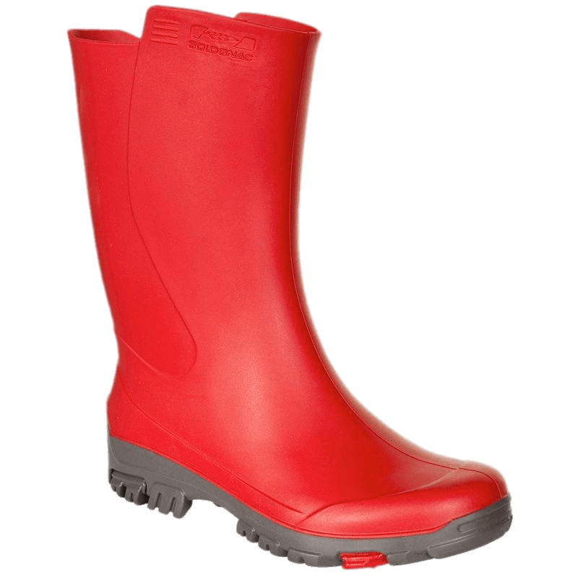
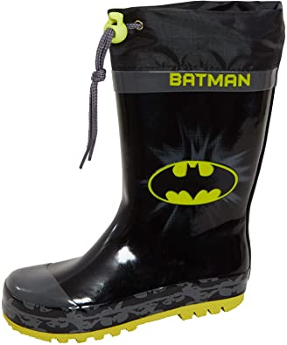
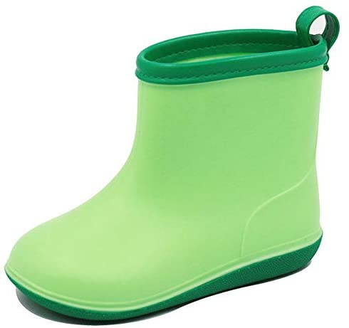
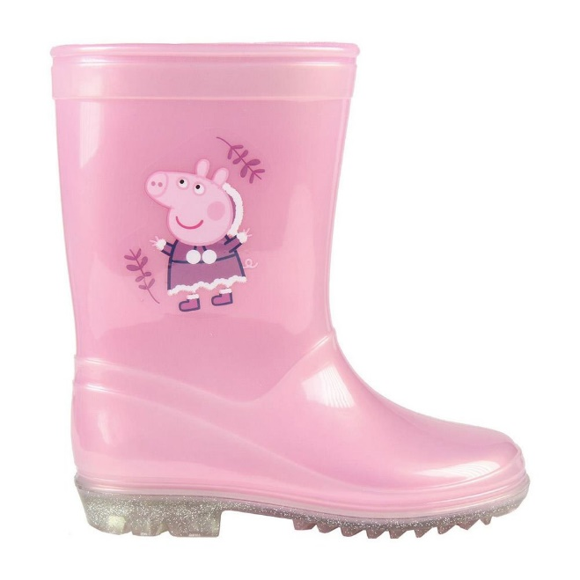
1
2
3
What colour is it?
What colour is it?
What colour is it?
4
5
6
What colour is it?
What colour is it?
What colour is it?

Slide 6


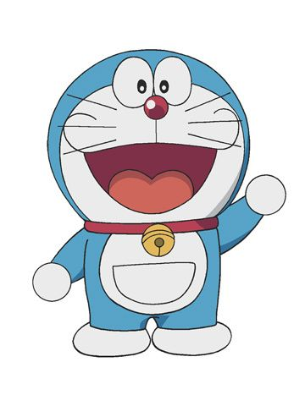
Hi! I’m Doraemon. I’m in Japan.
This is my magic bag.
What’s in my bag?

Slide 7
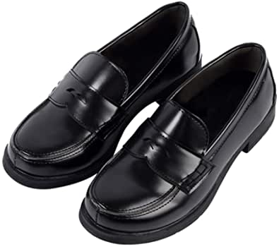
What’s in my bag?
shoes

Slide 8
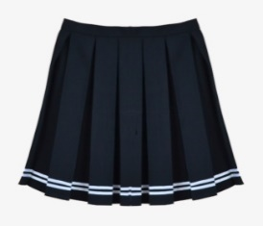
What’s in my bag?
skirt

Slide 9
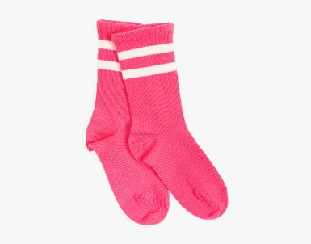
What’s in my bag?
socks

Slide 10
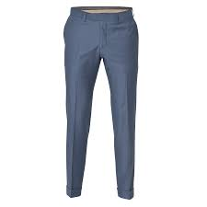
What’s in my bag?
trousers

Slide 11
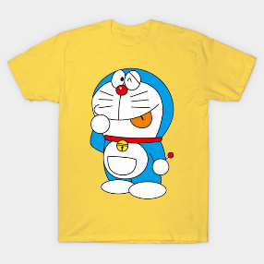
What’s in my bag?
T-shirt

Slide 12

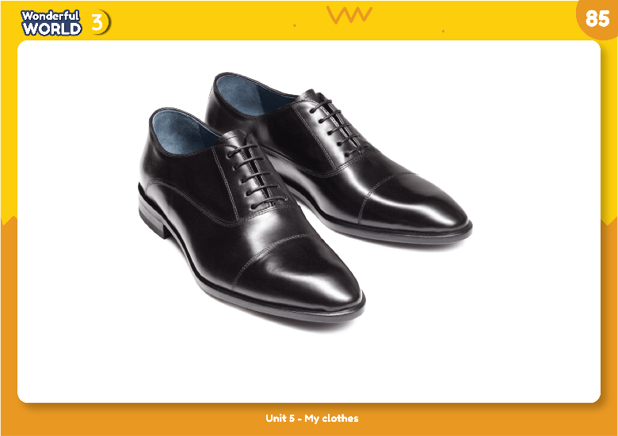
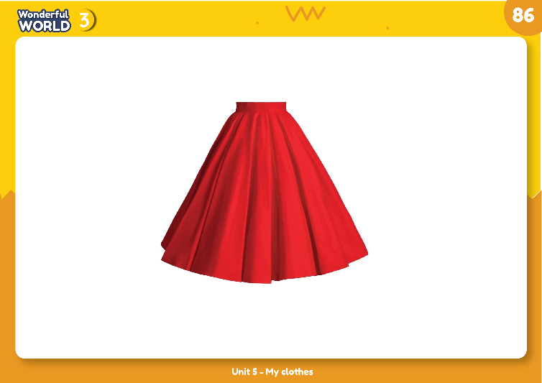
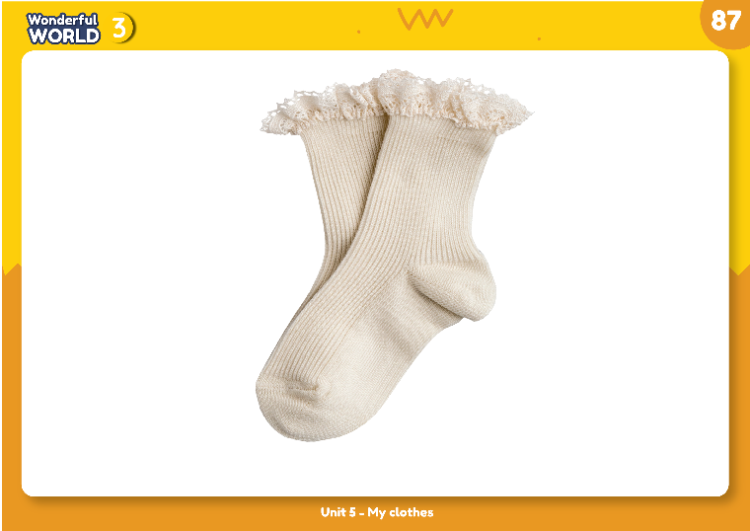
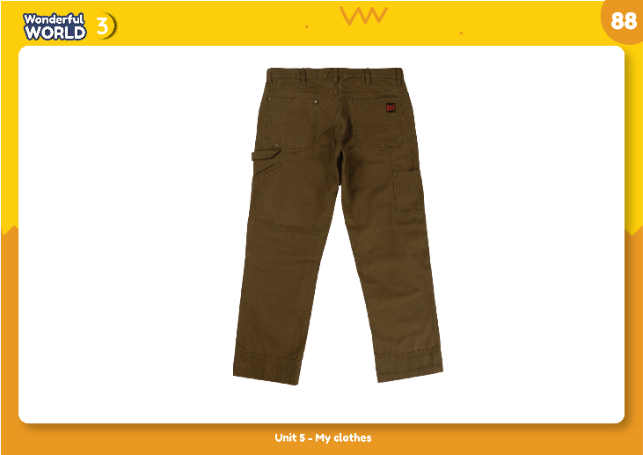
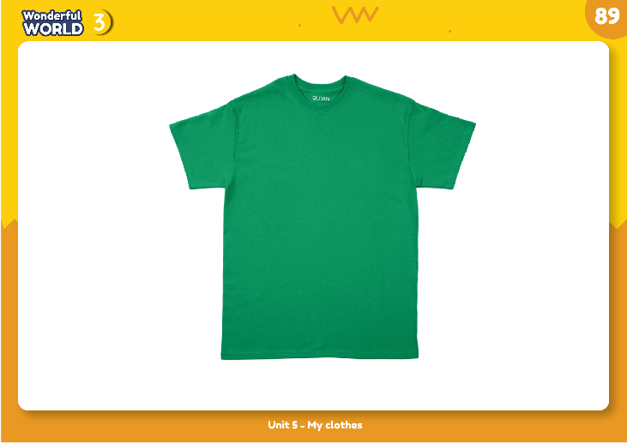
2 PRESENTATION
Listen and point. Repeat.
NEW WORDS

Slide 13

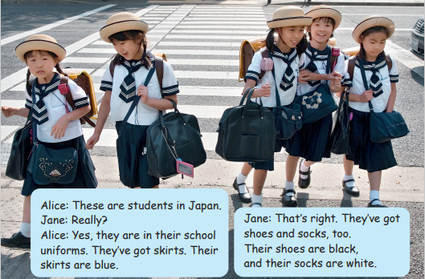
3 PRACTICE

Slide 14



Tasks:Work in group!
Role play with your groups!

Slide 15










4 PRODUCTION
Draw your uniform.
There are ___.
There aren’t ___.

Slide 16

worksheet

Slide 17

tT
tT
tT
tT
tT
tT
tT
1.
There are
skirts
uniforms.
in
their
blue.
They
are
There are skirts in their uniforms. They are blue.
tT
tT
tT
tT
tT
2.
There aren’t
trousers
uniforms.
in
their
There aren’t trousers in their uniforms.
3.
tT
tT
tT
tT
tT
white.
tT
tT
There are
their
uniforms.
in
socks
They
are
There are socks in their uniforms. They are white.
tT
tT
tT
tT
tT
tT
tT
4.
There are
shoes
uniforms.
are
their
They
black.
in
There are shoes in their uniforms. They are black.
Notes:
THIẾT KẾ HOẠT ĐỘNG TƯƠNG TÁC CHO 4 CÂU NÀY

Slide 18
5 ASSESSMENT
1. Which topic do we learn today?
Clothes
2. How many words have we learn?
Five words: shoes, skirt, trousers, T-shirt
3. What’s activity do you like the most?
Notes:
THIẾT KẾ HOẠT ĐỘNG TƯƠNG TÁC CHO 3 CÂU HỎI NÀY. VỚI CÂU HỎI 3 LÀ TRẢ LỜI THEO Ý CỦA HS.

Slide 19


Goodbye💛!

