Slide 1

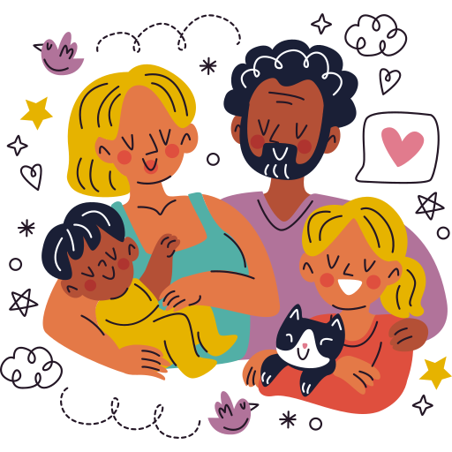
Unit 1:
FAMILY AND FRIENDS
Lesson 2 – Part 4, 5, 6

Slide 2

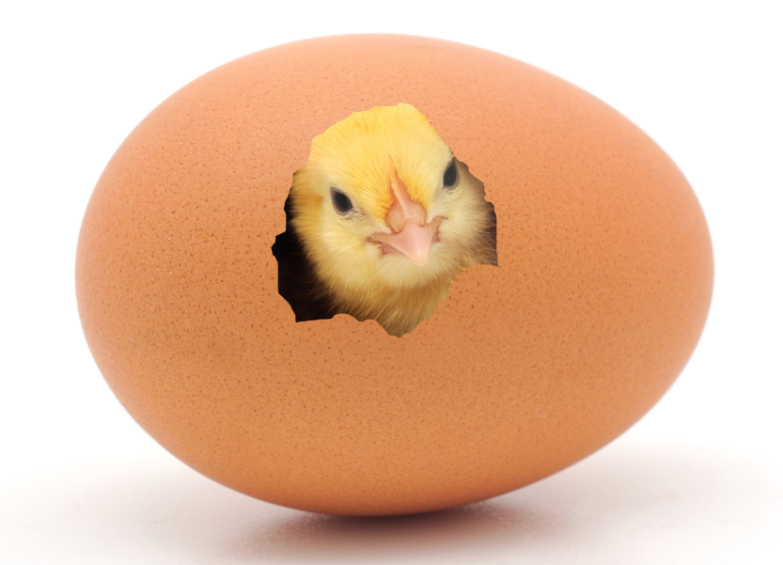
Order the words
moce tou fo
=> come out of

Slide 3
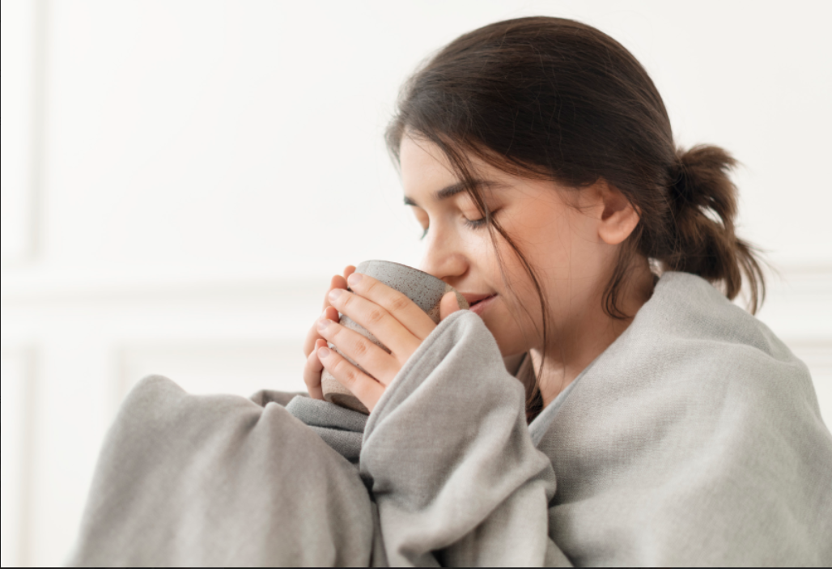
Order the word
peke rwma
=> keep warm

Slide 4

Order the word
veale
=> leave

Slide 5

Order the word
srpetna
=> parents

Slide 6
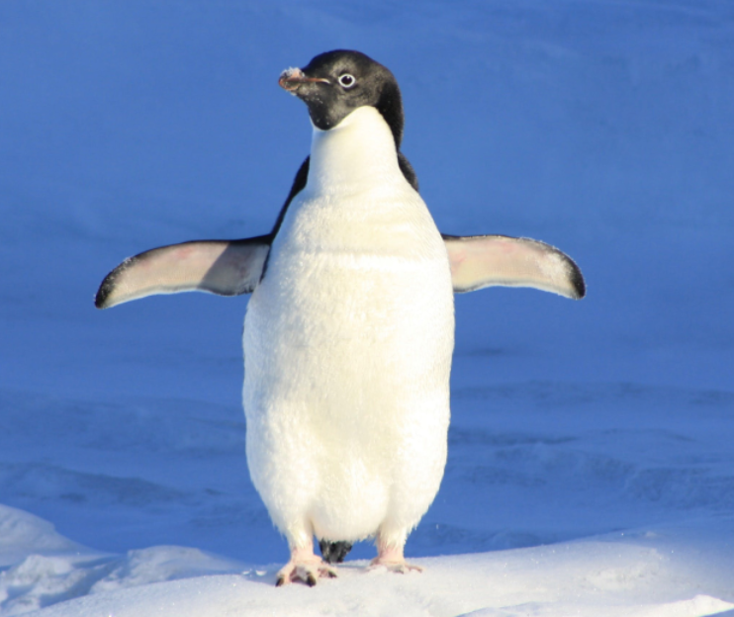
Order the word
ennpgiu
=> penguin

Slide 7

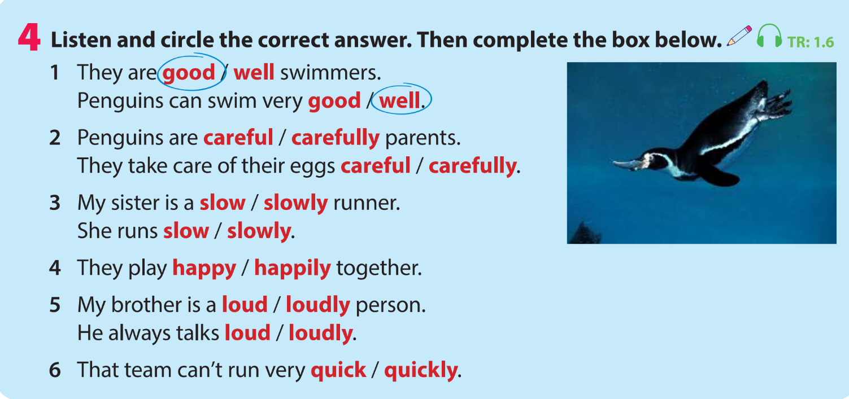


Slide 8

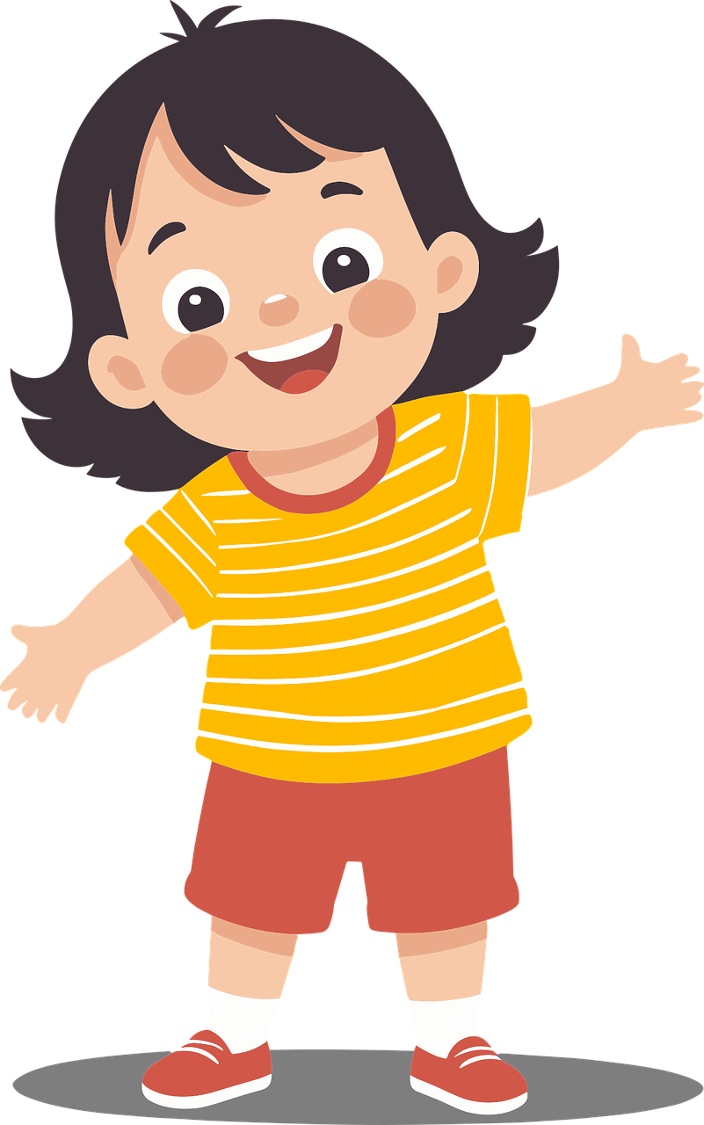
She is a happy girl.
noun
+
adjective
The adjective comes before the noun.

Slide 9

The cat dances happily.
verb
adverb
+
The adverb comes after the verb.

Slide 10


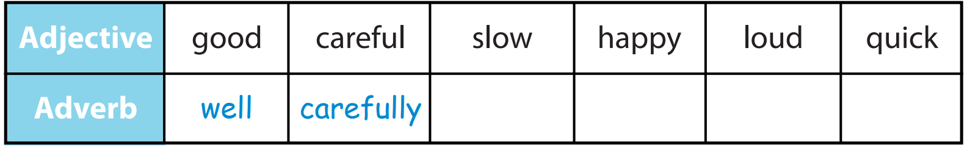


Complete the box below
slowly
loudly
quickly
happily

Slide 11

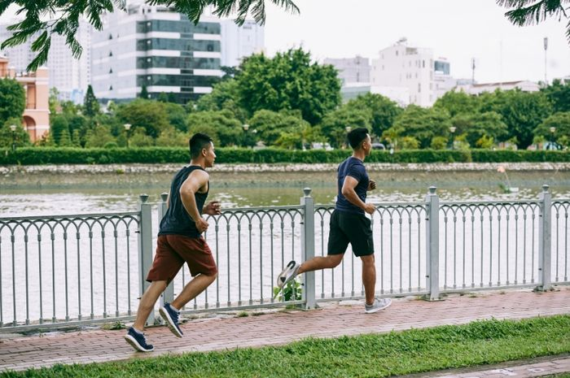

Who can run quickly?
Minh
Nam
Nam can run quickly.

Slide 12
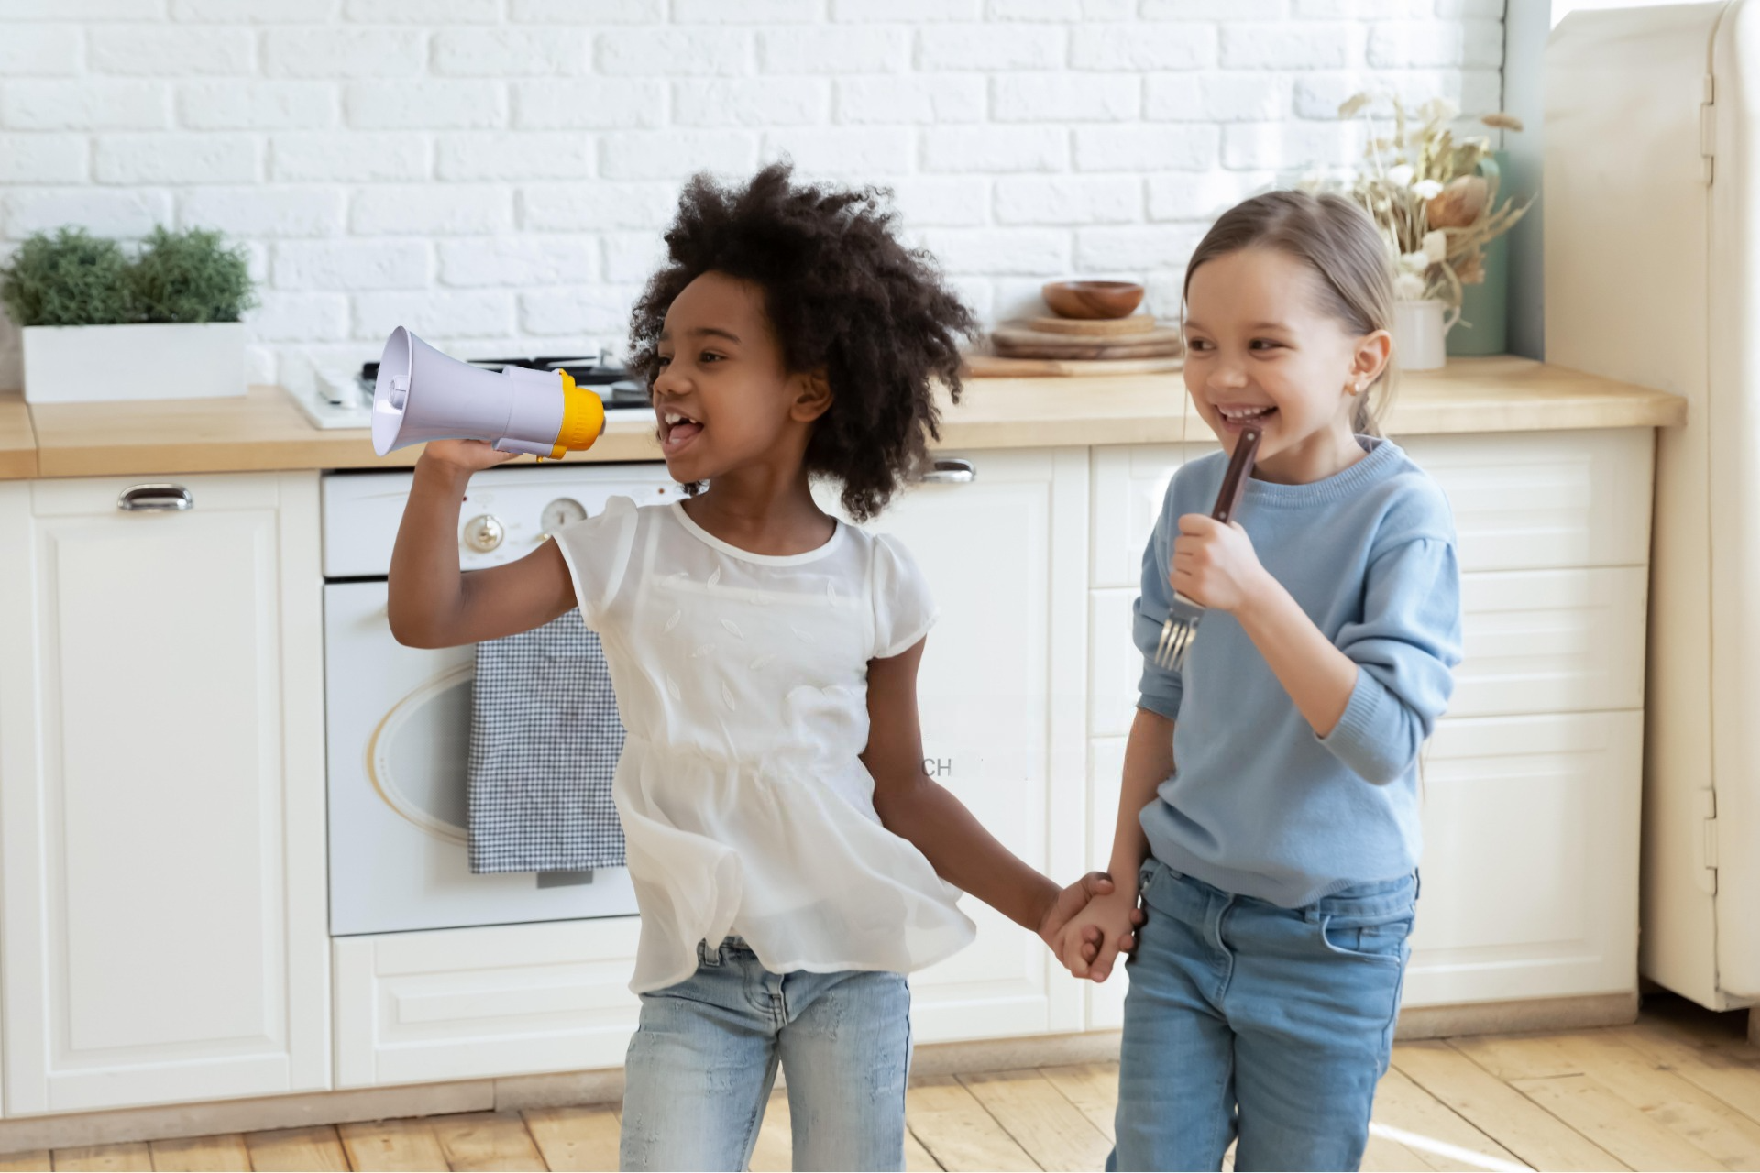

Who can sing loudly?
Mary
Mia
Mia can sing loudly.

Slide 13
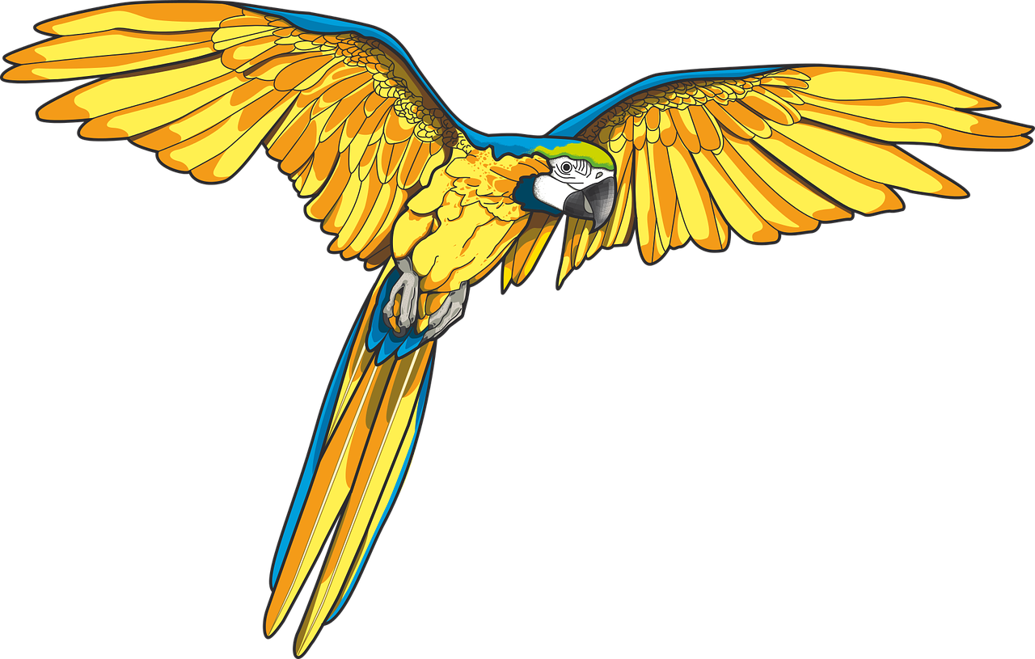


Which animal can fly well?
Parrots can fly well.

Slide 14
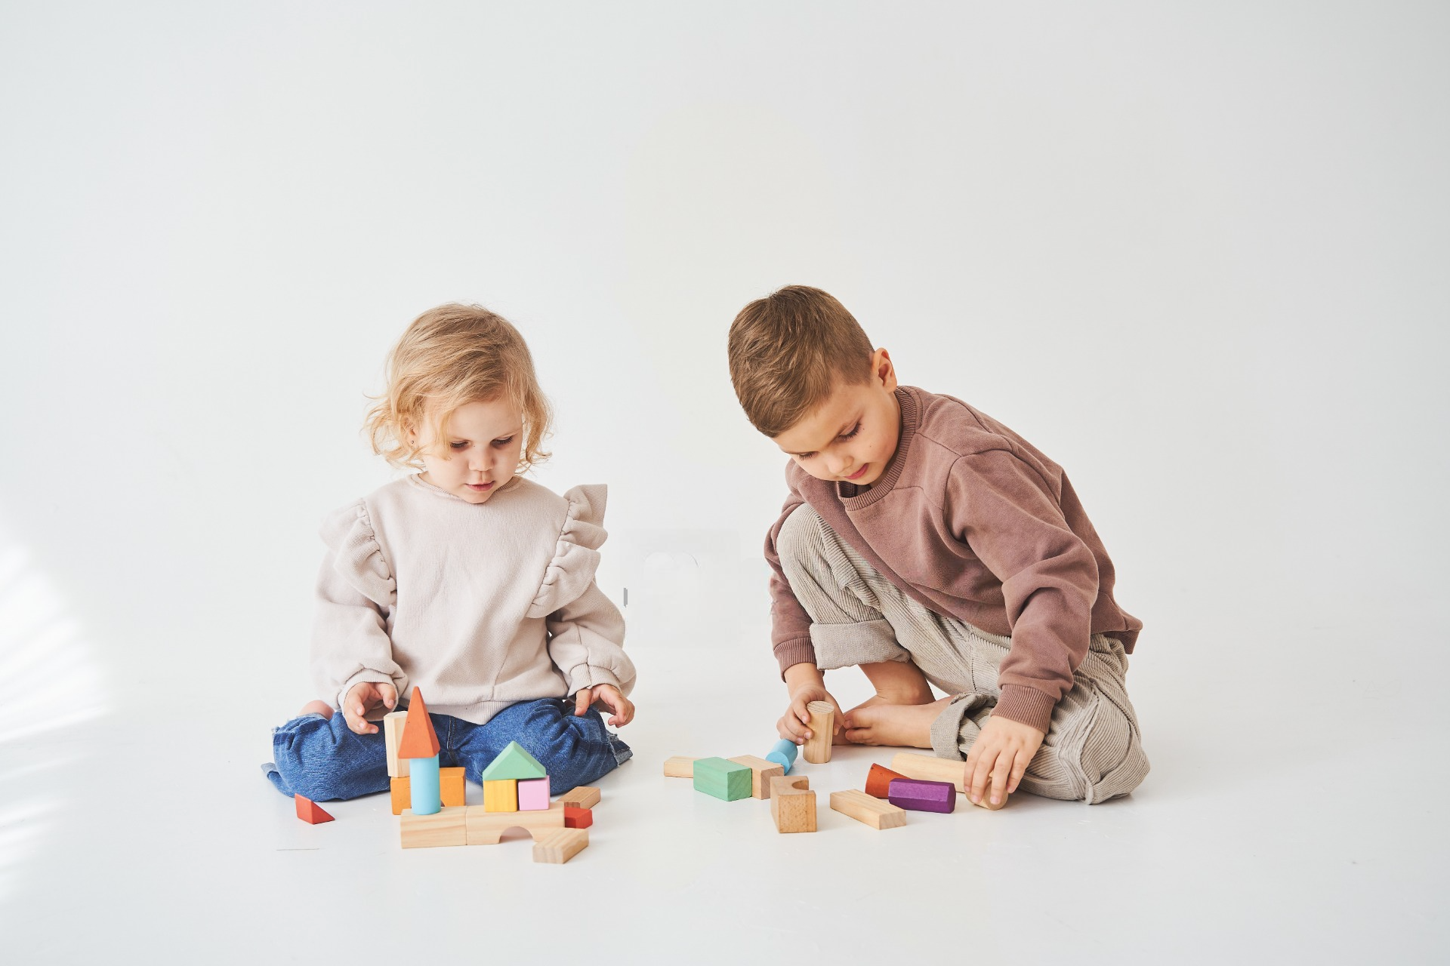
Who can build things carefully?
Peter
Anna
Anna can build things carefully.

Slide 15
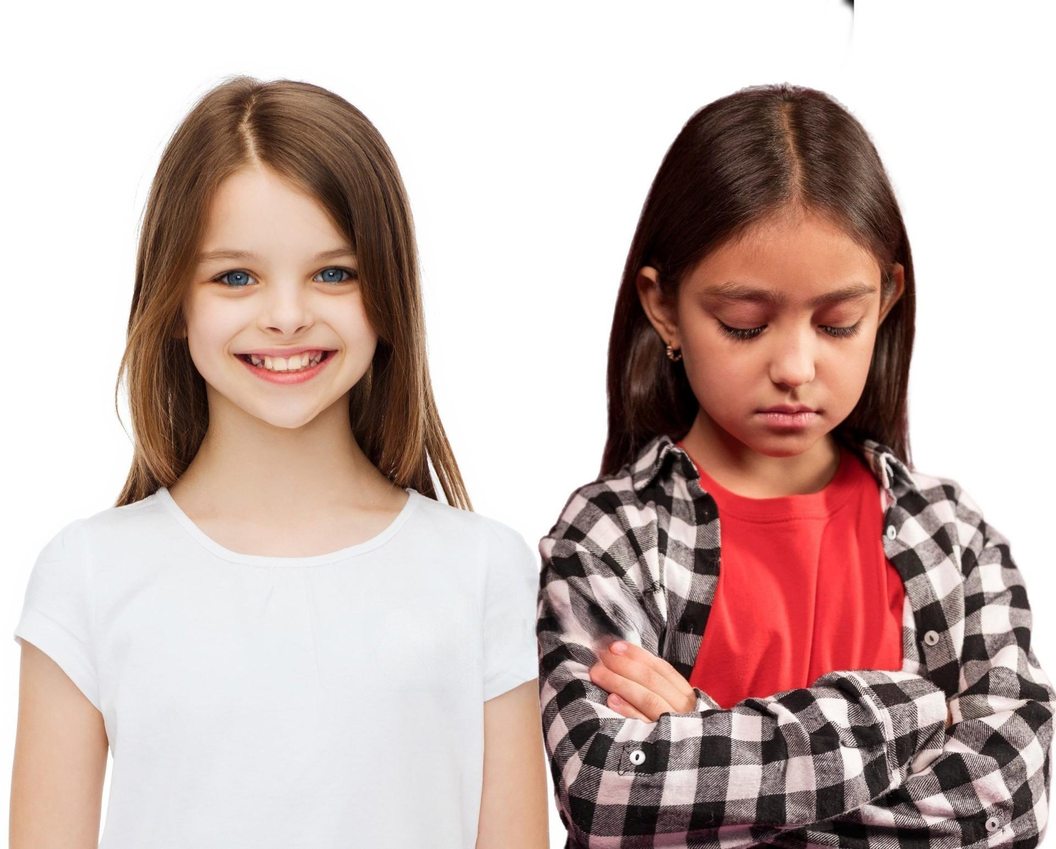

Who can smile happily?
Shally
Tina
Tina can smile happily.

Slide 16

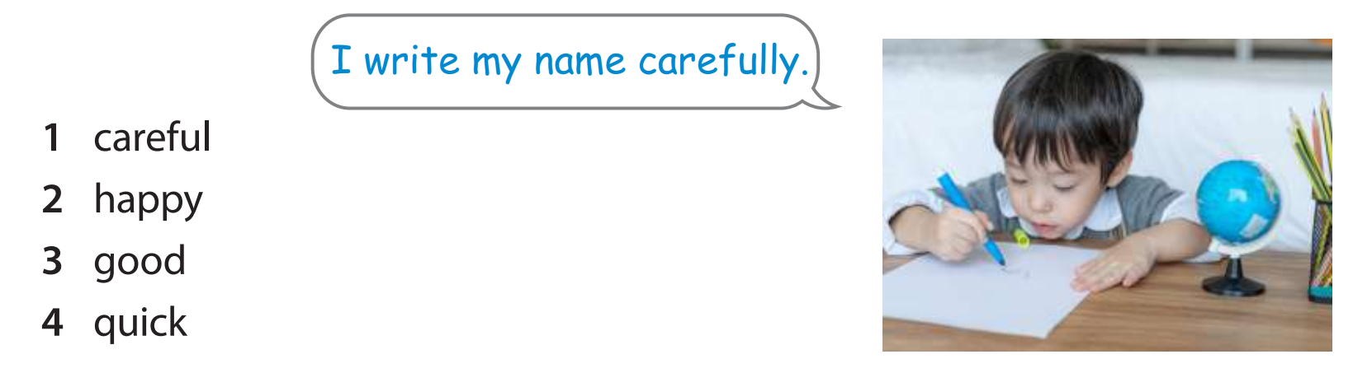
I laugh happily.
I cook well.
I can run quickly.

Slide 17


Listen and write
Listen and write
slowly
My dad walks ______.

Slide 18

Listen and write
Listen and write
careful
John is a ______ taxi driver.

Slide 19

Listen and write
Listen and write
well
Anna can speak English very _____.

Slide 20
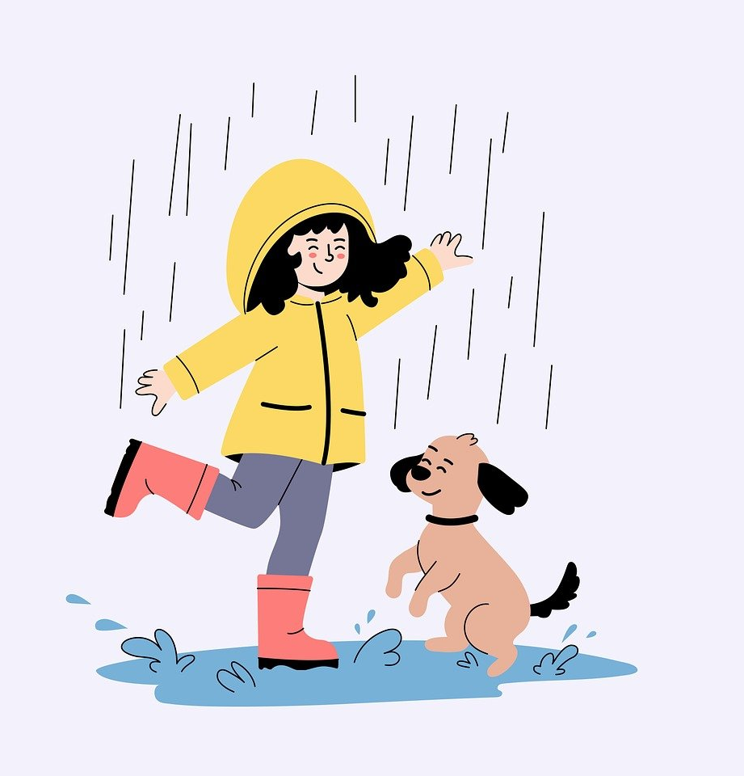
Listen and write
Listen and write
happily
They play ______ in the rain.

Slide 21

Wrap up
Unit 1: Family and friends
Lesson 2 – Part 4,5,6
What have we learnt today?
Adverbs:
well, carefully, slowly, loudly, quickly

Slide 22

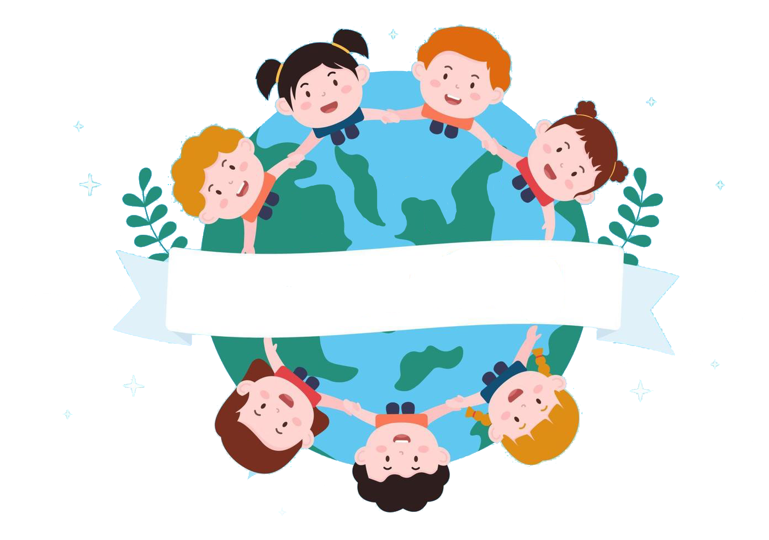
Thank you
& goodbye!

