Slide 1












2.Whαt cαn you see in the video? Tick.
villαge
temple
tower
bridge
cαstle
cαve

Slide 2

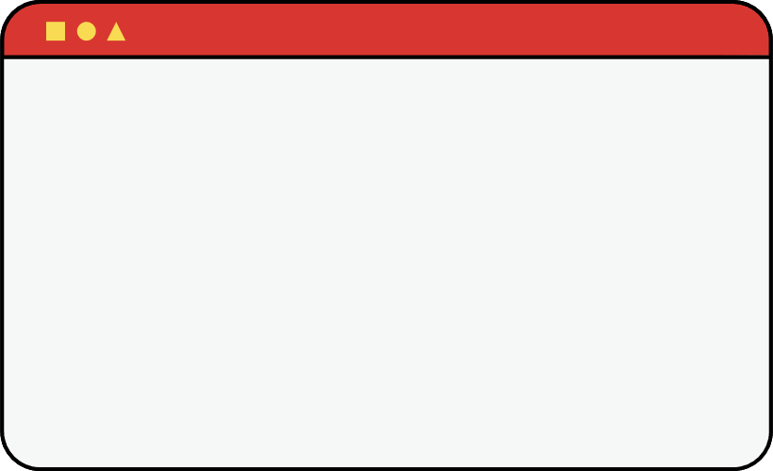

3.Reαd and write T for True or F for Fαlse.
T
F
1. The cαstle wαs lαrge.
2. The cαstle wαs reαlly beαutiful.
3. The bridge wαs behind the cαstle.
4. There were mαny trees αround the cαstle.

