Slide 1











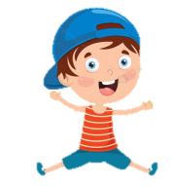

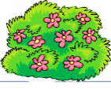
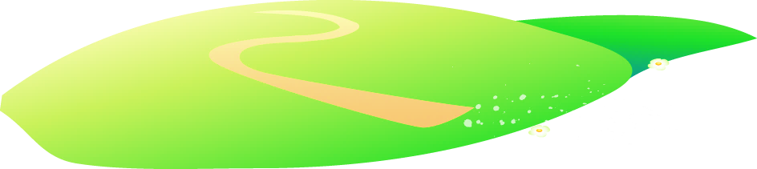







Notes:
Để nguyên trang bìa như này, chỉ thay đổi tên bài trong quá trình làm. Logo của sách Wonderful World

Slide 2

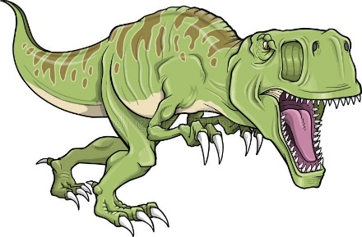
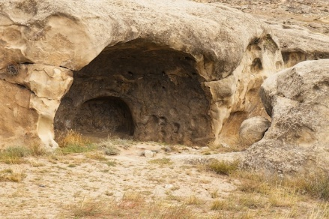
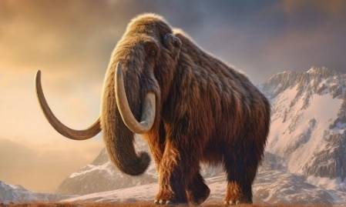
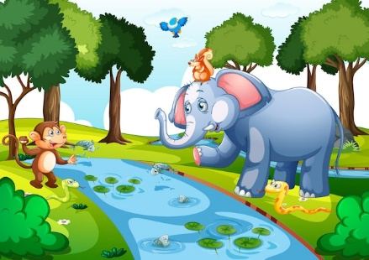
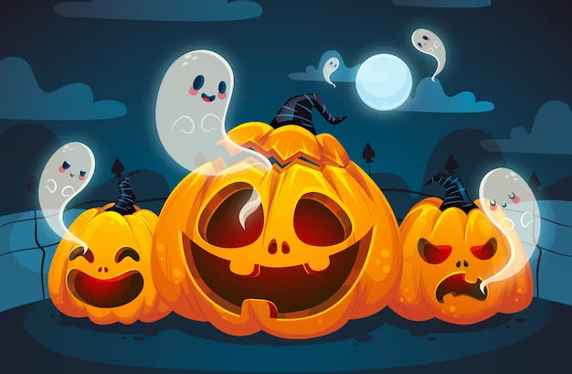

1. Look and write.
inosaur
ave
d______
c______
ammoth
uge
m______
h______
trong
cary
s______
s______

Slide 3
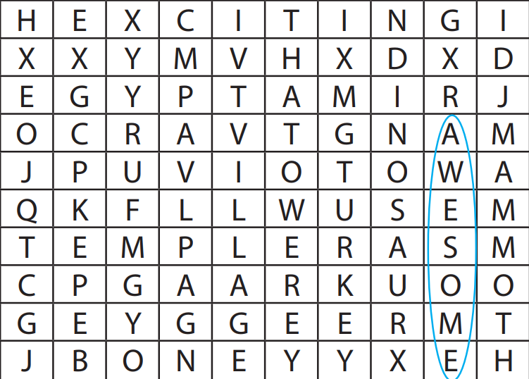
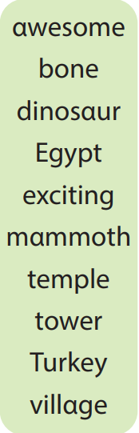
2. Find the words

Slide 4
3. Match and say.
The cat was in our garden last week.
1. The cat was in
a. a scary dinosaur.
2. He was at the
b. dark caves.
3. T.rex was
c. our garden last week.
4. Mammoths weren’t
d. clever and strong.
5. Early people were
e. dinosaurs.
6. Their homes were in
f. dinosaur museum yesterday.

Slide 5
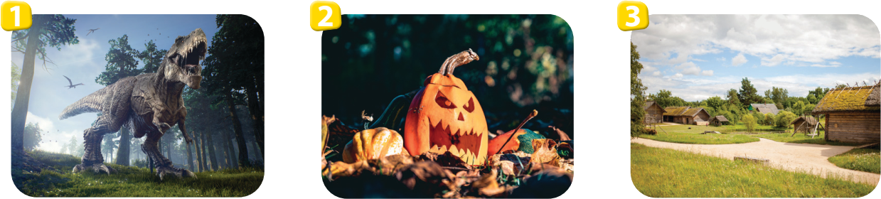

Look and write.
inosaur
d________
cary
s________
v________
illage
emple
ngland
t________
E________
merica
A________
Notes:
Image link: https://verbnow.com/wp-content/uploads/2021/04/dinosaur4-apr21.jpg

Slide 6
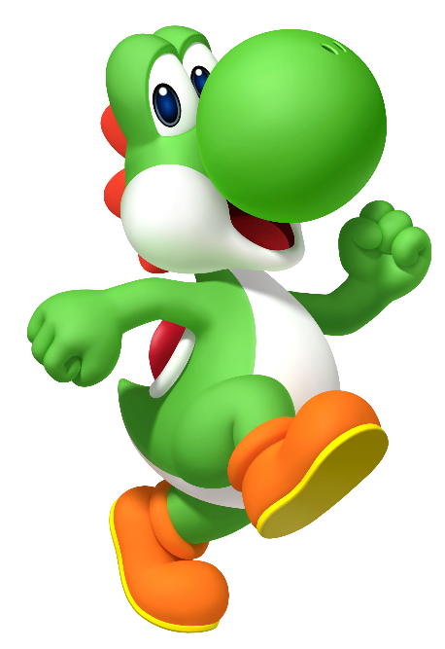
REVIEW 6 – PART 1
What we learnt today:
2. Structures:
I was at the museum last week.
They were at the museum last month.
T.rex was a strong dinosaur.
They were scary dinosaurs.
The dinosaur wasn’t small.
Early people weren’t tall.
Notes:
Image link: https://verbnow.com/wp-content/uploads/2021/04/dinosaur4-apr21.jpg

