Slide 1









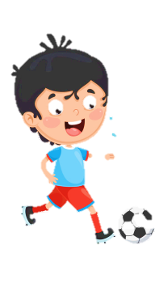
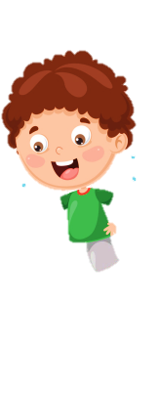











Notes:
Để nguyên trang bìa như này, chỉ thay đổi tên bài trong quá trình làm. Logo của sách Wonderful World

Slide 2
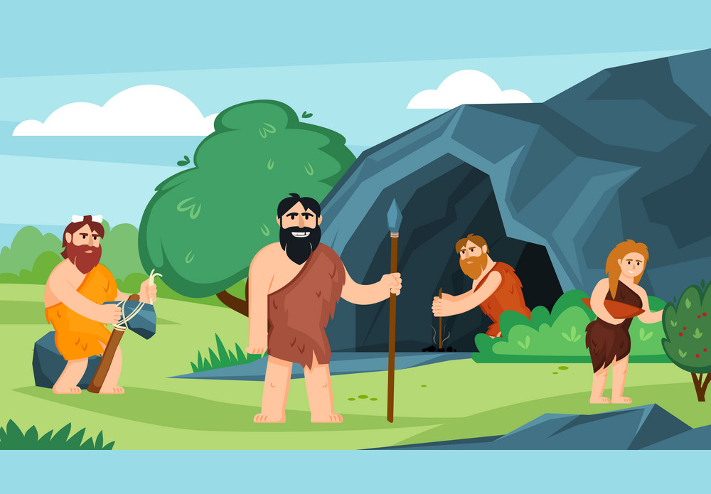
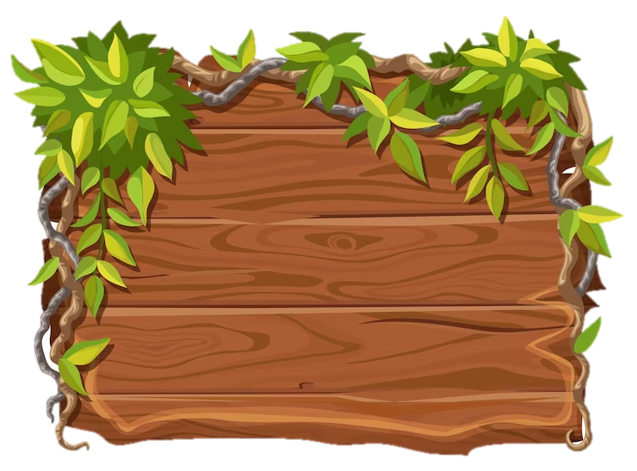
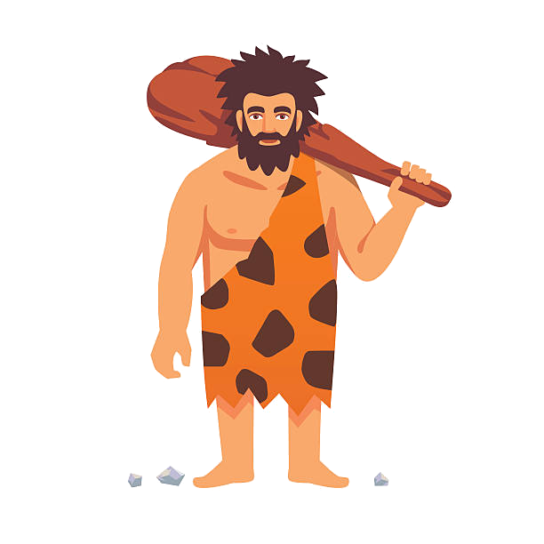
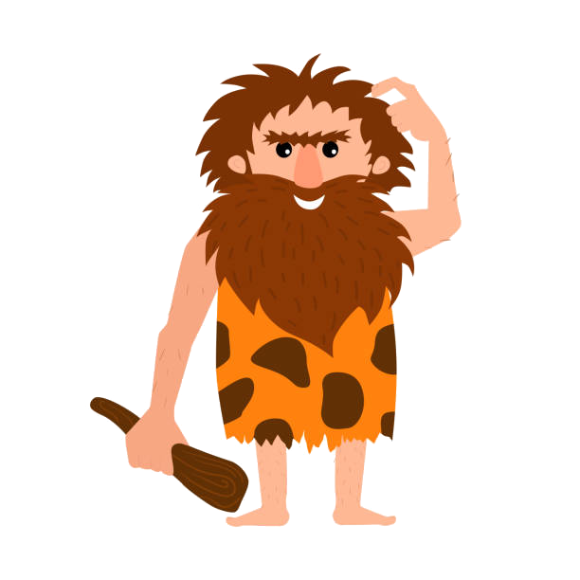
Unit 11: Before out time
Lesson 3
Task 1, 2, 3

Slide 3
1. Warm up
Catch the words

Slide 4
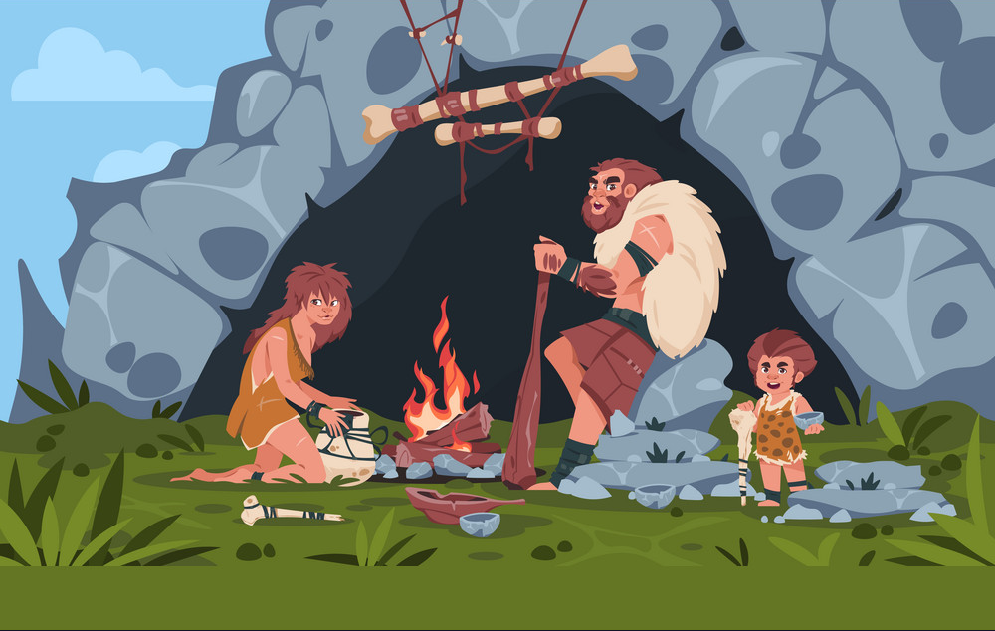

Notes:
Catch the words game
Each team will stand in lines. The first SS will be given a word and they must draw a picture according to that word.
After finishing, the picture will be passed down to the next one to re-draw. The last SS will write down the answer on the paper. Each turn will last for 1’30s.

Slide 5
2. PRESENTATION

Slide 6

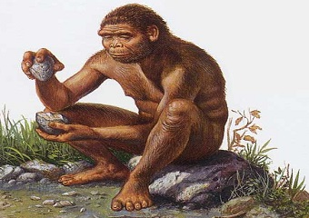
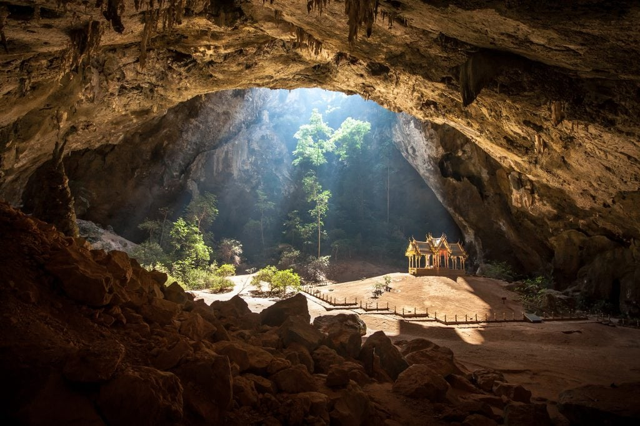
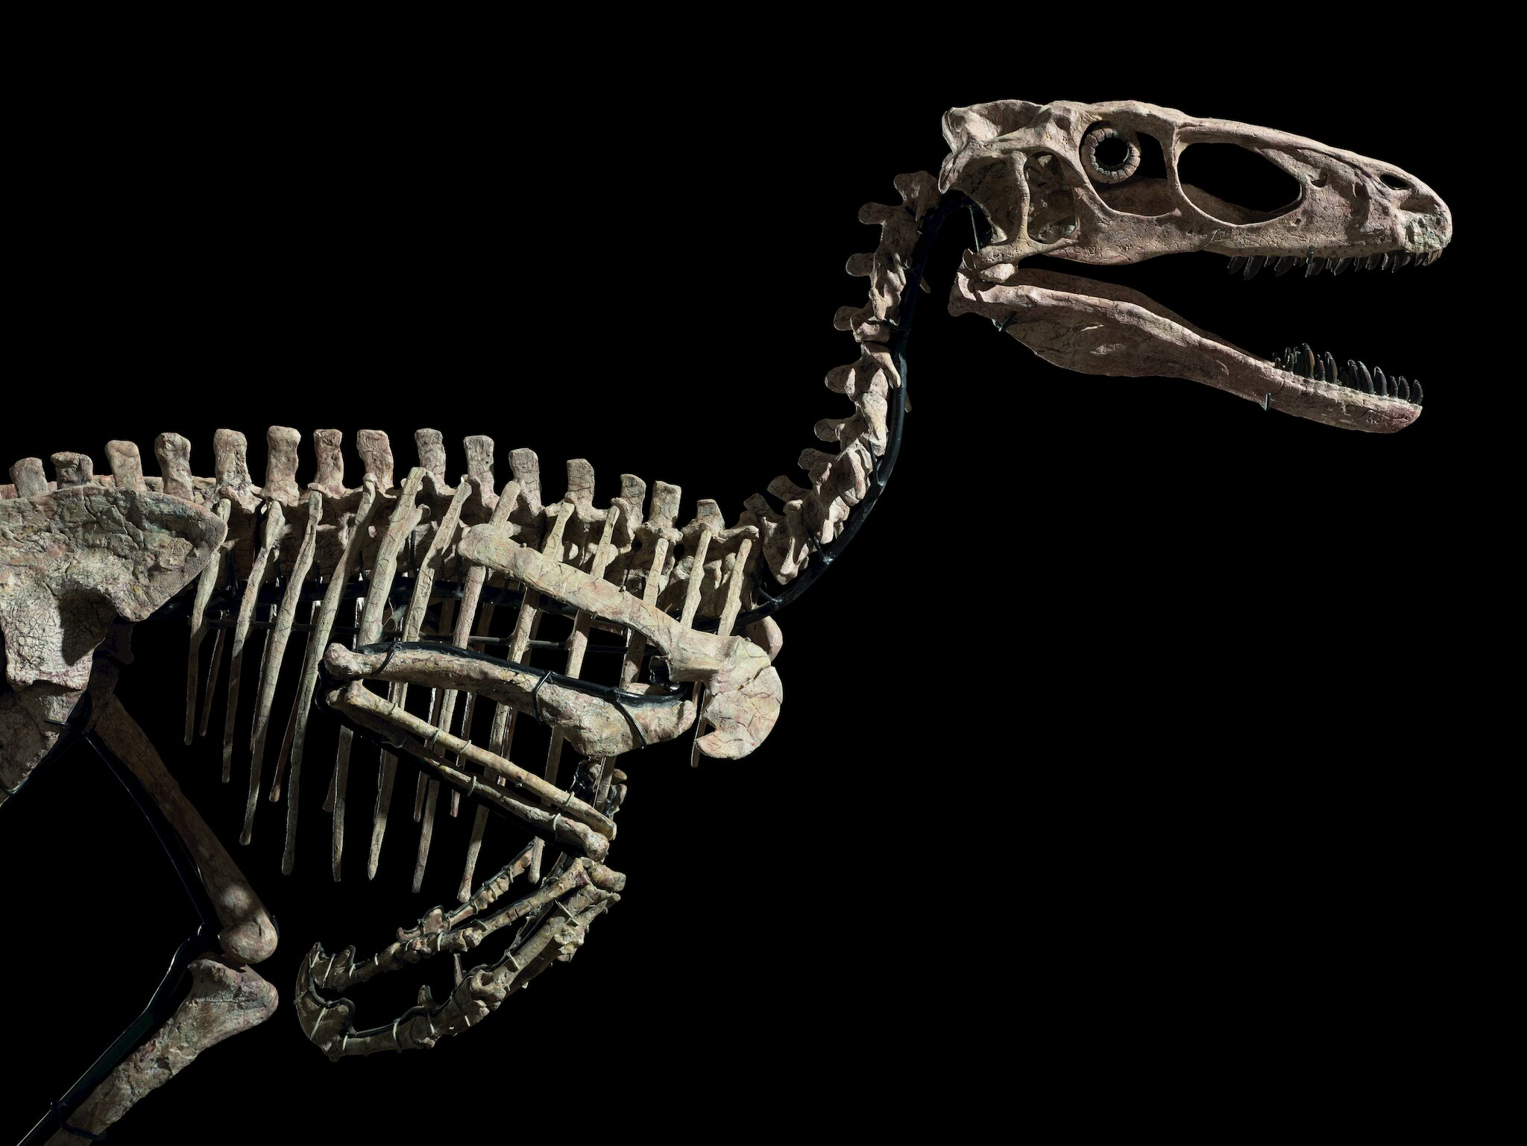
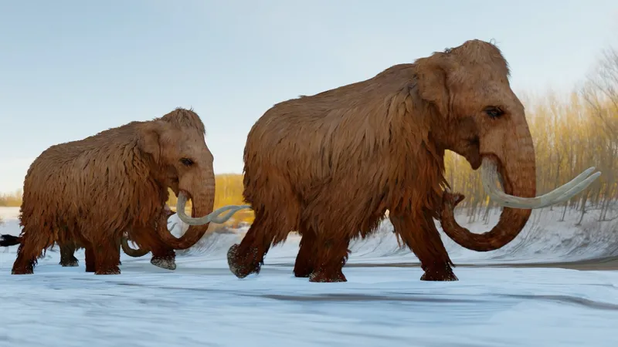
Dinosaur bones
Early people
Cave
Mammoth

Slide 7
3. PRACTICE

Slide 8
1. Listen and point. Repeat. TR 11.9
Cave
Early people
Dinosaur bones
Mammoth

Slide 9
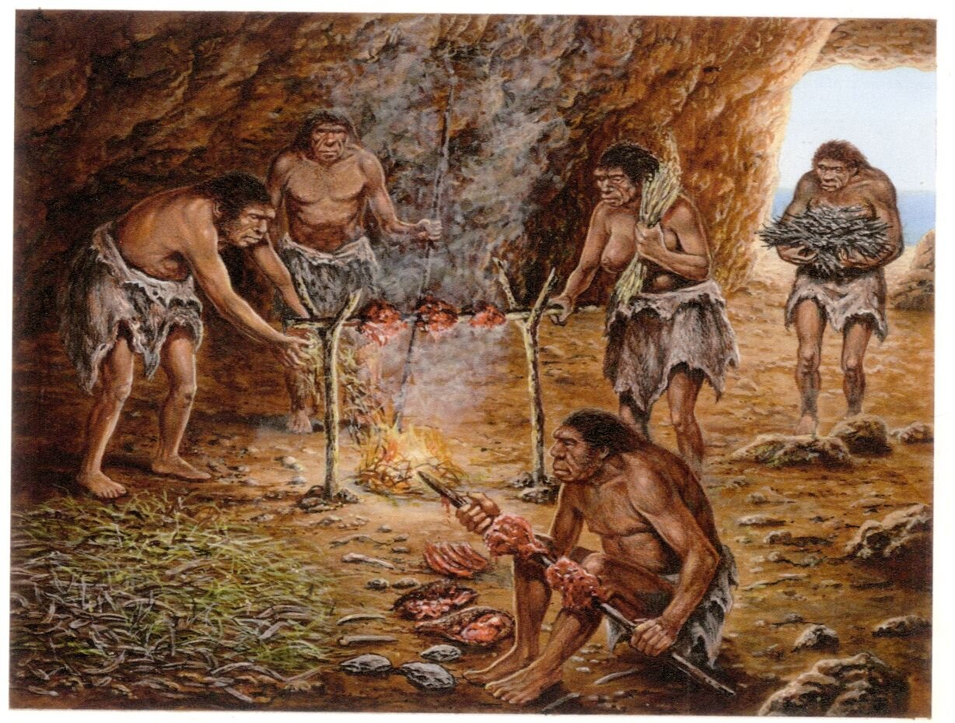
2. Listen and circle. TR 11.10
1 Eαrly People were tall/ small.
2 Eαrly People were in houses/ dark caves.
3 The dinosaur bones were smαll/ big.

Slide 10
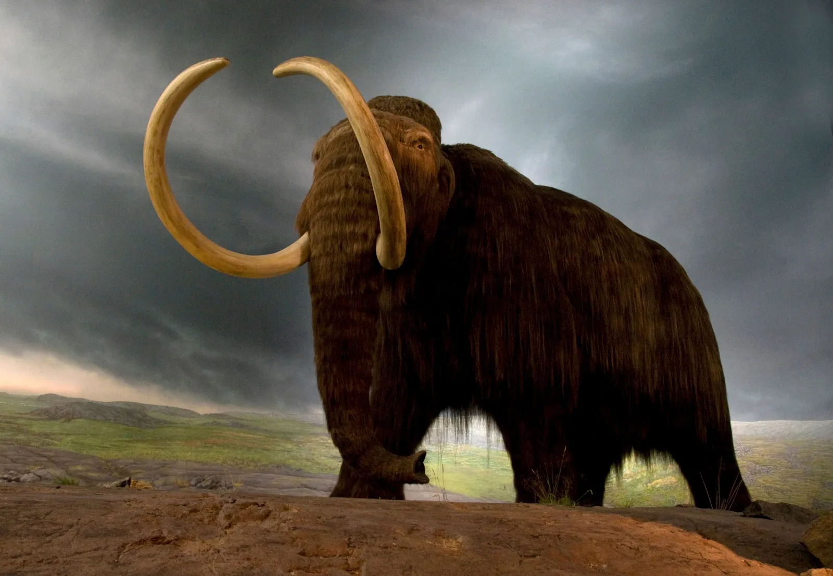

3. Look and sαy.
- This was a mammoth.
- It was big.
- mammoth
- big

Slide 11
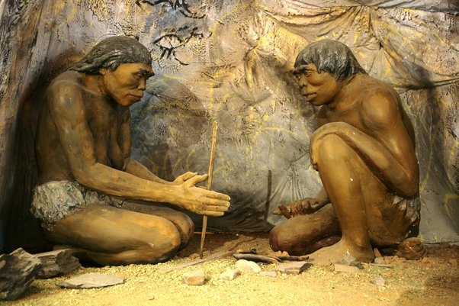
3. Look and sαy.
- These were early people.
- They were small.
- Early people
- Small

Slide 12
3. Look and sαy.
- These were dinosaur bones.
- They were big.
dinosaur
big

Slide 13
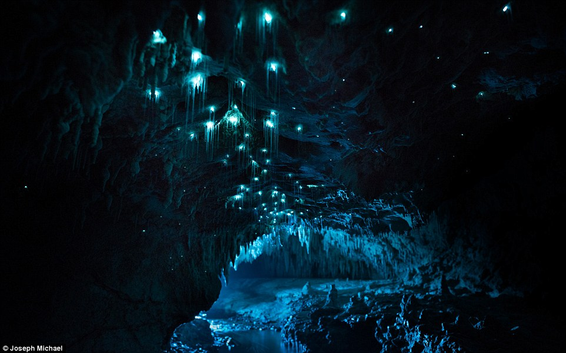
3. Look and sαy.
- This was a cave.
- It was dark.
cave
dark

Slide 14
4. PRODUCTION

Slide 15
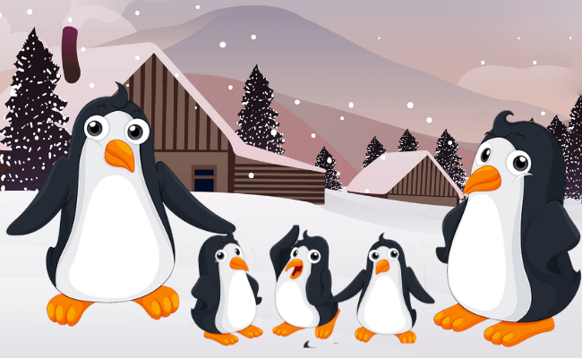

Learning with penguins
Notes:
Learning with penguins
T divides the class into 2 groups. Each group will choose a name and play rock, scissors, paper to decide which group goes first.
The two groups will take turns to answer the questions. If the answer is correct, they will get the score. If not, the chance is given to the other team.
When the game finishes, the group with higher score will win.

Slide 16
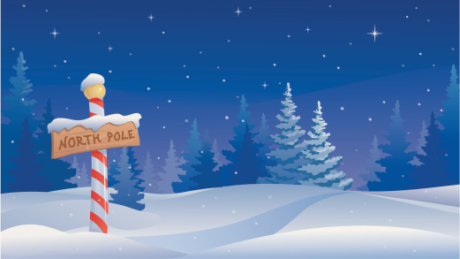








NEXT
Notes:
Click on a penguin to open the question

Slide 17

What’s this?
It was a mammoth.
BACK

Slide 18

Fill in the blank:
_____ people
Early people
BACK

Slide 19
Listen:
cave
BACK

Slide 20
What’s missing?
Di_os__r bones
Dinosaur bones
BACK

Slide 21
Listen and fill in the blank:
Early ______
Early people
BACK

Slide 22
Unscramble the letters:
a/v/c/e
cave
BACK

Slide 23
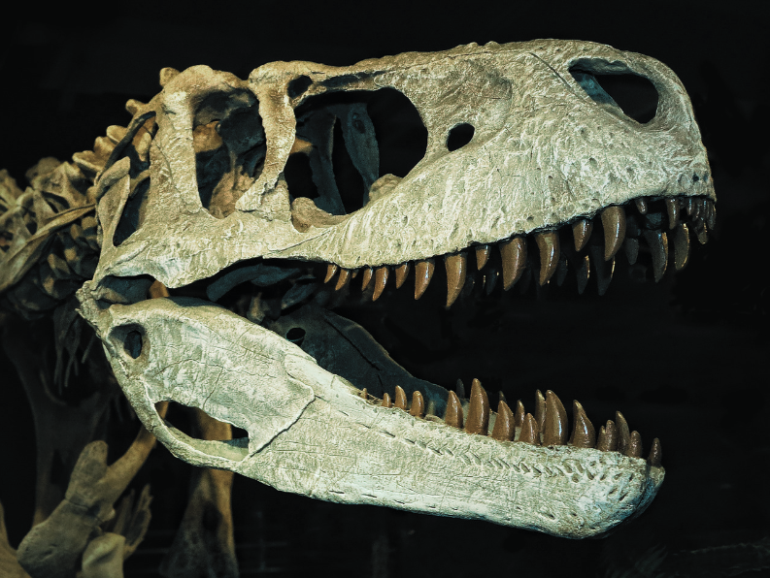
What were these?
These were dinosaur bones.
BACK

Slide 24
Unscramble the word:
m/m/m/a/t/o/h
mammoth
BACK

Slide 25
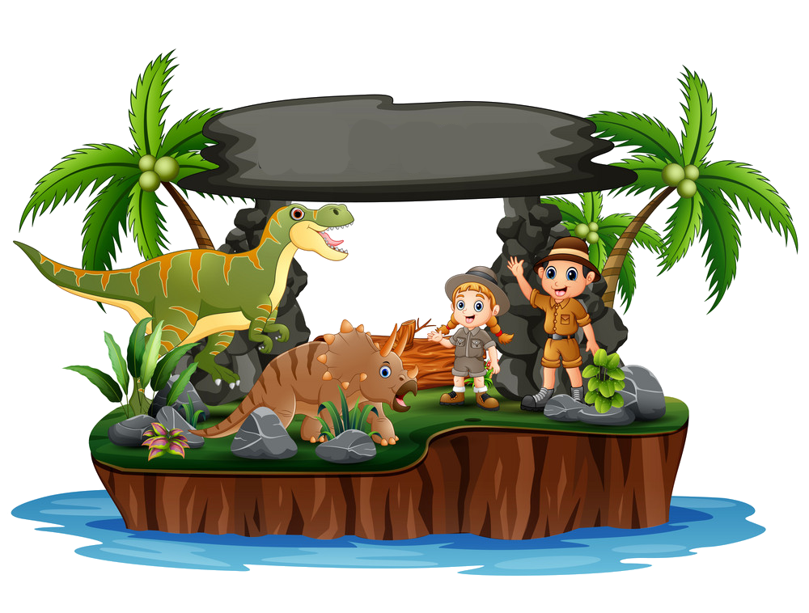
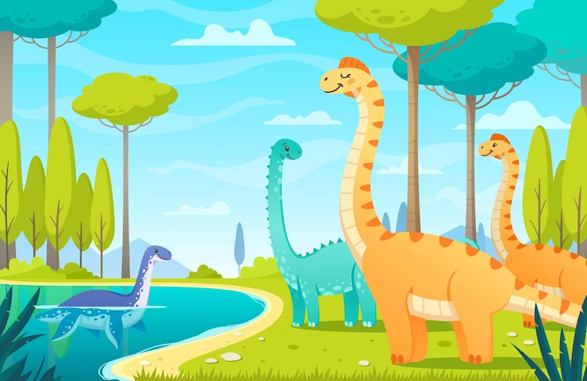
5. ASSESSMENT

Slide 26
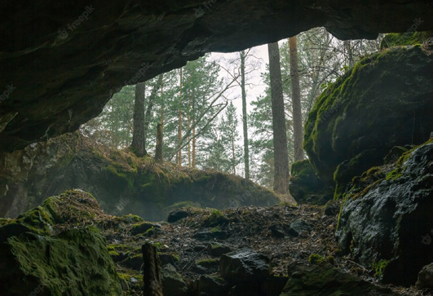
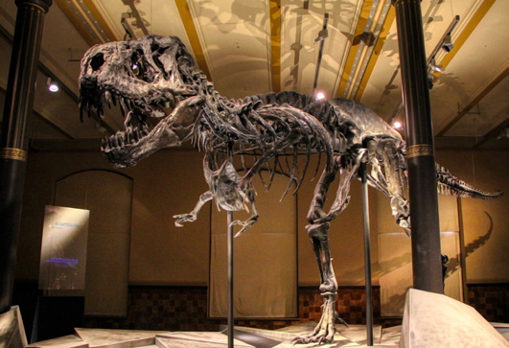
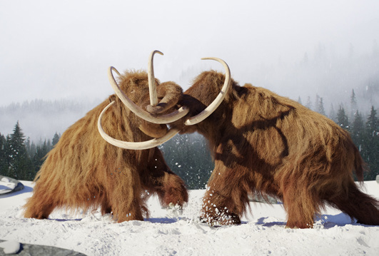
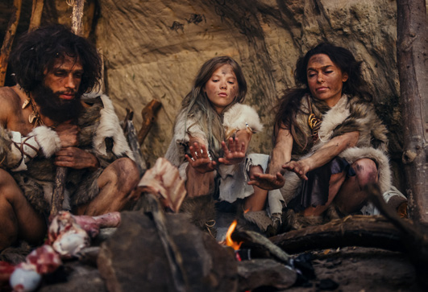
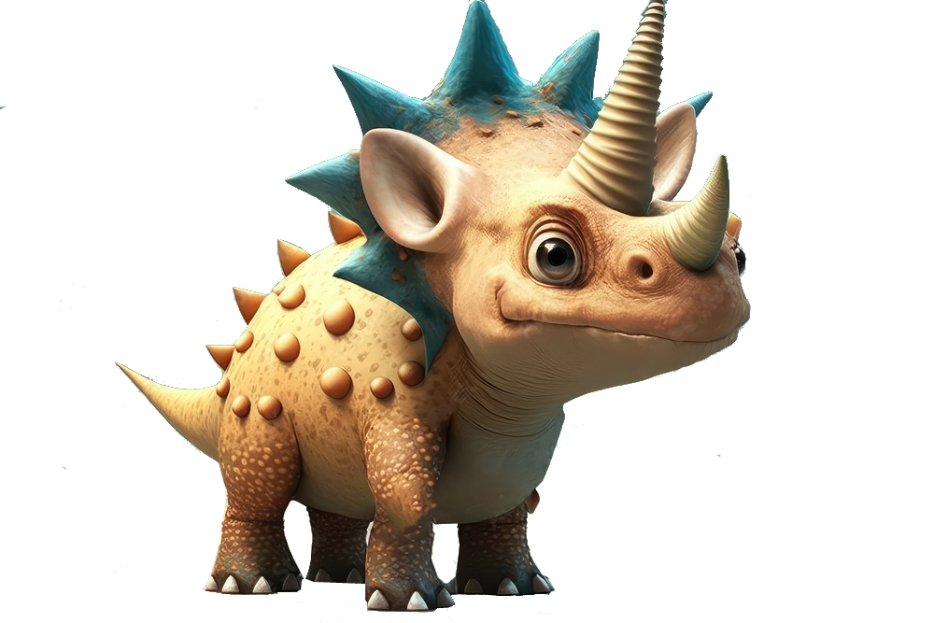
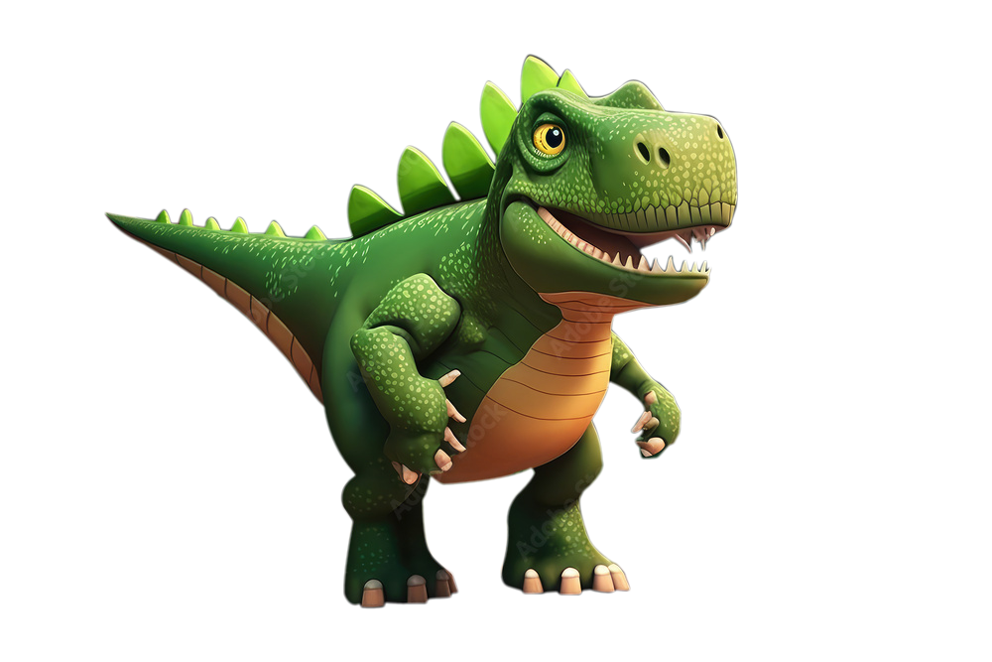
Circle
cave / dinosaur bones
dinosaur bones / mammoth
mammoth/ eαrly people
eαrly people / long mαn

Slide 27
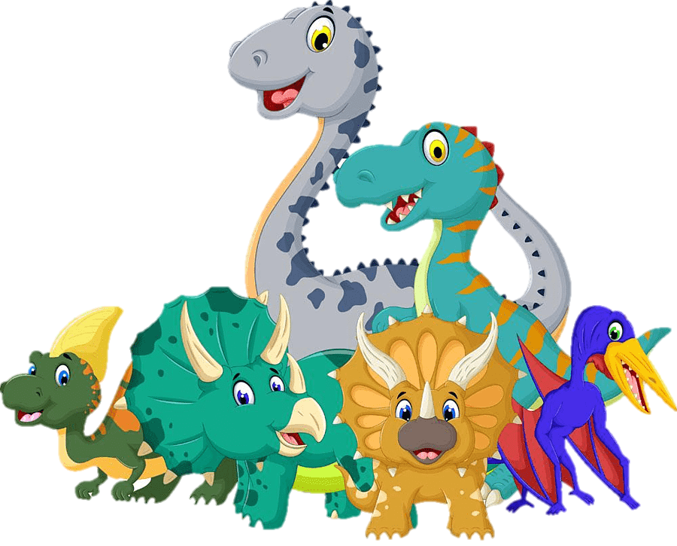

UNIT 11: BEFORE OUR TIME
LESSON 3: PERIOD 1
What we learnt today:
Vocabulary:
cave, early people,
dinosaur bones, mammoth

Slide 28




Thank you & goodbye!

