Slide 1




















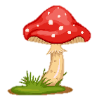
Notes:
Để nguyên trang bìa như này, chỉ thay đổi tên bài trong quá trình làm. Logo của sách Wonderful World

Slide 2


Review 2
Part 3

Slide 3
Warm-up
01
Practice
02
Content
03
Production
04
Wrap-up & Assessment

Slide 4
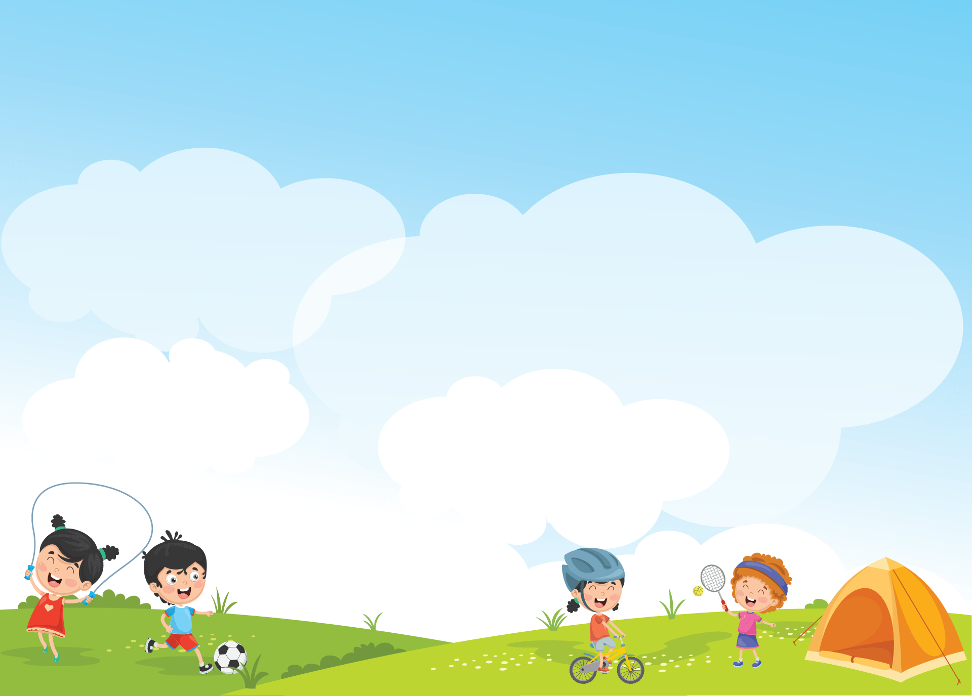


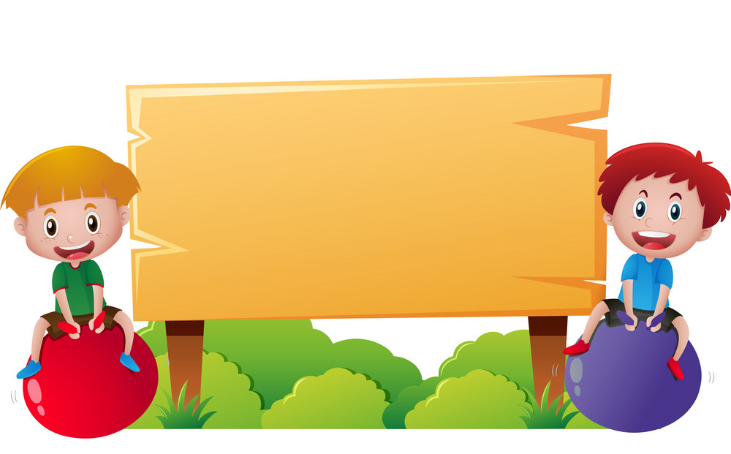
1 WARM-UP
Let’s dance

Slide 5
Let’s review

Slide 6





PLAY

Slide 7



There are a lot of books in this room.
A playground
A library
NEXT

Slide 8
We __________our bikes to school.
usually ride
ride usually
usually ride
NEXT

Slide 9
______________ playing the piano?
Are you good at
Do you good at
Are you good at
NEXT

Slide 10
2 Practice

Slide 11
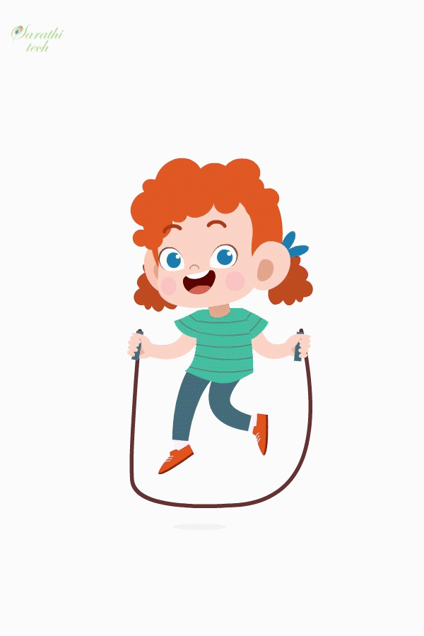
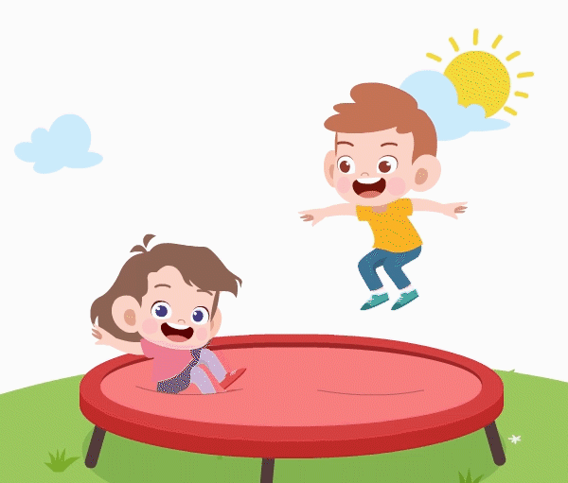

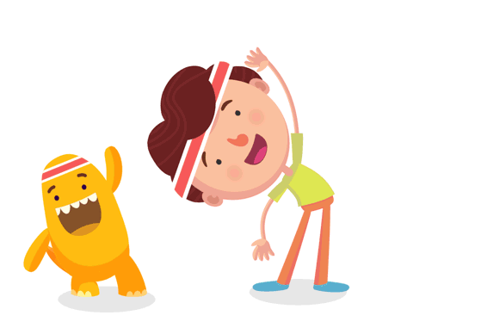

1. Read and tick. Then talk about your weekend activities.
fly a kite
play the piano
go on rides
watch TV
go swimming
do exercise
read
go to the playground
tidy my room
do homework


I go to the playground at the weekend.




I go swimming at the weekend.





Slide 12
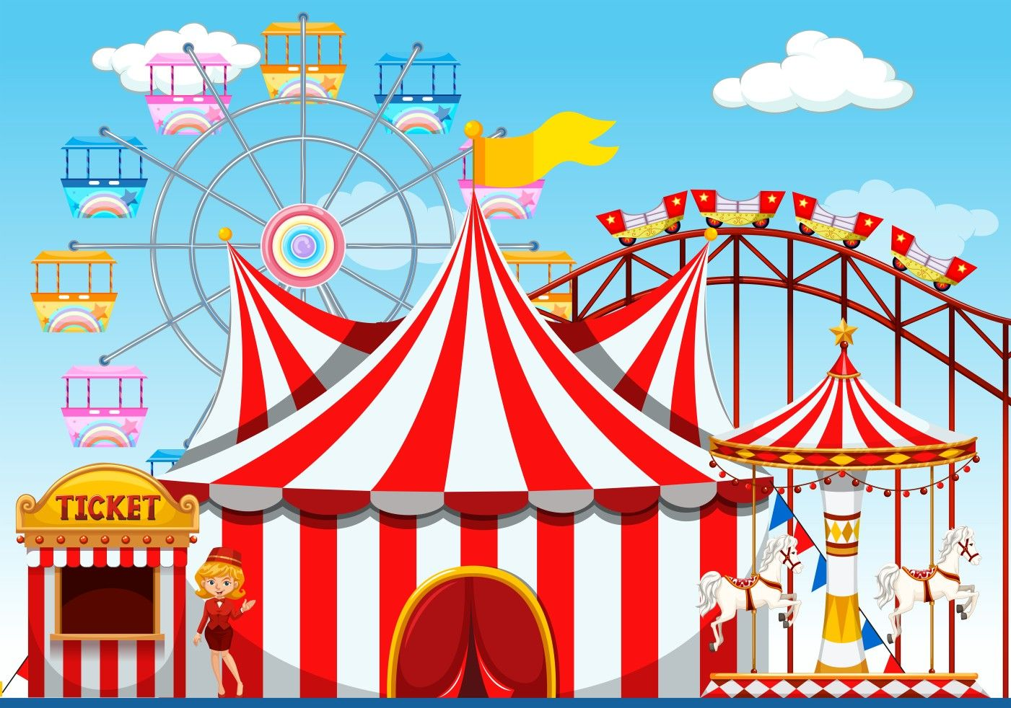
Before watching the video...
amusement park
/əˈmjuːzmənt ˌpɑːk/

Slide 13
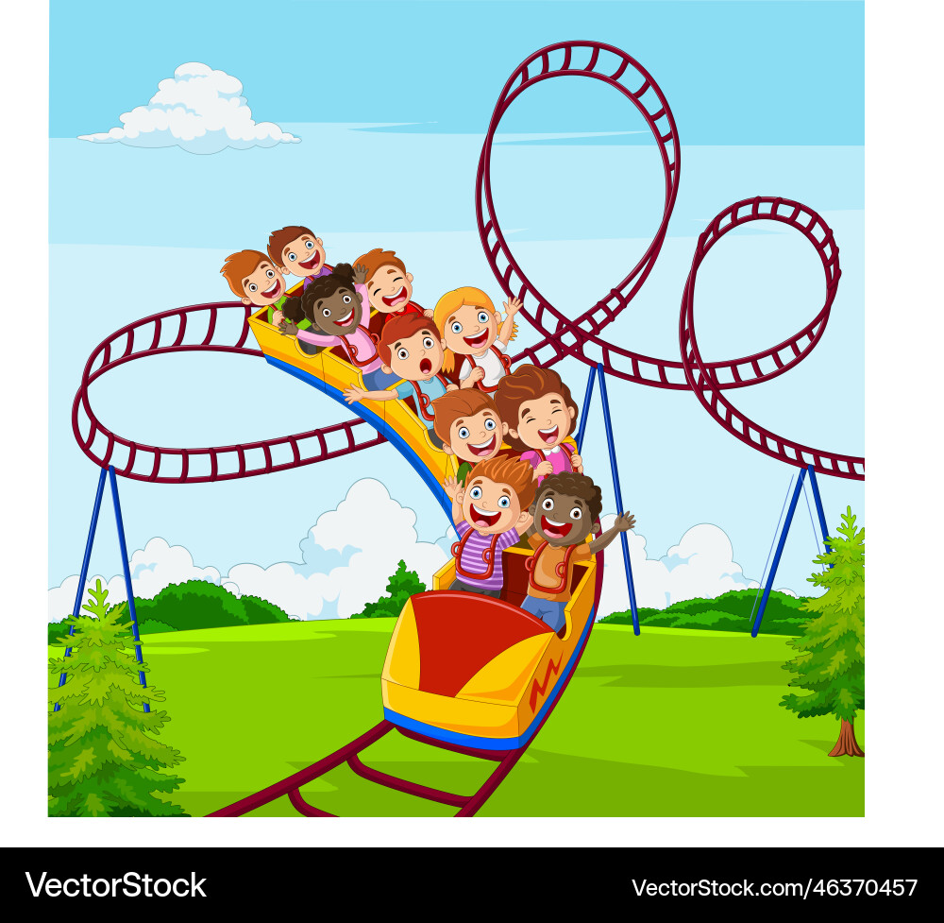
roller coaster
/ˌrəʊ·lə ˈkəʊs·tər/

Slide 14
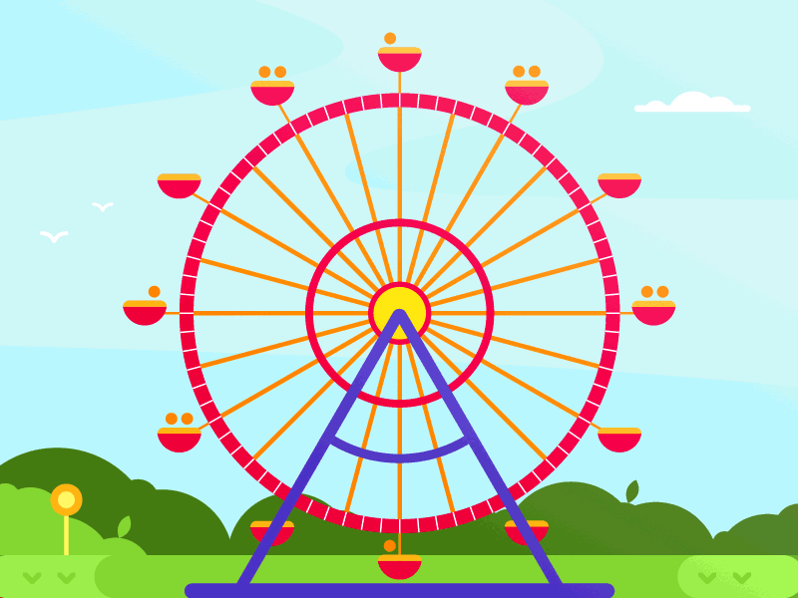
ferris wheel
/ˈfer.ɪs ˌwiːl/

Slide 15
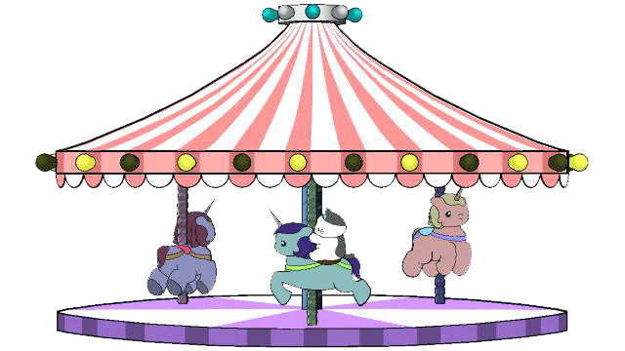
merry-go-round
/ˈmer.i.ɡəʊˌraʊnd/

Slide 16
2. Watch the video. Tick T for True or F for False.
1 A Ferris wheel is very fast.
2 A roller coaster is very fast.
3 There are only horses on the merry-go-round.
4 A merry-go-round is very slow.
5 People have lots of fun at an amusement park.
T
F






Slide 17
3 Production

Slide 18

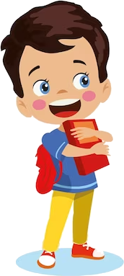
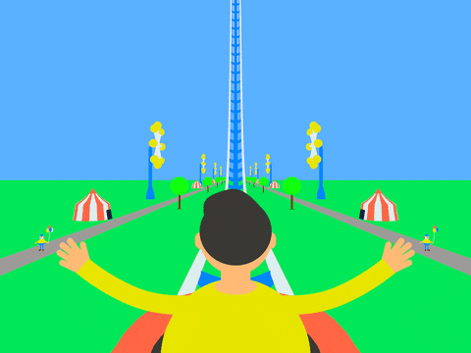
Tell your class about your weekend activities.
I ride the roller coaster at the weekend…

Slide 19
4 WRAP-UP & ASSESSMENT

Slide 20
đ
What are you good at?
1. ___________________________________
- I’m good at playing the piano.
2. ___________________________________
- I like riding the roller coaster.
3. ___________________________________
- I like going bowling because it’s fun.
4. ___________________________________
- I go to the bookshop twice a week.
5. ___________________________________
- I often go to the sports centre with my cousins.
What is your hobby?
Why do you like going bowling?
How often do you go to the bookshop?
Who do you go to the sports centre with?

Slide 21
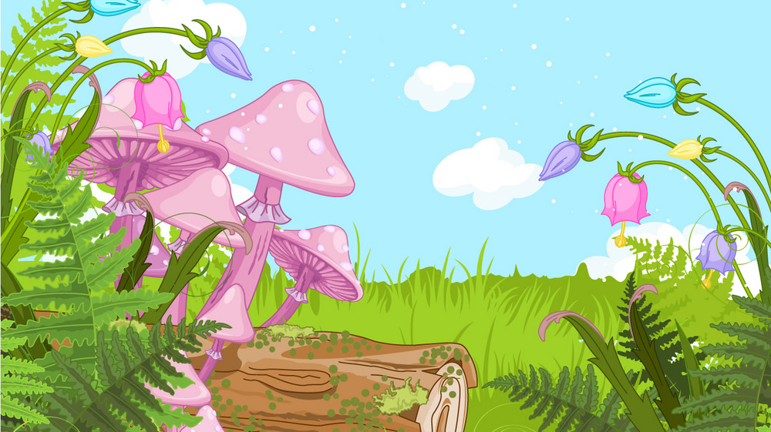
Wrap-up
What have we learnt today?
Review vocabulary: Topics: School life & Free time
Review grammar:
to be good at + V-ing
can (permission)
verb forms

Slide 22




Thank you & goodbye!

