Slide 1





















Review 2
Part 4
Notes:
Để nguyên trang bìa như này, chỉ thay đổi tên bài trong quá trình làm. Logo của sách Wonderful World

Slide 2



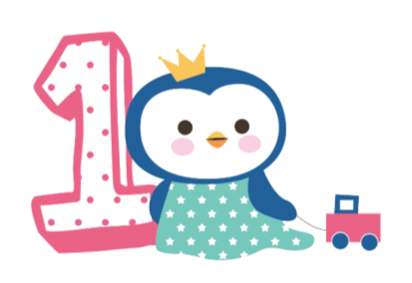



Warm up

Slide 3
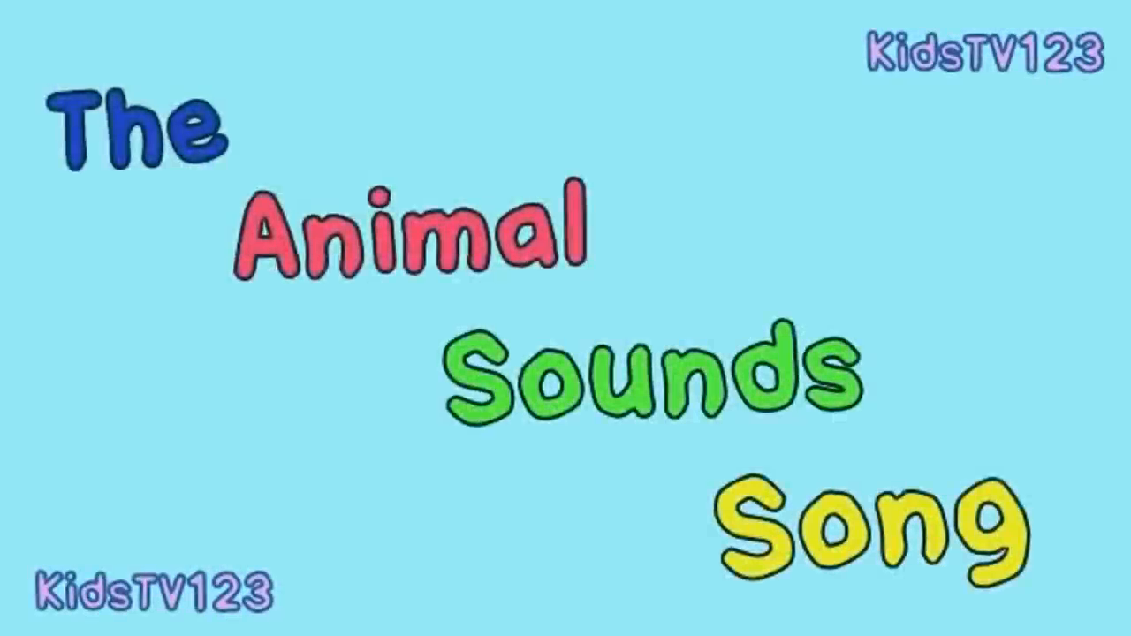
The Animal sounds song

Slide 4

Review

Slide 5

1.List the things you see in the school.
Inside the classroom | Outside the classroom
1. | 1.
2. | 2.
3. | 3.

Slide 6



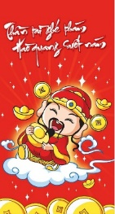
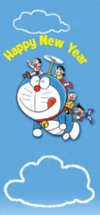
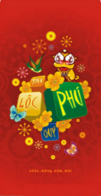
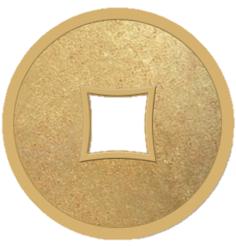





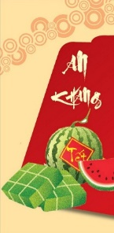

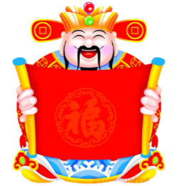
Apricot team
Peach team

Slide 7
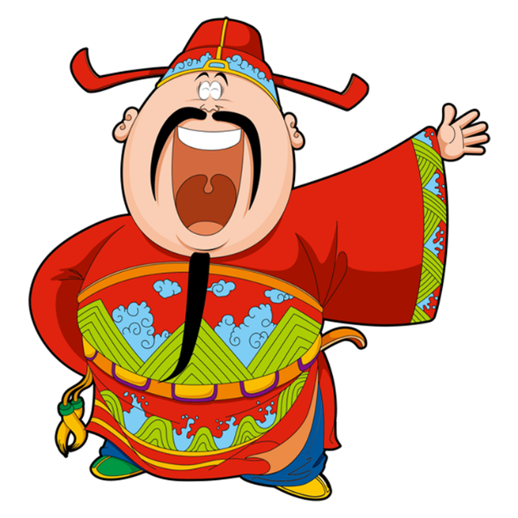
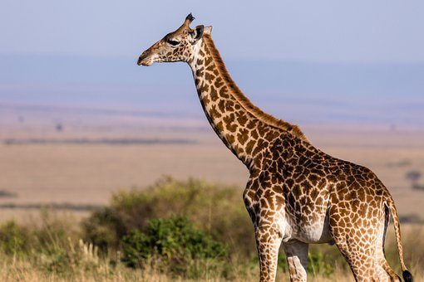
Fill letters in the blank
g_ra_ _e
i
f
f

Slide 8
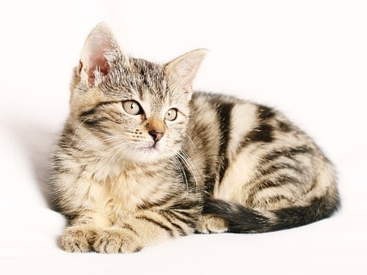
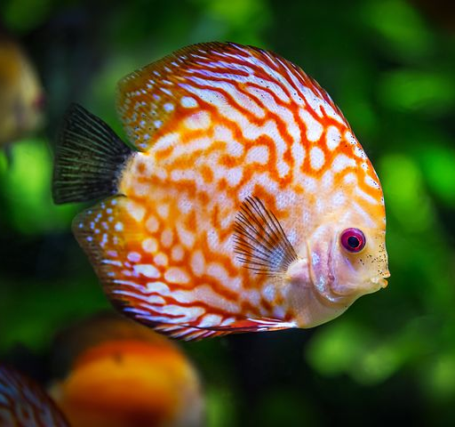
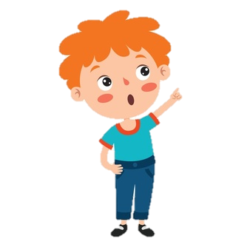
Look and circle
This / That is a cat.
This / That is a fish .

Slide 9

Choose the correct answer
What’s this ?
A. It’s a pen.
B. It’s a rubber.
C. It’s a board.

Slide 10
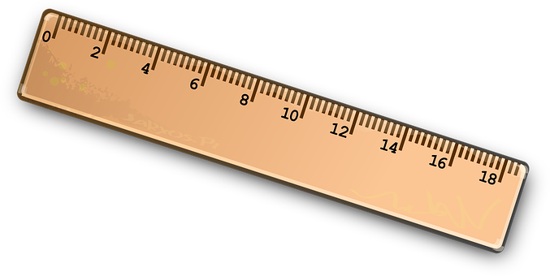
Write question and answer.
Are they clocks ?
No, they aren’t.
They/ clocks

Slide 11
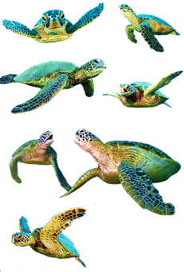
Choose the correct answer
What are those?
A. Those are turtle.
B. Those is turtles.
C. Those are turtles.

Slide 12
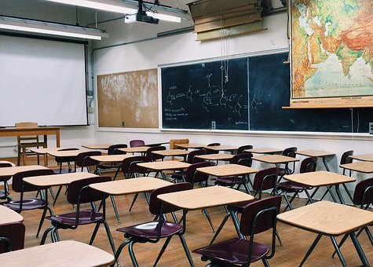
Fill letters in the blank
a
o
cl_ssr_ _m
o

Slide 13

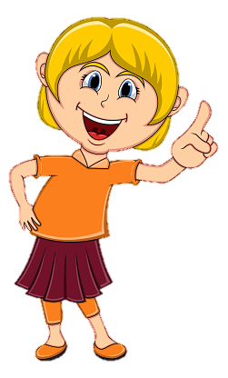
Look and circle
This / That is a clock.
This / That is a book .

Slide 14
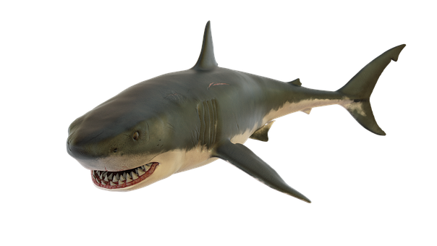
Choose the correct answer.
What’s that ?
C. It’s a shark.
B. It’s a whale.
A. It’s a rabbit.

Slide 15
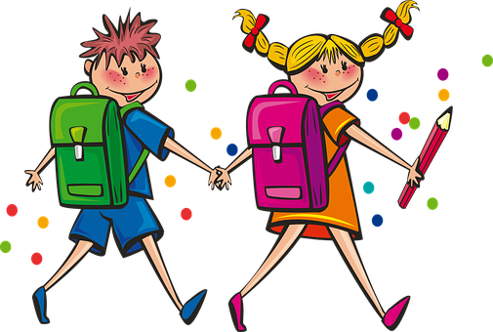
Write question and answer.
Are they students?
Yes, they are.
they / students

Slide 16
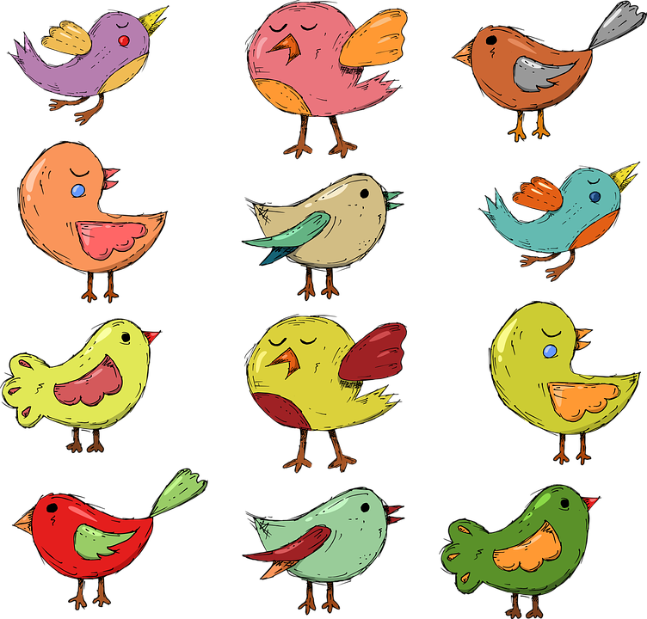
Choose the correct answer
What are these?
A. There are birds.
B. These are birds.
C. These are turtle.

Slide 17
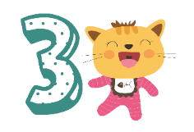
Extra Activity

Slide 18
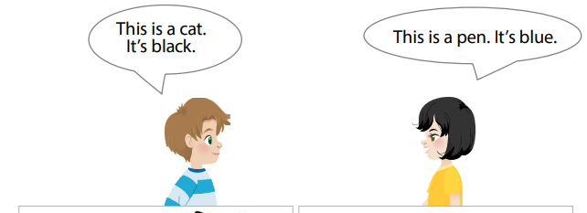
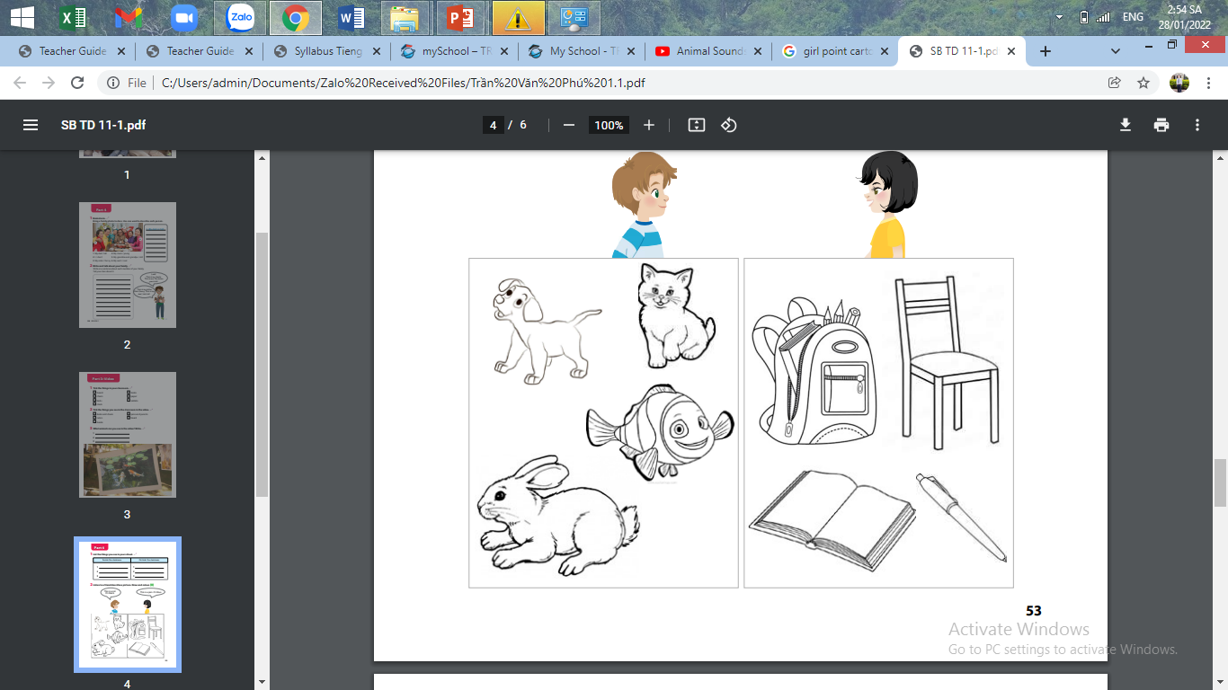
Task1: Listen to a friend describe a picture. Draw and colour.

Slide 19
Task 2: circle the correct word.
1.That / Those are ducks.
2.This / These are frogs.
3.This / Those is an elephant.
4.That / Those are lions.
5.This / These is a tree.
6.That / Those is a giraffe.

Slide 20



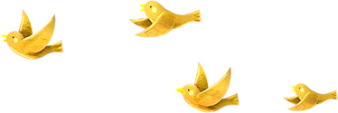
Good bye.
See you again!

