Slide 1











Slide 2


Spin and stop the pointer and click the pointed topic
HOUSE
COLOURS
BODY
PARTS
TRANSPORT
SCHOOL
NUMBERS
JOBS
TOYS
WILD
ANIMALS
FRUIT
CLOTHES
FAMILY

Slide 3

Say the colours of this rainbow
TIME’S UP
yellow
orange
green
blue
red
purple
WHEEL
CHECK

Slide 4
Spin and stop the pointer and click the pointed topic
HOUSE
COLOURS
BODY
PARTS
TRANSPORT
SCHOOL
NUMBERS
JOBS
TOYS
WILD
ANIMALS
FRUIT
CLOTHES
FAMILY

Slide 5





What are these?
TIME’S UP
bicycle
car
lorry
boat
aeroplane
WHEEL
CHECK

Slide 6
Spin and stop the pointer and click the pointed topic
HOUSE
COLOURS
BODY
PARTS
TRANSPORT
SCHOOL
NUMBERS
JOBS
TOYS
WILD
ANIMALS
FRUIT
CLOTHES
FAMILY

Slide 7
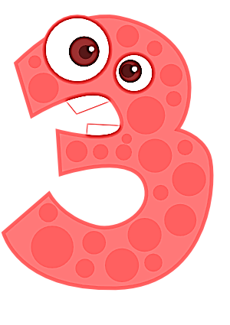
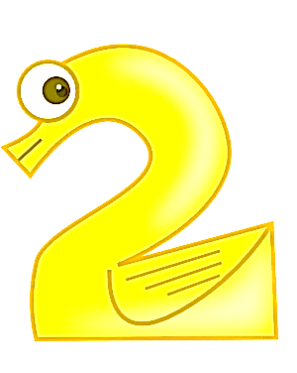
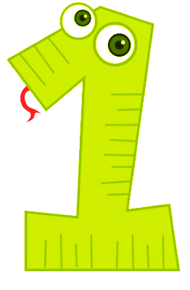

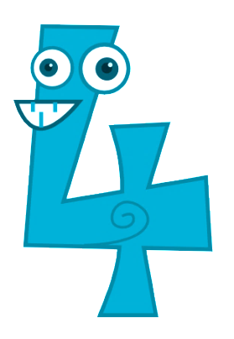
Say these numbers out loud
TIME’S UP
five
four
three
two
one
Can you count from 1 to 20?
WHEEL
CHECK

Slide 8
Spin and stop the pointer and click the pointed topic
HOUSE
COLOURS
BODY
PARTS
TRANSPORT
SCHOOL
NUMBERS
JOBS
TOYS
WILD
ANIMALS
FRUIT
CLOTHES
FAMILY

Slide 9





What are these?
TIME’S UP
pencil
pen
notebook
rubber
book
Can you say more words on this topic?
WHEEL
CHECK

Slide 10
Spin and stop the pointer and click the pointed topic
HOUSE
COLOURS
BODY
PARTS
TRANSPORT
SCHOOL
NUMBERS
JOBS
TOYS
WILD
ANIMALS
FRUIT
CLOTHES
FAMILY

Slide 11
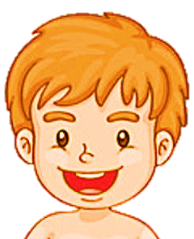
Say the pointed parts of the face
TIME’S UP
nose
hair
ear
eye
mouth
Can you say more parts of the body?
WHEEL
CHECK

Slide 12
Spin and stop the pointer and click the pointed topic
HOUSE
COLOURS
BODY
PARTS
TRANSPORT
SCHOOL
NUMBERS
JOBS
TOYS
WILD
ANIMALS
FRUIT
CLOTHES
FAMILY

Slide 13





What are these?
TIME’S UP
giraffe
elephant
lion
zebra
monkey
Can you say more words on this topic?
WHEEL
CHECK

Slide 14
Spin and stop the pointer and click the pointed topic
HOUSE
COLOURS
BODY
PARTS
TRANSPORT
SCHOOL
NUMBERS
JOBS
TOYS
WILD
ANIMALS
FRUIT
CLOTHES
FAMILY

Slide 15


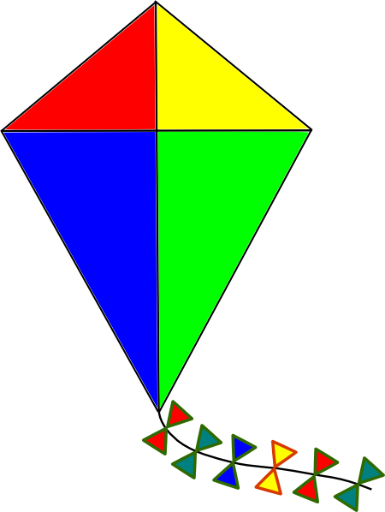


Say these toys out loud
TIME’S UP
teddy bear
ball
doll
kite
puppet
Can you say more words on this topic?
WHEEL
CHECK

Slide 16
Spin and stop the pointer and click the pointed topic
HOUSE
COLOURS
BODY
PARTS
TRANSPORT
SCHOOL
NUMBERS
JOBS
TOYS
WILD
ANIMALS
FRUIT
CLOTHES
FAMILY

Slide 17






He/She is Lisa’s …
TIME’S UP
grandfather
mother
father
brother
sister
Can you say more words on this topic?
WHEEL
CHECK

Slide 18
Spin and stop the pointer and click the pointed topic
HOUSE
COLOURS
BODY
PARTS
TRANSPORT
SCHOOL
NUMBERS
JOBS
TOYS
WILD
ANIMALS
FRUIT
CLOTHES
FAMILY

Slide 19





Say these jobs out loud
TIME’S UP
baker
fireman
farmer
doctor
teacher
Can you say more words on this topic?
WHEEL
CHECK

Slide 20
Spin and stop the pointer and click the pointed topic
HOUSE
COLOURS
BODY
PARTS
TRANSPORT
SCHOOL
NUMBERS
JOBS
TOYS
WILD
ANIMALS
FRUIT
CLOTHES
FAMILY

Slide 21





Call this fruit out loud
TIME’S UP
banana
cherry
apple
lemon
orange
Can you say more words on this topic?
WHEEL
CHECK

Slide 22
Spin and stop the pointer and click the pointed topic
HOUSE
COLOURS
BODY
PARTS
TRANSPORT
SCHOOL
NUMBERS
JOBS
TOYS
WILD
ANIMALS
FRUIT
CLOTHES
FAMILY

Slide 23
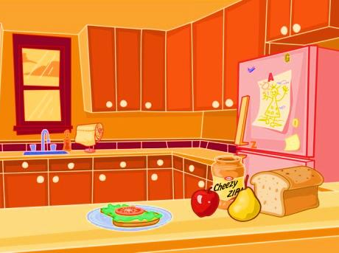
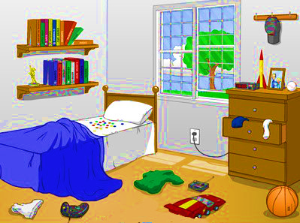
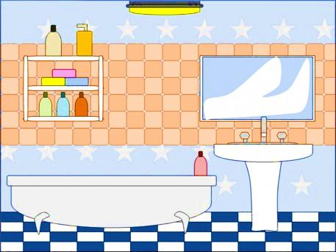
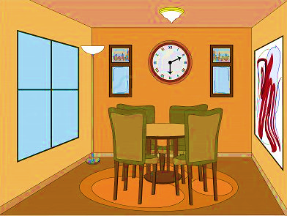
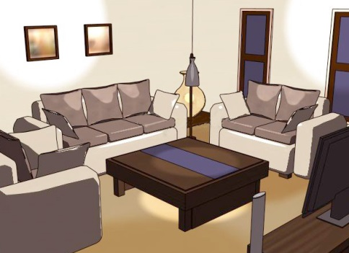

Say the name of these rooms
TIME’S UP
kitchen
bedroom
bathroom
dinning room
living room
WHEEL
CHECK
Can you say more words on this topic?

Slide 24
Spin and stop the pointer and click the pointed topic
HOUSE
COLOURS
BODY
PARTS
TRANSPORT
SCHOOL
NUMBERS
JOBS
TOYS
WILD
ANIMALS
FRUIT
CLOTHES
FAMILY

Slide 25

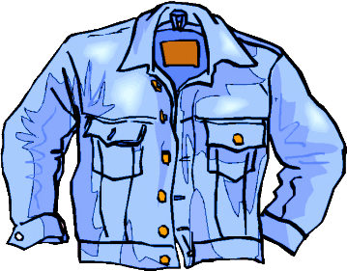
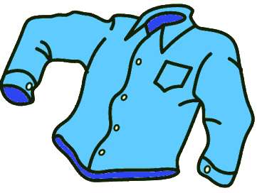

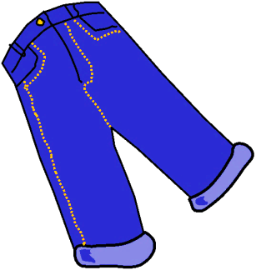
What are these?
TIME’S UP
jacket
coat
shirt
jumper
jeans
Can you say more words on this topic?
EXIT
CHECK

