Slide 1




Slide 2
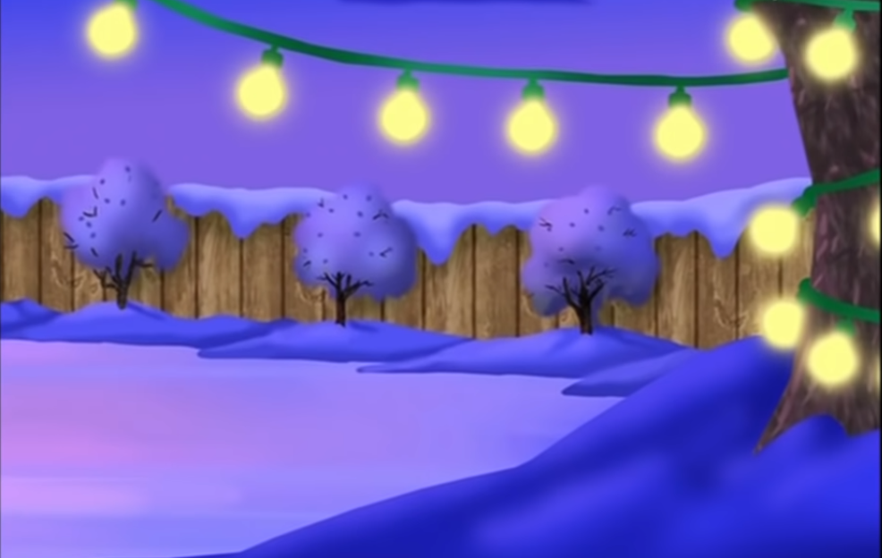

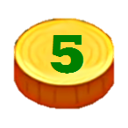






HOMEWORK

Slide 3


Slide 4

1. for/ Collect/ recycling./ newspapers
Collect newspapers for recycling.

Slide 5


Slide 6

2. Don't/ food./ away/ throw
Don't throw away food.

Slide 8

3. bottles./ Recycle/ plastic
Recycle plastic bottles.

Slide 10
4. Pick/ trash/ streets./ up/ the/ off
Pick up trash off the streets.

Slide 12
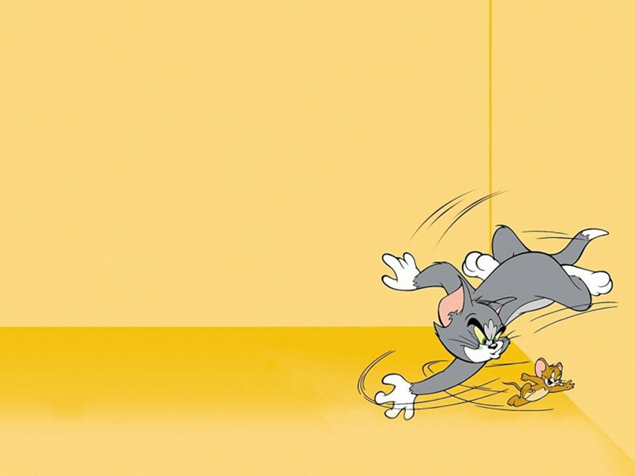
5. night./ Turn/ computers/ at/ off
Turn off computers at night.

Slide 14
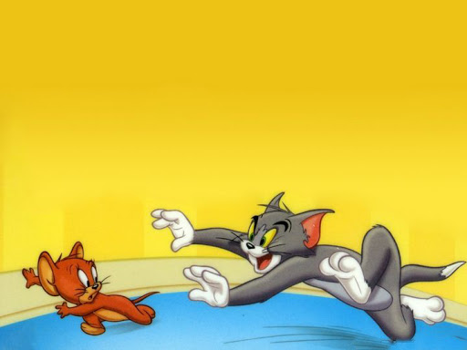
6. glass/ Reuse/ jars/ to/ food./ store
Reuse glass jars to store food.

Slide 16
7. you/ bottles/ them./ Wash/ before/ recycle
Wash bottles before you recycle them.

Slide 18
8. throw/ clothes. / away/ Don't/ old / Give/ them/ your/ friends./ to
Don't throw away old clothes. Give them to your friends.

Slide 20
9. cans / Recycle / and / bottles.
Recycle cans and bottles.

Slide 22

10. up/ Pick/ and/ school./ your/ trash/ house/ near
Pick up trash near your house and school.

Slide 23

End!

