Slide 1


Unit 10.
Lesson 3. Task 4,5,6

Slide 2
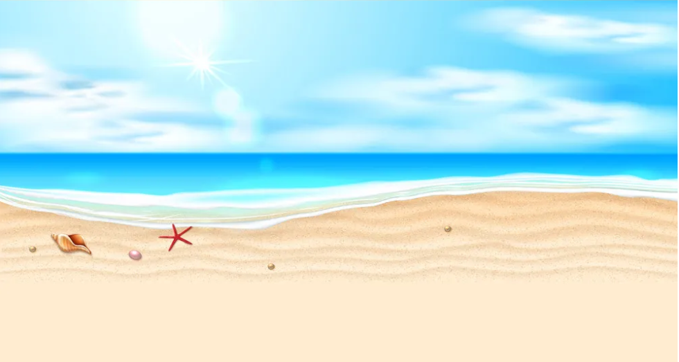
01
Warm Up

Slide 3
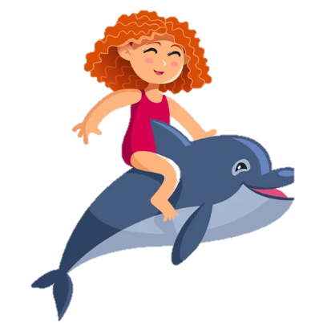

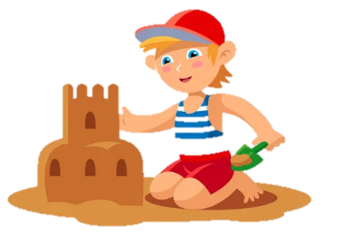
2
Presentation

Slide 4

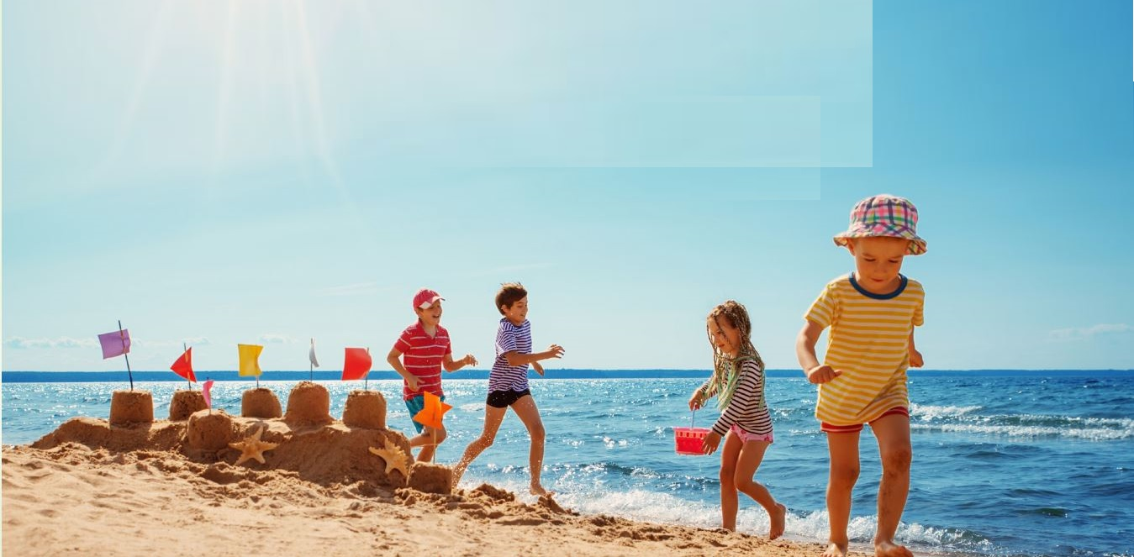
4
Listen and repeat.
I like summer.
I don’t like winter.

Slide 5
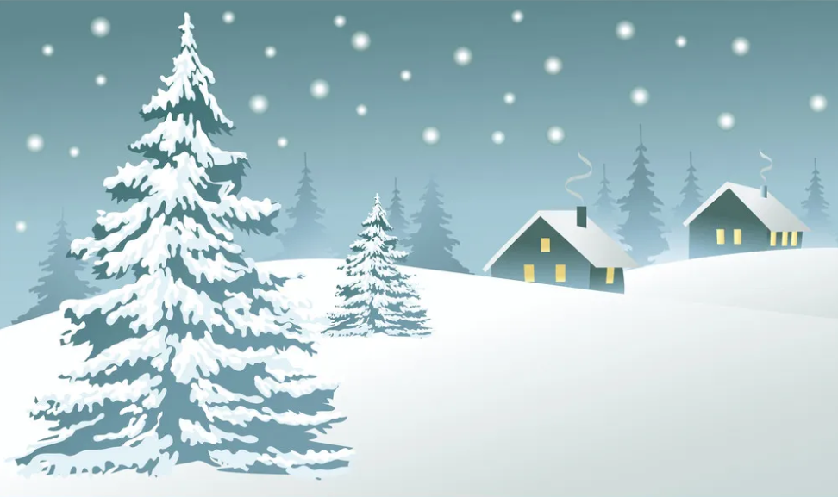
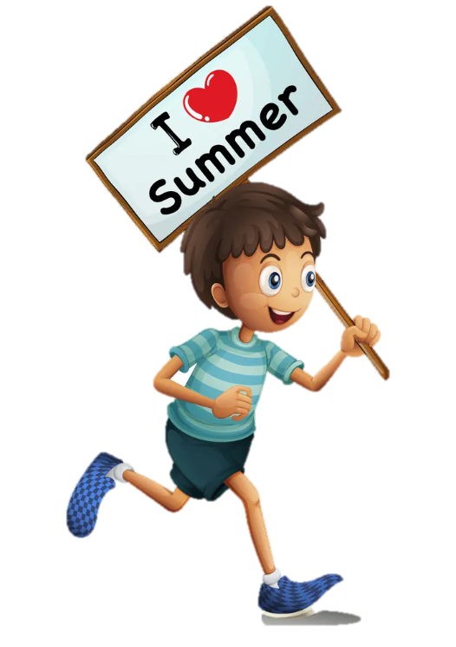
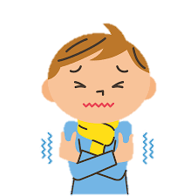
I like summer.
I don’t like winter .

Slide 6

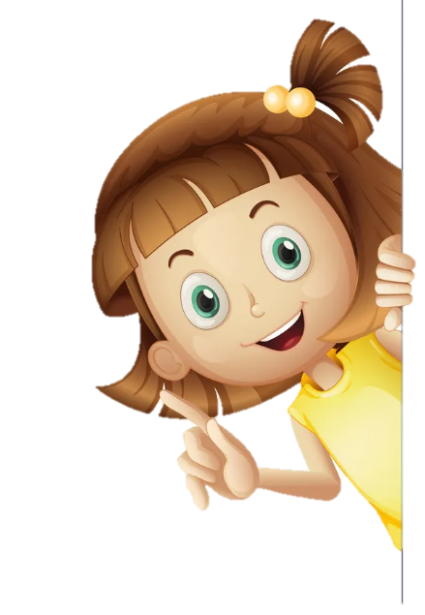
5
Circle and say.
I like spring.
I don’t like autumn.

Slide 7
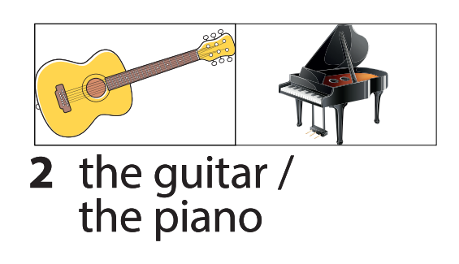
I like the guitar.
I don’t like the piano.

Slide 8
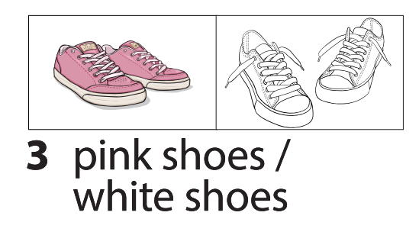
I like pink shoes. I don’t like white shoes.

Slide 9
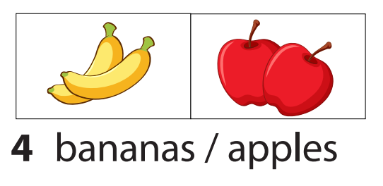
I like apples. I don’t like bananas.

Slide 10
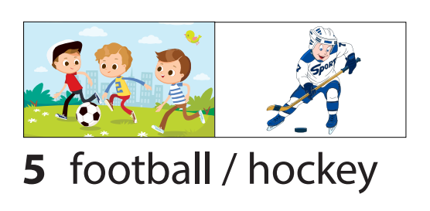
I like football. I don’t like hockey.

Slide 11
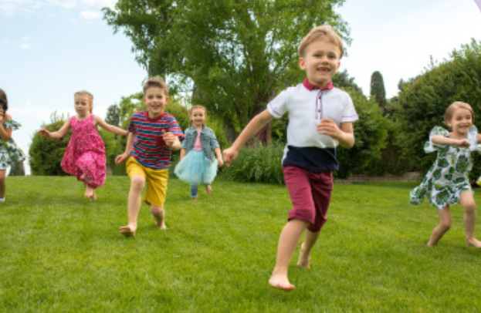
6
Listen and sing
It’s sunny today!
It’s sunny today!
On sunny days, we play in the park.
We run, we climb!
We have fun outside!
Let’s go to the park!

Slide 12
4
Production

Slide 13


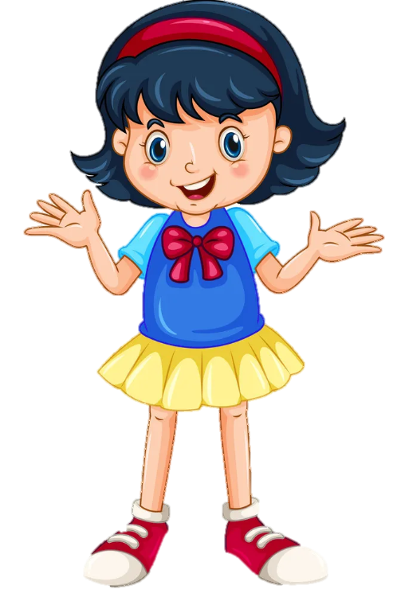

I like …
Project
I don’t like …

Slide 14
5
Assessment
Notes:
HOẠT ĐỘNG TƯƠNG TÁC SLIDE 27,28

Slide 15


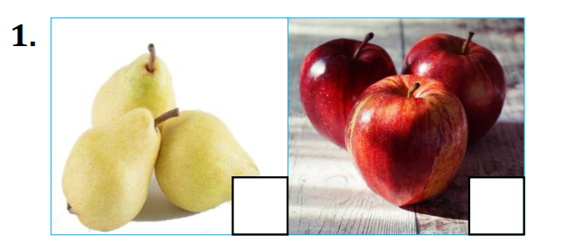
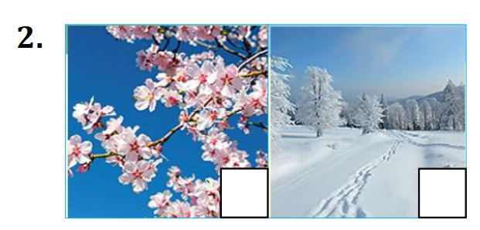
Put a tick (✓) or a cross (✗) in each box.
I like apples. I don’t like pears.
I like spring. I don’t like winter.

Slide 16
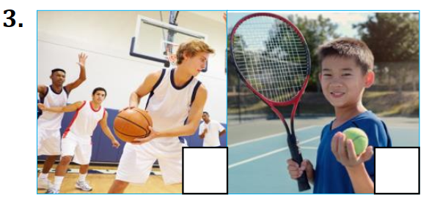
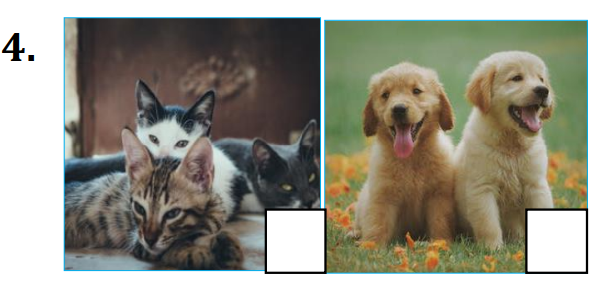
Put a tick (✓) or a cross (✗) in each box.
I like basketball. I don’t like tennis.
I like dogs. I don’t like cats.

Slide 17




Thank you & goodbye!

