Slide 1



Unit 10
Our World
Lesson 3 – Task 1,2,3

Slide 2
1
Warm Up

Slide 3
2
Presentation

Slide 4


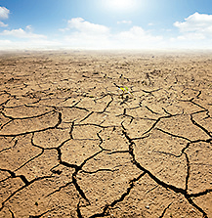
1
Listen and point. Repeat.
It’s …
It’s dry.
dry.

Slide 5
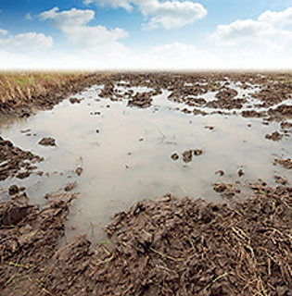


It’s …
dry.
wet.
spring.
autumn.

Slide 6
3
Practice

Slide 7

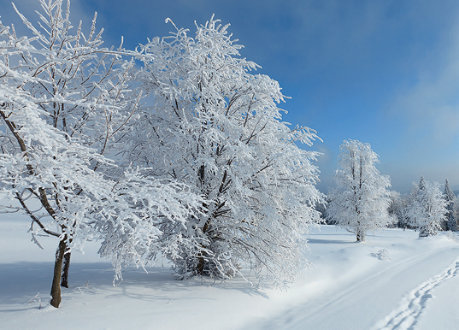

summer
winter
It’s dry and sunny.
It’s cold and wet.

Slide 8
2
Listen and match.
1. In spring,
a. I go to the sea.
2. In summer,
b. I go to school.
3. In autumn,
c. I go to the park.
4. In winter,
d. I play at home.

Slide 9

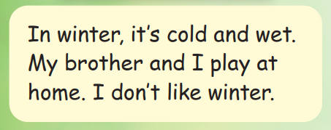

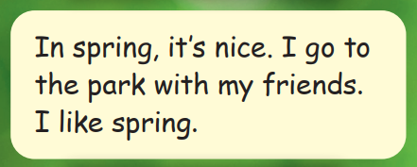
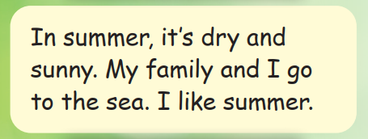
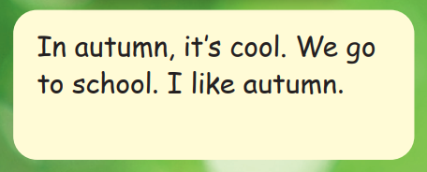
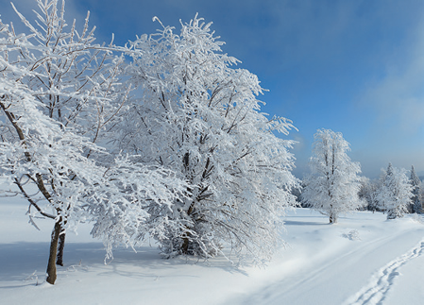
A
Read
and
match
B
C
D

Slide 10
4
Production
Speaking contest

Slide 11

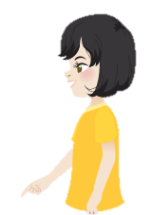
It’s spring.
I go to the park.

Slide 12
5
Assessment

Slide 13
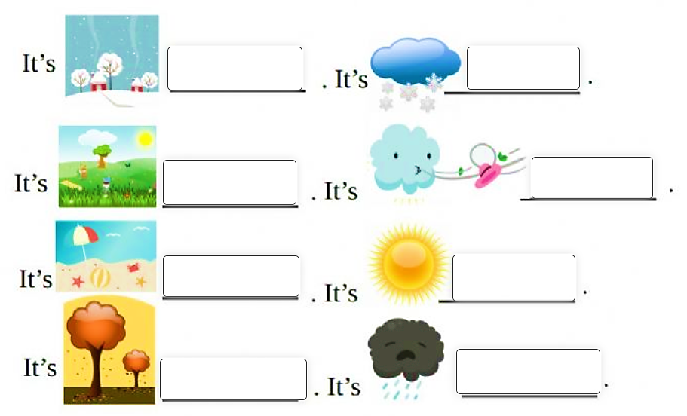
Fill in the blanks
winter
snowy
spring
windy
summer
sunny
autumn
rainy
Notes:
HOẠT ĐỘNG TƯƠNG TÁC

Slide 14




Thank you & goodbye!

