Slide 1


Unit 10
Our World
Lesson 2 – Task 7,8,9

Slide 2




01
1
WARM UP
You can enter a subtitle here if you need it

Slide 3

01
Name of the section
2
Presentation
You can enter a subtitle here if you need it

Slide 4

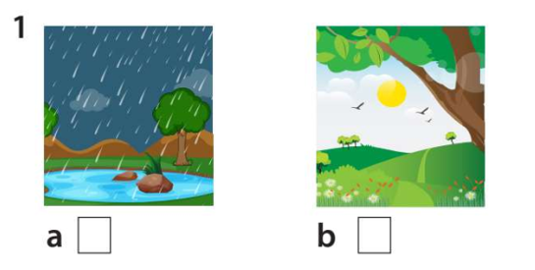

7. Listen and tick.

Slide 5
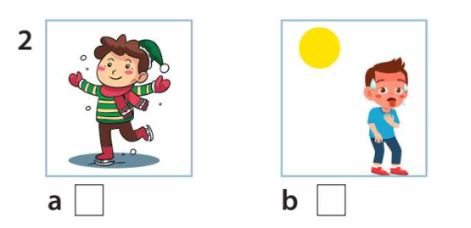
Listen and tick

Slide 6
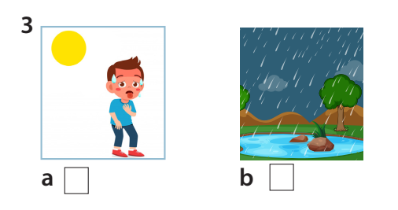
Listen and tick

Slide 7
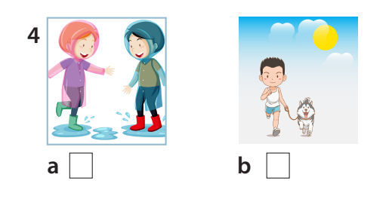
Listen and tick

Slide 8

01
Name of the section
3
Writing
You can enter a subtitle here if you need it

Slide 9
8. Write and say.
1. It’s / summer./ hot / the / in
→ It’s hot in the summer.
2. winter. / It’s / in / the / cold
→ It’s cold in the winter.
3. I / hot / go /weather. / in / swimming
→ I go swimming in hot weather.
4. My / winter. / play / the / chess/ friends / in
→ My friends play chess in the winter.
5. My / shopping/ summer. /family / go / and / I / in hot
→ My family and I go shopping in hot summer.

Slide 10
01
Name of the section
4
Production
You can enter a subtitle here if you need it

Slide 11

Season talking

Slide 12




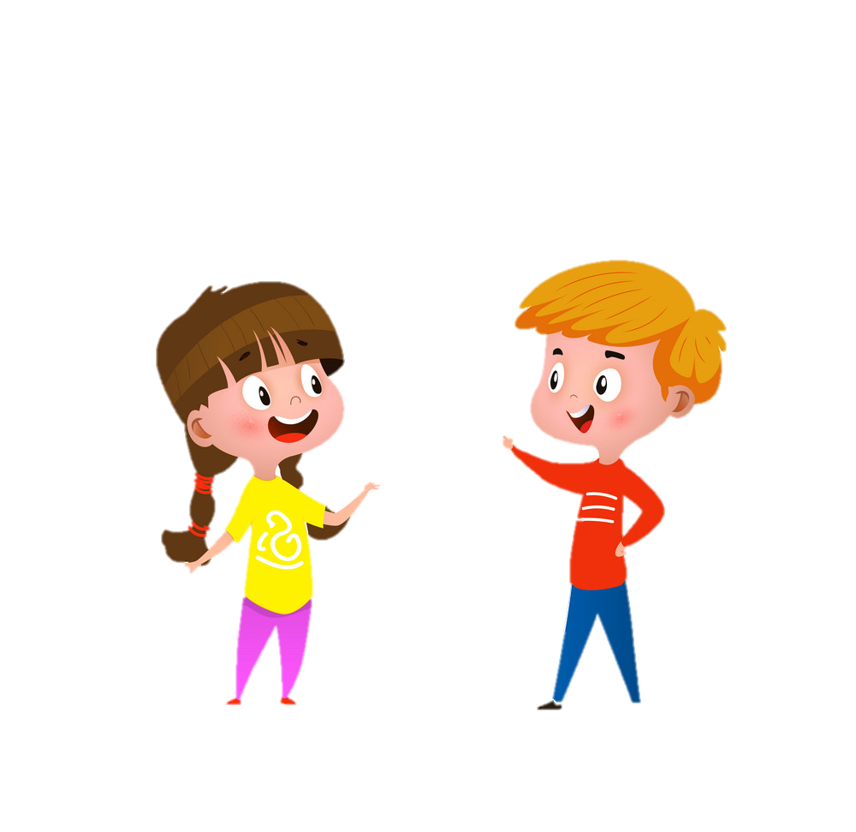

9. Let’s talk.
It’s cold and rainy in winter. Do you go to the park ?
No, I don’t. I play games in the living room.

Slide 13
01
Name of the section
5
Assessment
You can enter a subtitle here if you need it

Slide 14
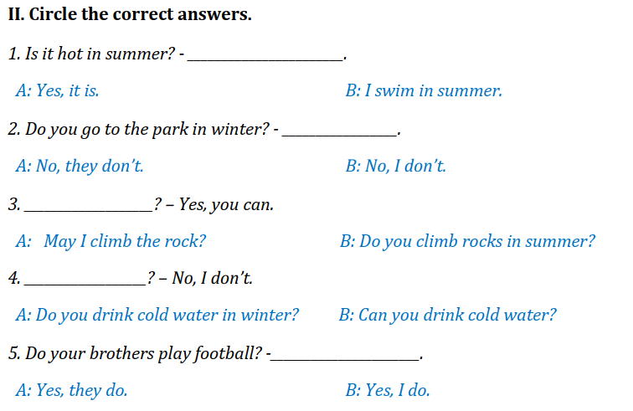
Circle the correct answers
Notes:
HOẠT ĐỘNG TƯƠNG TÁC

Slide 15




Thank you & goodbye!

