Slide 1
WELCOME TO TEACHERS AND STUDENTS!
Teacher: Vu Thi Thu Ha
CLASS: 9A2

Slide 2
Unit 3: HEALTHY LIVING FOR TEENS
Period 18
LESSON 3: A CLOSER LOOK 2

Slide 3

After this lesson, students will be able to:
Review the knowledge of first conditional sentences;
Distinguish the uses of modal verbs in first conditional sentences;
Use modal verbs in first conditional sentences in real-life situations.
apply the knowledge to do exercises in the entrance exam

Slide 4
WHICH GROUP IS FASTER?

Slide 5
RULES
- Joining two halves of papers together to make meaningful sentences
- The group which has the fastest with more correct answer will be the winner.

Slide 6
If you finish your paper,
She can run faster than you.
If she trains harder,
You can hand it in and leave for home.
If you do physical exercise regularly,
If he is good at IT.
He may/ might get a good job
you must get rid of all the distractions.
You should balance your study and life
your health will improve.
If you want to manage your time effectively,
If you want to have good mental health.

Slide 7


Slide 8
If you finish your paper,
She can run faster than you.
If she trains harder,
You can hand it in and leave for home.
If you do physical exercise regularly,
If he is good at IT.
He may/ might get a good job
you must get rid of all the distractions.
You should balance your study and life
your health will improve.
If you want to manage your time effectively,
If you want to have good mental health.

Slide 9
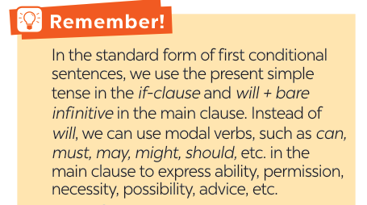

Slide 10
If you finish your paper, You can hand it in and leave for home.
permission
If she trains harder, She can run faster than you.
ability
If you do physical exercise regularly, your health will improve.
Standard form
He may/ might get a good job If he is good at IT.
possibility
You should balance your study and life If you want to have good mental health.
advice
If you want to manage your time effectively, you must get rid of all the distractions.
necessity

Slide 11
Ex1. Write the correct form of each verb in brackets.
doesn’t want
1. If Mai (not want) __________________ to gain weight, she shouldn’t eat much fast food.
2. If you stay up too late tonight, you might (feel) ________________ tired tomorrow morning.
3. You should (sleep) ____________ eight hours a night if you want to be awake and fully alert.
4. If Tom (complete) _______________ his assignment on Friday, he can go out with his friends at the weekend.
5. You must (be) _______________ careful if you don’t want to get burnt.
feel
sleep
completes
be

Slide 12
Ex2. Circle the correct modal verbs to complete the following sentences.
1. She can / should go home early if she finishes her work.
2. If you train hard, you might / shouldn’t win the first prize.
3. If they don’t want to be punished, they must / may follow the rules.
4. If students have an upcoming exam, they shouldn’t / can’t wait to study until the day before it.
5. If you’re having a bad day, you should / may do your best to get through it.

Slide 13
GAME
TUG OF WAR

Slide 14


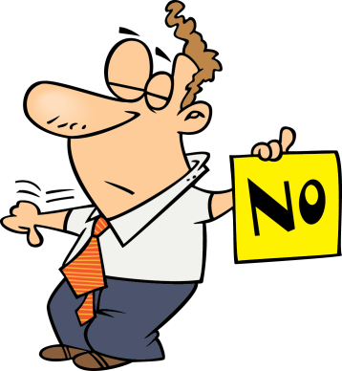
can
She ………….. go home early if she finishes her work.
should
can
NEXT

Slide 15
might
If you train hard, you ………………win the first prize
shouldn’t
might
NEXT

Slide 16
If they don’t want to be punished, they ……………….follow the rules.
must
may
must
NEXT

Slide 17
shouldn’t
If students have an upcoming exam, they …………….. wait to study until the day before it.
shouldn’t
can’t
NEXT

Slide 18
should
If you’re having a bad day, you ………………….. do your best to get through it.
should
may
EXIT

Slide 19
Ex2. Circle the correct modal verbs to complete the following sentences.
1. She can / should go home early if she finishes her work.
2. If you train hard, you might / shouldn’t win the first prize.
3. If they don’t want to be punished, they must / may follow the rules.
4. If students have an upcoming exam, they shouldn’t / can’t wait to study until the day before it.
5. If you’re having a bad day, you should / may do your best to get through it.

Slide 20
Ex3. Match the first half of the sentence in A with the second half in B.
1. If you spend too much time on the computer,
2. If you put too much sugar in your coffee,
3. If you want to manage your time effectively,
4. If you want to have perfect white teeth,
5. If you take a cooking class,
d. you might get shoulder pains.
a. you can make your favourite food at home.
b. you should use a calendar to plan your work ahead.
c. you may put on more weight.
c. you may put on more weight.
b. you should use a calendar to plan your work ahead.
d. you might get shoulder pains.
e. you must brush your teeth regularly.
a. you can make your favourite food at home.
e. you must brush your teeth regularly.

Slide 21
Ex4. What will you say in each situation below? Use first conditional sentences with modal verbs.
Your friend wants to lose weight.
You advise him / her to eat less high fat food and do more exercise.
=> If you want to lose weight, you should eat less high fat food and do more exercise.

Slide 22
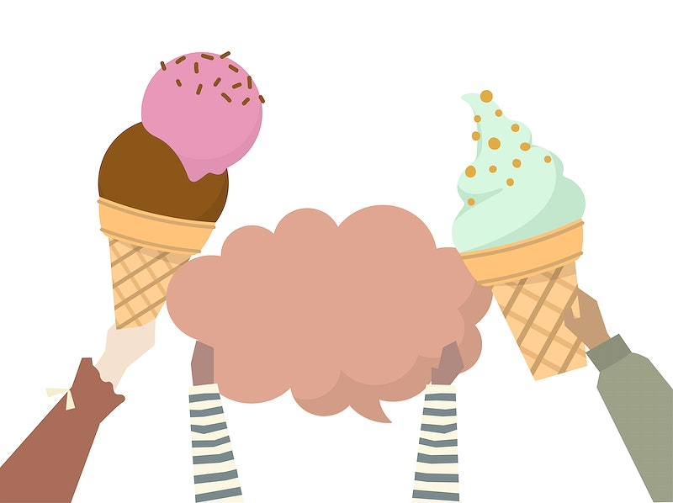
2. Your friend invites you out for an ice cream, but it’s possible that you will have a sore throat.
=> If I have an ice cream, I may have a sore throat.

Slide 23
3. Your roommate often stays up late at
night. You think it is necessary to get
enough sleep every night; otherwise,
his health will suffer.
=> If you want to have good health, you must get 8 hours of sleep per night.

Slide 24
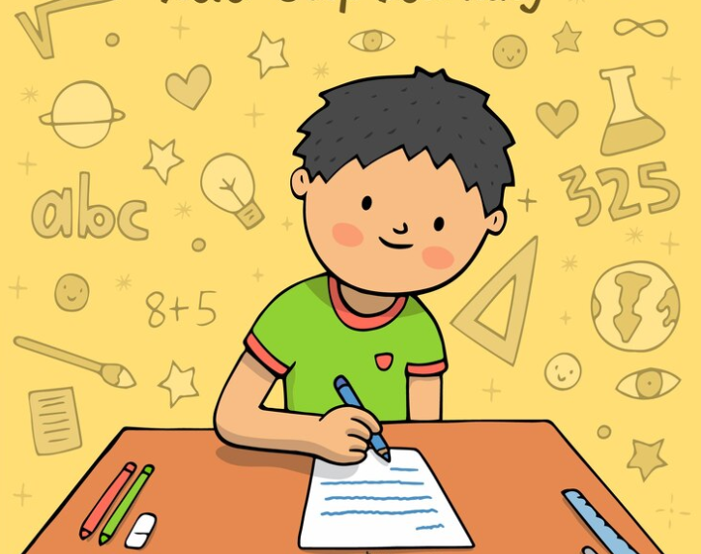
4. Your little brother wants to go for a swim. You agree but ask him to finish all his homework first.
=> You can go for a swim if you finish all your homework.

Slide 25

5. You’re able to make a delicious pizza when you have all the needed ingredients.
=> If I have all needed ingredients, I can make a delicious pizza.

Slide 26
Ex5. Complete the sentences with your own ideas using the modal verbs you have learnt
1. If you spend too much time playing computer games, ______________________________________________.
2. If you want to get a good night’s sleep, _________________.
3. If you don’t feel well, ______________________________.

Slide 27
CONSOLIDATION

Slide 28
Choose the best answer
1. If you follow my directions, you ………. her house easily.
will find B. would have found
C. found D. would find
2. If you feel unwell, you …… eat fast food.
should B. shouldn’t
C. must D. may
3. 3. If you finish your dinner, you …….. watch TV.
can B. may
C. shouldn’t D. must

Slide 29

2
Homework
Learn by heart the grammar.
Do the exercises Part B – Unit 3 (Workbook)
Prepare: Communication

Slide 30


