Slide 1
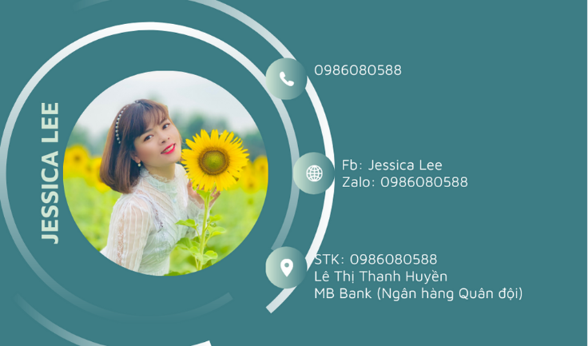

Slide 2
Unit 1
HOBBIES
A CLOSER LOOK 2

Slide 3

Unit 1
Warm up

Slide 4
Unit 1
Vocabulary

Slide 5


rise (V)
/raɪz/
nhô lên, mọc lên

Slide 6
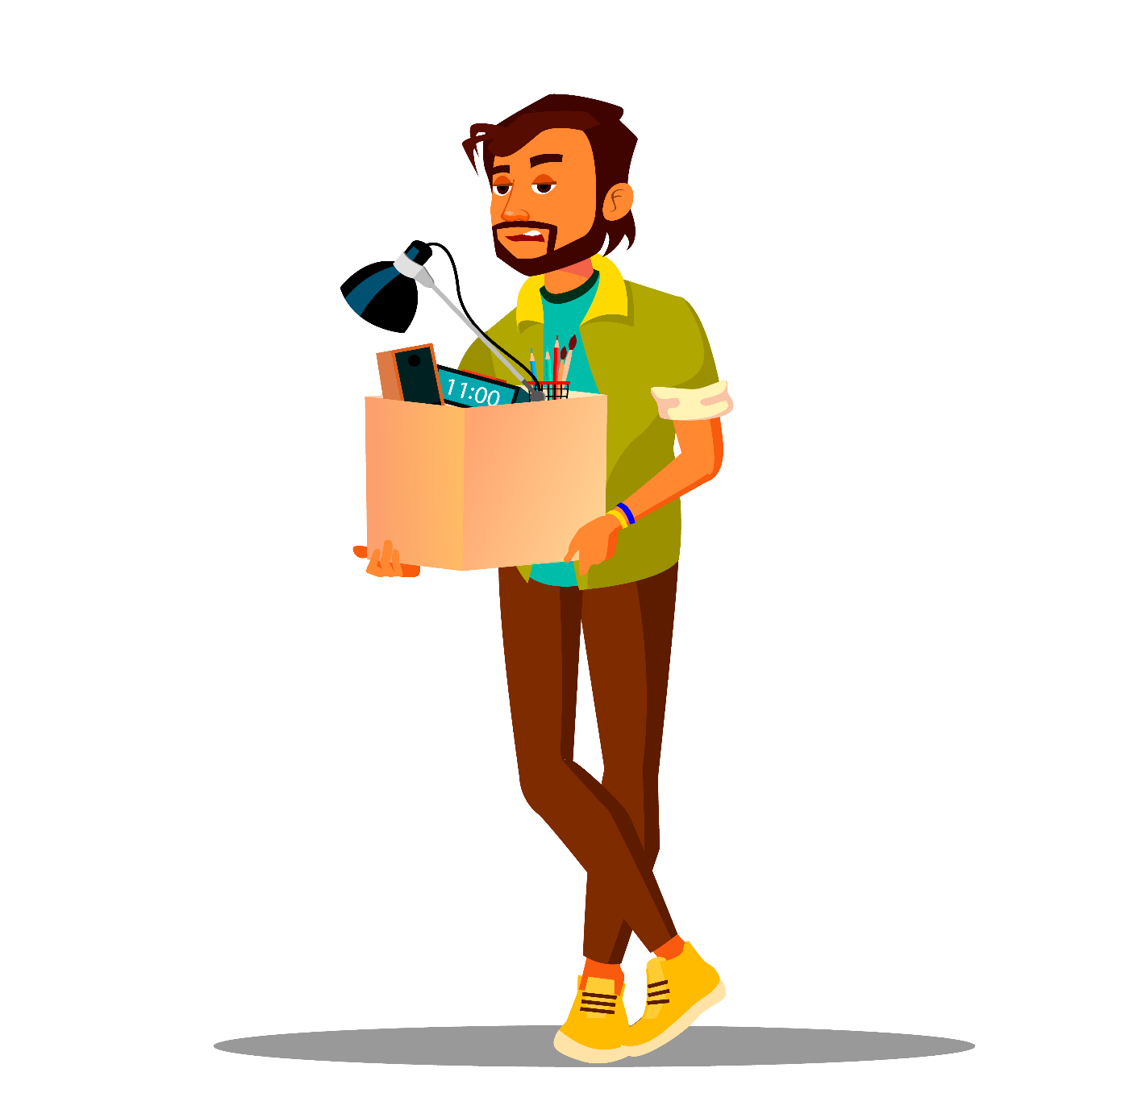
leave
/liːv/
rời khỏi

Slide 7
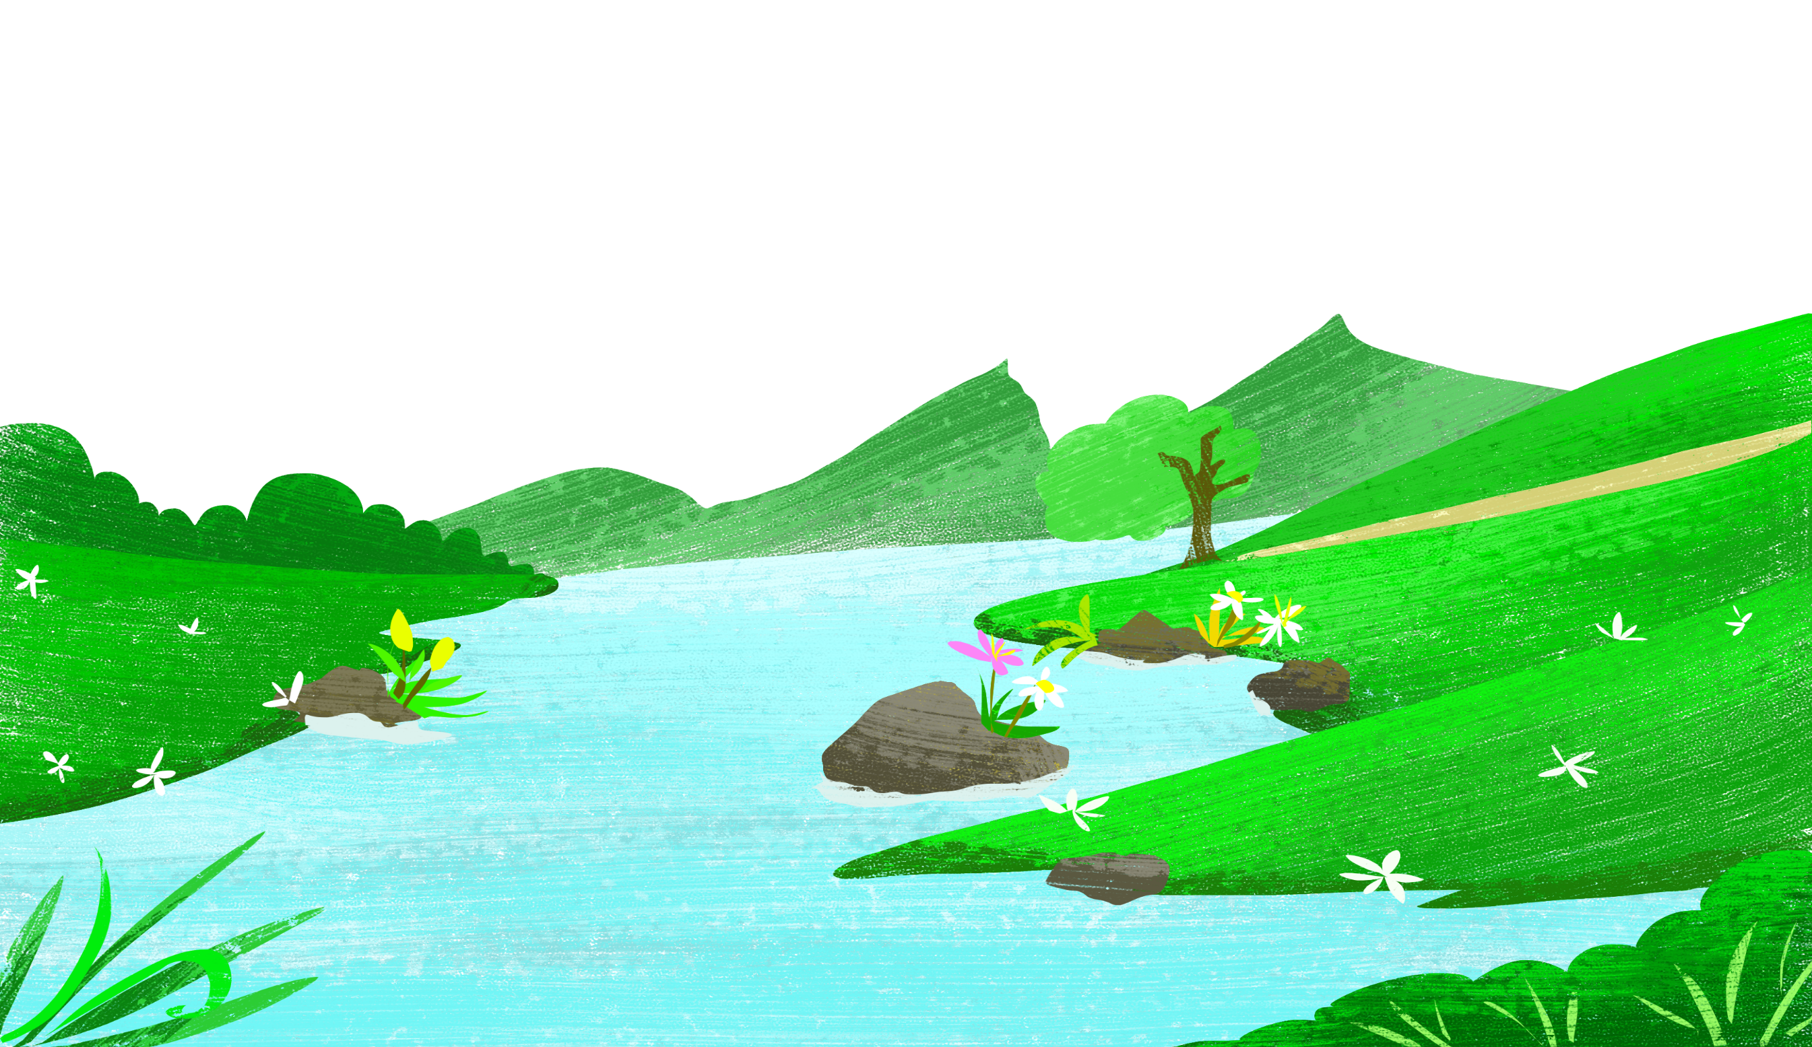
flow through
/floʊ θru/
chảy qua

Slide 8
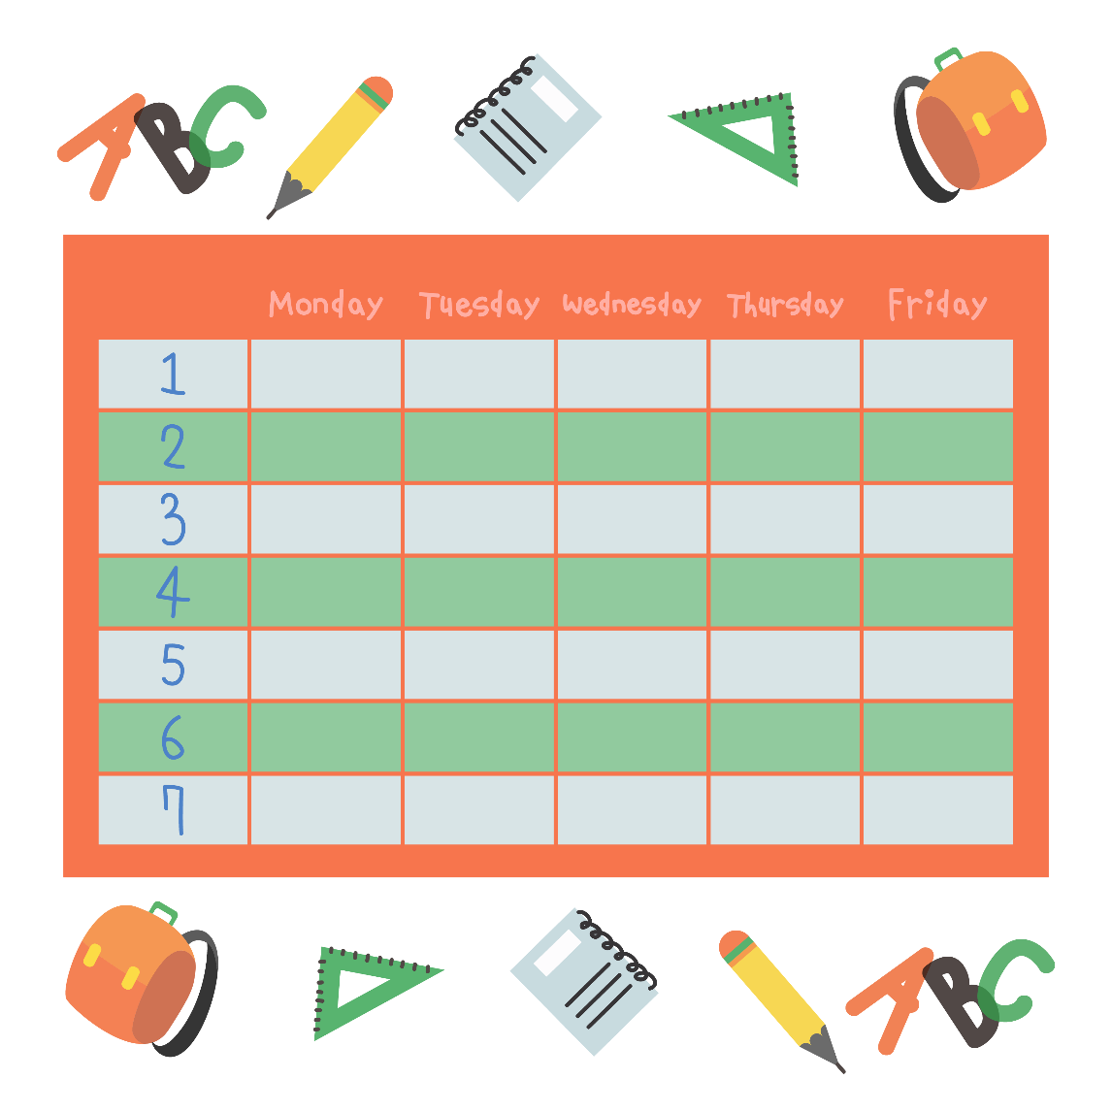
timetable
/ˈtaɪmteɪbl/
Thời khóa biểu

Slide 9
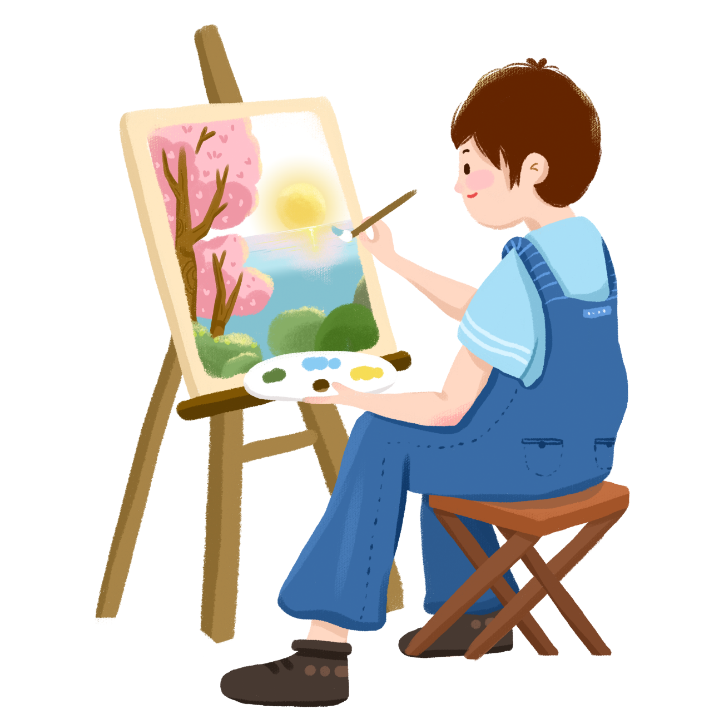
drawing class
/ˈdrɔɪŋ klæs/
Lớp học vẽ

Slide 10
Unit 1
Grammar
The present simple

Slide 11
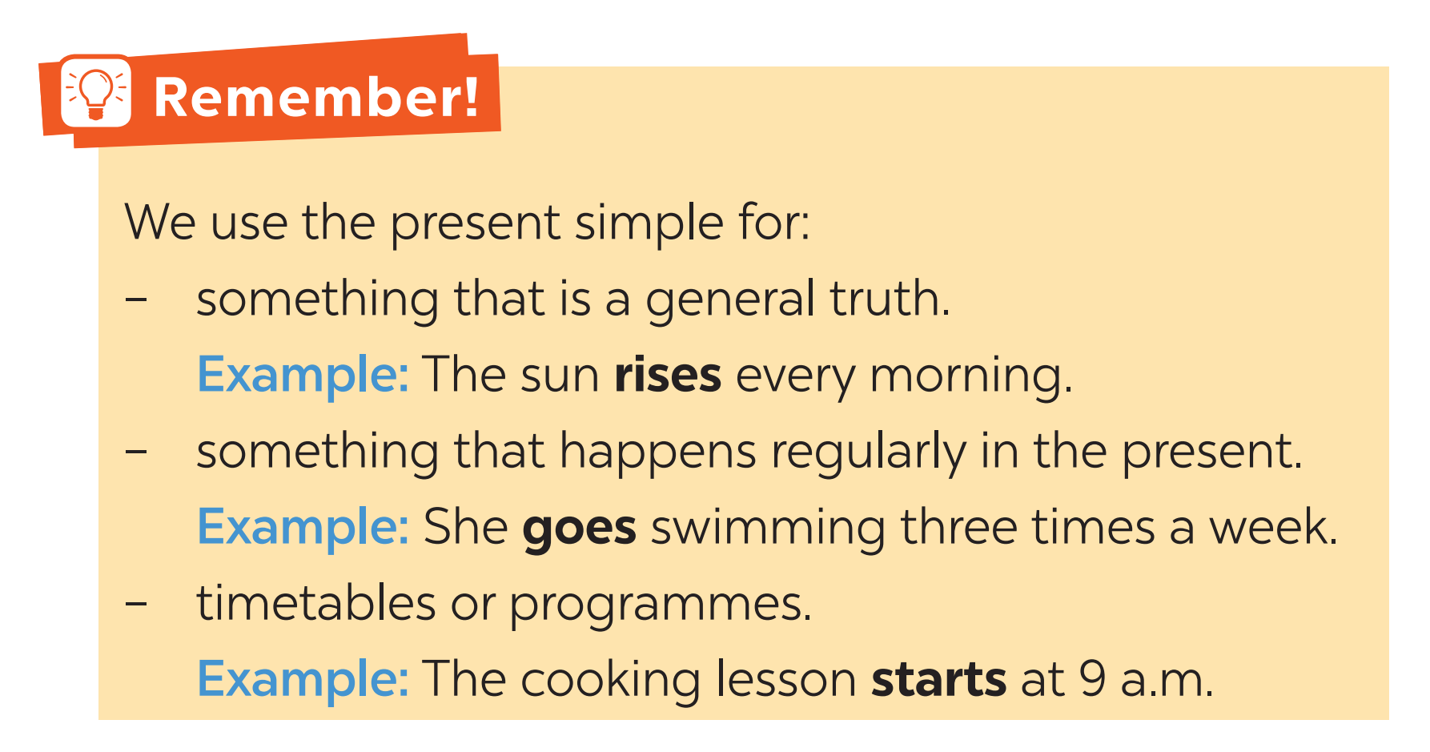
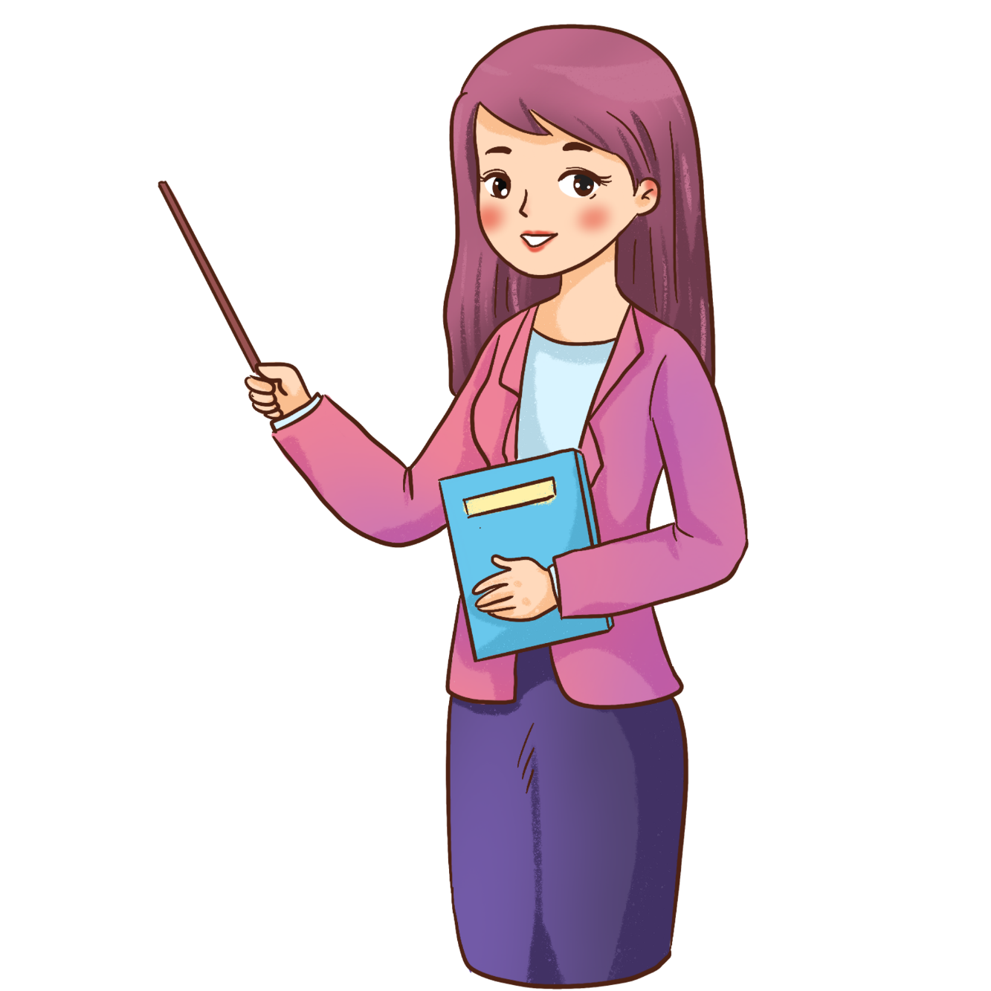

Slide 12
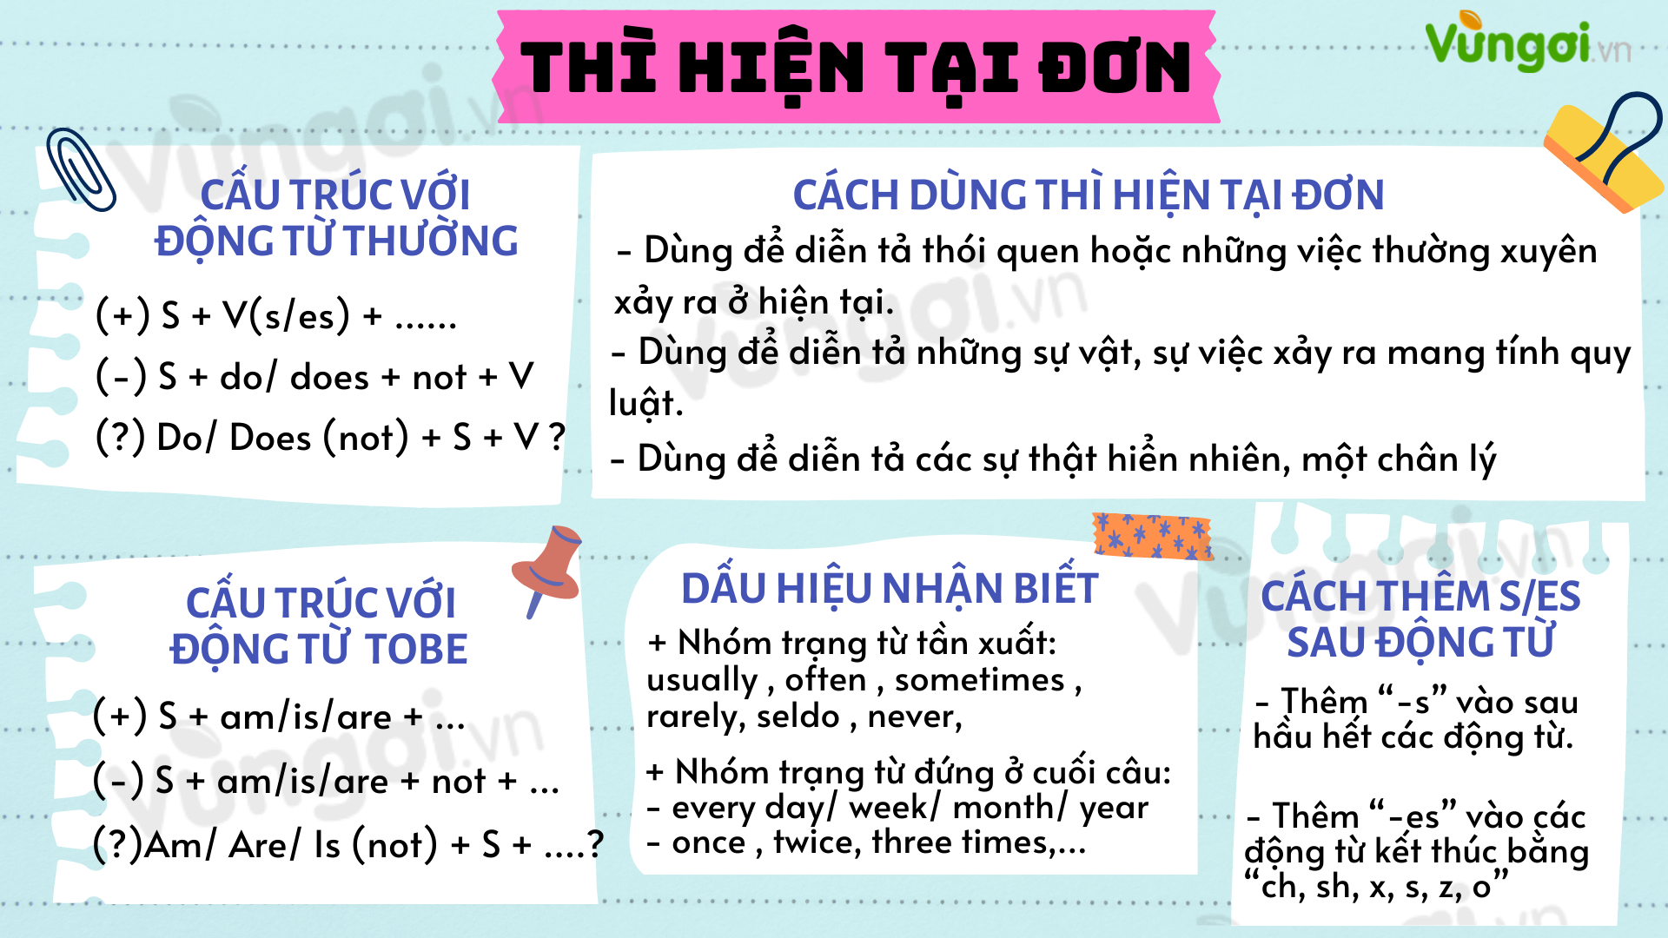


Slide 13
Monday……
Unit 1. Hobbies
A Closer look 2
1. Match the sentences (1-5) to the correct uses (a-c)

Slide 14
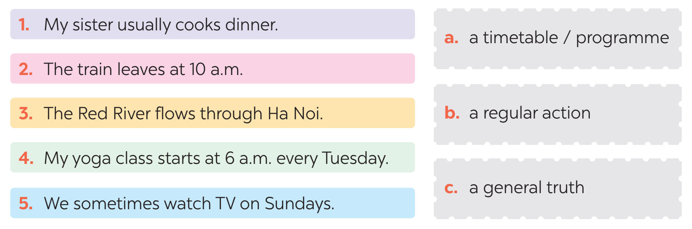


Slide 15
Monday……
Unit 1. Hobbies
A Closer look 2
1. Match the sentences (1-5) to the correct uses (a-c)
2. Complete the sentences. Use the present simple form of the verbs.

Slide 16
1. My brother and I (make) ________ a new model every month. 2. What _________ Lan (do) ________ in her free time? 3. I (have) _________ a drawing lesson every tuesday. 4. Mark (not like) ____________ doing judo. 5. _________ your English lesson (start) _________ at 6 p.m.?
make
does
do
have
doesn’t like
Does
start

Slide 17
Monday……
Unit 1. Hobbies
A Closer look 2
1. Match the sentences (1-5) to the correct uses (a-c)
2. Complete the sentences. Use the present simple form of the verbs.
3. Fill in each blank with the correct form of the verb in brackets.

Slide 18

My family members have different hobbies. My dad (1. enjoy) _______ gardening. He (2. spend) __________ two hours in our garden every day. My mum and sister (3. not like) __________ gardening, but they love cooking. They (4. go) _______ to a cooking class every Sunday. Their lesson (5. begin) ________ at 9 a.m. I (6. not enjoy) __________ cooking, and I cannot cook very well.
enjoys
spends
don’t like
go
begins
don’t enjoy

Slide 19
Giải thích:
(1) Thì hiện tại đơn câu khẳng định, chủ ngữ “my dad” số ít nên động từ “enjoy” thêm “-s” => enjoys
(2) Thì hiện tại đơn câu khẳng định, chủ ngữ “he” số ít nên động từ “spend” thêm “-s” ⇒ spends
(3) Thì hiện tại đơn câu phủ định, chủ ngữ “my mum and sister” số nhiều nên thêm “don’t”, động từ giữ nguyên ⇒ don’t like
(4) Thì hiện tại đơn câu khẳng định, chủ ngữ “they” số nhiều nên động từ giữ nguyên ⇒ go
(5) Thì hiện tại đơn câu khẳng định, chủ ngữ “their lesson” số ít nên động từ “begin” thêm “-s” => begins
(6) Thì hiện tại đơn câu phủ định, chủ ngữ “I” số nhiều nên thêm “don’t”, động từ giữ nguyên ⇒ don’t enjoy

Slide 20
Monday……
Unit 1. Hobbies
A Closer look 2
1. Match the sentences (1-5) to the correct uses (a-c)
2. Complete the sentences. Use the present simple form of the verbs.
3. Fill in each blank with the correct form of the verb in brackets.
4. Write complete sentences, using the given words and phrases. You may have to change the words or add some.

Slide 21

1. sun / set / in / west / every evening. __________________________________________________________ 2. Trang and Minh / play / basketball / every day / after school? __________________________________________________________ 3. flight / from / Ho Chi minh City / not arrive / 10:30. __________________________________________________________ 4. our science teacher / start / our lessons / 1 p.m. / on Fridays. __________________________________________________________ 5. you / make / model / at / weekend? __________________________________________________________
The sun sets in the west every evening.
Do Trang and Minh play basketball every day after school?
The flight from Ho Chi Minh City doesn’t arrive at 10:30.
Our science teacher starts our lessons at 1 p.m. on Fridays.
Do you make models at the weekend?

Slide 22
Monday……
Unit 1. Hobbies
A Closer look 2
1. Match the sentences (1-5) to the correct uses (a-c)
2. Complete the sentences. Use the present simple form of the verbs.
3. Fill in each blank with the correct form of the verb in brackets.
4. Write complete sentences, using the given words and phrases. You may have to change the words or add some.
5. (Game) Sentence race. Work in groups.

Slide 23
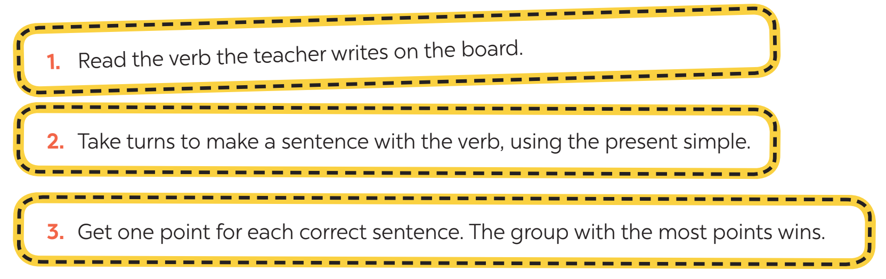

Slide 24
Unit 1
Pronunciation
/ə/ and /ɜ:/

Slide 25
Unit 1
Consolidation

Slide 26

Correct the mistakes!
GO!

Slide 27
Mary don’t take the bus to school.
don’t
NEXT

Slide 28
Mary doesn’t take the bus to school.
NEXT

Slide 29
cook
Dad cook very well.
NEXT

Slide 30
Dad cooks very well.
NEXT

Slide 31
You go to school by bike?
You go
NEXT

Slide 32
Do you go to school by bike?
NEXT

Slide 33
I have always English classes at CCAA in the afternoon.
have always
NEXT

Slide 34
I always have English classes at CCAA in the afternoon.
NEXT

Slide 35

Home-link
Complete exercises in the Workbook.

Slide 36
