Slide 1
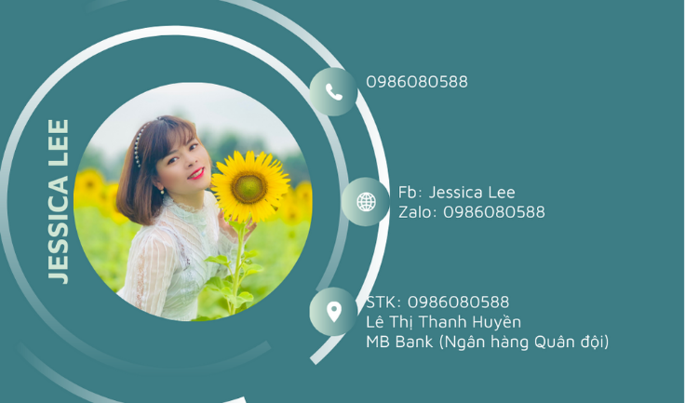

Slide 2
Unit 1
HOBBIES
A CLOSER LOOK 1

Slide 3

Unit 1
Warm up

Slide 4
Unit 1
Vocabulary

Slide 5

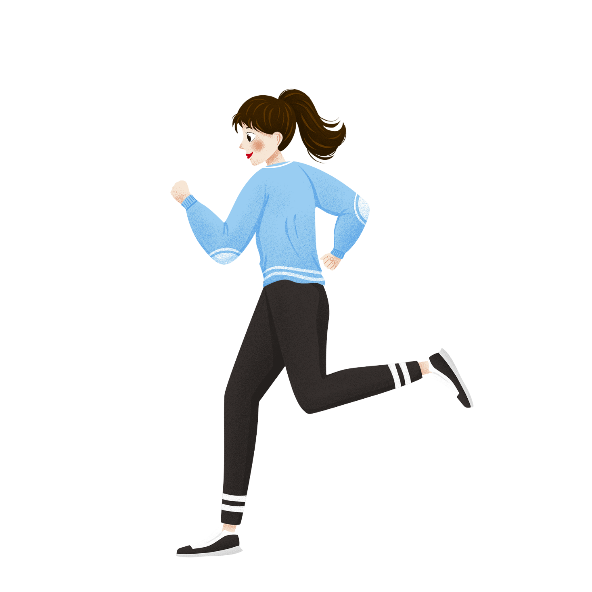

jogging (n)
/ˈdʒɒɡɪŋ /
đi/ chạy bộ thư giãn

Slide 6

coin (n)
/kɔɪn/
đồng xu

Slide 7
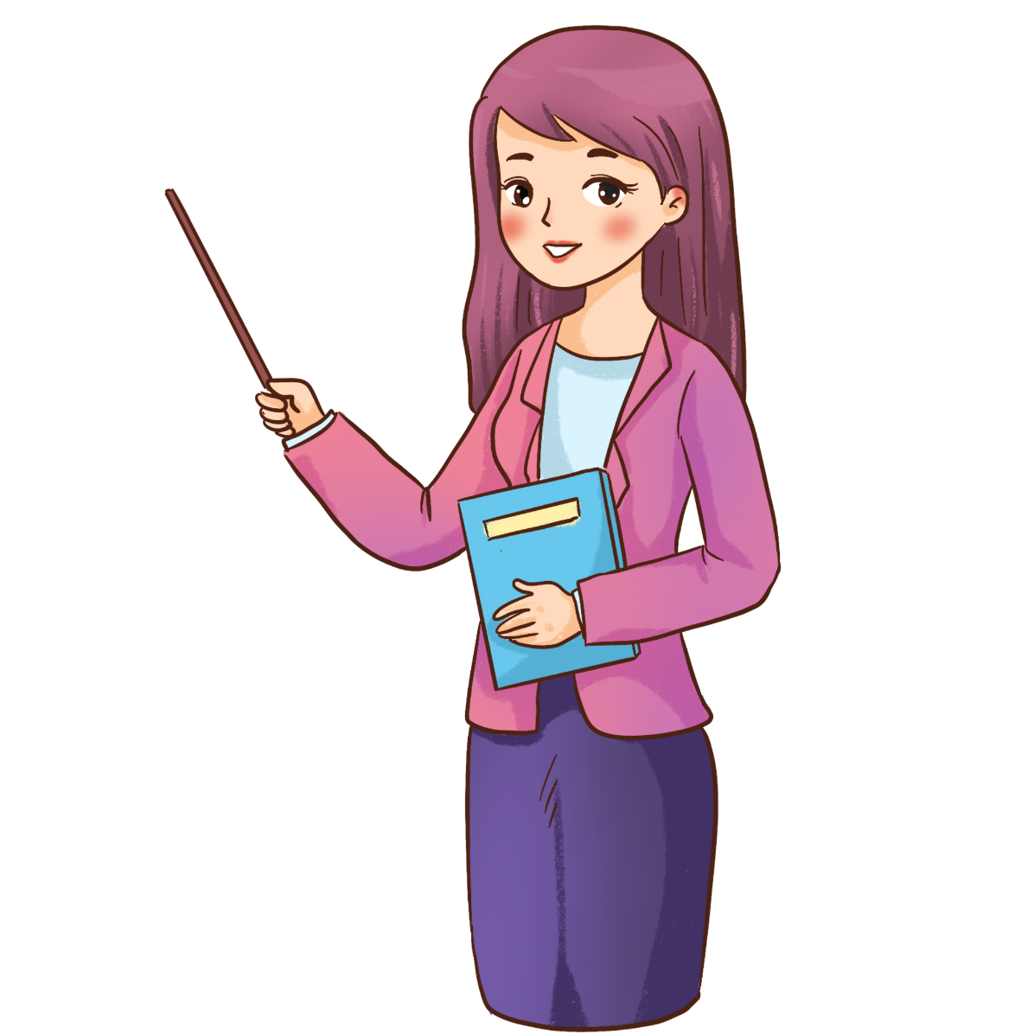

Vocabulary
New words | Pronunciation | Meaning
1. jogging (n) | / ˈdʒɒɡɪŋ / | đi, chạy bộ thư giãn
2. coin (n) | / kɔɪn / | đồng xu

Slide 8
Monday……
Unit 1. Hobbies
A Closer look 1
1. Complete the words webs below with the words from the box.

Slide 9
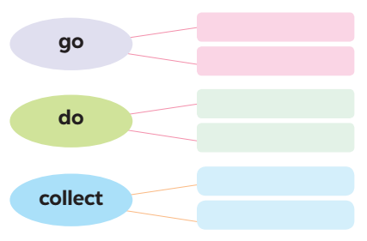

dolls
jogging
coins
judo
swimming
yoga
jogging
swimming
judo
yoga
dolls
coins

Slide 10
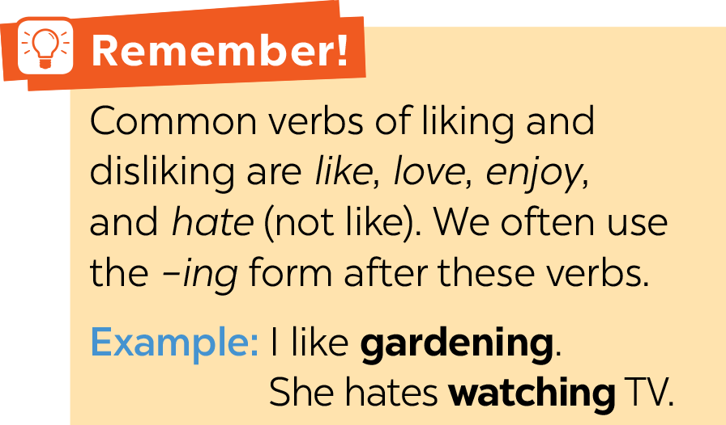

Slide 11
Monday……
Unit 1. Hobbies
A Closer look 1
1. Complete the words webs below with the words from the box.
2. Complete the sentences, using the -ing form of the verbs from the box.

Slide 12

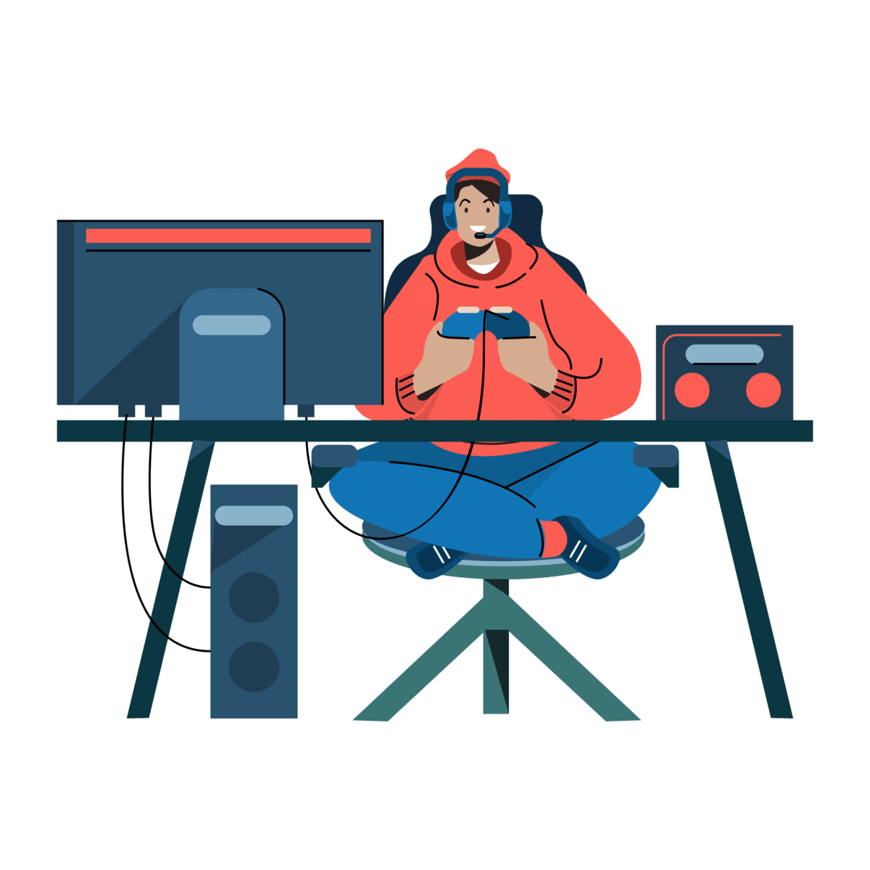

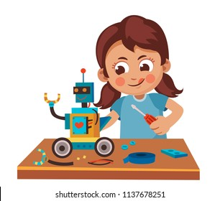

1. My dad has a big bookshelf because he loves _________ old books. 2. My sister likes _________ camping at the weekend. 3. My best friend hates _________ computer games. 4. Does your brother like _________ models? 5. My mum enjoys _________ yoga every day to keep fit.
collecting
going
playing
making
doing

Slide 13
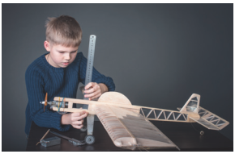
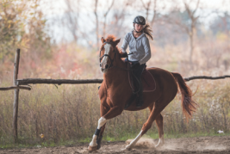
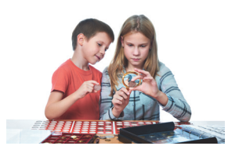
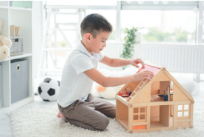
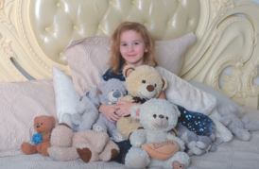
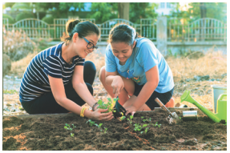
making models
riding a horse
collecting coins
gardening
building dollhouses
collecting teddy bears

Slide 14
Monday……
Unit 1. Hobbies
A Closer look 1
1. Complete the words webs below with the words from the box.
2. Complete the sentences, using the -ing form of the verbs from the box.
3. Look at the pictures and say the sentences. Use suitable verbs of liking or disliking and the -ing form.

Slide 15
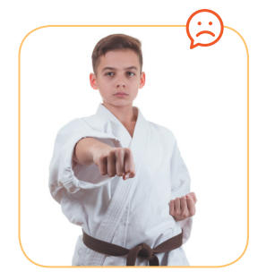
He hates / doesn’t like doing judo.

Slide 16
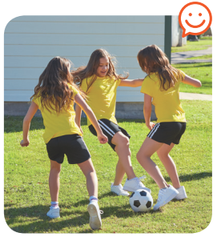
They like / love / enjoy playing football.

Slide 17
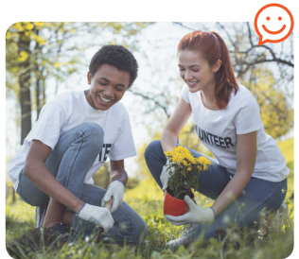
They love / like / enjoy gardening.

Slide 18

They enjoy / like / love collecting stamps.

Slide 19
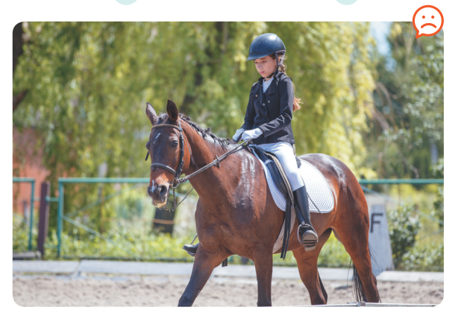
She hates / doesn’t like riding a horse / horse riding.

Slide 20
Unit 1
Pronunciation
/ə/ and /ɜ:/

Slide 21
Monday……
Unit 1. Hobbies
A Closer look 1
1. Complete the words webs below with the words from the box.
2. Complete the sentences, using the -ing form of the verbs from the box.
3. Look at the pictures and say the sentences. Use suitable verbs of liking or disliking and the -ing form.
4. Listen and repeat. Pay attention to the sounds /ə/ and /ɜː/

Slide 22


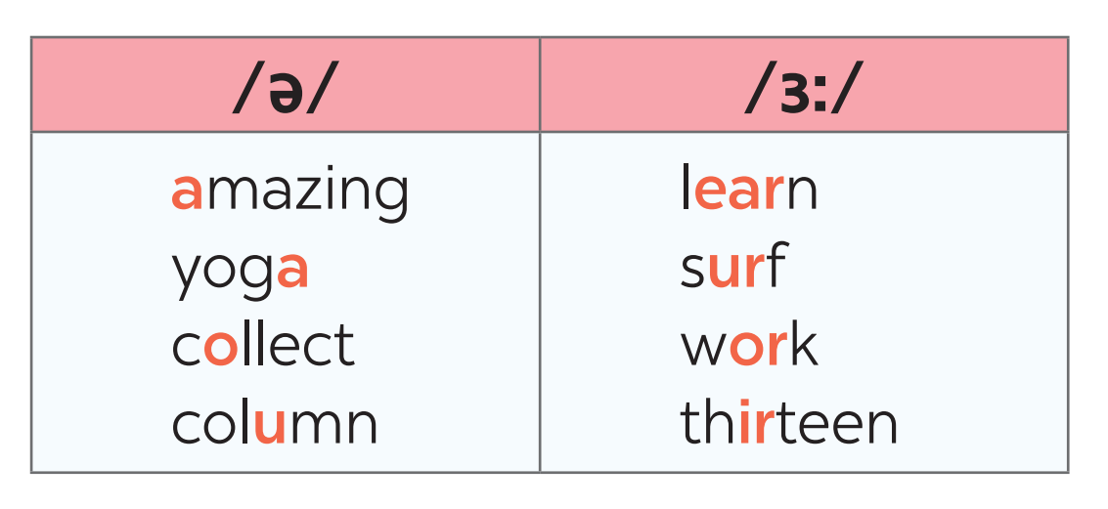

Slide 23
Monday……
Unit 1. Hobbies
A Closer look 1
1. Complete the words webs below with the words from the box.
2. Complete the sentences, using the -ing form of the verbs from the box.
3. Look at the pictures and say the sentences. Use suitable verbs of liking or disliking and the -ing form.
4. Listen and repeat. Pay attention to the sounds /ə/ and /ɜː/
5. 5. Listen to the sentences and pay attention to the underlined parts. Tick the appropriate sounds. Practise the sentences.

Slide 24
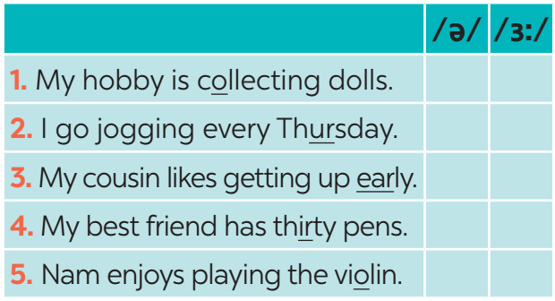



Slide 25
Unit 1
Consolidation

Slide 26
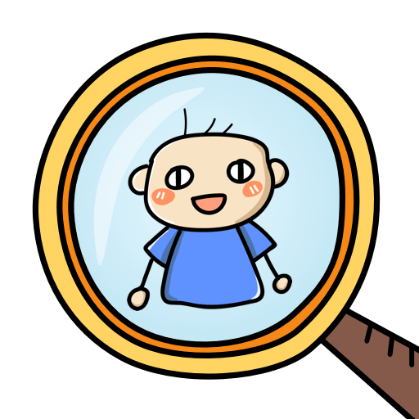
Who’s the faster?
Work in groups of four
Write sentences including: hobbies and one of the sounds /ə/ and /ɜ:/
(e.g: Listening to music is a very common hobby.)
The group with the most correct sentences is the winner.

Slide 27

Home-link
Find 3 more words relating to hobbies that have the sound /ə/ or /ɜ:/.

Slide 28



