Slide 1
SONG VE SECONDARY SCHOOL
Welcome to our class
7A
NGUYỄN THỊ THU BA

Slide 2

WARM-UP
Brainstorming:
horror film
cartoon
Types of films
comedy
documentary
fantasy
fiction film
action film
romance film

Slide 3
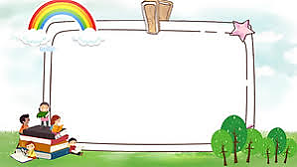


Unit
8
FILMS
LESSON 7: LOOKING BACK & PROJECT
- Vocabulary review
- Grammar review
- Project: Design film posters

Slide 4
* Vocabulary
1
Match the types of film in column A with their descriptions in column B.
A | B
1. science fiction film | a. This type of film makes you laugh.
2. comedy | b. This type of film has supernatural.
3. horror film | c. This type of film gives us useful information about animals, science or technology.
4. documentary | d. This type of film is about life in the future, robots, and space travel.
5. fantasy | e. This is a frightening type of film.
1 - d | 2 - a | 3 - e | 4 - c | 5 - b

Slide 5
2
Give an example for every film type in the box.
comedy documentary fantasy horror film science-fiction film
* Example: a comedy: Mr Bean
- a documentary: Pirates of Southeast Asia
- a fantasy: The Arabian Nights
- a horror film: Annabelle
- a science-fiction film: Avatar

Slide 6



3
Choose the correct answer (A, B, or C) to complete each of the following sentences.
5
4
1
3
2
1. The film was long and ______. Many people went home before it ended.
a. funny
b. shocking
c. dull

Slide 7
3
Choose the correct answer (A, B, or C) to complete each of the following sentences.
5
4
1
3
2
2. The film is too ______ with a lot of fighting and killing scenes.
a. funny
b. violent
c. interesting

Slide 8
3
Choose the correct answer (A, B, or C) to complete each of the following sentences.
5
4
1
3
2
3. A ______ story often makes us feel afraid.
a. moving
b. interesting
c. frightening

Slide 9
3
Choose the correct answer (A, B, or C) to complete each of the following sentences.
5
4
1
3
2
4. The news was ______. I couldn't believe it.
a. shocking
b. funny
c. confusing

Slide 10
3
Choose the correct answer (A, B, or C) to complete each of the following sentences.
5
4
1
3
2
5. ______ films often make us cry.
a. Amusing
b. Moving
c. Funny

Slide 11
3
Choose the correct answer (A, B, or C) to complete each of the following sentences.
5
4
1
3
2
6. The road signs were ______ and we soon got lost.
c. confusing
a. shocking
b. interesting

Slide 12

* Grammar review
4
Match the sentences or sentence halves in columns A and B.

Slide 13
4
Match the sentences or sentence halves in columns A and B.
A | B
1. Although he arrived late, | a. people still buy them.
2. The film received good reviews. | b. However, the number of people going to cinemas is increasing.
3. Though popcorn and other snacks in the cinema are very expensive, | c. I don’t want to stay home tonight.
4. Cinema tickets are expensive. | d. he left the cinema early.
5. Although I don’t really like to go to the cinema, | e. However, only a few people saw it.
1. d
2. e
3.a
4. b
5. c

Slide 14
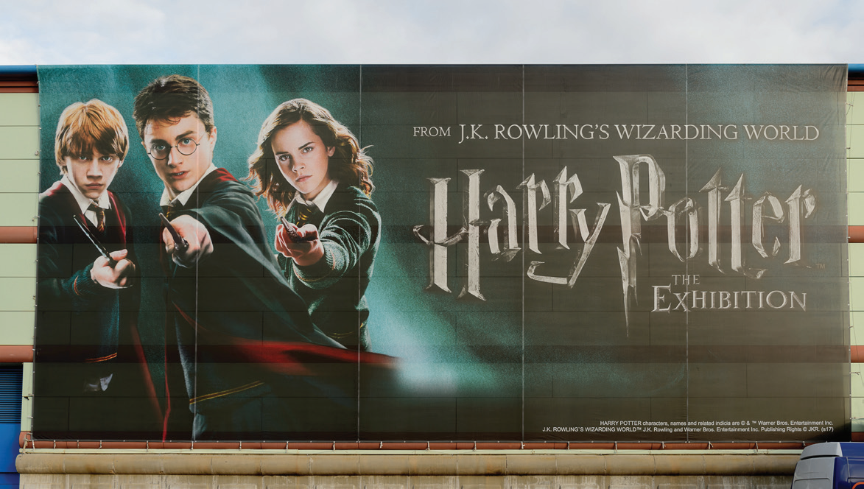
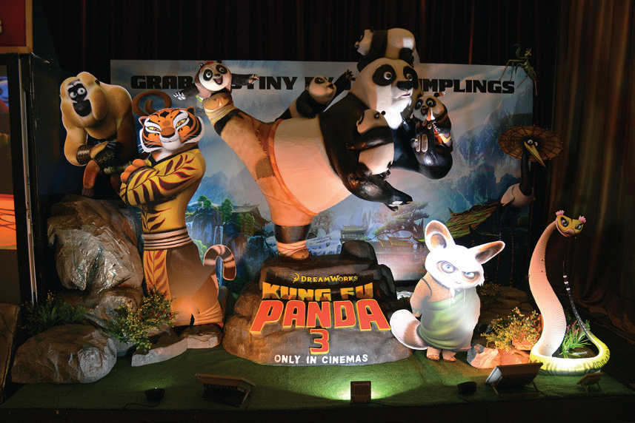
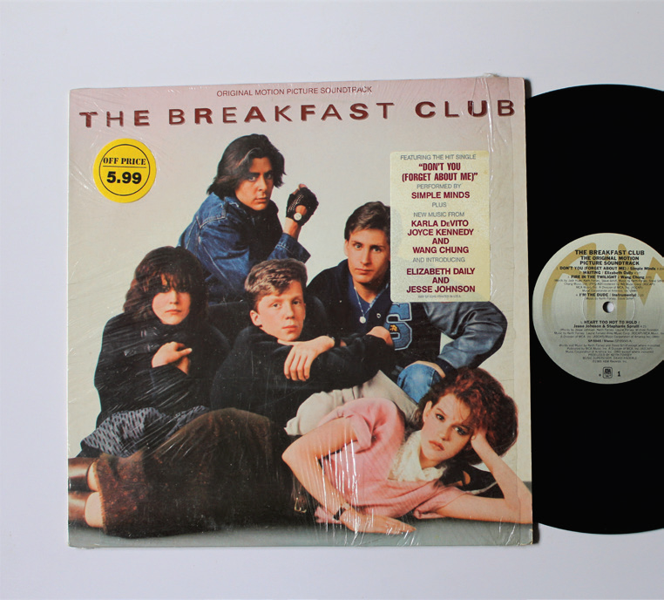
* PROJECT
Posters exhibition
5
Work in groups.
1
Choose one of your favourite films and design a poster for it, including:
- name of the film;
- type of film;
- its director and main actors / actresses;
- a short summary;
- your overall opinions about the film;
- the showtime and cinema;
- pictures or photos to illustrate the film.
2
Organise them into an exhibition.
3
Vote for the best poster.

Slide 15
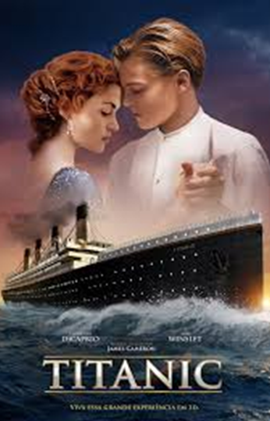
* PROJECT
Posters exhibition
Romantic: About the sinking of the ship Titanic on its first voyage. Jack, the main character, saves Rose from killing herself during the journey. Although they are from different social classes, and Rose is already engaged, they fall in love. The film has a sad ending: more than a thousand people die in the disaster.
It stars: Leonardo DiCaprio and Kate Winslet.
Critics say: it is a must-see. The story is moving and the acting is excellent. The special effects, visuals, and music are also incredible.
Showtimes: 5:30 p.m and 8:30 p.m
daily at Thang Loi Theatre

Slide 16
* CONSOLIDATION
Vocabulary review
Grammar review
Project: Design film posters

Slide 17

homework
- Do exercise in the workbook.
- Prepare for the next lesson: Unit 9 – Getting started

Slide 18








Slide 19

Tug of war
PLAY

Slide 20


This is a frightening type of film.
science fiction
comedy
horror
fantasy
documentary
NEXT

Slide 21
The film was long and _____. Many people went home before it ended.
dull
dull
funny
shocking
NEXT

