Slide 1
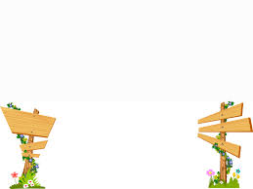
Song Ve Secondary School
Good morning class !!!
English 7

Slide 2

WARM-UP
Game: Conversation rearranging
a. Hey, Let’s go out for dinner!
b. Give me 5 minutes and I’ll be right at the door.
c. I can’t, either. How about you, Sally?
d. Good idea! I like Japanese food.
e. Oh. It’s okay. I will book a table in advance. You two get ready and hurry up.
f. So do I but I can’t eat raw fish.
g. I will, too. See you guys later.
h. I’m afraid I can’t. I need to go home early to finish my art project.
i. Sure. How about having something to drink after dinner?
k. Neither can I. We can order bento and skip the raw fish.
l. I can’t, either. But why don’t we have some Japanese green tea there?

Slide 3
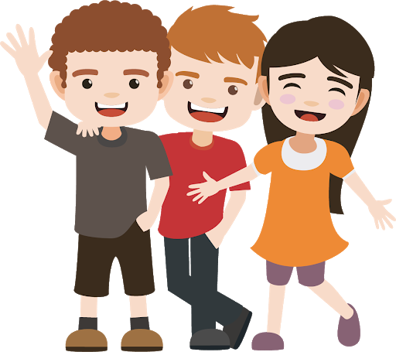
* WARM-UP
* KEY
1 - a Tom: Hey, Let’s go out for dinner!
2 - d Sally: Good idea! I like Japanese food.
3 - f John: So do I but I can’t eat raw fish.
4 - c Tom: I can’t, either. How about you, Sally?
5 - k Sally: Neither can I. We can order bento and skip the raw fish.
6 - i John: Sure. How about having something to drink after dinner?
7 - h Tom: I’m afraid I can’t. I need to go home early to finish my art project.
8 - l Sally: I can’t, either. But why don’t we have some Japanese green tea there?
9 - e John: Oh. It’s okay. I will book a table in advance. You two get ready and hurry up.
10 - b Sally: Give me 5 minutes and I’ll be right at the door.
11- g Tom: I will, too. See you guys later.

Slide 4
* WARM-UP
Tom: Hey, Let’s go out for dinner!
Sally: Good idea! I like Japanese food.
John: So do I but I can’t eat raw fish.
Tom: I can’t, either. How about you, Sally?
Sally: Neither can I. We can order bento and skip the raw fish.
John: Sure. How about having something to drink after dinner?
Tom: I’m afraid I can’t. I need to go home early to finish my art project.
Sally: I can’t, either. But why don’t we have some Japanese green tea there?
John: Oh. It’s okay. I will book a table in advance. You two get ready and hurry up.
Sally: Give me 5 minutes and I’ll be right at the door.
Tom: I will, too. See you guys later.

Slide 5




Unit
8
FILMS
LESSON 4: COMMUNICATION
Unit
HOBBIES

Slide 6
EVERYDAY ENGLISH
How about + V-ing?
Let’s + V-infinitive!
How about going to the cinema tonight?
That’s a great idea.
Let’s go to see A Nightmare at Sao Mai Cinema tonight.
I’d love to, but that’s too far for me to travel.

Slide 7
EVERYDAY ENGLISH
It sounds good/ interesting/ great to me.
I’m up for it./ I’m on it./
I’m in./ Count me in.
I can’t agree more./ Sure, let’s do it.
No, thanks./ Thanks but I can’t…
That’s not my type/ cup of tea/ interest/ thing/ favourite…
I would rather/ had better not/
am busy/ am not interested…

Slide 8
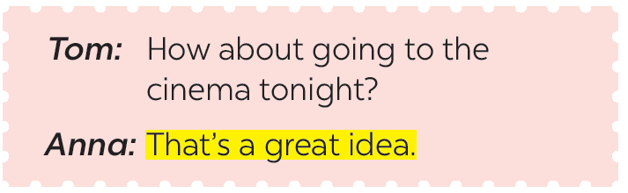
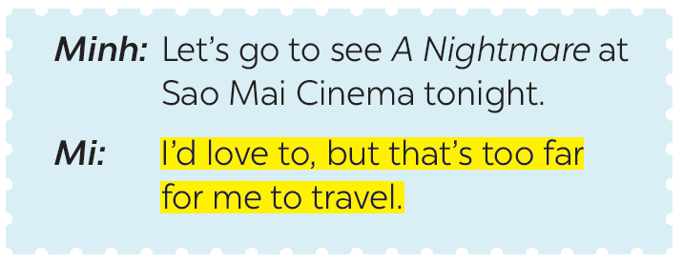
1
Listen and read the conversations. Pay attention to the highlighted sentences.

Slide 9

2
Work in pairs. Make similar conversations with the following situations.
Student A suggests going to the cinema and student B accepts.
Student A: Hey, let’s go to the cinema this weekend!
Student B: Good idea! I like action movie.
Student A: So do I. I’ll see you at 6 p.m. this Sunday.
Student B: Great. See you.

Slide 10
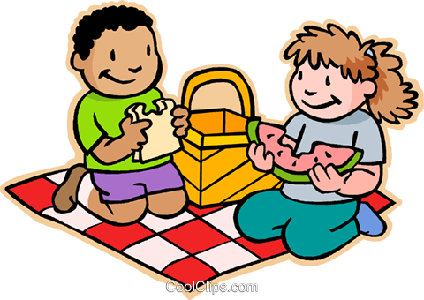
2
2
Work in pairs. Make similar conversations with the following situations.
Student A suggests going for a picnic but student B declines.
Student A: It’s sunny today. How about going for a picnic?
Student B: Oh sorry, I can’t. I have a lot of homework to do.
Student A: That’s a pity. Maybe next time.
Student B: Sure.

Slide 11
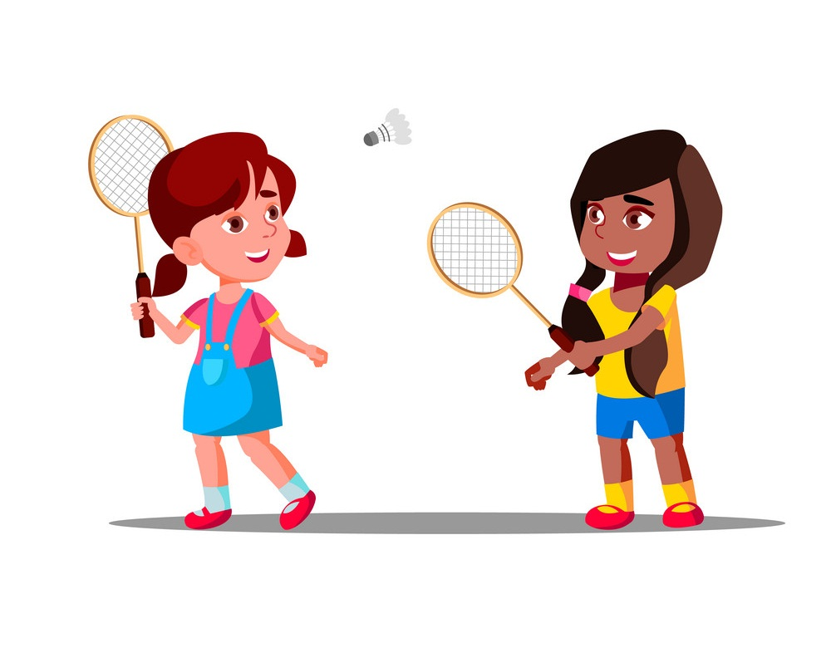
2
2
Work in pairs. Make similar conversations with the following situations.
Student A suggests playing badminton after school, student B accepts.
Student A: Let’s play badminton after class!
Student B: It sounds nice. Where should we play?
Student A: How about the park behind school?
Student B: Good idea.

Slide 12

A SURVEY ABOUT FILMS
3
Listen to the conversation and fill in the blanks with the words you hear.
Tom: Hi Lan. I’m doing a survey about films. Can I ask you some questions?
Lan: Sure. Go ahead.
Tom: What kind of films do you like (1) _____________?
Lan: I love (2) _____________.
Tom: What’s the name of your (3) _____________ comedy?
Lan: It’s Dr Johnny.
Tom: Who (4) _____________ in it?
Lan: Bill Harris.
Tom: What do you think of it?
Lan: It’s very (5) _____________.
Tom: Thank you.
best
comedies
favourite
stars
funny

Slide 13
3
Listen to the conversation and fill in the blanks with the words you hear.
Tom: Hi Lan. I’m doing a survey about films. Can I ask you some questions?
Lan: Sure. Go ahead.
Tom: What kind of films do you like (1) _____________?
Lan: I love (2) _____________.
Tom: What’s the name of your (3) _____________ comedy?
Lan: It’s Dr Johnny.
Tom: Who (4) _____________ in it?
Lan: Bill Harris.
Tom: What do you think of it?
Lan: It’s very (5) _____________.
Tom: Thank you.
best
comedies
favourite
stars
funny

Slide 14
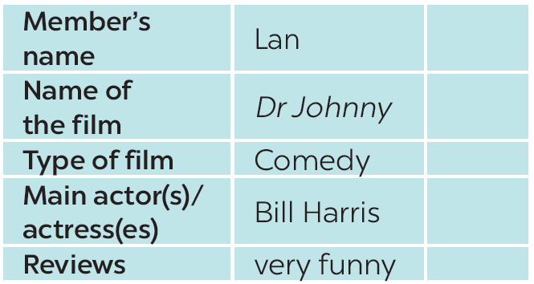

A SURVEY ABOUT FILMS
4
Work in groups. Do a survey about your group members’ favourite films.

Slide 15
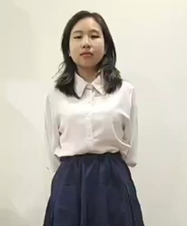
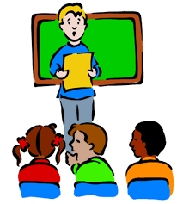
FURTHER PRACTICE
5
Report your results to the class.
My friend's name is Steve. His favourite film is Finding Nemo because he loves animated films from Disney. The main character "Nemo" was voiced by Albert Brooks. This animated film is both educational, moving and funny.

Slide 16

FURTHER PRACTICE
5
4
Report your results to the class.
My friend's name is Nam. His favourite film is Tom and Jerry because he likes cartoon. The main character are "Tom and Jerry" ,…. this film is funny.

Slide 17

CONSOLIDATION
In this lesson, we have learnt to:
accept and decline suggestions.
do a survey about group members’ favorite film.
report the survey’s result to class.

Slide 18


homework
- Do exercises in the workbook.
- Prepare lesson 5 ( Skills 1)

Slide 19




