Slide 1
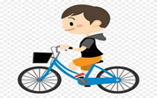
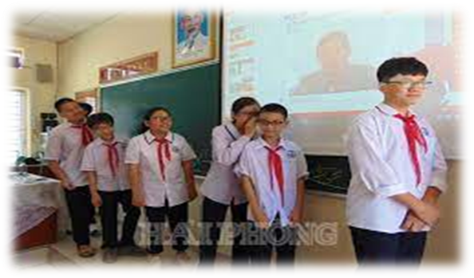
WARM-UP
Miming game
ride a bike

Slide 2


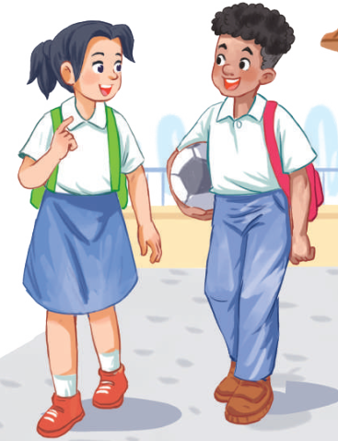
Unit
7
TRAFFIC
LESSON 1: GETTING STARTED
Meeting in the school yard

Slide 3


* Vocabulary
- cycle (v)
= ride a bike
/ˈsaɪkl/

Slide 4
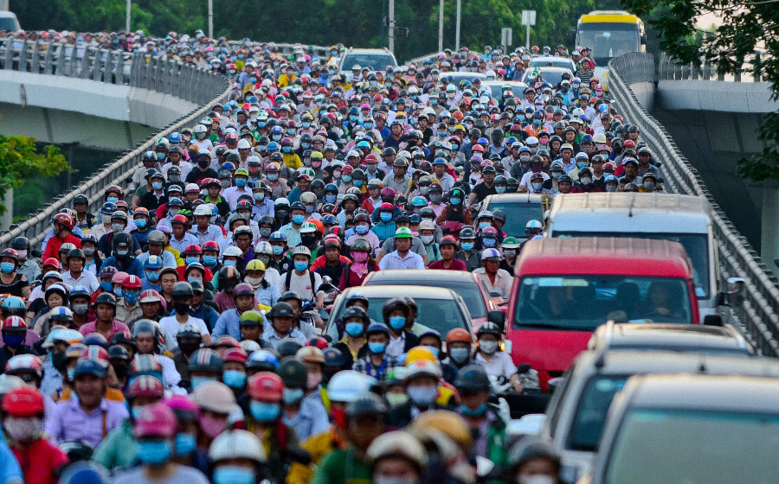
- traffic jam (n):
/ˈtræfɪk dʒæm/
Tắc đường, nạn kẹt xe

Slide 5
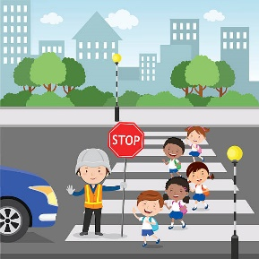
- cross the road (v):
/krɒs ðə rəʊd/
Băng qua đường

Slide 6

-rush hour (n):
/ˈrʌʃ aʊə(r)/
Giờ cao điểm

Slide 7
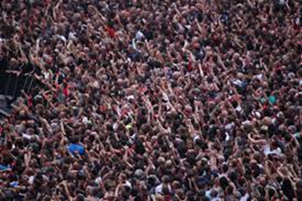
- crowded (adj)
/ˈkraʊdɪd/
đông đúc

Slide 8
* Vocabulary
New words | Pronunciation | Meaning
-cycle (v) | /ˈsaɪkl/ | đạp xe
-traffic jam (n) | /ˈtræfɪk dʒæm/ | tắc đường
-cross the road (v) | /krɒs ðə rəʊd/ | băng qua đường
-rush hour (n) | /ˈrʌʃ aʊə(r)/ | giờ cao điểm
- crowded (adj) | /ˈkraʊdɪd/ | đông đúc

Slide 9
* Vocabulary
New words | Meaning
 | đạp xe
 | tắc đường
 | băng qua đường
 | giờ cao điểm
 | đông đúc
-cycle (v)
-traffic jam (n)
-cross the road (v)
-rush hour (n)
- crowded (adj)

Slide 10
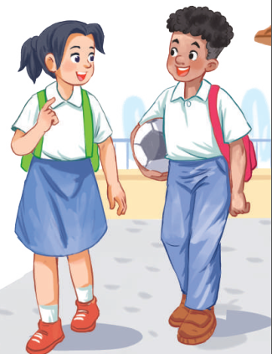
1. LISTEN AND READ
a) Who are they in the dialogue?
→ They are Lan and Mark
b) Where are they?
→ They are at the schoolyard.

Slide 11

1. LISTEN AND READ
Lan: Hi, Mark. How are you?
Mark: Good, thanks. And you?
What did you do last Sunday?
Lan: I’m fine. Last Sunday afternoon,
I cycled round the lake near my home.
Mark: That sounds really healthy.
By the way, do you often cycle to
school too?
Lan: Yes, but sometimes my mum takes
me on her motorbike.
Mark: How far is it from your home
to school?
Lan: It’s about two kilometres.
Mark: How long does it take you to
cycle there?
Lan: About 10 minutes. Sometimes,
when there are traffic jams, it takes
longer.
Mark: You should be careful, especially
when you cross the road.
Lan: Right. The roads get really crowded.
Mark: Hey, how about going cycling
round the lake this Sunday?
Lan: Great! Can you come to my house
at 3 p.m.?
Mark: OK, Lan. See you then.

Slide 12
2
Read the conversation and choose the correct answer
1. How does Lan often go to school?
A. By bicycle. B. By motorbike. C. On foot.
2. It normally takes Lan ___ to get to school.
A. two minutes B. ten minutes C. twenty minutes
3. Lan and Mark agree to go cycling ______.
A. tomorrow B. every day C. at the weekend

Slide 13
3
Write one word from the conversation to complete each sentence.
1. Last Sunday afternoon, Lan ______ round the lake near her home.
2. Mark says to Lan: “You ______ be careful, especially when you cross the road.
3. Traffic ______ are a problem in big cities.
4. – ______ does your mum go shopping?
– She often walks.
5. This road is very __________ during the rush hours.,
Game:
Lucky number

Slide 14
LUCKY NUMBERS
1
2
3
4
5
6
7
8
A
2
4
6
8
10
12
14
B
2
4
6
8
10
12
14

Slide 15

3
Write one word from the conversation to complete each sentence.
1. Last Sunday afternoon, Lan ______ round the lake near her home.
cycled

Slide 16
3
Write one word from the conversation to complete each sentence.
2. Mark says to Lan: “You ______ be careful, especially when you cross the road.
should

Slide 17
3
Write one word from the conversation to complete each sentence.
3. Traffic ______ are a problem in big cities.
jams

Slide 18

3
Write one word from the conversation to complete each sentence.
4. – ______ does your mum go shopping?
– She often walks.

Slide 19

3
Write one word from the conversation to complete each sentence.
5. This road is very __________ during the rush hours.,

Slide 20

LUCKY NUMBER!

Slide 21
LUCKY NUMBER!

Slide 22
LUCKY NUMBER!

Slide 23
3
Write one word from the conversation to complete each sentence.
1. Last Sunday afternoon, Lan ______ round the lake near her home.
2. Mark says to Lan: “You ______ be careful, especially when you cross the road.
3. Traffic ______ are a problem in big cities.
4. – ______ does your mum go shopping?
– She often walks.
5. This road is very __________ during the rush hours.,
cycled
should
jams
How
crowded

Slide 24
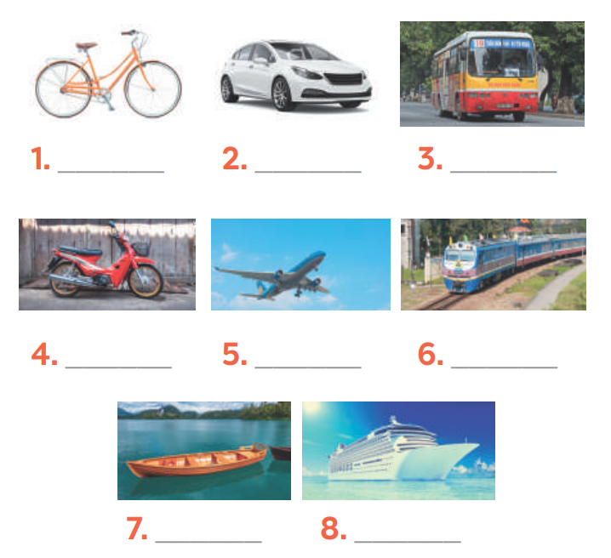
4
Look at the pictures and write a word under each.
bicycle
car
bus
motorbike
air-plane
train
boat
ship

Slide 25

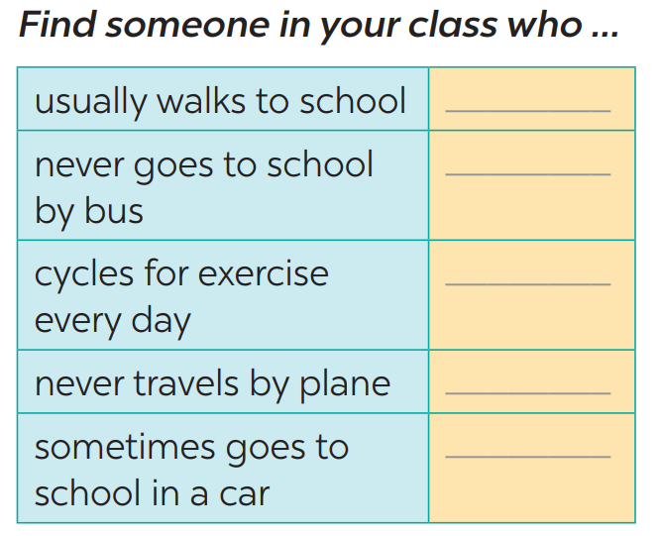
* PRODUCTION
5
Find someone who … Write your friends’ names in the blanks. Then report to the class

Slide 26
5
Find someone who … Write your friends’ names in the blanks. Then report to the class
5
Eg: Do you usually walk to school?
Have you ever gone to school by bus/…?
Do you ride a bike to school?
Do you ever travel by plane?
→ Yes, I do.
→ No, never/notyet.

Slide 27
* CONSOLIDATION
TRAFFIC
MEANS OF TRANSPORT
TRAFFIC PROBLEMS
Topic of the unit
Vocabulary

Slide 28
* Homework
Learn new words by heart.
Practise the exercises again.
Prepare: A closer look 1.

Slide 29



