Slide 1


Friday, December 21st , 2021
love
Class: 6 C
Teacher: Nguyen Thi Thu Ba

Slide 2





* WARM UP
MATCHING
1
2
3
4
5
A. Romania
B. Switzerland
C. Japan
D.Thailand
E. Spain

Slide 3




UNIT 6: OUR TET HOLIDAY
LESSON 4
Everyday English
Saying New Year’s wishes

Slide 4
UNIT 6: OUR TET HOLIDAY
Everyday English
Saying New Year’s wishes

Slide 5
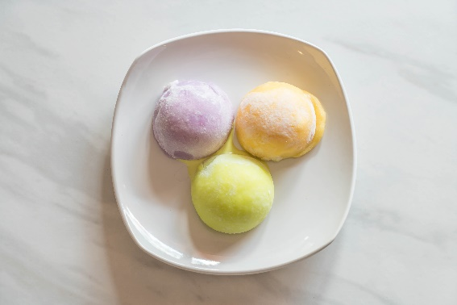
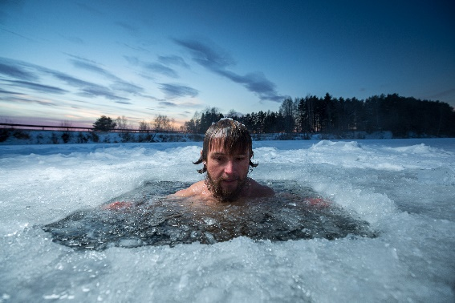
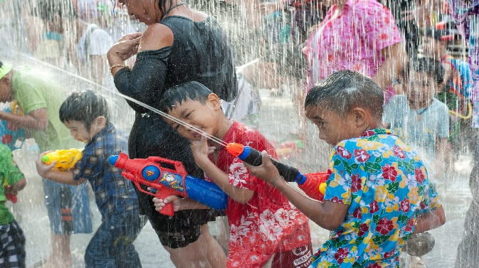
* Vocabulary:
- Japan (n):
Nhật
- Spain (n):
Tây Ban Nha
- Switzerland (n):
Thụy Sĩ
- rice cakes (n):
bánh gạo
- bathe (v):
tắm
- ice hole (n):
hố băng.
- throw water ( phrv:)
ném nước, tạt nước

Slide 6
* Checking vocabulary:
RUB OUT AND REMEMBER
- Japan (n):
Nhật
- Spain (n):
Tây Ban Nha
- Switzerland (n):
Thụy Sĩ
- rice cakes (n):
bánh gạo
- bathe (v):
tắm
- ice hole (n):
hố băng.
- throw water ( phrv:)
ném nước, tạt nước

Slide 7
Wish you healthy and successful
Happy New Year
* Some common wishes on New Year holiday,
Best wishes for a happy and successful new year!
Best wishes for the new year.

Slide 8




Listen and read the New Year’s wish.
Wishing you joy
& laughter … from January to December!
Notes:
Slide này không đúng.

Slide 9

Practise saying New Year’s wishes to your friends, using the suggestions below or creating your own.
happy days from january to december
a year full of fun
happiness and cheers
a life full of happy moments
success in your studies
* Note:
Wishing you
I wish you
+ noun/ noun phrase.
EX:
* I wish you happy days from january to december
Notes:
Slide này không đúng.

Slide 10
* Suggested answers:
I wish / Wishing you happy days all the year round.
I wish / Wishing you good health and happiness.
I wish / Wishing you success in your work and a happy New Year.
I wish / Wishing you success in your study and laughter all the year round.
I wish / Wishing you a year full of joy and success.
I wish / Wishing you love and care from everybody around you.

Slide 11


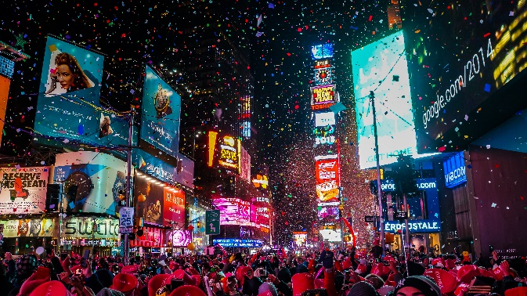
New Year practices in the world
Match the sentences with the picture.
Then match them with the countries.
3.
They eat mochi rice cakes.
1.
They go to Times Square to watch the New Year’s Eve Ball drop.
4.
They throw water on other people.
2.
They bathe in an ice hole.
a
b
c
d

Slide 12

b
a
1.
They go to Times Square to watch the New Year’s Eve Ball drop.
Thailand
The USA
b
c
2.
They bathe in an ice hole.
Japan
Russia
c
a
3.
They eat mochi rice cakes.
Japan
The USA
d
4.
They throw water on other people.
Thailand
Russia

Slide 13

Read how people in different countries celebrate their New Year. Then match the countries with the activities.
In Japan, temples ring their bells 108 times at midnight on December 31. By doing so, people believe the bad things of the past year will leave.
In Spain, people try to put 12 grapes in their mouth at midnight for good luck.
In Switzerland, they drop ice cream on the floor to celebrate the New Year.
In Romania, they throw coins into a river for good luck.
In Thailand, they throw water on other people to wash away bad luck.
Notes:
City landmarks phải ở trên mục 3

Slide 14
MATCHING
Countries
Activities
1. Japan
a. put 12 grapes in the mouth
2. Spain
b. ring bells 108 times
3. Switzerland
c. throw coins into a river
4. Romania
d. Throw water on other people
5. Thailand
e. drop ice cream on the floor
=> Answer:
1- b 2- a 3- e 4- c 5- d

Slide 15

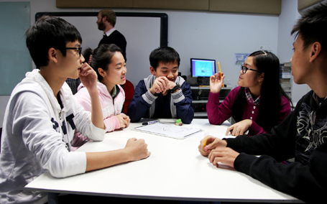
Work in groups. Each student chooses one activity from 4. Take turns to say them aloud. The group says which country he / she is talking about.
Example:
They throw water on other people.
It’s in Thailand.

Slide 16



Homework
Learn by heart all new words.
Do exercises on workbook.
Prepare skills 1.

Slide 17

Thank you!
Have a nice day!

Slide 18
Japan
Thailand
Romania
Spain
Switzerland

