Slide 1


Hello every one !!!

Slide 2


UNIT 12. ROBOTS
LESSON 2:

Slide 3




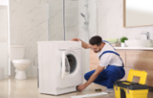

* Game: Matching
do the dishes
move heavy things
repair a broken machine
iron clothes
put toys away
make meals

Slide 4


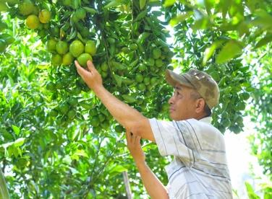
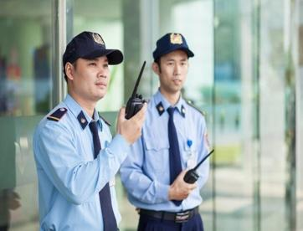
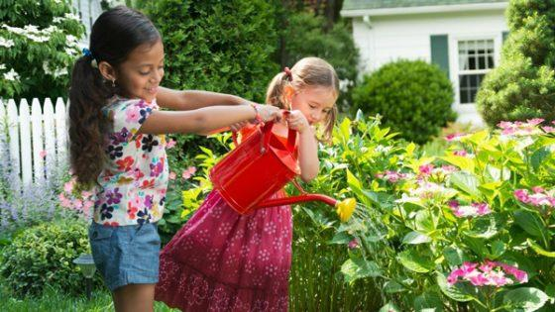
* Vocabulary
guard (n) /ɡɑːrd/
pick (v) /pɪk/
water (v) /ˈwɔːtər/
delicious (adj) /dɪˈlɪʃəs/
understand (v) /ˌʌndərˈstænd/
helpful (adj) /ˈhelpfl/
Bảo vệ
Hái
Tưới nước
Ngon
Hiểu
Hữu ích

Slide 5
* Checking vocabulary
What and Where
understand
guard
pick
helpful
delicious
water

Slide 6

Match the verbs in column A to the words or phrases in column B. Then listen, check and repeat them.
A
B
c. our feelings
1.
understand
a. fruit
a. fruit
2.
pick
b. the washing
b. the washing
3.
do
c. our feelings
e. plants
4.
water
d. as a guard
d. as a guard
5.
work
e. plants

Slide 7

Work in pairs. Tell your partner the activities in 1 you can or can’t do now.
Example:
- I can pick fruit but I can’t understand your feelings.
1. Pick fruit
2. Understand our feelings
3. Do the washing
4. Water plants
5. Work as a guard
I can water plants but I can’t word as a guard
………….

Slide 8

Work in pairs. Read the information about what V10, a robot, can or can’t do. Ask and answer questions.
Skills of V10 | Can | Can’t
Repair a broken machine |  | 
Do the washing | 
Work as a guard | 
Read our moods |  | 
Water plants | 
Understand what we say |  | 
Example:
A: Can V10 do the washing?
B: Yes, it can.

Slide 9
Work in pairs. Read the information about what V10, a robot, can or can’t do. Ask and answer questions.
Skills of V10 | Can | Can’t
Repair a broken machine |  | 
Do the washing | 
Work as a guard | 
Read our moods |  | 
Water plants | 
Understand what we say |  | 
A: Can V10 repair a broken machine?
B: No, it can’t.
A: Can V10 read our mood?
B: No: It can't
A: Can V10 water plant?
B: Yes, it can

Slide 10

Pronunciation
Falling tone in statements
( Ngữ điệu xuống giọng trong câu trần thuật)
Our voice often goes down at the end of a statement.
Example:
We go to school every morning.

Slide 11

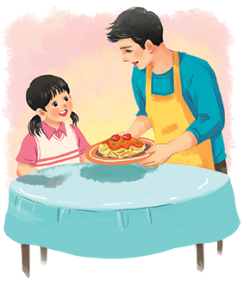
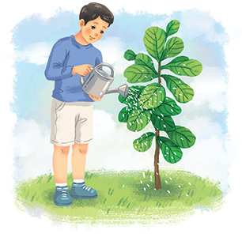
* Pronunciation
Falling tone in statements
Listen and repeat the following sentences.
1.
I often water plants after school.
2.
Shifa can do many things like humans.
3.
My dad makes delicious meals at weekends.
4.
WB2 is the strongest of all the robots.
5.
H8 is a home robot.

Slide 12

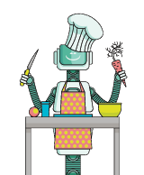
Practise saying the statements in the following paragraph. Then listen and repeat.
My robot is Jimba. It’s a home robot. It’s very helpful. It can do the housework. It can also water plants and pick fruit. It can work as a guard. I love my robot very much.

Slide 13


homework
- Learn by heart all the new words.
- Do exercises in the workbook.
- Prepare lesson 3 ( A closer look 2)

Slide 14




