Slide 1

GOOD MORNING
EVERYONE !!!

Slide 2
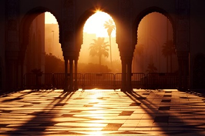
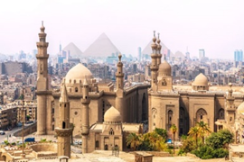
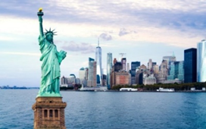
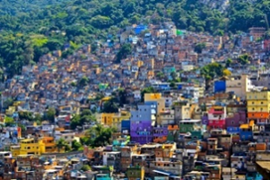
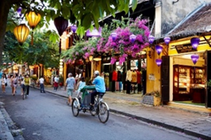
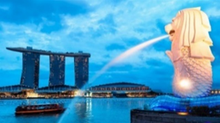
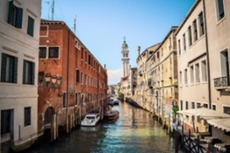
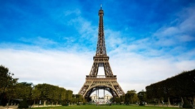
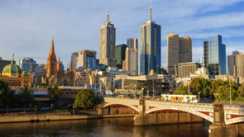
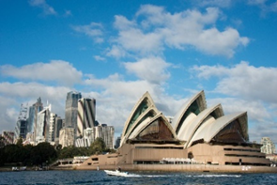
GAME:
Match 10 pictures about cities with the name of the
5 continents.
Casablanca
Cairo
New York
Rio De Janeiro
Europe
Asia
Africa
America
Oceania
Hoi An
Singapore
Venice
Paris
Melbourne
Sydney

Slide 3
Casablanca
Cairo
New York
Rio De Janeiro
Africa
America
Hoi An
Singapore
Asia
Venice
Paris
Melbourne
Sydney
Europe
Oceania

Slide 4




LESSON 1
OBJECTIVES:
- use the lexical items related to the topic Cities of the World;
- use the vocabulary and structures to describe cities and landmarks.

Slide 5




Listen and read.
What nice photos!
1. What are Mai and Tom doing?
2. What are they looking at?
3. What is the name of the city?
4. What landmark is in the picture?
1. They are talking to/ discussing with each other.
2. They are looking at some photos about places around the world
3. It’s Sydney in Australia.
4. It’s the Opera House.

Slide 6
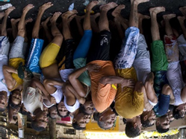


* Vocabulary
- rainy (adj) /ˈreɪni/:
có mưa
- crowded (adj) /ˈkraʊdɪd/:
đông đúc
- beautiful (adj) /ˈbjuːtɪfl/:
đẹp
- interesting (adj) /ˈɪntrestɪŋ/:
hấp dẫn, thú vị
- exciting (adj) /ɪkˈsaɪtɪŋ/:
thú vị, phấn khích

Slide 7
Checking vocab
What and Where
beautiful
interesting
crowded
exciting
rainy

Slide 8
1. What do you think Mai and Tom are talking about?
2. What city can you recognize from the photos?
3. What is it famous for?

Slide 9
What nice photos!
Mai: Tom, are these photos from your vacations?
Tom: Yes, they are. This is Sydney, a city in Australia.
Mai: What’s it like?
Tom: It’s exciting with a lot of beaches.
Mai: What a beautiful place!
Tom: Yes, its beaches are very clean.
Mai: Wonderful. Oh, this is London. Isn’t it raining?
What bad weather!
Tom: Yes, it rains all the time. Can you see Big Ben?
Mai: Yeah ... on the River Thames. It’s a landmark of London.
Tom: It is. And this is Times Square in New York, crowded but interesting.
Mai: You’re lucky to visit many places.
Tom: I am. What about your vacations?
Mai: Here are some photos of mine. This is ...

Slide 10


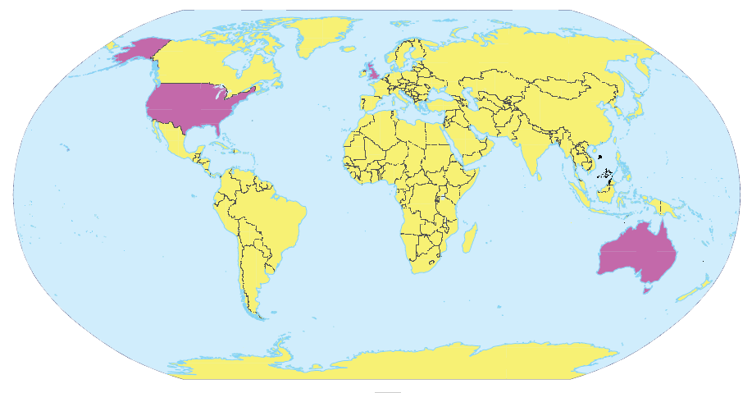
Write the names of the cities in the correct place.
1.
New York
2.
London
Sydney
London
New York
3.
Sydney

Slide 11

Read the conversation again and match the cities with the adjectives describing them.
a. rainy
?
1. Sydney
b. crowded
?
2. London
c. exciting
d. beautiful
?
3. New York
e. interesting

Slide 12
SUGGEST
What nice photos!
Mai: Tom, are these photos from your vacations?
Tom: Yes, they are. This is Sydney, a city in Australia.
Mai: What’s it like?
Tom: It’s exciting with a lot of beaches.
Mai: What a beautiful place!
Tom: Yes, its beaches are very clean.
Mai: Wonderful. Oh, this is London. Isn’t it raining? What bad weather!
Tom: Yes, it rains all the time. Can you see Big Ben?
Mai: Yeah... on the River Thames. It’s a landmark of London.
Tom: It is. And this is Times Square in New York, crowded but interesting.
Mai: You’re lucky to visit many places.
Tom: I am. What about your vacations?
Mai: Here are some photos of mine. This is…

Slide 13
SUGGEST
What nice photos!
Mai: Tom, are these photos from your vacations?
Tom: Yes, they are. This is Sydney, a city in Australia.
Mai: What’s it like?
Tom: It’s exciting with a lot of beaches.
Mai: What a beautiful place!
Tom: Yes, its beaches are very clean.
Mai: Wonderful. Oh, this is London. Isn’t it raining? What bad weather!
Tom: Yes, it rains all the time. Can you see Big Ben?
Mai: Yeah... on the River Thames. It’s a landmark of London.
Tom: It is. And this is Times Square in New York, crowded but interesting.
Mai: You’re lucky to visit many places.
Tom: I am. What about your vacations?
Mai: Here are some photos of mine. This is…

Slide 14
SUGGEST
What nice photos!
Mai: Tom, are these photos from your vacations?
Tom: Yes, they are. This is Sydney, a city in Australia.
Mai: What’s it like?
Tom: It’s exciting with a lot of beaches.
Mai: What a beautiful place!
Tom: Yes, its beaches are very clean.
Mai: Wonderful. Oh, this is London. Isn’t it raining? What bad weather!
Tom: Yes, it rains all the time. Can you see Big Ben?
Mai: Yeah... on the River Thames. It’s a landmark of London.
Tom: It is. And this is Times Square in New York, crowded but interesting.
Mai: You’re lucky to visit many places.
Tom: I am. What about your vacations?
Mai: Here are some photos of mine. This is…

Slide 15

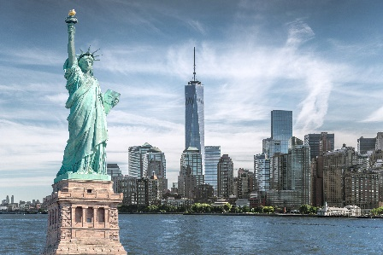
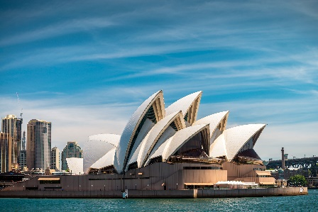
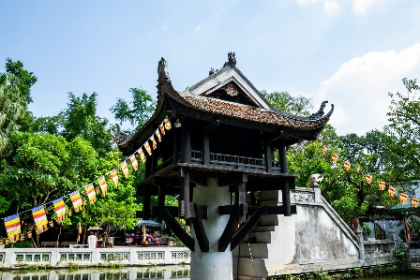
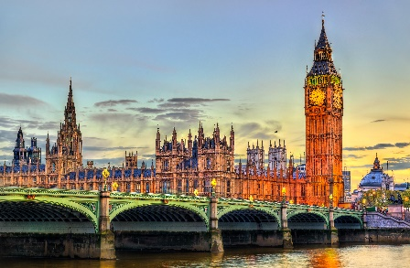
Match the cities with their landmarks.
a
1. Ha Noi
b
2. London
c
3. New York
d
4. Sydney

Slide 16
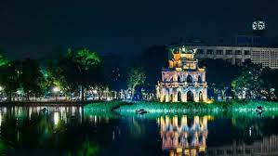
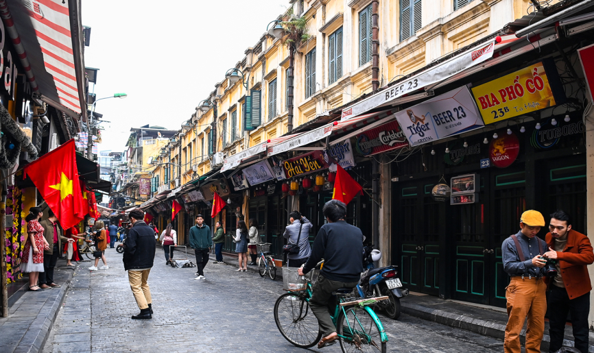
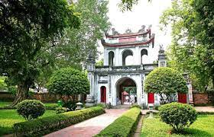
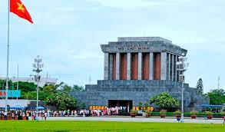
* Choose a landmark or a city to present about it.
EX:
Ha Noi
Hanoi Old Town Quarter
Hoan Kiem Lake
Temple of Literature
Ho Chi Minh Mausoleum

Slide 17
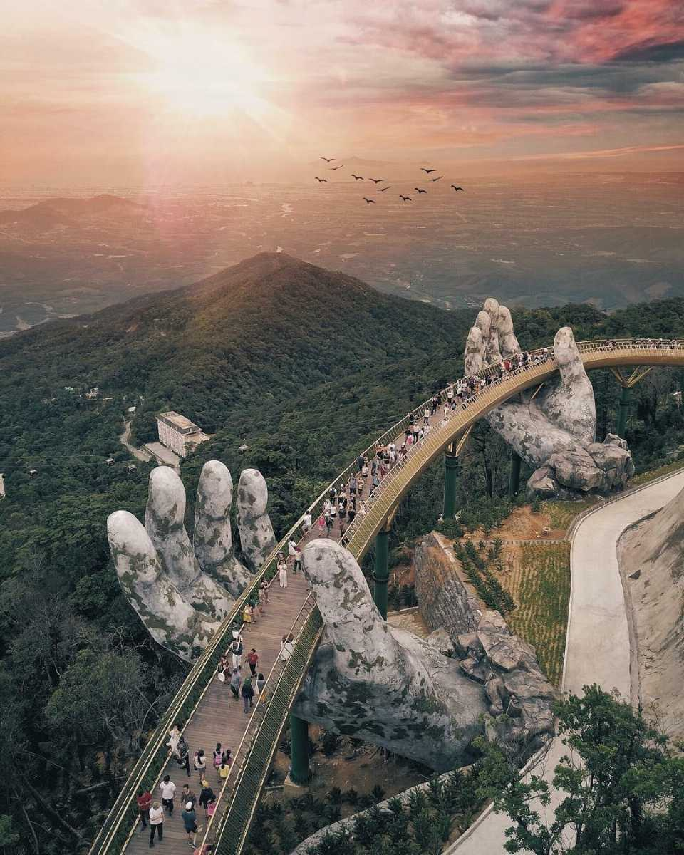
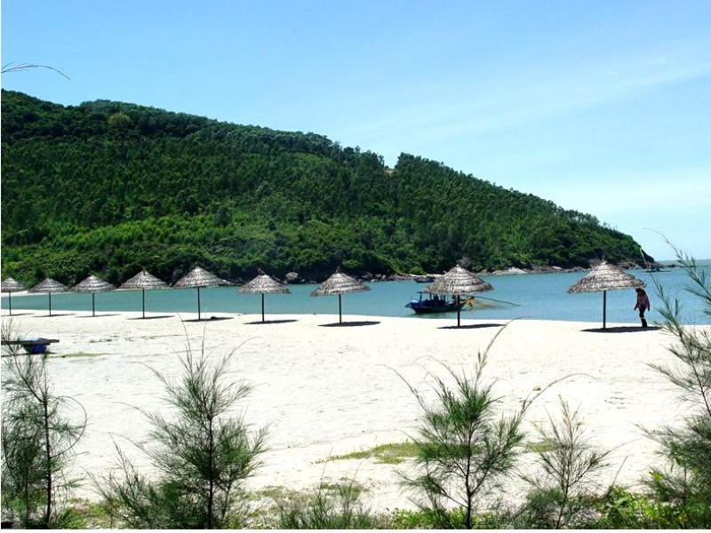
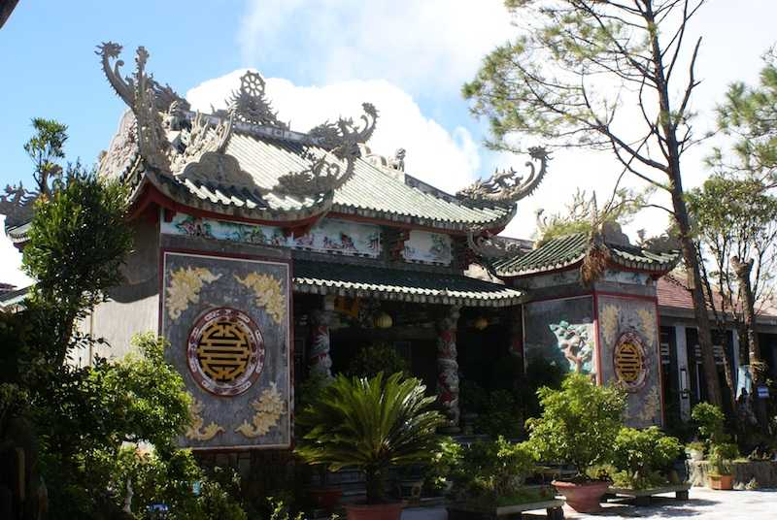
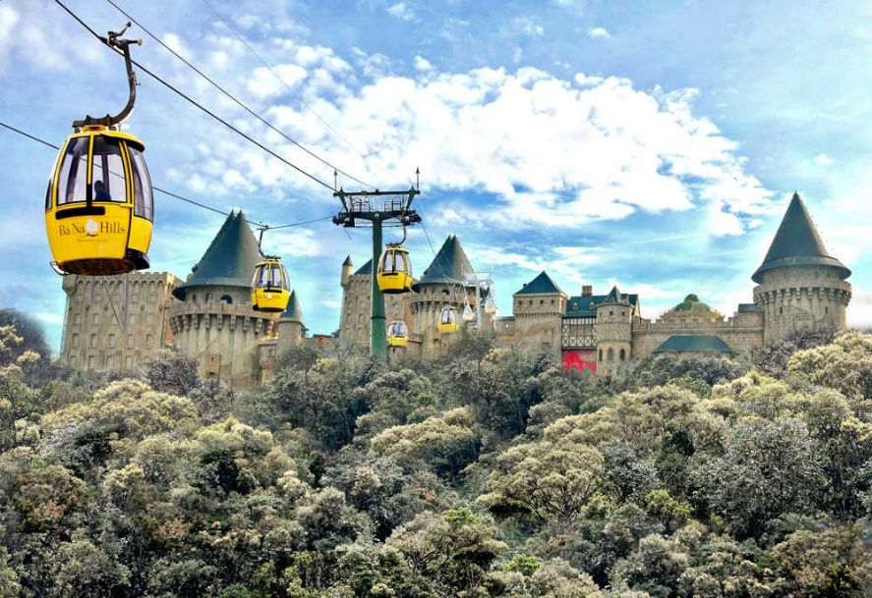
Da Nang
Golden Bridge
My Khe Beach
Linh Ung Pagoda
Ba Na Hills

Slide 18
New York
- Statue of Liberty, Central Park, Empire State Building, Times Square, etc.

Slide 19


What city is it?
Example:
A: What’s it like?
B: It has beautiful beaches.
C: Is it in Australia?
B: Yes, it is.
A: It’s Sydney.
B: Right.

Slide 20

WRAP-UP
- Learn some new words.
- Read and understand content of the conversation.
- Know some famous places around the world.

Slide 21
homework
- Learn by heart all the new words.
- Go to the Internet and search for the information on your favourite cities in the world (food, people, weather, etc.)
- Prepare lesson 2 (A closer look 1).

Slide 22

Goodbye!
See you again
Thank you!
Have a nice day!

