Slide 1
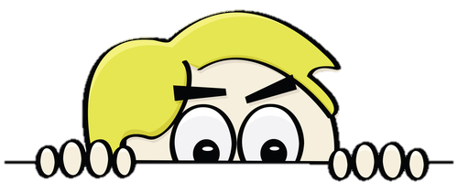
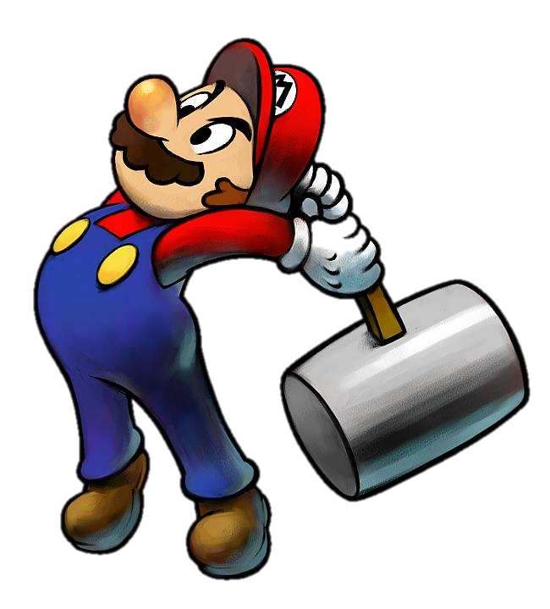
START
What activity is behind the wall?
BRICKS DOWN

Slide 2
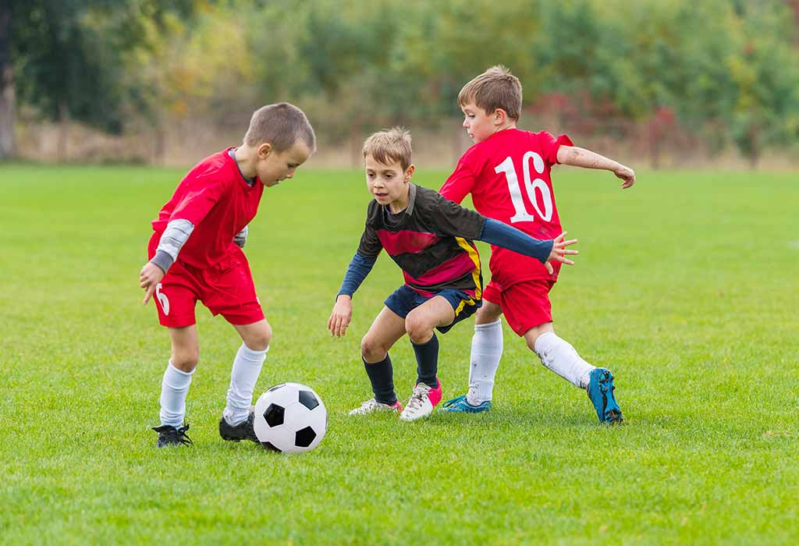
CHECK
NEXT
playing football
Click on the bricks

Slide 3
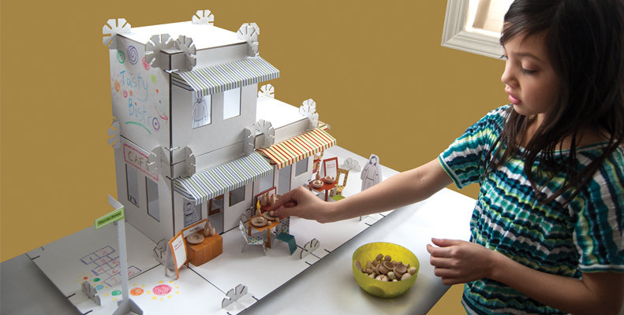
CHECK
NEXT
building dollhouse
Click on the bricks

Slide 4
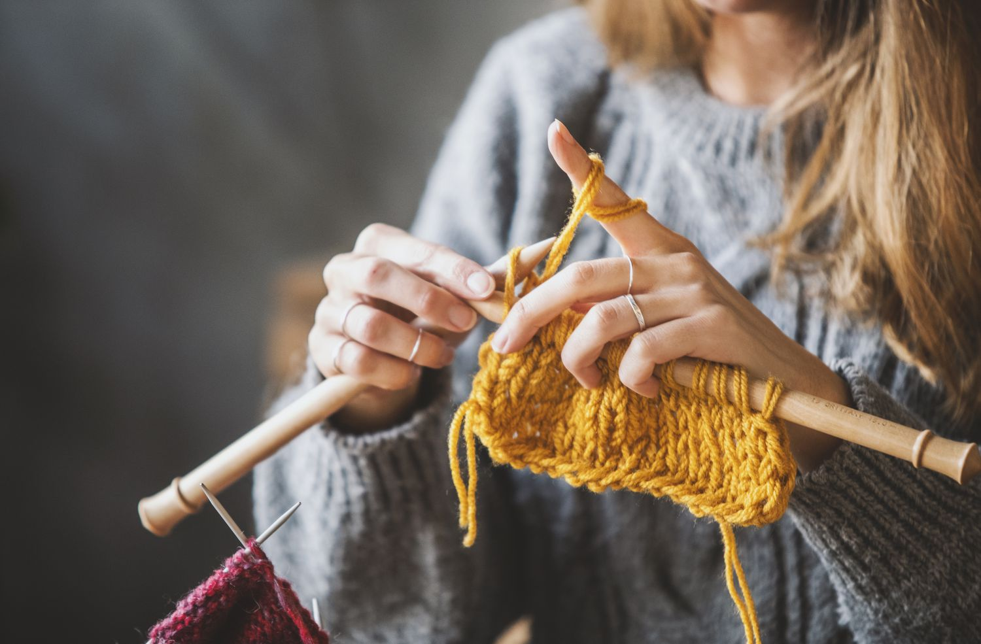
CHECK
NEXT
knitting
Click on the bricks

Slide 5
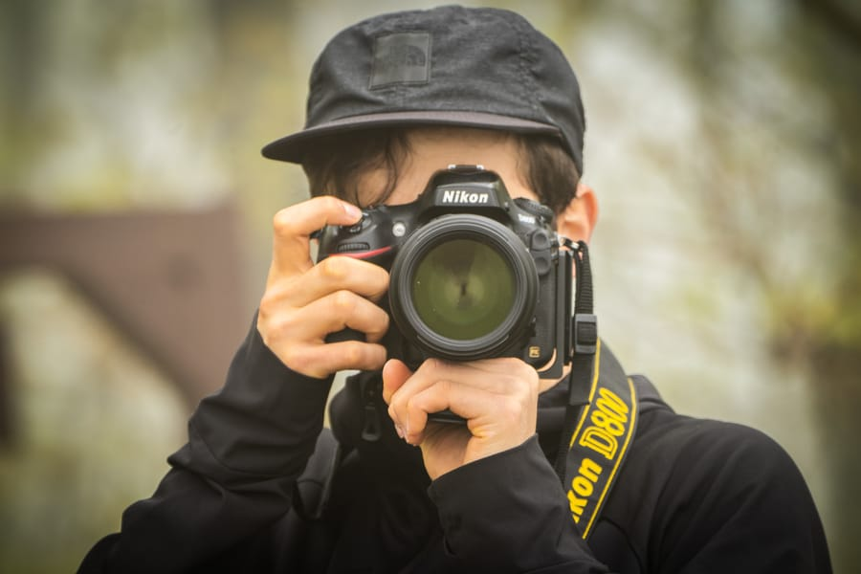
CHECK
NEXT
taking photos
Click on the bricks

Slide 6
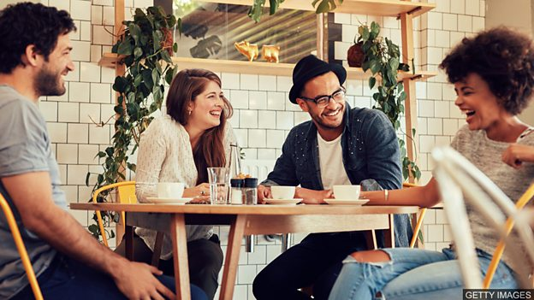
CHECK
NEXT
hanging out
Click on the bricks

Slide 7

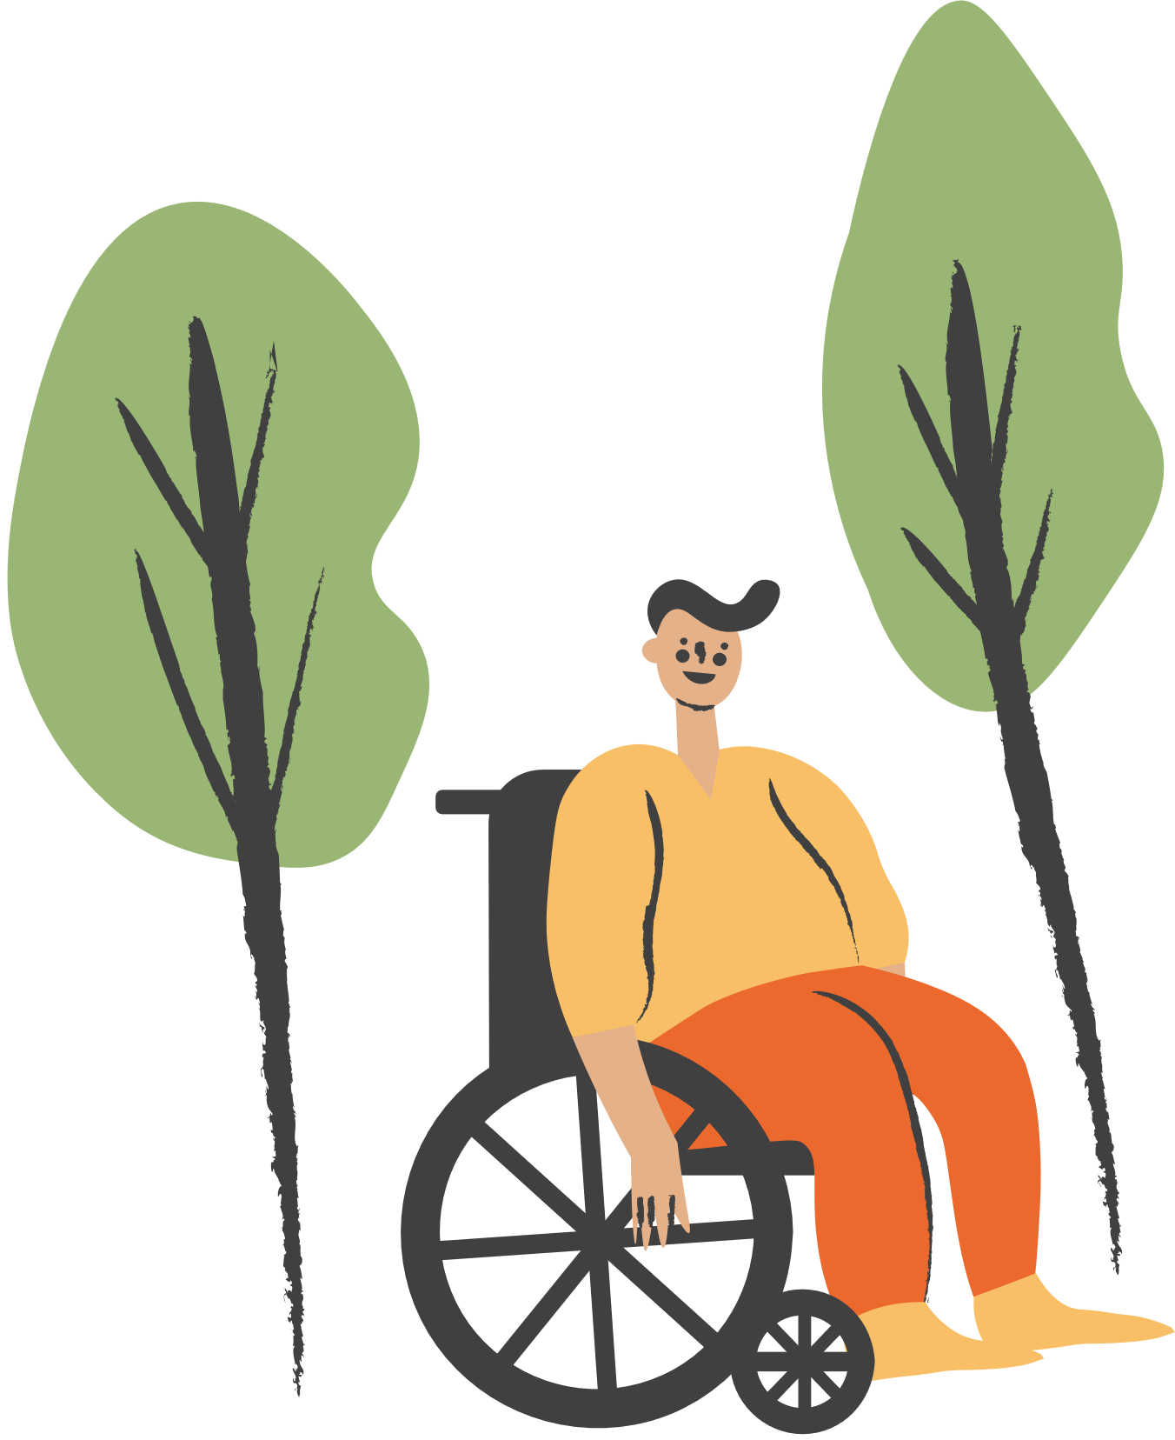
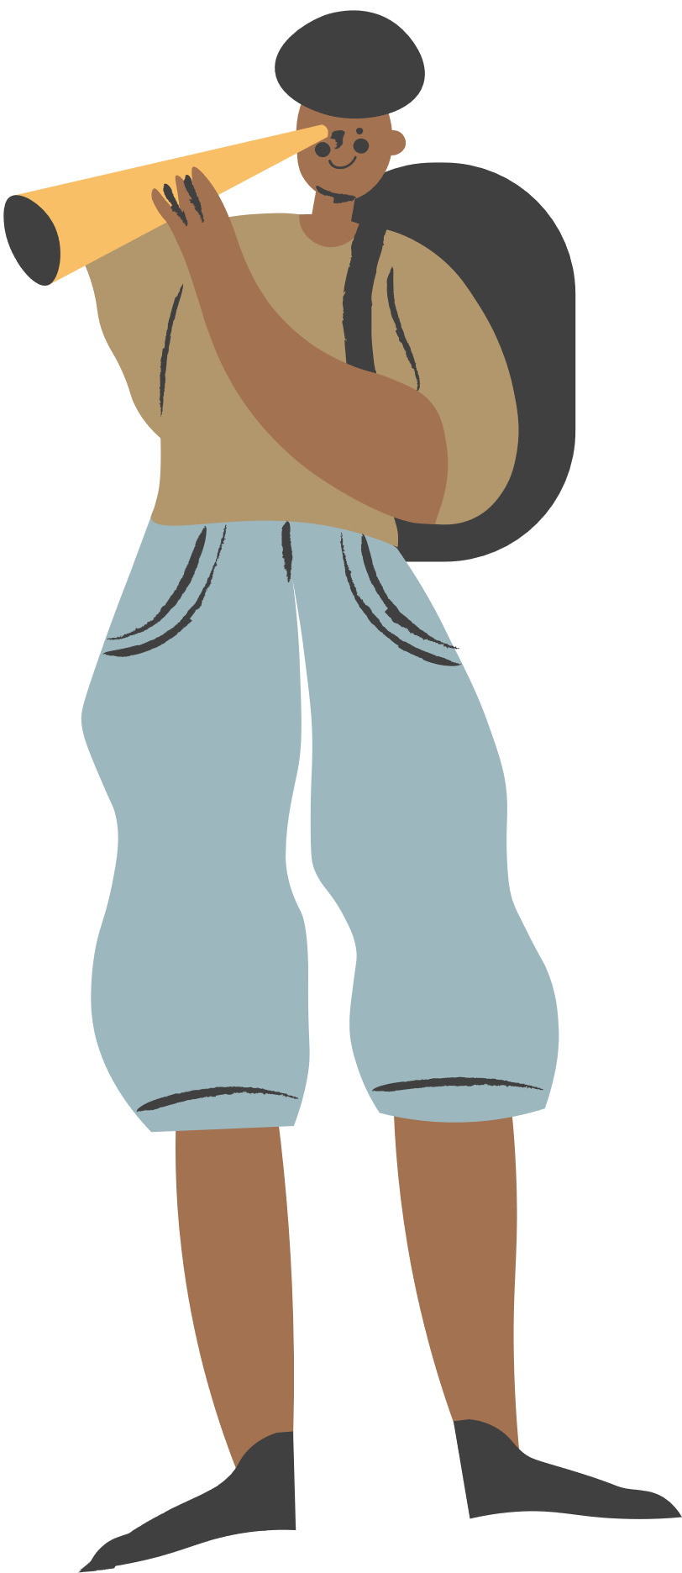

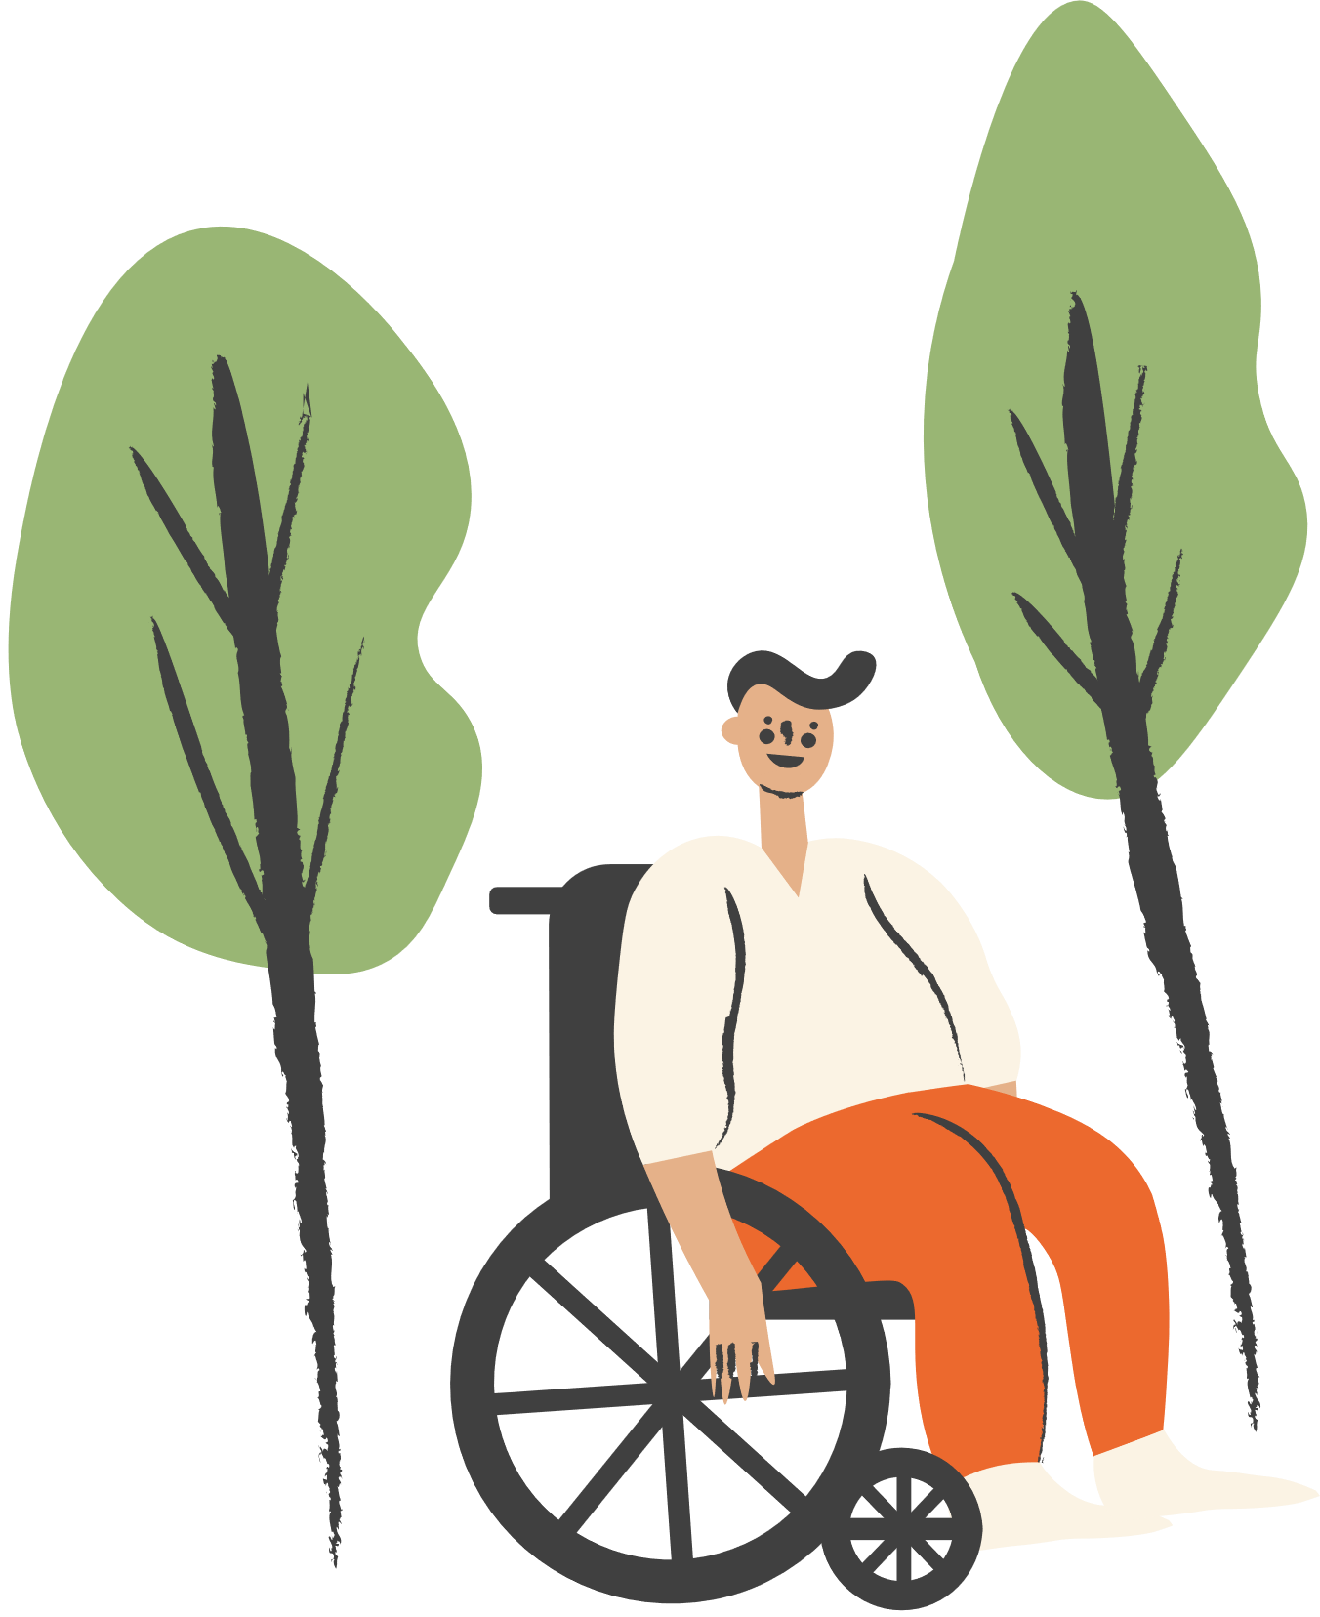
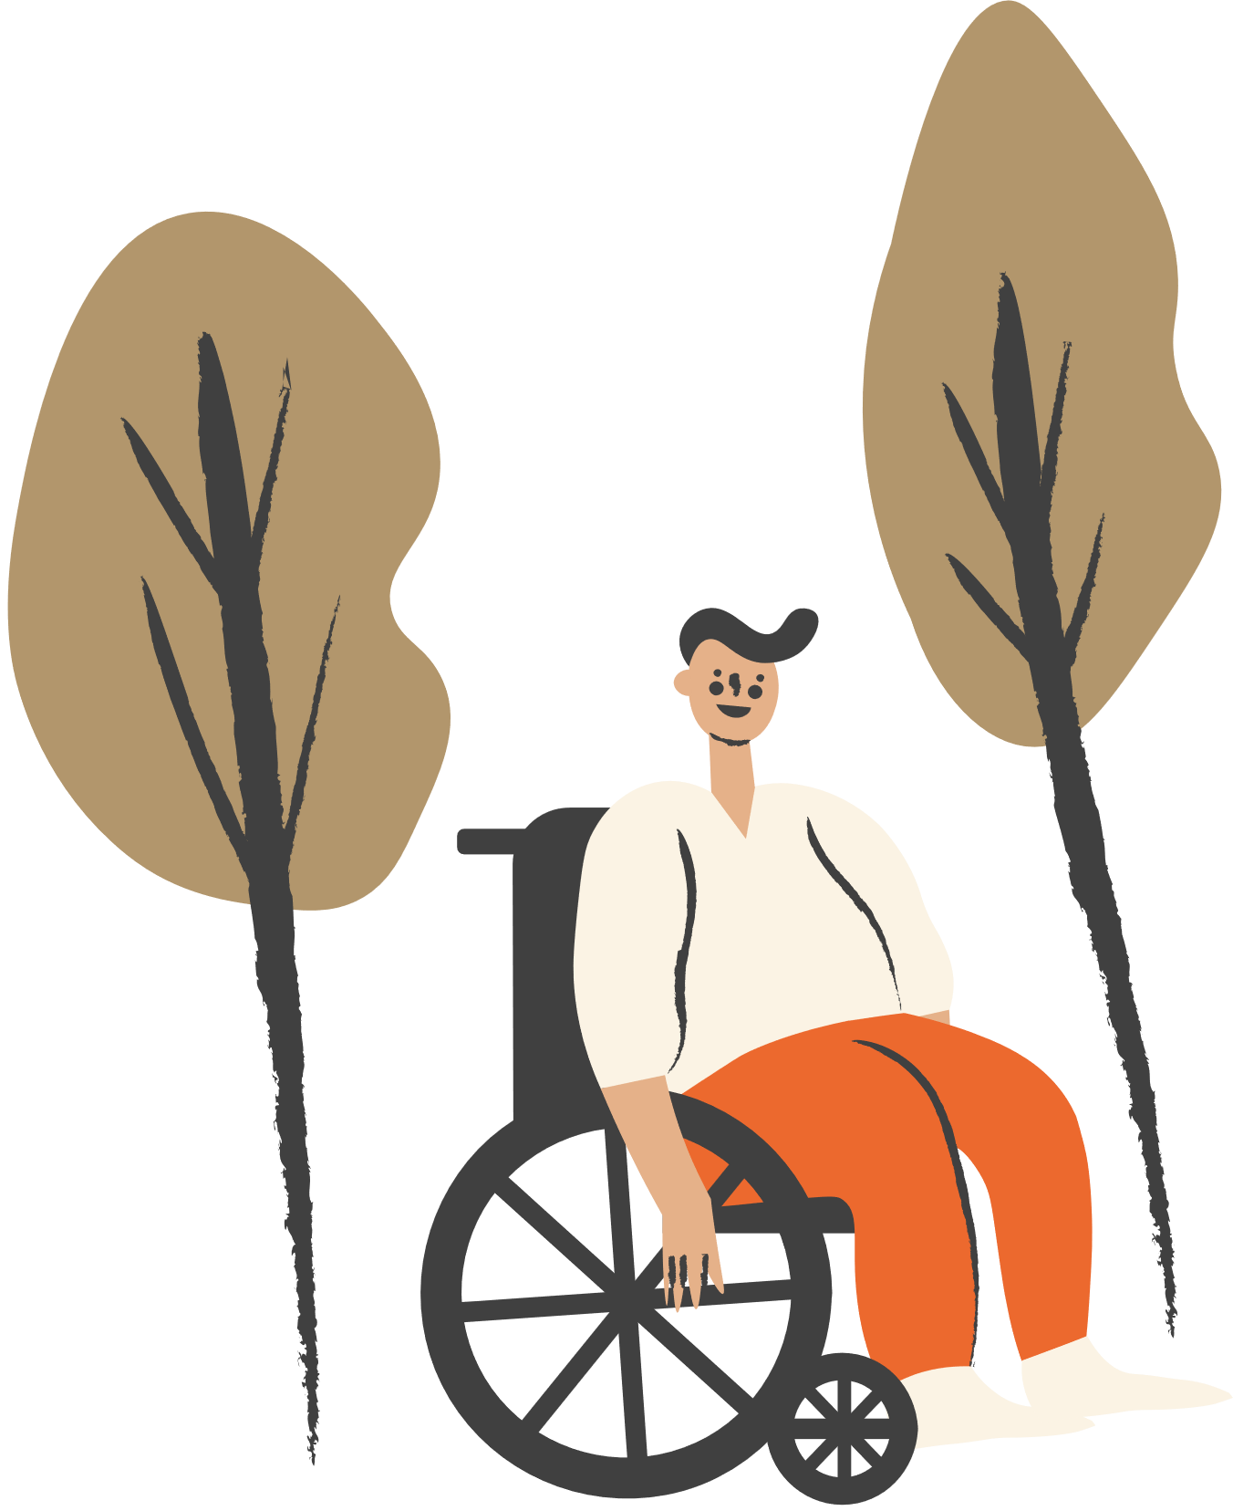
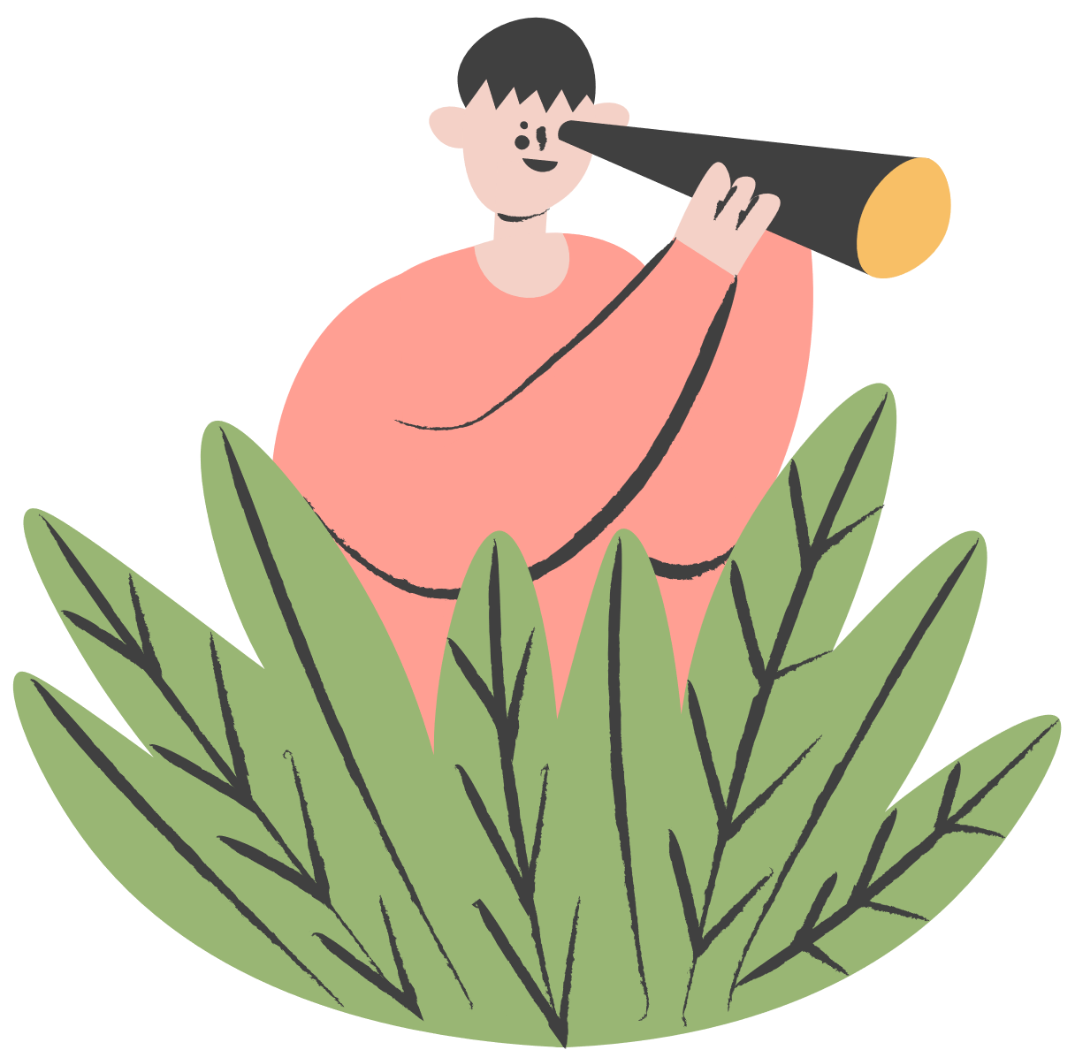


Unit 1:
LEISURE TIME
Lesson 5: Skills 1

Slide 8
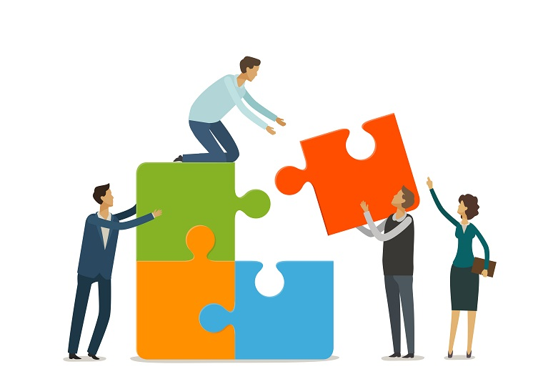

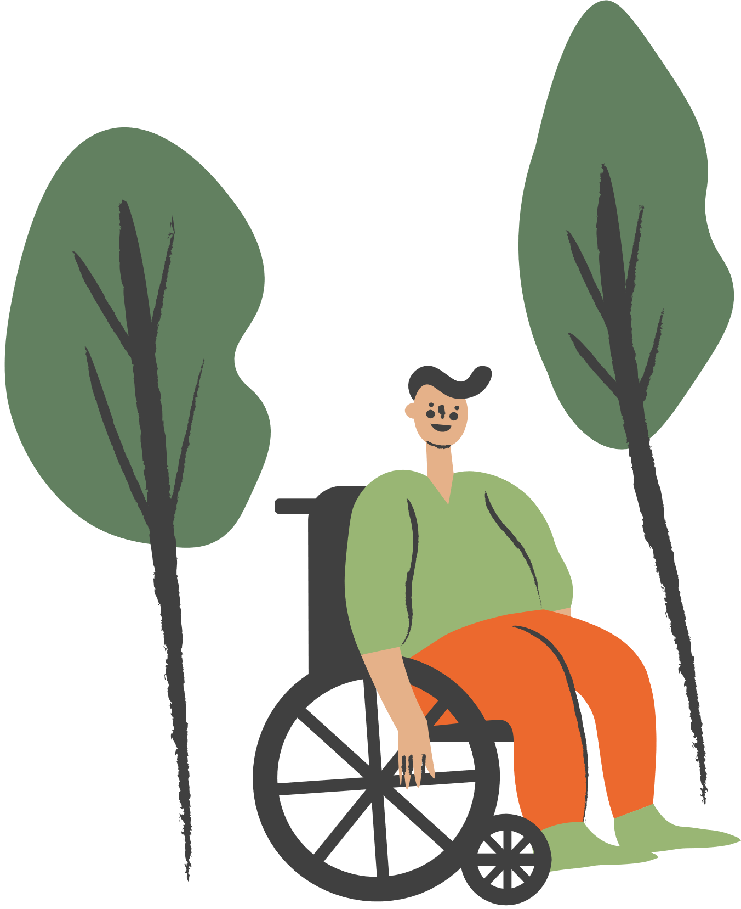
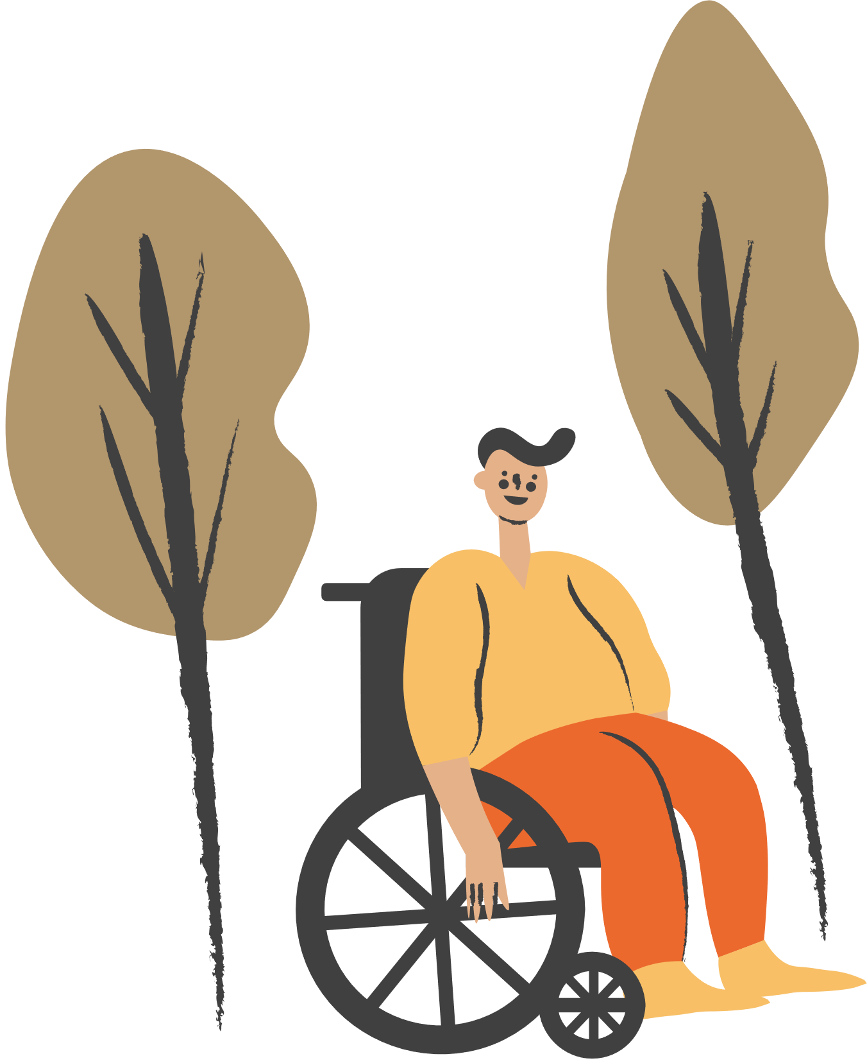
VOCABULARY
connect (v)
/kəˈnekt/
kết nối

Slide 9
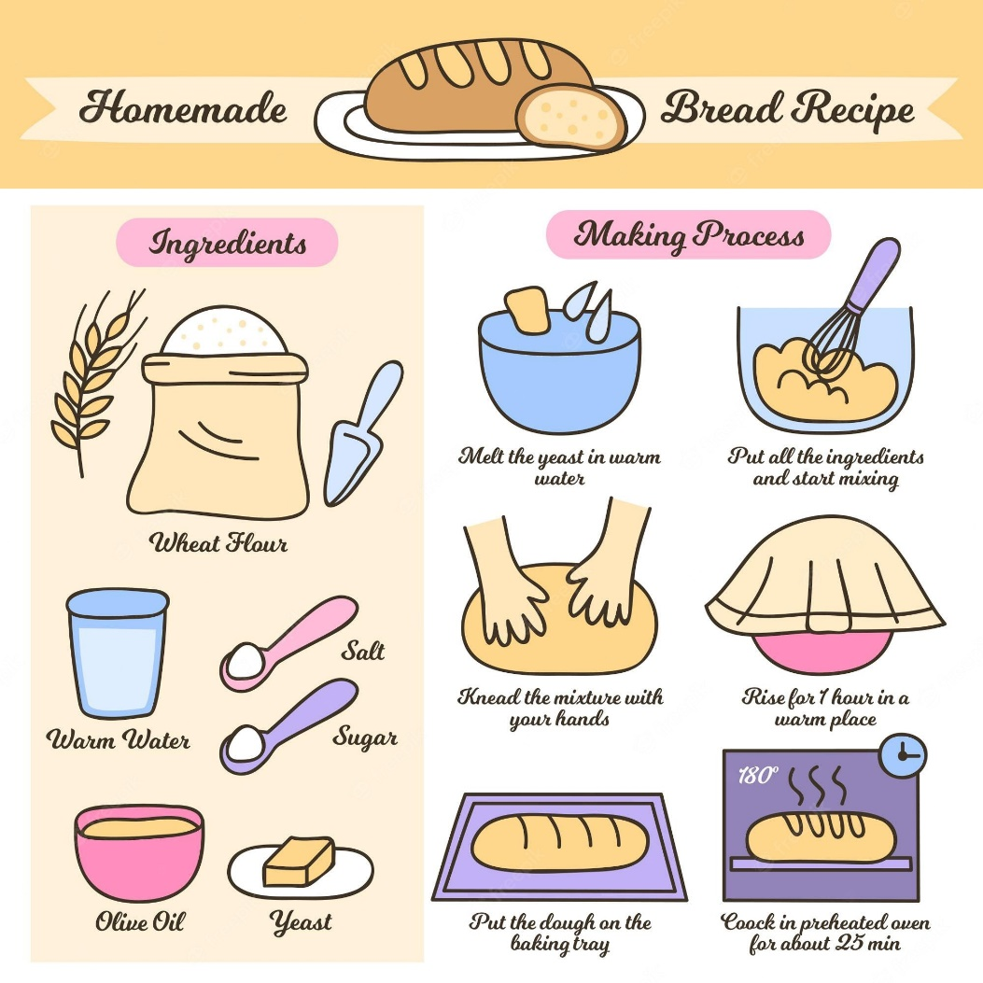
VOCABULARY
recipe (n)
/ˈresɪpi/
công thức

Slide 10
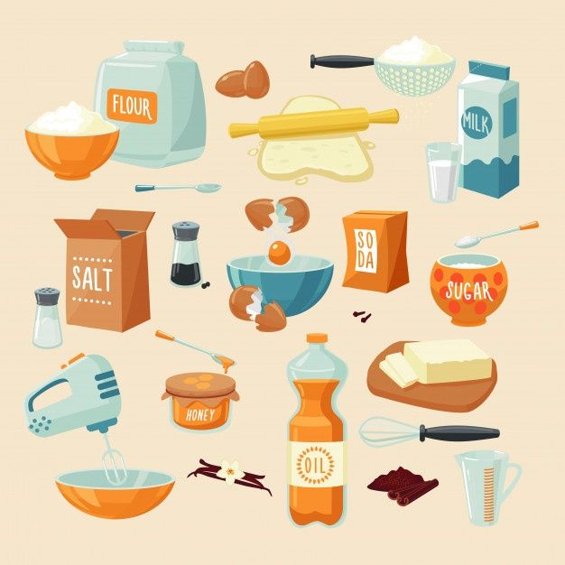
VOCABULARY
ingredient (n)
/ɪnˈɡriːdiənt/
nguyên liệu

Slide 11
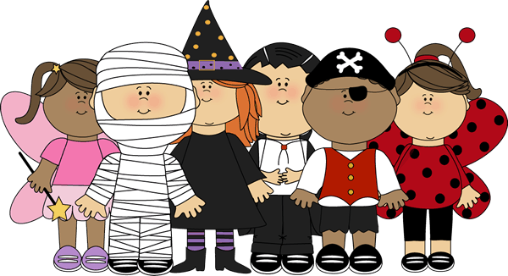
VOCABULARY
costume (n)
/ˈkɒstʃuːm/
trang phục

Slide 12
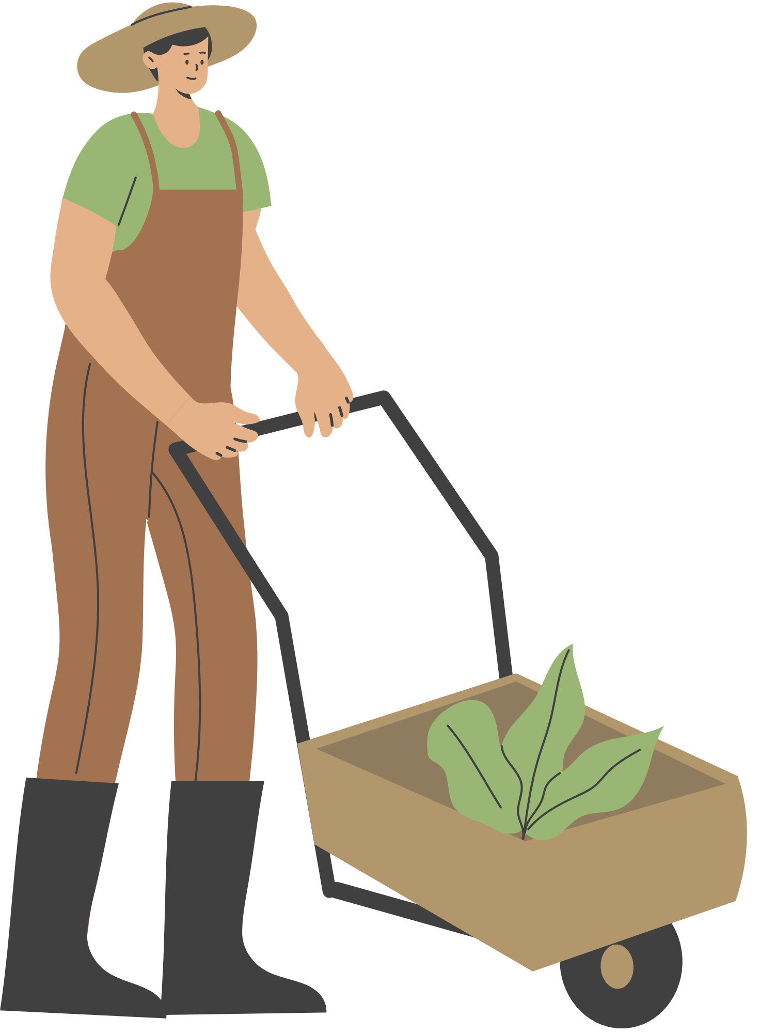
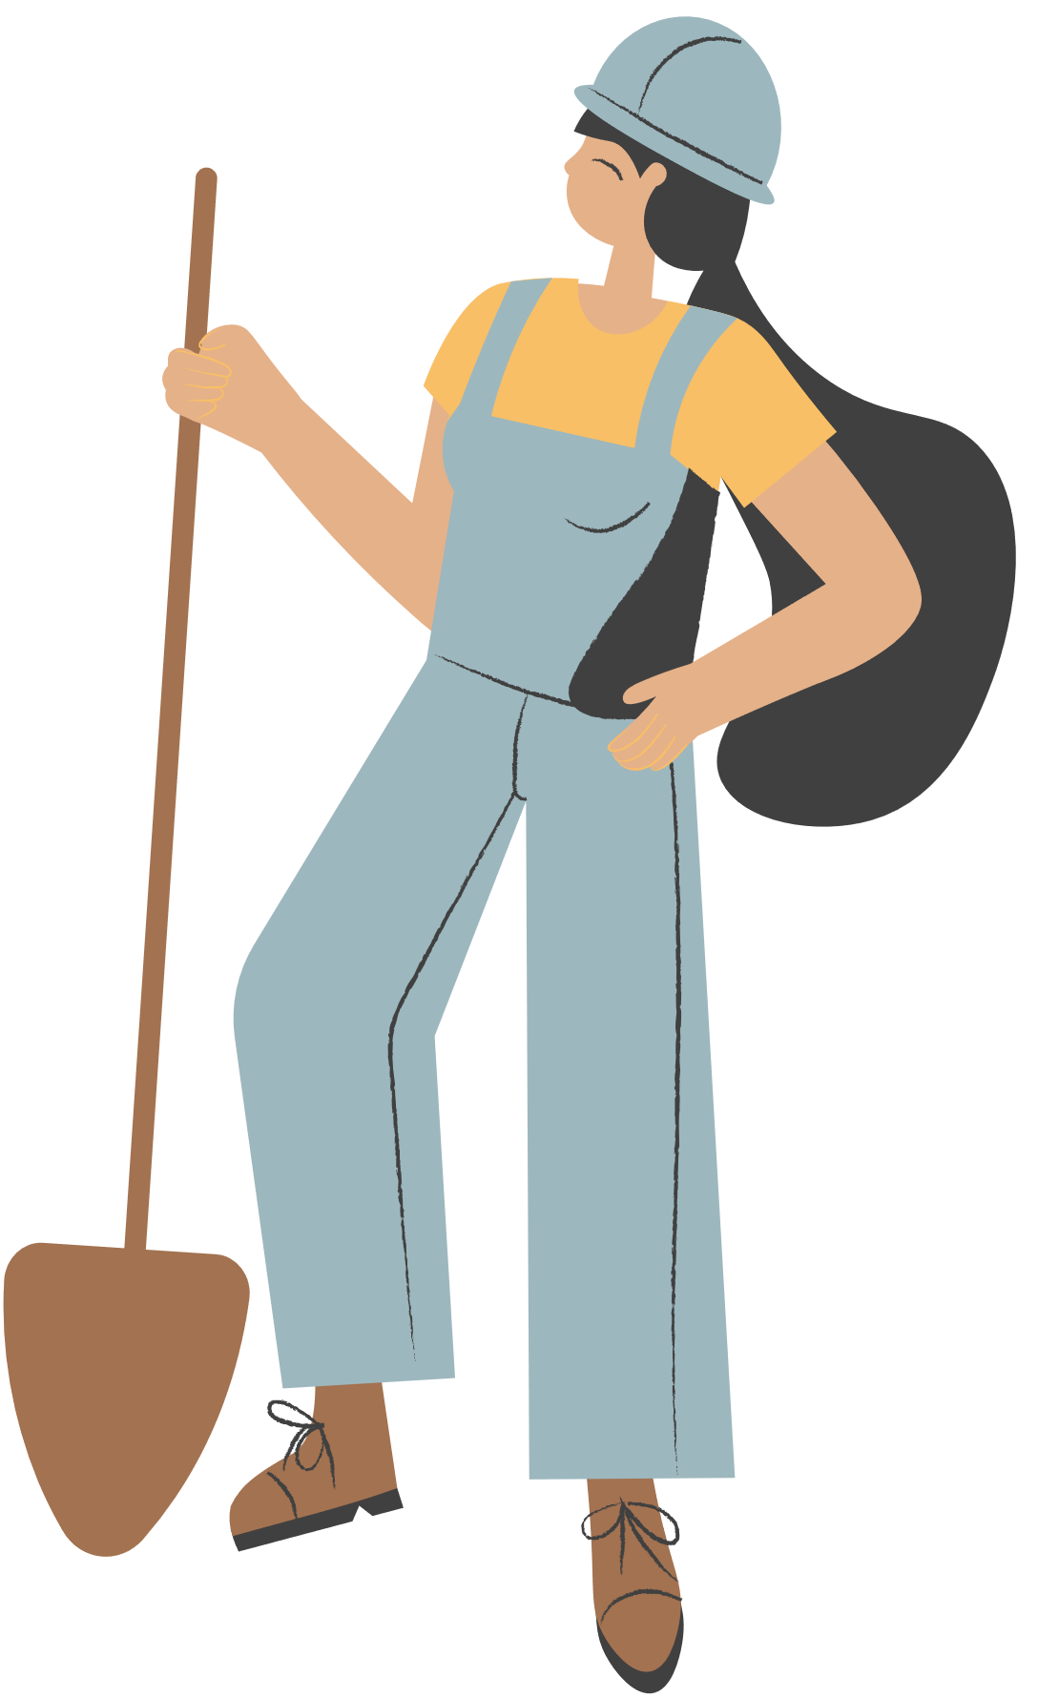
VOCABULARY
- connect (v) | /kəˈnekt/ | kết nối
- recipe (n) | /ˈresɪpi/ | công thức
- ingredient (n) | /ɪnˈɡriːdiənt/ | nguyên liệu
- costume (n) | /ˈkɒstʃuːm/ | trang phục

Slide 13
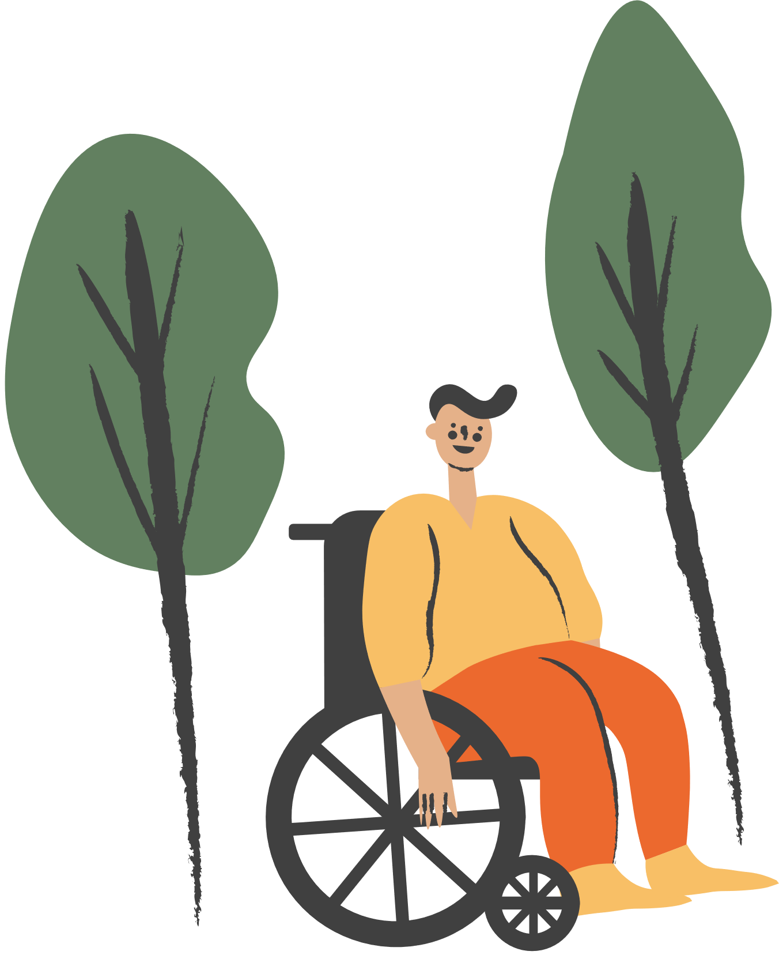
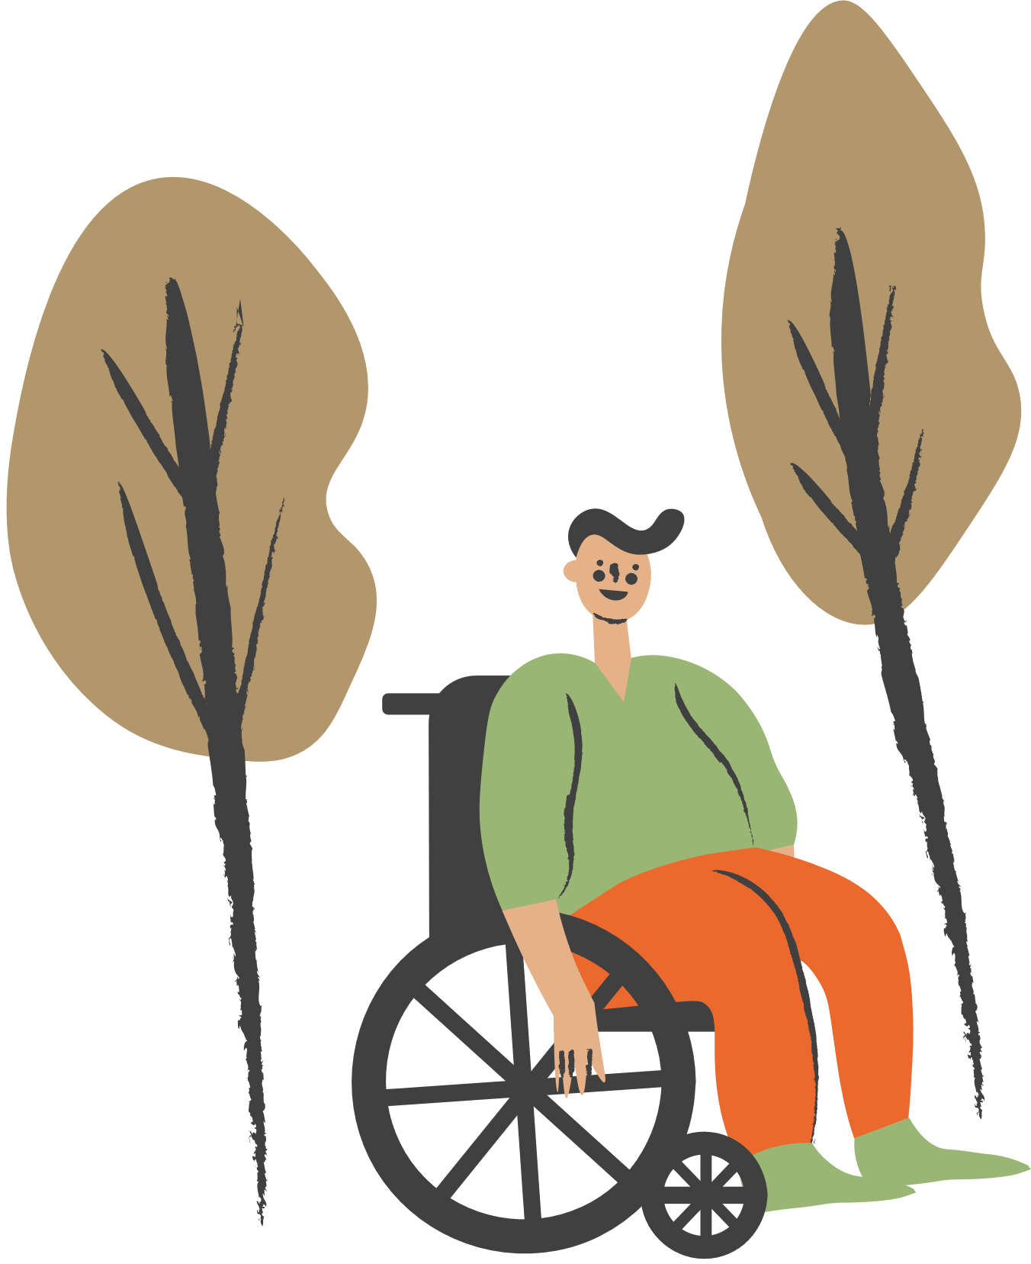
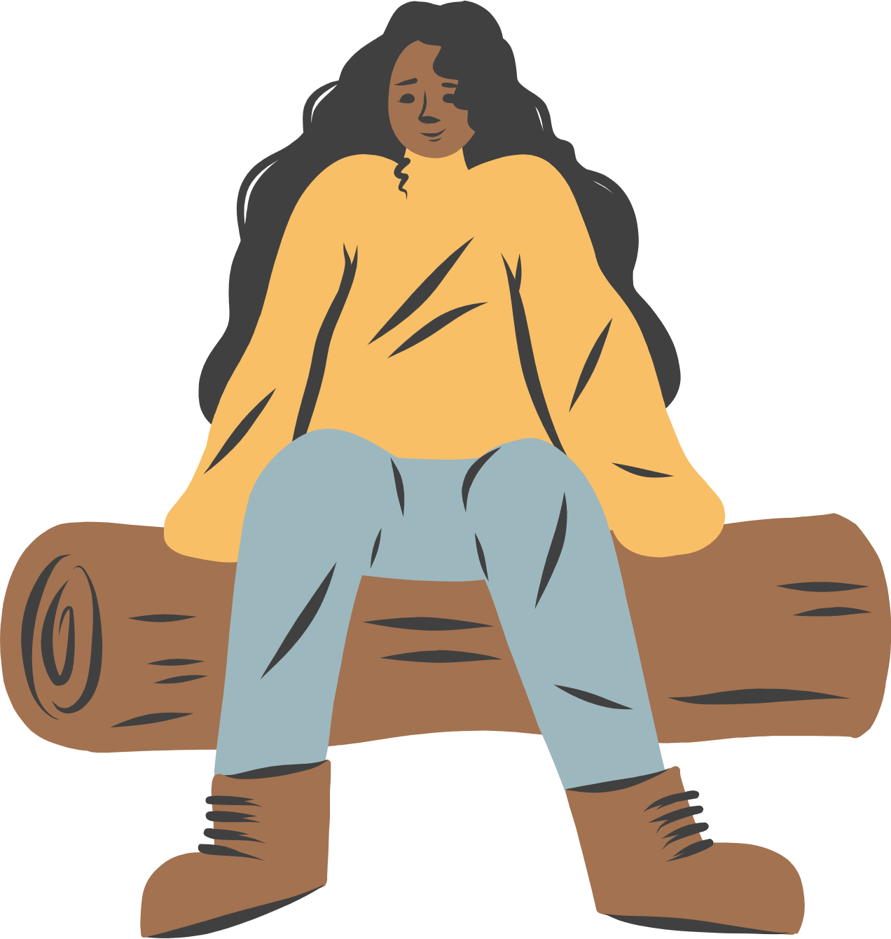
READING

Slide 14
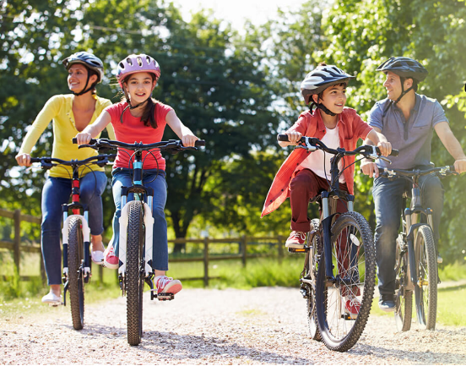
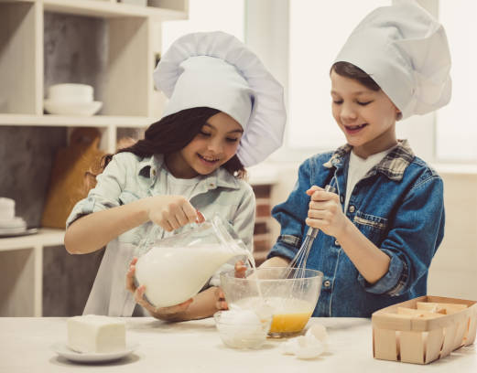
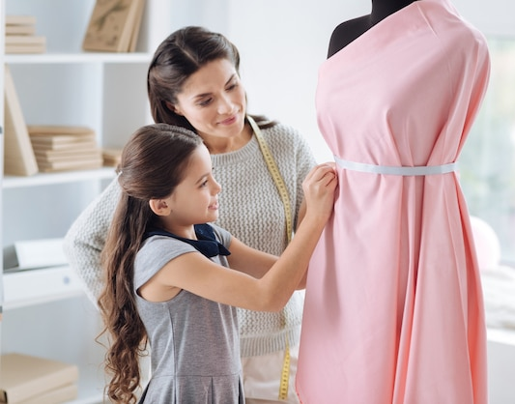
1. Look at the pictures. What activities can you see?
riding a bike/ cycling
cooking
making a dress
LEISURE ACTIVITIES

Slide 15

2. Read about Trang’s leisure activities. Choose the correct answer.
1. The text is about Trang’s leisure activities ______.
A. in the past
B. with her friends
C. with her family
2. The word “connect” is closest in meaning to ______.
A. join with something
B. better understand someone
C. speak to someone by phone
Some teenagers enjoy spending free time with their friends. Others prefer doing leisure activities with their family members. I love spending time with my family because it’s a great way to connect with them.
At the weekend, we usually go for a bike ride. We cycle to some nearby villages to enjoy the fresh air. We take photos and look at them later. My big brother and I are also into cooking. My brother looks for easy recipes. After that, we prepare the ingredients and cook. Sometimes, the food is good, but sometimes it isn’t; nevertheless, we love whatever we cook. The leisure activity I like the most is doing DIY projects with my mum. She teaches me to make my own dresses and doll clothes. On special occasions, we make special dresses together. Once I won the first prize in a costume contest at my school.

Slide 16
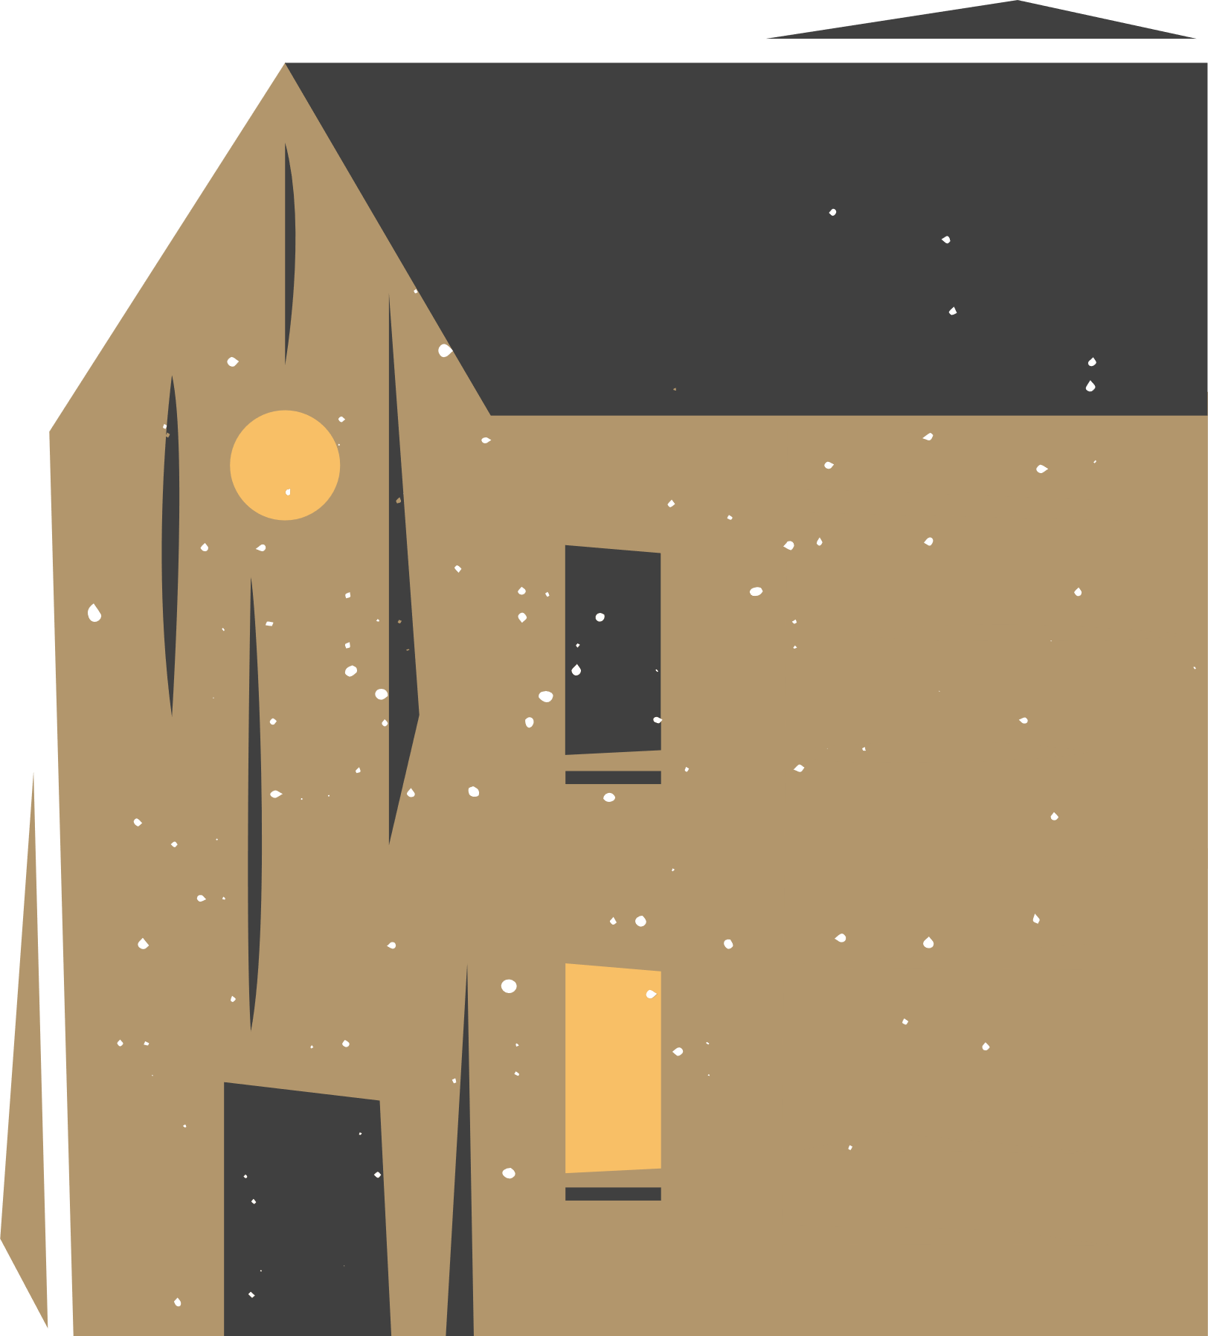
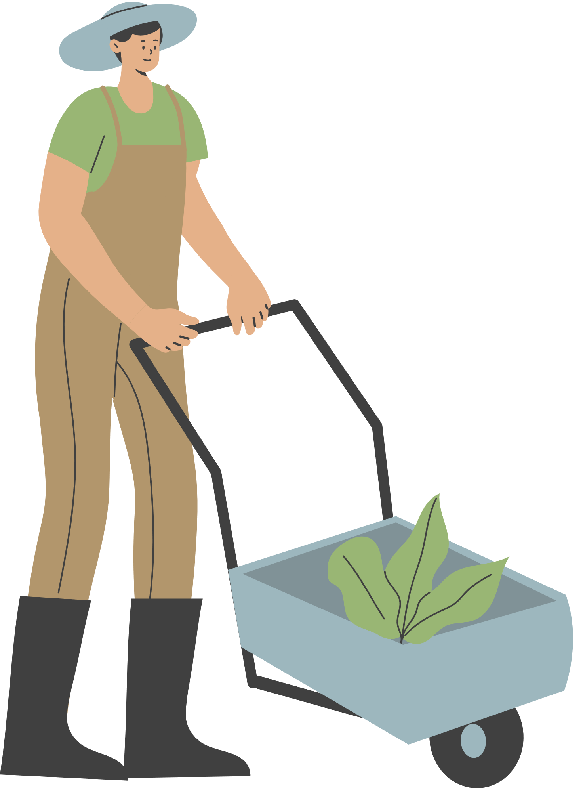
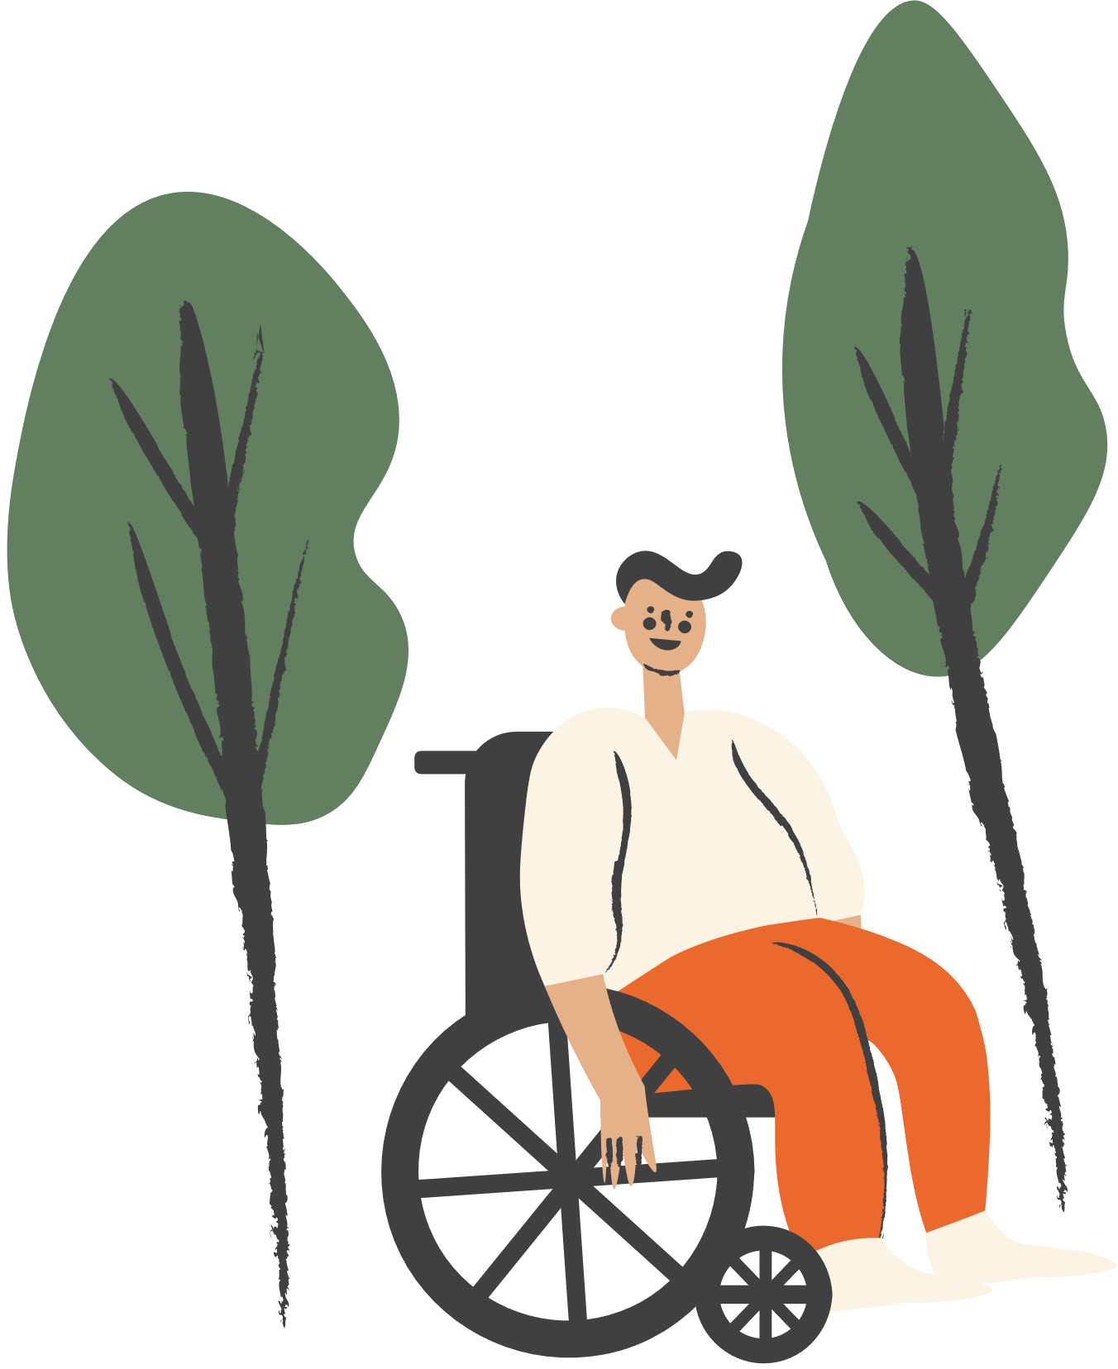
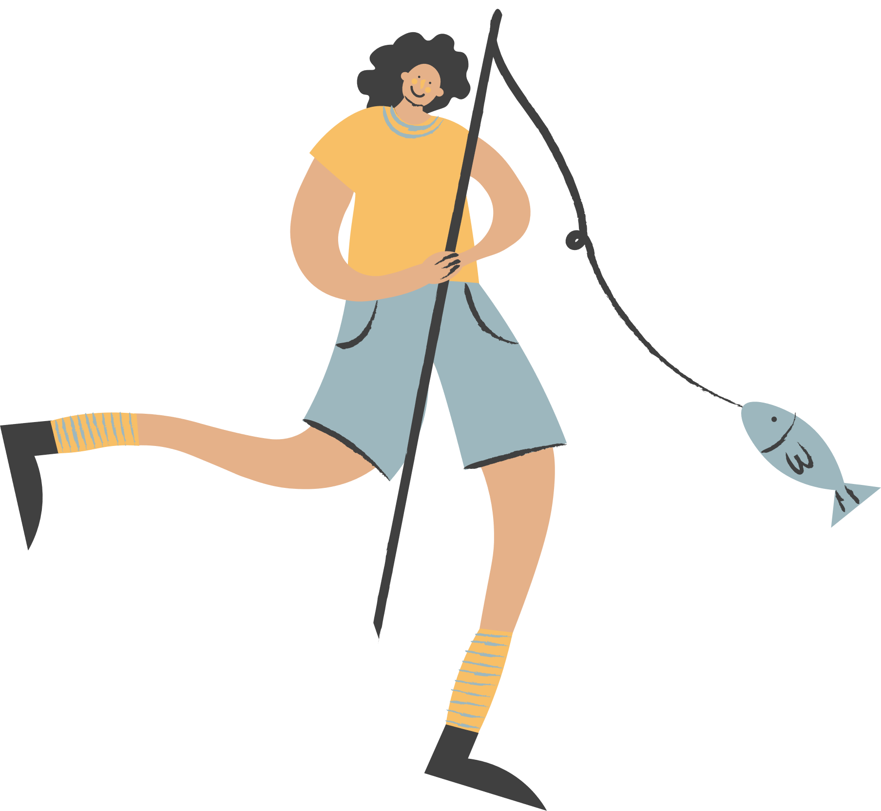


3. Read the text again and answer the questions.
1. What does Trang do with her family members at the weekend?
2. Who looks for recipes when Trang and her brother cook?
3. Which leisure activity does she love the most?
4. What does Trang’s mum teach her to do?
5. What did she win?

Slide 17

3. Read the text again and answer the questions.
Some teenagers enjoy spending free time with their friends. Others prefer doing leisure activities with their family members. I love spending time with my family because it’s a great way to connect with them.
At the weekend, we usually go for a bike ride. We cycle to some nearby villages to enjoy the fresh air. We take photos and look at them later. My big brother and I are also into cooking. My brother looks for easy recipes. After that, we prepare the ingredients and cook. Sometimes, the food is good, but sometimes it isn’t; nevertheless, we love whatever we cook. The leisure activity I like the most is doing DIY projects with my mum. She teaches me to make my own dresses and doll clothes. On special occasions, we make special dresses together. Once I won the first prize in a costume contest at my school.
1. What does Trang do with her family members at the weekend?
She goes for a bike ride, cooks, and does DIY projects.

Slide 18
3. Read the text again and answer the questions.
Some teenagers enjoy spending free time with their friends. Others prefer doing leisure activities with their family members. I love spending time with my family because it’s a great way to connect with them.
At the weekend, we usually go for a bike ride. We cycle to some nearby villages to enjoy the fresh air. We take photos and look at them later. My big brother and I are also into cooking. My brother looks for easy recipes. After that, we prepare the ingredients and cook. Sometimes, the food is good, but sometimes it isn’t; nevertheless, we love whatever we cook. The leisure activity I like the most is doing DIY projects with my mum. She teaches me to make my own dresses and doll clothes. On special occasions, we make special dresses together. Once I won the first prize in a costume contest at my school.
2. Who looks for recipes when Trang and her brother cook?
Her brother does.

Slide 19
3. Read the text again and answer the questions.
Some teenagers enjoy spending free time with their friends. Others prefer doing leisure activities with their family members. I love spending time with my family because it’s a great way to connect with them.
At the weekend, we usually go for a bike ride. We cycle to some nearby villages to enjoy the fresh air. We take photos and look at them later. My big brother and I are also into cooking. My brother looks for easy recipes. After that, we prepare the ingredients and cook. Sometimes, the food is good, but sometimes it isn’t; nevertheless, we love whatever we cook. The leisure activity I like the most is doing DIY projects with my mum. She teaches me to make my own dresses and doll clothes. On special occasions, we make special dresses together. Once I won the first prize in a costume contest at my school.
3. Which leisure activity does she love the most?
She loves doing DIY projects with her mum the most.

Slide 20
3. Read the text again and answer the questions.
Some teenagers enjoy spending free time with their friends. Others prefer doing leisure activities with their family members. I love spending time with my family because it’s a great way to connect with them.
At the weekend, we usually go for a bike ride. We cycle to some nearby villages to enjoy the fresh air. We take photos and look at them later. My big brother and I are also into cooking. My brother looks for easy recipes. After that, we prepare the ingredients and cook. Sometimes, the food is good, but sometimes it isn’t; nevertheless, we love whatever we cook. The leisure activity I like the most is doing DIY projects with my mum. She teaches me to make my own dresses and doll clothes. On special occasions, we make special dresses together. Once I won the first prize in a costume contest at my school.
4. What does Trang’s mum teach her to do?
Her mum teaches her to make her own dresses and doll clothes.

Slide 21
3. Read the text again and answer the questions.
Some teenagers enjoy spending free time with their friends. Others prefer doing leisure activities with their family members. I love spending time with my family because it’s a great way to connect with them.
At the weekend, we usually go for a bike ride. We cycle to some nearby villages to enjoy the fresh air. We take photos and look at them later. My big brother and I are also into cooking. My brother looks for easy recipes. After that, we prepare the ingredients and cook. Sometimes, the food is good, but sometimes it isn’t; nevertheless, we love whatever we cook. The leisure activity I like the most is doing DIY projects with my mum. She teaches me to make my own dresses and doll clothes. On special occasions, we make special dresses together. Once I won the first prize in a costume contest at my school.
5. What did she win?
She won the first prize in a costume contest at her school.

Slide 22
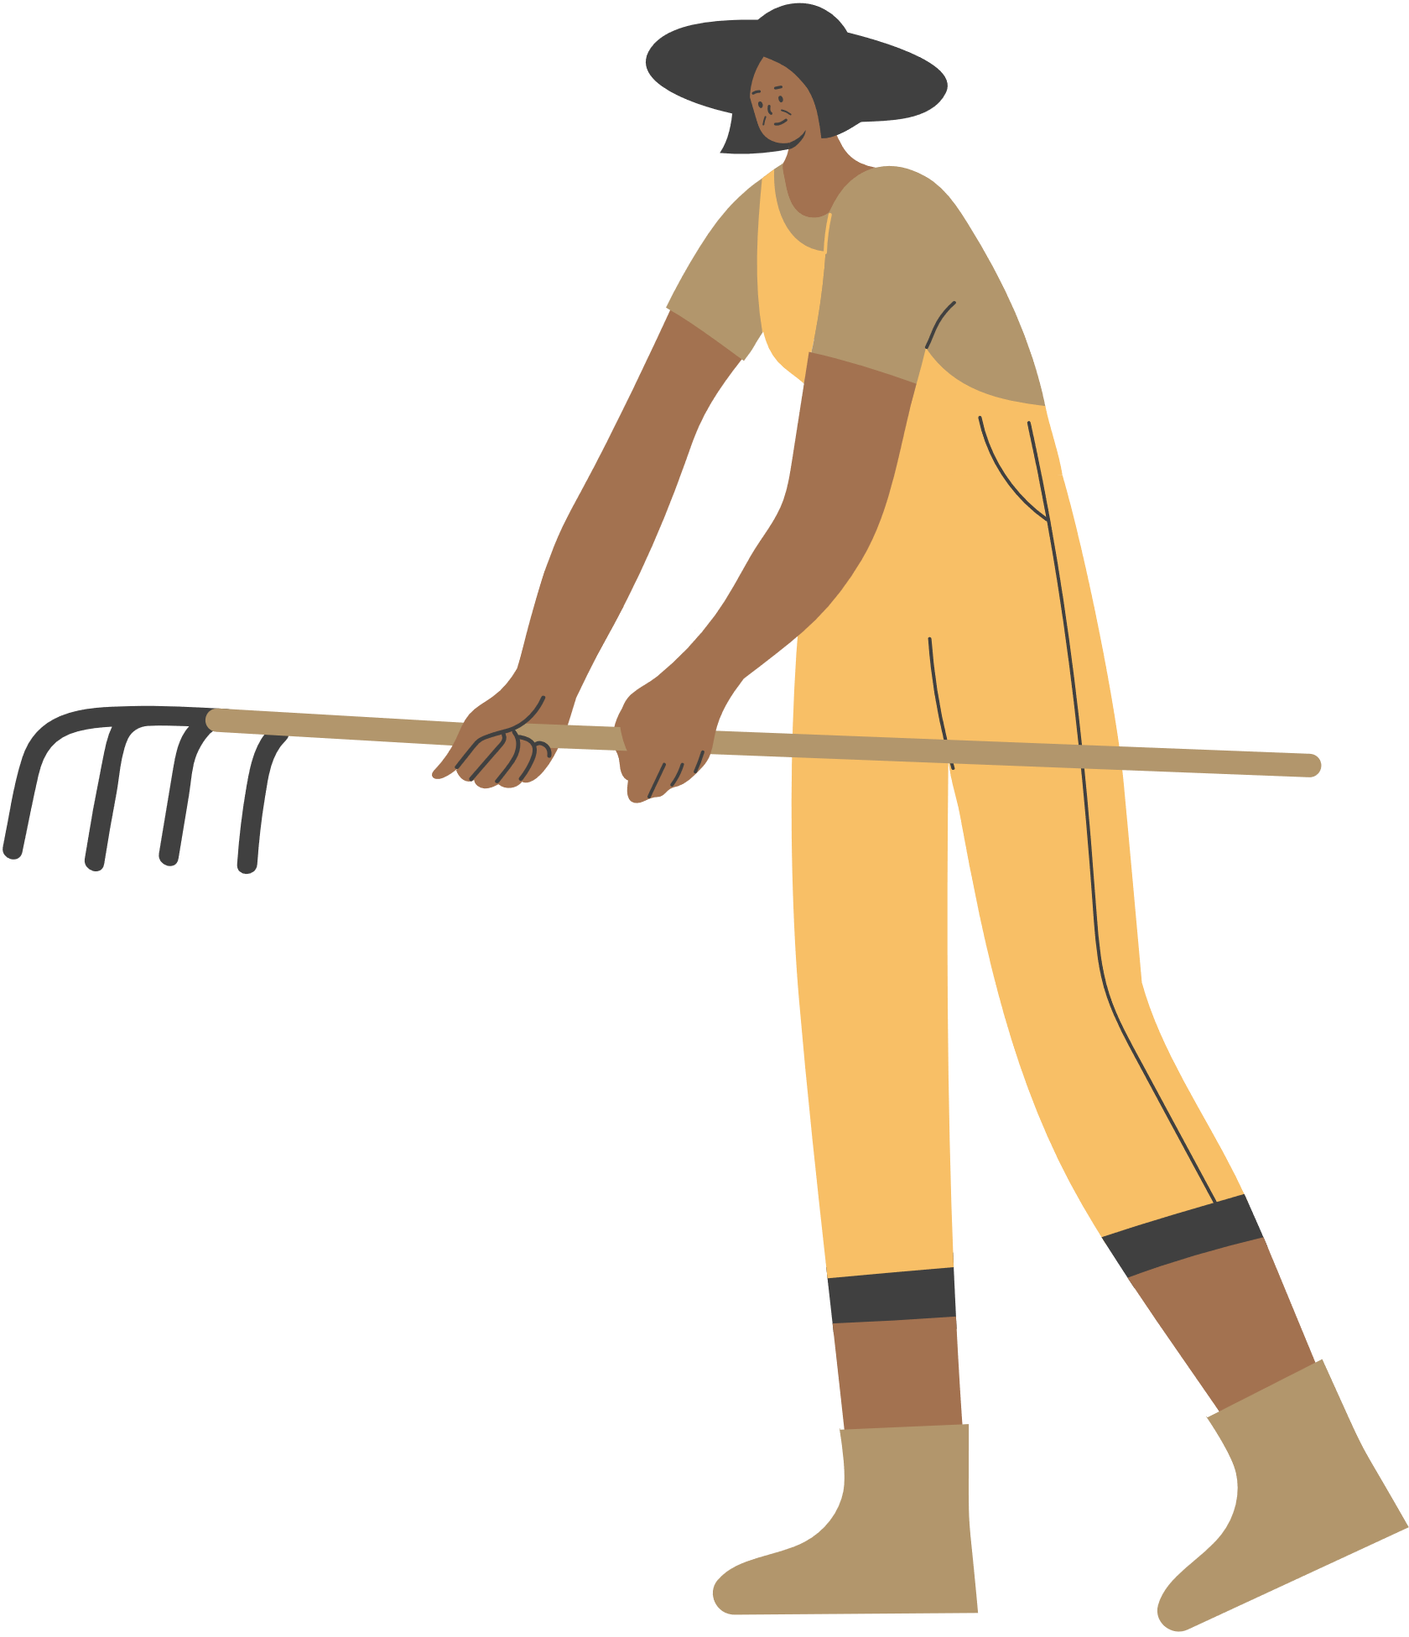
Look at the answer again.
1. She goes for a bike ride, cooks, and does DIY projects.
2. Her brother does.
3. She loves doing DIY projects with her mum the most.
4. Her mum teaches her to make her own dresses and doll clothes.
5. She won the first prize in a costume contest at her school.

Slide 23
SPEAKING

Slide 24
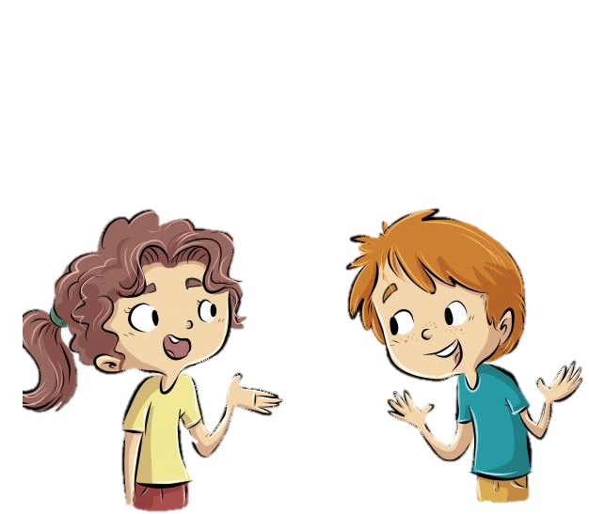
I usually play football, watch TV and cook meal with my family.
What leisure activities do you usually do with your family?
I like playing football with my father and my brother best. Because it helps me stronger.
Which one do you like the most? Why?
How do you feel when you spend time with your family member?
Oh, I feel very happy. I really enjoy the time I spend with my family.

Slide 25
4. Work in groups. Take turns to ask and answer the questions. Record your friends’ answer in the table below.
1. What leisure activities do you usually do with your family?
2. Which one do you like the most? Why?
3. How do you feel when you spend time with your family members?
Friends’ name | Questions 1 | Questions 2 | Questions 3

Slide 26
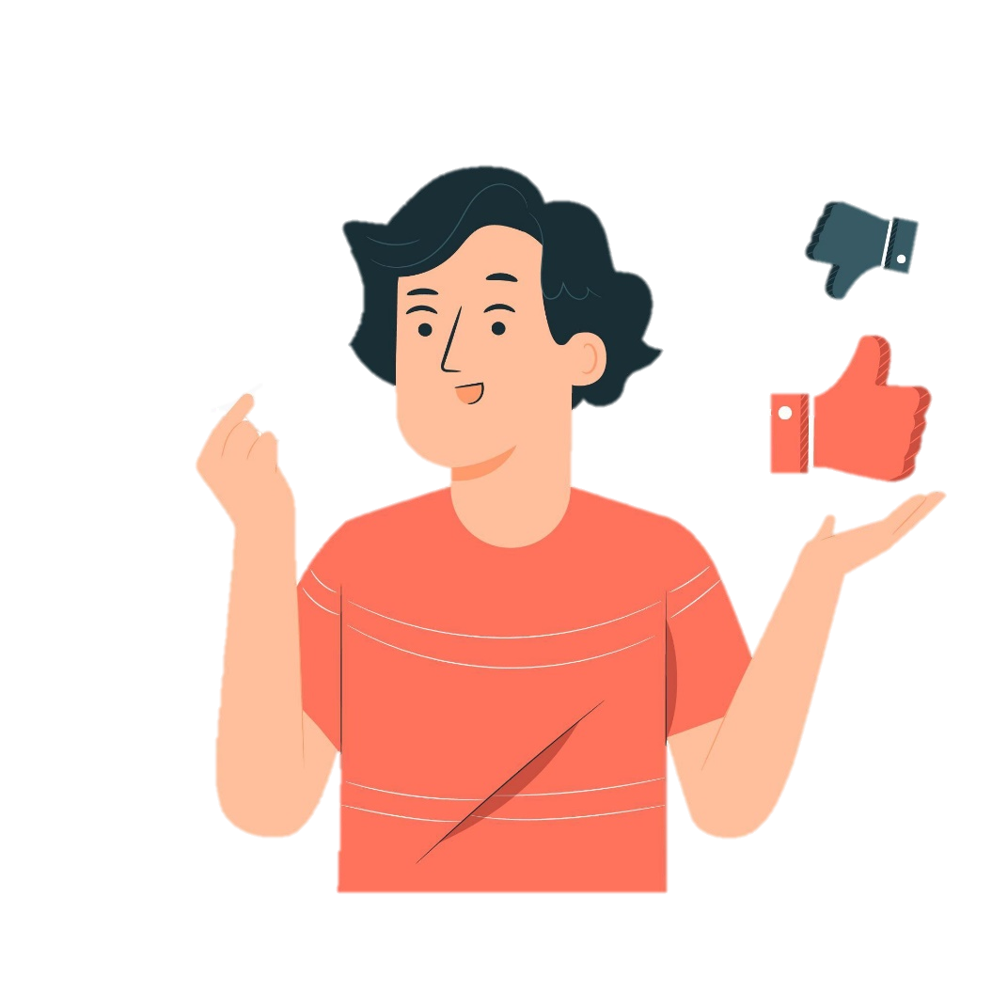
5. Report your group members’ answers to the class. What activities are the most common?
The most common activities is …………

Slide 27

Wrap-up
What have you learnt in this lesson?
read about teen’s leisure activities
talk about friends’ leisure activities

Slide 28
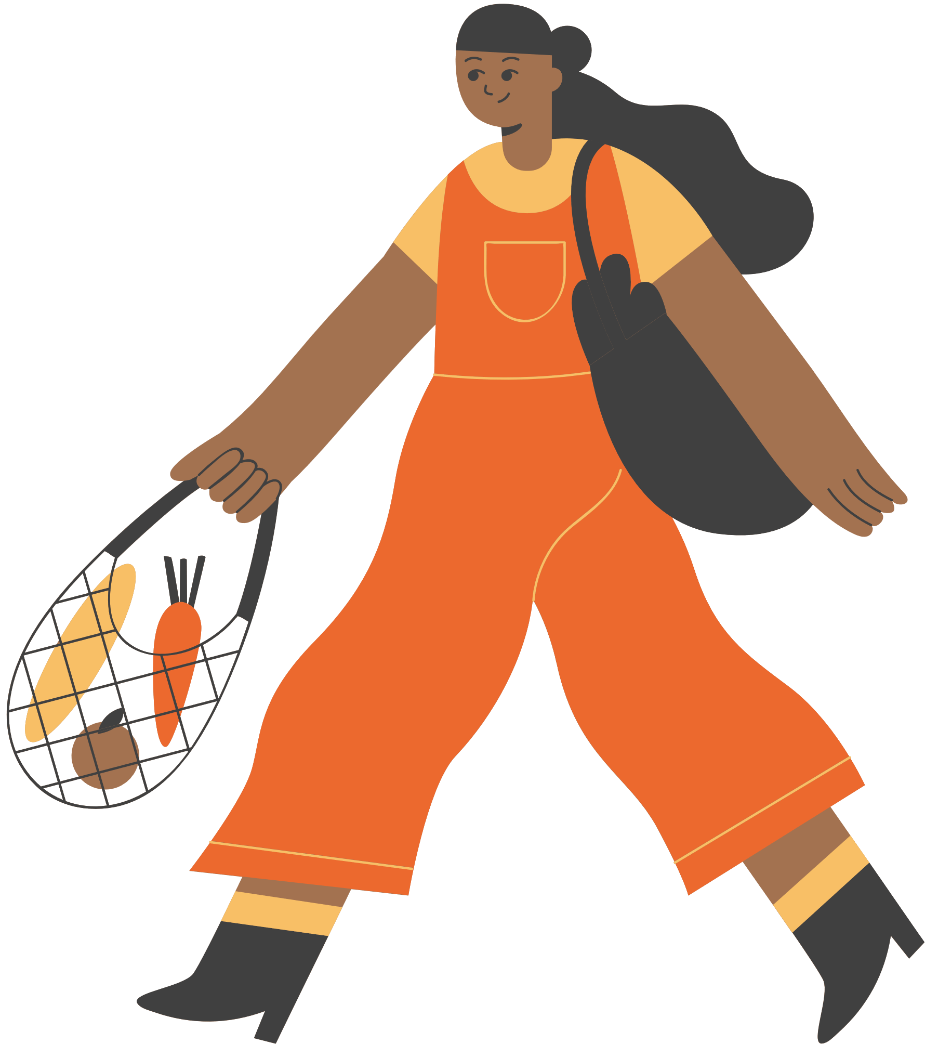
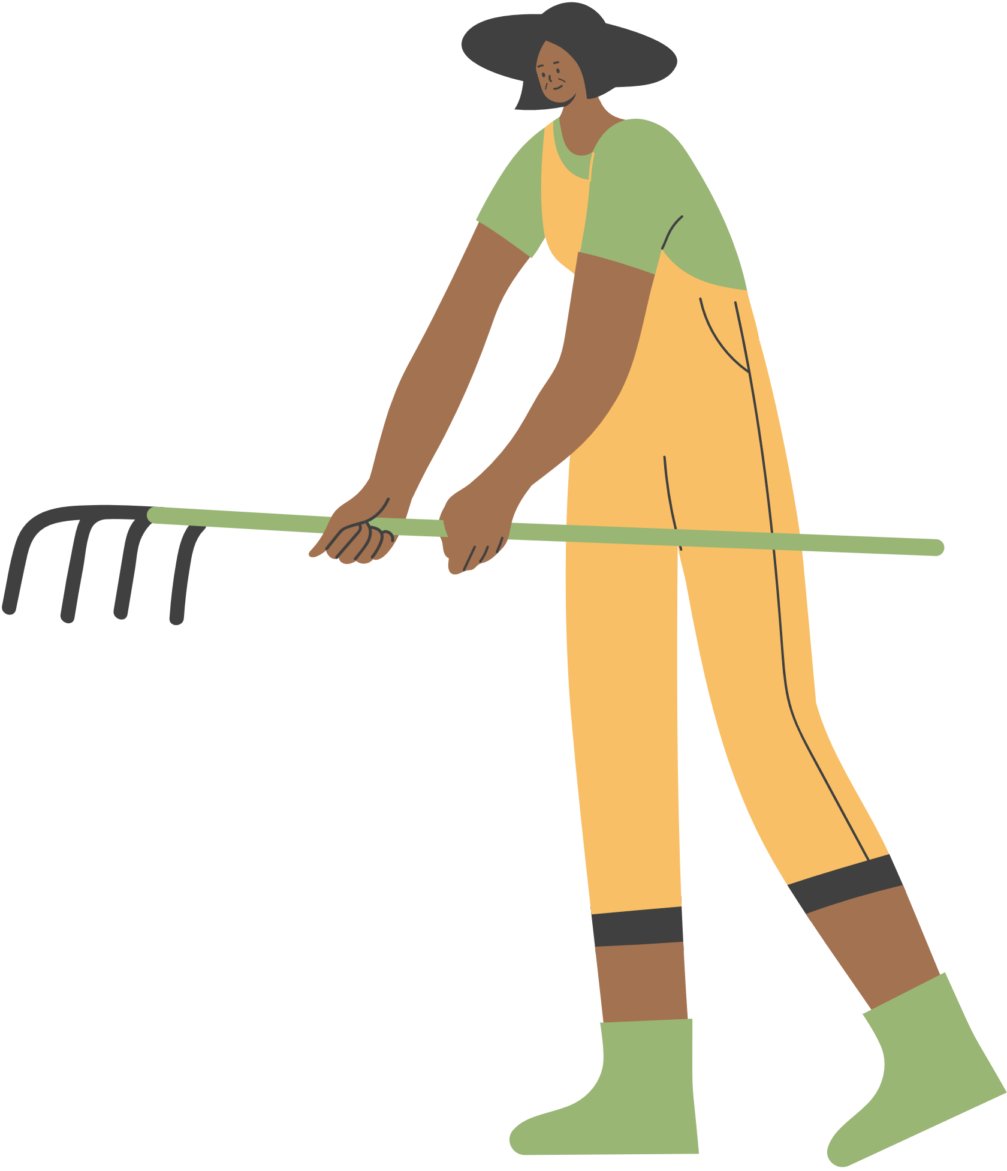

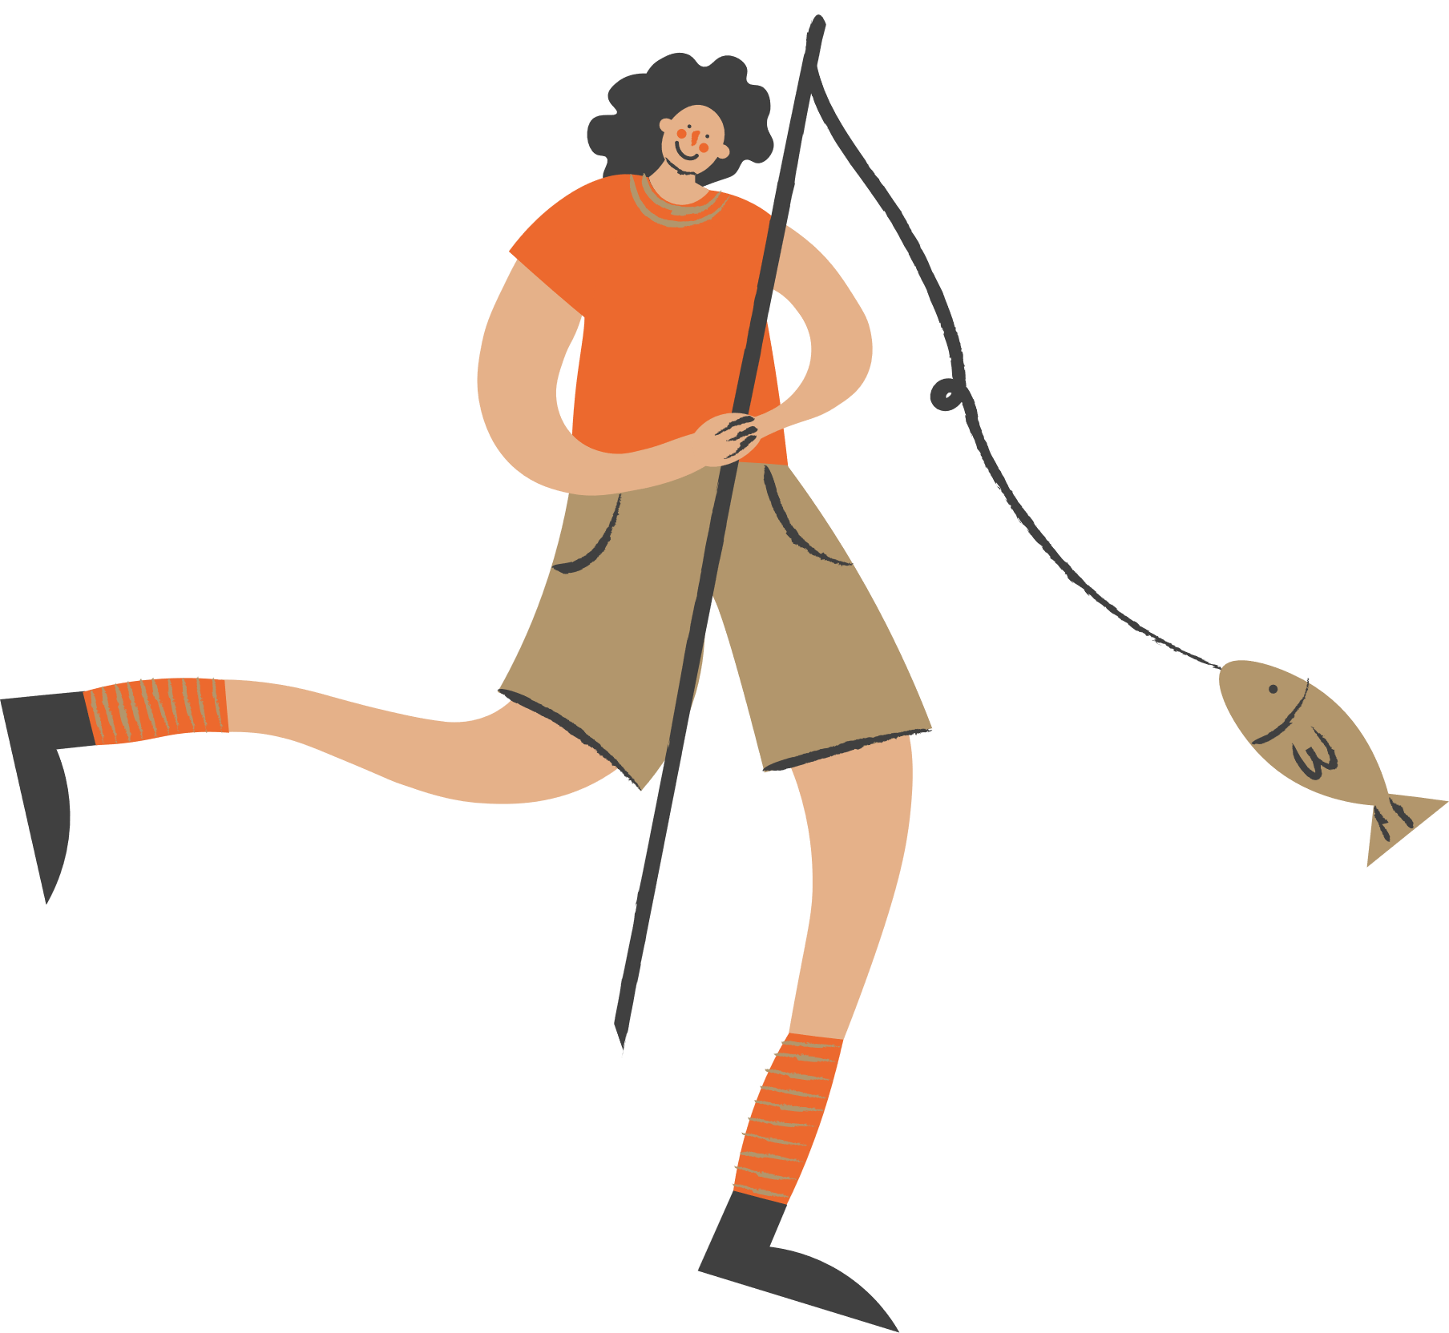
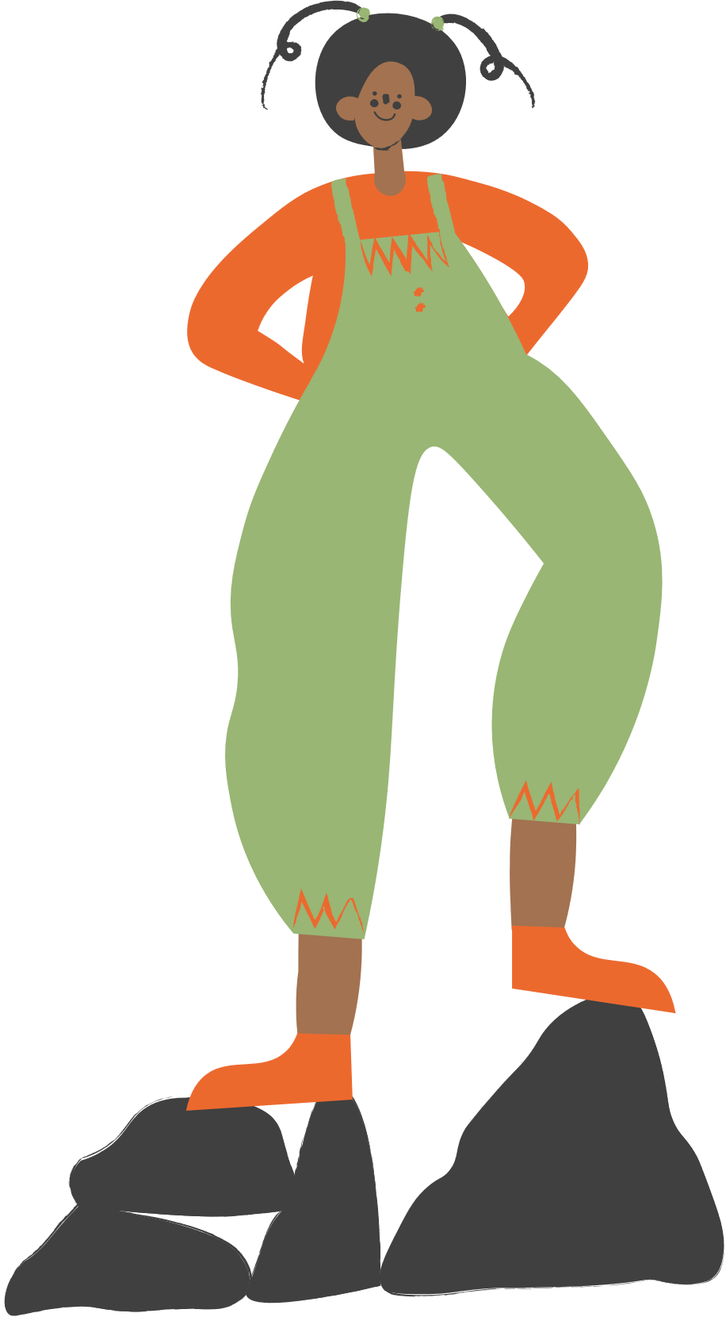
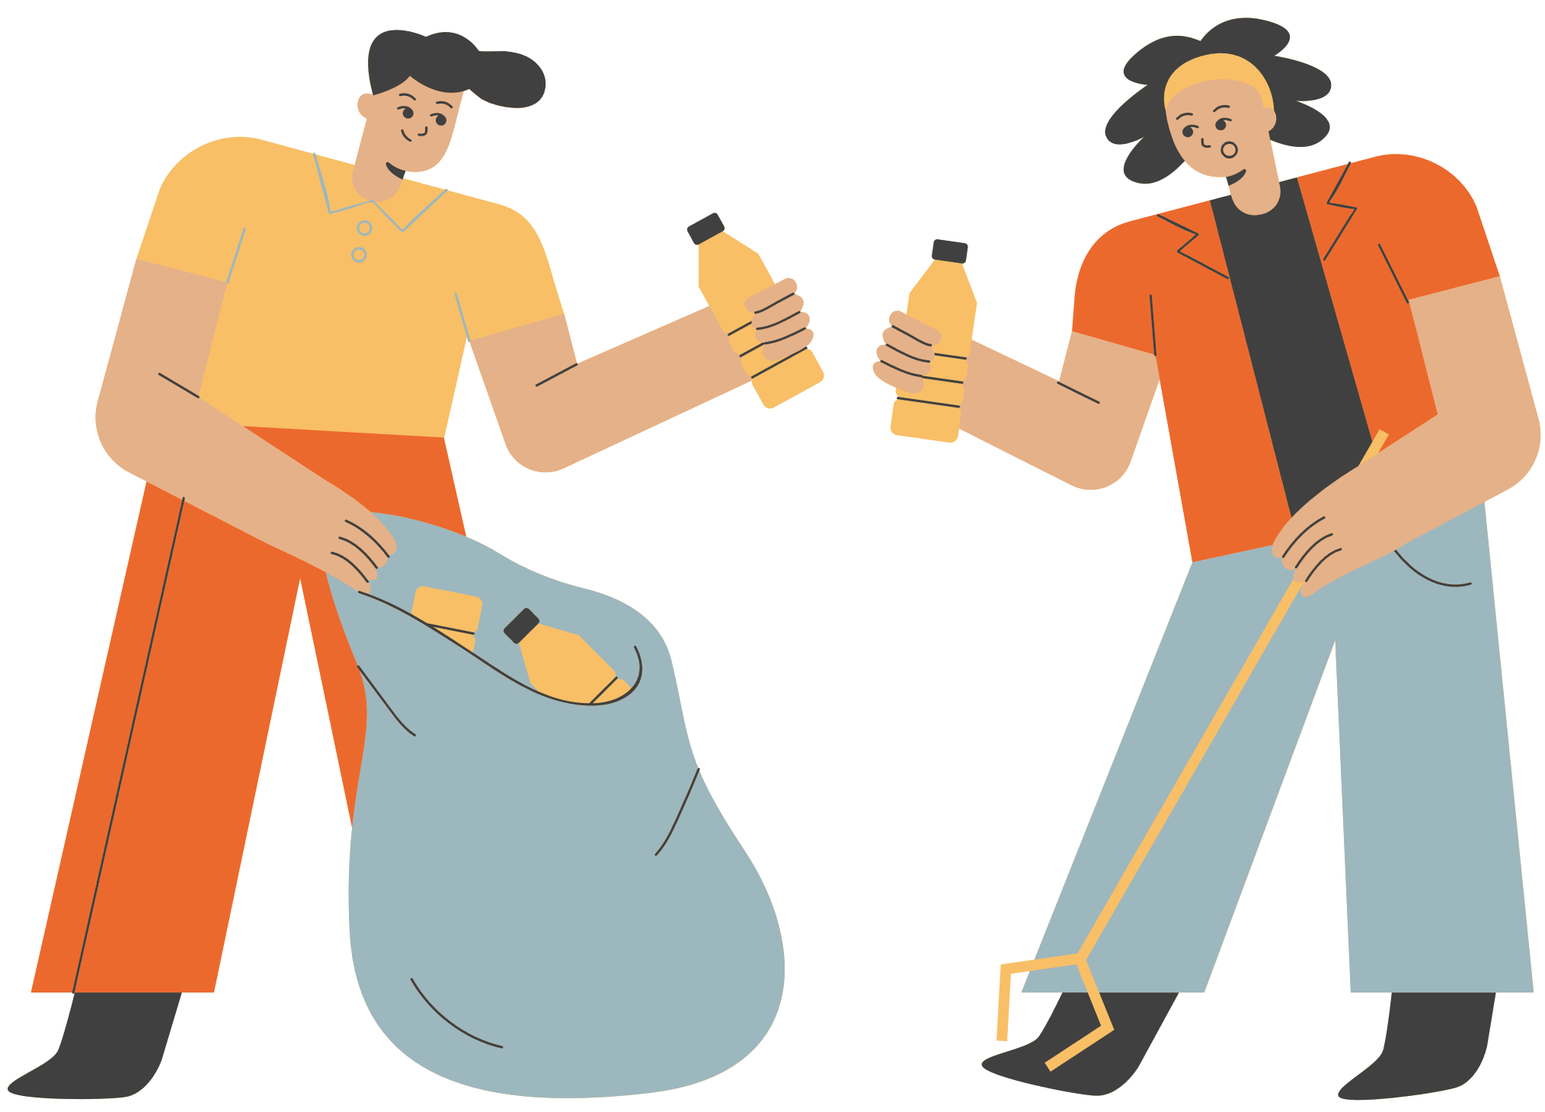
THANK YOU!

