Slide 1

……Secondary School
Teacher: ……

Slide 2









CHATTING
What do you like doing in your free time?
What do your friends like doing in their free time?
What do young people in Viet Nam often do in their free time?

Slide 3












Unit 1: LEISURE TIME
Lesson 4: Communication

Slide 4






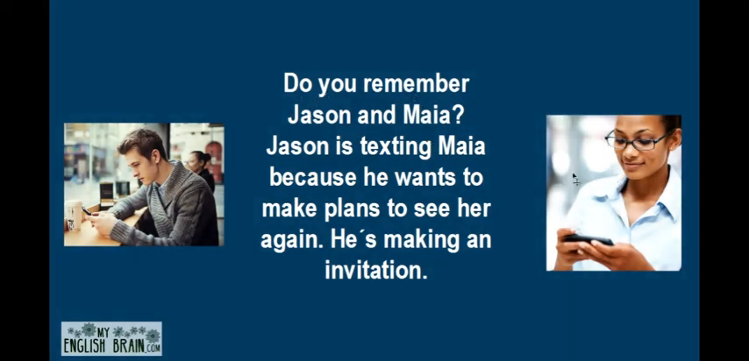




EVERYDAY ENGLISH

Slide 5






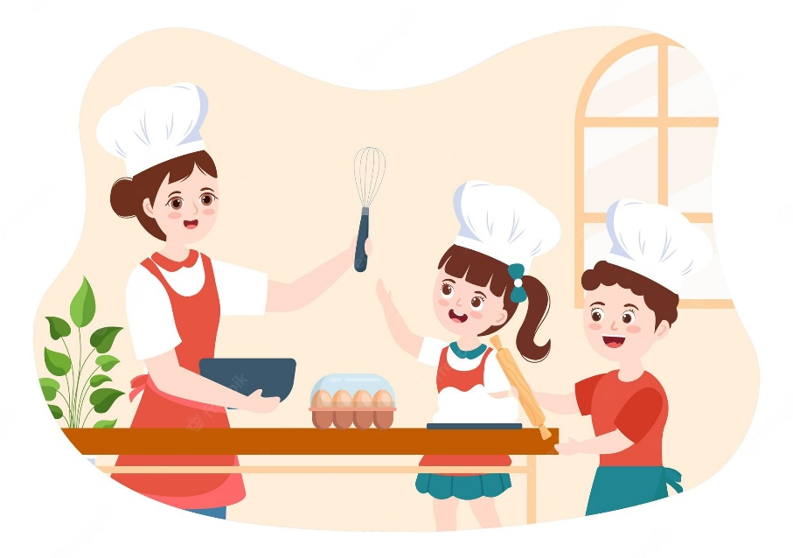





Listen and read the conversations.
Pay attention to the highlighted sentences.
Trang: Would you like to go to the
cooking club with me this Sunday?
Ann: I’d love to. Thanks.
Tom: Do you fancy going for a walk?
Mark: That’s great. Thanks.

Slide 6









Making invitation and accepting
Structures | Examples
How to invite | Would you like to… Do you fancy…
How to accept invitations | I’d love to. That’s great.

Slide 7







2. Work in pairs. Practice inviting and accepting invitations in the following situations. Remember to use the highlighted language in 1.
You invite your friend to play badminton.
You invite your friend to make paper flowers with you.
You invite your friend to try your home-made pizza.

Slide 8






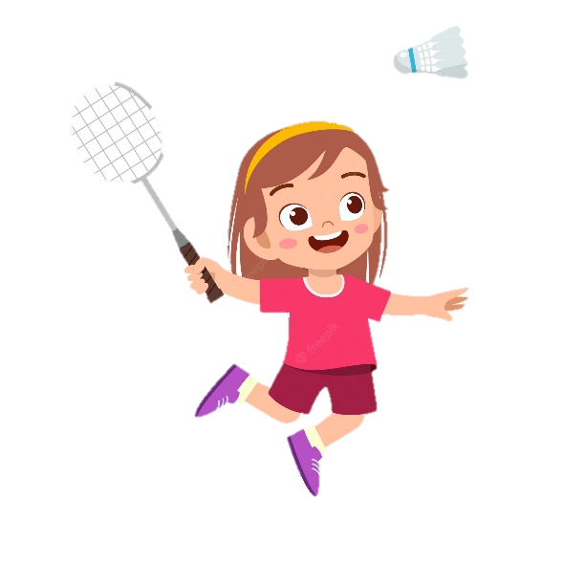



You invite your friend to play badminton.

Slide 9

You invite your friend to make paper flowers with you.

Slide 10
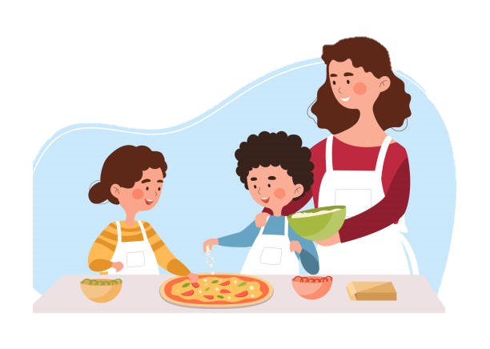
You invite your friend to try your home-made pizza.

Slide 11










TEEN’S LEISURE ACTIVITIES AROUND THE WORLD

Slide 12





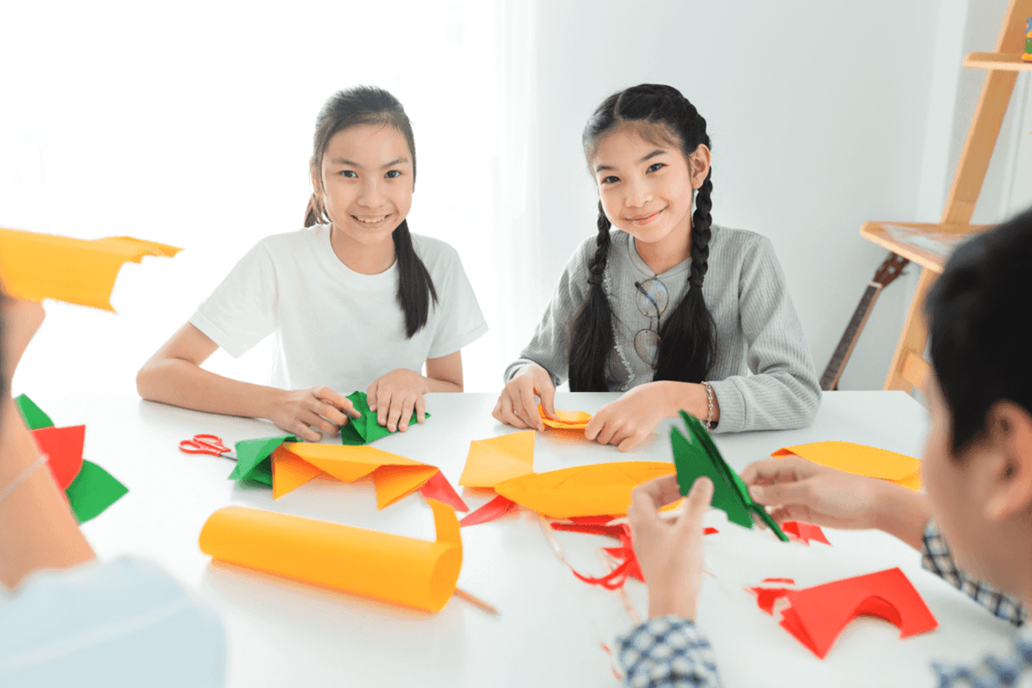
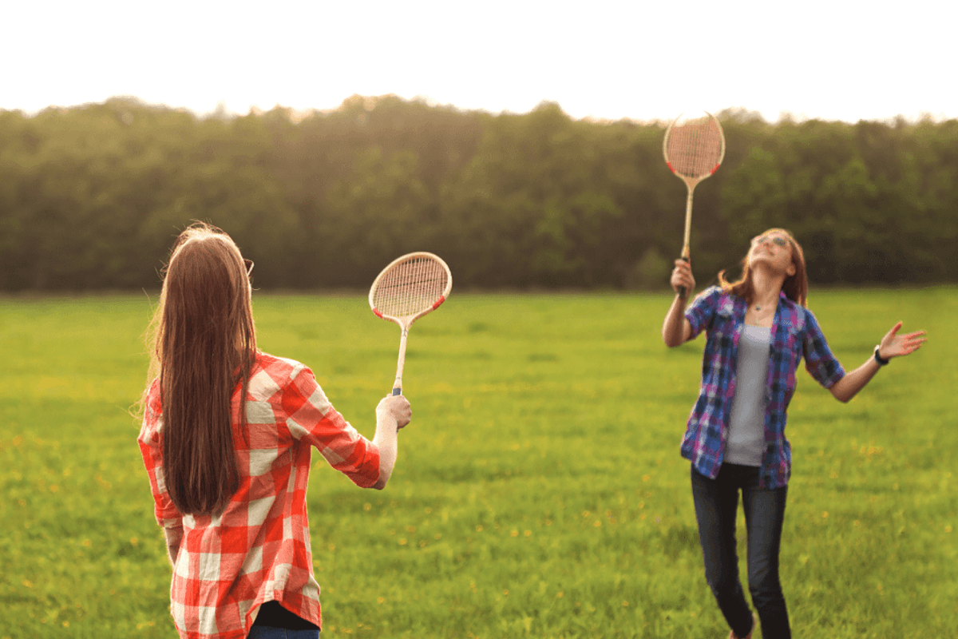
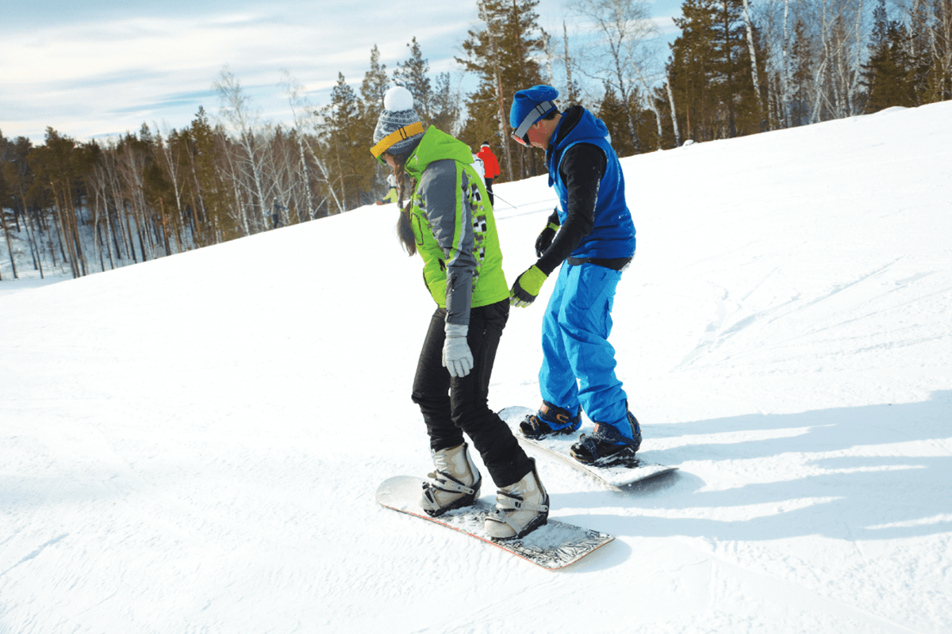

3. Work in pairs. Answer the question.
What is the activity in each picture?
doing origami
playing badminton
snowboarding

Slide 13







4. Read what three teenagers say about their leisure activities. Complete the table with the information from the text.
Name | Country | Leisure activity | Person / People to do the activity with | Benefits of the activity
Sakura | Japan
Eric | Switzerland
Lan | Viet Nam
helps her to relax
doing origami
no one
improves his overall health and balance
snowboarding
parents
- improves her muscle strength
- reduces stress
playing badminton
best friend

Slide 14
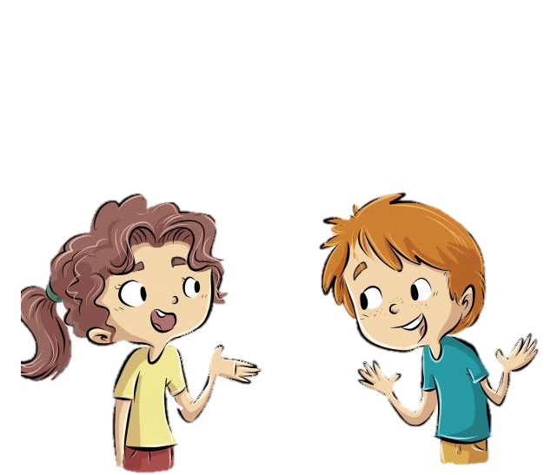
Which of the activities in 4 do you want to try?.
I would like to try snowboarding.
Because it can improve my overall health and balance.
Why do you want to try it?

Slide 15







5. Work in groups. Ask and answer the questions.
Which of the activities in 4 do you want to try?
Why do you want to try it?
Report your group’s answer to the class.

Slide 16


THANK YOU!

