Slide 1



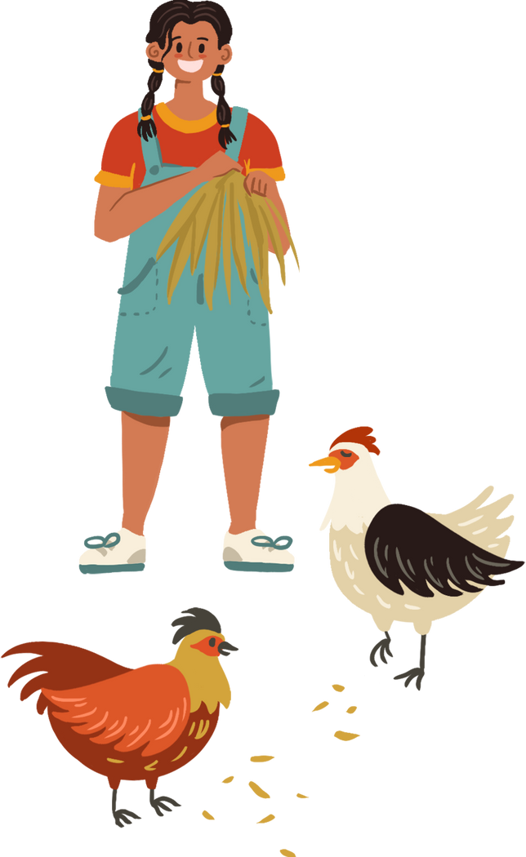




WELCOME TO OUR CLASS
Teacher:….

Slide 2


Match a word/ phrase in column A with a word in column B to make expressions about likes.
A
B
1. be fond
a. about
MATCHING GAME
2. be keen
b. in
3. be interested
c. on
4. be crazy
d. into
5. be
e. of

Slide 3
Match a word/ phrase in column A with a word in column B to make expressions about likes.
A
B
1. be fond
a. about
2. be keen
b. in
3. be interested
c. on
4. be crazy
d. into
5. be
e. of

Slide 4

be fond of
be keen on
How to express “likes”
be into
be crazy about
be interested in

Slide 5
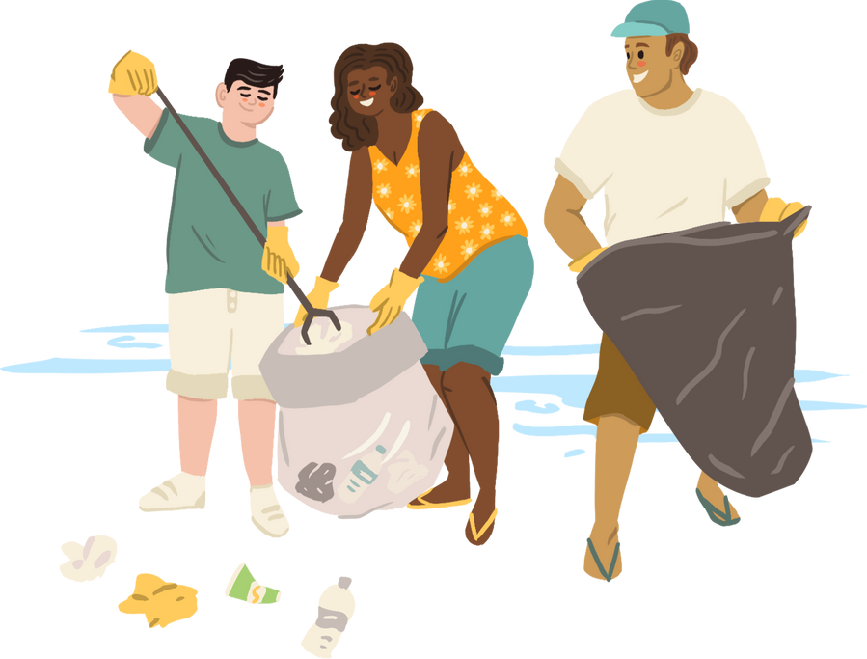
VOCABULARY
New words | Pronunciation | Meaning
1. be interested in | /biː ɪntrəstɪd ɪn/ | hứng thú với
2. be fond of | /biː fɒnd əv/ | thích
3. be keen on | /biː kiːn ɒn/ | quan tâm đến
4. be crazy about | /biː ˈkreɪzi əˈbaʊt/ | say mê
5. be into | /biː ˈɪntuː/ | thích

Slide 6

4. Listen and repeat the words. Pay attention to the sound /ʊ/and /u:/. Then put the words into the correct columns.
cook group push June
school would woman move
/ʊ/ | /u:/
cook
group
push
June
would
school
woman
move

Slide 7

5. Listen and practice the sentences. Underline the bold words with /ʊ/ and circle the bold words with /u:/
She likes reading books and swimming in the pool.
When it is cool, we like to play football.
She drew and made puddings in her free time.
My mum loves pumpkin soup and coffee with a little sugar.
My brother is fond of watching the cartoon about a clever wolf.

Slide 8
THANKS
HOMEWORK
Learn by heart vocabulary
Practice the sound /ʊ/and /u:/
Prepare: Unit 1 - A Closer Look 2

