Slide 1


ENGLISH 8
Hello everyone !!!

Slide 2

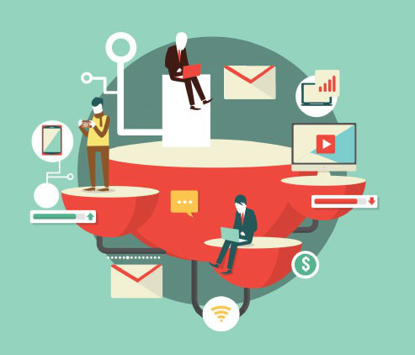
* WARM-UP
BRAINSTORMING
Name the technological applications your school uses.
Work in groups

Slide 3




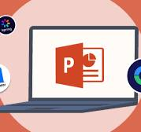

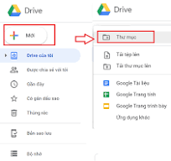


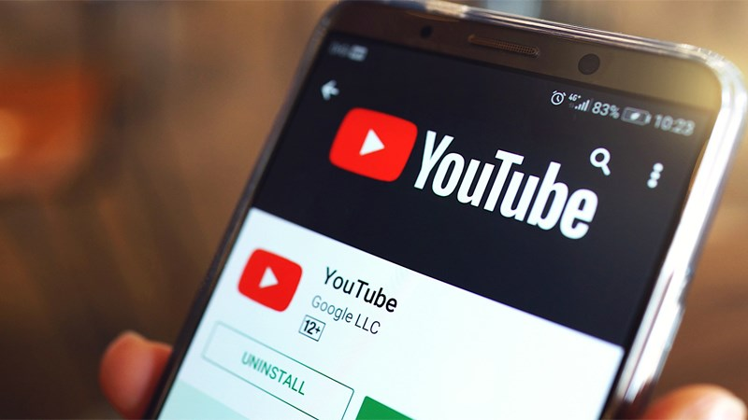
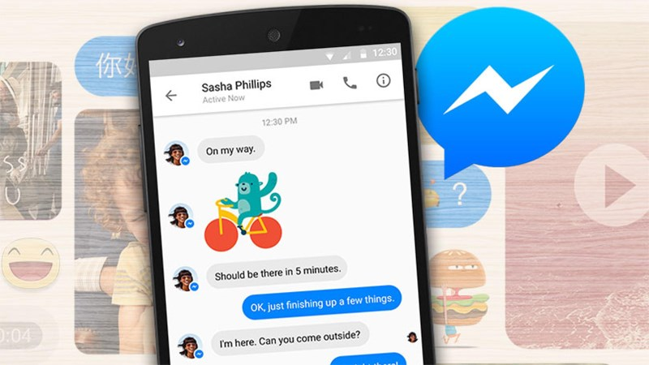


Slide 4

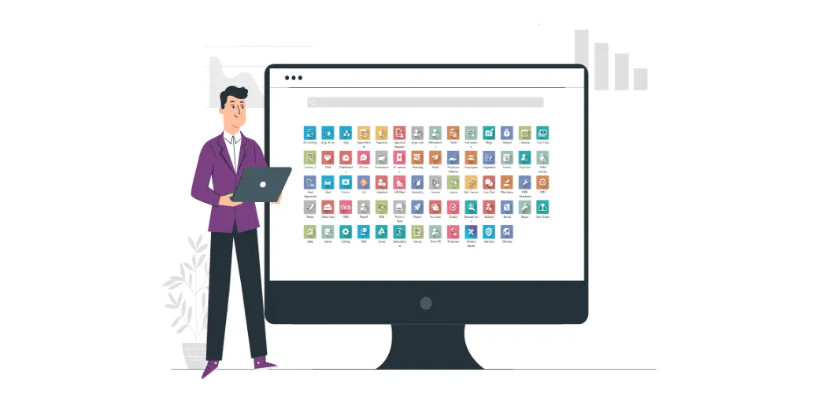
Unit
11
SCIENCE AND TECHNOLOGY
LESSON 5: SKILLS 1

Slide 5
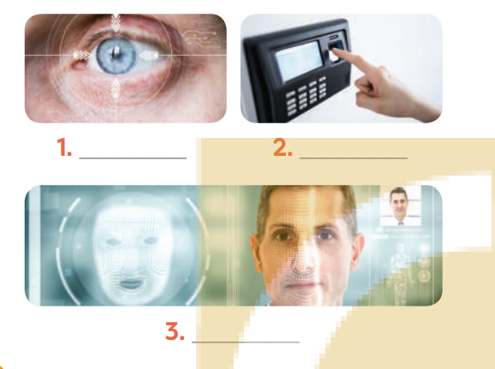
I. READING
1
Work in pairs. Name the technological applications in the pictures. Can they be used in schools?
2
1
eye-tracking
fingerprint scanner
3
face recognition

Slide 6

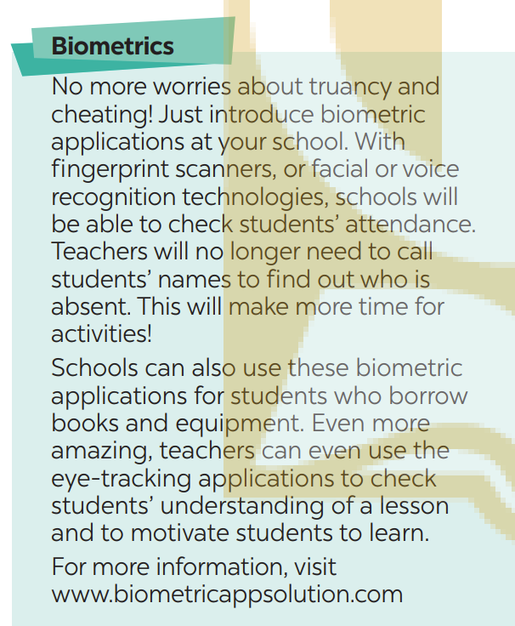
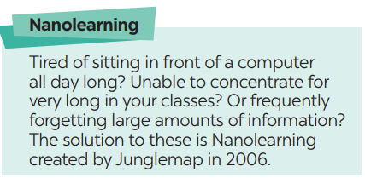
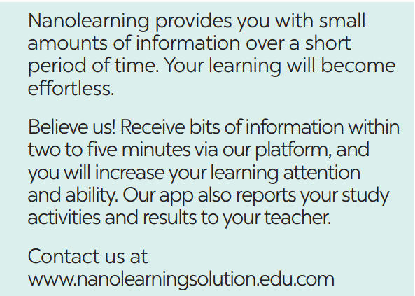
I. READING
Read the passage and pay attention to the underlined words and guess their meaning.

Slide 7
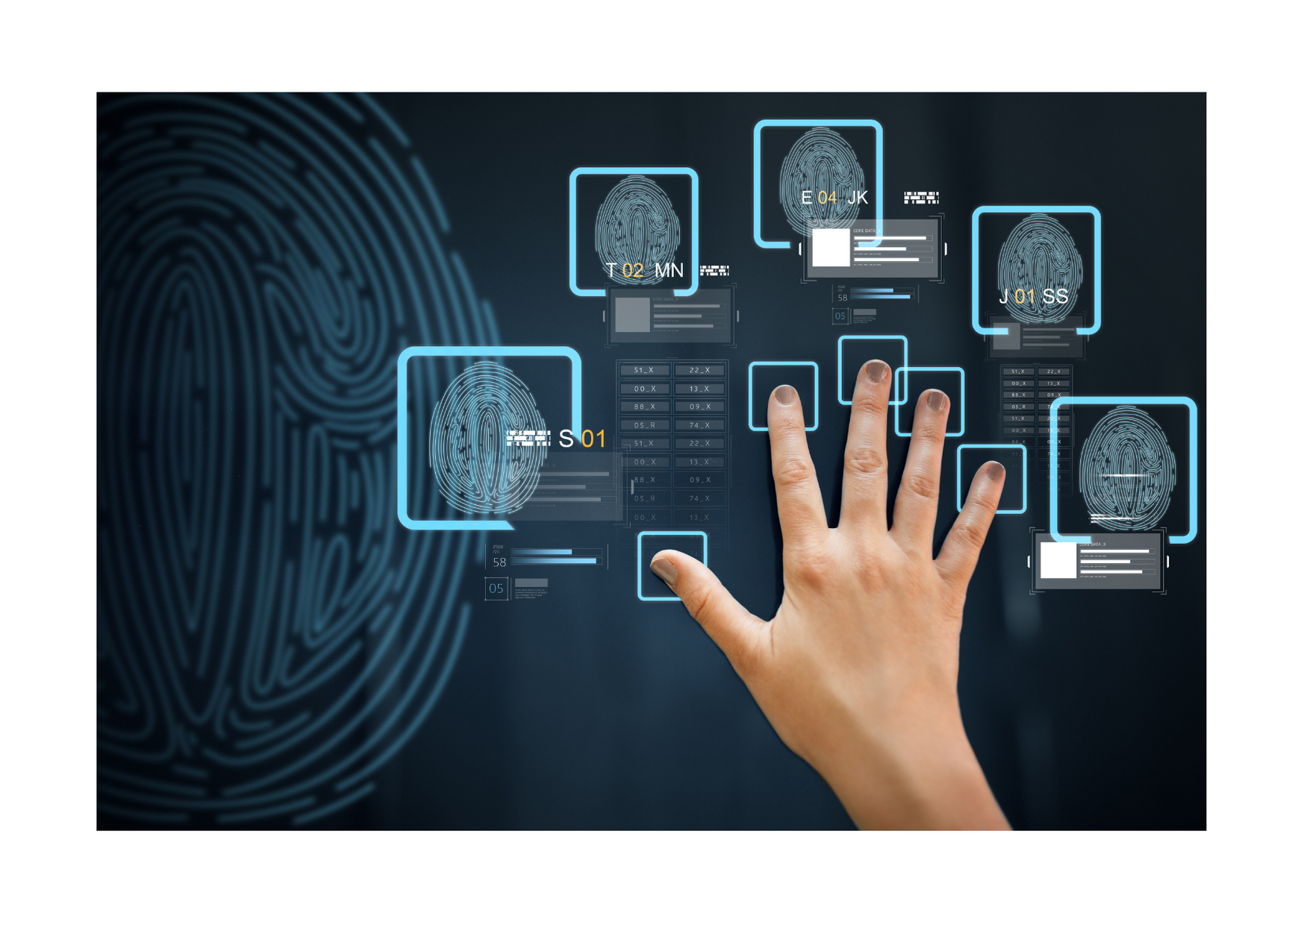
* VOCABULARY
biometrics (n)
/ˌbaɪəʊˈmetrɪks/
Khoa học sinh trắc

Slide 8
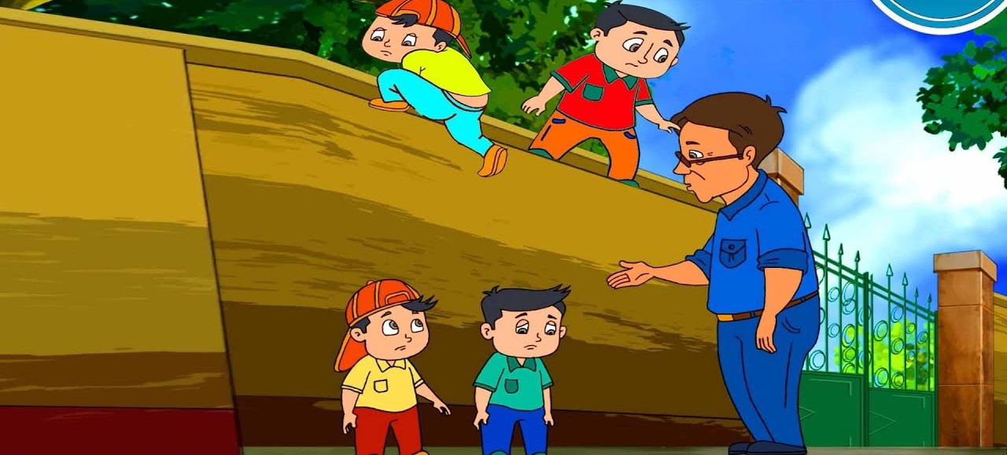
* VOCABULARY
truancy (v)
/ˈtruːənsi/
Trốn học, nghỉ học không phép

Slide 9
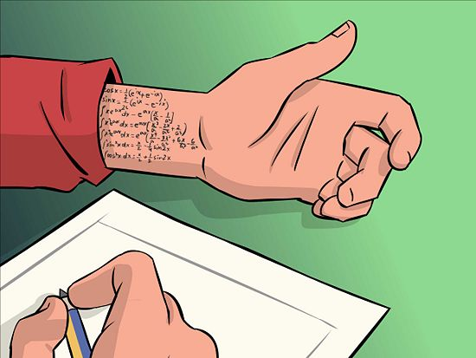
* VOCABULARY
cheating (n)
/tʃiːtɪŋ/
Gian lận

Slide 10

* VOCABULARY
Nanolearning(n)
/’nænəʊlɜːnɪŋ/
Một chương trình cho phép người tham gia học một chủ đề nhất định trong thời gian từ 2-10 phút thông qua việc sử dụng phương tiện điện tử và không tương tác với người hướng dẫn trong thời gian thực.

Slide 11

* VOCABULARY
effortless (adj)
/ˈefətləs/
Không cần (nhiều) nỗ lực

Slide 12
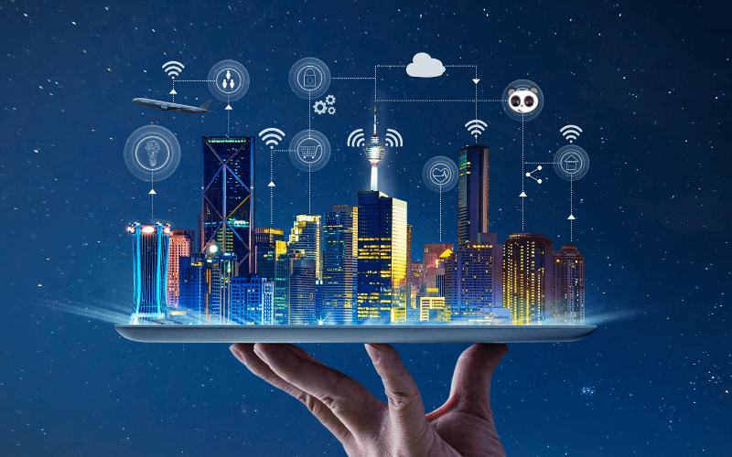
* VOCABULARY
platform(n)
/ˈplætfɔːm/
Nền tảng

Slide 13
* VOCABULARY
New words | Pronunciation | Meaning
1. biometrics (n) | /ˌbaɪəʊˈmetrɪks/ | Khoa học sinh trắc
2. truancy (n) | /ˈtruːənsi/ | Trốn học, nghỉ học không phép
3. Nanolearning (n) | /’nænəʊlɜːnɪŋ/ | Dạy học với bài dạy kích thước nhỏ
4. effortless(adj) | /ˈefətləs/ | Không cần nhiều nỗ lực
5. platform(v) |  | Nền tảng
6. cheating (n) | /tʃiːtɪŋ/ | Gian lận

Slide 14
* Checking vocab
New words | Meaning
1. | Khoa học sinh trắc
2. | Trốn học, nghỉ học không phép
3. | Dạy học với bài dạy kích thước nhỏ
4. | Không cần nhiều nỗ lực
5. | Nền tảng
6. | Gian lận
biometrics (n)
truancy (n)
Nanolearning (n)
effortless(adj)
platform(v)
cheating (n)

Slide 15
I. READING
2
Read the passage and tick (v) B (Biometrics) or N (Nanolearning)

Slide 16

I. READING
2
Read the passage and tick B (Biometrics) or N (Nanolearning)
Benefits | B | N
1. It makes learning effortless.
2. It checks students’ understanding of the lessons.
3. Students use it when they borrow books and equipment.
4. It helps increase students’ learning attention.
5. It records students’ study activities and result.

Slide 17
* PRACTICE
3
Read the passage and choose the correct answer A, B, or C.
1. What does checking students’ attendance mean?
A. Checking their presence B. Scanning their faces C. Checking their fingerprints
2. With Nanolearning students can______.
access large amounts of information
improve their learning quality
Concentrate longer
3. What DOESN’T Nanolearning do?
Provide platform B. Report students’ results C. entertain students
4. The texts are from______.
A. Science books B. advertisements C. manuals

Slide 18
3
Read the passage and choose the correct answer A, B, or C.
1. What does checking students’ attendance mean?
A. Checking their presence B. Scanning their faces C. Checking their fingerprints
No more worries about truancy and cheating! Just introduce biometric applications at your school. With fingerprint scanners, or facial voice recognition technologies, schools will be able to check students’ attendance. Teachers will no longer need to call students’ names to find out who is absent. This will make more time for activities.

Slide 19
3
Read the passage and choose the correct answer A, B, or C.
2. With Nanolearning students can______.
access large amounts of information
improve their learning quality
Concentrate longer
Believe us! Receive bits of information within two to five minutes via our platform, and you will increase your learning attention and ability. Our app also reports your study activities and results to your teacher.

Slide 20
3
Read the passage and choose the correct answer A, B, or C.
3. What DOESN’T Nanolearning do?
Provide platform B. Report students’ results C. entertain students
Believe us! Receive bits of information within two to five minutes via our platform, and you will increase your learning attention and ability. Our app also reports your study activities and results to your teacher.

Slide 21
3
Read the passage and choose the correct answer A, B, or C.
4. The texts are from______.
A. Science books B. advertisements C. manuals
Believe us! Receive bits of information within two to five minutes via our platform, and you will increase your learning attention and ability. Our app also reports your study activities and results to your teacher.
Contact us at.
www.nanolearningsolution.edu.com

Slide 22
3
Read the passage and choose the correct answer A, B, or C.
1. What does checking students’ attendance mean?
A. Checking their presence B. Scanning their faces C. Checking their fingerprints
2. With Nanolearning students can______.
access large amounts of information
improve their learning quality
Concentrate longer
3. What DOESN’T Nanolearning do?
Provide platform B. Report students’ results C. entertain students
4. The texts are from______.
A. Science books B. advertisements C. manuals

Slide 23
II. SPEAKING
4
Work in pairs. Discuss and match the questions in A with the answers in B, and then make a conversation about an invention.
A | B
What invention? Who invented it? When invented? What benefit? | Alphonse Bertillon Check identities of people at airports or offices. Biometrics 1800s Check students’ attendance

Slide 24
4
Work in pairs. Discuss and match the questions in A with the answers in B, and then make a conversation about an invention.
A | B
What invention? Who invented it? When invented? What benefits? | Alphonse Bertillon Check identities of people at airports or offices. Biometrics 1800s Check students’ attendance
A: What technology do you like?
B: I like ____________________
A: Who invented it?
B: ________________________
A: When did he invent it?
B: In ______________________
A: How can it help us?
B: It can help us________________

Slide 25
4
Work in pairs. Discuss and match the questions in A with the answers in B, and then make a conversation about an invention.
A: What invention do you like?
B:
A: Who invented it?
B:
A: When did biometrics invented?
B:
A: What are the benefits of biometrics?
B:
I like biometrics.
Alphonse Bertillon.
Biometrics invented in 1800s.
Check identities of people at airports or offices and check students attendance.

Slide 26

5
Work in groups. Ask and answer questions about a technology or an invention. Use the example in 4 as a cue. Then report your answers to the class.
Example:
Mi likes biometrics. Alphonse Bertillon invented it in 1800s. It is a very important technology. We use it to …
Mi likes biometrics. Alphonse Bertillon invented it in 1800s. It is a very important technology. We use it to check the identities of people at airports or offices and check students attendance.

Slide 27

* CONSOLIDATION
What have we learnt in this lesson?
Some new technologies that are applied at schools
Information about some inventions or technologies

Slide 28

* Homework
Learn the new words by heart.
Do Exercises in the Workbook

Slide 29



Slide 30
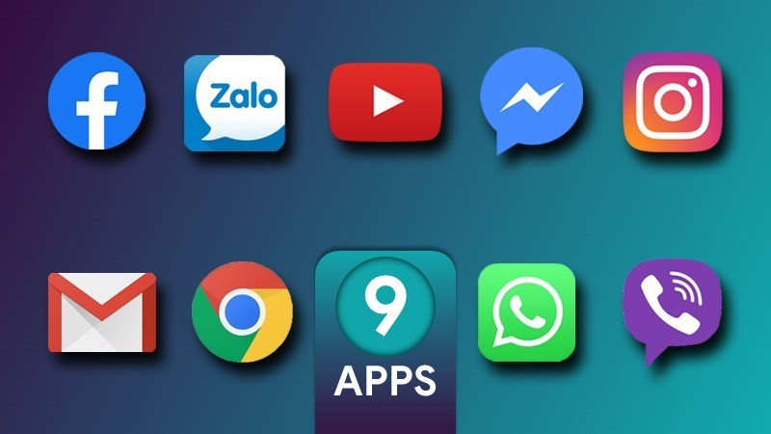
Ứng dụng xây dựng bài giảng

