Slide 1
UNIT 8: FILMS
Lesson 6: Skills 2

Slide 2
OBJECTIVES
LISTENING
WRITING
After this lesson, students will be able to
listen for specific information about a film
write a paragraph about one's favourite film.
Notes:
;

Slide 3
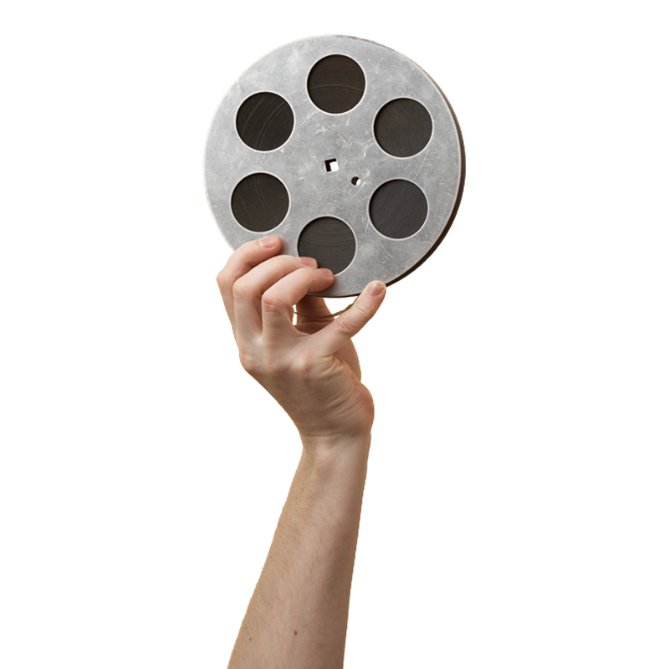
01
LISTENING

Slide 4
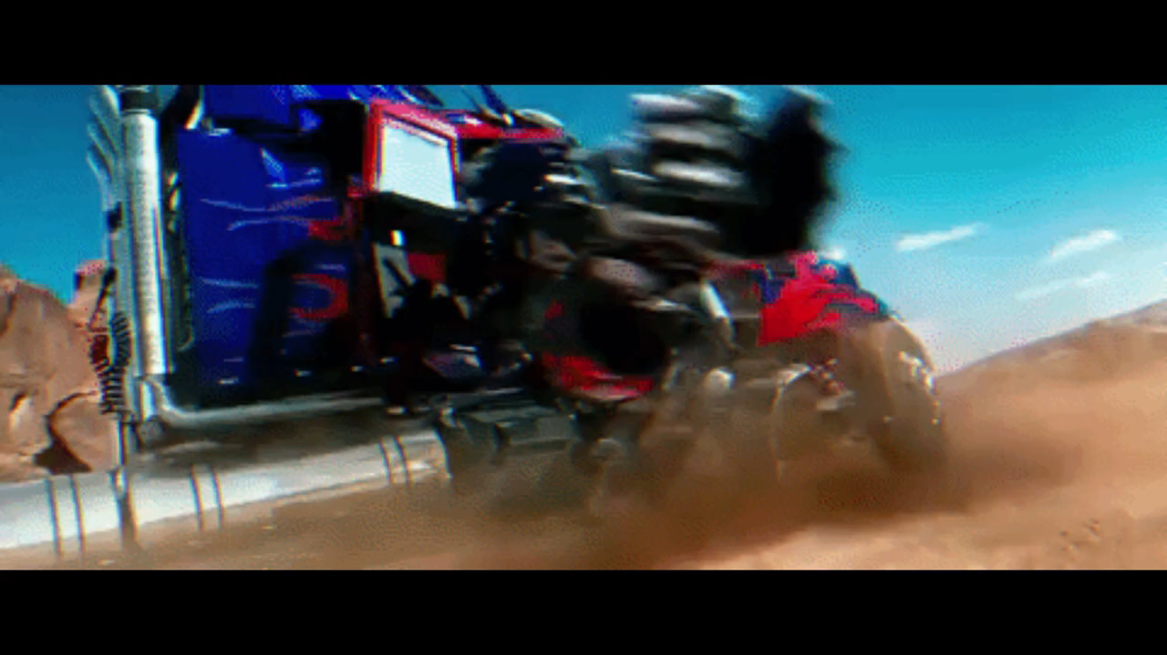
Watch the video and write down the types of the films.

Slide 5
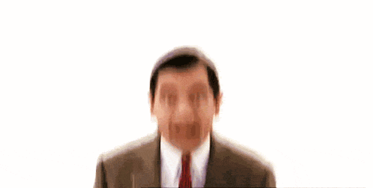


1. Work in pairs. Discuss the following question.
What do you like / dislike about a comedy?
Makes people laugh
Mostly not educational
Helps people relax
Some are not suitable for children
Reduces stress

Slide 6

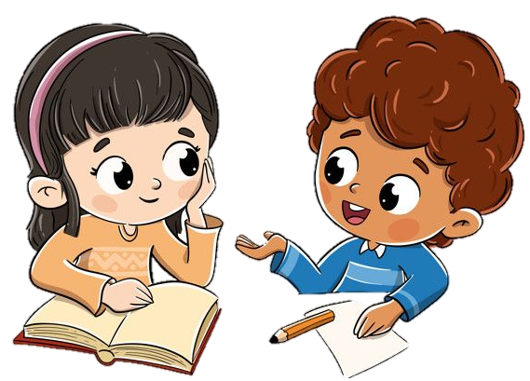
2.Mark and Hoa are talking about the film Naughty Twins.
Hoa
Mark
Listen. Who stars in the film?
A. Linda Smith and Susan Brown
B. Linda Brown and Susan Smith
C. Susan Linda and Brown Smith
Hoa: I like Simon's films. Who stars in it?
Mark: Linda Brown and Susan Smith.

Slide 7
3. Before listening again, underline keywords.
(words that contain important information)
3. Listen to the conversation again. Choose the best answer to each question below.
1. Naughty Twins is a ___.
A. comedy
B. science fiction film
C. horror film
2. The main characters are ___.
A. old classmates
B. twin brothers
C. twin sisters
3. Where do the twins meet each other for the first time?
A. At a summer camp.
B. At a summer school.
C. At a hospital.
4. People say Naughty Twins is a film that ___.
A. young people should see
B. young people shouldn’t see
C. is shocking

Slide 8
3. Listen to the conversation again. Choose the best answer to each question below.
1. Naughty Twins is a ___.
A. comedy
B. science fiction film
C. horror film
2. The main characters are ___.
A. old classmates
B. twin brothers
C. twin sisters
Hoa: Mark, what film did you see last week?
Mark: Naughty Twins. It’s a comedy and its director is Nancy Simon.
Hoa: What is it about?
Mark: It's about two naughty girls. Although they are twins, they don't grow up together after their parents' marriage ends.

Slide 9
3. Listen to the conversation again. Choose the best answer to each question below.
3. Where do the twins meet each other for the first time?
A. At a summer camp.
B. At a summer school.
C. At a hospital.
4. People say Naughty Twins is a film that ___.
A. young people should see
B. young people shouldn’t see
C. is shocking
Hoa: What happens next? Mark: The twins meet each other for the first time at a summer camp.
Hoa: Did it receive good reviews?
Mark: Yes, most people say it's a must-see for young people because it's funny and moving.
Notes:
Hoa: I like Simon's films. Who stars in it? Mark: Linda Brown and Susan Smith. Hoa: They're well-known actresses. What is it about? Mark: It's about two naughty girls. Although they are twins, they don't grow up together after their parents' marriage ends. Hoa: What happens next? Mark: The twins meet each other for the first time at a summer camp. They make a plan to bring their parents back together. And then many funny things happen. Hoa: Did it receive good reviews? Mark: Yes, most people say it's a must-see for young people because it's funny and moving. The acting and music are excellent, too....

Slide 10

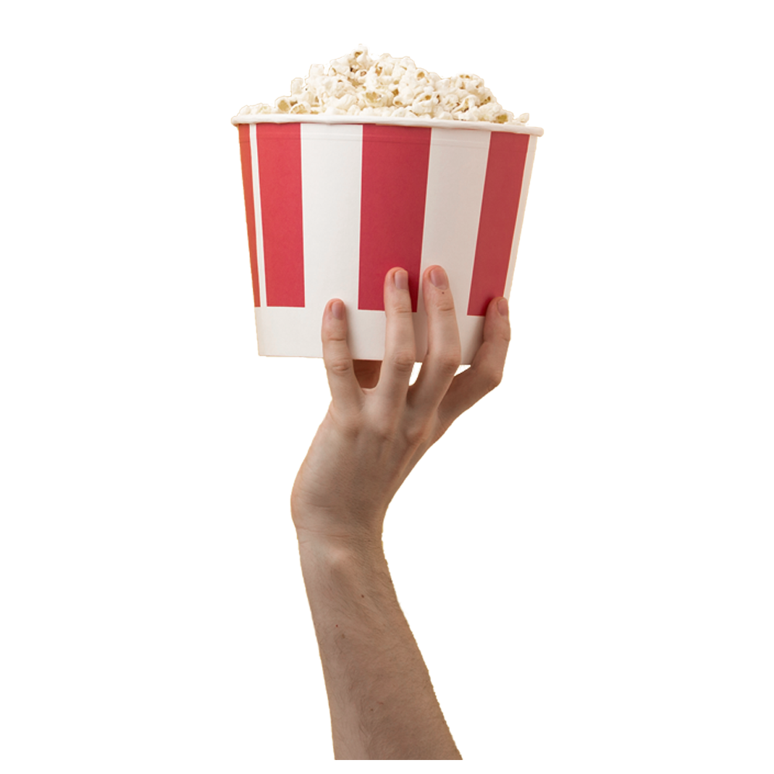
02
WRITING

Slide 11
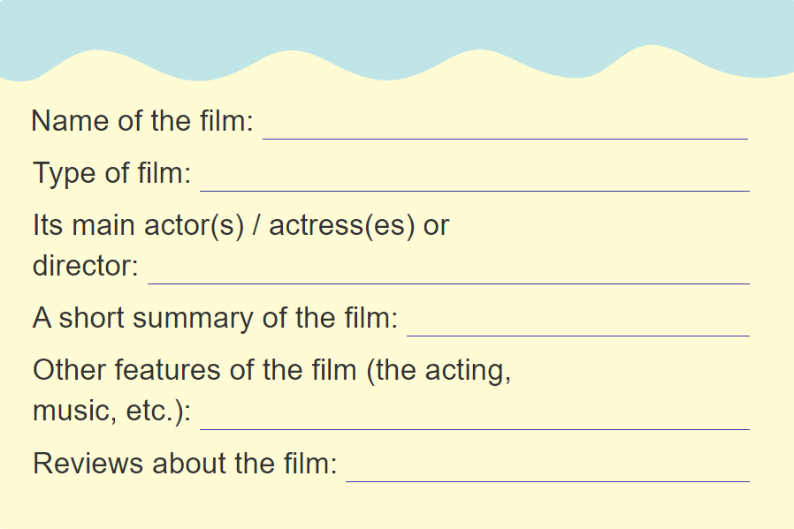
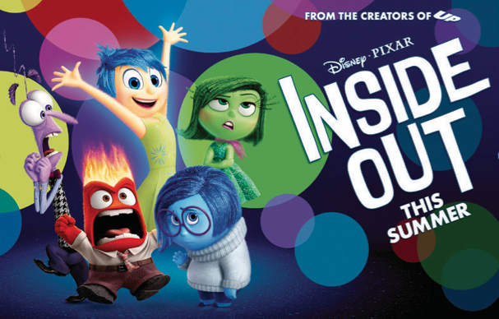
Refer back to the Reading & complete the notes.
Sample
Inside out
Animation
Directed by Pete Docter and co-directed by Ronnie del Carmen
Riley and her emotions struggle to adjust to the new life.
Beautiful, original story about handling big feelings
A very creative and touching film
Notes:
Riley is a 11-year-old girl. When Riley moves from Minnesota to San Francisco, she and her emotions struggle to adjust to the new life. After one year, everything is fine and Riley is happy.

Slide 12

4. Make notes about one of your favourite films in 5 mins.

Slide 13
Use the information in ex 4 to write a paragraph of about 70 words about the favourite film.
Name of the film: Inside out
Type of film: Animation
Its main actor(s) / actress(es) or director: Directed by Pete Docter and co-directed by Ronnie del Carmen
A short summary of the film: Riley and her emotions struggle to adjust to the
Other features of the film (the acting, new life. music, etc.): Beautiful original story about handling big feelings
Reviews about the film: A very creative and touching film
My favourite film is Inside out. This animation is directed by Pete Docter and co-directed by Ronnie del Carmen. The movie is about Riley, a 11-year-old girl. She moves from Minnesota to San Francisco because her father starts a new job here. Riley and her emotions struggle to adjust to the new life. The films is based on a beautiful original story about handling big feelings. People say that it is a very creative and touching film.

Slide 14
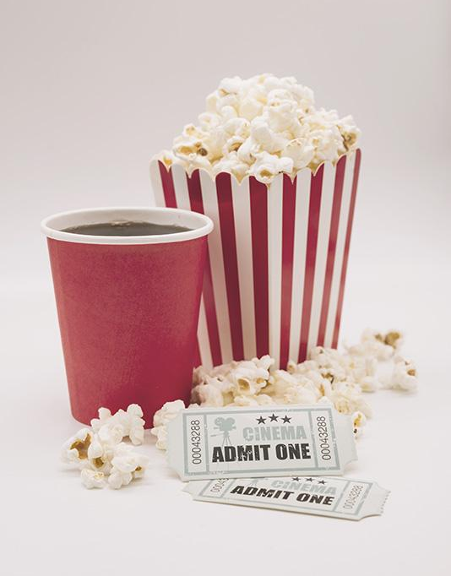
5. Use the information in ex 4 to write a paragraph of about 70 words about your favourite film.
________________________________
________________________________
________________________________
________________________________
________________________________
________________________________
________________________________
________________________________

Slide 15
WRAP UP
LISTENING
listen for specific information about a film
WRITING
write a paragraph about one's favourite film

Slide 16
THANKS FOR
YOUR ATTENTION!

