Slide 1

Song Ve Secondary School
Good morning class !!!
English 8

Slide 2
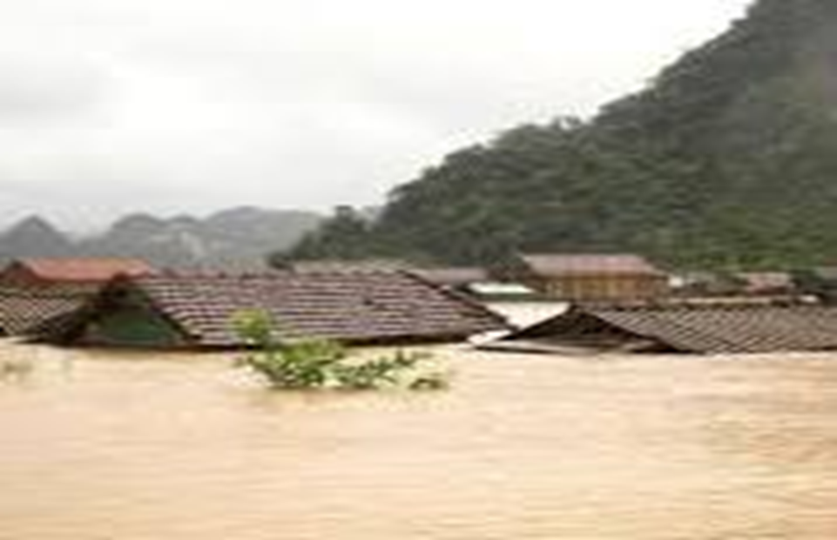
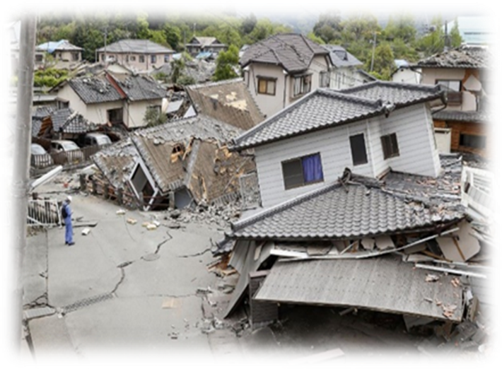
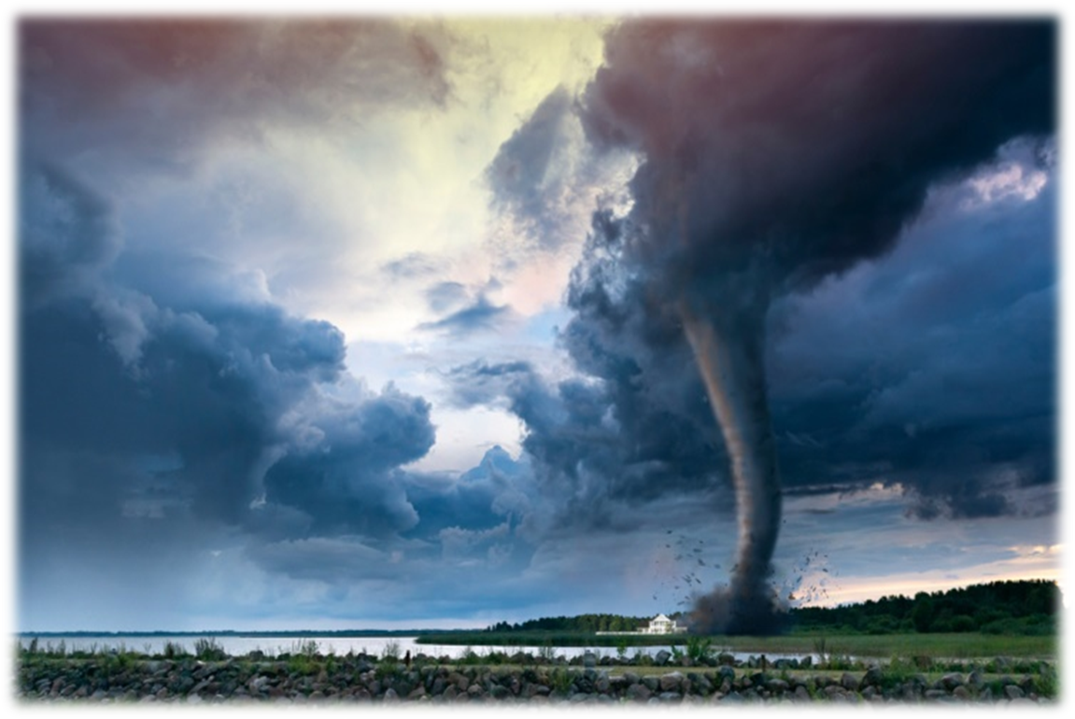
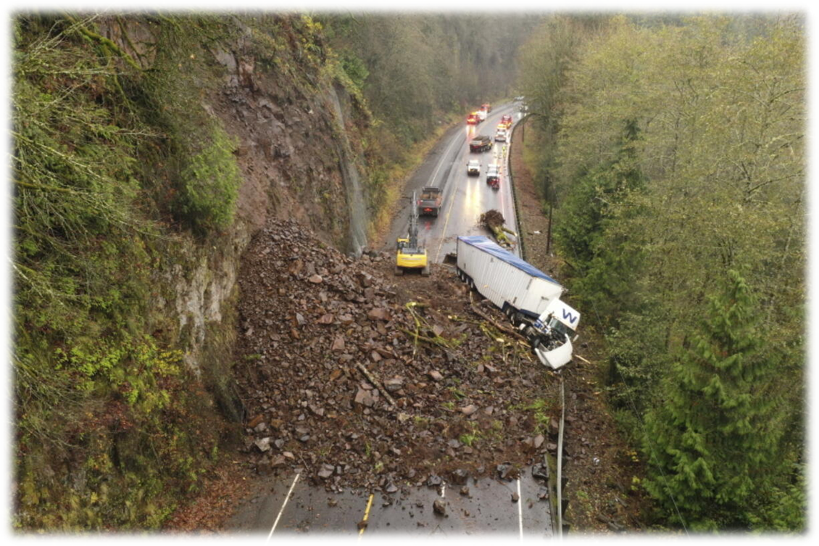
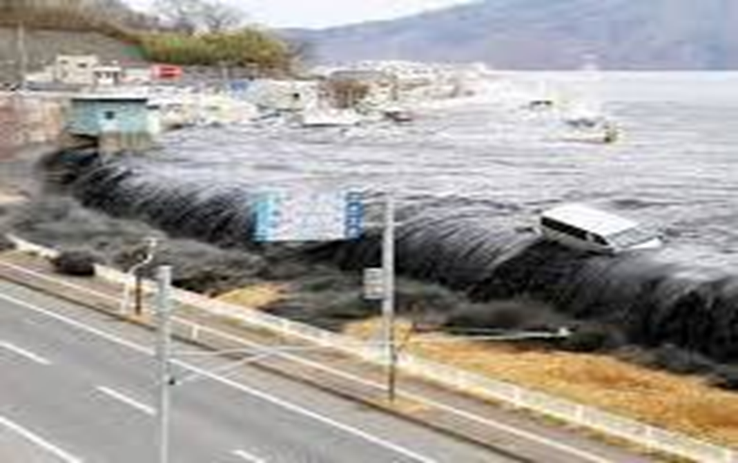
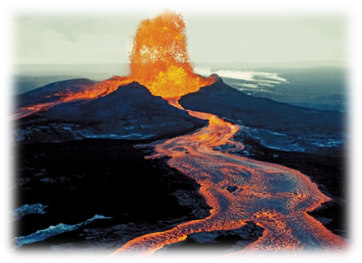
* WARM UP: PELMANISM
Match the picturtes (1-6 ) with the name of natural disasters (a-e)
1
2
3
4
5
6
A
B
C
D
landslide
flood
volcanic eruption
Tidal wave/ tsunami
E
F
tornado
earthquake
1
2
3
4
5

Slide 3
* WARM UP: PELMANISM
Match the picturtes (1-6 ) with the name of natural disasters (a-e)
flood
earthquake
tornado
landslide
Tidal wave/ tsunami
volcanic eruption

Slide 4

Unit
9
NATURAL DISASTERS
LESSON 7: Looking back & Project
LESSON 3: A CLOSER LOOK 2
Vocabulary
Grammar
Project

Slide 5
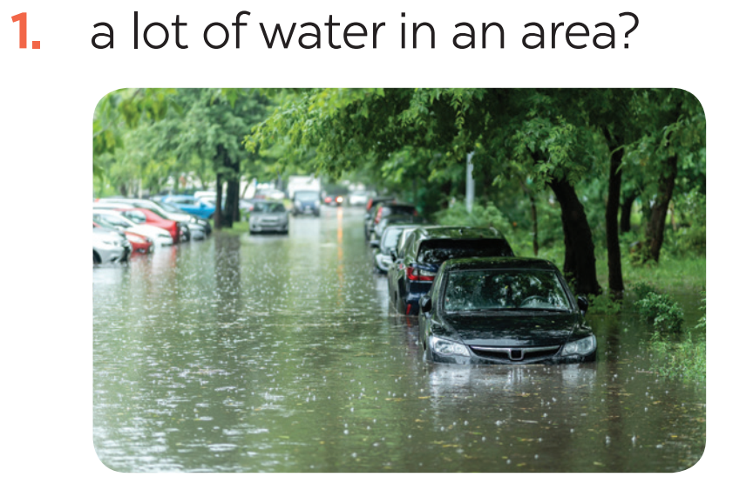
* VOCABULARY
1
Write the name of a natural disaster in each blank.
flood

Slide 6
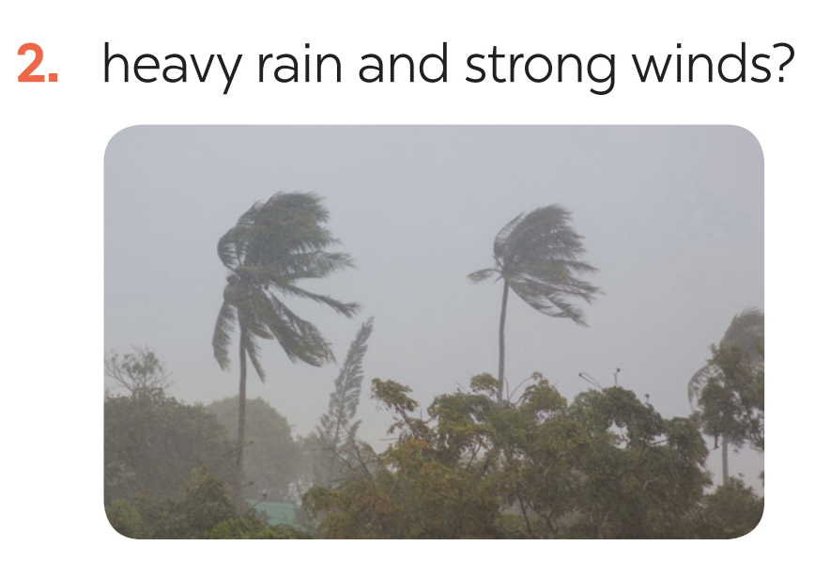
* VOCABULARY
1
Write the name of a natural disaster in each blank.
storm

Slide 7
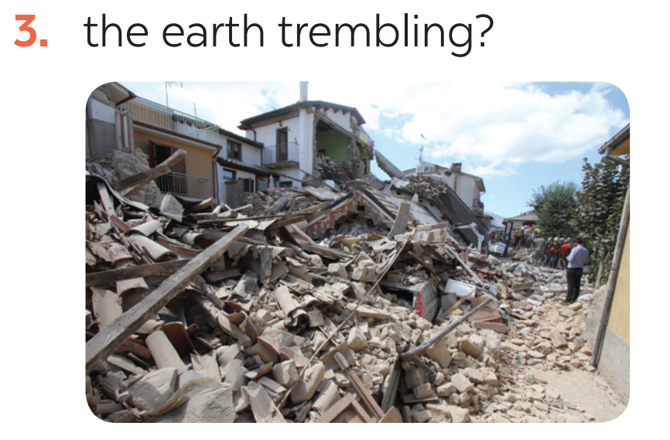
* VOCABULARY
1
Write the name of a natural disaster in each blank.
earthquake

Slide 8
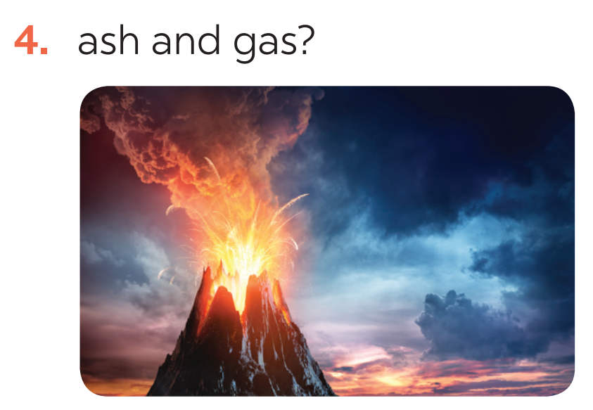
* VOCABULARY
1
Write the name of a natural disaster in each blank.
volcanic eruption

Slide 9
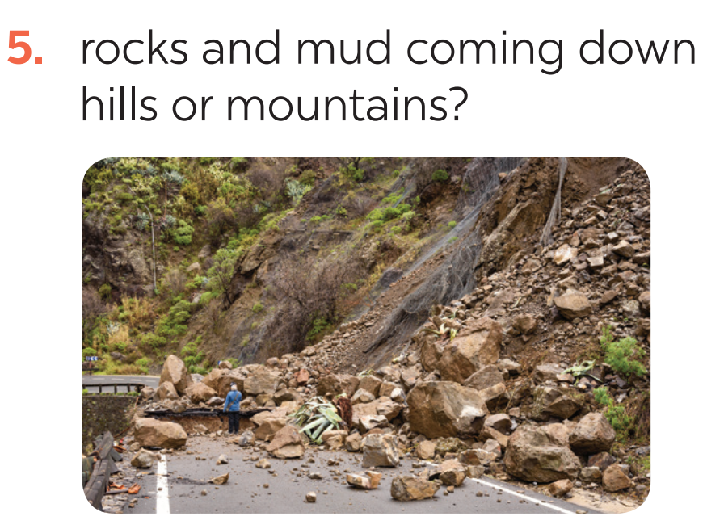
* VOCABULARY
1
Write the name of a natural disaster in each blank.
landslide

Slide 10
* VOCABULARY
2
Fill in each blank with the correct form of the word in brackets.
1. The tsunami brought __________ to cities and towns near the sea. (destroy)
2. The government has developed some systems to help make __________ about natural disasters. (predict)
3. We are donating money and food to help the ______ of the landslide. (victim)
4. The local authorities _______ the villagers about a landslide yesterday. (warning)
5. Rescue _______ are trying hard to save people in the flooded area. (work)
destruction
predictions
victims
warned
workers

Slide 11
* GRAMMAR
3
Put the verbs into the correct tense: the past simple or past continuous.
1. What _____ you (do) _____ at 8 o’clock yesterday morning?
2. Last year, earthquakes (destroy) _________ a lot of houses in Japan.
3. He (water) ____________ the flowers in his garden when the tornado (come) _____.
4. While they (call) __________ for help, the rescue workers (appear) ________.
5. _______ you (listen) ________ to music at 9 o’clock yesterday evening?
6. I _______ (not go) to school last Sunday.
Game

Slide 12
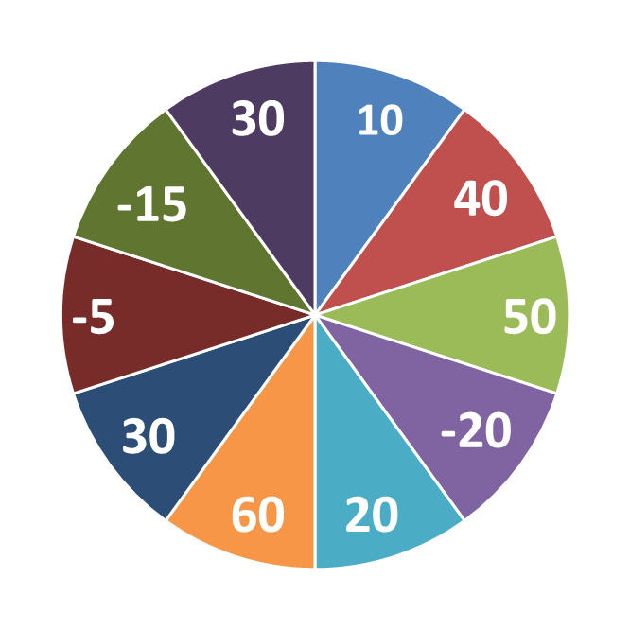
* GRAMMAR
3
Put the verbs into the correct tense: the past simple or past continuous.
1
2
3
4
5
6
WORK IN 2 GROUPS

Slide 13

* GRAMMAR
3
Put the verbs into the correct tense: the past simple or past continuous.
were
1. What ______ you (do) _______ at 8 o’clock yesterday morning?
doing

Slide 14
* GRAMMAR
3
Put the verbs into the correct tense: the past simple or past continuous.
2. Last year, earthquakes (destroy) _________ a lot of houses in Japan.
destroyed

Slide 15
* GRAMMAR
3
Put the verbs into the correct tense: the past simple or past continuous.
3. He (water) ____________ the flowers in his garden when the tornado (come) _____.
was watering
came

Slide 16
* GRAMMAR
3
Put the verbs into the correct tense: the past simple or past continuous.
4. While they (call) __________ for help, the rescue workers (appear) ________.
were calling
appeared

Slide 17
* GRAMMAR
3
Put the verbs into the correct tense: the past simple or past continuous.
5. _______ you (listen) ________ to music at 9 o’clock yesterday evening?
Were
listening

Slide 18
* GRAMMAR
3
Put the verbs into the correct tense: the past simple or past continuous.
6. I _______ (not go) to school last Sunday.
didn’t go

Slide 19
* GRAMMAR
3
Put the verbs into the correct tense: the past simple or past continuous.
1. What _____ you (do) _____ at 8 o’clock yesterday morning?
2. Last year, earthquakes (destroy) _________ a lot of houses in Japan.
3. He (water) ____________ the flowers in his garden when the tornado (come) _____.
4. While they (call) __________ for help, the rescue workers (appear) ________.
5. _______ you (listen) ________ to music at 9 o’clock yesterday evening?
6. I _______ (not go) to school last Sunday.
were
doing
destroyed
was watering
came
were calling
appeared
Were
listening
didn’t go

Slide 20
* GRAMMAR
4
Complete the sentences about you and your family members.
At 7 p.m. yesterday, …
1. I was ________________________________.
2. my grandmother / grandfather ____________.
3. my mother ____________________________.
4. my father _____________________________.
5. my sister / brother ______________________.
was watching TV

Slide 21
* GRAMMAR
4
Complete the sentences about you and your family members.
At 7 p.m. yesterday, …
1. I was ________________________________.
2. my grandmother / grandfather ____________.
3. my mother ______________________.______.
4. my father _____________________________.
5. my sister / brother ______________________.
doing my homework.
was watching TV
was surfing the facebook
was watering flowers.
was listening to music

Slide 22
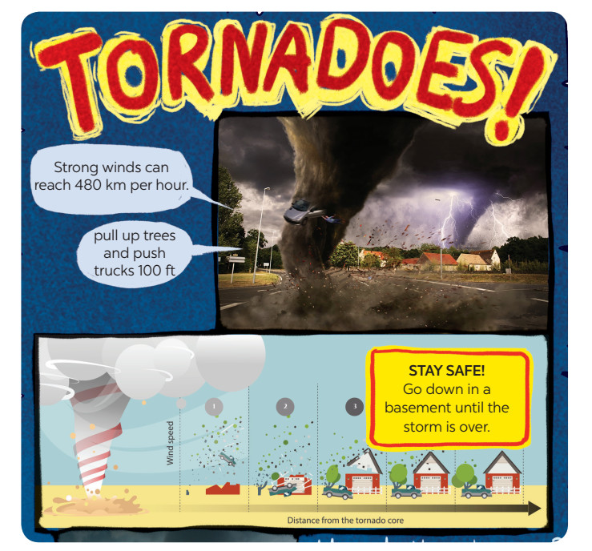
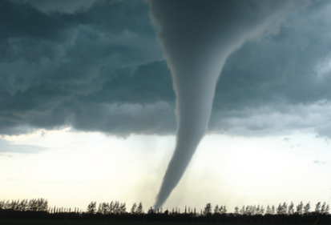
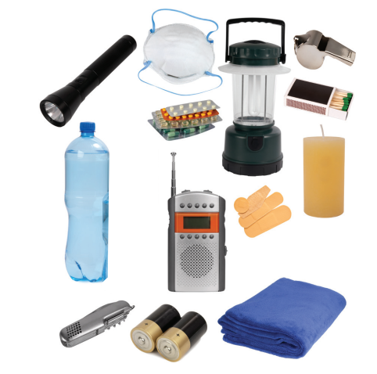
* PROJECT

Slide 23
* PROJECT
1. Choose a natural disaster you want to learn more about.
volcanic eruption
flood
earthquake
landslide
tornado
cyclone
hurricane / storm
tsunami

Slide 24
* PROJECT
2. Research it. You can use these questions to guide you:
What causes it?
Where and when does it usually happen?
What effects can it have?
What should people do before, during, and after it happens?

Slide 25
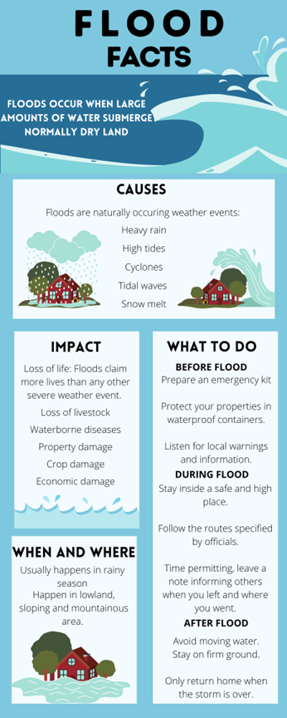
* PROJECT
3. Create a poster about this natural disaster.
Draw pictures or find suitable photos for it.

Slide 26

CONSOLIDATION
In this lesson, you have:
revised more vocabulary items you have learnt in the unit.
revised the differences between the past simple and past continuous.
revised the past continuous.
researched more deeply into a natural disaster.

Slide 27

* Homework
Do exercises in the workbook.
Prepare for revision for the middle term.

Slide 28




Slide 29
1
2
3
4
5
6

