Slide 1




Welcome to our class!

Slide 2


Word jumble
WHAT IS THE NAME OF THE ETHNIC GROUP?

Slide 3
WHAT IS THE NAME OF THE ETHNIC GROUP?
BRAU
A
B
U
R

Slide 4
WHAT IS THE NAME OF THE ETHNIC GROUP?
NUNG
G
U
N
N

Slide 5
WHAT IS THE NAME OF THE ETHNIC GROUP?
HMONG
O
H
N
M
G

Slide 6
WHAT IS THE NAME OF THE ETHNIC GROUP?
TAY
Y
T
A

Slide 7
WHAT IS THE NAME OF THE ETHNIC GROUP?
KHMER
E
M
R
K
H

Slide 8
WHAT IS THE NAME OF THE ETHNIC GROUP?
EDE
D
E
E

Slide 9
WHAT IS THE NAME OF THE ETHNIC GROUP?
HOA
A
H
O

Slide 10
WHAT IS THE NAME OF THE ETHNIC GROUP?
CHAM
A
H
M
C

Slide 11
Brau
Nung
Hmong
Tay
Khmer
Ede
Hoa
Cham

Slide 12

Unit 4:
ETHNIC GROUPS OF VIETNAM
Lesson 4: COMMUNICATION

Slide 13
EVERYDAY ENGLISH

Slide 14



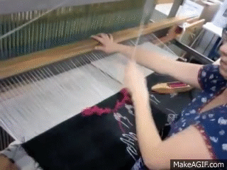
VOCABULARY
weave (v)
/wi:v/
dệt, đan

Slide 15
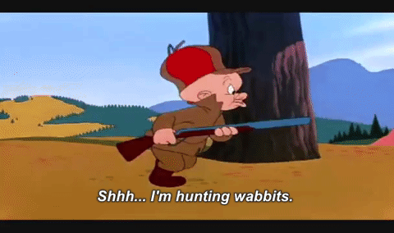
VOCABULARY
hunt (v)
/hʌnt/
săn, săn đuổi

Slide 16
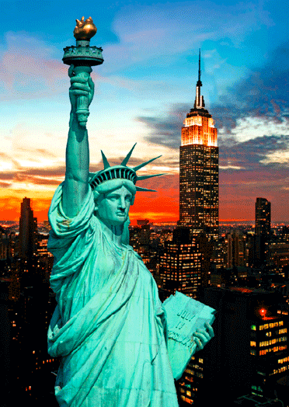
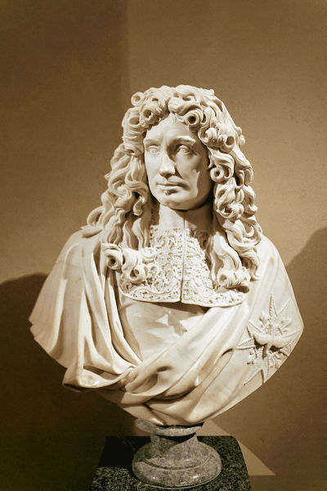
VOCABULARY
statue (n)
Goal 2
/ˈstætʃuː/
tượng

Slide 17
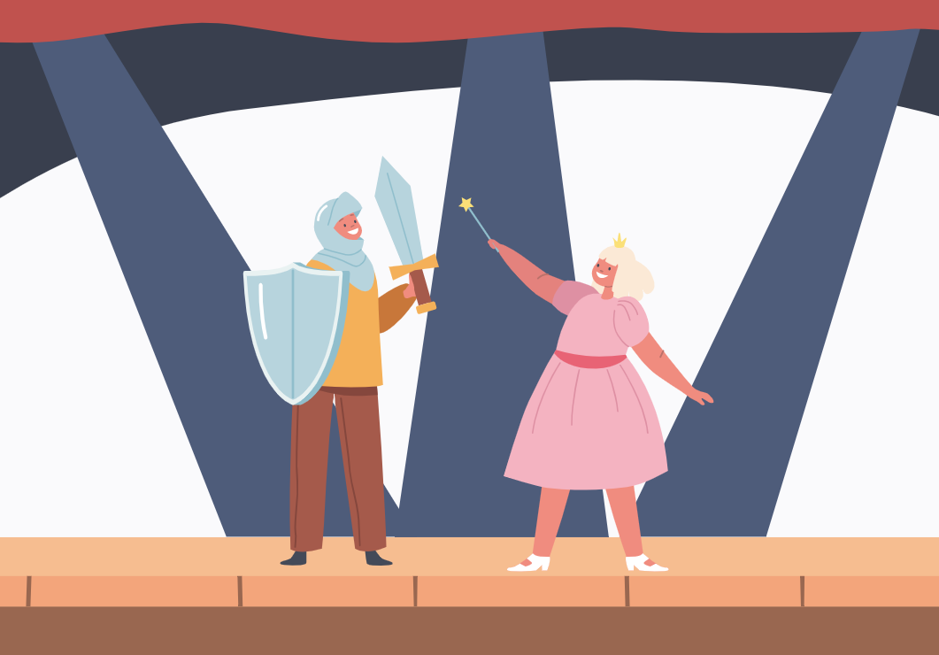
VOCABULARY
role (n)
/rəʊl/
vai trò

Slide 18
VOCABULARY
- weave (v) | /wiːv/ | dệt, đan
- hunt (v) | /hʌnt/ | săn, săn đuổi
- statue (n) | /ˈstætʃuː/ | tượng
- role (n) | /rəʊl/ | vai trò

Slide 19
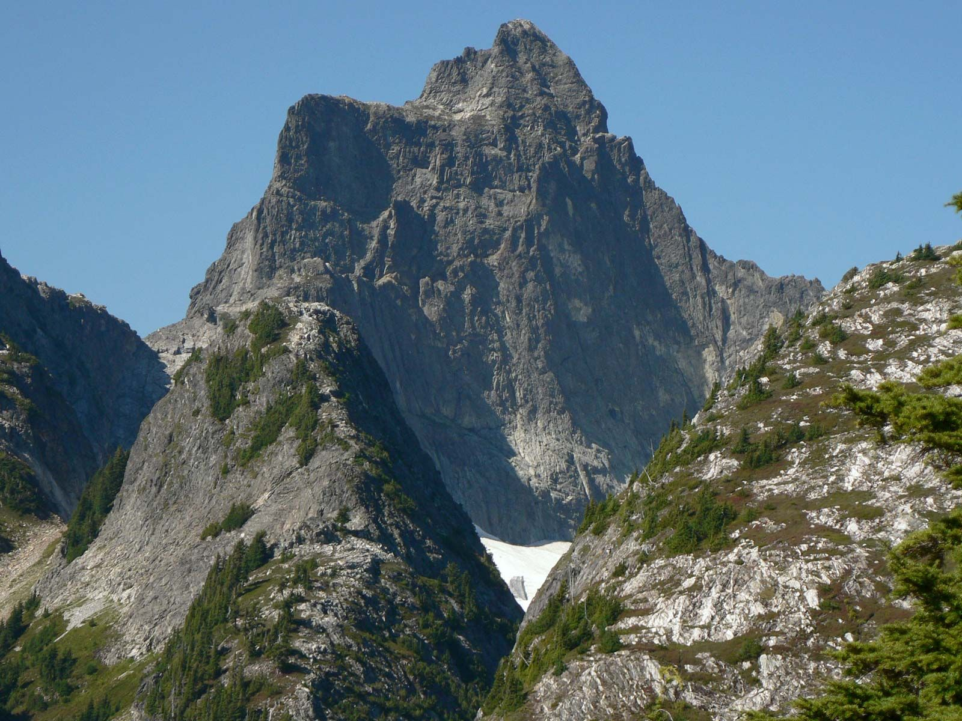
Where is it?

Slide 20



1. Listen and read the conversations. Pay attention to the highlighted parts.
Tom: What do you think about life in the mountains?
Trang: I think it’s very interesting. People in the mountains live close to nature.
Tom: What about you, Mai? What do you think?
Mai: To my way of thinking, there are better services in the city.

Slide 21
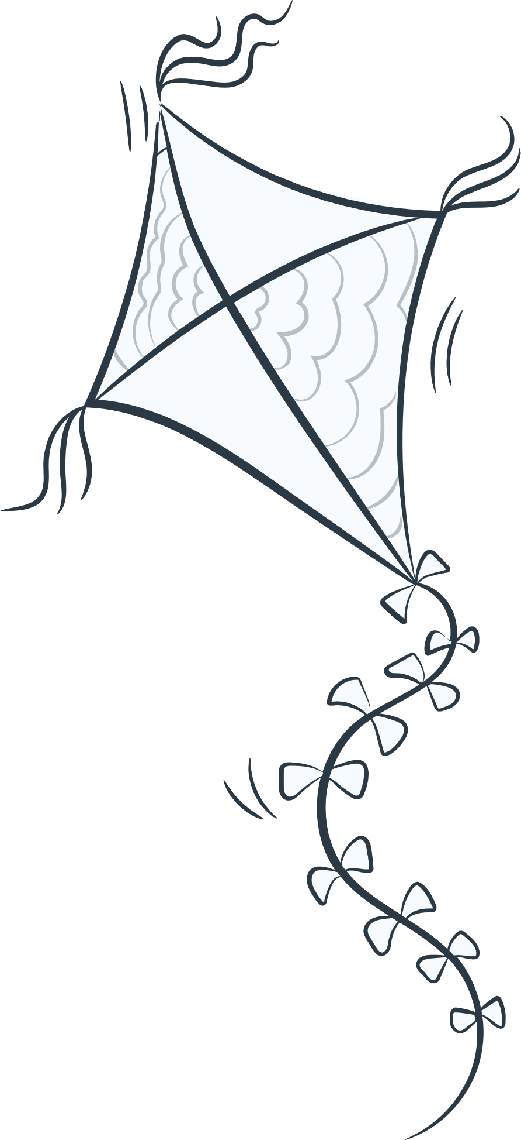


Structures giving opinions:
To my way of thinking
I think

Slide 22


Match the idea with the suitable topic.
Children always love it
Learn how to protect our planet
Improve our mental health
Bring people together
Playing traditional games
Living close to nature

Slide 23

2. Work in pairs. One asks the questions and the other gives opinion about these topics.
Playing traditional games
Living close to nature
Children always love it
Learn how to protect our planet
Bring people together
Improve our mental health
To my way of thinking
I think

Slide 24
LIFESTYLE OF
THE ETHNIC MINORITY GROUPS
How much do you know about ethnic groups in Viet Nam?

Slide 25
How much do you know about ethnic groups in Viet Nam?

Slide 26




Slide 27
1. There are ________ ethnic groups in Viet Nam.
63
45
A:
B:
C: 54
54
C:

Slide 28
2. Ethnic minority groups form about ________ of the total population of Viet Nam.
7%
13%
A:
B:
25%
C:

Slide 29
3. They mainly live ________.
in the lowlands
in the mountains
A:
B:
in the Mekong Delta
C:

Slide 30
4. The Jrai decorate houses for the dead with a lot of ________.
wood statues
flowers
A:
B:
colourful pictures
C:

Slide 31
5. The Khmer mostly earn their living from weaving and ______.
farming
hunting
A:
B:
C: fishing
fishing
C:

Slide 32
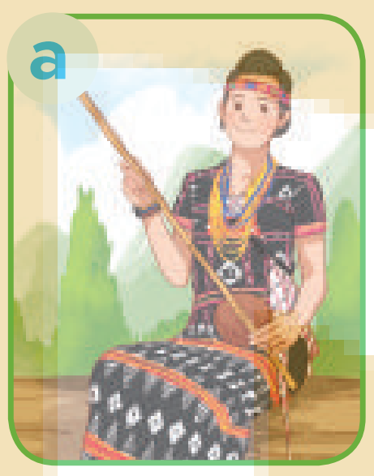
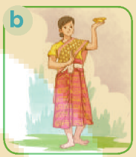
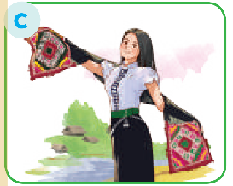
6. Picture ________ shows a Thai woman’s costume.
A:
B:
C:
C:

Slide 33

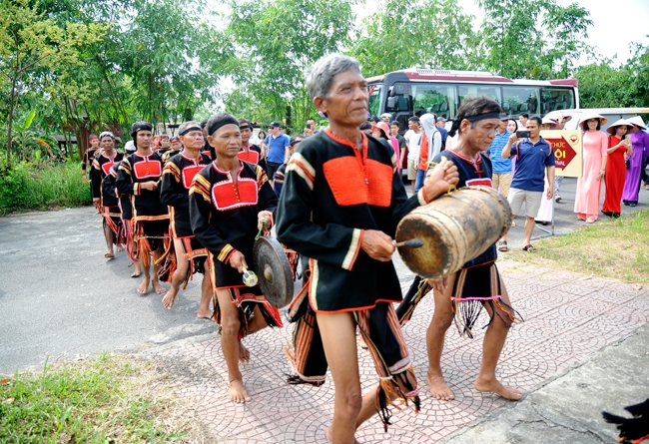
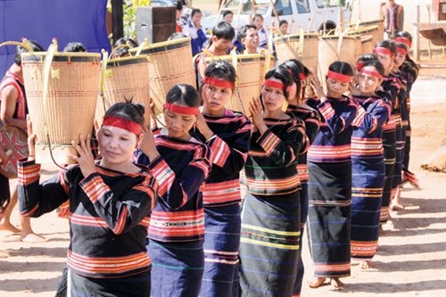
The Jrai

Slide 34


4. Work in pairs. Read the information below about the Jrai. Take turns to ask and answer about the information.
1. What is the population of the Jrai?
→ It is about 513,930.

Slide 35
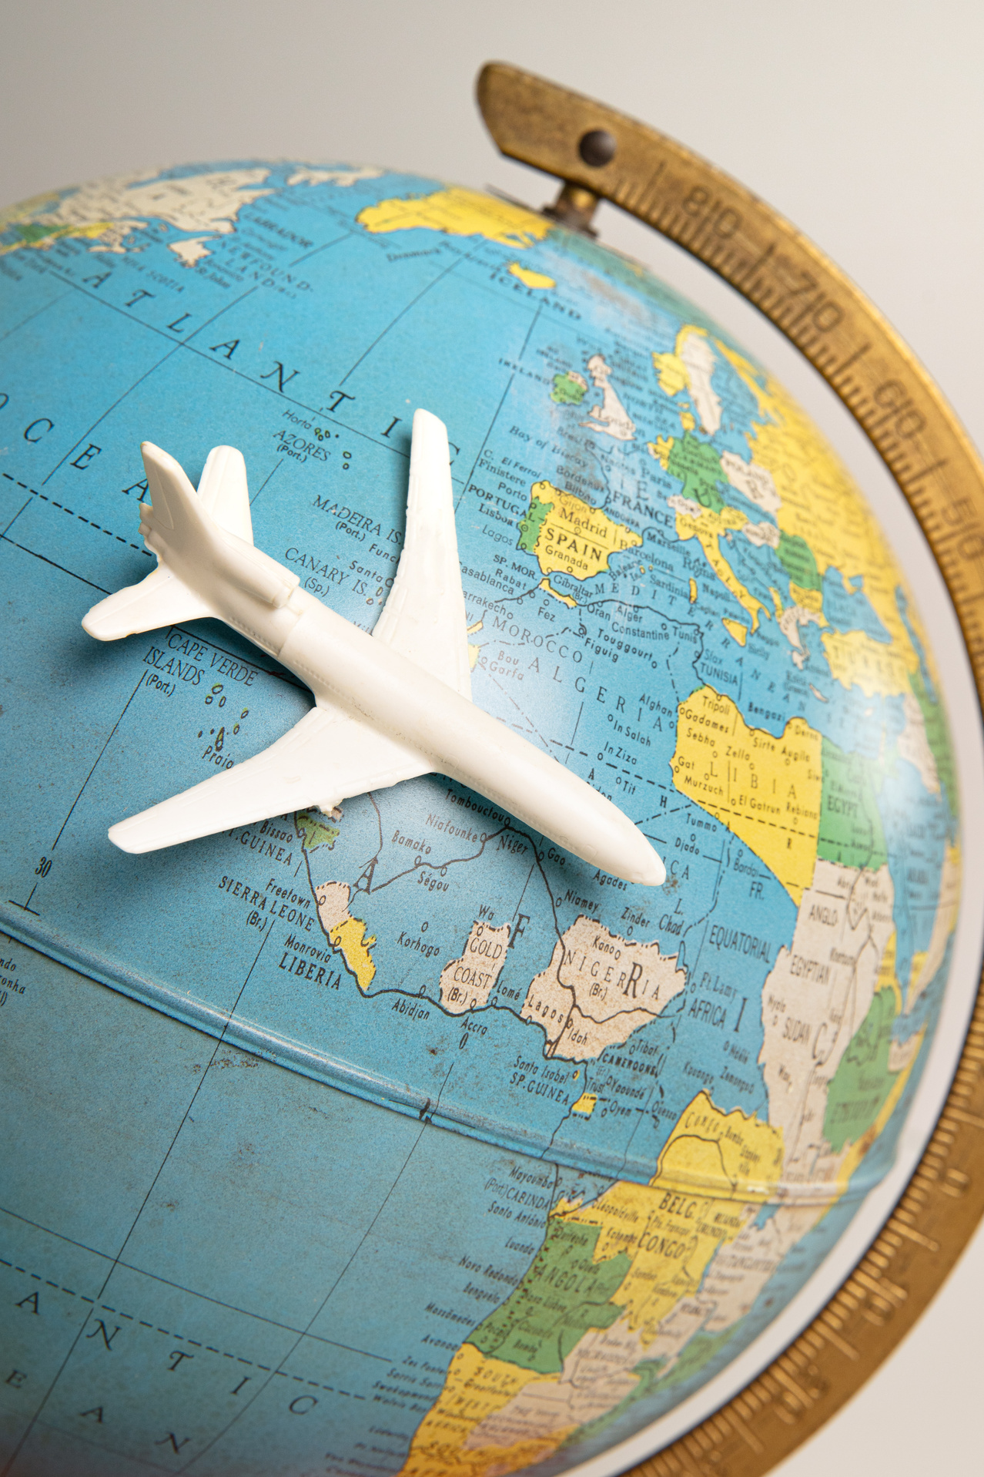






5. Work in groups. Share with your group the information about the Jrai people you find interesting.
I like … because …
I think that …

Slide 36



HOMEWORK
Practice everyday English
Find more information about the ethnic groups
Prepare for the next lesson

Slide 37
Thank You

