Slide 1



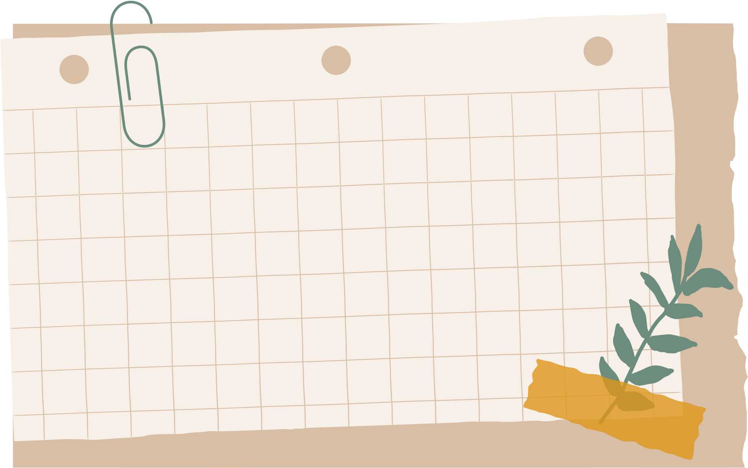
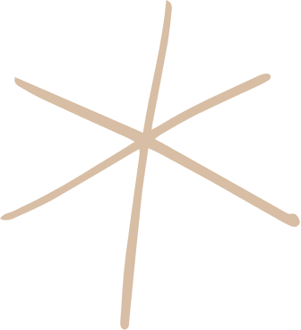




Welcome to our class!
Teacher: ……………

Slide 2
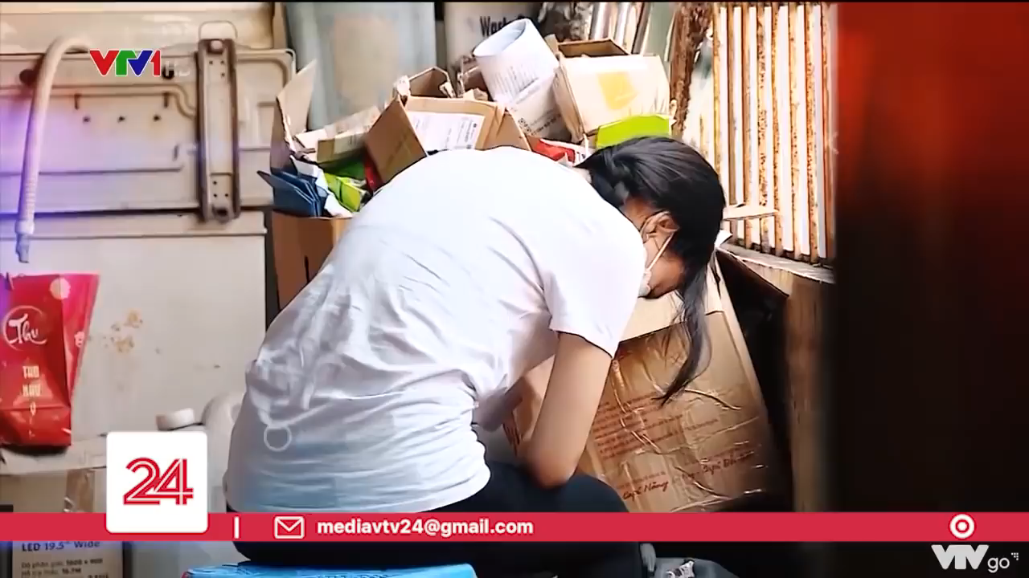


How do you think about the problem in the video?

Slide 3

TABLECLOTH
RULE:
- Work in 4 teams.
- In 2 minutes, write down on the posters as many types of pressure as possible
- The group with the most correct answers will be the winner.
Suggested answers:
Pressure from parents
Pressure from work
Pressure from schoolwork
Pressure from friends
Exam pressure
Pressure to get into gifted/ high schools
Pressure of getting higher marks
….

Slide 4

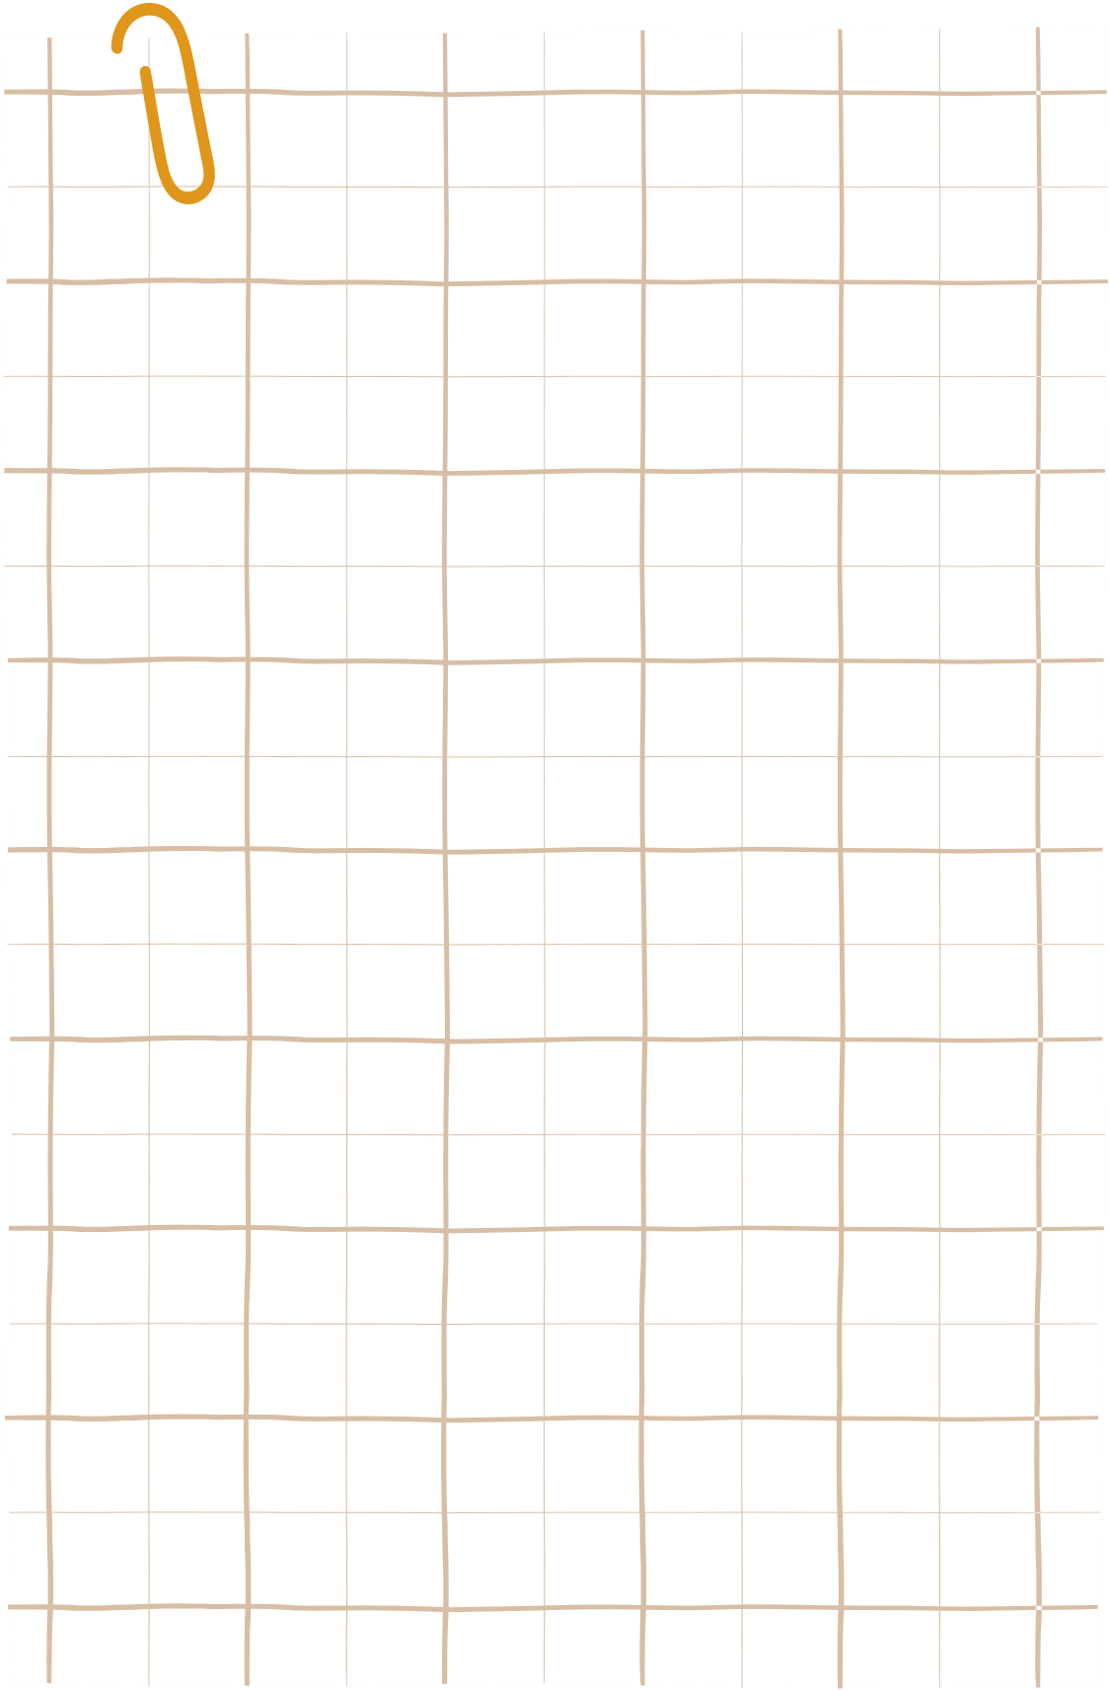

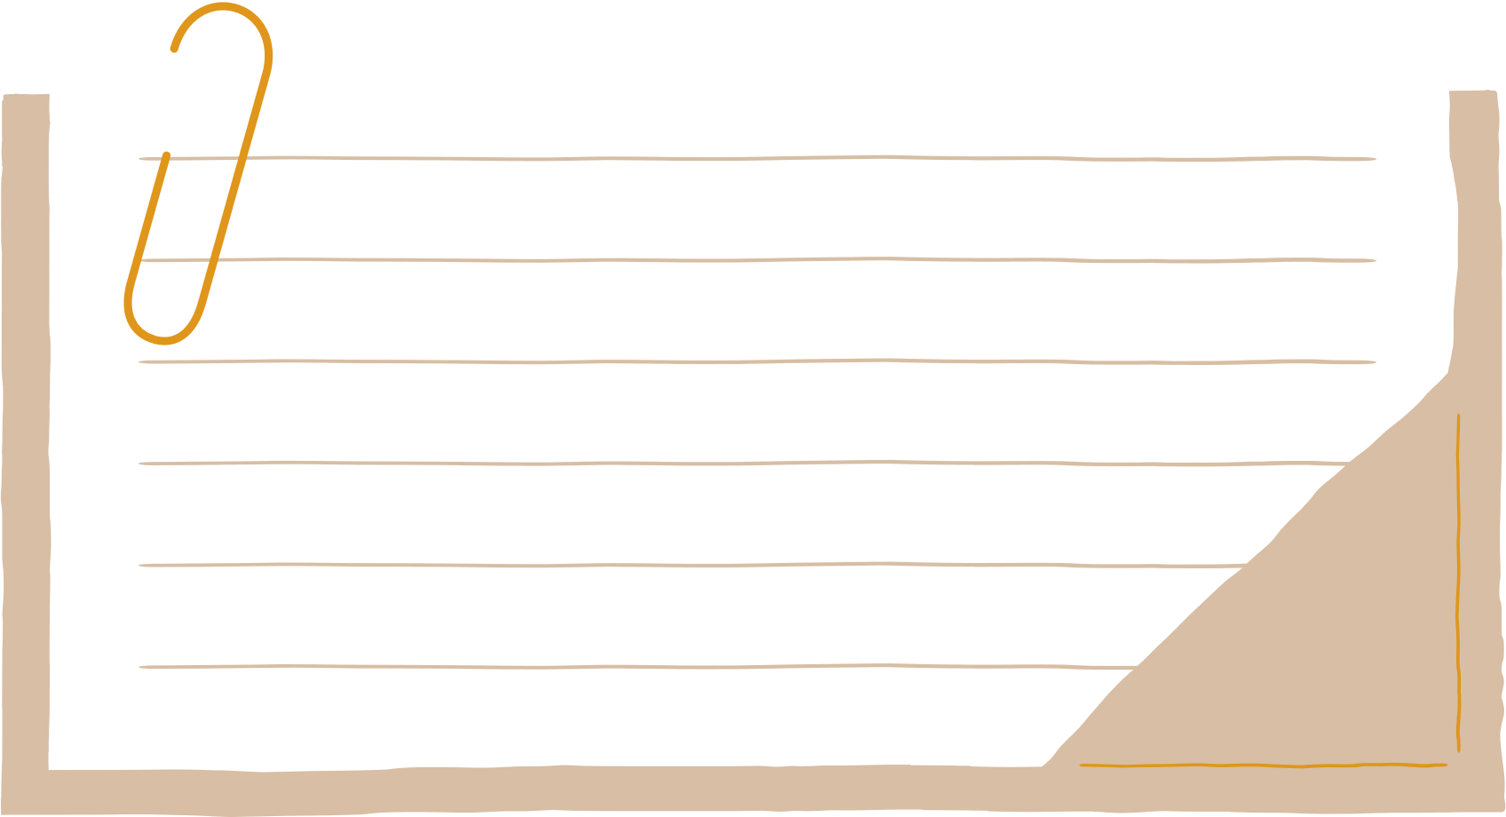
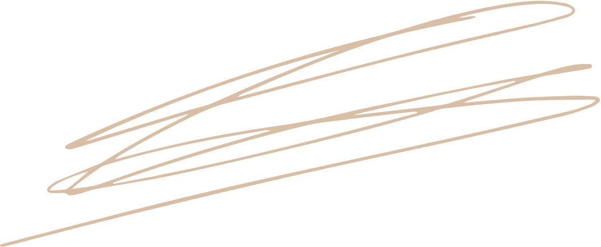
Unit 3: TEENAGERS
Lesson 6: Skills 2

Slide 5
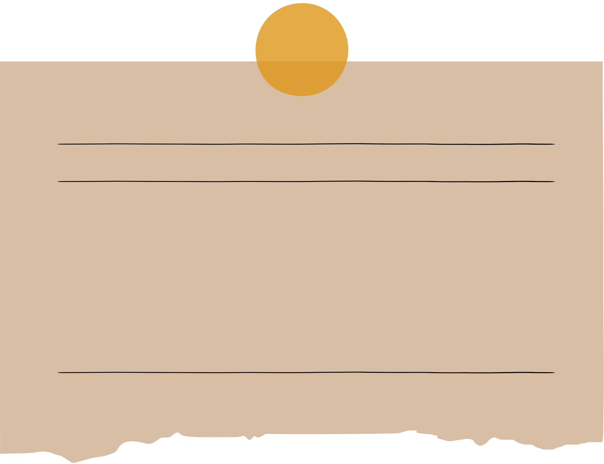
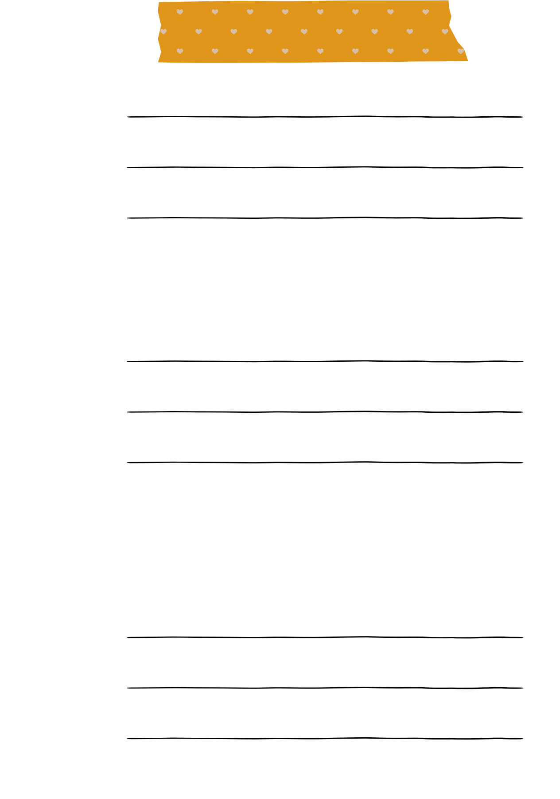
VOCABULARY

Slide 6
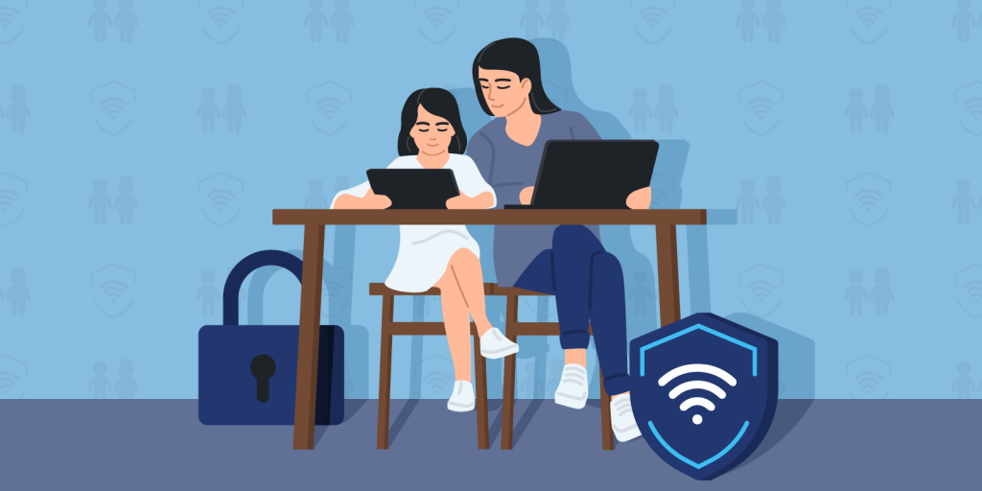

VOCABULARY
parental (adj)
/pəˈrentl/
liên quan tới bố mẹ, thuộc bố mẹ

Slide 7
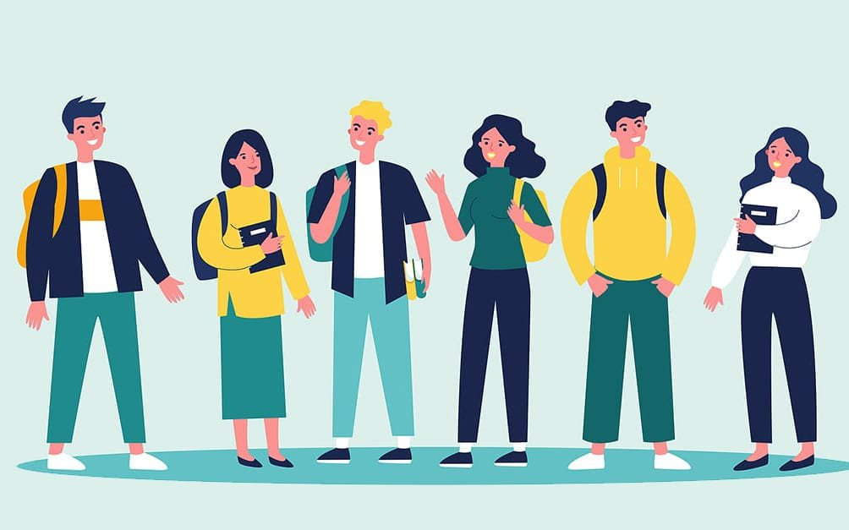
VOCABULARY
peer (n)
/pɪə(r)/
người ngang hàng, bạn đồng lứa

Slide 8
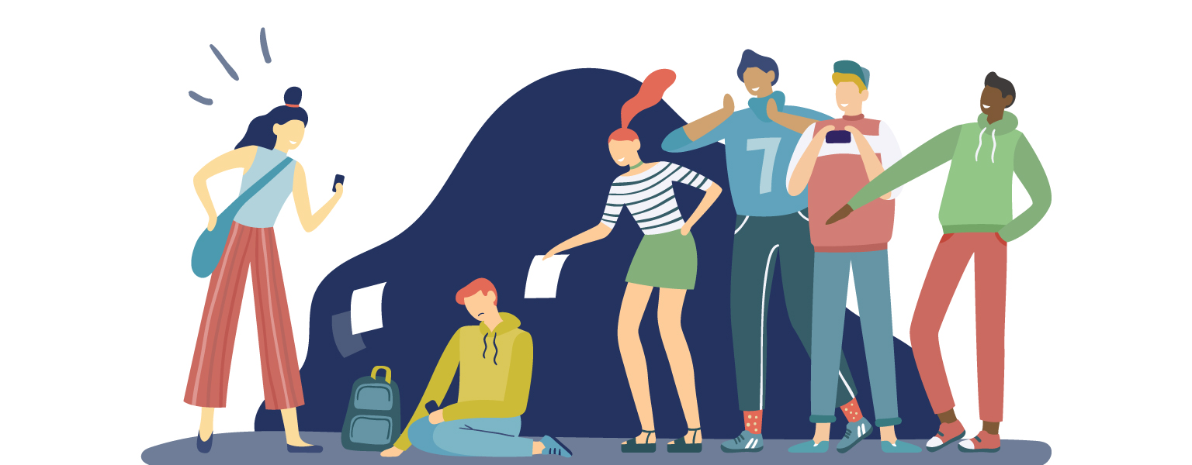
VOCABULARY
bully (v)
/ˈbʊli/
bắt nạt

Slide 9
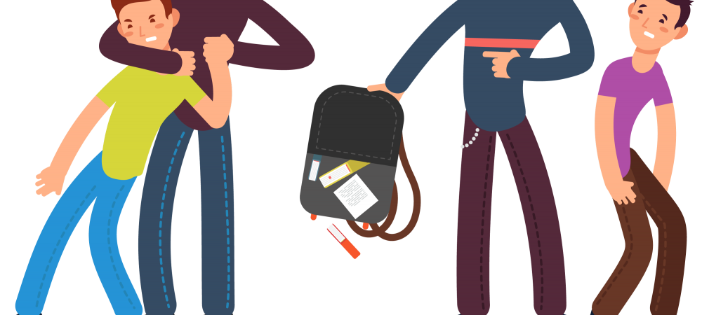
VOCABULARY
bullying (n)
/ˈbʊliɪŋ/
sự bắt nạt

Slide 10
VOCABULARY
- parental (adj) | /pəˈrentl/ | liên quan tới bố mẹ, thuộc bố mẹ
- peer (n) | /pɪə(r)/ | người ngang hàng, bạn đồng lứa
- bully (v) | /ˈbʊli/ | bắt nạt
- bullying (n) | /ˈbʊliɪŋ/ | sự bắt nạt

Slide 11
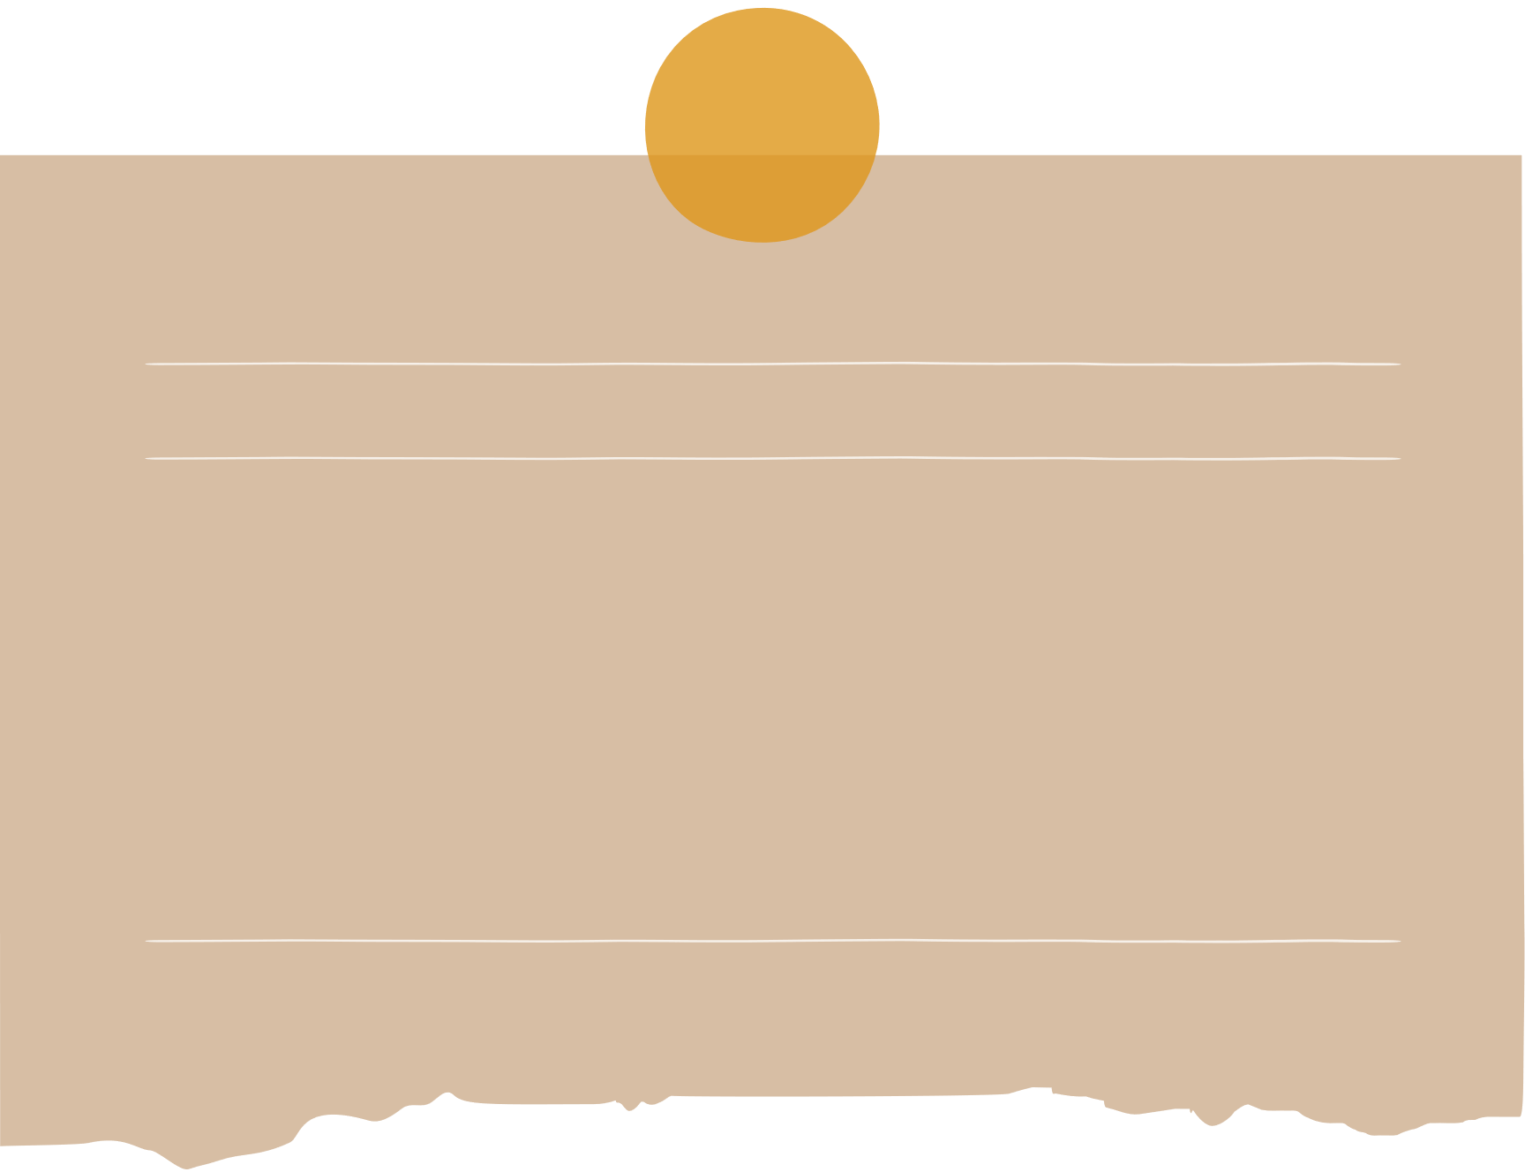

1. Which types of pressure below do you think teens face?
parental pressure
pressure from work
pressure from schoolwork
pressure from their clubs

Slide 12
2. Listen to a conversation and choose the correct answer to each question.
1. How many students are talking?
One.
Two.
Three.
2. What are they discussing?
Their class forum.
Their stress.
Their community activities.

Slide 13
3. Listen to the conversation again and fill each blank with ONE word.
Problems | Solutions
Minh has pressure from his (1)________. | Minh should tell his parents about his interests and (2) __________.
Ann is unhappy about her (3) _____________. | Ann should feel (4)________ about her body.
Mi doesn’t get on with her (5)________. | She should (6) ______ to her mum.
parents
abilities
good
body / weight
talk
sister

Slide 14
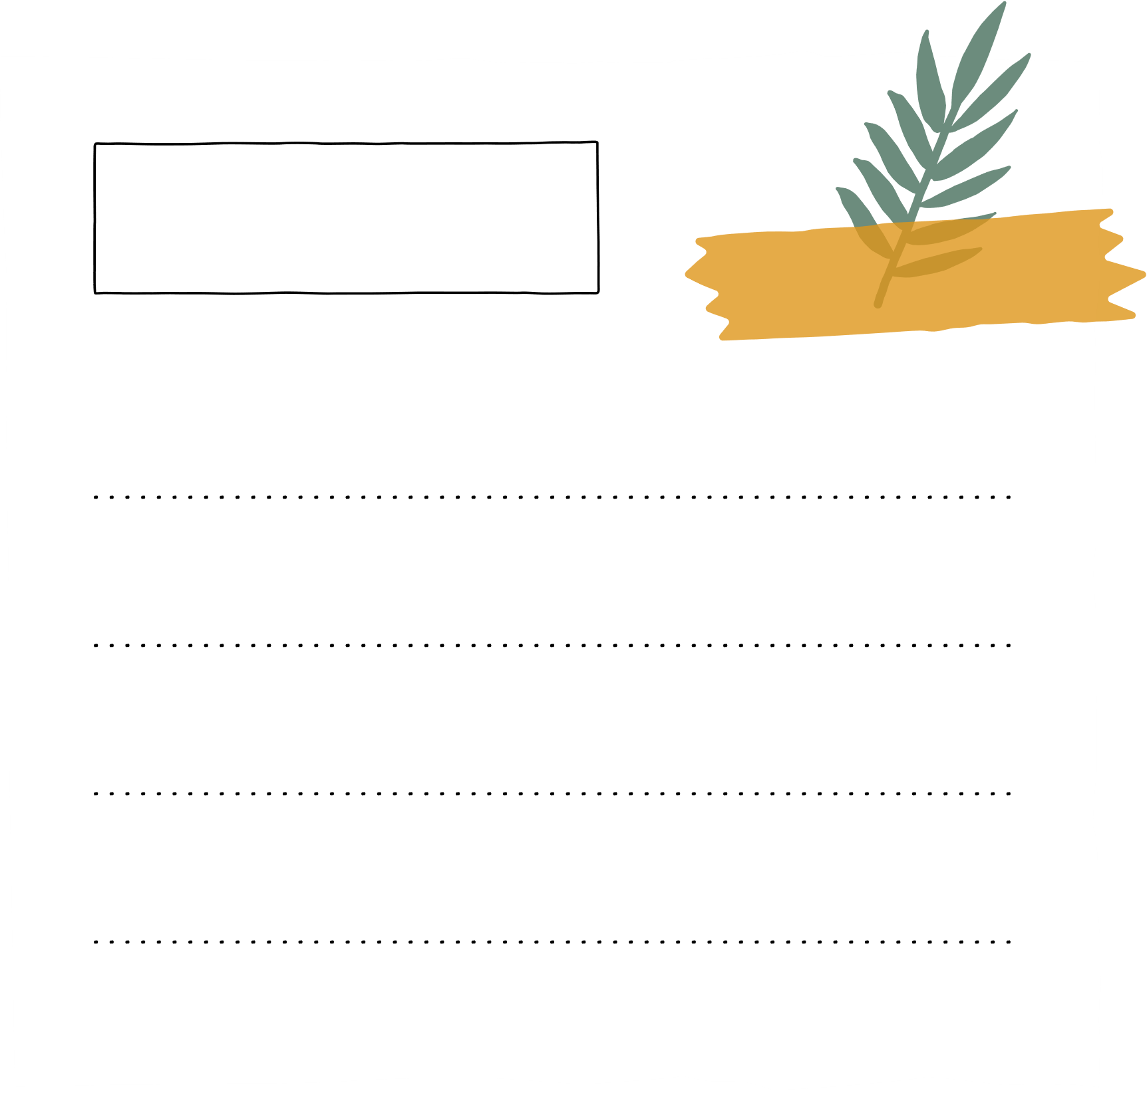
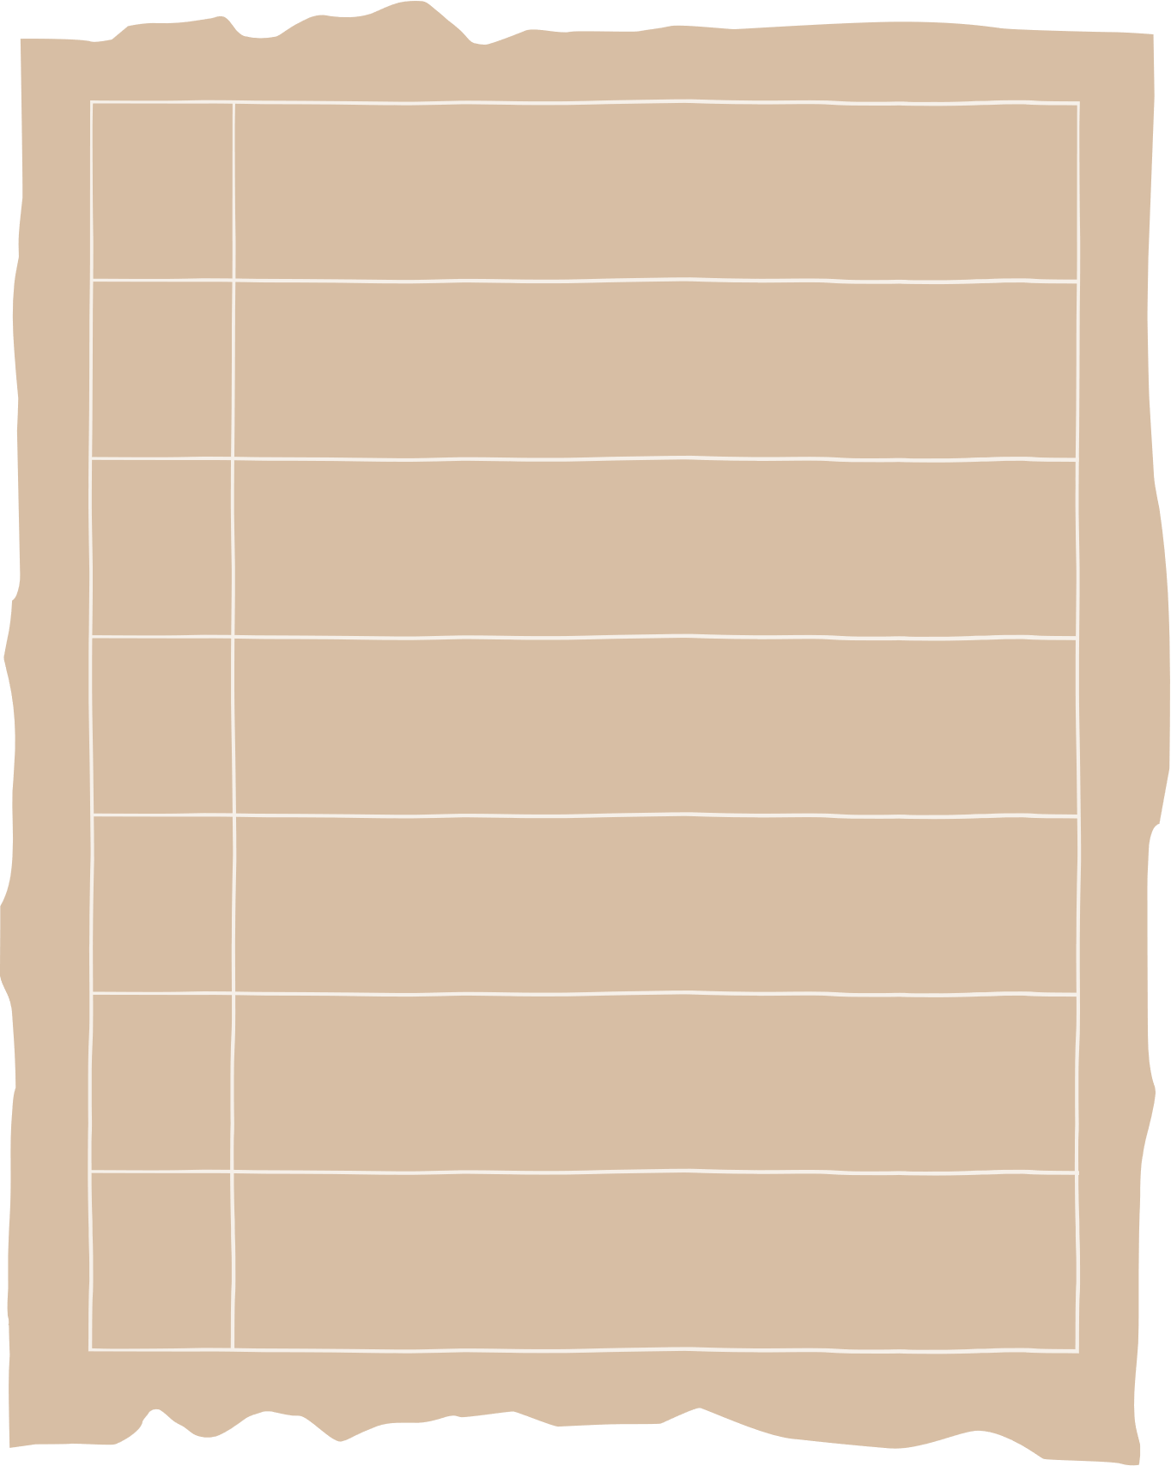

4. Match the causes of teen stress with the possible solutions. There may be more than one solution to a problem.
Causes of teen stress
Possible solutions
1. peer pressure
2. too much schoolwork
A. avoiding bullies wherever possible
spending too much
time on social media
B. staying calm and relaxed
C. turning off smartphones
4. bullying
D. talking to teachers

Slide 15


4. Match the causes of teen stress with the possible solutions. There may be more than one solution to a problem.
Possible solutions
Causes of teen stress
B. staying calm and relaxed
1. peer pressure
D. talking to teacher

Slide 16

4. Match the causes of teen stress with the possible solutions. There may be more than one solution to a problem.
Possible solutions
Causes of teen stress
B. staying calm and relaxed
D. talking to teacher
2. too much schoolwork

Slide 17

4. Match the causes of teen stress with the possible solutions. There may be more than one solution to a problem.
Causes of teen stress
Possible solutions
spending too much
time on social media
C. turning off smartphones

Slide 18

4. Match the causes of teen stress with the possible solutions. There may be more than one solution to a problem.
Causes of teen stress
Possible solutions
4. bullying
A. avoiding bullies wherever possible
B. staying calm and relaxed
D. talking to teachers

Slide 19
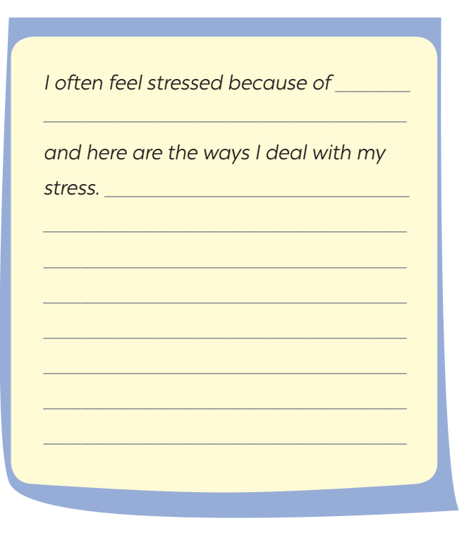
5. Write a paragraph (80 - 100 words) about the cause(s) of your stress
and offer solutions.

Slide 20

Suggested answer:
I often feel stressed because of my schoolwork, my parents and my friends. There are so much homework to do in the evening. And my parents also complaining about why I can’t be as good as a student who I never know about. My classmates are really excellent, they’re not only intelligent but also energetic, and they acquire a lot of achievement. To deal with my stress, I divide my schoolwork in parts to do. That way reduces my tiring feeling after finishing my homework. I ignore my parent’s complaint and focus on my own goals. I also ask my friends about tips about how to become excellent like them. I feel motivated after receiving so much useful advices from my friends.

Slide 21
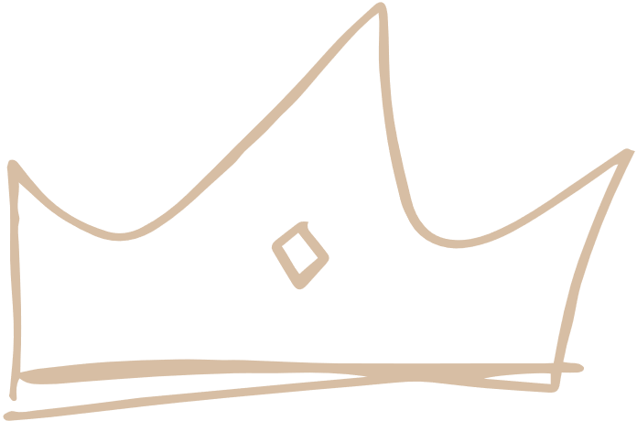
Wrap-up
What have we learned in this lesson?
Tell the whole class about their stress and what they often do to deal with stress.

Slide 22
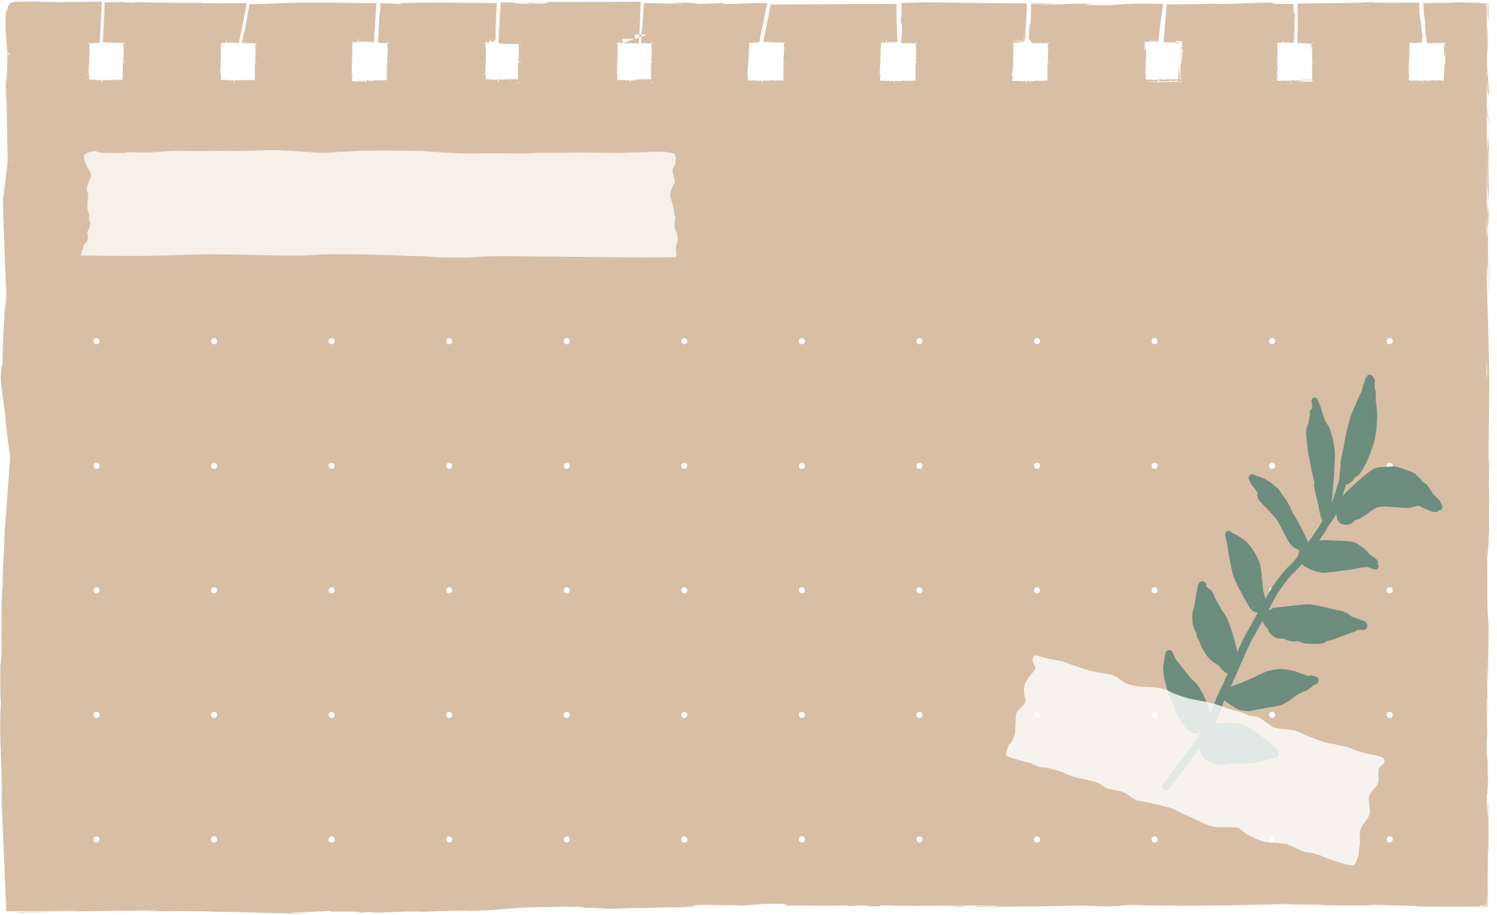
Thank you!

Slide 23
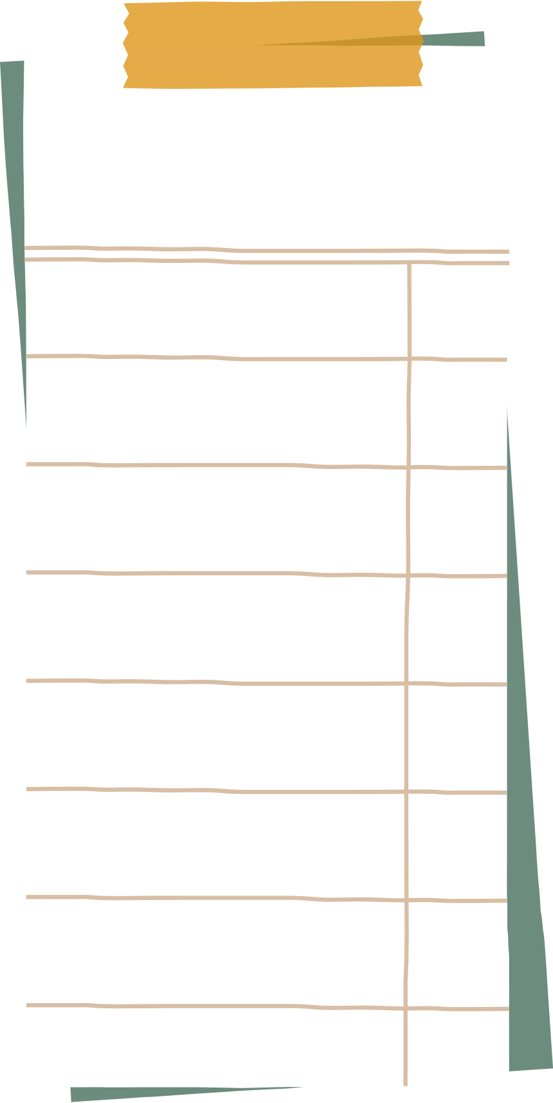
Resource
Page
Use these design resources
in your Canva Presentation.
Happy designing!
Don't forget to delete this page before presenting.

Slide 24

Resource
Page
Use these design resources
in your Canva Presentation.
Happy designing!
Don't forget to delete this page before presenting.

