Slide 1


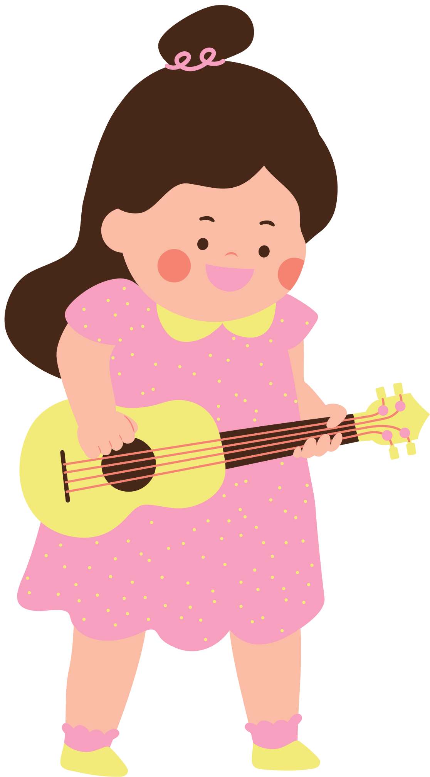
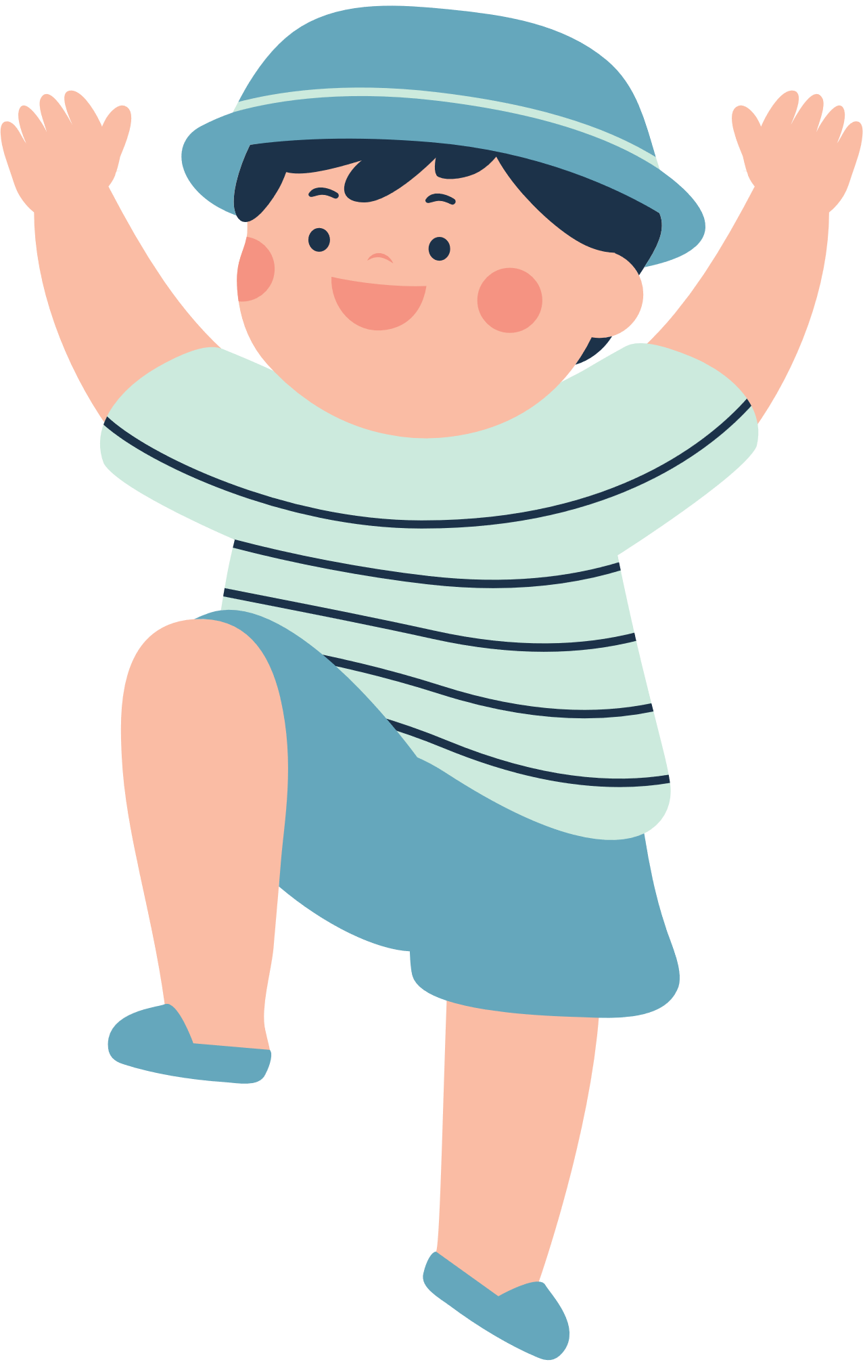


WELCOME TO OUR CLASS!
Teacher: ………..

Slide 2


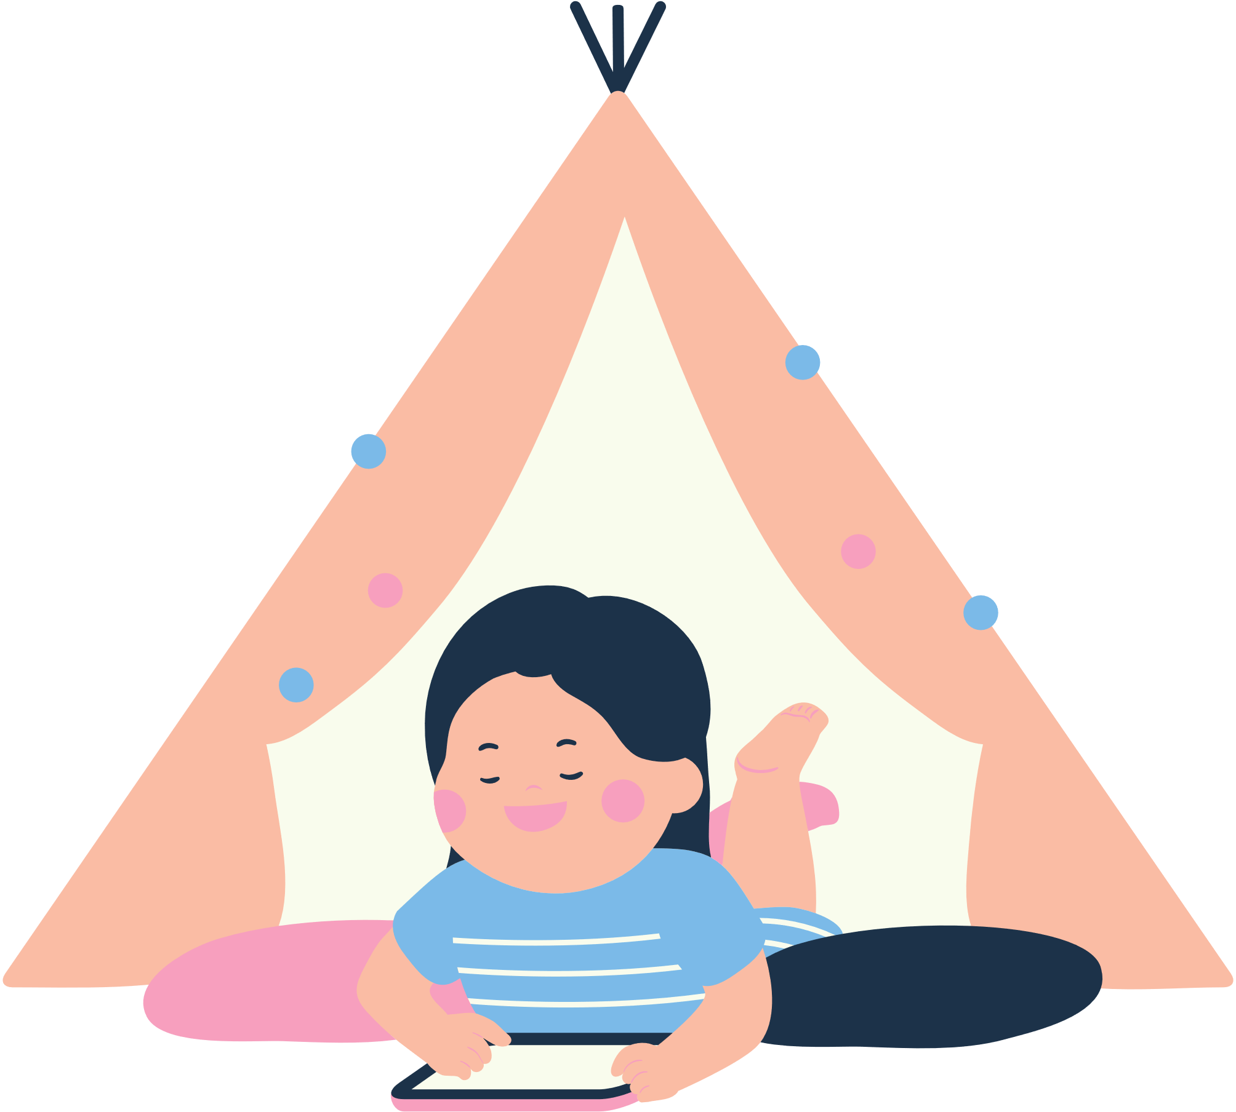
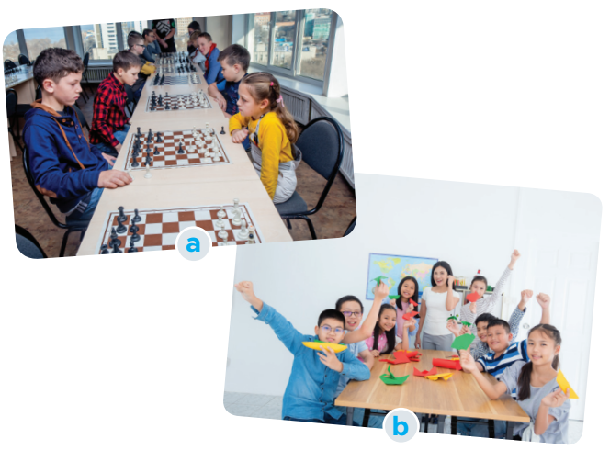
BRAINSTORMING
Look at the picture and say what club it is.
b. Which of your school clubs do you want to join?
Chess club
Arts and crafts club

Slide 3

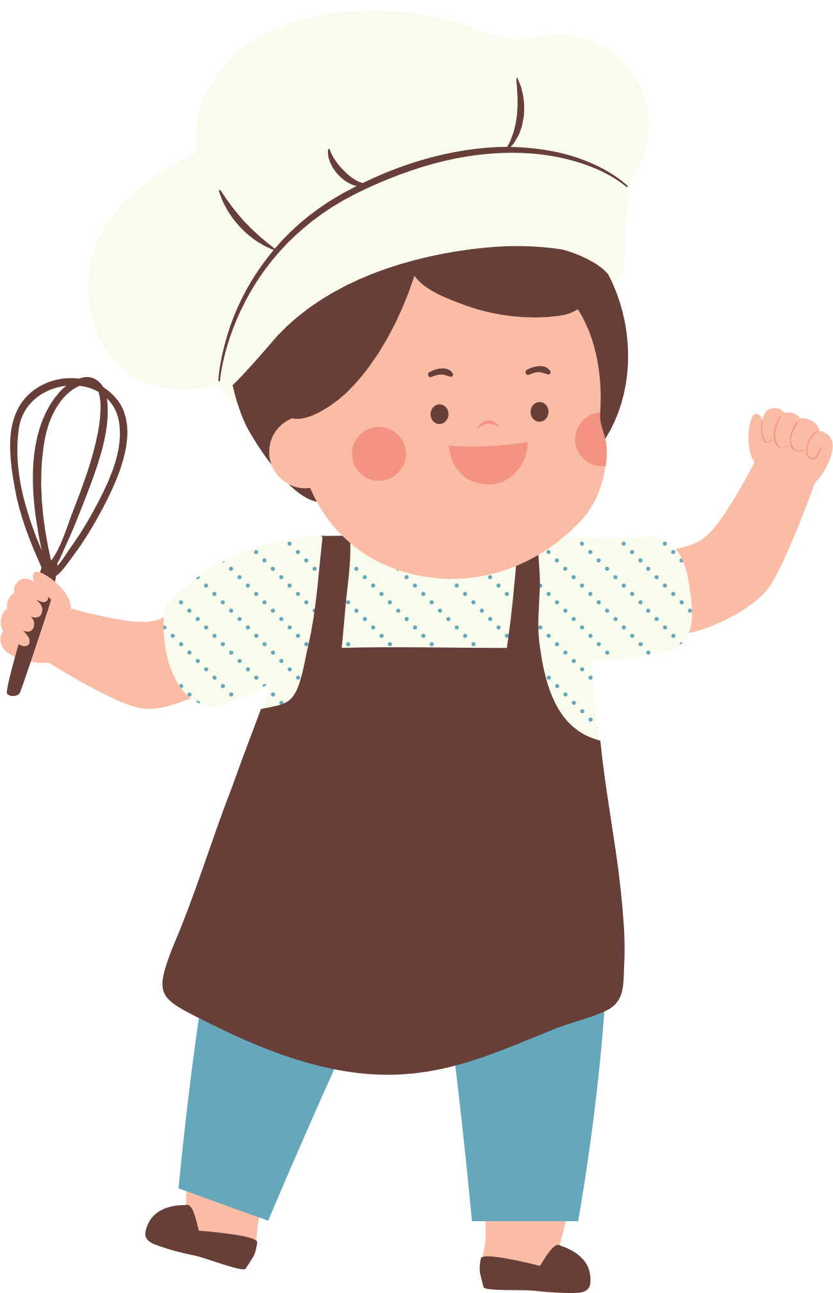
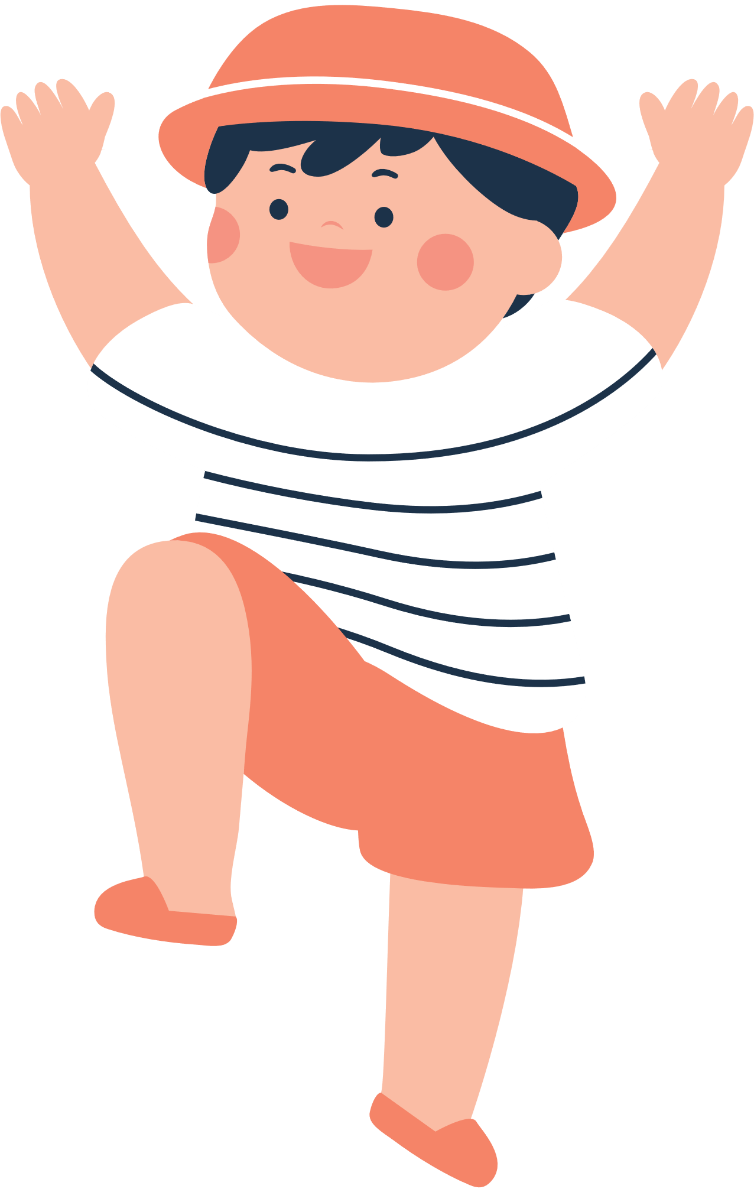
Unit 3: TEENAGERS
Lesson 5: Skills 1

Slide 4
VOCABULARY

Slide 5
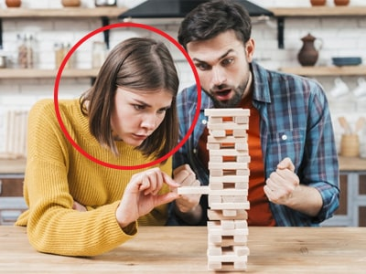

VOCABULARY
concentrate (v)
/ˈkɒnsntreɪt/
tập trung

Slide 6

VOCABULARY
focused (adj)
/ˈfəʊkəst/
chuyên tâm, tập trung

Slide 7

VOCABULARY
craft (n)
/krɑːft/
(nghề, đồ, kỹ nghệ) thủ công

Slide 8
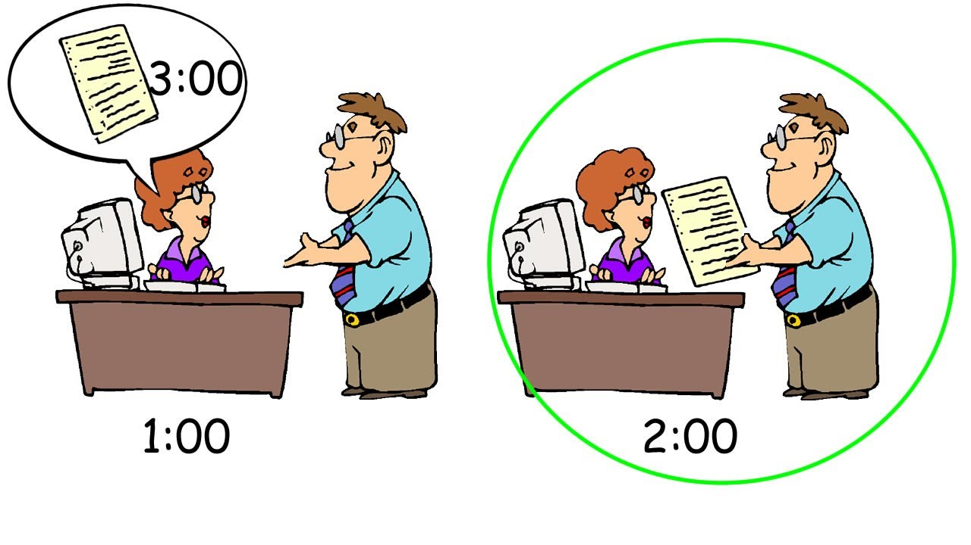
VOCABULARY
beforehand (adv)
/bɪˈfɔːhænd/
trước

Slide 9
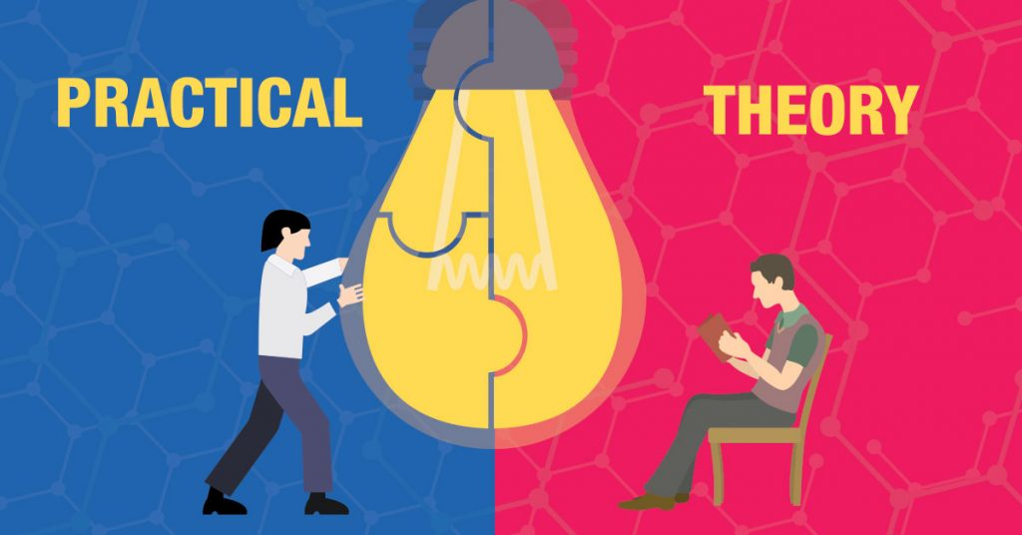
VOCABULARY
practical (adj)
/ˈpræktɪkl/
thực tế, thực tiễn

Slide 10

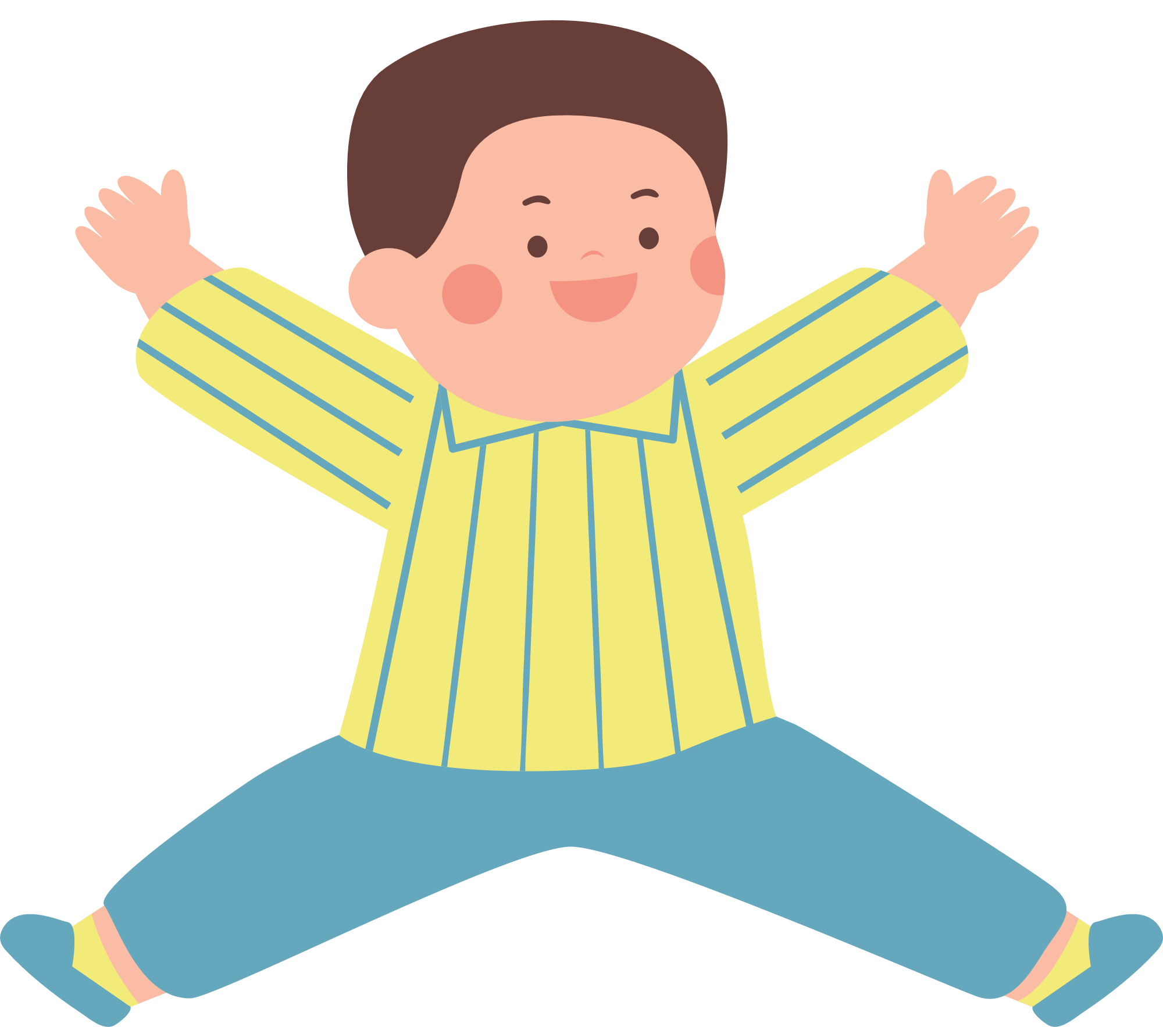
VOCABULARY
- concentrate (v) | /ˈkɒnsntreɪt/ | tập trung
- focused (adj) | /krɑːft/ | chuyên tâm, tập trung
- craft (n) | /ˈstresfl/ | thủ công
- beforehand (adv) | /bɪˈfɔːhænd/ | trước
- practical (adj) | /ˈpræktɪkl/ | thực tế, thực tiễn

Slide 11
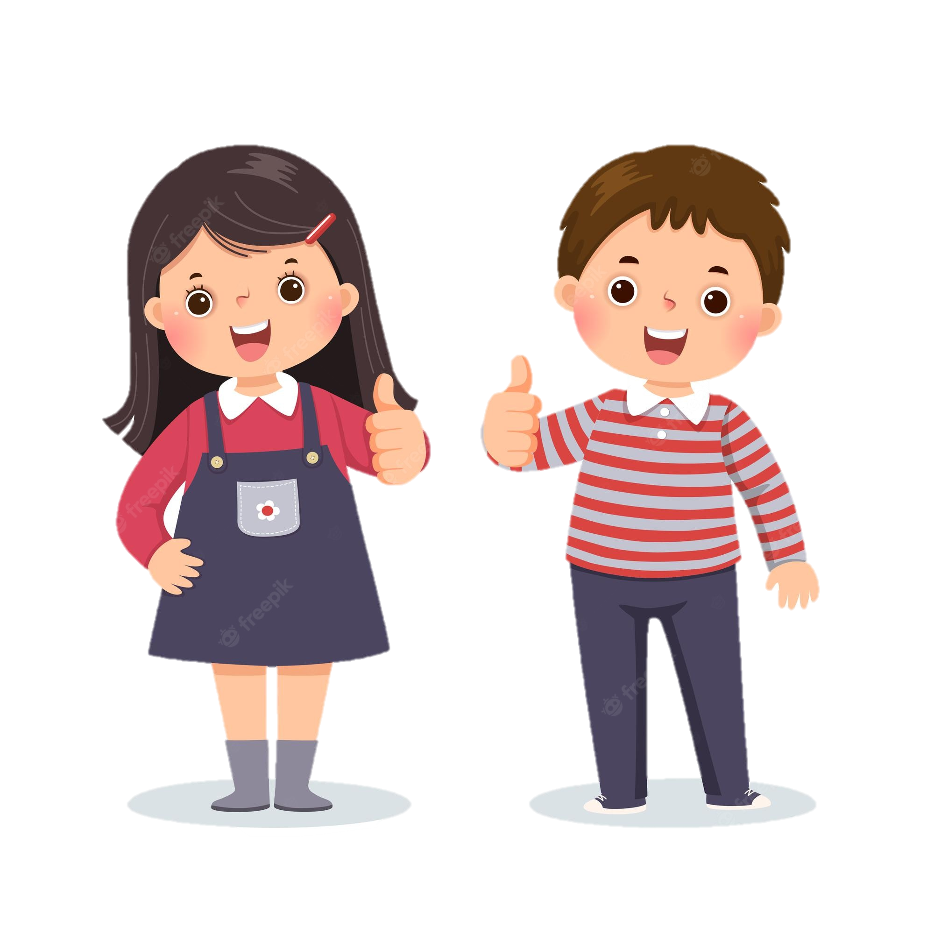

MAI
TOM
SCHOOL CLUB

Slide 12

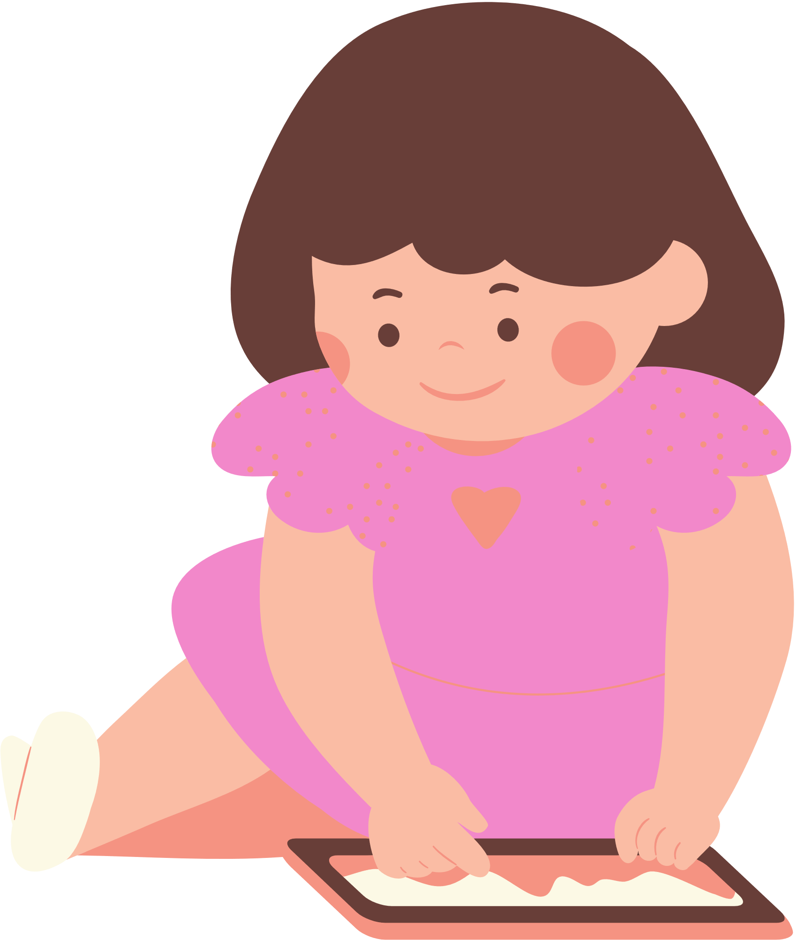
2. Read the conversation and tick T (true) or F (false) for each sentence.
1. The school has badminton, chess, and arts and crafts clubs.
T
F
T
F
2. The badminton club activities are after school.
T
F
3. Tom stayed playing chess when he was five.
4. Members of the arts and crafts club do community activities.
T
F

Slide 13
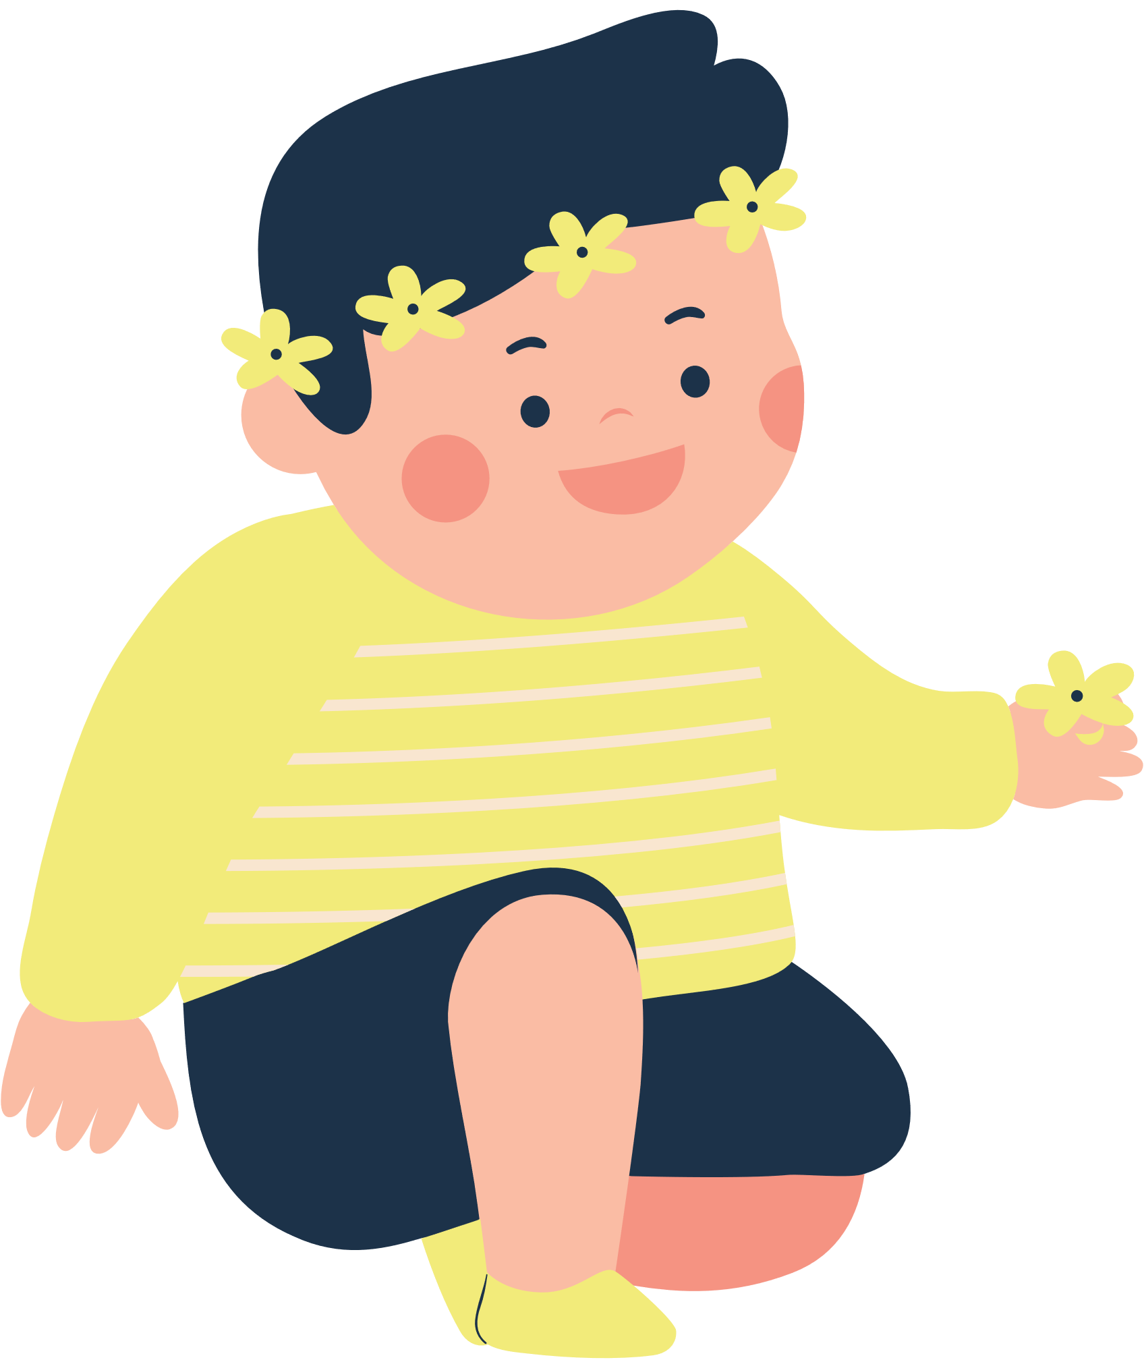
2. Read the conversation and tick T (true) or F (false) for each sentence.
1. The school has badminton, chess, and arts and crafts clubs.
T
F
Tom: I’m interested in two clubs: badminton and chess.
Mai: Actually, this year there is a new arts and crafts club, and I want to join it.

Slide 14
2. Read the conversation and tick T (true) or F (false) for each sentence.
T
F
2. The badminton club activities are after school.
Mai: OK. It’s on Tuesdays and Fridays from 5:00 p.m. to 6:30 p.m. It starts 30 minutes after school, so we have enough time to get some snacks beforehand.

Slide 15
2. Read the conversation and tick T (true) or F (false) for each sentence.
T
F
3. Tom stayed playing chess when he was five.
Tom: Well, I started playing it five years ago. My mum first sent me to a chess club because she wanted me to be more focused.

Slide 16
2. Read the conversation and tick T (true) or F (false) for each sentence.
4. Members of the arts and crafts club do community activities.
T
F
Mai: … I hear that the members will work together in small community service projects. Members can do art projects and also improve their practical skills and teamwork skills too.

Slide 17



Look at the answers again.
Sentences | T | F
1. The school has badminton, chess, and arts and crafts clubs.
2. The badminton club activities are after school.
3. Tom stayed playing chess when he was five.
4. Members of the arts and crafts club do community activities.
five years ago

Slide 18
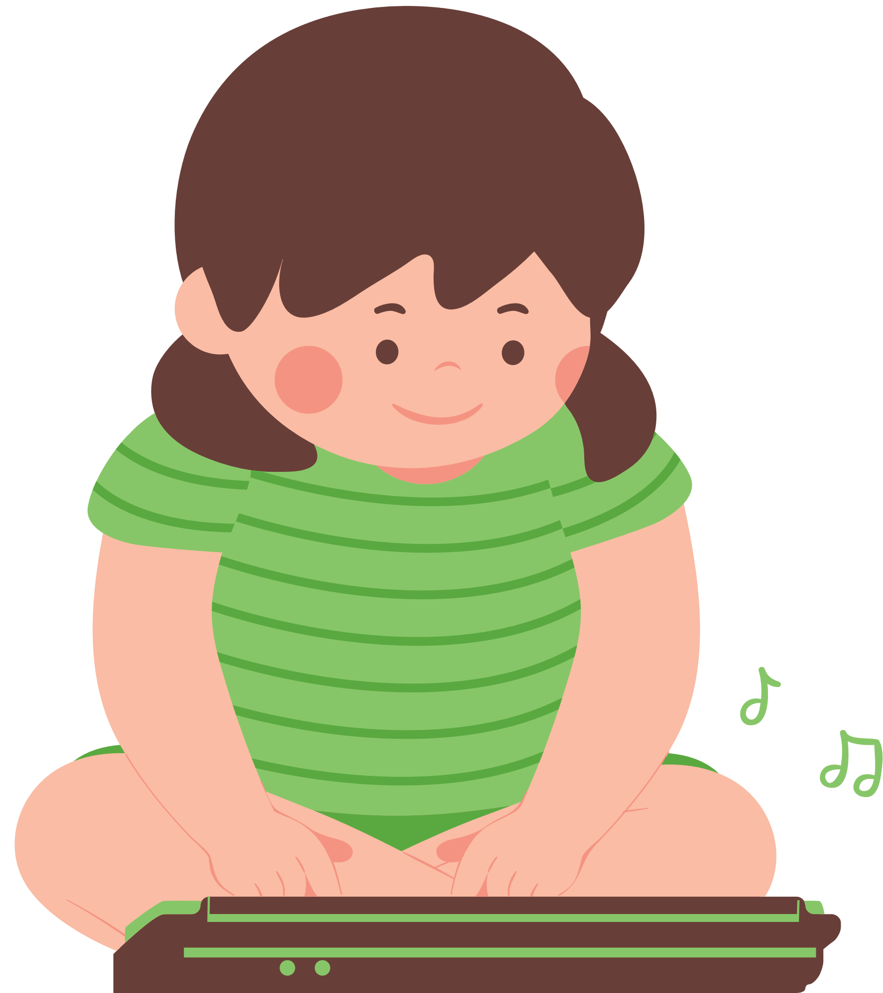
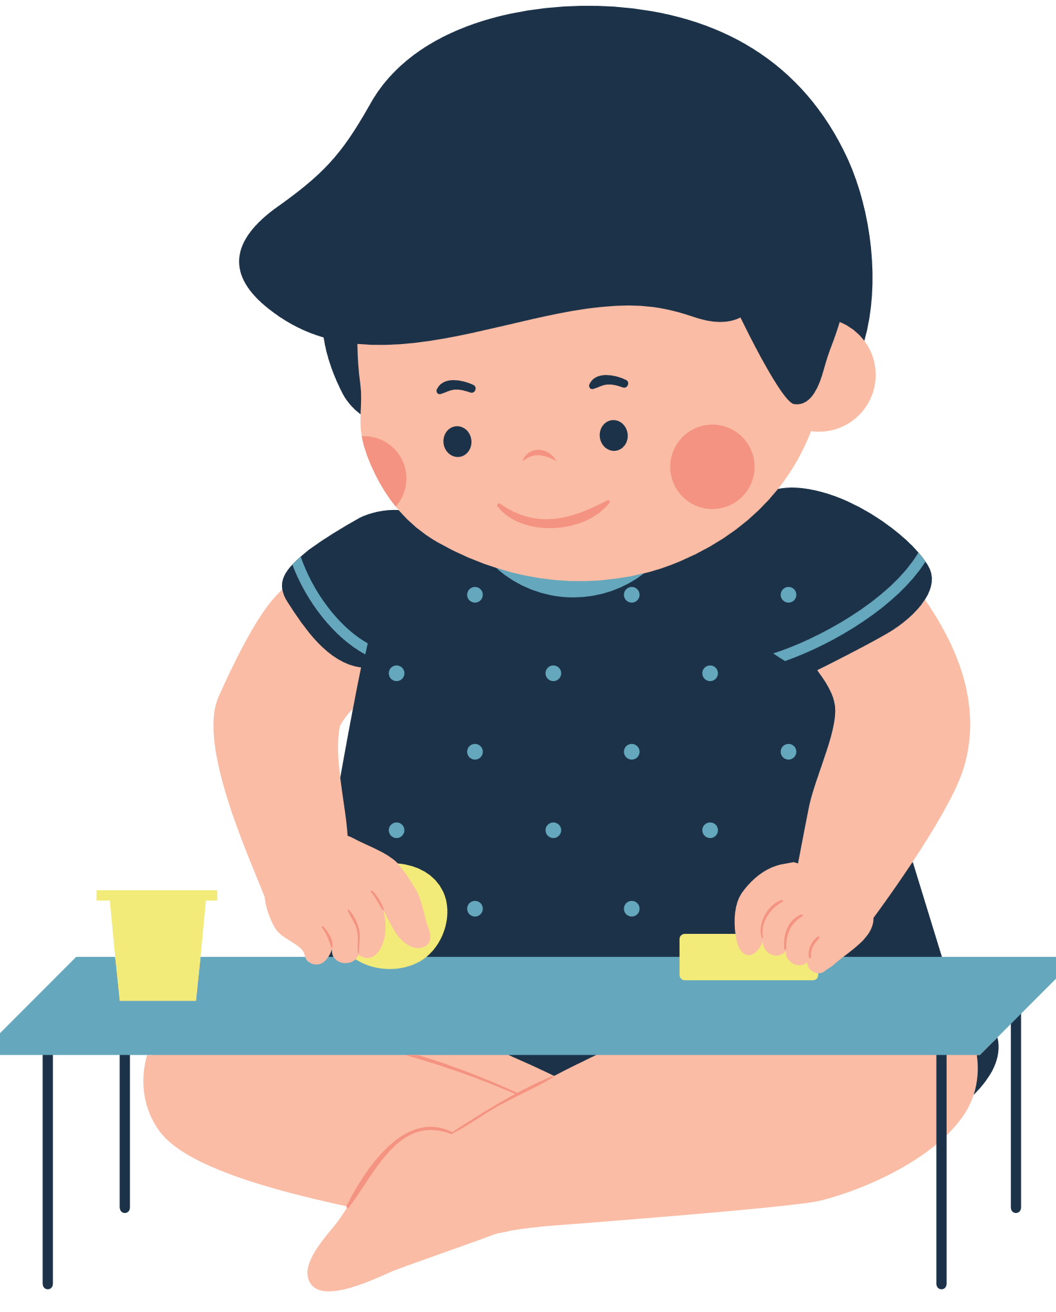
3. Read the conversation again and choose the correct answer A, B, or C.
1. Tom and Mai are discussing _________.
A. their leisure time activities
B. their school club activities
C. their likes and dislikes
2. Tom started playing chess because ________.
A. he loved it
B. he wanted to stay focused
C. his mum wanted him to play
3. Playing chess helps Tom________.
A. connect with other members
B. concentrate better
C. do community service
4. The word “it” refers________.
A. chess club B. arts and crafts club C. community service
5. Mai will participate in the arts and crafts club to ________.
A. help the school B. coach her friends C. do art projects

Slide 19


Slide 20



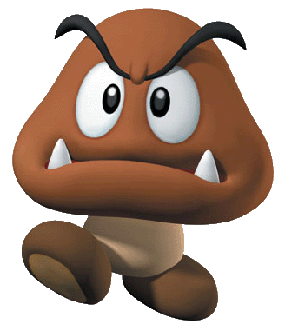


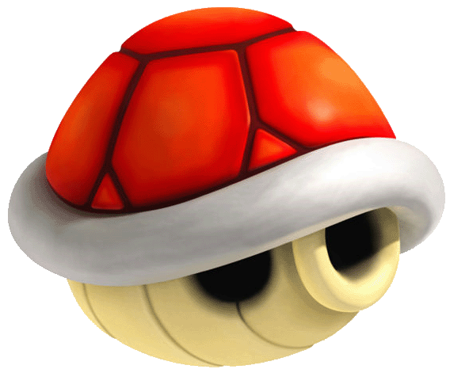



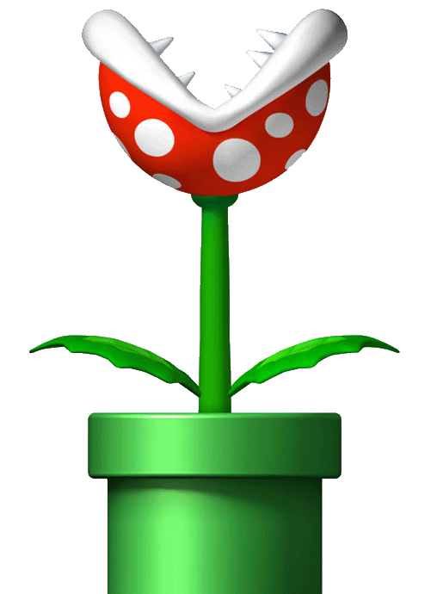


Enemies will kill you! Lose all points!
1 point
Double your points
2 points
Steal other team’s points.
3 points
Enemies will kill you!
Lose all points!
4 points
5 points

Slide 21

A
B
C
D
E
F

Slide 22
3. Read the conversation again and choose the correct answer A, B, or C.
1. Tom and Mai are discussing _________.
A. their leisure time activities
B. their school club activities
C. their likes and dislikes

Slide 23


Slide 24
3. Read the conversation again and choose the correct answer A, B, or C.
2. Tom started playing chess because ________.
A. he loved it
B. he wanted to stay focused
C. his mum wanted him to play

Slide 26
3. Read the conversation again and choose the correct answer A, B, or C.
3. Playing chess helps Tom________.
A. connect with other members
B. concentrate better
C. do community service

Slide 28
3. Read the conversation again and choose the correct answer A, B, or C.
4. The word “it” refers________.
A. chess club
B. arts and crafts club
C. community service

Slide 30
3. Read the conversation again and choose the correct answer A, B, or C.
5. Mai will participate in the arts and crafts club to ________.
A. help the school
B. coach her friends
C. do art projects

Slide 32


Slide 33

Steal other team’s points.

Slide 34
Double your points.

Slide 35
Lose all points.

Slide 36
Look at the answers again.
1. Tom and Mai are discussing _________.
A. their leisure time activities
B. their school club activities
C. their likes and dislikes
2. Tom started playing chess because ________.
A. he loved it
B. he wanted to stay focused
C. his mum wanted him to play
3. Playing chess helps Tom________.
A. connect with other members
B. concentrate better
C. do community service
4. The word “it” refers________.
A. chess club B. arts and crafts club C. community service
5. Mai will participate in the arts and crafts club to ________.
A. help the school B. coach her friends C. do art projects

Slide 37

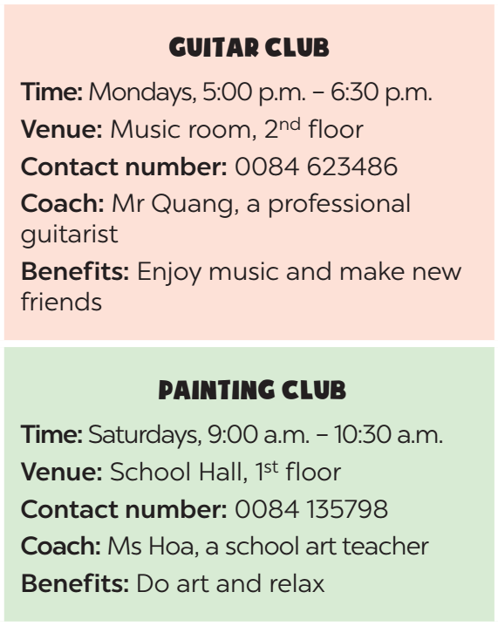
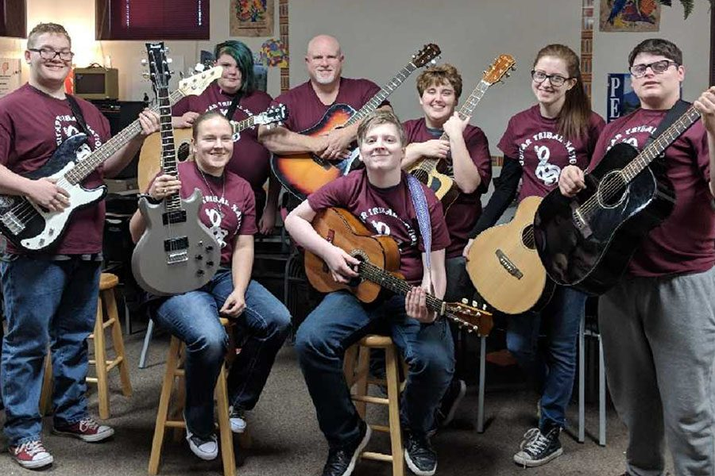
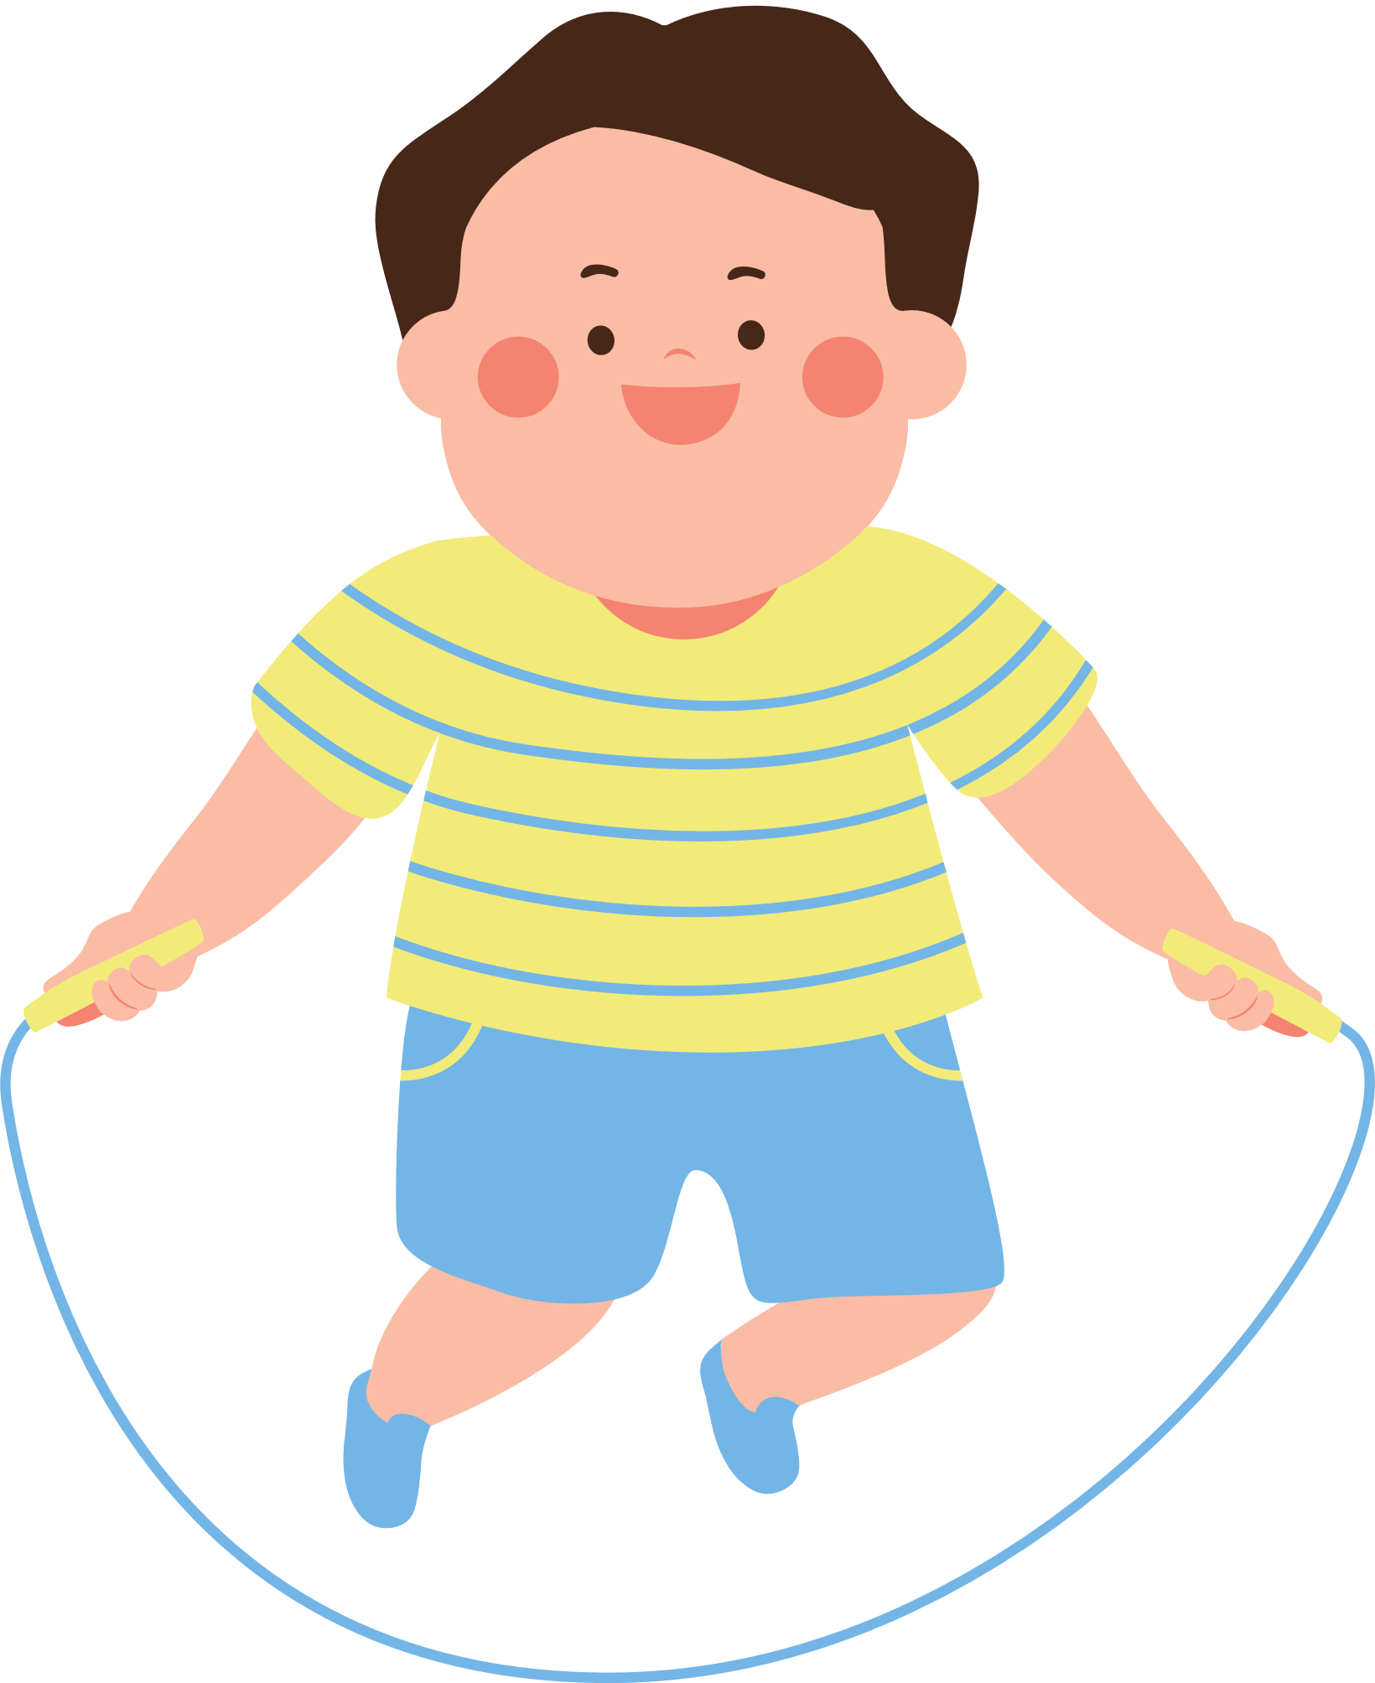
4. Work in groups. Make conversations using the given information.
Guitar club

Slide 38
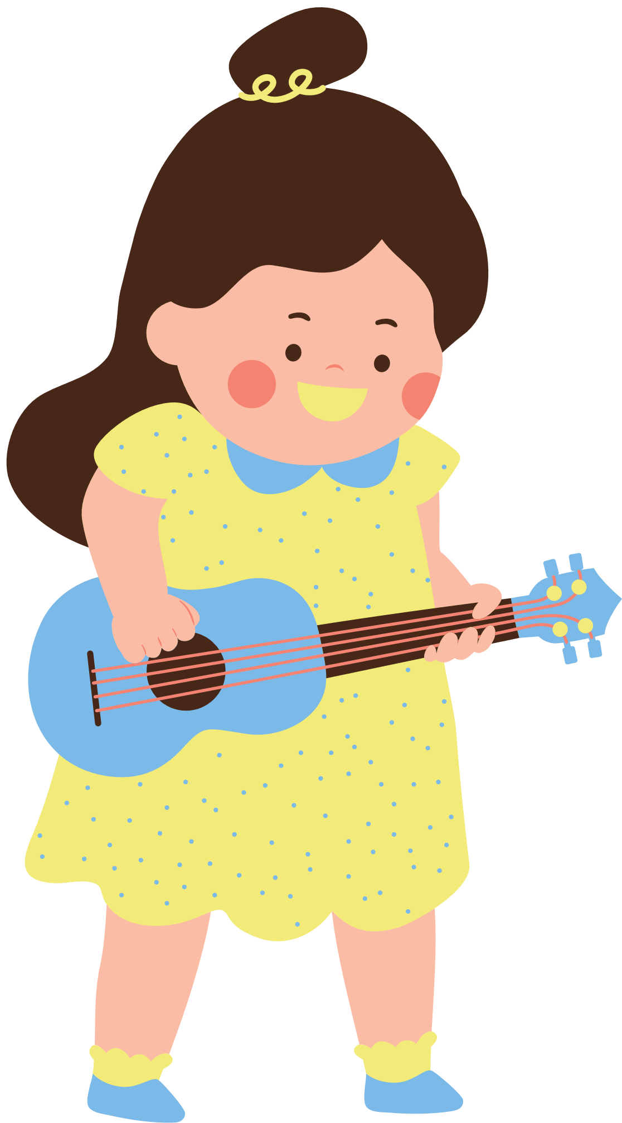
4. Work in groups. Make conversations using the given information.
What time does the guitar club meet?
It meets on Mondays, from 5:00 p.m. to 6: 30 p.m.
It meets in the music room, on the second floor.
Where does it meet?
Suggested questions:
- How can I contact the club? / What is the contact number of the club?
- Who will coach the club?
- What are the benefits you get when you join the club? / Why do you want to join this club?

Slide 39
4. Work in groups. Make conversations using the given information.
What time does the …..meet?
It meets on ….
It meets in …
Where does it meet?
Suggested questions:
- How can I contact the club? / What is the contact number of the club?
- Who will coach the club?
- What are the benefits you get when you join the club? / Why do you want to join this club?

Slide 40

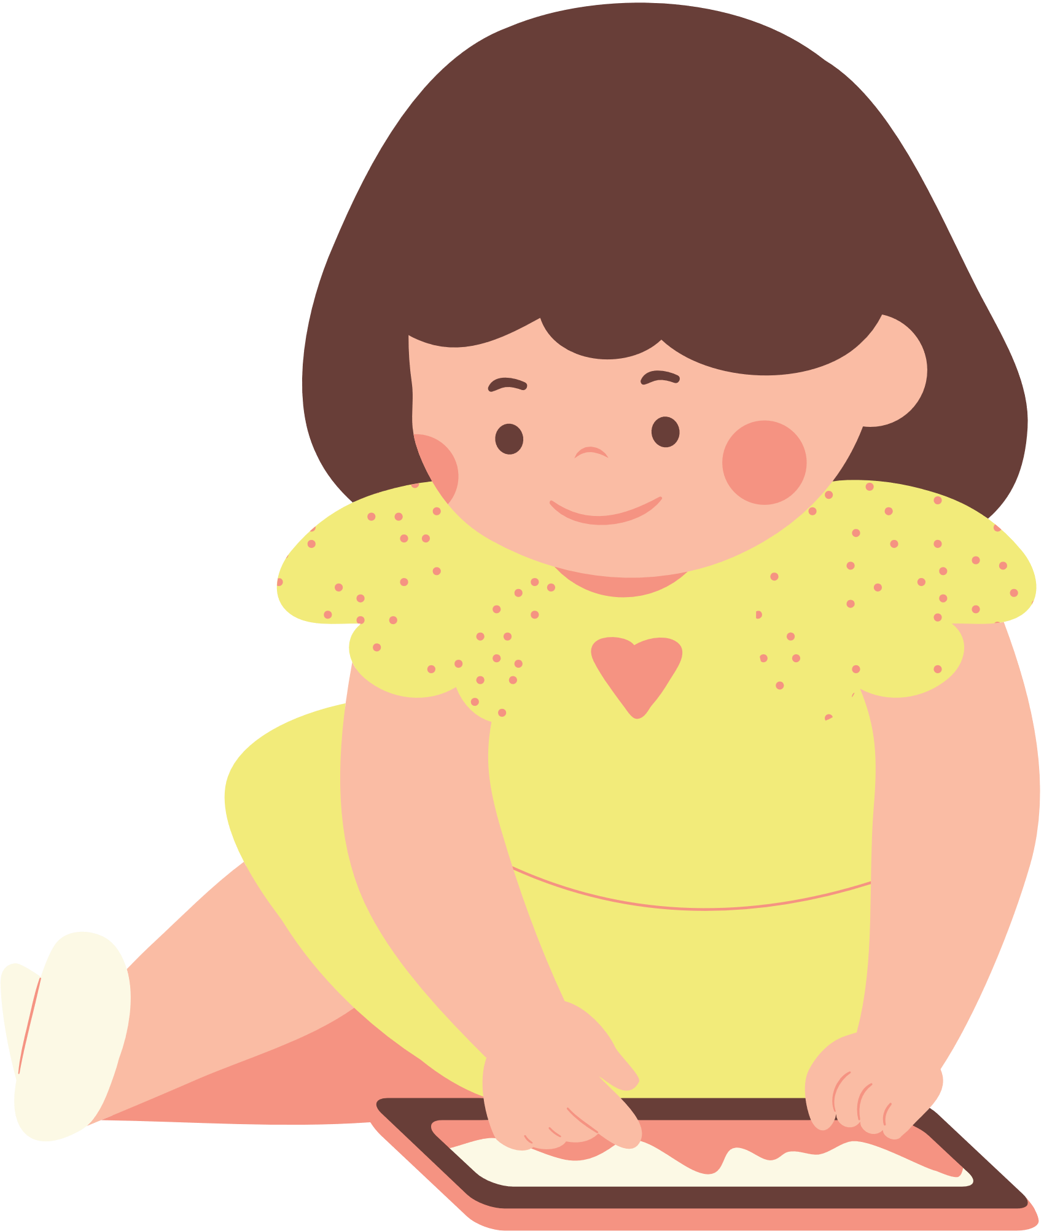

5. Work in groups. Ask and answer questions about a club at your school. Report the answers to your class.
The music club at my school meets on Tuesdays, from 5:00 p.m. to 6:30p.m. It meets in the music room, on the second floor…
Suggested questions:
- What time does the club meet?
- Where does it meet?
- How can I contact the club? / What is the contact number of the club?
- Who will coach the club?
- What are the benefits you get when you join the club? / Why do you want to join this club?

Slide 41
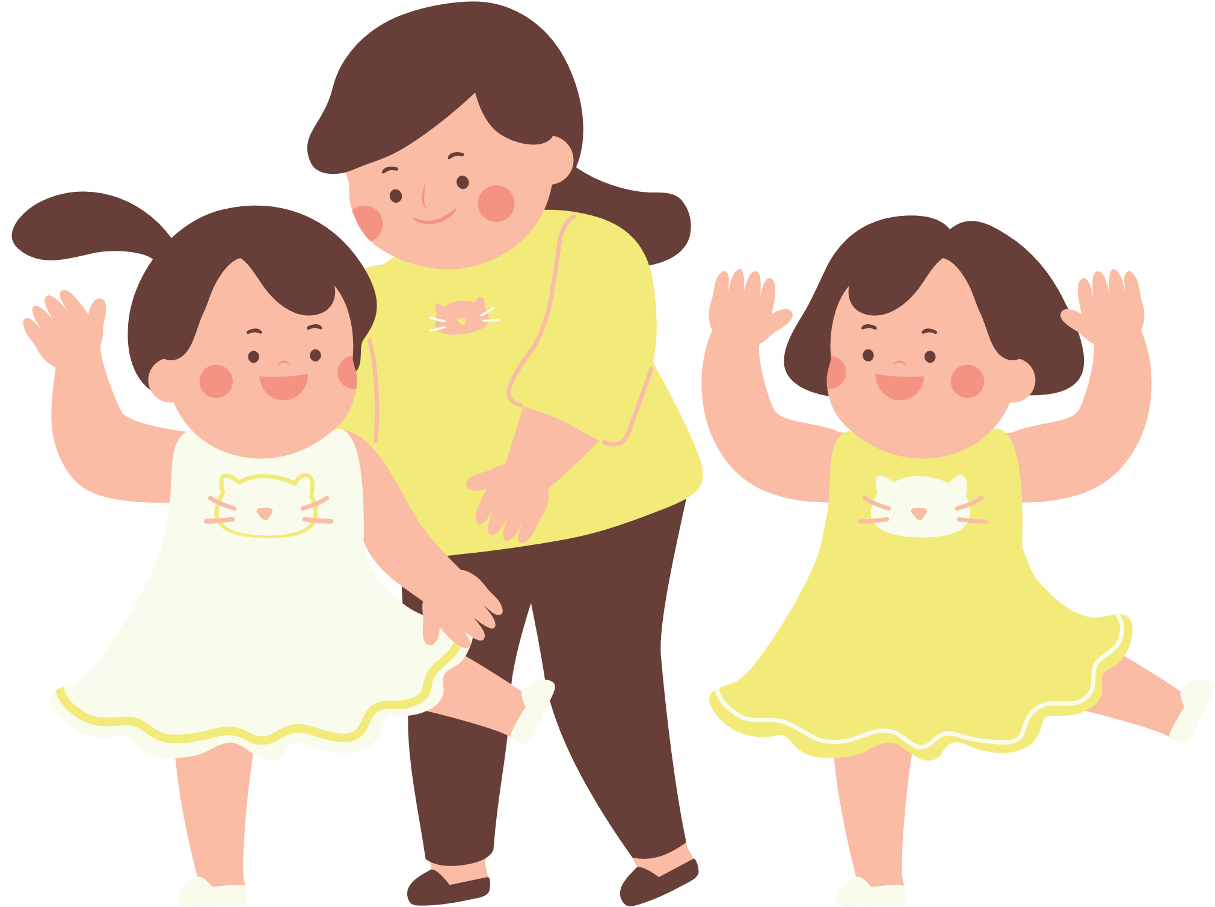
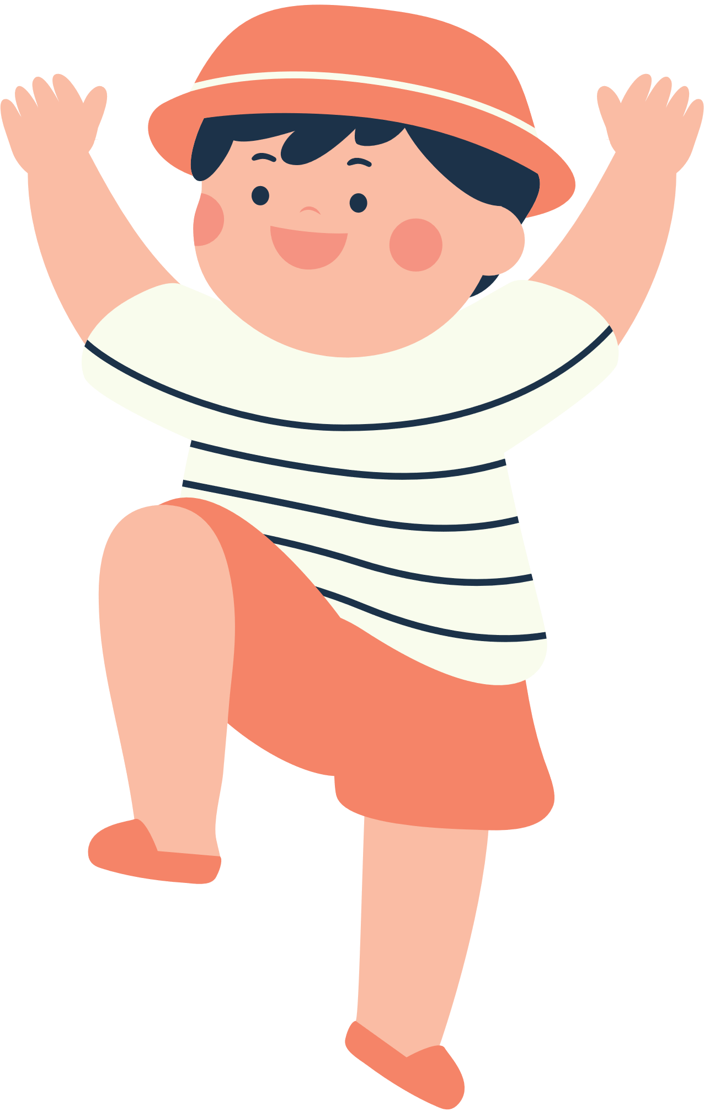
WRAP –UP
Retell some school clubs they have learned after the lesson and their benefits.

Slide 42
THANK YOU!

Slide 43
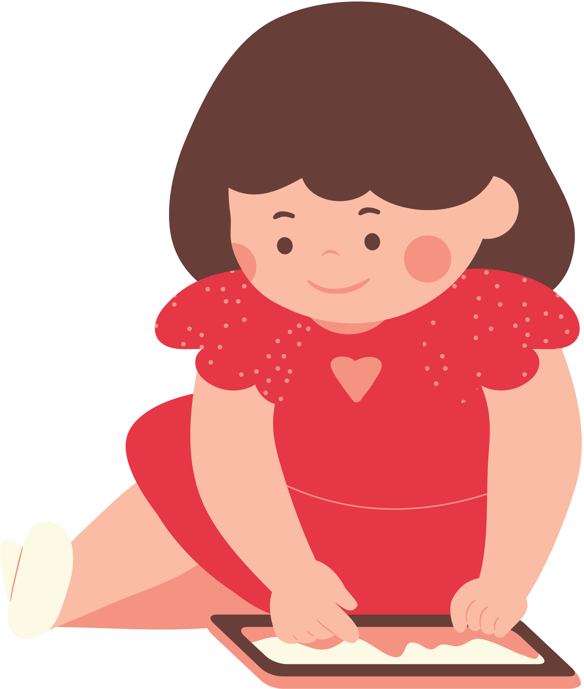
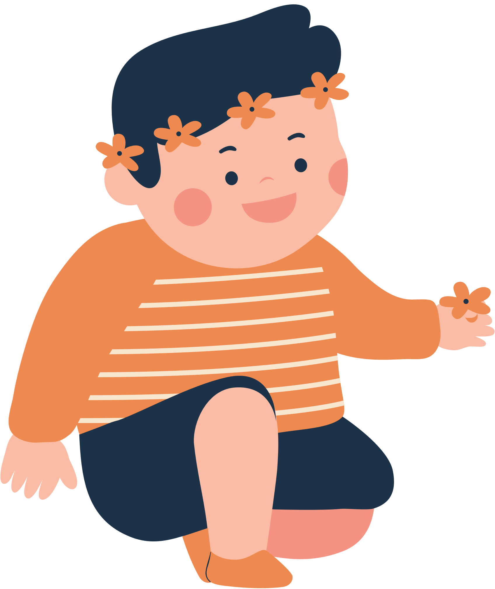
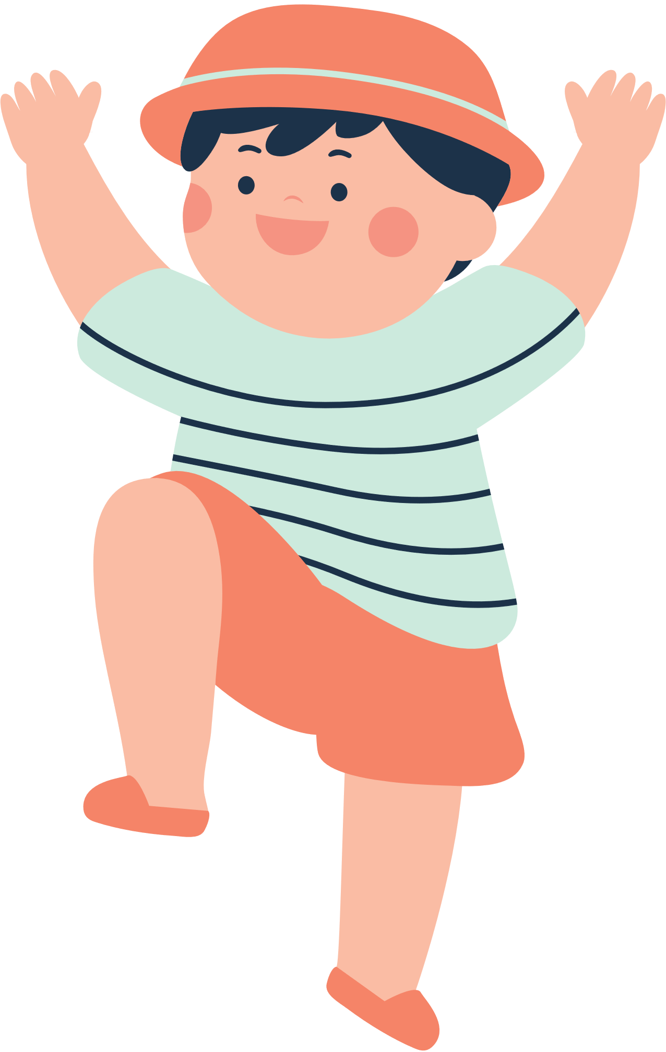
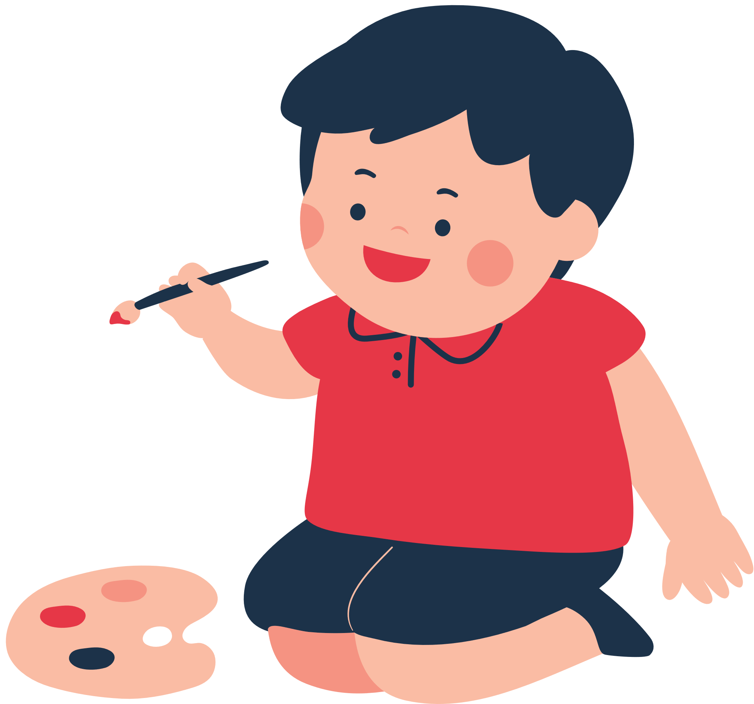

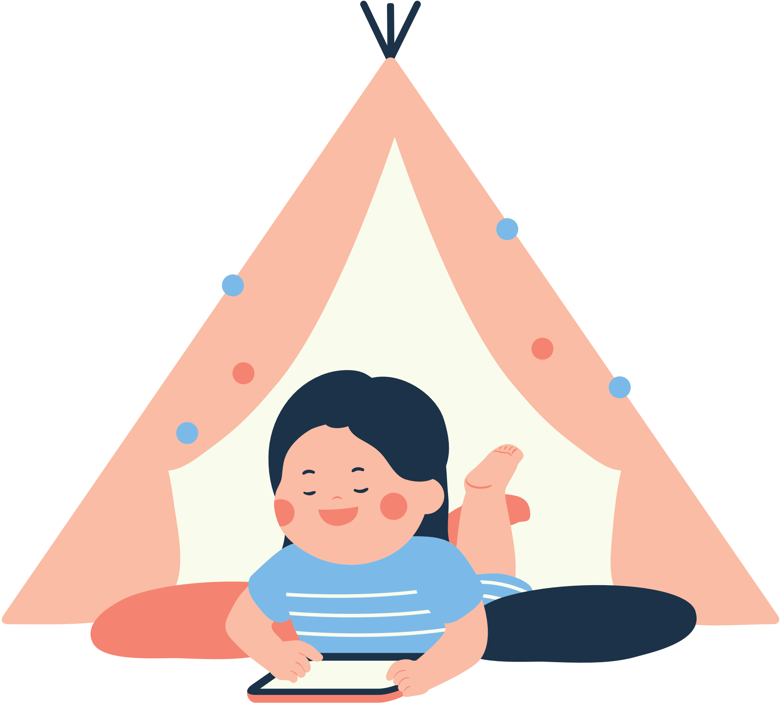
RESOURCES

