Slide 1


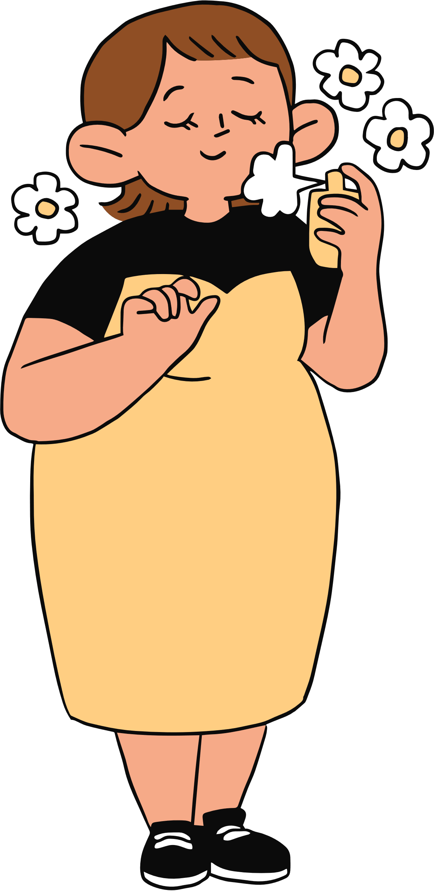
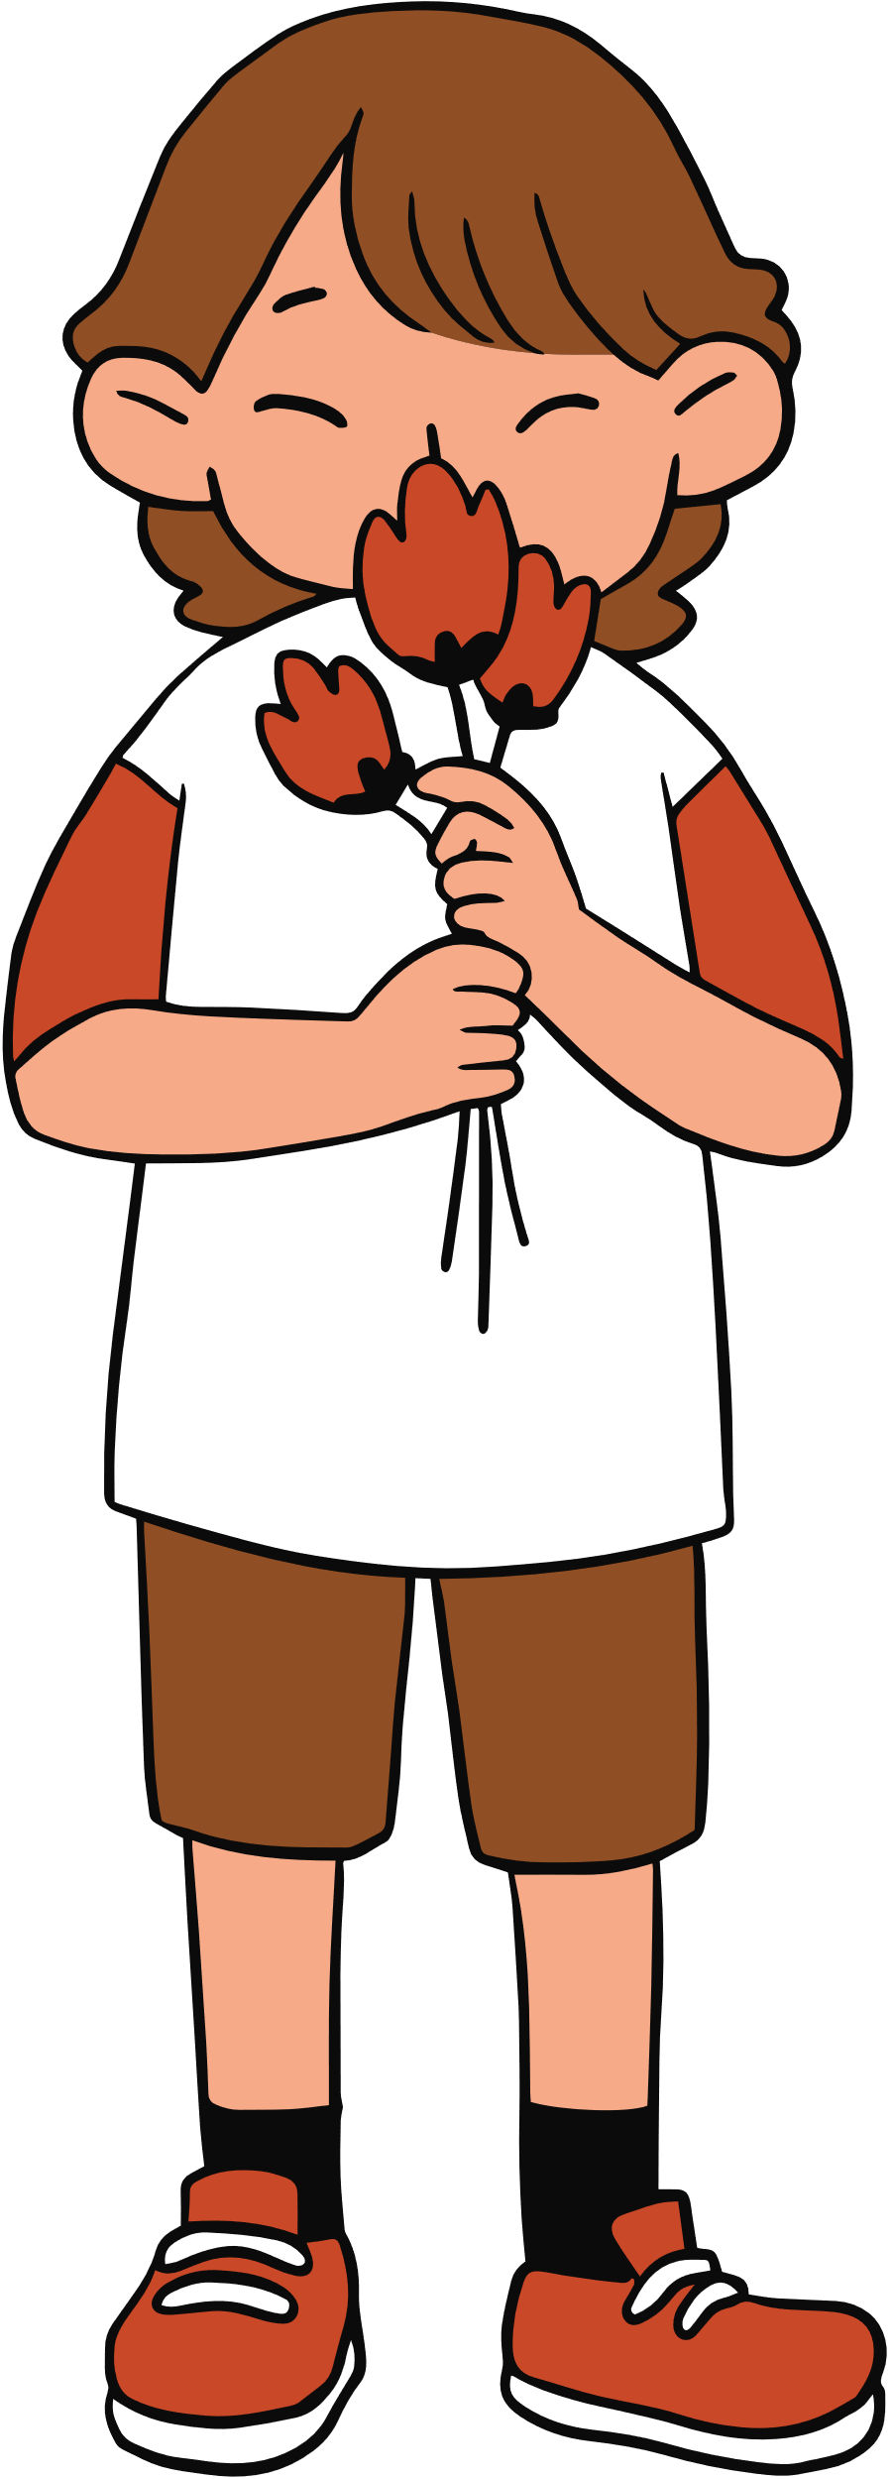


WELCOME TO OUR CLASS!
Teacher: …………

Slide 2
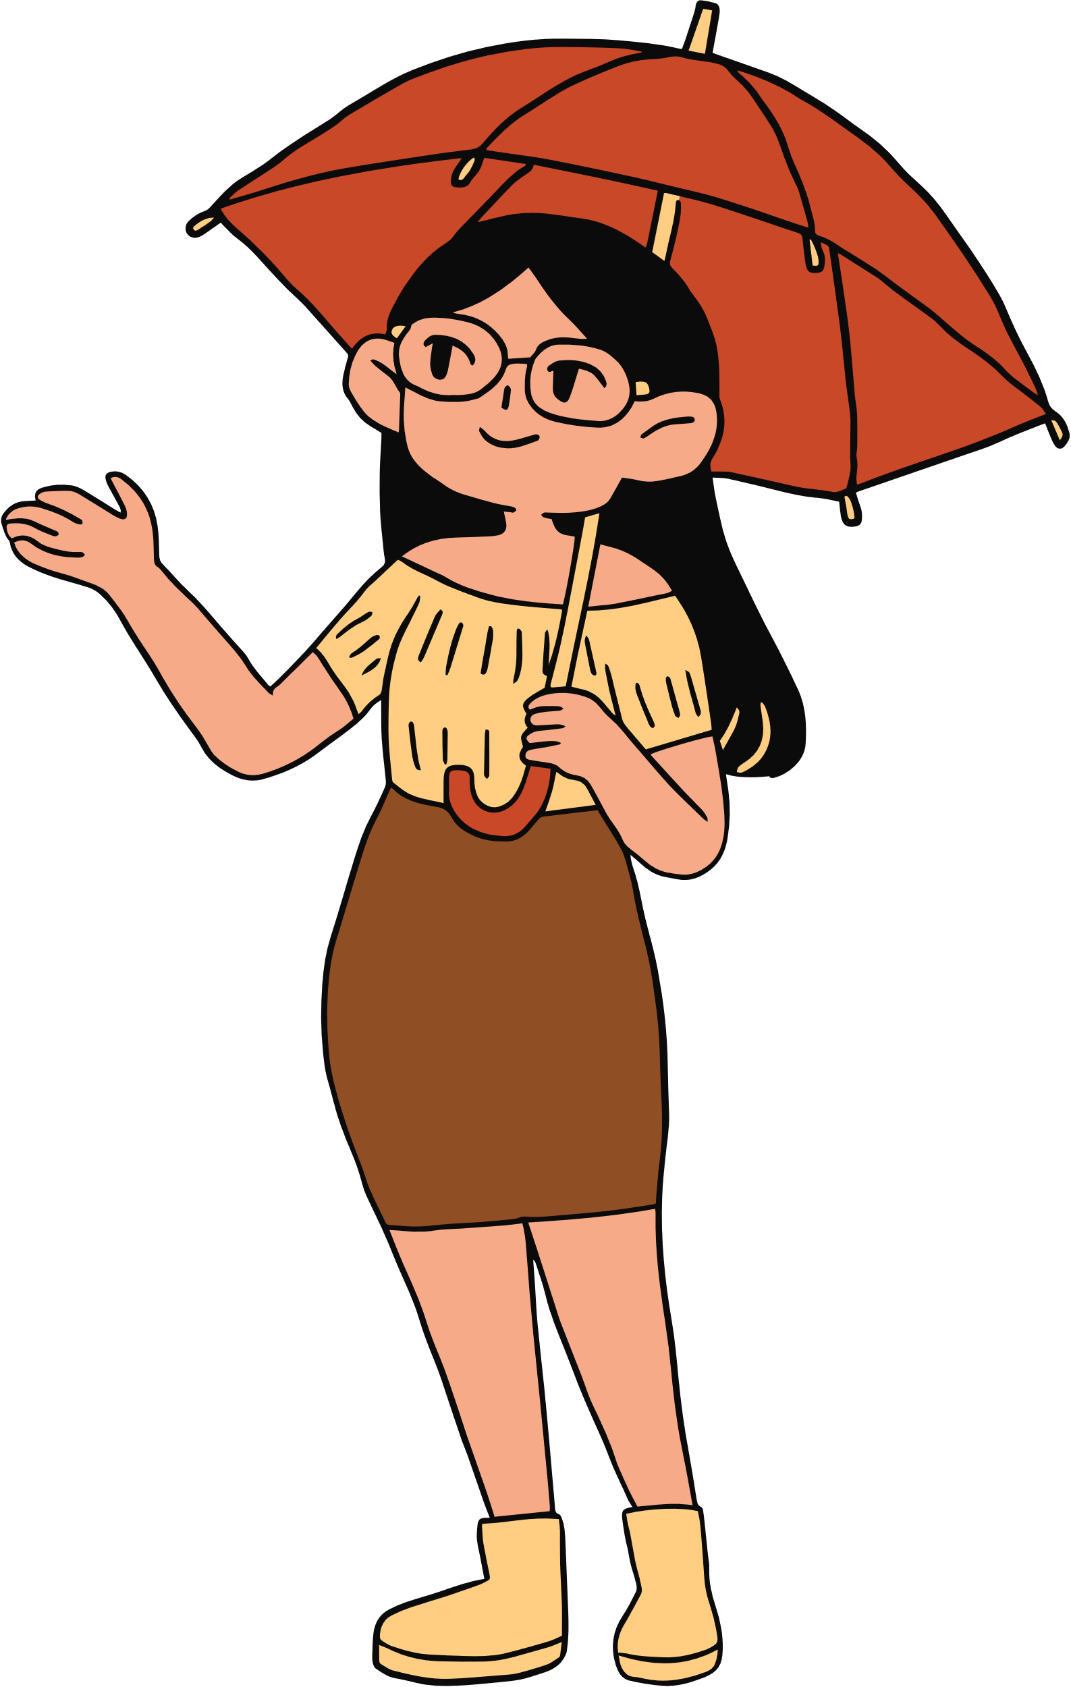
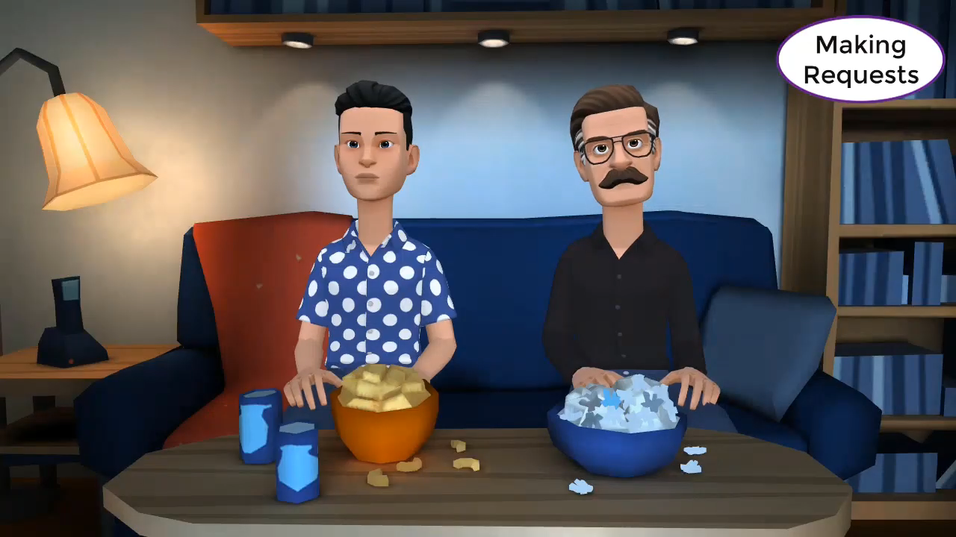
Watch a video and complete the sentences.
Could
1.______ you give me 60$?
2._____________lending me your pink shirt?
3.__________________ lend me your scooter?
Do you mind
I wonder if you could

Slide 3
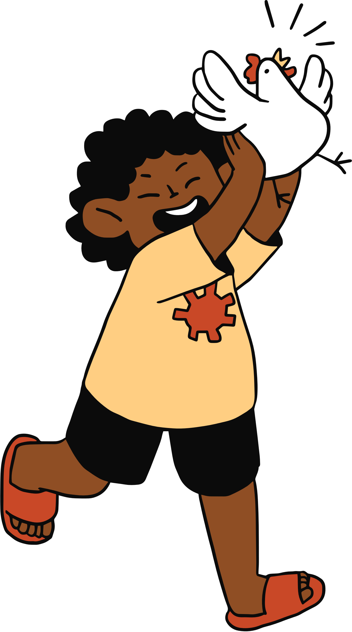
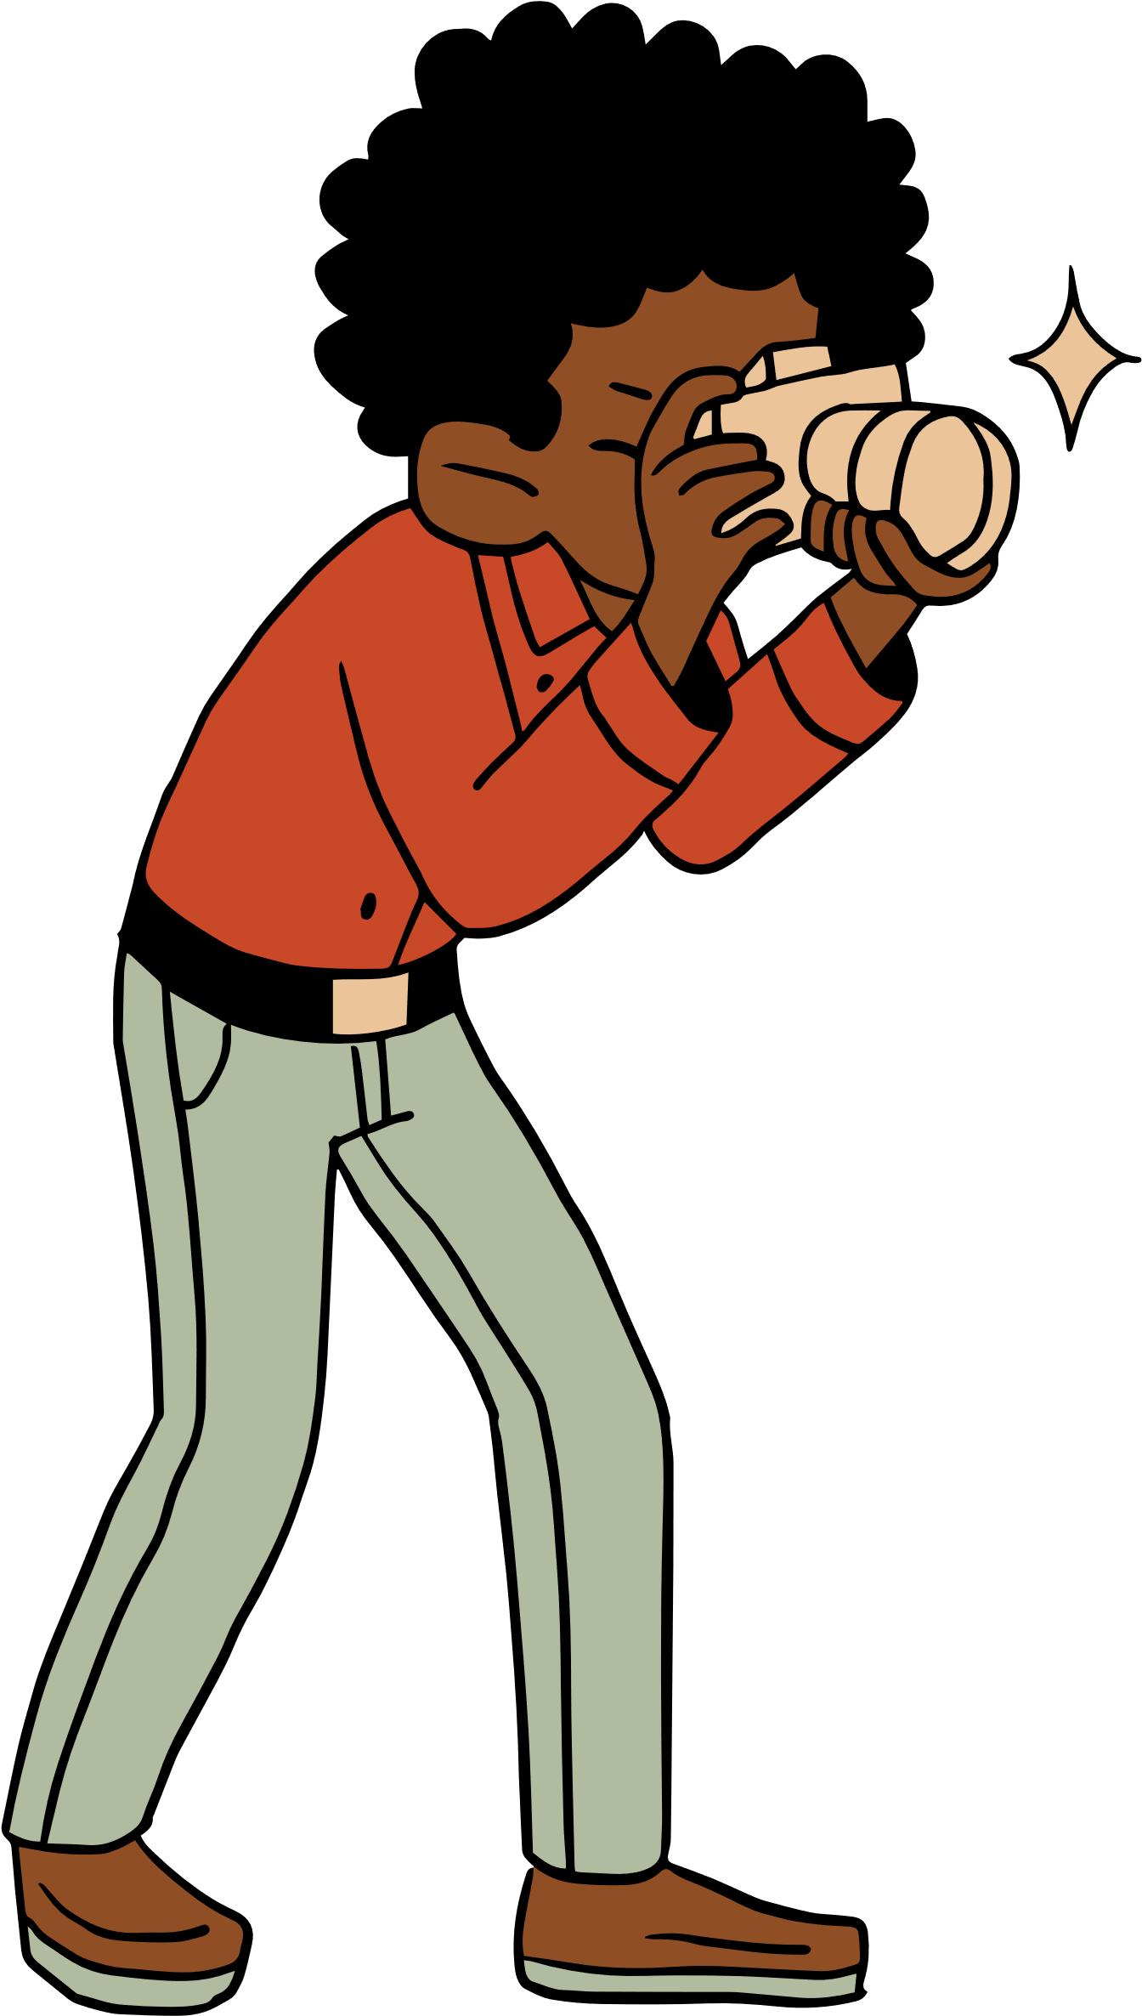

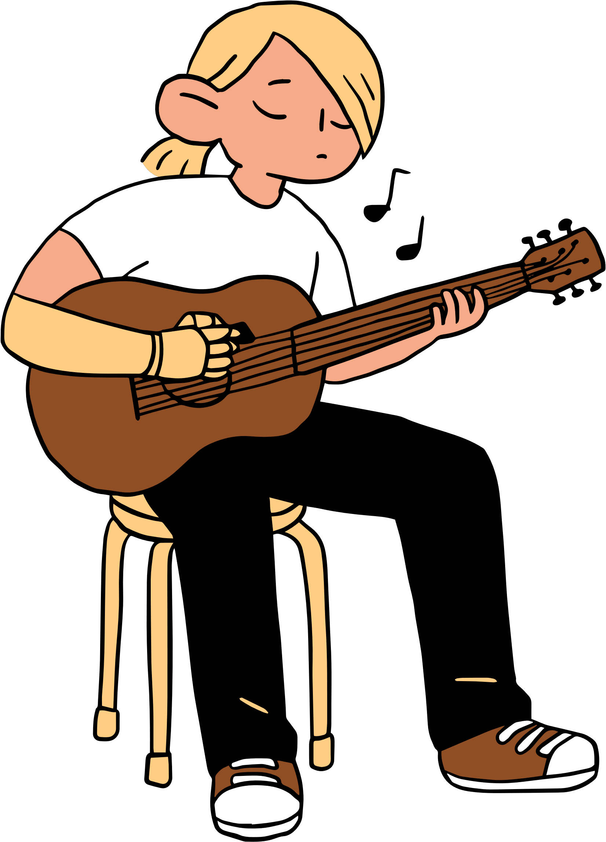
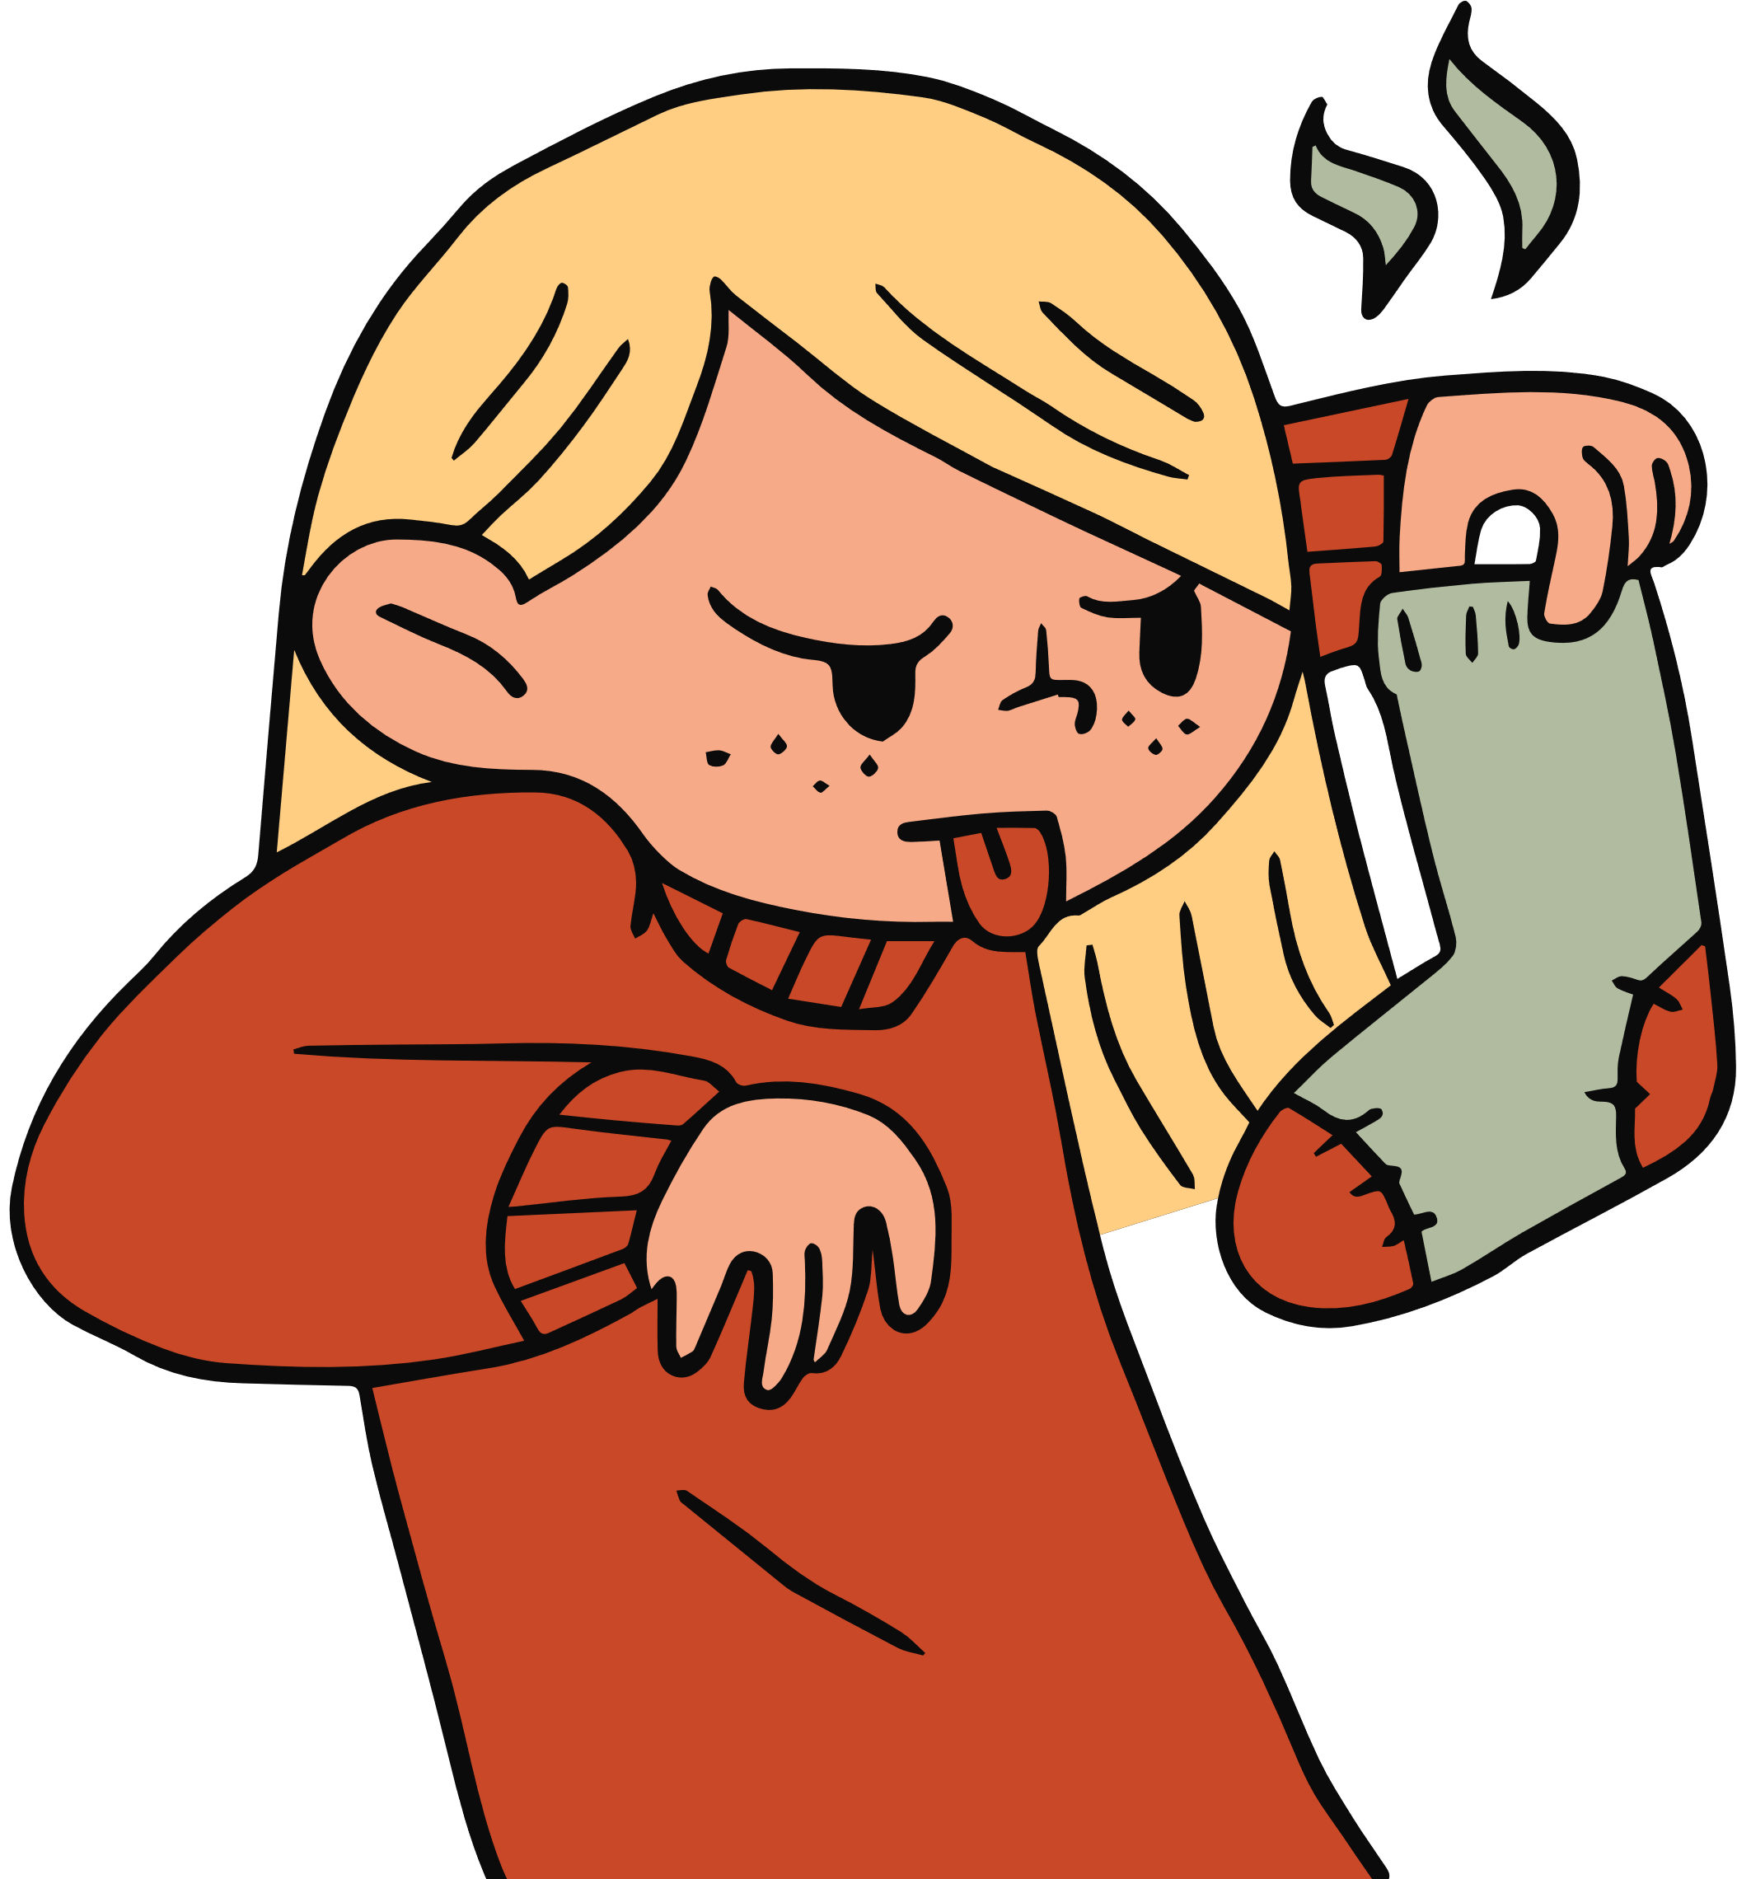

Unit 3: TEENAGERS
Lesson 4: Communication

Slide 4


Everyday English
Making request

Slide 5



1. Listen and read the dialogues below. Pay attention to the highlighted sentences.
Student: Can you tell me more about the music club, please?
School club leader: Certainly. It meets on Mondays and Thursdays.
Student: Could you tell me the time it meets?
School club leader: Yes, it’s after school, from 5:00 p.m. to 6:30 p.m.

Slide 6

Making requests | Examples
- Can you…, please? - Could you…(, please)? | - Can you tell me more about the music club, please? - Could you tell me the time it meets?

Slide 7
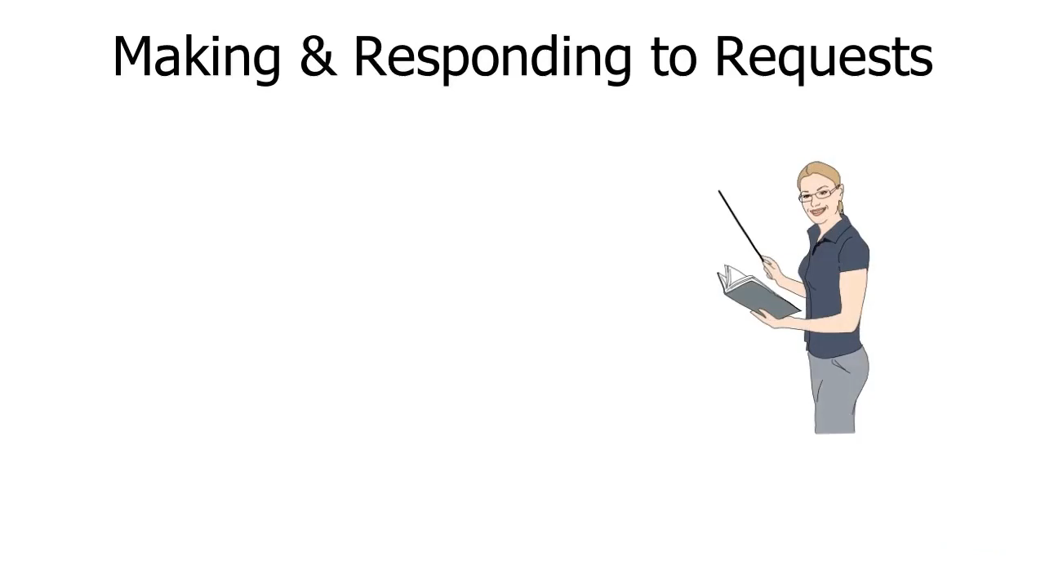
Find more…

Slide 8


2. Work in pairs. Make similar conversations, using the cues below.
Ask to borrow a book from your classmate.
Example: Can you lend me your book that you finished reading, please?

Slide 9

2. Work in pairs. Make similar conversations, using the cues below.
- Request some advice on how to do your science project.
Example: Could you tell me how to start a science project?

Slide 10

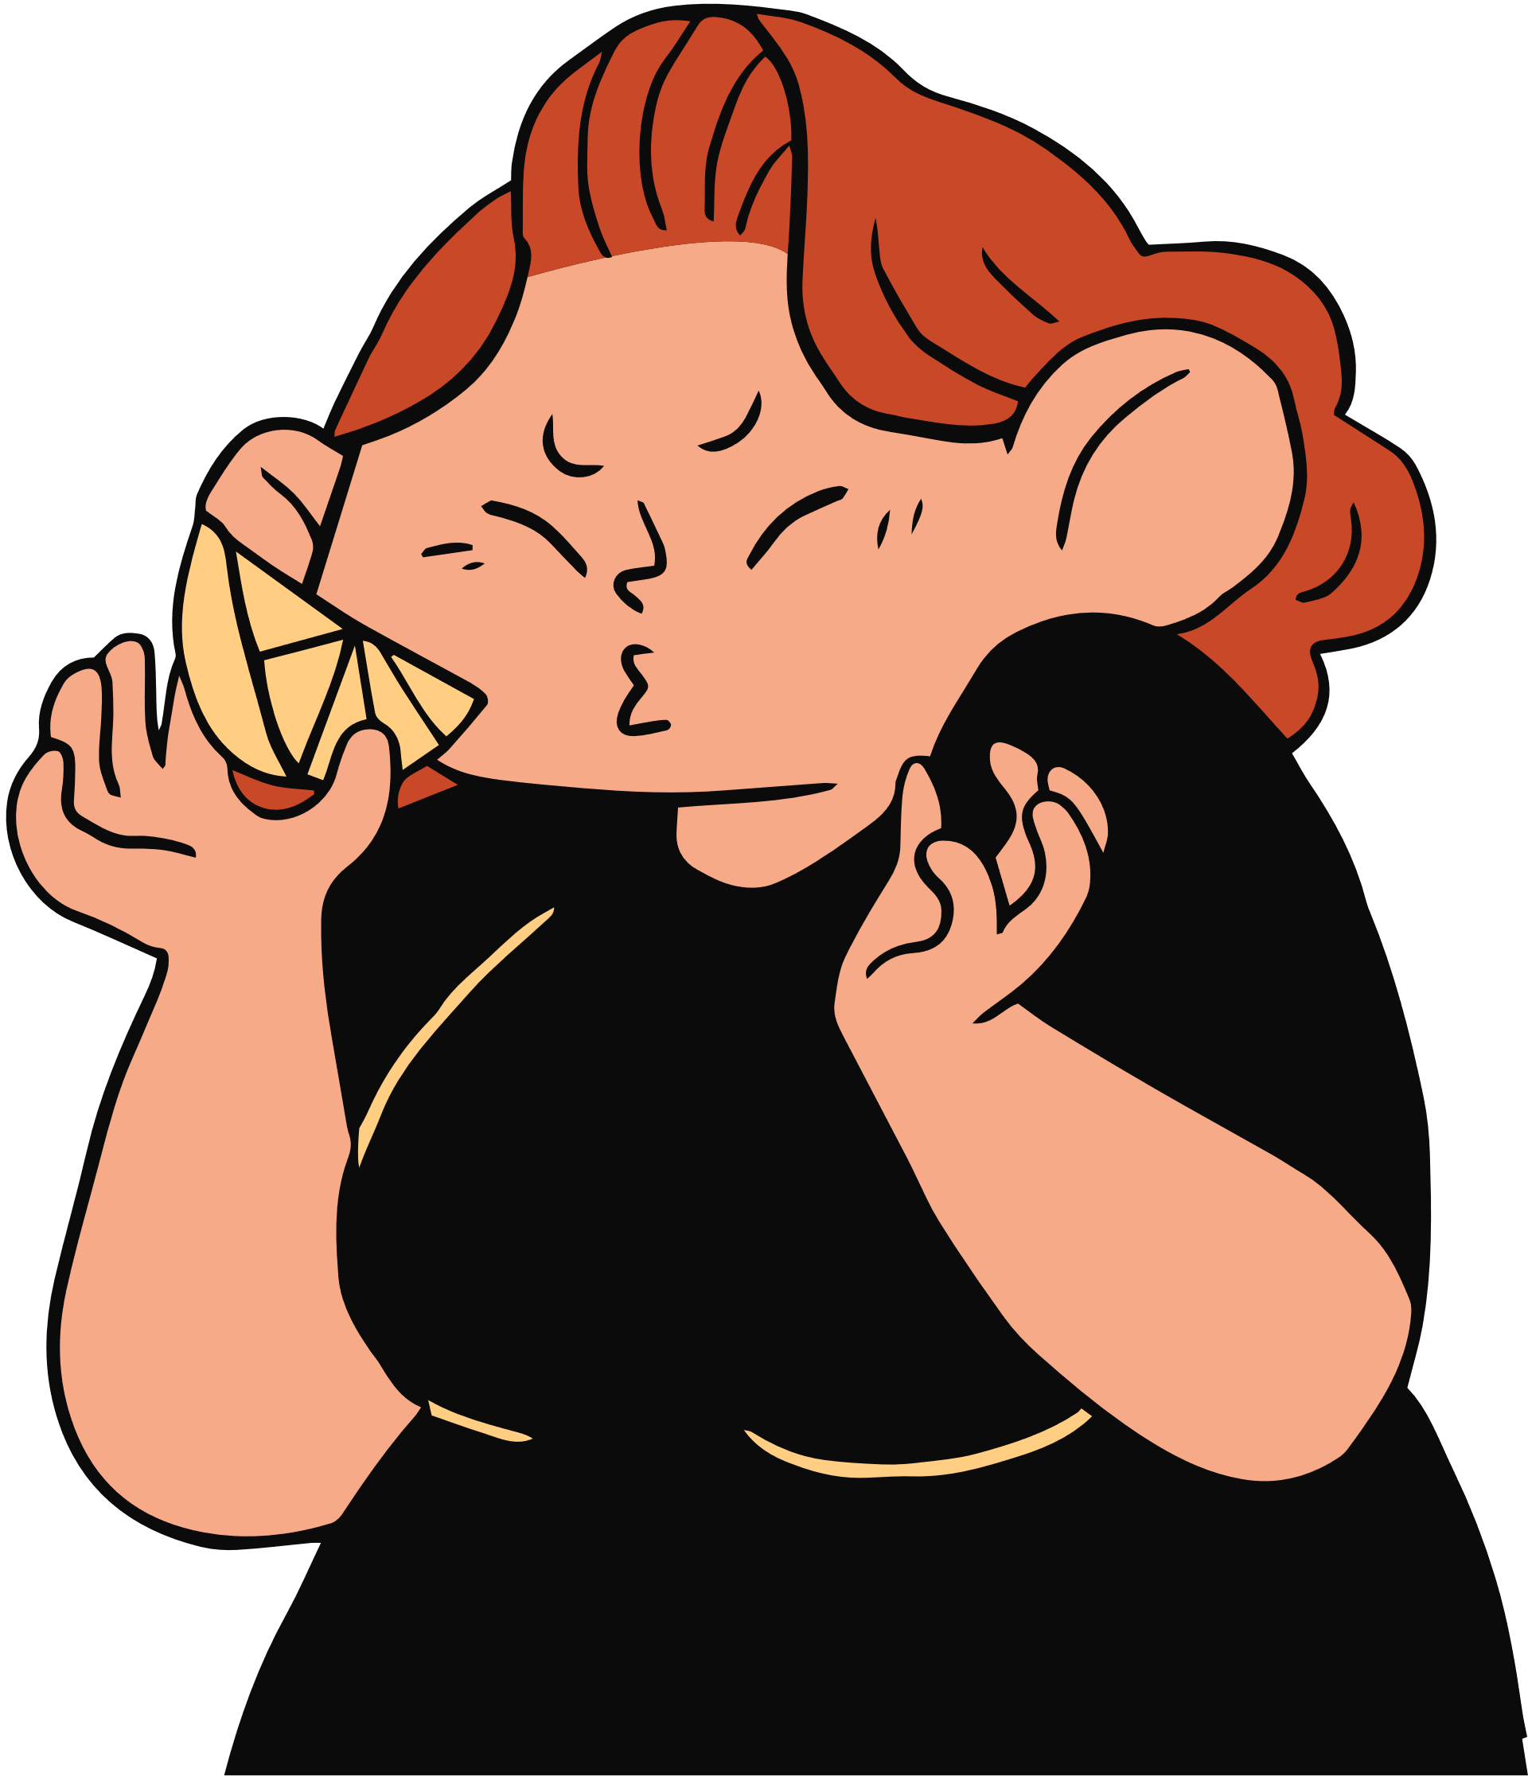
SOCIAL MEDIA POPULAR AMONG TEENS

Slide 11
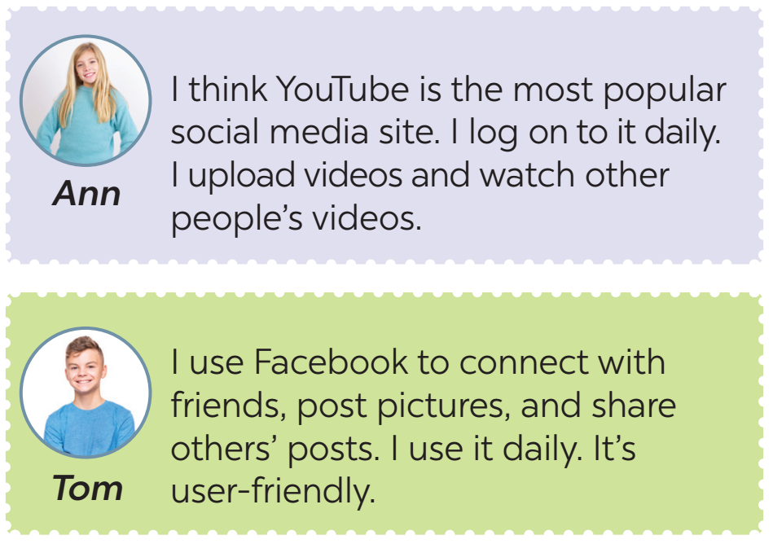
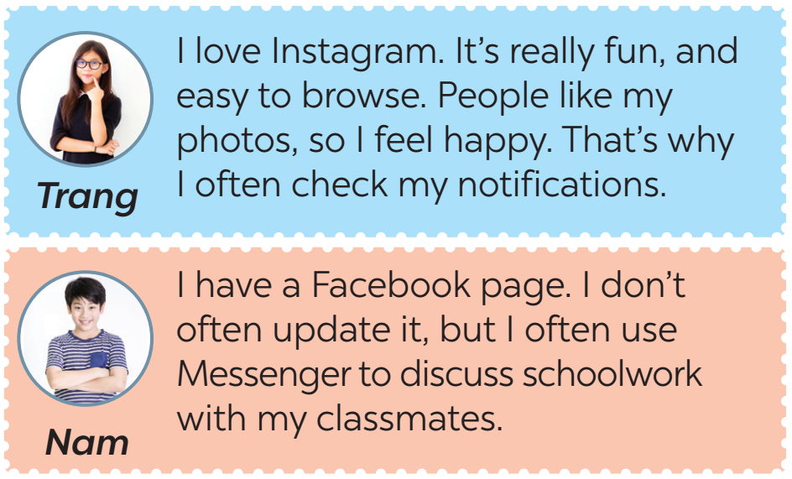
3. Read some posts on a forum about different social media and match the names of the posters with their activities.

Slide 12
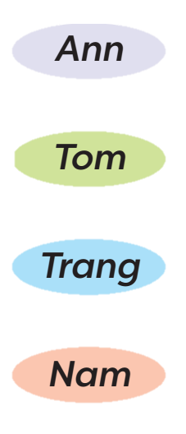
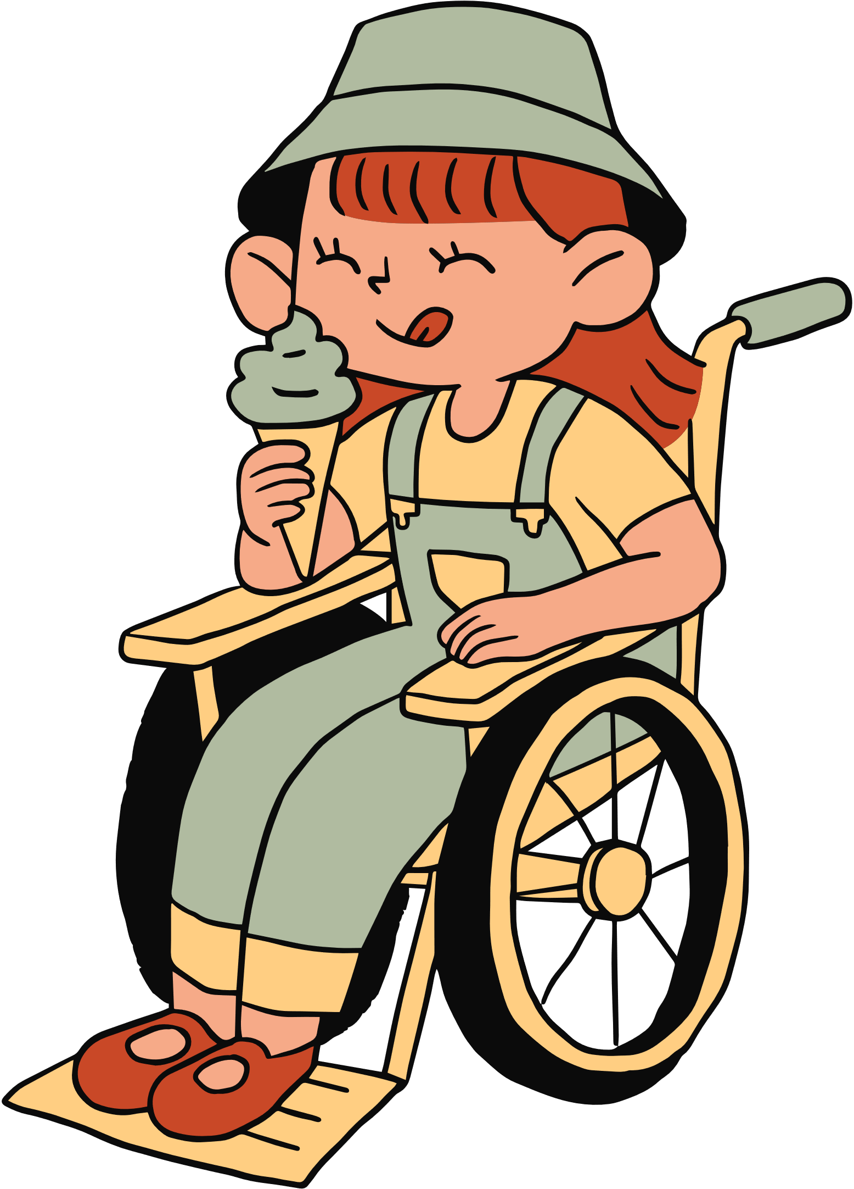
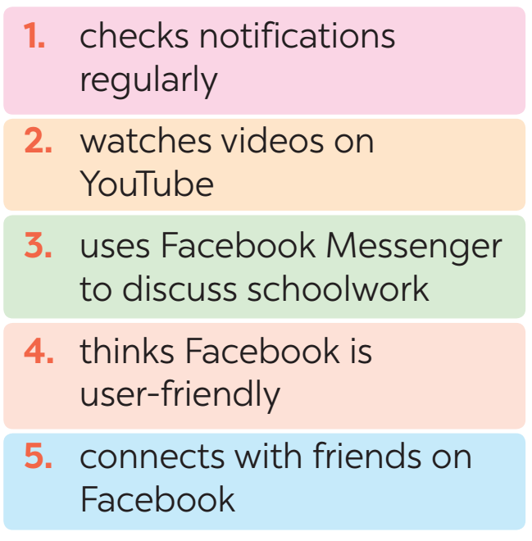

3. Read some posts on a forum about different social media and match the names of the posters with their activities.

Slide 13
4. Work in pairs. Ask and answer questions about what social media the teens in 3 use, why, and how often they use them.
Tom: What social media does Ann use?
Nam: She uses YouTube.
Tom: What does she use it for?
Nam: She uploads her videos and watch other people’s videos.
Tom: How often does she use it?
Nam: Every day.

Slide 14
5. Work in groups. Discuss the following questions:
What social media do you use?
How often do you use it?
What do you use it for?
Report your group’s results to the class.

Slide 15
WRAP -UP
Retell 2 ways of making requests
List some popular social media among teens.

Slide 16
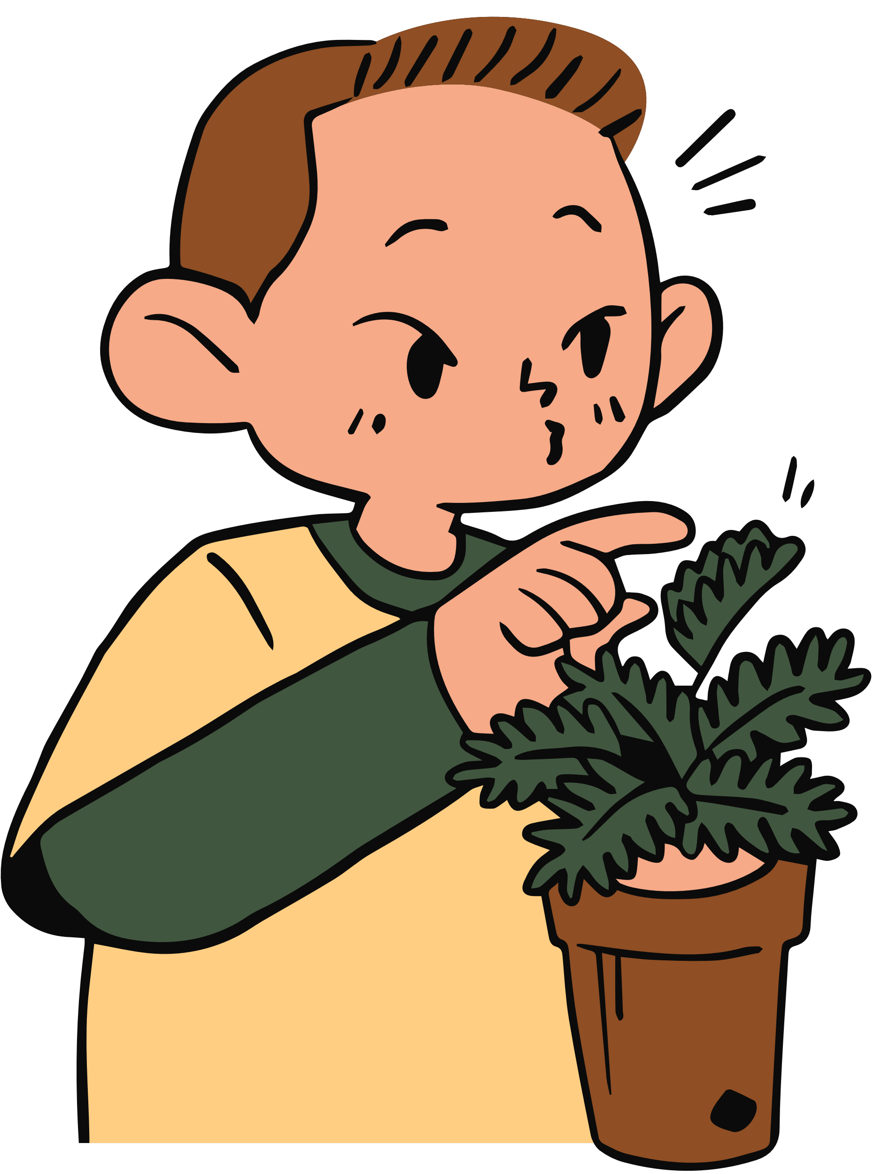
THANK YOU!

Slide 17
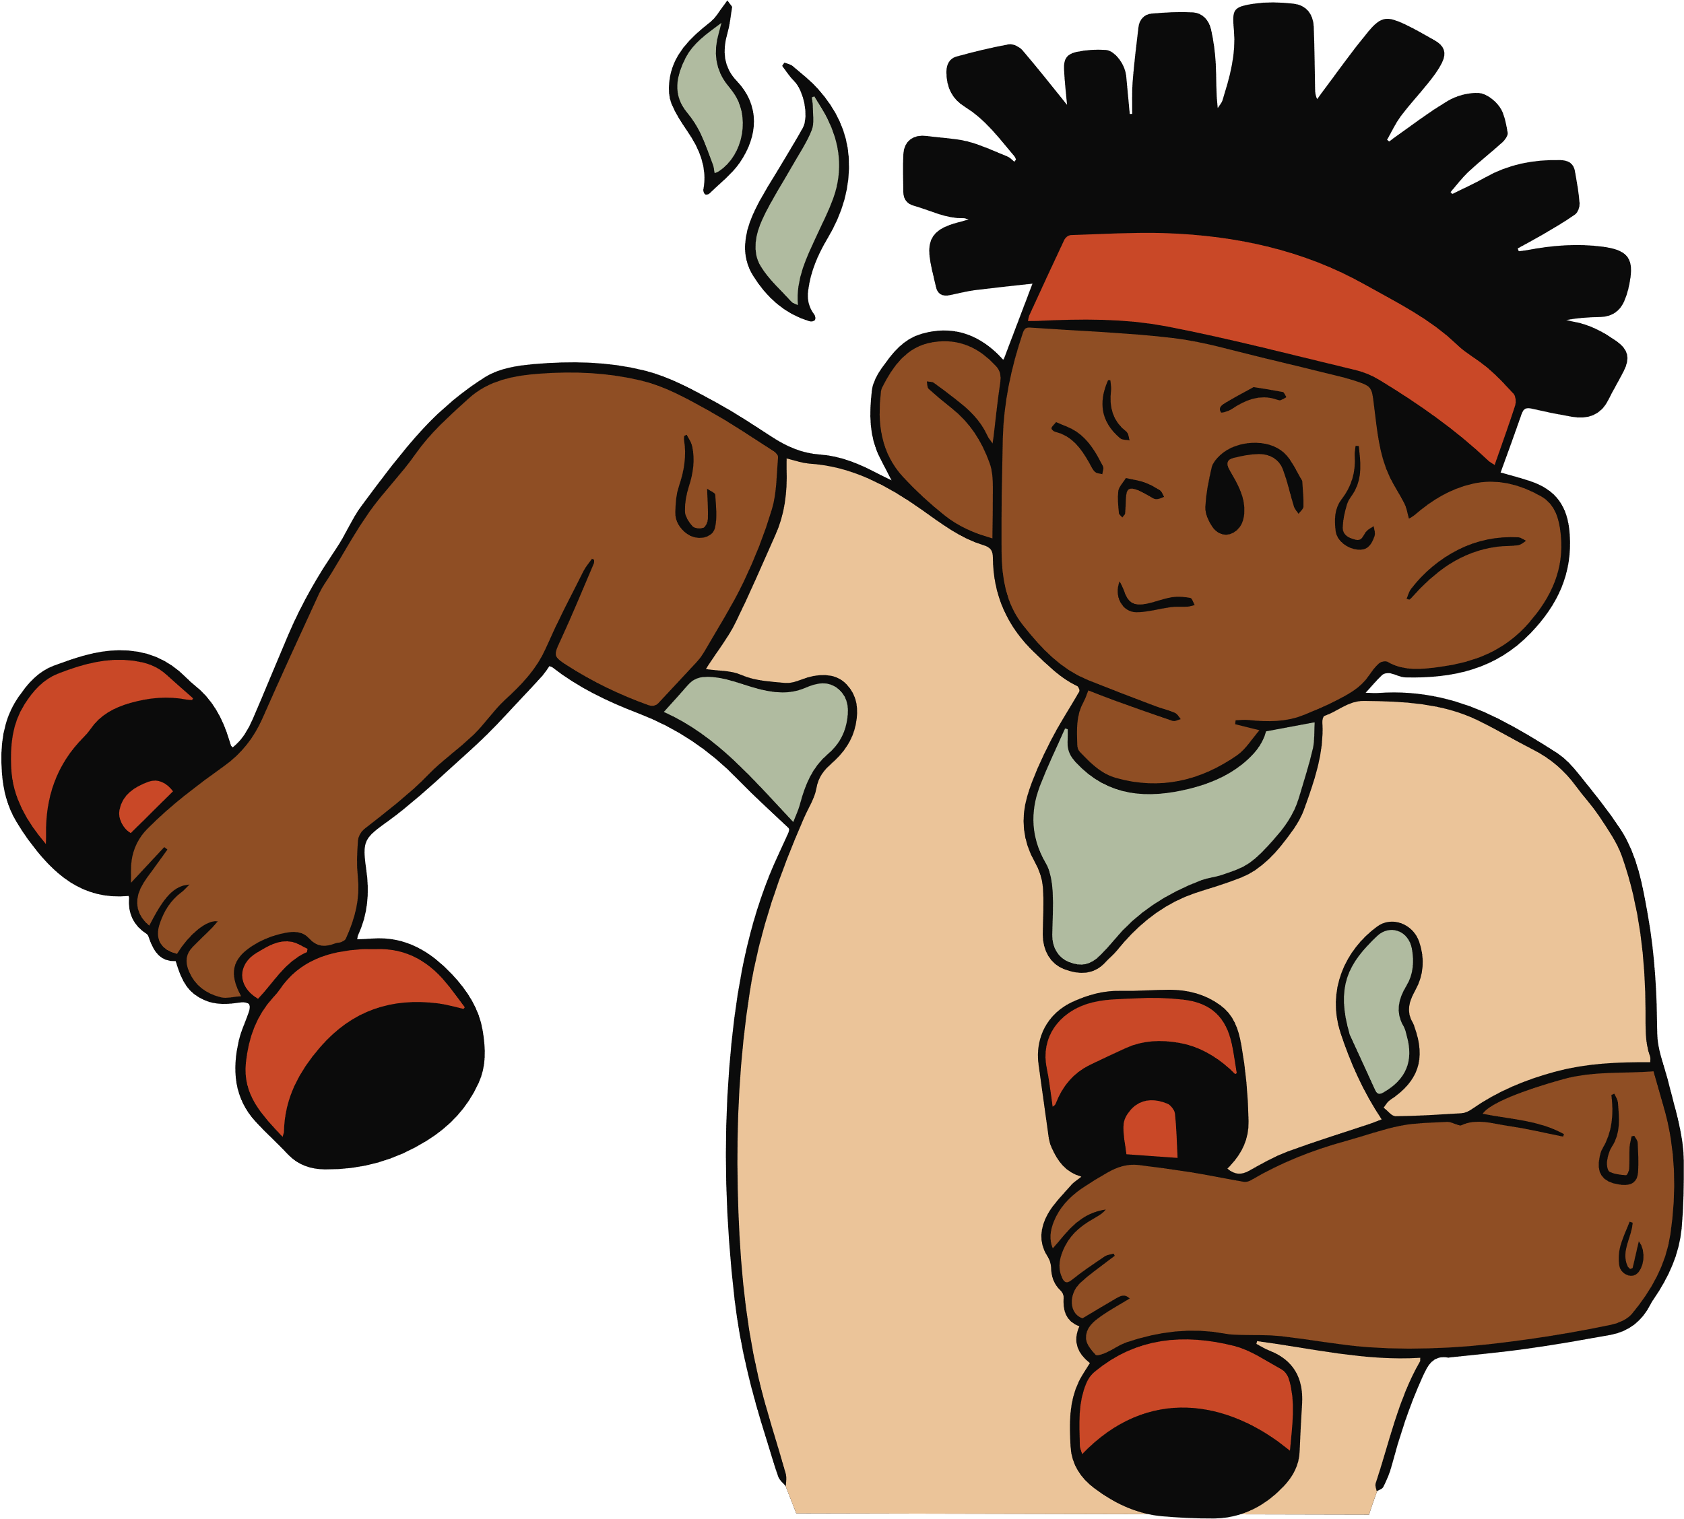
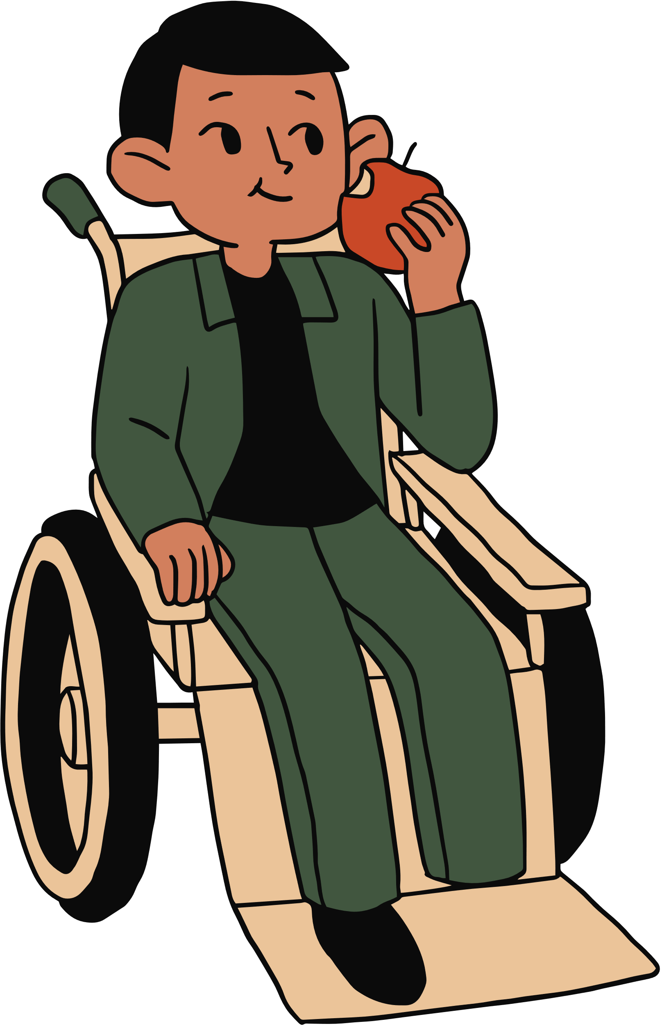

THANK YOU FOR LISTENING

Slide 18

FREE RESOURCE PAGE
You can use these gorgeous elements to customize the slides.

Slide 19
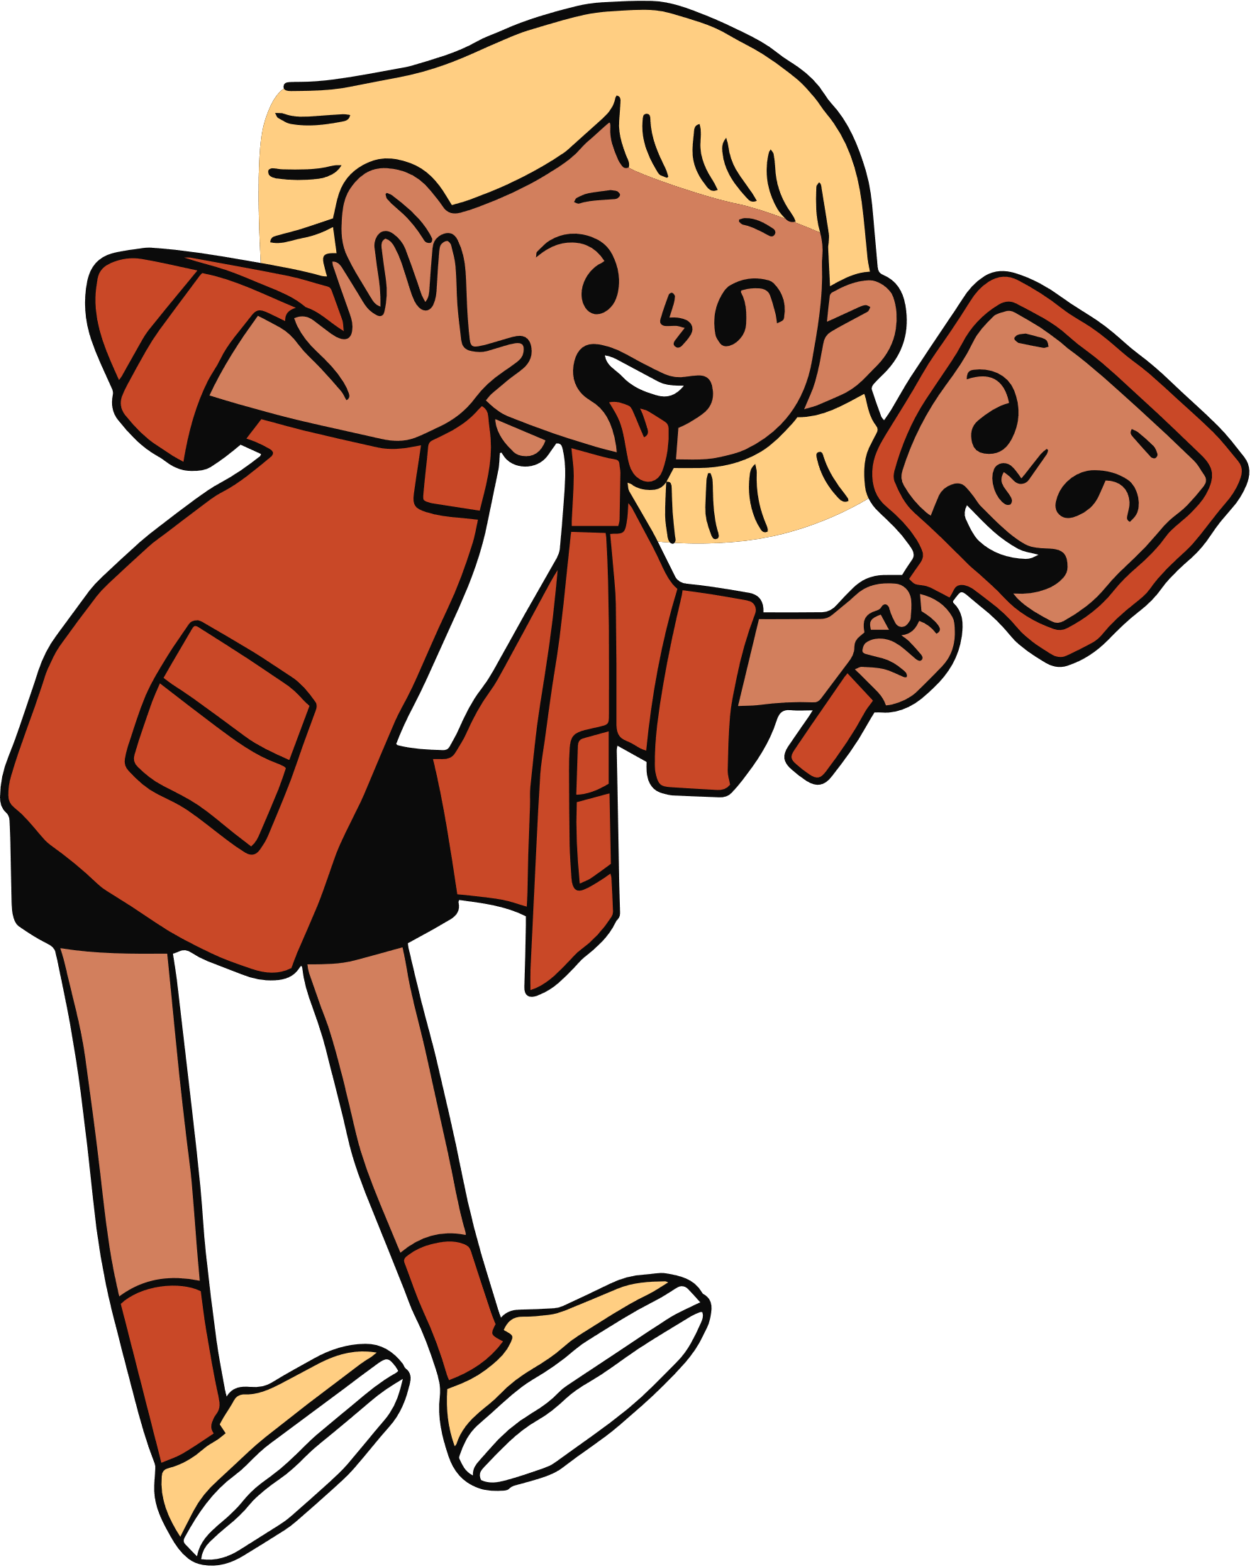
FREE RESOURCE PAGE
You can use these gorgeous elements to customize the slides.

