Slide 1







WELCOME TO OUR CLASS
Teacher: …

Slide 2




What can you remember in the video?

Slide 3
Unit 4:
ETHNIC GROUPS OF VIETNAM
Lesson 3: A CLOSER LOOK 2

Slide 4





YES/NO &
WH-QUESTION
Let's begin

Slide 5



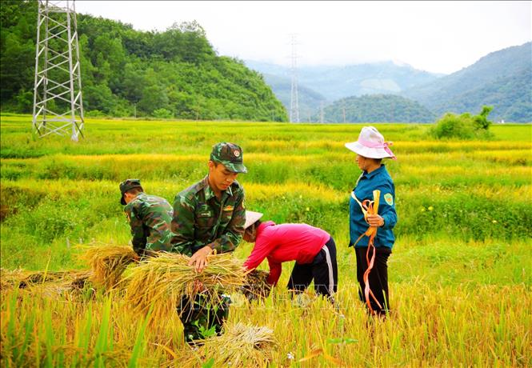




VOCABULARY
harvest (v)
/ˈhɑːvɪst/
gặt hái,
thu hoạch

Slide 6
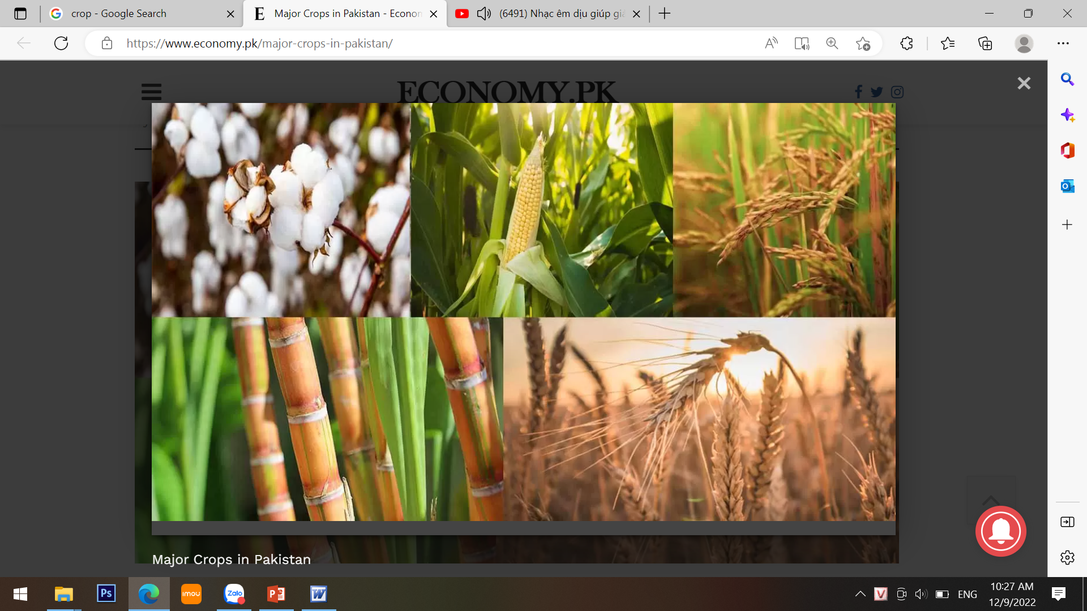
VOCABULARY
crop (n)
/krɒp/
vụ mùa,
vụ trồng trọt

Slide 7
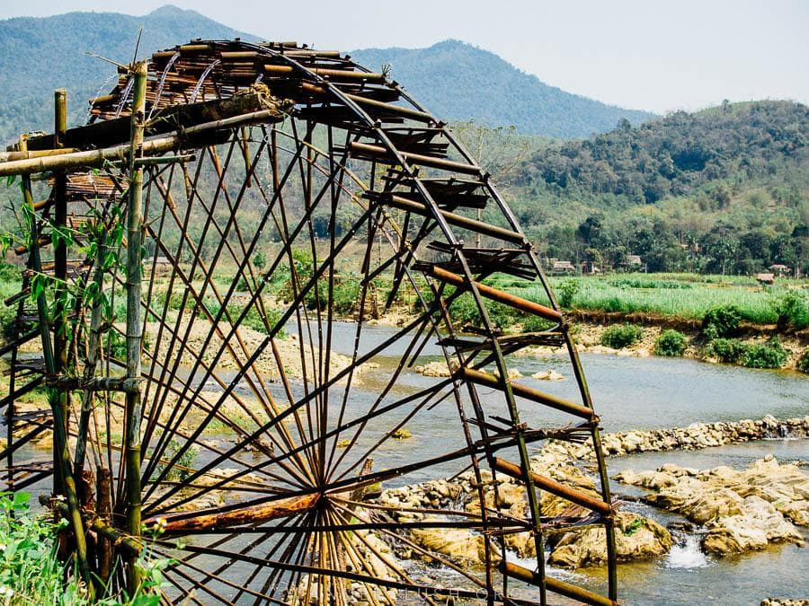
VOCABULARY
waterwheel (n)
/ˈwɔːtəwiːl/
bánh xe nước

Slide 8





1. Change the sentences into Yes / No questions.
Women play an important role in a Jrai family.
1
→ Do women play an important role in a Jrai family?
Mua sap is a popular folk dance of the Thai people.
2
→ Is mua sap a popular folk dance of the Thai people?
We didn’t have boarding schools for minority students in 1950.
3
→ Did you have boarding schools for minority students in 1950?
I attended the Ban Flower Festival in Dien Bien last year.
4
→ Did you attend the Ban Flower Festival in Dien Bien last year?
We will watch a documentary about the Khmer.
5
→ Will you watch a documentary about the Khmer?

Slide 9



2. Choose the correct question word for each question below.
1. A: ______ do you like best about Sa Pa?
B: I like its local markets best.
A. Why B. What
2. A: ______ can we find the most beautiful terraced fields?
B: In Mu Cang Chai.
A. When B. Where
3. A: ______ is the Ban Flower Festival?
B: It’s in spring.
A. When B. Why
4. A: ______ tall is an average stilt house?
B: About 5 - 6 metres tall.
A. How B. What
5. A: ______ festival is more important for the Kinh: the Mid-Autumn or the Lunar New Year?
B: The Lunar New Year.
A. What B. Which

Slide 10



PLAY

Slide 11



1
What
A: ______ do you like best about Sa Pa?
B: I like its local markets best.
Why
What
NEXT

Slide 12
Where
A: ________ can we find the most beautiful terraced fields?
B: In Mu Cang Chai.
2
When
Where
NEXT

Slide 13
A: ______ is the Ban Flower Festival?
B: It’s in spring.
3
When
When
Why
NEXT

Slide 14
4
How
A: ______ tall is an average stilt house?
B: About 5 - 6 metres tall.
How
What
NEXT

Slide 15
Which
A: ______ festival is more important for the Kinh: the Mid-Autumn or the Lunar New Year?
B: The Lunar New Year.
5
What
Which
NEXT

Slide 16
Look at the answers again.
1. A: ______ do you like best about Sa Pa?
B: I like its local markets best.
A. Why B. What
2. A: ______ can we find the most beautiful terraced fields?
B: In Mu Cang Chai.
A. When B. Where
3. A: ______ is the Ban Flower Festival?
B: It’s in spring.
A. When B. Why
4. A: ______ tall is an average stilt house?
B: About 5 - 6 metres tall.
A. How B. What
5. A: ______ festival is more important for the Kinh: the Mid-Autumn or the Lunar New Year?
B: The Lunar New Year.
A. What B. Which

Slide 17
COUNTABLE AND UNCOUNTABLE NOUNS
Let's begin

Slide 18
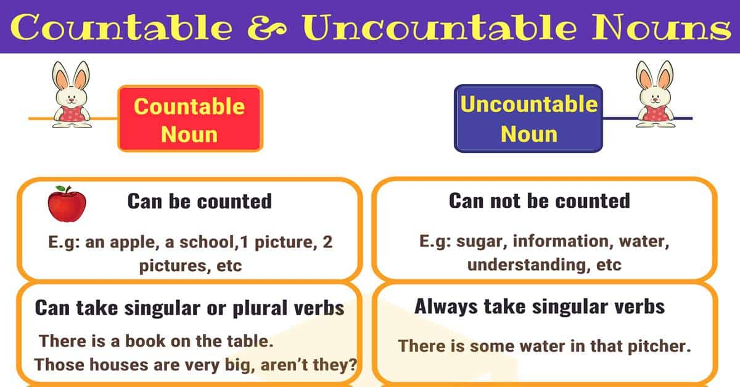

Slide 19




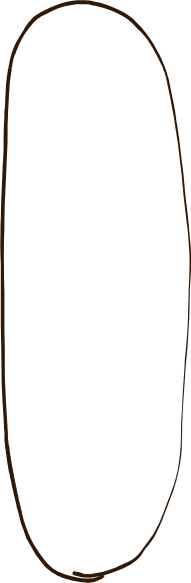
3. Write C (countable) or U (uncountable) for the underlined words.
Some minority (1) groups are farmers. They do not have much (2) land and they use simple farming techniques. After finding an (3) area for a garden, the men cut the (4) trees down and burn them. The (5) ash they collect helps enrich the soil. They then grow a few (6) crops like rice and corn.
(1)
C
(2)
U
(3)
C
(4)
C
(5)
U
(6)
C

Slide 20


4. Fill in the blank with a, much, many, a little, or a few.
a
1. My uncle has _____coffee plantation in Kon Tum.
2. How _______ ethnic groups live on the Hoang Lien Son mountain range?
3. There are only _______ waterwheels left in my village.
4. You should add ________ more water to your noodles. It’s a bit dry.
5. How ______ information about the Van Kieu have you collected?
many
a few
a little
much

Slide 21


Wrap - up
Choose the correct answer for each question
1. ________ dress in red and black costume?’ - ‘The Dao’?
A. What
B. Who
C. When
D. Which
2. _______ is it from the centre to the Museum of Ethnology? ~ It’s about senven kimoleters.
A. How long B. How far
C. How often D. How much
3. How_______ milk is there in the carton?
A. many
B. much
C. a lot of
D. few
4. Do you have _______ about ethnic minority groups in Viet Nam?
A. a few books
B. a lot of books
C. any books
D. any book
5. There's _________ milk left in the fridge. It should be enough for our coffee.
A. a little
B. little
C. a few
D. few
6. __________ethnic group has a large population, the Tay or the Ede?
A. What
B. Why
C. Which
D. Who

Slide 22


Practice the grammar point
Homework
1
Prepare for the next lesson
2

Slide 23




Thank you!
See you next time!

