Slide 1


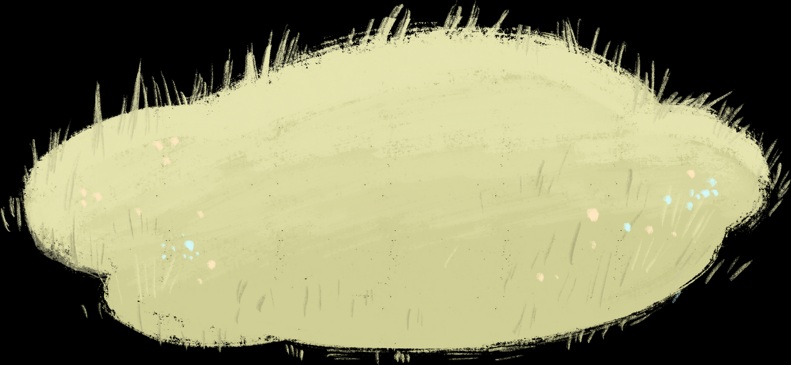

WELCOME TO OUR Class!
Teacher:

Slide 2



Let’s play Pelmanism

Slide 3
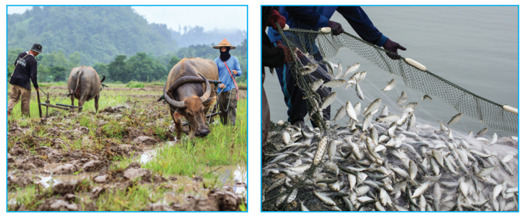
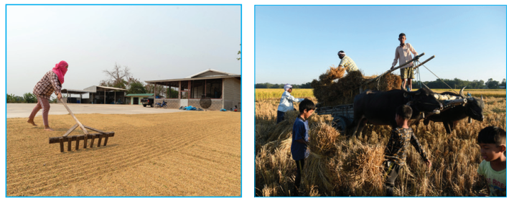
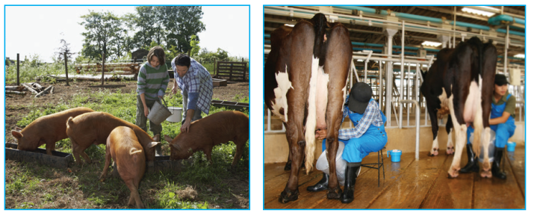
A
B
1
2
milking cows
unloading rice
C
D
3
4
feedings pigs
catching fish
ploughing fields
F
E
drying rice
5
6

Slide 4





Unit 2:
LIFE IN THE COUNTRYSIDE
Lesson 7: Looking back and project

Slide 5
ploughing fields
milking cows
unloading rice
feeding pigs
catching fish
drying rice
VOCABULARY

Slide 6
2. Choose the correct answer A, B, or C.
1. There is a huge cloud ______ as far as the eye can see. A. surrounded B. stretching C. vast
2. People in my village are really ______; they are always generous and friendly to visitors. A. well-trained B. funny C. hospitable
3. The development of cities destroys ______ areas of countryside. A. vast B. much C. stretching
4. The workers in our factory are very ______ because they took a lot of good training courses. A. hospitable B. kind C. well-trained
5. The area around the village is famous for its ______ landscape. A. picturesque B. boring C. dull

Slide 7
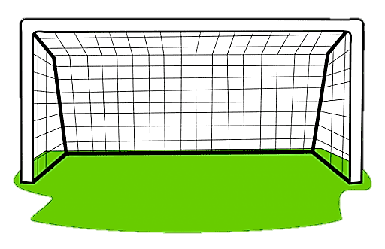



1. There is a huge cloud ______ as far as the eye can see.
A. surrounded
B. stretching
C. vast

Slide 8
2. People in my village are really ______; they are always generous and friendly to visitors.
A. well-trained
B. funny
C. hospitable

Slide 9
3. The development of cities destroys ______ areas of countryside.
A. vast
B. much
C. stretching

Slide 10
4. The workers in our factory are very ______ because they took a lot of good training courses.
A. hospitable
B. kind
C. well-trained

Slide 11
5. The area around the village is famous for its ______ landscape.
A. picturesque
B. boring
C. dull

Slide 12
Look at the answers again.
1. There is a huge cloud ______ as far as the eye can see. A. surrounded B. stretching C. vast
2. People in my village are really ______; they are always generous and friendly to visitors. A. well-trained B. funny C. hospitable
stretch: trải dài
hospitable: hiếu khách
3. The development of cities destroys ______ areas of countryside. A. vast B. much C. stretching
4. The workers in our factory are very ______ because they took a lot of good training courses. A. hospitable B. kind C. well-trained
5. The area around the village is famous for its ______ landscape. A. picturesque B. boring C. dull
vast: mênh mông
well-trained: được đào tạo tốt
picturesque: đẹp như tranh vẽ

Slide 13
– For most adverbs (often with two or more syllables), we make comparative forms by adding more.
– For adverbs that have the same forms as adjectives like fast, hard, soon, etc., we make comparative forms by adding -er.
– Some irregular adverbs:
well → better
badly → worse
GRAMMAR
(Comparative adverbs)

Slide 14
3. Complete the sentences with suitable comparative forms of the adverbs from the box.
1. Every morning nick gets up ten minutes (early) __________ than his sister.
2. I speak French (fluently) _______________ now than I did last year.
3. You’ll find your way around the village (easily) _______________ if you have a good map.
4. It rained (heavily) _______________ today than it did yesterday.
5. If you work (hard) ___________, you will do (well) _____________ in your exam.
earlier
more fluently
more easily
more heavily
harder
better

Slide 15
4. Underline the mistakes in the sentences and correct them.
1. I run faster as my brother does. 2. People in the city seem to react quicklier to changes than those in the country.
→ than
→ more quickly
3. We need to work more hardly, especially at exam time. 4. You must finish harvesting the rice the earlier this year than you did last year. 5. As they climbed more highly up the mountain, the air became cooler.
→ harder
→ earlier
→ higher

Slide 16
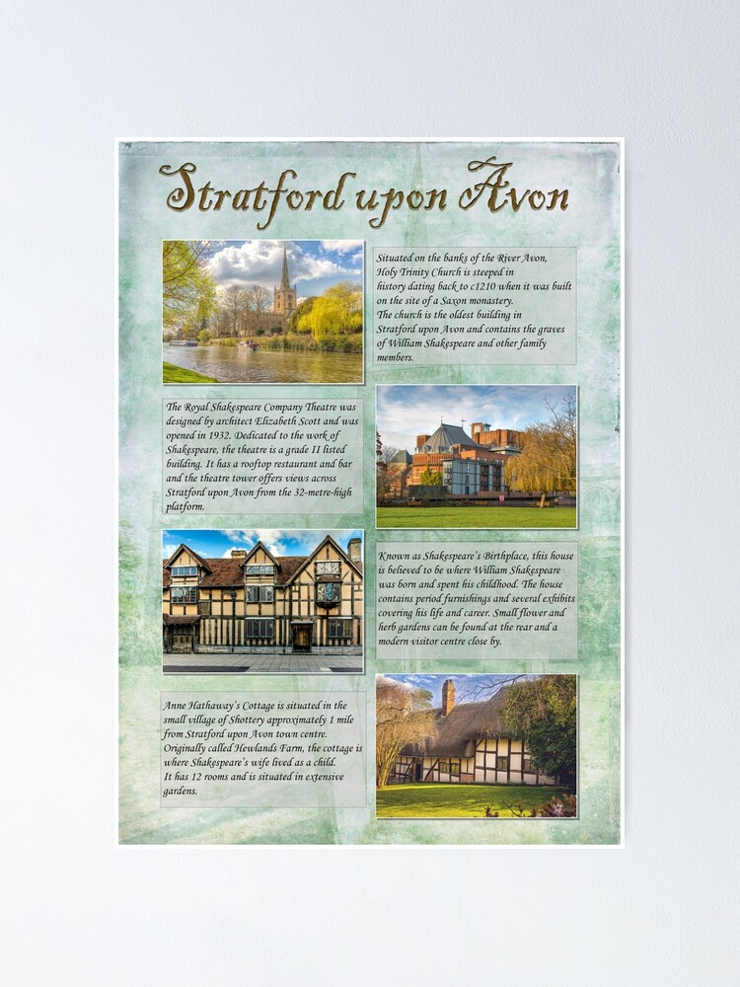
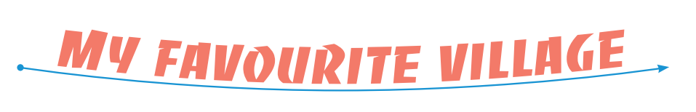

PROJECT PRESENTATION

Slide 17

WRAP - UP
01
02
03
Vocabulary review
Grammar review
Project presentation

Slide 18
Thank you

