Slide 1

Hello everyone !!!

Slide 2
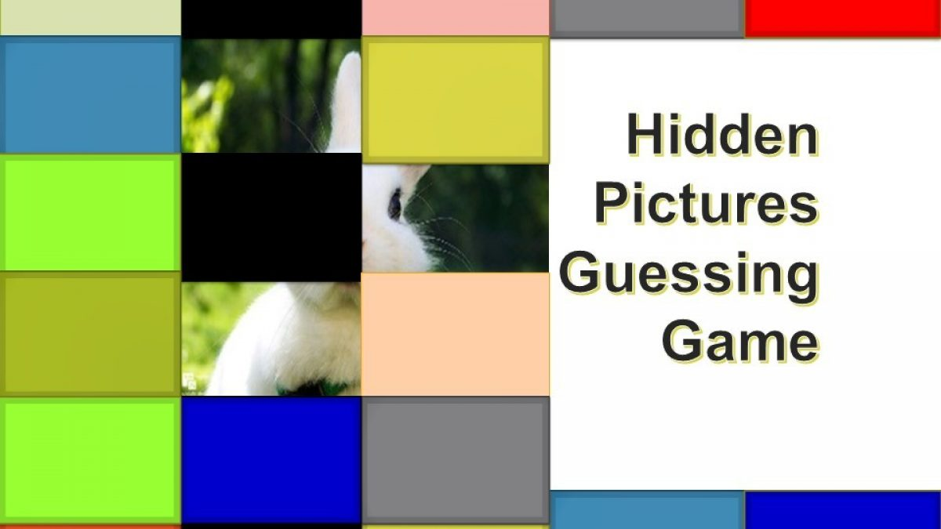
* WARM-UP: HIDDEN PICTURES
- The teacher slowly removes the squares while the groups write the answers on their mini boards.
- The groups that guesses the right word will have the points.

Slide 3

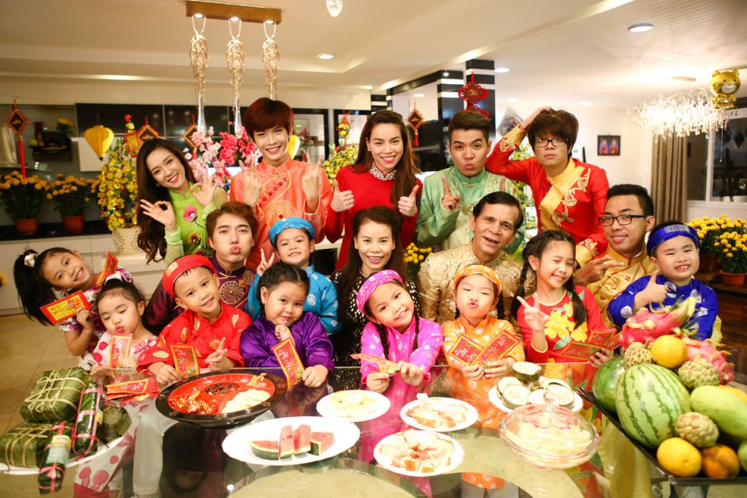
family reunion
/ˌfæmɪli ˌriːˈjuːnjən/
SHOW

Slide 4
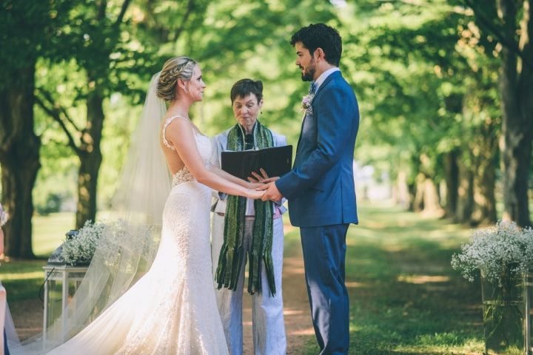
wedding ceremony
/ˈwed.ɪŋ/ /ˌser.ə.mə.ni/
SHOW

Slide 5
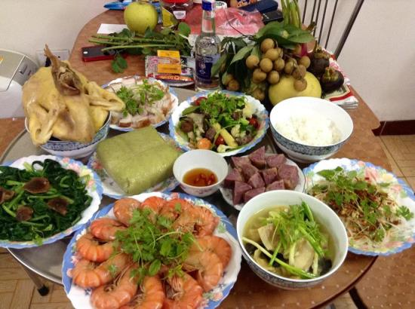
food offerings
/fuːd ˈɑː.fɚ.ɪŋz/
SHOW

Slide 6
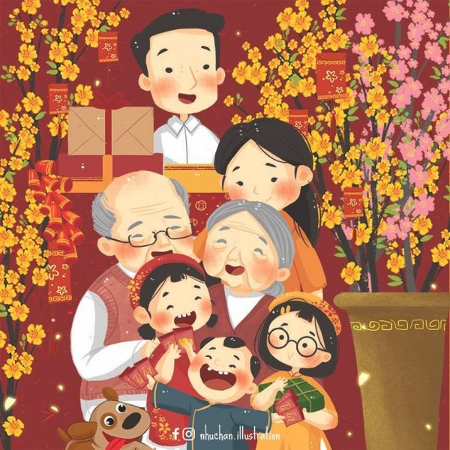
Tet Holiday
SHOW

Slide 7
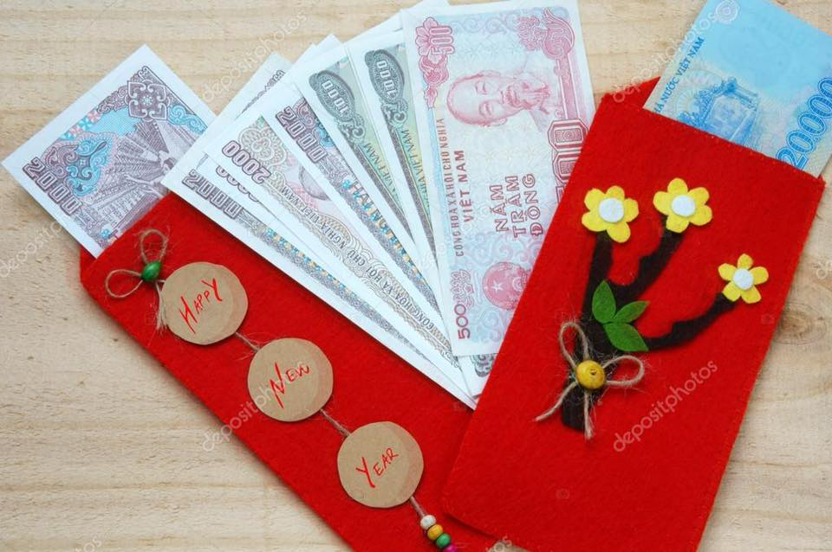
lucky money
SHOW

Slide 8

Unit
5
OUR CUSTOMS AND TRADITIONS
LESSON 2: A CLOSER LOOK 1
VOCABULARY
PRONUNCIATION
HOBBIES

Slide 9
* VOCABULARY
wedding ceremony:
lễ cưới
/ˈwedɪŋ ˌserəməni/

Slide 10
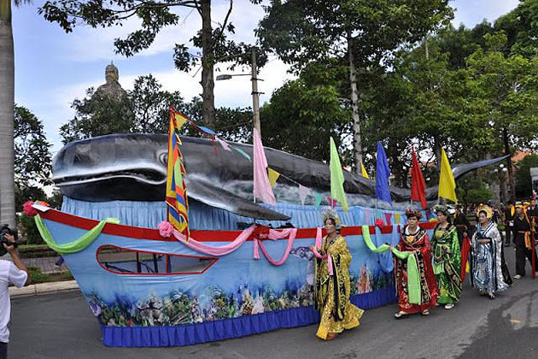
* VOCABULARY
- whale worship :
tục thờ cá Ông
/weɪl ˈwəːʃɪp/

Slide 11
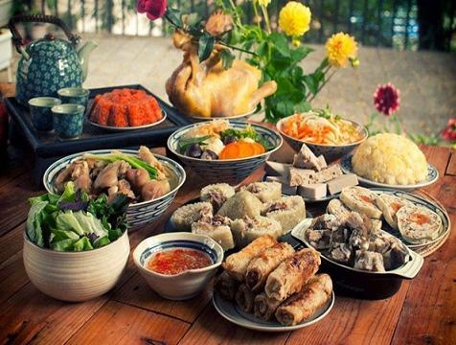
* VOCABULARY
- food offerings:
mâm cúng
/fuːd ˈɑːfəɪŋz/

Slide 12
* VOCABULARY
- family reunion :
đoàn tụ gia đình
/ˌfæmɪli ˌriːˈjuːnjən/

Slide 13
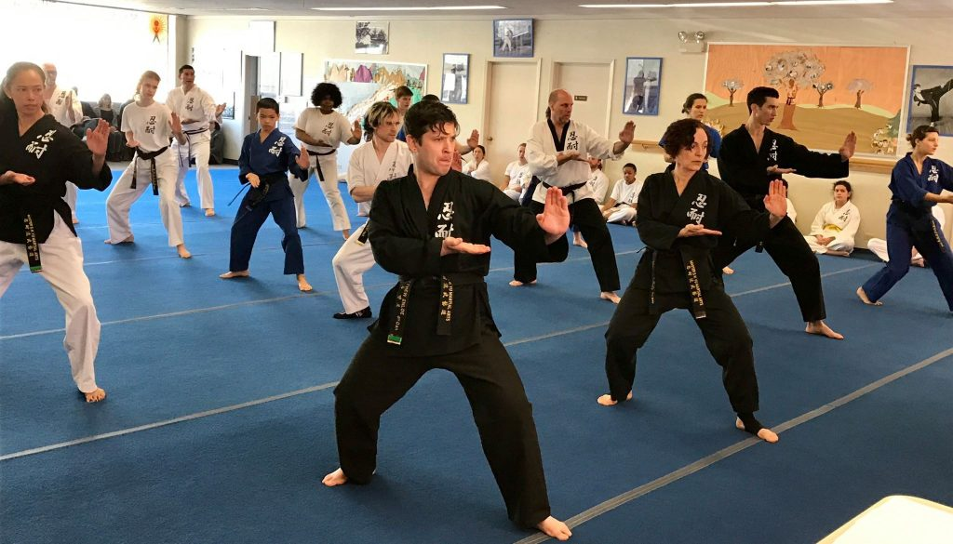
* VOCABULARY
- martial arts (n):
võ thuật
/ˌmɑːrʃl ˈɑːts/

Slide 14
* VOCABULARY
someone who goes to a festival
festival goer
người đi lễ hội
/ˈfɛstɪvl ˌgəʊə/

Slide 15
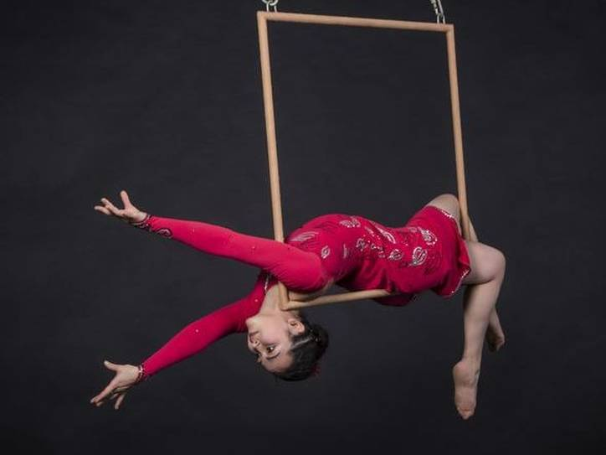
* VOCABULARY
- Acrobat (n):
vận động viên
nhào lộn
/ˈækrəbæt/

Slide 16
* VOCABULARY
to keep
- maintain (v):
duy trì
/meɪnˈteɪn/

Slide 17
* VOCABULARY
- longevity (n)
living for a long time
/lɒnˈdʒevəti/
sự sống lâu, tuổi thọ

Slide 18
* VOCABULARY
New words | Pronunciation | Meaning
1. wedding ceremony | /ˈwedɪŋˌserəməni/ | lễ cưới
2. whale worship | /weɪl ˈwəːʃɪp/ | tục thờ cá Ông
3. food offerings | /fuːd ˈɑːfəɪŋz/ | đồ ăn cúng
4. family reunion | /ˌfæmɪli ˌriːˈjuːnjən/ | đoàn tụ gia đình
5. martial arts (n) | /ˌmɑːrʃl ˈɑːts/ | võ thuật

Slide 19
* VOCABULARY
New words | Pronunciation | Meaning
6. festival goer | /ˈfɛstɪvl ˌgəʊə/ | người tham gia lễ hội
7. acrobat (n) | /ˈækrəbæt/ | vận động viên nhào lộn
8. maintain (v) | /meɪnˈteɪn/ | duy trì
9. longevity | /lɒnˈdʒevəti/ | sự sống lâu, tuổi thọ

Slide 20
* Checking vocab
say words in English
Lễ Cưới
wedding ceremony
người tham
gia lễ hội
festival goer
Sự sống lâu
longevity
Võ thuật
martial arts
vận động viên nhào lộn
acrobat
tục thờ cá Ông
whale worship
mâm cúng
food offerings
đoàn tụ gia đình
family reunion
duy trì
maintain

Slide 21
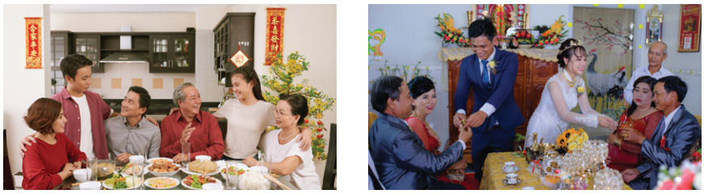
* PRACTICE
1
Write a phrase from the box under each picture.
wedding ceremony | whale worship | food offerings
family reunion | martial arts | festival goers
family reunion
wedding ceremony
1._______________
2.__________________

Slide 22
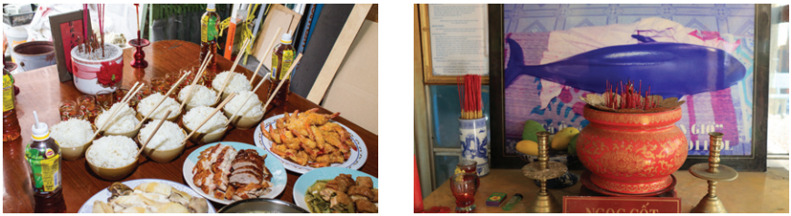
1
Write a phrase from the box under each picture.
wedding ceremony | whale worship | food offerings
family reunion | martial arts | festival goers
food offerings
whale worship
3._______________
4.__________________

Slide 23
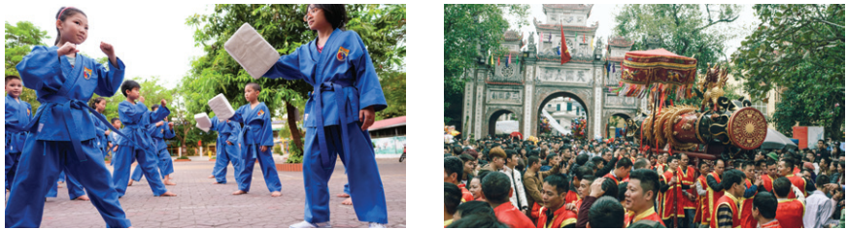
1
Write a phrase from the box under each picture.
wedding ceremony | whale worship | food offerings
family reunion | martial arts | festival goers
martial arts
festival goers
5._______________
6.__________________

Slide 24
2
Complete each sentence with the correct option A, B, or C
1. We have a tradition of holding a family ______ on the first day of Tet. A. reunion B. work C. meal
2. It’s a tradition for shops to have a lion dance performance at their opening ______.
A. worship B. celebration C. ceremony
3. The tradition of ______ whales is popular in Vietnamese coastal villages.
A. admiring B. worshipping C. praying

Slide 25
2
Complete each sentence with the correct option A, B, or C
4. She broke with family tradition by not practising ______.
A. acrobat B. martial arts C. oﬀering
5. Traditionally, the Vietnamese prepare ______ to worship their ancestors during Tet.
A. oﬀerings B. decoration C. worshipping

Slide 26
3
Complete the sentences with the words from the box.
custom | practise | keep | break | traditionally
break
1. This year, we will ______ with tradition and go on holiday instead of staying at home during Tet.
2. ___________, children in the US go from house to house to ask for sweets on halloween.
3. Holding a party to wish our grandparents longevity is one of the customs we ________ at Tet.
Traditionally
practise

Slide 27
3
Complete the sentences with the words from the box.
custom | practise | keep | break | traditionally
keep
4. Organising a folk song club is one way for us to ______ our traditions alive.
5. It’s becoming a _______ for young people to celebrate new years in addition to Tet.
custom

Slide 28

PRONUNCIATION
4
Listen and repeat the words. Pay attention to the sounds /n/ and /ŋ/.
/n/ | /ŋ/
thin land ceremony longevity tradition | thing thank single language offering

Slide 29

* PRONUNCIATION
How to pronounce the sounds /n/ and /ŋ/

Slide 30
5
Listen and practise the sentences. Underline the words
with the sound /n/ and circle the words with the sound /ŋ/.
1. Mary wore a pink dress last night.
2. I think we should buy this ornamental tree. 3. He thanked the host for the enjoyable party.
4. My mum made the spring rolls for the longevity party.
5. I will bring some food to the party on Saturday.

Slide 31
* CONSOLIDATION
PRONUNCIATION
VOCABULARY

Slide 32

* Homework
Learn new words by heart.
Practice pronouncing the sound /n/ and /ŋ/.
Do exercises in the workbook.

Slide 33



