Slide 1

Long Bien secondary school
GOOD MORNING CLASS !!!
Mrs Thuy Trang

Slide 2

* Game: Mindmap
Language focus in Unit 11
Vocabulary
Grammar
Pronunciation

Slide 3
* Game: Mindmap
Language focus in Unit 11
Vocabulary
Grammar
Pronunciation
talk about future means of transport
The future simple
Possessive pronouns
Sentence stress

Slide 4


Unit
11
TRAVELLING IN THE FUTURE
LESSON 7: LOOKING BACK & PROJECT
Vocabulary review
Grammar review
Project: Our future means of transport
Unit

Slide 5
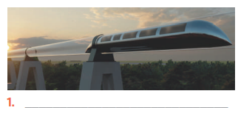
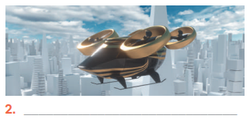
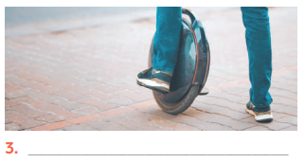
* VOCABULARY REVIEW
1
Write three adjectives or phrases to describe each picture.
* Suggested answers:
1. fast, green, carrying many passengers
2. fast, convenient, autopilot function
3. electric, green, convenient

Slide 6
2
Complete the sentences with the words and phrases from the box.
eco-friendly runs on driverless bamboo-copter bullet trains
1. A teleporter is _____________, so it does not cause pollution.
2. A solowheel ____________ electricity, so it is safe for the environment.
3. A convenient way to go to school is by __________________. Just put it on and fly away.
4. You can sleep when you travel by _____________ car.
5. _____________ are faster and greener than normal trains.

Slide 7


LUCKY NUMBERS
1
2
3
4
5
6
7
8
GA
2
4
6
8
10
12
14
GB
2
4
6
8
10
12
14

Slide 8
2
Complete the sentences with the words and phrases from the box.
eco-friendly runs on driverless bamboo-copter bullet trains
1. A teleporter is _____________, so it does not cause pollution.
eco- friendly

Slide 9
2
Complete the sentences with the words and phrases from the box.
eco-friendly runs on driverless bamboo-copter bullet trains
2. A solowheel ____________ electricity, so it is safe for the environment.
runs on

Slide 10
2
Complete the sentences with the words and phrases from the box.
eco-friendly runs on driverless bamboo-copter bullet trains
3. A convenient way to go to school is by _________________. Just put
it on and fly away.
bamboo - copter

Slide 11
2
Complete the sentences with the words and phrases from the box.
eco-friendly runs on driverless bamboo-copter bullet trains
4. You can sleep when you travel by _____________ car.
driverless

Slide 12
2
Complete the sentences with the words and phrases from the box.
eco-friendly runs on driverless bamboo-copter bullet trains
5. _____________ are faster and greener than normal trains.
Bullet trains

Slide 13


UNLUCKY NUMBER

Slide 14

LUCKY NUMBER!
you get 2 plus points

Slide 15
LUCKY NUMBER!
you get 2 plus points

Slide 16
2
Complete the sentences with the words and phrases from the box.
eco-friendly runs on driverless bamboo-copter bullet trains
1. A teleporter is _____________, so it does not cause pollution.
2. A solowheel ____________ electricity, so it is safe for the environment.
3. A convenient way to go to school is by __________________. Just put it on and fly away.
4. You can sleep when you travel by _____________ car.
5. _____________ are faster and greener than normal trains.
eco- friendly
runs on
bamboo - copter
driverless
Bullet trains

Slide 17
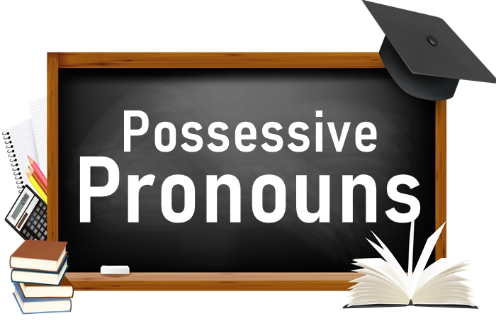
* GRAMMAR REVIEW
3
Find one mistake in each sentence and correct it.
1. My motorbike is an electric one. Her is not. __________
2. Her car can carry four passengers. Our can carry seven passengers. _______
3. Their car runs on petrol. My runs on solar energy. _________
4. We go to school together. I ride my bike, and he rides its. ________
5. My city has a skyTran system. Does yours city have one? _______
Hers
Ours
Mine
his
your

Slide 18
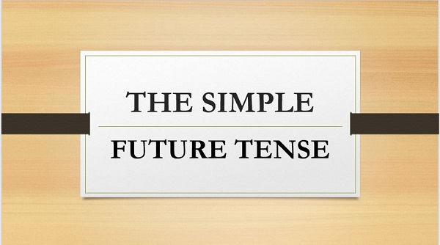
4
Read the passage and put the verbs in brackets in the correct future form.

Slide 19
4
Read the passage and put the verbs in brackets in the correct future form.
In the future, we will travel much further than we do now. We will also visit new places for our holidays.
Some scientists think we (1. travel) __________to new planets. We (2. go) ___________there by spaceship, but we (3. need) _________ new special means of transport. These new means of transport (4. carry) ____________ one or two passengers, but many. ________our dream (5. come) _________true soon? Let’s wait and see.
will travel
won’t go
will need
won’t carry
Will
come

Slide 20
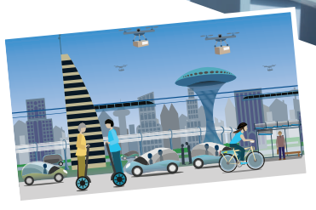
5
* PROJECT
5
Work in groups.
Imagine a future means of transport you would like to see in the future. Use these questions to think about it:
– What is the name of the means of transport?
– What road system does it run on?
– What kind of energy does it use?
– How many passengers can it carry?
– What are some of its advantages?
Draw your means of transport.

Slide 21
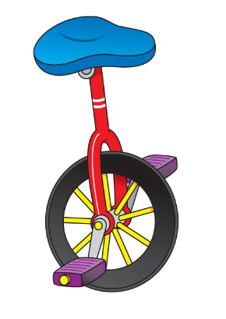
* PROJECT
6
Work in groups. Posters exhibition
5
Hello everyone, today I will present about my future means of transport. This is Solowheel. It runs on road system and runs by electricity. It can carry only one person. It is easy to use it because it can be self–balancing. Solowheel is very cheap and eco-friendly. Besides, it is small, so it can save parking spaces too.

Slide 22
*CONSOLIDATION
Vocabulary review
Grammar review
Project: Our future means of transport

Slide 23

4. homework
Redo all the exercises.
Prepare for the next lesson: Unit 12 – Getting started

Slide 24
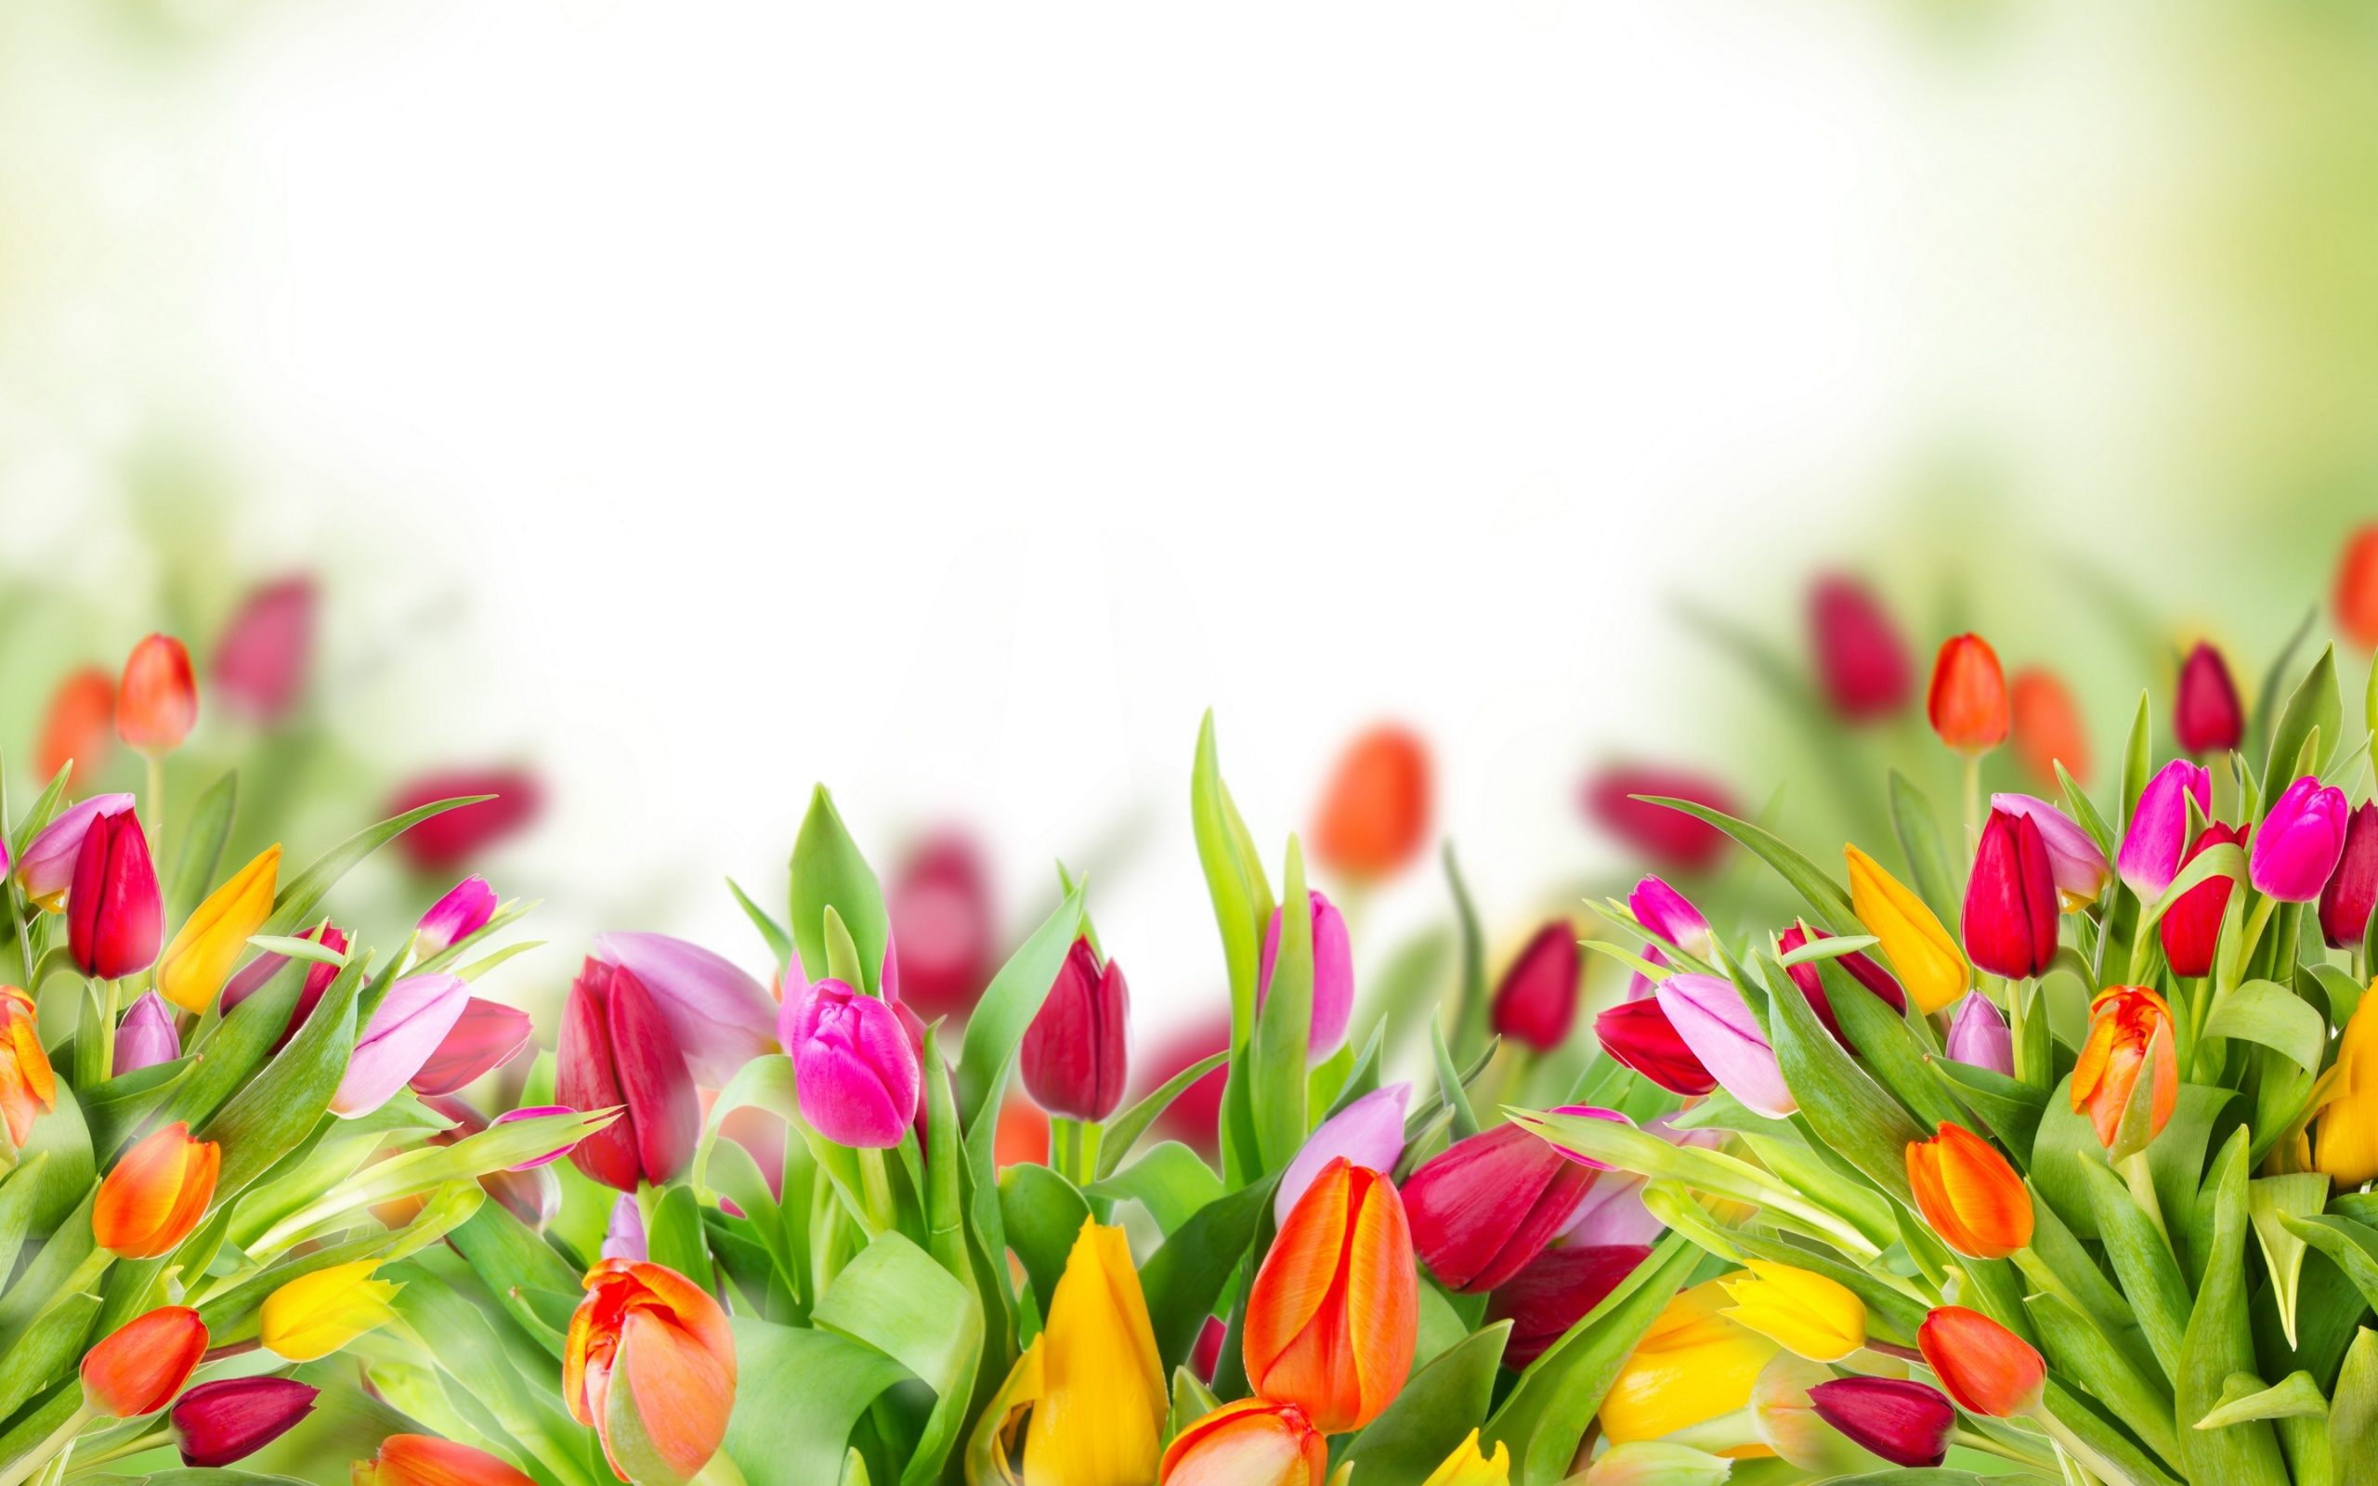
Thank you!
Have a nice day!

