Slide 1

Hello every one !!!
TRUONG MY THUY TRANG

Slide 2
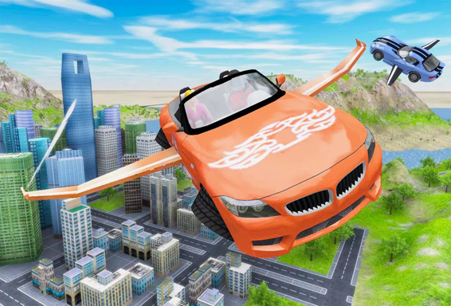
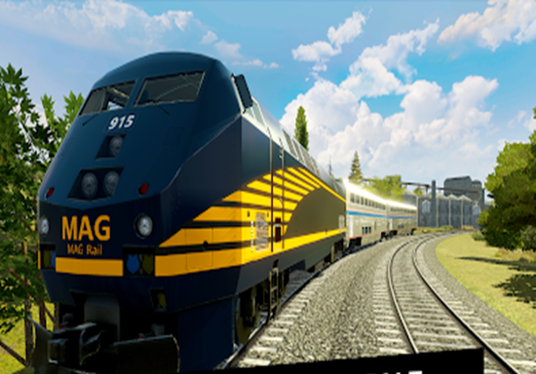
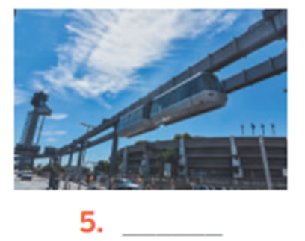
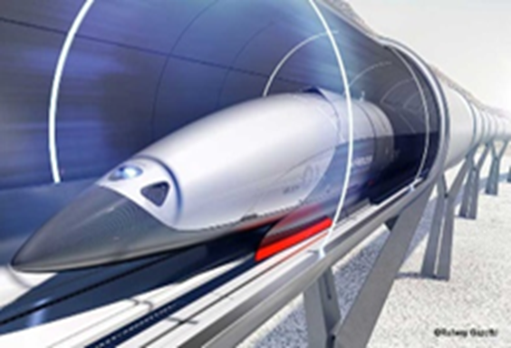
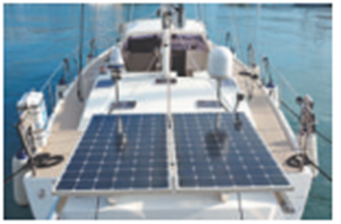
* Warm -up
* Game: Pelmanism:
Future means of transport
1
2
3
4
5
6
7
10
skyTran
Flying car
Hyperloop
9
8
Train
solar - powered ship

Slide 3



Unit
11
TRAVELLING IN THE FUTURE
LESSON 2: A CLOSER LOOK 2
* Grammar: - The future simple
- Possessive pronouns

Slide 4

Grammar 1: The future simple
Unit
HOBBIES

Slide 5
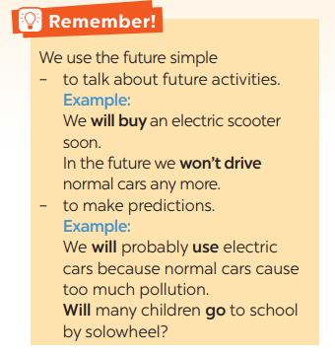
Grammar 1: The future simple
+ Usage: to talk about future activities and to make predictions.
+ Form: (+) S + will + V
(-) S + will + not / (won’t) + V
(?) Will + S + V?

Slide 6
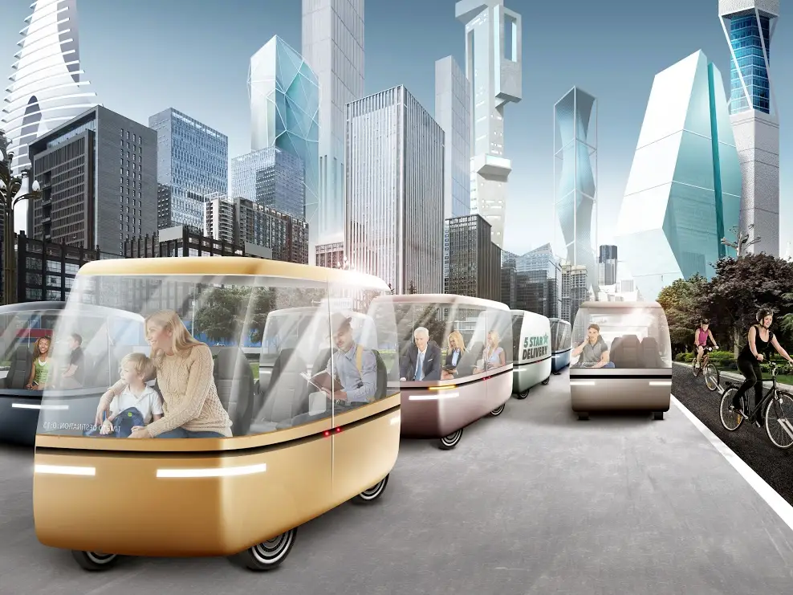
1
Complete the sentences with will or won’t.

Slide 7
*PRACTICE
1
Complete the sentences with will or won’t.
1. Petrol-powered cars are not eco-friendly, so they ______ be popular.
2. We ______ travel by teleporter soon because it is faster.
3. Rich people _____ choose to travel to other planets for their holidays.
4. People ______ take holidays in crowded places as in the past.
5. Bullet trains ______ soon become a popular means of transport in Viet Nam because they are green and safe.
won’t
will
will
won’t
will

Slide 8
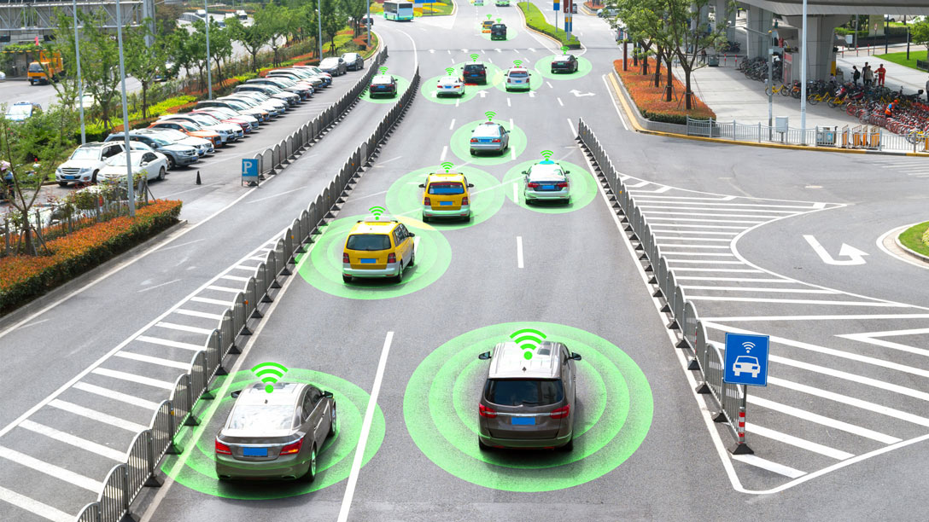
2
Rearrange the words and phrases to make sentences.
driverless cars / we / will have / in 2030 /.
2. cars / cities / won’t allow / in 2050 /.
3. electric cars / will / popular / be /?
4. we / use / will / buses / soon / solar-powered/.
5. have / enough parking places / we / will / in ten years /?
→ We will have driverless cars in 2030.
→ Cities won’t allow cars in 2050.
→ Will electric cars be popular?
→ We will use solar-powered buses soon
→ Will we have enough parking places in ten years?

Slide 9
3
Use the correct form of the verbs in brackets to complete the conversation.
Alice: Do you think travelling by teleporter will become possible soon?
Tom: Yes. I hear that it ..…………very little time to travel from one country to another.
Alice: Right. And we ………………. to wait at the airport
Tom: ……….we ………… to learn to drive it?
Alice: No. We …………… it. It makes us disappear then appear in another place in just seconds.
Tom: How wonderful! There …………….. traffic jams any more, right?
will take
won’t have
Will
have
won’t drive
won’t be

Slide 10
* GRAMMAR 2: POSSESSIVE PRONOUNS (REVIEW)
* Examples:
- This is your bicycle.
That bicycle is her bicycle.
(That bicycle is hers)

Slide 11
* GRAMMAR 2: POSSESSIVE PRONOUNS (REVIEW)
Personal pronouns | Possessive adjectives | Possessive pronouns
I | my
You | your
We | our
They | their
He | his
She | her
It | its
mine
yours
ours
theirs
his
hers
its

Slide 12
4
Replace the underlined phrases with possessive pronouns.
Eg: This is your bicycle. That bicycle is her bicycle -> hers
1. My motorbike runs on electricity. How about their motorbikes? _______
2. Your bicycle is blue and my bicycle is red.______
3. My dream is to travel to the moon. His dream is different. _____
4. My bus was late. Your bus was on time. ______
5. His car is a flying car. Our car is an electric one. _____
theirs
mine
His
yours
ours

Slide 13
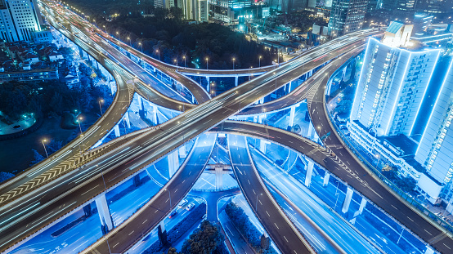
* PRODUCTION
5
Look at the pictures and tell your partner if you will / won’t travel by these means of transport. Give reason(s).

Slide 14
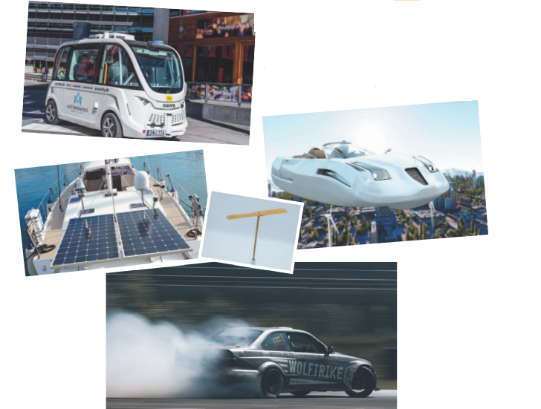
5
Look at the pictures and tell your partner if you will / won’t travel by these means of transport. Give reason(s).

Slide 15
5
Look at the pictures and tell your partner if you will / won’t travel by these means of transport. Give reason(s).
- I can see a / an (electric) bus / coach. I can see many people on this bus / coach. I think I will go to school by electric coach because it has no fumes, and it can carry many people at the same time.

Slide 16

5
Look at the pictures and tell your partner if you will / won’t travel by these means of transport. Give reason(s).
I think I will travel by flying car. Because It will be fast and very fun .
I will be able to see the city below

Slide 17
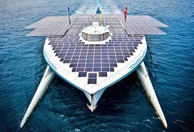
5
Look at the pictures and tell your partner if you will / won’t travel by these means of transport. Give reason(s).
- In picture 3, I can see a ship. It has solar panels. I will travel on a solar-powered ship to visit some islands.
It will be comfortable / fun to travel by solar-powered ship.

Slide 18
5
Look at the pictures and tell your partner if you will / won’t travel by these means of transport. Give reason(s).
In picture 5, I can see a car with a lot of smoke behind it.
I won’t go by car in the future. It pollutes the environment.

Slide 19
* CONSOLIDATION
Grammar: + The future simple
+ Possessive pronouns

Slide 20
* HOMEWORK
Do exercises in the workbook.
Prepare lesson 4 ( communication)

Slide 21




Slide 22
