Slide 1
Unit 12: ROBOTS
Lesson 1:
Getting started

Slide 2
This unit includes
Vocabulary
Daily activities
Pronunciation
Tones in statements
Grammar
Superlative adjectives: short adjectives (smallest, tallest, etc.)
Skills
• Reading about an international robot show
• Talking about what robots can do
• Listening about what robots can do
• Writing a paragraph about a robot you would like to have
Everyday English
Expressing agreement and disagreement

Slide 3
Objectives
By the end of the lesson, students will be able to:
use the lexical items related to the topic robots and daily activities;
use the vocabulary and structures to talk about what a robot can do.

Slide 4

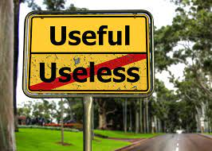
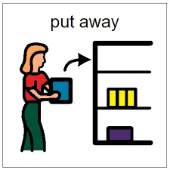
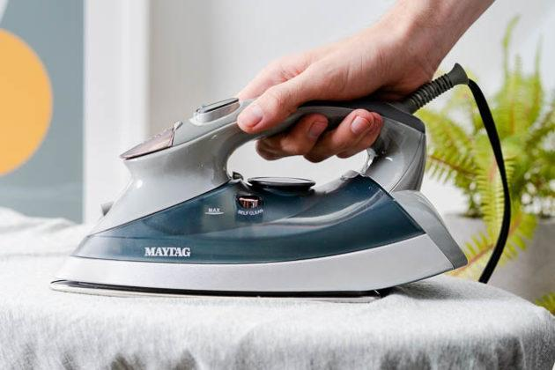
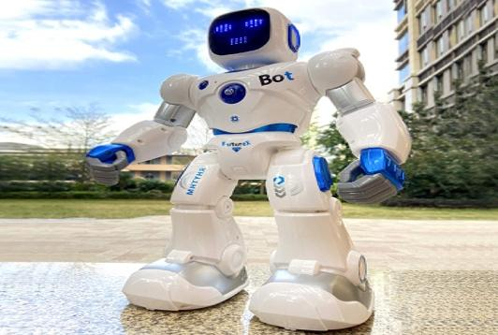

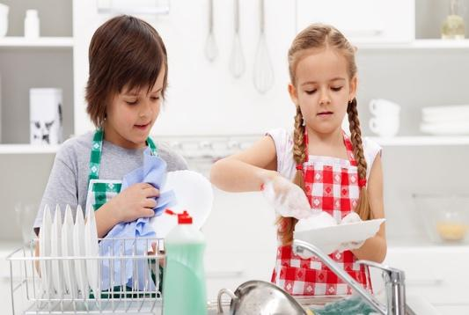

Vocabulary
robot (n) /ˈrəʊbɒt/
iron (v) /ˈaɪən/
broken (a) /ˈbrəʊkən/
Useful (a) /ˈjuːsfl/
do the dishes (vph)
/duː ðə dɪʃiz/
6. put st away (vph)
/pʊt əˈweɪ/
7. repair (v) /rɪˈpeə(r)/
a machine that is made to look like a human and that can do some things that a human can do
​to make clothes, etc. smooth by using an iron
no longer whole or working correctly
​that can help you to do or achieve what you want
to wash plates, glasses, bowls, etc. with soap and water after a meal.
to put something in the place where it is kept because you have finished using it
to fix something that is damaged
Người máy
Là phẳng (quần áo)
Vỡ, nát, hỏng
Có ích, hữu dụng
Rửa bát đĩa
Cất đi
Sửa chữa

Slide 5
Checking Vocabulary matching
robot
iron
broken
Useful
do the dishes
put st away
7. repair
Rửa bát đĩa
Người máy
Là phẳng (quần áo)
Có ích, hữu dụng
Sửa chữa
Cất đi
Vỡ, nát, hỏng

Slide 6
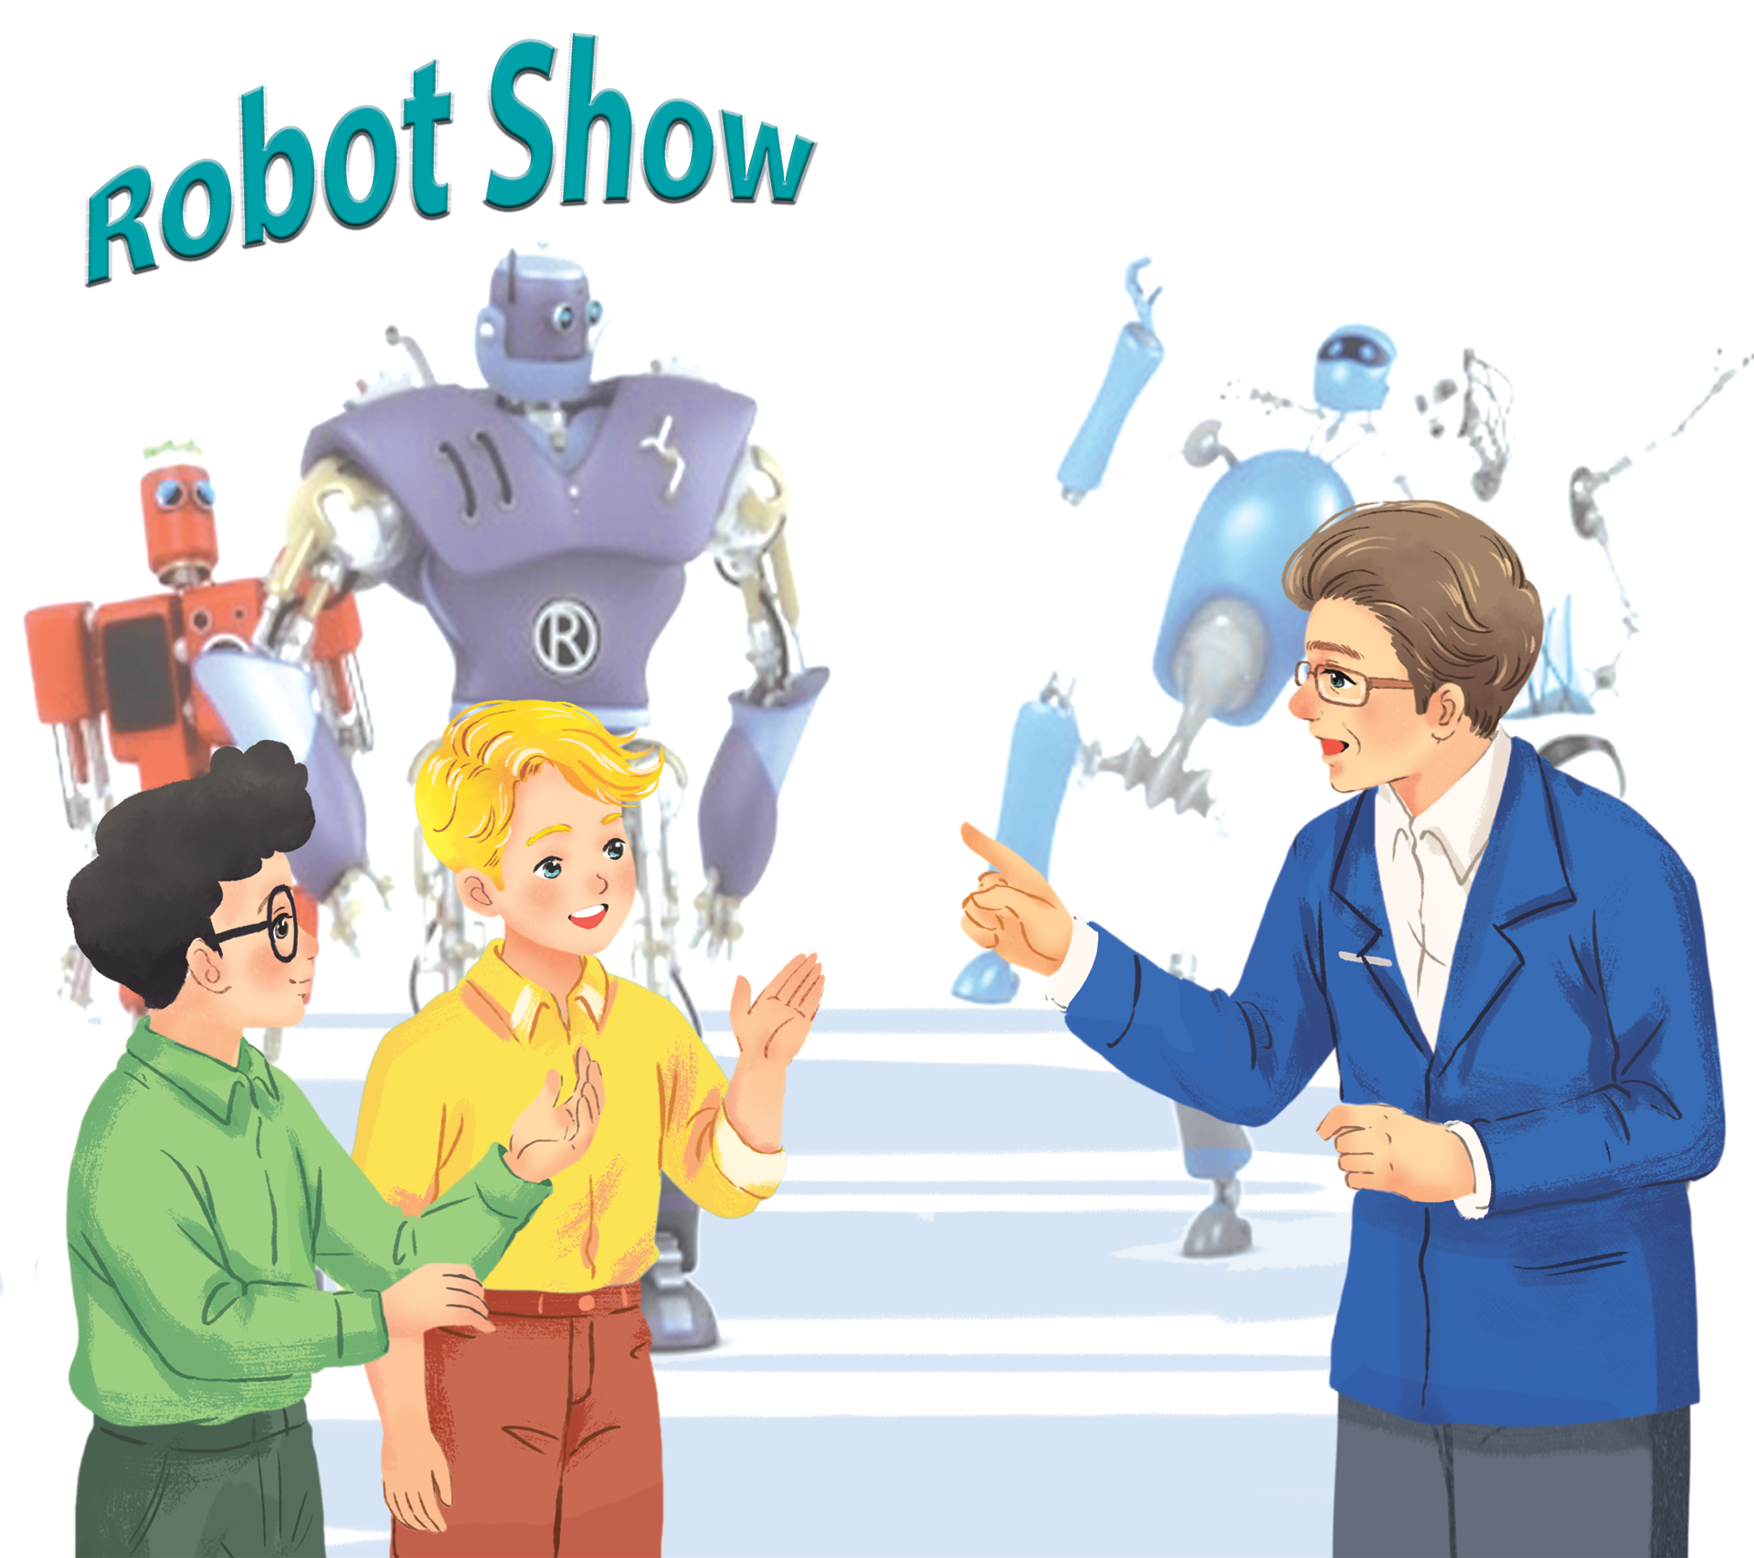
Before reading
1. Where are they?
=> They are in a robot show.
2. What types of robot do you know?
=> Doctor robot, teacher robot, worker robot, home robot, space robot

Slide 7

At an International Robot Show
Nick: Dr Adams! Can you tell us about the robots in the show, please?
Dr Adams: Sure. This is H8, a home robot. It can do the dishes, iron clothes, put toys away...
Nick: It looks very useful!
Dr Adams: Yes, it can even make meals.
Phong: Look! That's the biggest robot in the show.
Dr Adams: Right, it's WB2, a worker robot. It's the strongest and fastest robot here.
Nick: What can it do?
Dr Adams: It can move heavy things or repair broken machines.
Nick: And what is this?
Dr Adams: It's Shifa, a doctor robot. It's the smartest robot. It can help sick people and do many things like humans.

Slide 8
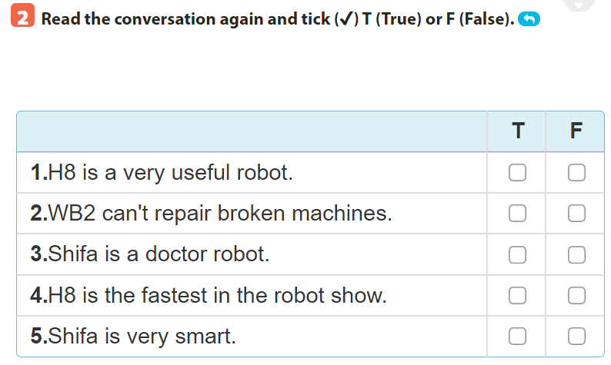
✓
✓
✓
✓
✓
Dr Adams: Yes, it can even make meals.]
Phong: Look! That's the biggest robot in the show.
Nick: What can it do?
Dr Adams: It can move heavy things or repair broken machines.
Dr Adams: It's Shifa, a doctor robot. It's the smartest robot. It can help sick people and do many things like humans.
Nick: And what is this?
Dr Adams: It's Shifa, a doctor robot. It's the smartest robot. It can help sick people and do many things like humans.
Dr Adams: Yes, it can even make meals.]
Phong: Look! That's the biggest robot in the show.

Slide 9
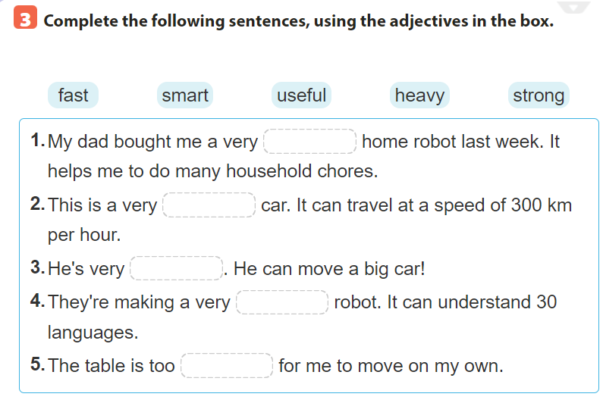

Slide 10

Choose the best answer
Note: click anywhere to run the time.
Click a, b or c to choose the correct answer.

Slide 11

1.My dad bought me a very ……. home robot last week. It helps me to do many household chores.
5
4
1
3
2
a. Useful
b. strong
c. heavy

Slide 12
2. This is a very ……. car. It can travel at a speed of 300 km per hour.
5
4
1
3
2
a. strong
b. heavy
c. fast

Slide 13
3. He's very…..... He can move a big car!
5
4
1
3
2
a. smart
b. strong
c. fast

Slide 14
4. They're making a very ….… robot. It can understand 30 languages.
5
4
1
3
2
a. smart
b. useful
c. heavy

Slide 15
5. The table is too ….. for me to move on my own.
5
4
1
3
2
a. strong
b. fast
c. heavy

Slide 16

useful
fast
strong
smart
heavy

Slide 17
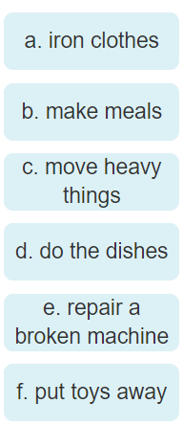
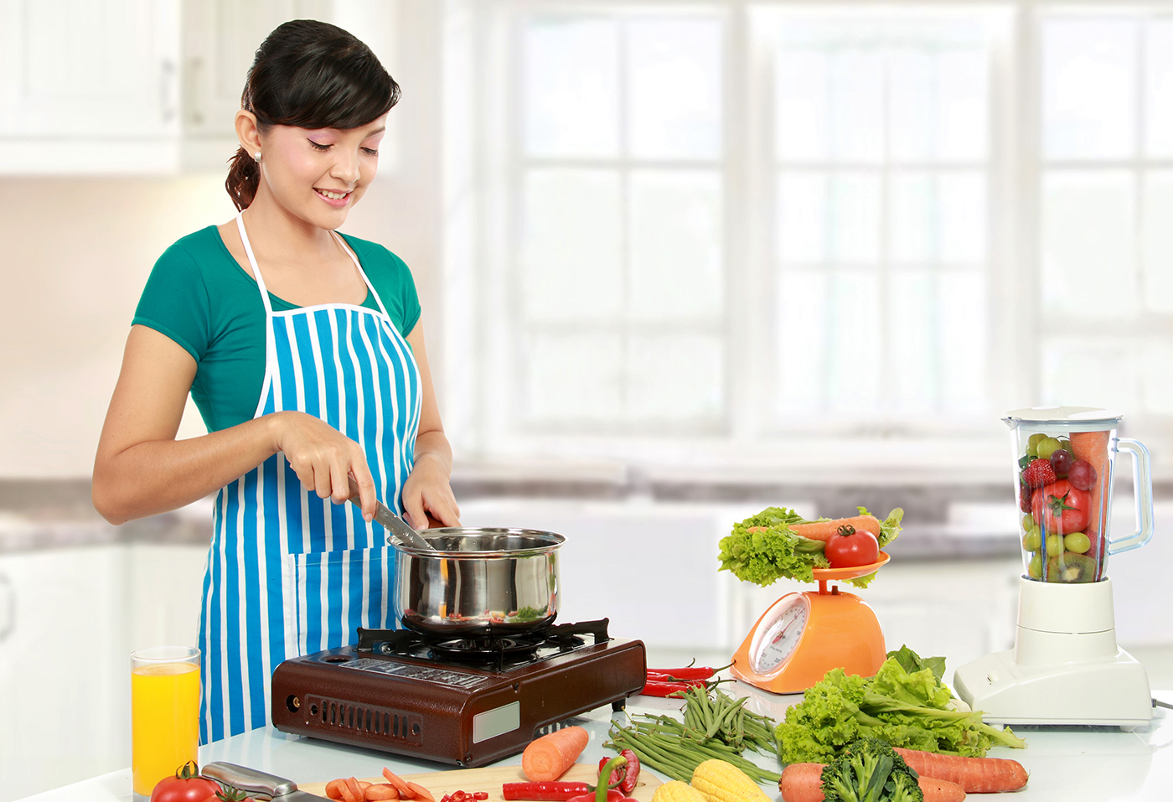
4. Choose the correct activities with the pictures

Slide 18

4. Choose the correct activities with the pictures

Slide 19
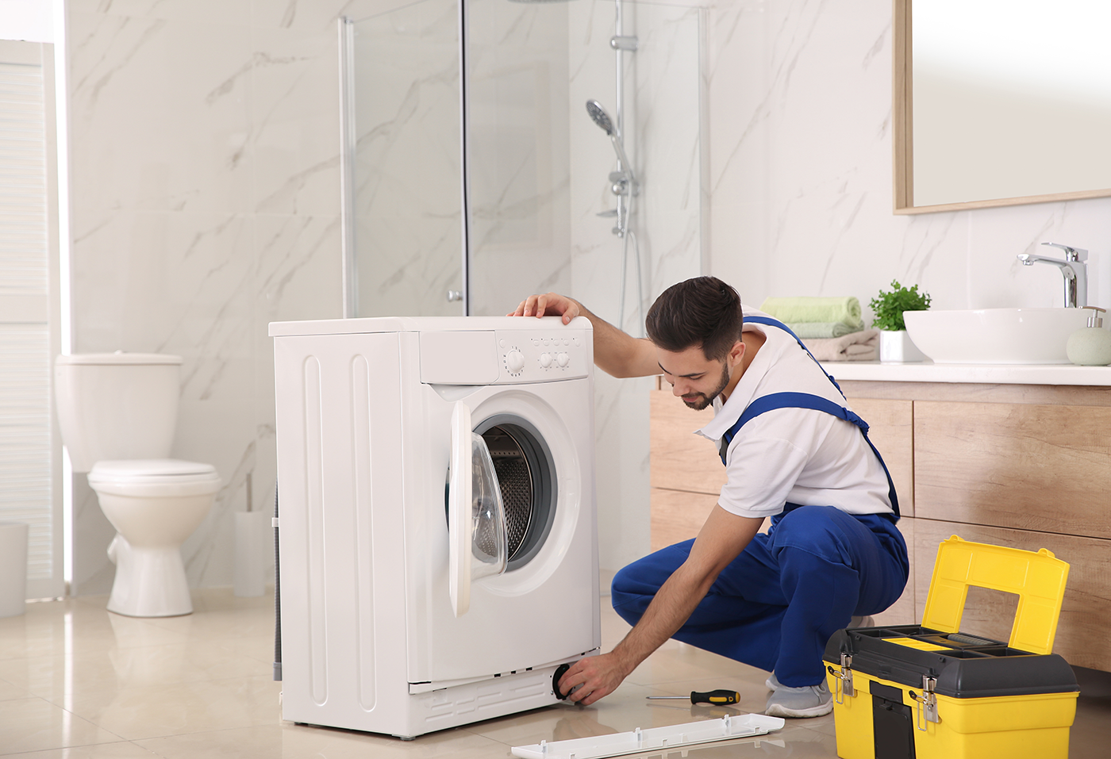
4. Choose the correct activities with the pictures

Slide 20
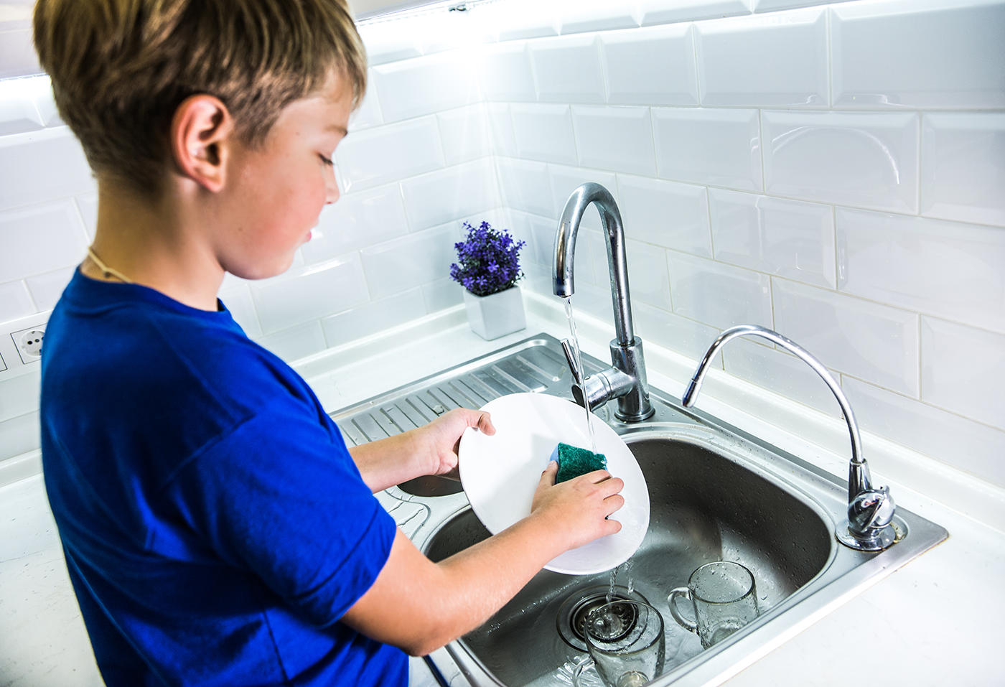
4. Choose the correct activities with the pictures

Slide 21

4. Choose the correct activities with the pictures

Slide 22

4. Choose the correct activities with the pictures

Slide 23
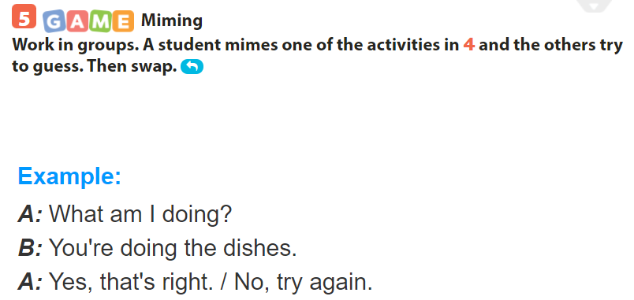

Slide 24
Sum up
By the end of the lesson, students will be able to:
- use the lexical items related to the topic robots and daily activities;
- use the vocabulary and structures to talk about what a robot can do.
- Do exercise page….
- Prepare “A closer look 1” part

Slide 25
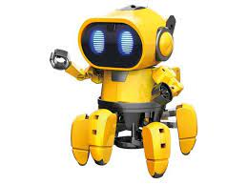
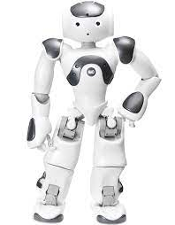
Thank you for your attention
robot

