Slide 1
Unit 12: ROBOTS
Lesson 2:
A closer look 1

Slide 2
Objectives
By the end of the lesson, students will be able to:
use the lexical items related to the topic Robots;
use the vocabulary and structures to talk about what a robot can and cannot do;
pronounce and recognize the falling tone in statements.

Slide 3
Part 1: Vocabulary

Slide 4

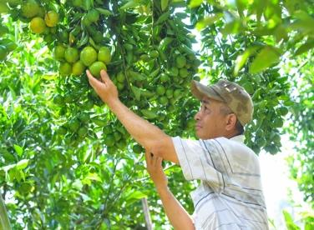


Vocabulary
guard (n) /ɡɑːrd/
pick (v) /pɪk/
water (v) /ˈwɔːtər/
delicious (adj) /dɪˈlɪʃəs/
understand (v) /ˌʌndərˈstænd/
helpful (adj) /ˈhelpfl/
Bảo vệ
Hái
Tưới nước
Ngon
Hiểu
Hữu ích

Slide 5
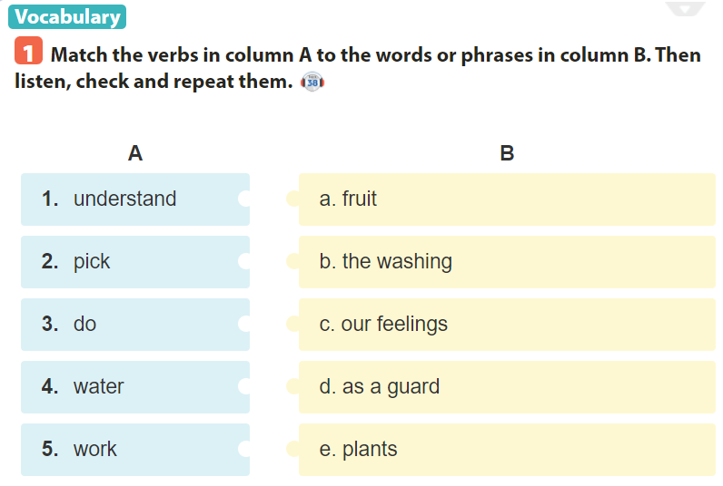

Slide 6
Example:
1. I can pick fruit but I can't understand your feelings.
1. Pick fruit
2. Understand our feelings
3. Do the washing
4. Water plants
5. Work as a guard
2. I can do the washing.
3. I can water plants and flowers.
4. I can’t work as a guard.

Slide 7
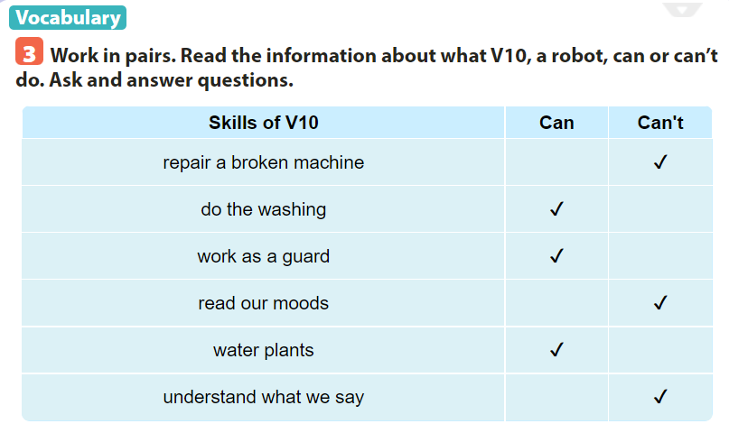
Example:
A: Can V10 do the washing?
=> Yes, it can.

Slide 8
Part 2: pronunciation
Tones in statements

Slide 9
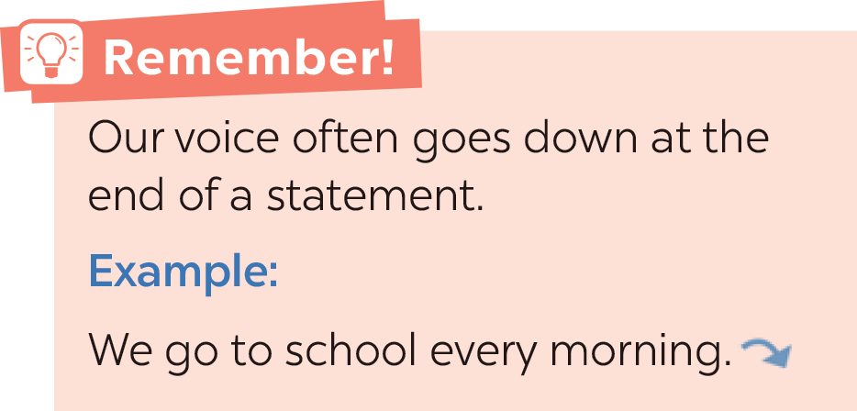

Slide 10
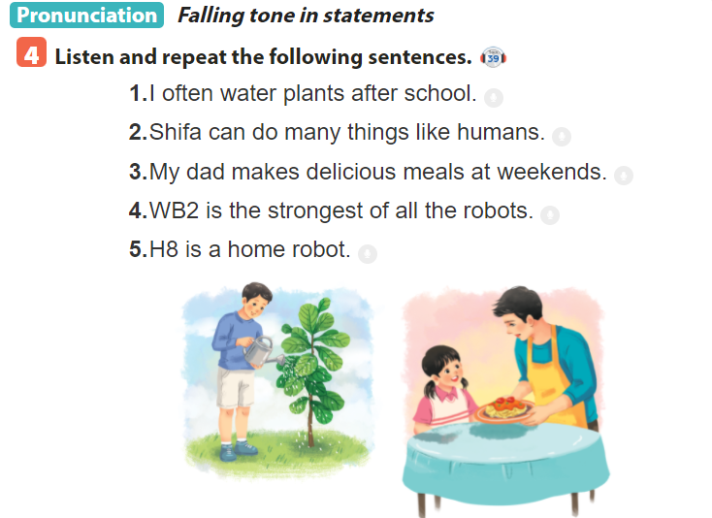

Slide 11
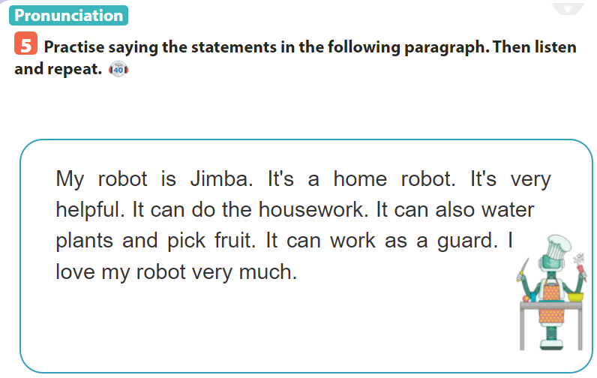

Slide 12
Sum up
By the end of the lesson, students will be able to:
- use the lexical items related to the topic Robots;
- use the vocabulary and structures to talk about what a robot can and cannot do;
- pronounce and recognize the falling tone in statements.
- Do homework page …..

Slide 13
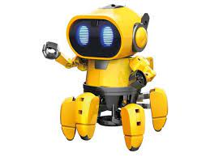
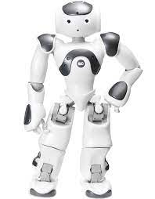
Thank you for your attention
robot

