Slide 1
HIDDEN PICTURE!

Slide 2

What is it?
Cycle lane
SHOW ALL

Slide 3

What is it?
No right turn
SHOW ALL

Slide 4

What is it?
Hospital ahead
SHOW ALL

Slide 5
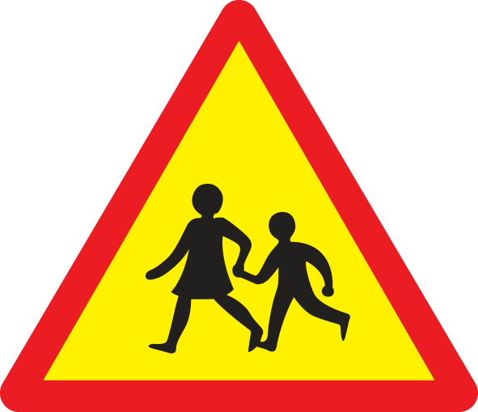
What is it?
School ahead
SHOW ALL

Slide 6

What is it?
No cycling
SHOW ALL

Slide 7

What is it?
Traffic light
SHOW ALL

Slide 8

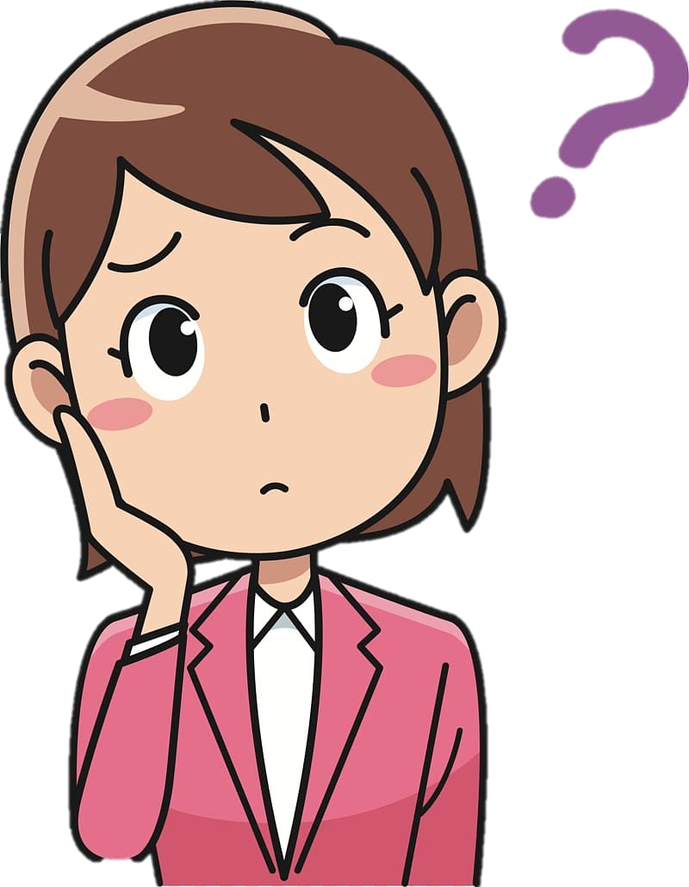
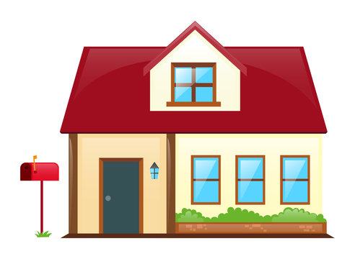
How can you answer the question?
How far is it from your house to school?

Slide 9
UNIT 7: TRAFFIC
Lesson 3: A closer look 2

Slide 10
OBJECTIVES
By the end of the lesson, students will be able to:
Know how to use:
  - It to indicate distance
- should and shouldn’t

Slide 11

It is about 1km from my house to school.
How far is it from your house to school?
1km

Slide 12
It indicating distance
- It is about 1km from my house to school.
It is + distance + from A to B

Slide 13
Ex 1. Write sentences with It. Use these cues. (P.75)
Example:
500 metres / my house / nearest shop.
→ It is about 500 metres from my house to the nearest shop.
1. 700 metres / my flat / Youth Club.
2. 5 kilometres (km) / my village/ nearest town.
3. about 120 km/ Ho Chi Minh City / Vung Tau.
4. 384,400 km / the Earth / the Moon.
5. not very far / Ha Noi centre / Noi Bai Airport.

Slide 14
Ex 1. Write sentences with It. Use these cues.
1. 700 metres / my flat / Youth Club.
2. 5 kilometres (km) / my village/ nearest town.
3. about 120 km/ Ho Chi Minh City / Vung Tau.
4. 384,400 km / the Earth / the Moon.
5. not very far / Ha Noi centre / Noi Bai Airport.
→ It is about 700 metres from my flat to the Youth Club.
→ It is about 5 kilometres from my village to the nearest town.
→ It is about 120 km from Ho Chi Minh City to Vung Tau.
→ It is about 384,400 km from the Earth to the Moon.
→ It is not very far from Ha Noi centre to Noi Bai Airport.

Slide 15
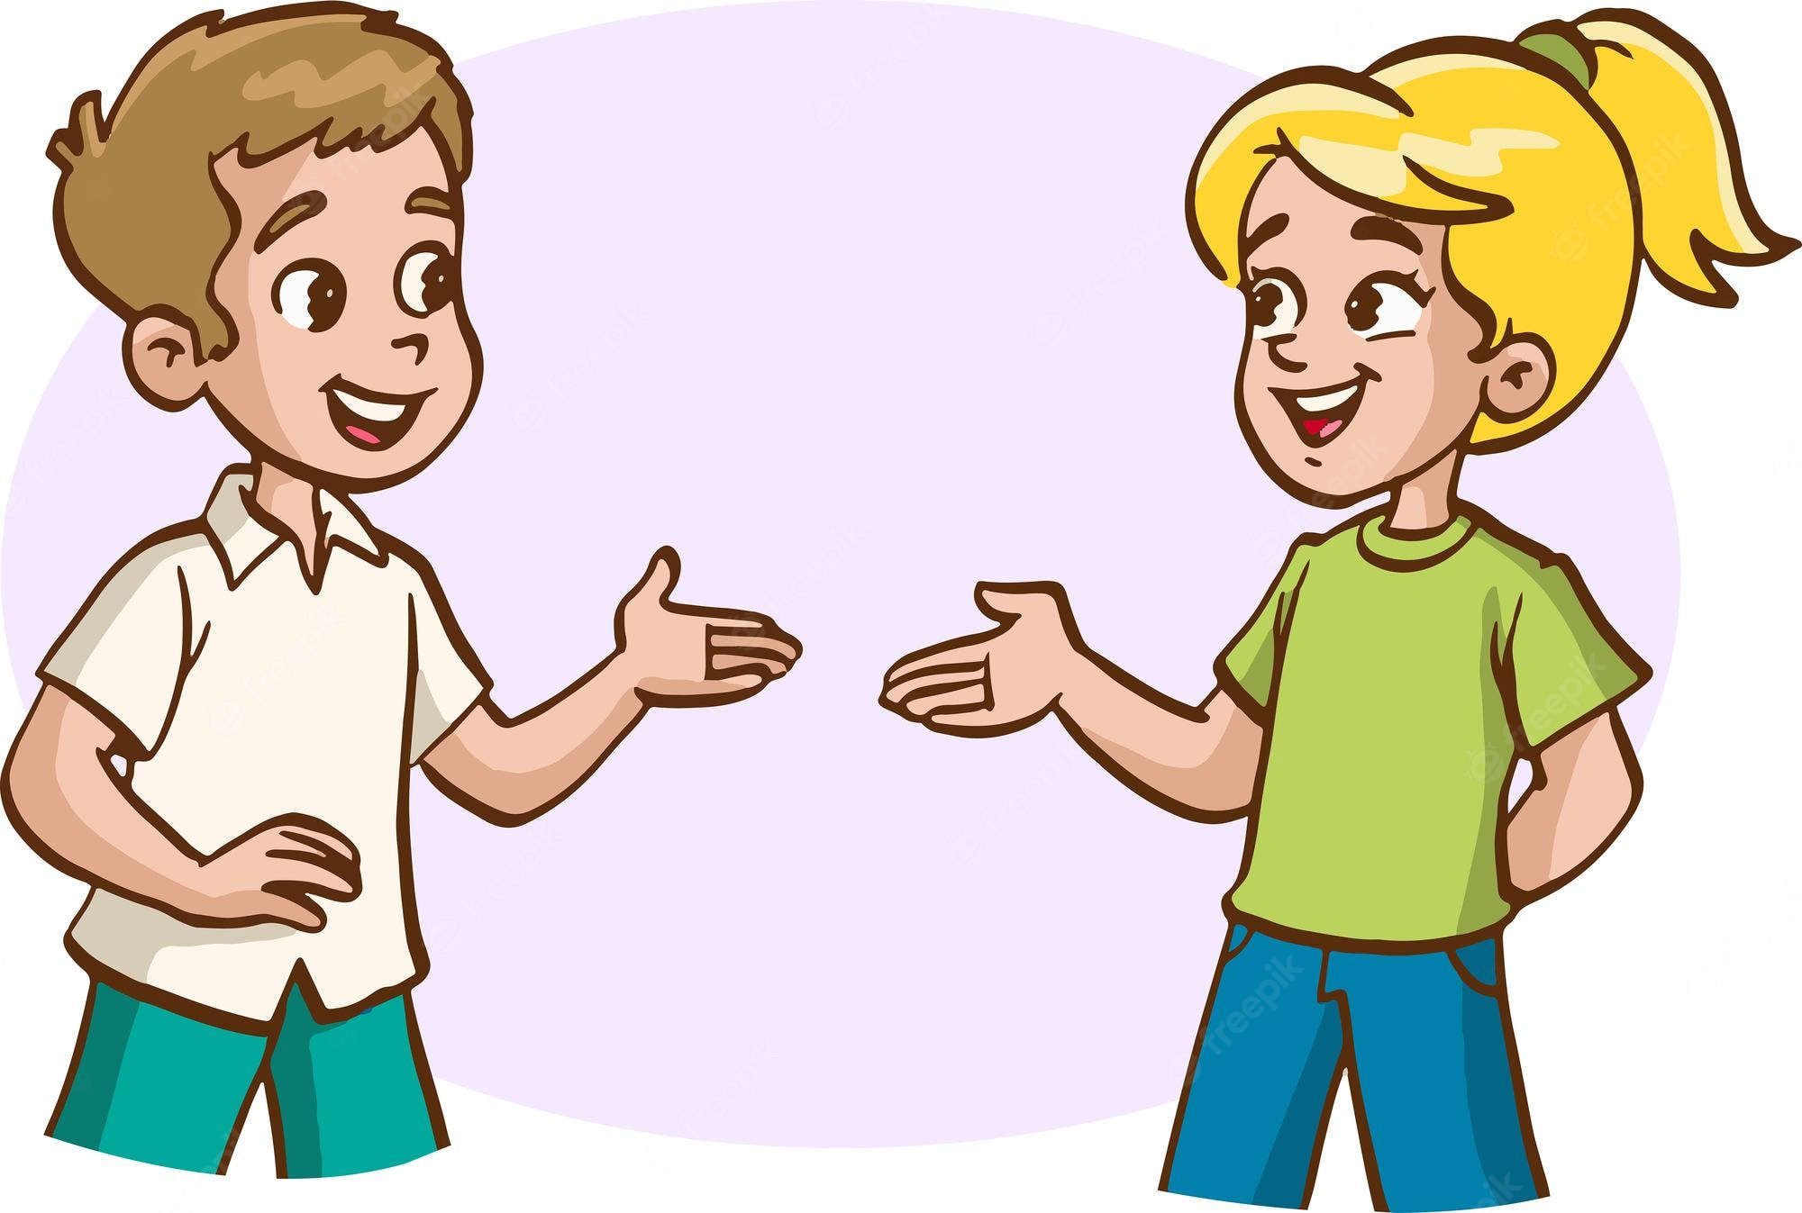
Ex 2. Work in pairs. Ask and answer questions about distances in your neighbourhood.
Example:
It is about 3 kilometres.
How far is it from your home to the gym?
You can use these cues:
your home – supermarket
your home – playground
your home – hospital
your home – school

Slide 16
Should / Shouldn’t
There are a lot of cars out today. He shouldn’t drive so fast.
I think that he should eat less. He’s becoming overweight.
→ To give advice
→ To say what is the best things to do.
Should / shouldn’t + V
Notes:
When do we use should/ shouldn’t

Slide 17
Ex 3. Choose the correct option in brackets.
1. That’s an interesting book. You (should / shouldn’t) read it.
2. You nearly fell off your bike! You really (should / shouldn’t) be more careful.
3. We (should / shouldn’t) go swimming right after eating.
4. I think that he (should / shouldn’t) eat less. He’s becoming overweight.
5. There are a lot of cars out today. He (should / shouldn’t) drive so fast.

Slide 18
Ex 4. Complete each sentence, using should / shouldn’t.
1. We _________ ride our motorbikes very fast in the rain.
2. You _________ study instead of watching YouTube.
3. My little sister _________ play outside late at night.
4. You _________ help your mum wash the dishes after dinner.
5. You look tired. You _________ probably get some sleep.
6. The children _________ eat so much ice cream.
shouldn’t
should
shouldn’t
should
should
shouldn’t

Slide 19
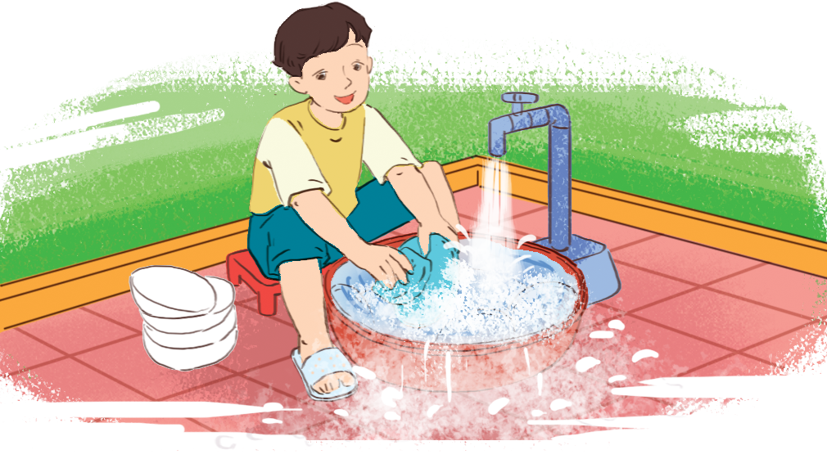
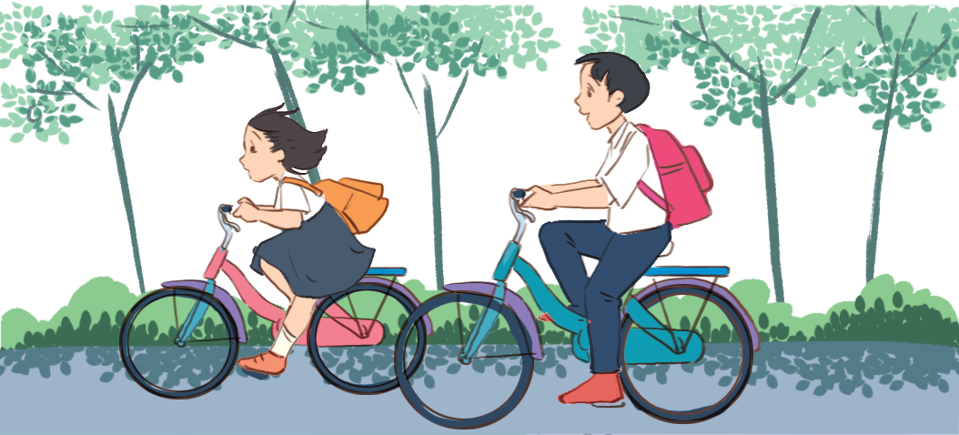
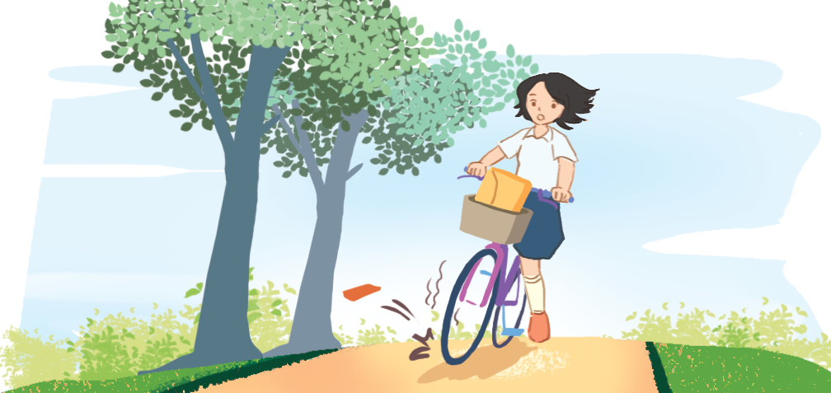
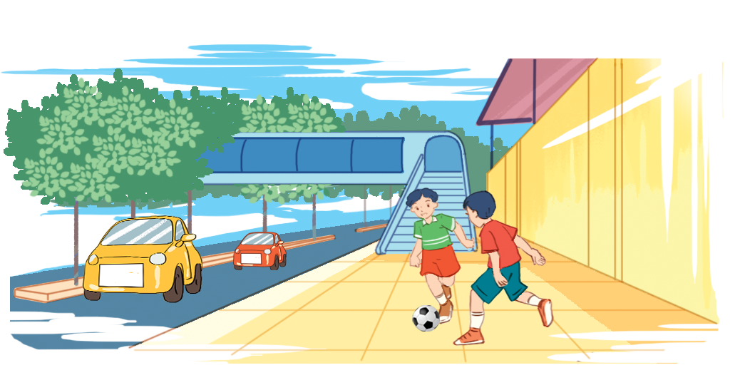
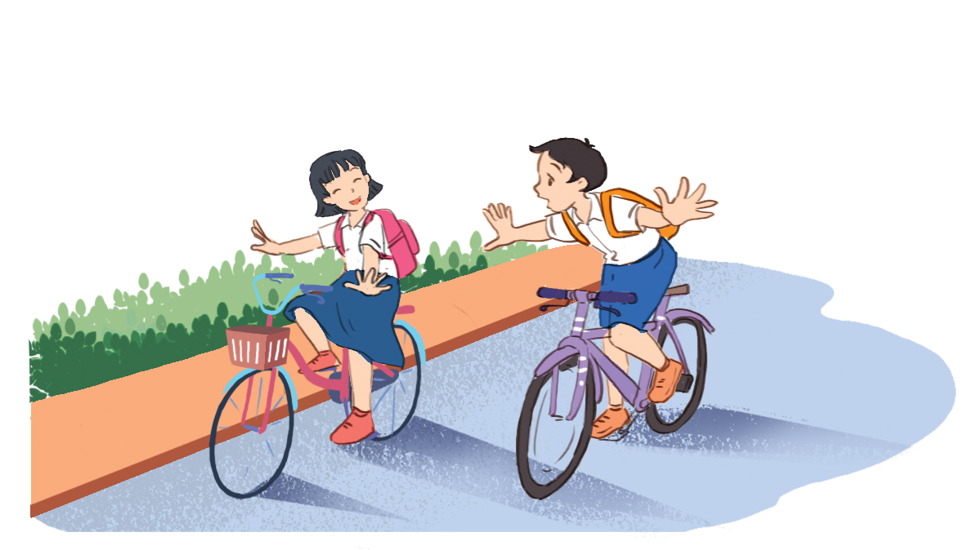
Ex 5. In pairs. Look at the pictures. Make sentences, using should / shouldn’t and the cues.
1. waste water
2. wear their helmets
3. be more careful
4. play football on the pavement
5. ride their bikes dangerously

Slide 20

Ex 5. In pairs. Look at the pictures. Make sentences, using should / shouldn’t and the cues.
He shouldn’t waste water when washing the dishes.
1. waste water

Slide 21
Ex 5. In pairs. Look at the pictures. Make sentences, using should / shouldn’t and the cues.
They should wear their helmets when riding bikes.
2. wear their helmets

Slide 22
Ex 5. In pairs. Look at the pictures. Make sentences, using should / shouldn’t and the cues.
She should be more careful.
3. be more careful

Slide 23
Ex 5. In pairs. Look at the pictures. Make sentences, using should / shouldn’t and the cues.
They shouldn’t play football on the pavement.
4. play football on the pavement

Slide 24
Ex 5. In pairs. Look at the pictures. Make sentences, using should / shouldn’t and the cues.
They shouldn’t ride their bikes dangerously.
5. ride their bikes dangerously

Slide 25

RECAP
Tick  the correct one?
It about 2 km from my house and the cinema.
It is about 2 km from my house to the cinema.
We _____ go now, or we might get stuck in the traffic jam.
should
shouldn’t

Slide 26
THANKS!
Do you have any questions?
Please keep this slide for attribution

