Slide 1
Unit 11: OUR GREENER WORLD lesson 1: Getting started
Grade 6

Slide 2
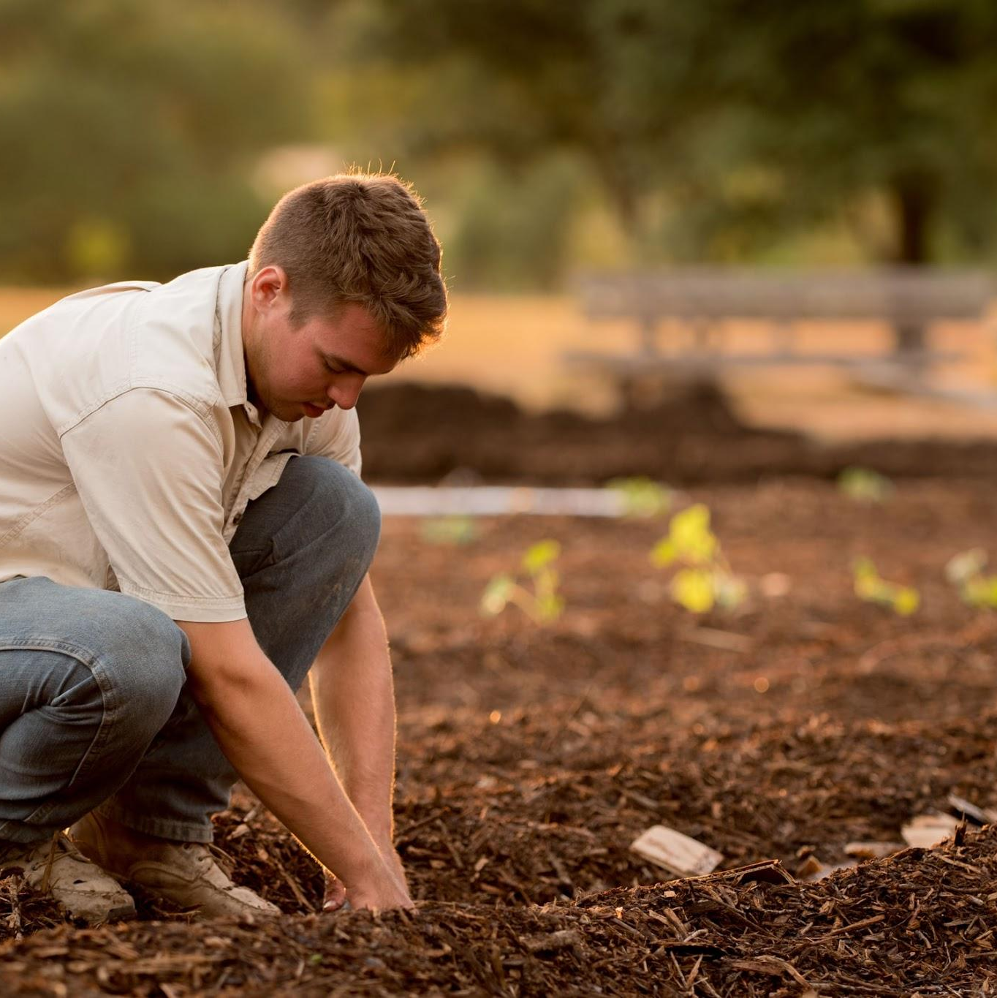
Before reading Discuss !
What do you think about our world in the future?
Is it greener or more polluted?

Slide 3
Objectives
By the end of the lesson, students can be able to:
use the lexical items related to the topic Our Greener world.
guess the meaning of new words based on clues including pictures and surrounding words.
pronounce the sounds /a:/ and /æ/ correctly in isolation and in context.

Slide 4

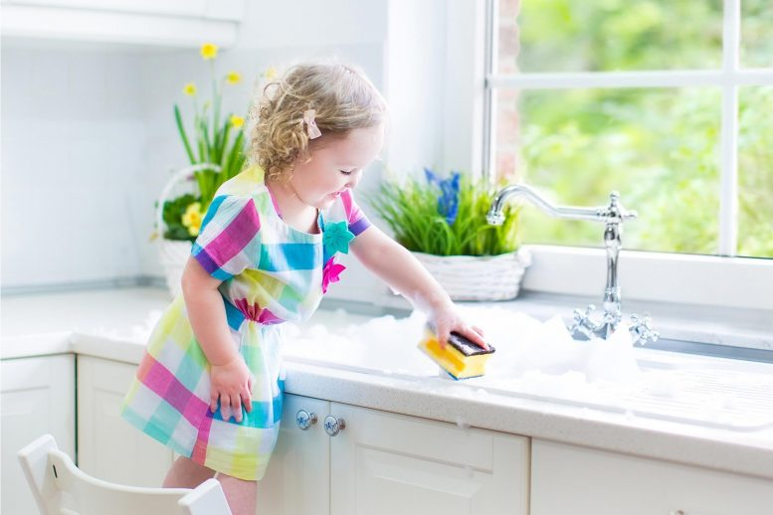
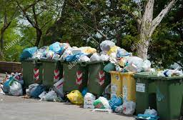
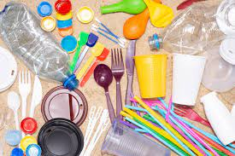

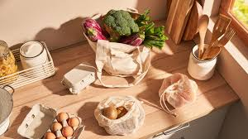
Explore vocabulary
1. Reusable (a):
/ˌriːˈjuː.zə.bəl/
2. Plastic (n):/ˈplæs.tɪk /
3. Clean (a,v) /kliːn/
4. Environment (n)
/ɪnˈvaɪ.rən.mənt/
5. Rubbish (n) /ˈrʌbɪʃ/
Có thể tái sử dụng
Nhựa
Sạch sẽ,dọn sạch
Môi trường
Rác thải

Slide 5
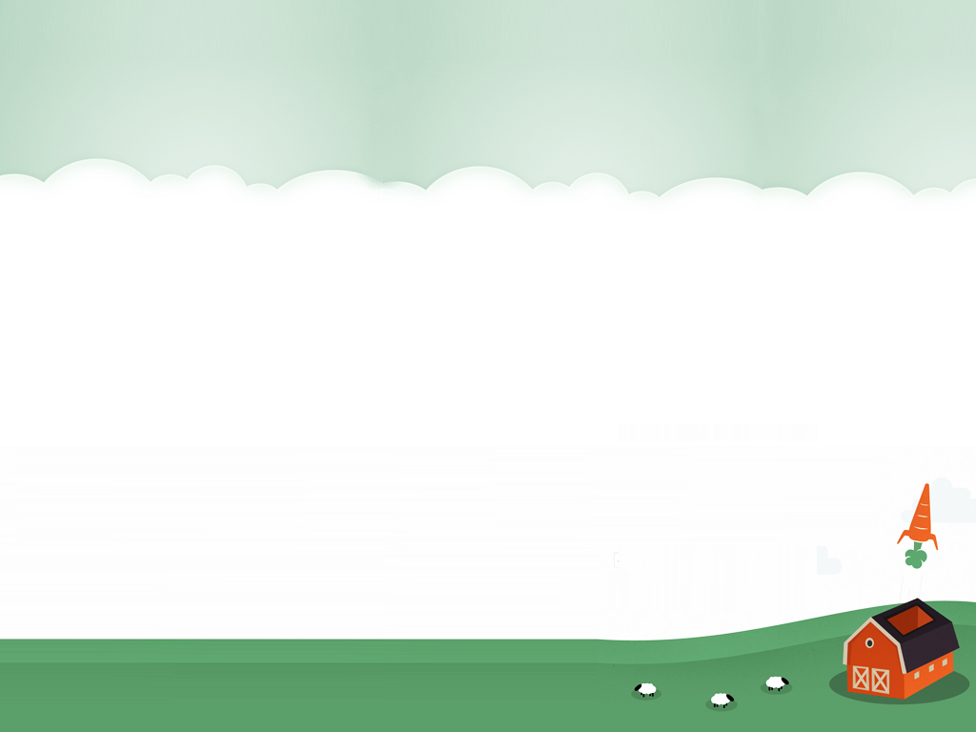

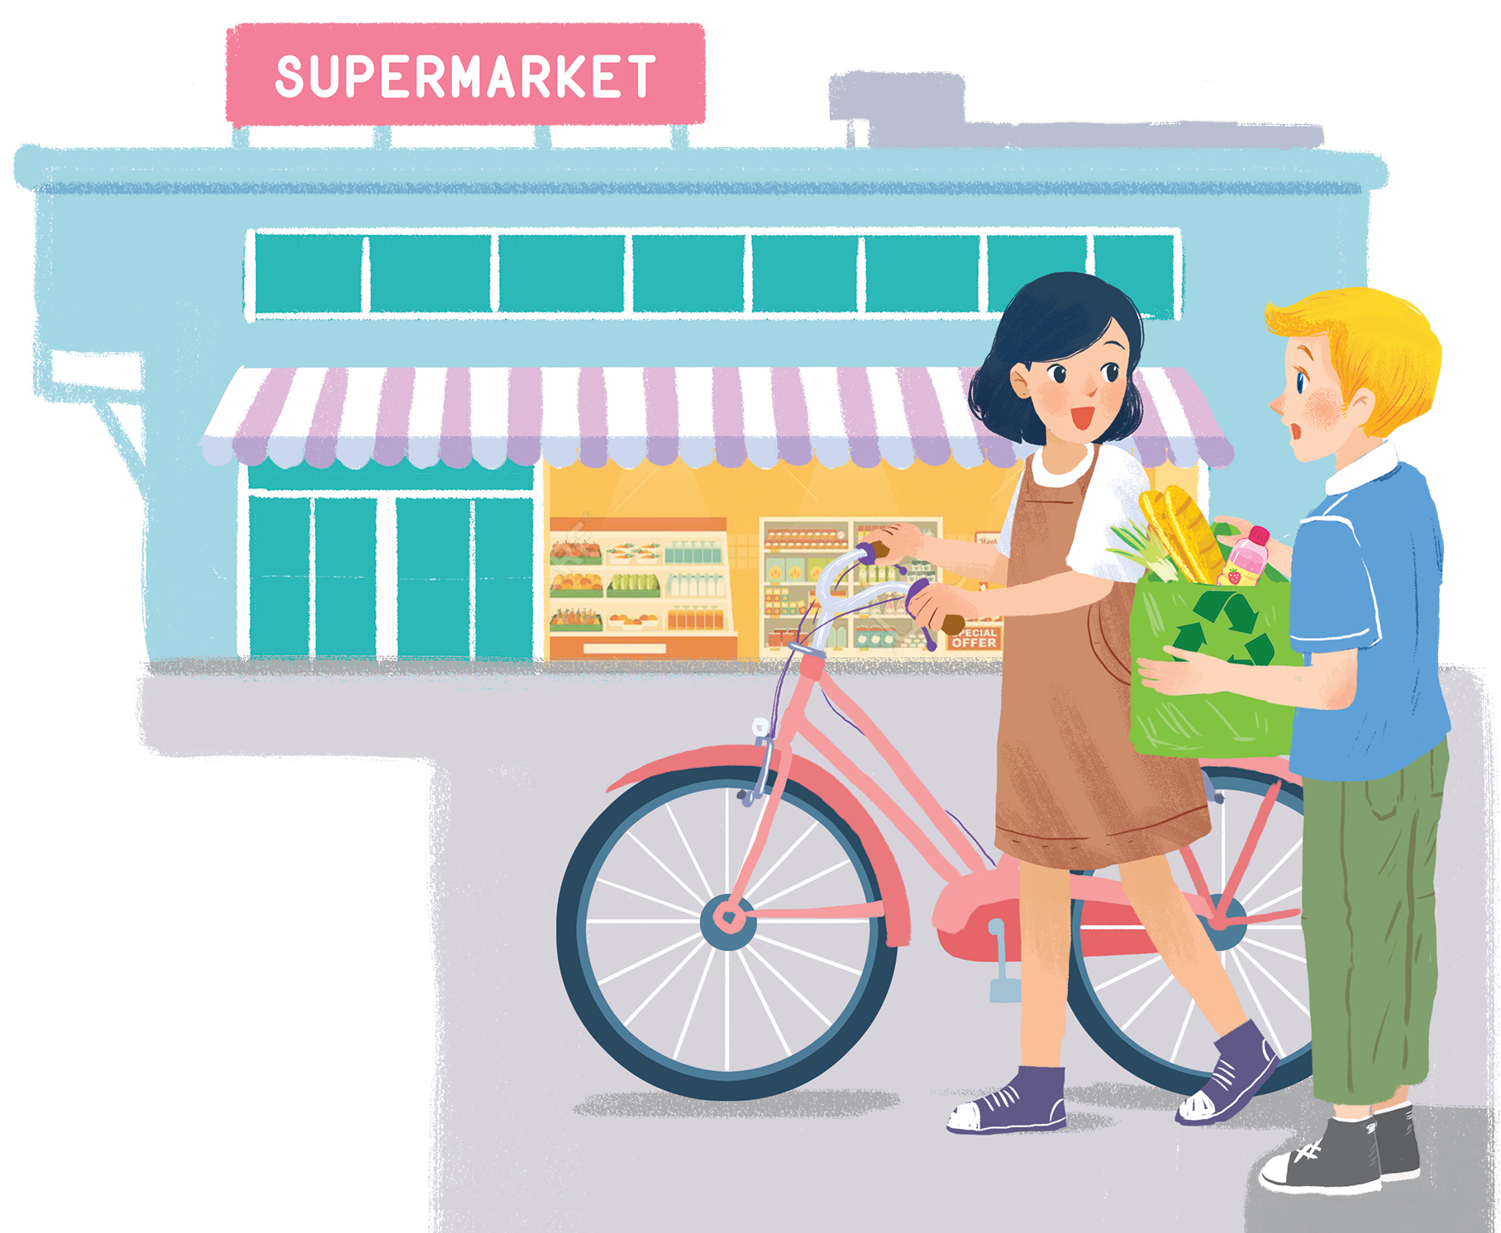
LET’S GO GREEN
Mi: Hi, Nick.
Nick: Hello, Mi.
Mi: You've bought a lot of things.
Nick: Yes. We're going on a picnic tomorrow. What are you doing
at the supermarket, Mi?
Mi: I'm buying some eggs. Hey, what's this?
Nick: It's a reusable shopping bag.
Mi: Do you always use it?
Nick: Yes. It's better than a plastic one. If we all use this kind of bag, we will help the environment.
Mi: I see. I'll buy one for my mum. Where can I buy one?
Nick: At the check-out. By the way, you're also green. You're cycling.
Mi: You're right. If more people cycle, the air will be cleaner. Right?
Nick: Yes. Oh, it's 5 o'clock already. I have to go now. See you later.
Mi: See you, Nick. Bye.

Slide 6
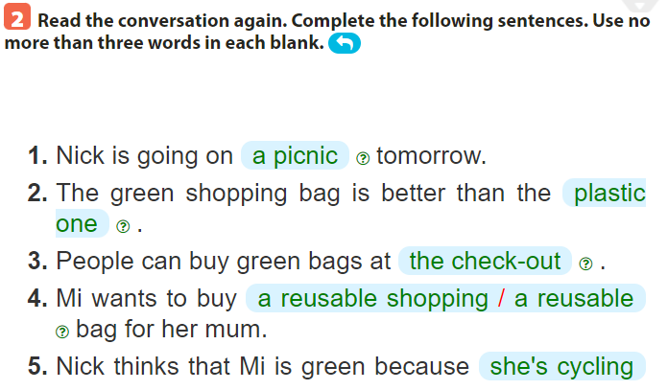

…………………
…………………
…………
…………………………….
……………………………………...
………………………………...

Slide 7
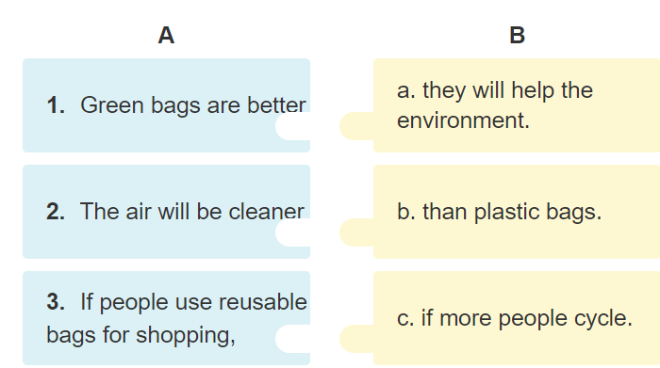

Slide 8
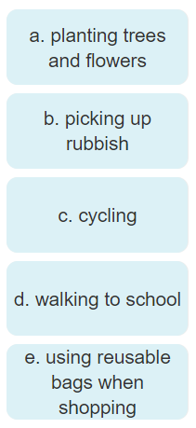
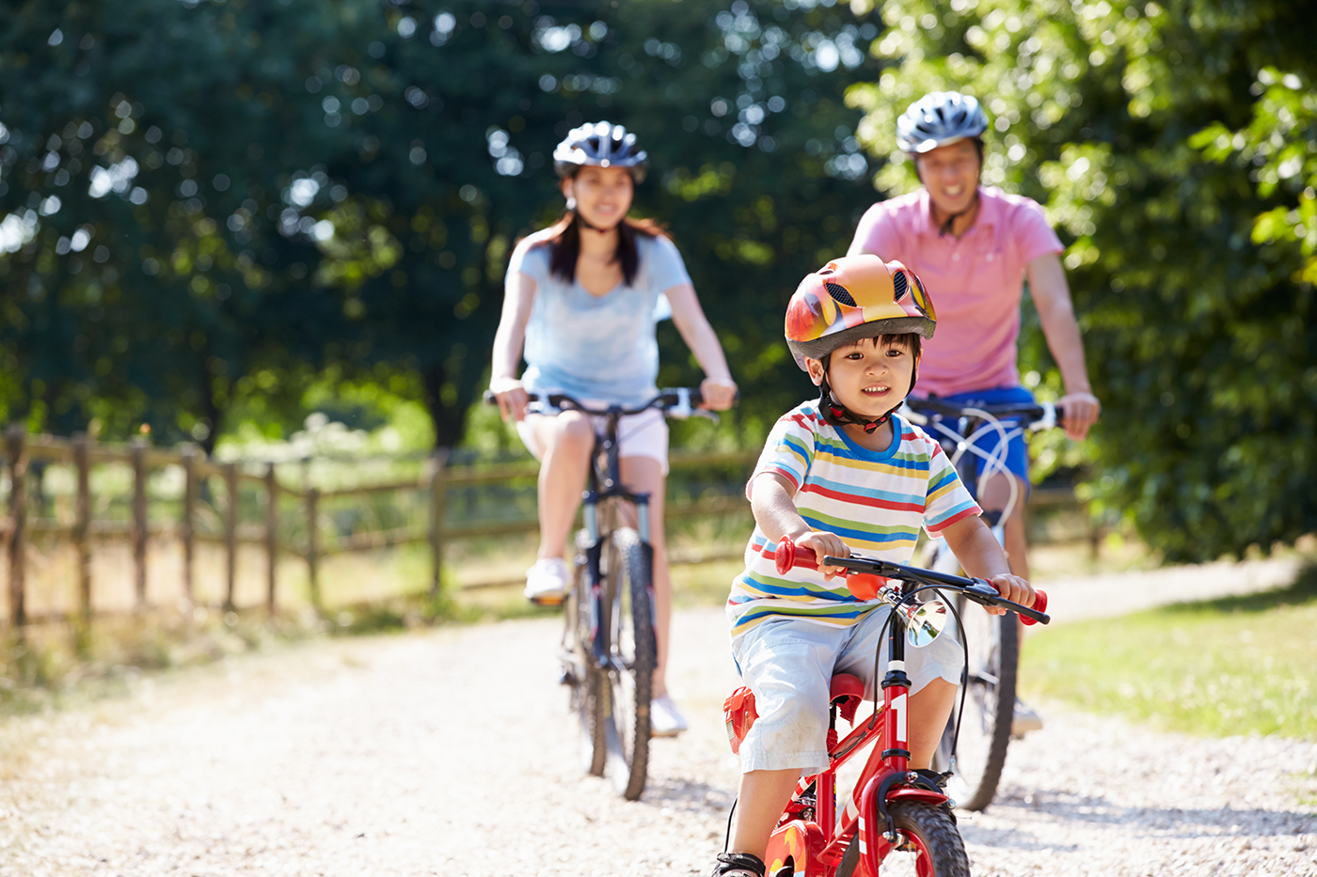


Slide 9
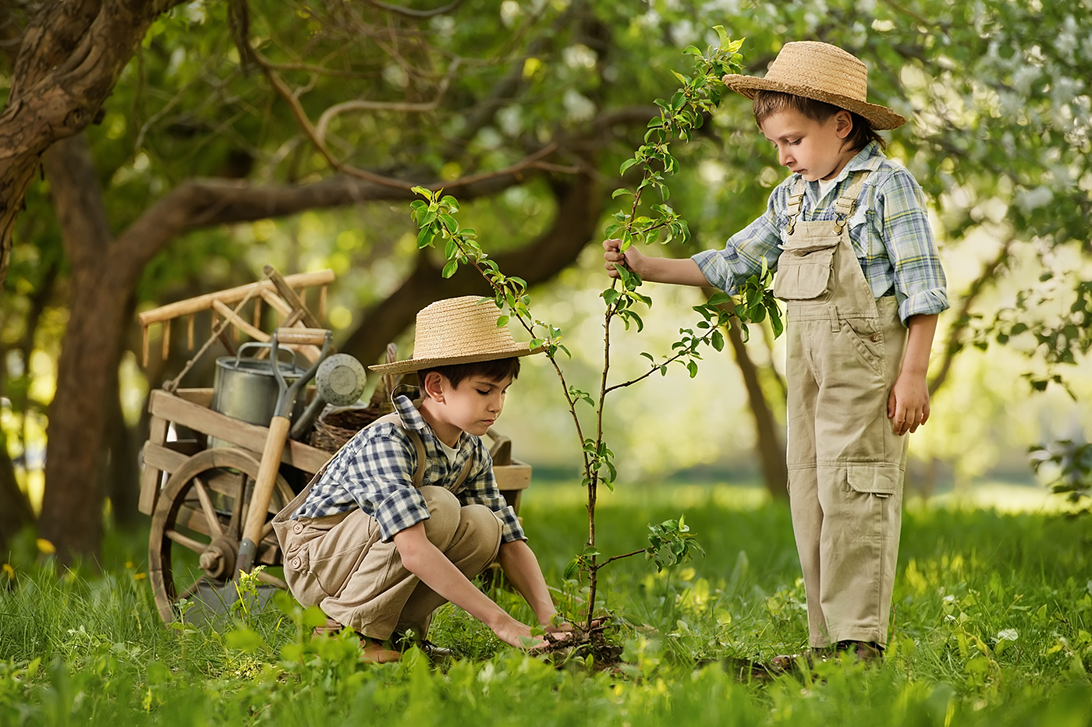

Slide 10
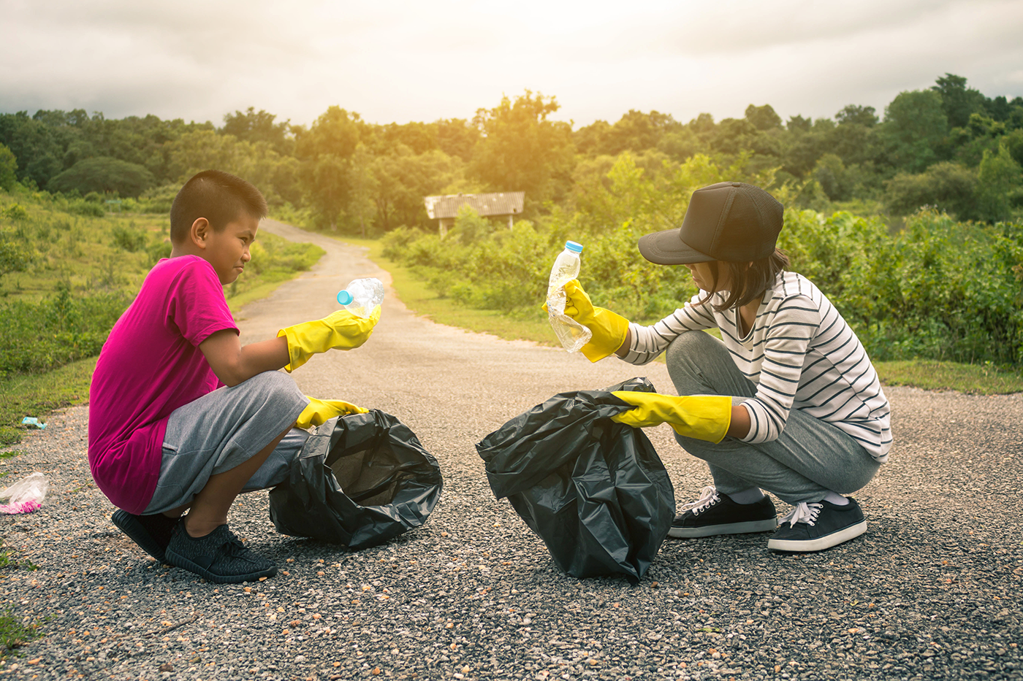

Slide 11
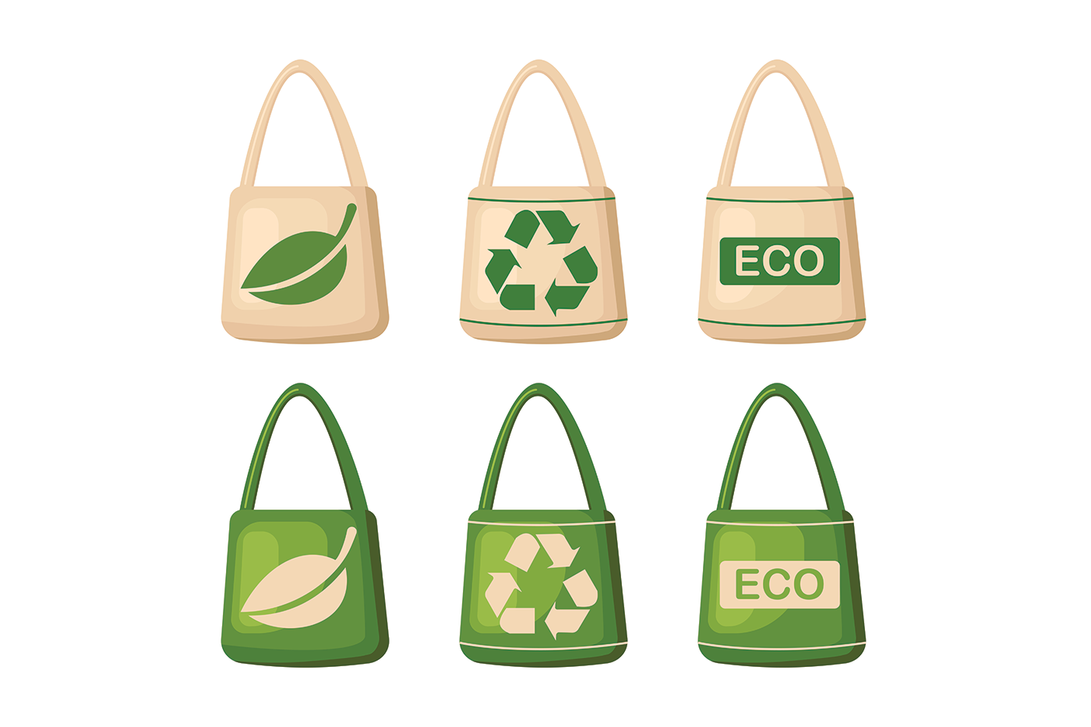

Slide 12
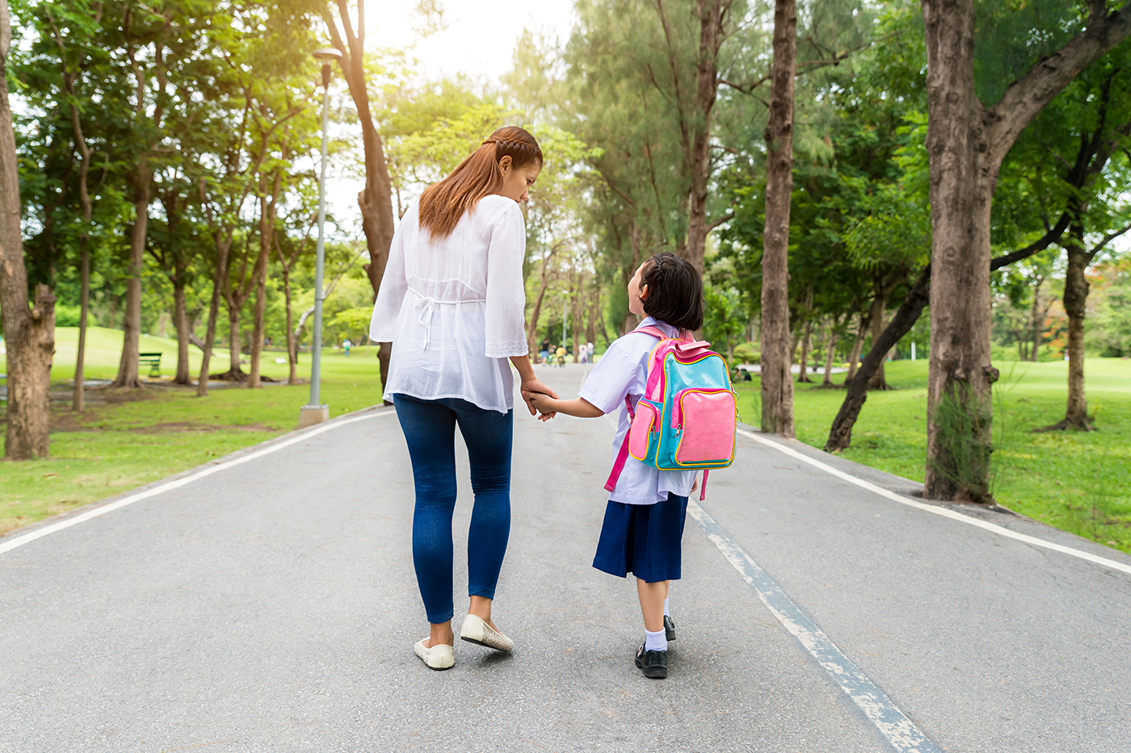

Slide 13

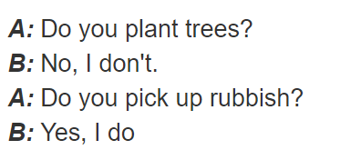
Use these phrases plant trees and flowers pick up rubbish cycle walk to school use reusable bags when shopping

Slide 14
SUM UP
By the end of the lesson, students can be able to:
- use the lexical items related to the topic Our Greener world.
- guess the meaning of new words based on clues including pictures and surrounding words.
- pronounce the sounds /a:/ and /æ/ correctly in isolation and in context.
- Do exercise page ……

Slide 16
Unit 11: OUR GREENER WORLD lesson 2: A closer look 1
Grade 6

Slide 17
Objectives
By the end of the lesson, students can be able to:
pronounce the sounds /a:/ and /æ/ correctly in isolation and in context;
use the lexical items related to the topic Our Greener world;
guess the meaning of new words based on clues including pictures and surrounding words.

Slide 18
Can you list some ways to help the environment?
Review
1
2
3
4
5
Use reusable bags when shopping
Plant trees and flowers
Pick up rubbish
cycle
Walk to school

Slide 19
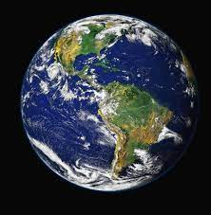
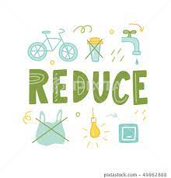

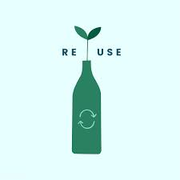

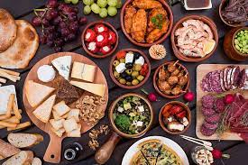

Explore vocabulary
Recycle (v) /ˌriːˈsaɪ.kəl/
Reuse (v)/ˌriːˈjuːz/
Reduce (v) /rɪˈdʒuːs/
Create (v) /kriˈeɪt/
Material (n) /məˈtɪə.ri.əl/
Earth (n) /ɜːθ/
Article (n) /ˈɑː.tɪ.kəl/
Tái chế
Tái sử dụng
Giảm, dùng it đi
Tạo ra
Nguyên liệu
Trái Đất
Bài luận, bài viết

Slide 20
Part 1: Vocabulary

Slide 21
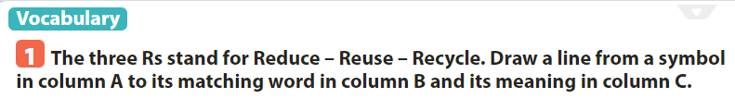
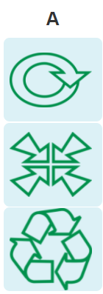
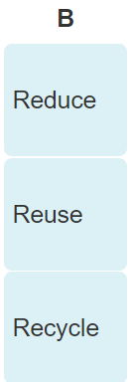
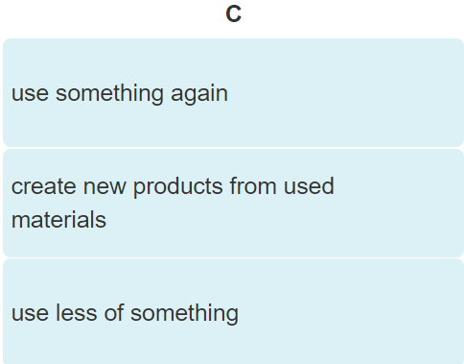

Slide 22

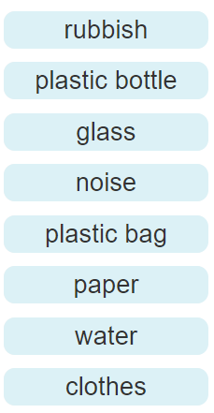

rubbish
Plastic bag
glass
Plastic bottle

Slide 23

noise
paper
water
clothes

Slide 24
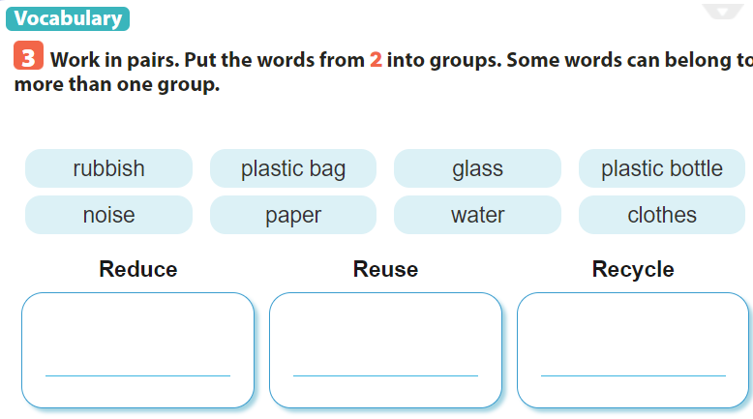
rubbish
plastic bag
glass
plastic bottle
paper
rubbish
plastic bag
noise
plastic bottle
paper
water
plastic bag
glass
plastic bottle
paper
water
clothes

Slide 25
Part 2: Pronunciation

Slide 26
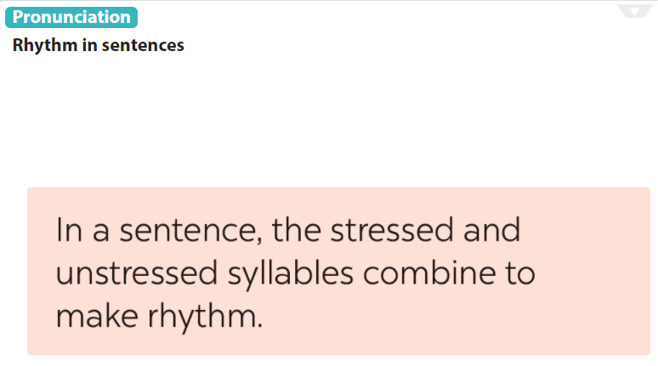

Slide 27
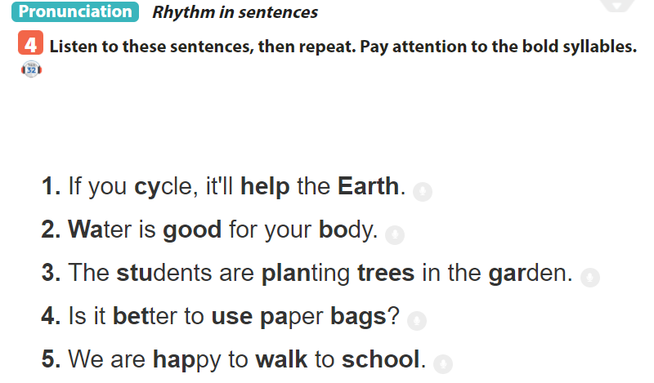

Slide 28
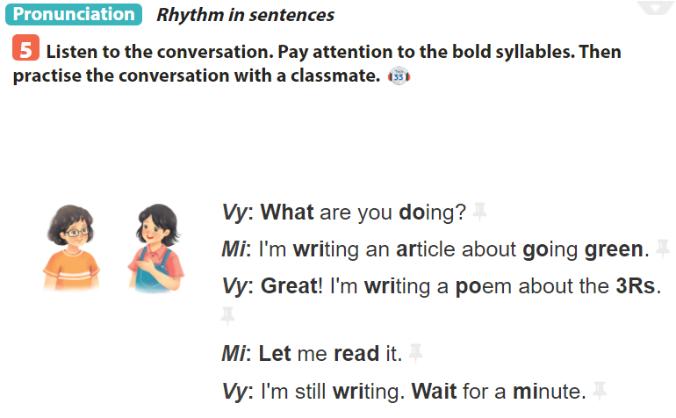

Slide 29
SUM UP
By the end of the lesson, students can be able to:
- pronounce the sounds /a:/ and /æ/ correctly in isolation and in context;
- use the lexical items related to the topic Our Greener world;
- guess the meaning of new words based on clues including pictures and surrounding words.
- Do exercise page ……

Slide 31
Unit 11: OUR GREENER WORLD lesson 3: A closer look 2
Grade 6

Slide 32
Objectives
By the end of the lesson, students can be able to:
understand and use the article and the first conditional sentence to make correct sentences, and use them in dialogues.

Slide 33
Grammar Part 1: ARTICLES

Slide 34
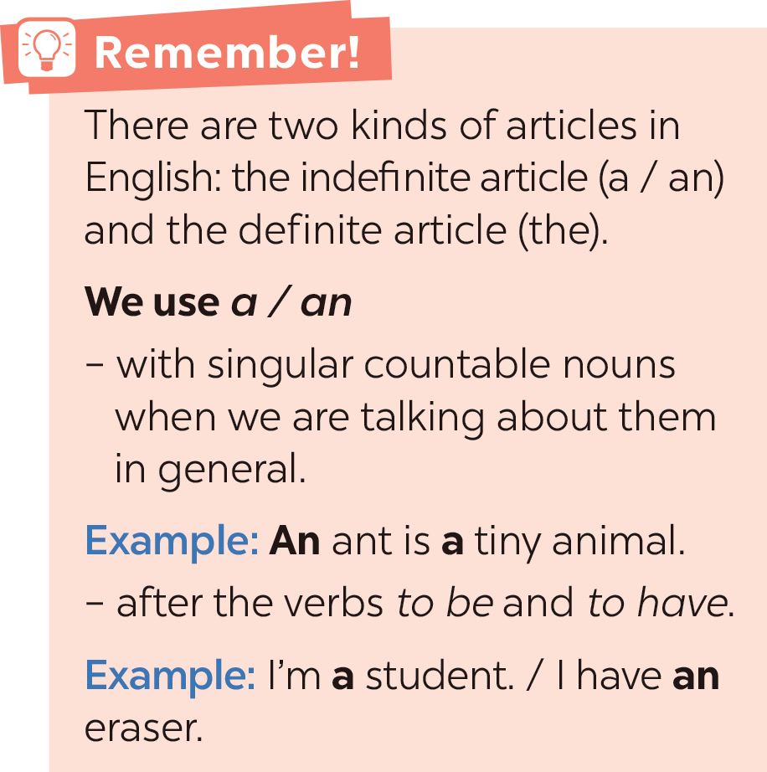
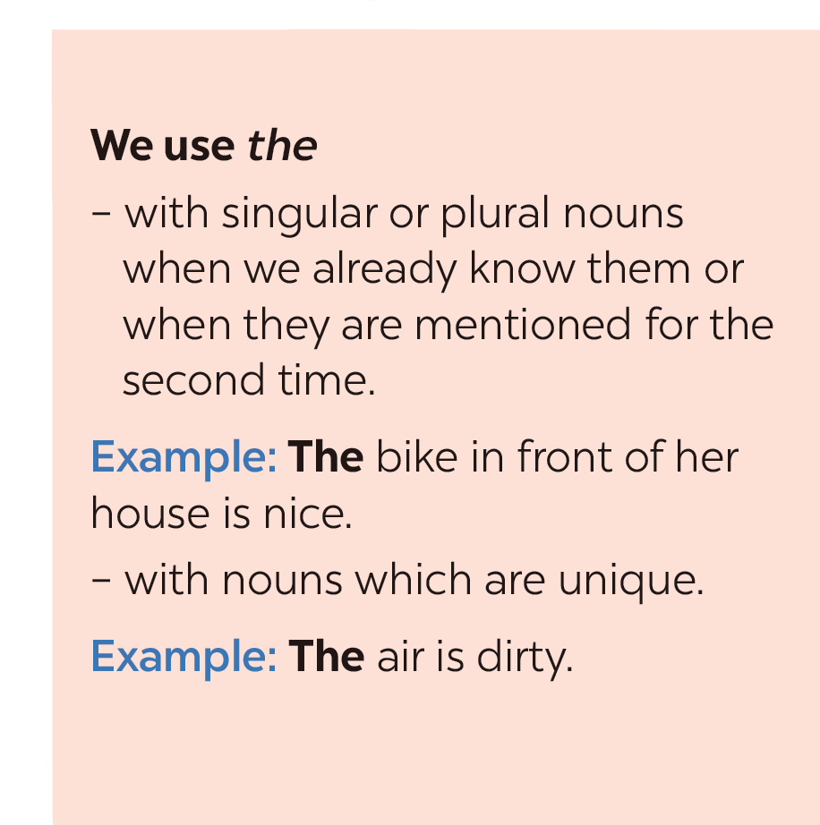

Slide 35

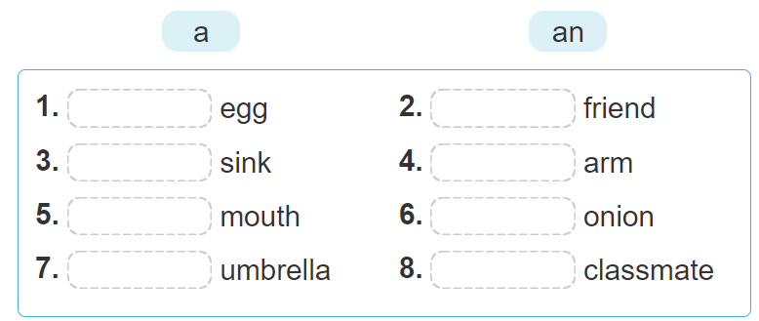
an
a
a
an
a
an
an
a

Slide 36
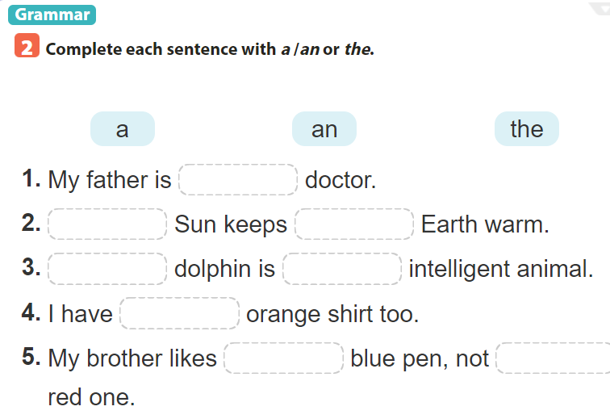

Slide 37

Choose the best answer
Note: click anywhere to run the time.
Click a, b or c to choose the correct answer.

Slide 38
5
1. My father is … doctor.
4
1
3
2
a. a
b. an
c. the

Slide 39
2. ……. Sun keeps………. Earth warm
5
4
1
3
2
b. The - an
b. The - a
c. The - the

Slide 40
5
3. ….. dolphin is …….intelligent animal.
4
1
3
2
a. A - an
b. The - a
c. The - an

Slide 41
5
4. I have ….. orange shirt too.
4
1
3
2
b. a
a. an
c. the

Slide 42
5. My brother likes……. blue pen, not ……. red one.
5
4
1
3
2
b. The - an
b. The - a
c. The - the

Slide 43

a
The
the
A
an
an
the
the

Slide 44
Grammar Part 2: First conditional sentence

Slide 45
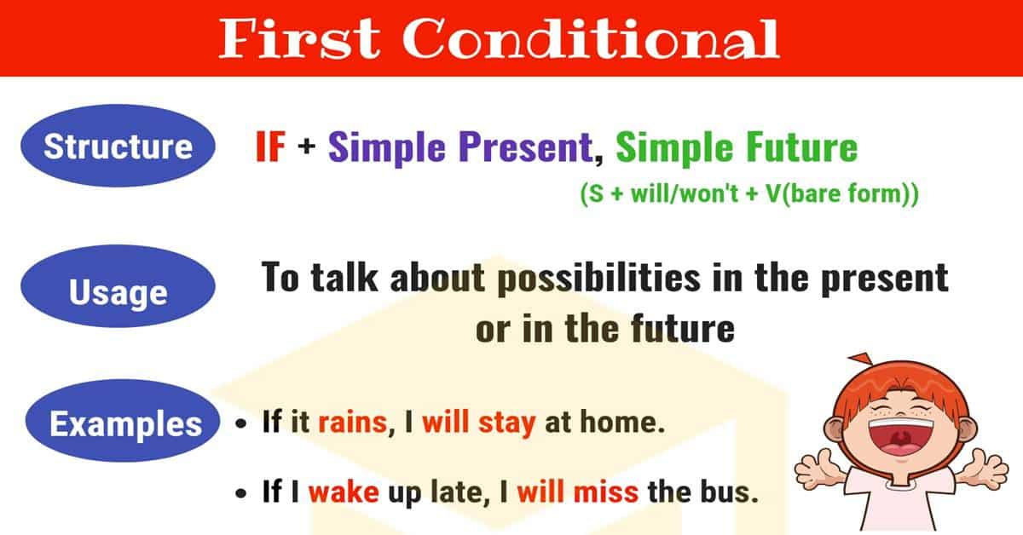

Slide 46

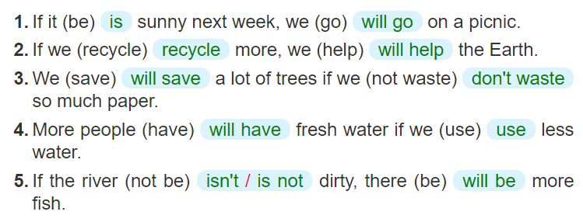

Slide 47
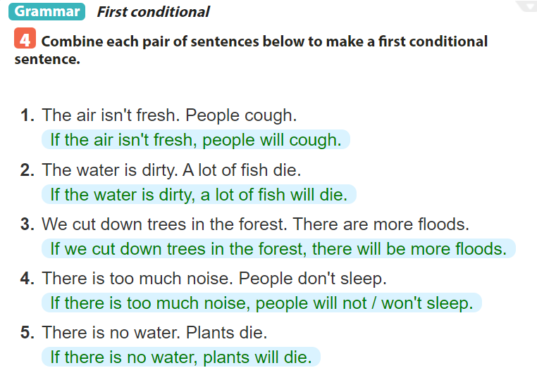
=>
=>
=>
=>
=>

Slide 48
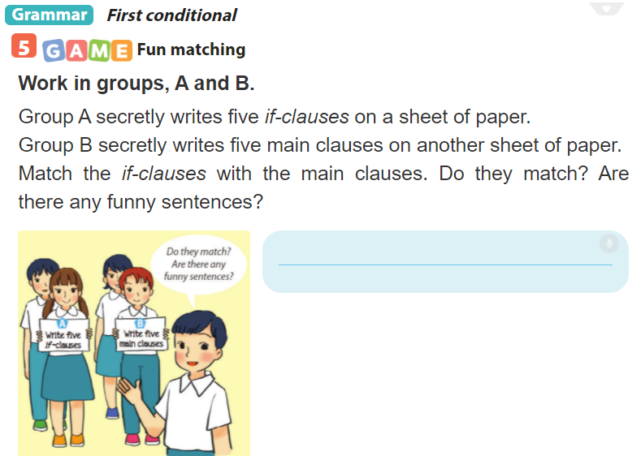

Slide 49
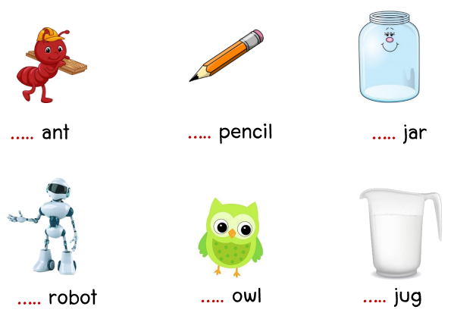
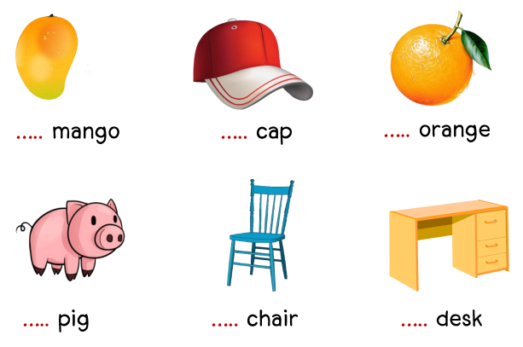
Extra exercise: a / an
a
a
an
a
a
a
a
an
a
a
a
a

Slide 50
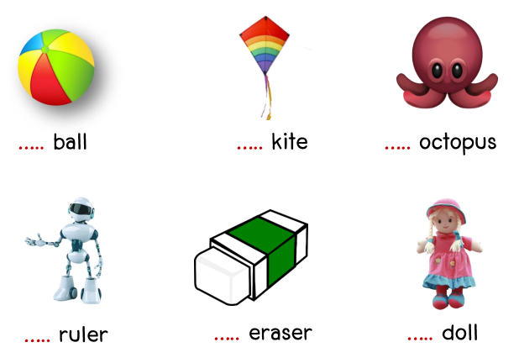
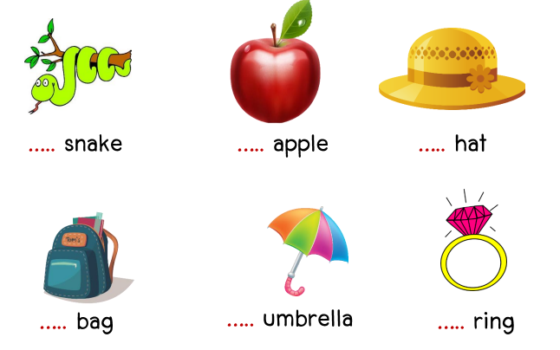
Extra exercise: a / an
a
a
an
a
an
a
a
an
a
a
an
a

Slide 51
Extra exercise:
Make the first conditional
1. If I (go) ……………………….out tonight, I (go)………………………….. to the cinema.
2. If you (get)…………………… back late, I (be) ………………........…….angry.
3. If he (come)………………………….. , I (be)…………………………… surprised.
4. If we (not/see) ……………………………………each other tomorrow, we (see)…………………….. each other next week.
5. If we (wait)………………………… here, we (be)……………………………. late.
go
will go
get
will be
comes
will be
don’t see
will see
wait
will be

Slide 52
SUM UP
By the end of the lesson, students can be able to:
understand and use the article and the first conditional sentence to make correct sentences, and use them in dialogues.
- Do exercise page ……

Slide 54
Unit 11: OUR GREENER WORLD lesson 4: communication
Grade 6

Slide 55
Objectives
By the end of the lesson, students can be able to:
learn how to give warnings;
practise using some grammar points and vocabulary related to the topic.

Slide 56

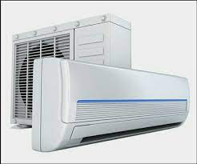

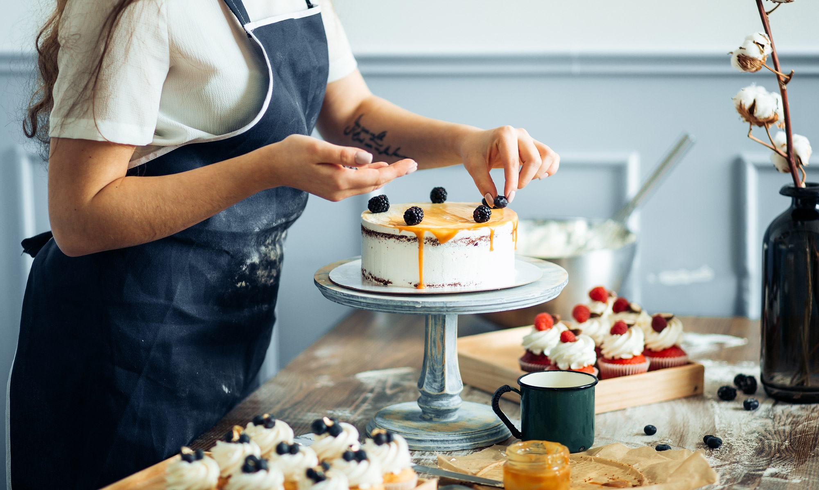

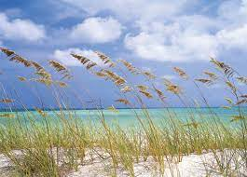
Vocabulary
1. Warning (n) /ˈwɔː.nɪŋ/
2. Breeze (n) /briːz/
3. Air conditioner (n)
/ˈeə kənˌdɪʃ.ən.ər/
4. Throw away (v)
5. Decorate (v)
6. Turn on (v)
Lời cảnh báo
Làn gió nhẹ lướt qua
Điều hòa
Vứt đi , quẳng đi
Trang trí
Bật lên

Slide 57
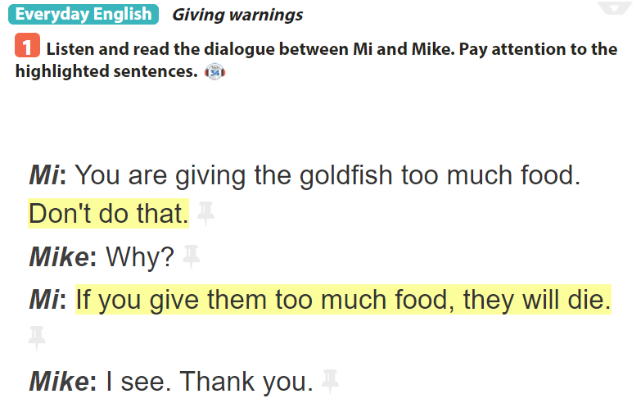

Slide 58
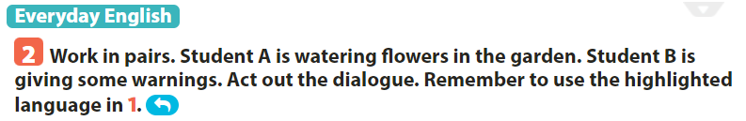
Example: A: Don’t water these flowers too much. B: Why? C: If you water them too much, they will die.

Slide 59
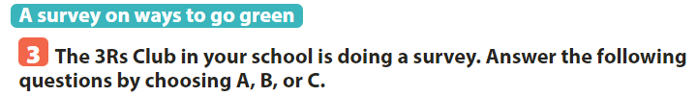
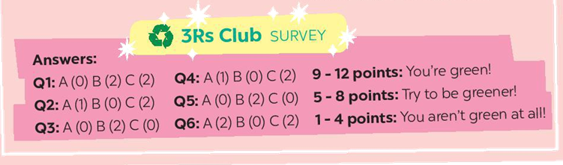
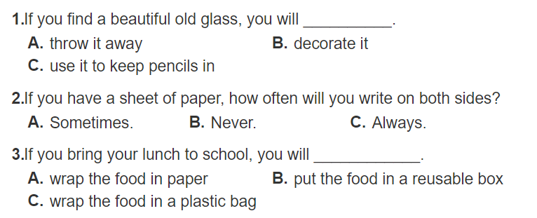

Slide 60
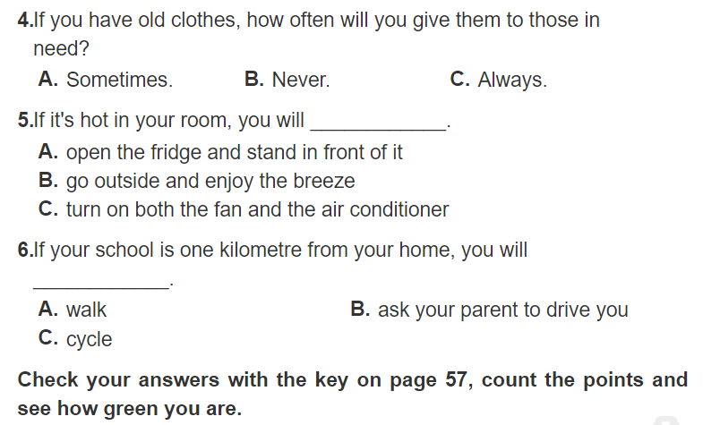

Slide 62

A: What’s your answer to question 2? B: It’s C. How about you? A: I choose B.

Slide 63
SUM UP
By the end of the lesson, students can be able to:
- learn how to give warnings;
- practise using some grammar points and vocabulary related to the topic.
- Do exercise page ……

Slide 65
Unit 11: OUR GREENER WORLD lesson 5: Skills 1
Grade 6

Slide 66
Objectives
By the end of the lesson, students can be able to:
use the lexical items related to the topic Our greener world;
read for specific information tips to become a green person;
talk about how to become ‘greener’.

Slide 67
Explore vocabulary
1. charity (n) /ˈtʃærɪ.ti/
2. creative (a) /kriˈeɪtɪv
3. swap (v) /swɒːp/
4. Exchange (v,n) /ɪksˈtʃeɪndʒ/
5. Borrow (v) /ˈbɒr.əʊ/
6. Share (v) /ʃeər/
7. Bring (v) /brɪŋ/
Lòng từ thiện
Sáng tạo
Trao Đổi
(sự) trao đổi
Mượn
Chia sẻ
Mang theo

Slide 68
Part 1: READING

Slide 69

Reporter: Can you share with us some tips to make your school greener? Nam: Sure. Firstly, we put recycling bins in every classroom. Reporter: What about old books and uniforms? Nam: We exchange them with our friends or give them to charity. We don't throw them away. Reporter: Anything else? Nam: We borrow books from the school library instead of buying new ones. Reporter: Great! You can save much paper. Nam: And there's another tip. We bring reusable water bottles to school. Reporter: I see lots of trees in your school. Is planting trees a good tip? Nam: Yeah. It makes our school greener. Reporter: Thanks for sharing. Do you want to add anything? Nam: Finally, we usually find creative ways to reuse old items before throwing them away.
instead of Exchange recycling bins Reusable charity
________
______
____
______
_____

Slide 70


Slide 71
1. “ INSTEAD OF”means:
a
b
c
d
e
Give something to a person and receive something from him /her
Can be used again
Containes for things that can be recycled
Giving things to people in need
In the place of somebody or somthing

Slide 72
2. “ CHARITY”means:
a
b
c
d
e
Give something to a person and receive something from him /her
Can be used again
Containes for things that can be recycled
Giving things to people in need
In the place of somebody or somthing

Slide 73
3. “ EXCHANGE”means:
a
b
c
d
e
Give something to a person and receive something from him /her
Can be used again
Containes for things that can be recycled
Giving things to people in need
In the place of somebody or somthing

Slide 74
4. “ REUSABLE”means:
a
b
c
d
e
Give something to a person and receive something from him /her
Can be used again
Containes for things that can be recycled
Giving things to people in need
In the place of somebody or somthing

Slide 75
5. “ RECYCLING BINS”means:
a
b
c
d
e
Give something to a person and receive something from him /her
Can be used again
Containes for things that can be recycled
Giving things to people in need
In the place of somebody or somthing

Slide 77

Reporter: Can you share with us some tips to make your school greener?
Nam: Sure. Firstly, we put recycling bins in every classroom.
Nam: We borrow books from the school library instead of buying new ones.
Reporter: What about old books and uniforms? Nam: We exchange them with our friends or give them to charity. We don't throw them away.
Nam: And there's another tip. We bring reusable water bottles to school.
Ways to become greener at school
Recycing bins
Exchange old uniforms with friends or give them to charity
Borrow books from the library
Reusable water bottles

Slide 78
Part 2: SPEAKING

Slide 79


Slide 80


Slide 81
SUM UP
By the end of the lesson, students can be able to:
- use the lexical items related to the topic Our greener world;
- read for specific information tips to become a green person;
- talk about how to become ‘greener’.
- Do exercise page ……

Slide 83
Unit 11: OUR GREENER WORLD lesson 6: Skills 2
Grade 6

Slide 84
Objectives
By the end of the lesson, students can be able to:
listen to get specific information about way to make the school a ‘green’ place;
write a paragraph about ways to make the school a ‘green’ place.

Slide 85
Explore vocabulary
Encourage (v) /ɪnˈkʌr.ɪdʒ/
Organize (v) /ˈɔː.ɡən.aɪz/
Save (v) /seɪv/
Fair (n) /feər/
Khuyến khích
Sắp xếp
Cứu, giúp
Hội chợ

Slide 86
Part 1: LISTENING

Slide 87


Slide 88


Slide 89


Slide 90
Part 2: WRITING

Slide 91

Mai
growing vegetables in the school garden
hold uniform fairs and exchange used uniforms

Slide 92


Slide 93
WRITING SAMPLE My classmate is Mai. If she becomes the president of the 3Rs Club, she will do two things. Firstly, she will talk to her friends about growing vegetables in the school garden. The school will become greener. Secondly, she will hold uniform fairs. We can exchange our used uniforms. We can save money and the environment. I think she will be a good president.

Slide 94
SUM UP
By the end of the lesson, students can be able to:
- listen to get specific information about way to make the school a ‘green’ place;
- write a paragraph about ways to make the school a ‘green’ place.
- Do exercise page ……

Slide 96
Unit 11: OUR GREENER WORLD lesson 7: Looking back and project
Grade 6

Slide 97
Objectives
By the end of the lesson, students can be able to:
review the vocabulary and grammar of Unit 11;
apply what they have learnt (vocabulary and grammar) into practice through a project.

Slide 98
List some things that we can reduce, reuse or recycle to save the environment:
Review
rubbish
glass
Plastic bag
paper
clothes
water
Plastic bottles

Slide 99
Part 1: Vocabulary

Slide 100

electricity
bottles
plastic boxes
water
envelopes
plastic bags
gas
light bulbs
Old books
paper
plastic bags
cans
rubbish
cans
newspapers

Slide 101



Slide 102


Slide 103

=>
=>
=>
=>
=>

Slide 104


Slide 105
Project

Slide 106


Slide 107


Slide 108


Slide 109
Sample
Hello, everyone. My name is …
Today I’m going to talk about a product I make from recycled paper. As you can see that I make these greeting cards from recycled paper. I use recycled paper, cut it, draw the funny pets or beautiful flowers on it and then I write the greetings on it to make birthday cards and invitation cards. I also decorate the cards to make them beautiful and look nice. I will give these cards as presents to my friends and relatives.
We can make many products from recycled paper so make sure not to
throw any paper into the recycling bin without recycling it.
Thanks for your listening.

Slide 111
SUM UP
By the end of the lesson, students can be able to:
- review the vocabulary and grammar of Unit 11;
- apply what they have learnt (vocabulary and grammar) into practice through a project.
- Do exercise page ……

