Slide 1

………..secondary school.
Good morning class!!!

Slide 2
* Warm up:
Brainstorming
- Wind energy
- Solar energy
Energy source
- Water energy
- Nuclear energy
Natural gas
- oil
- oal
- Hidro energy

Slide 3






Unit
10
ENERGY SOURCES
LESSON 1: GETTING STARTED
Types of energy sources
HOBBIES

Slide 4

Unit
10
ENERGY SOURCES
LESSON 1: GETTING STARTED
Types of energy sources

Slide 5
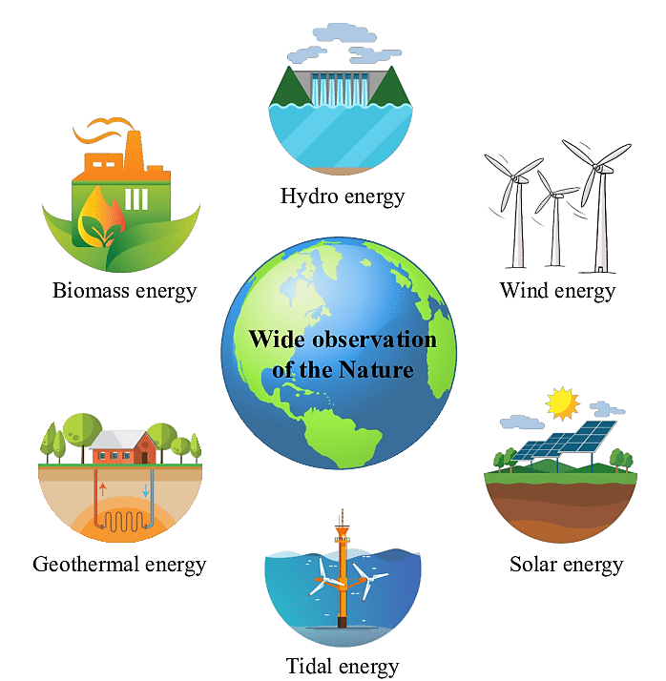
* Vocabulary
- energy source (n):
Nguồn năng lượng
/ˈenədʒi sɔːs/

Slide 6
* Vocabulary
- coal (n):
Than đá
/kəʊl/

Slide 7
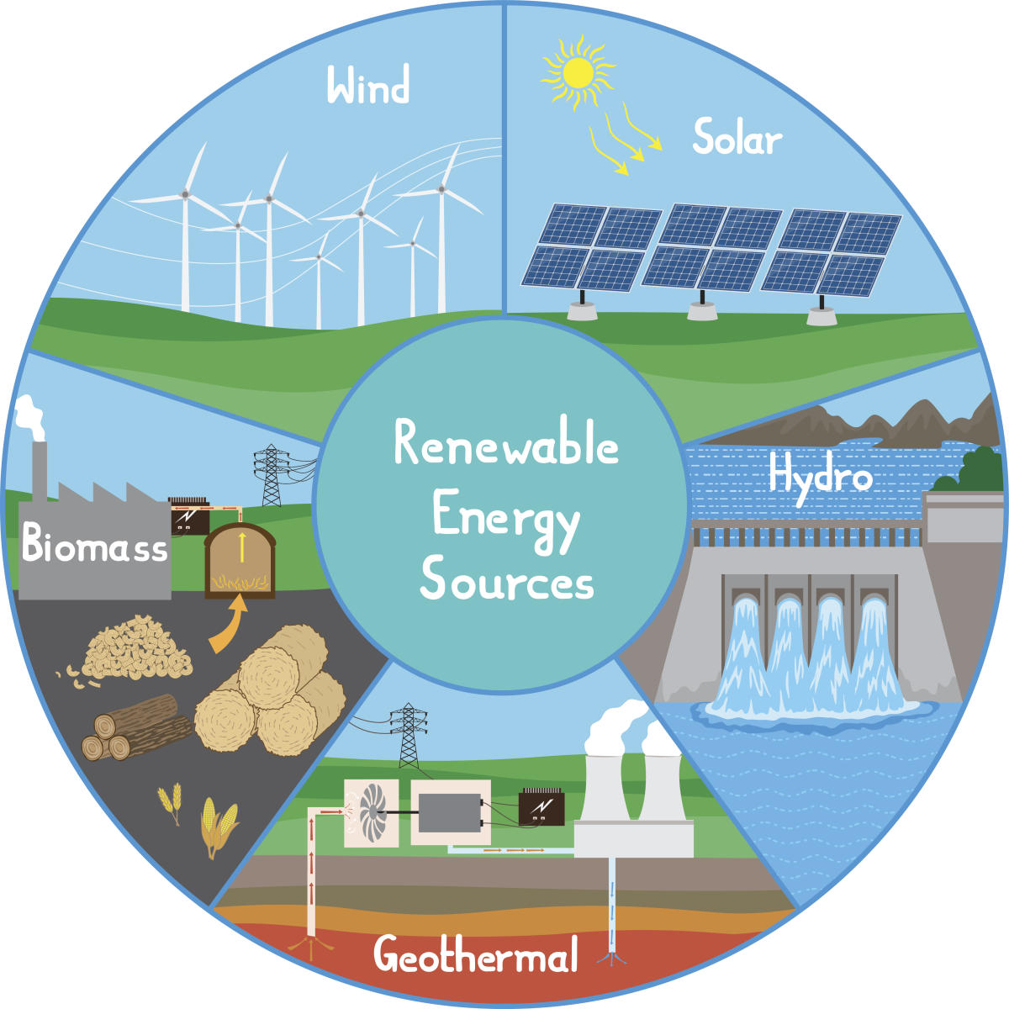
* Vocabulary
- renewable (a):
có thể tái tạo được
/rɪˈnjuːəbl/

Slide 8
* Vocabulary
- run out of (phr v):
cạn kiệt
/rʌn aʊt ɒv /

Slide 9
* Vocabulary
- replace (v):
thay thế
/rɪˈpleɪs/

Slide 10

* Vocabulary
New words | Pronunciation | Meaning
energy sources (n) | /ˈsaɪkl/ | nguồn năng lượng
coal (n) | /ˈtræfɪk dʒæm/ | than đá
renewable (adj) | /krɒs ðə rəʊd/ | có thể tái tạo được
run out of (phr v) | /rʌn aʊt ɒv/ | cạn kiệt
replace (v) | /rɪˈpleɪs/ | Thay thế

Slide 11
* Checking vocabulary
New words | Meaning
 | nguồn năng lượng
 | than đá
 | có thể tái tạo được
 | cạn kiệt
energy sources
coal
renewable
run out of
 | thay thế
replace

Slide 12
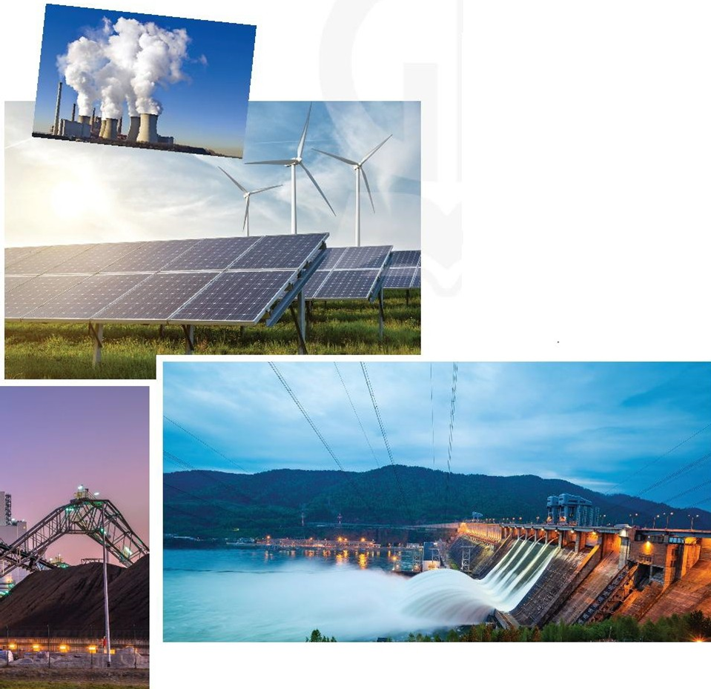
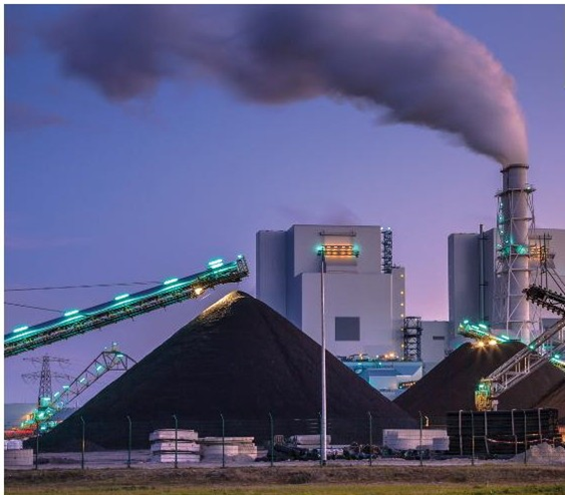
1
Listen and read
1. Who are they in the conversation.
2. What are they talking about?
3. What these pictures are about?
1. They are Lan and her father, Mr Tan
2. They are talking about types of energy source
3. These pictures are about coal, water, wind energy,….

Slide 13
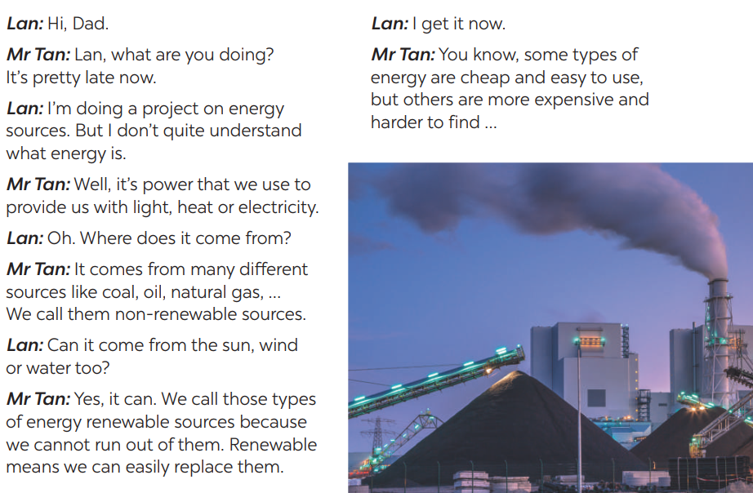
1
Listen and read

Slide 14
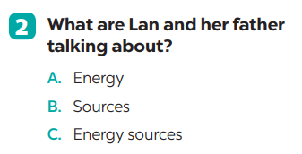


Slide 15
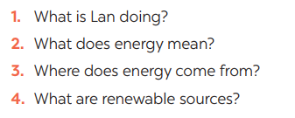
3
Read the conversation and answer the questions
* ANSWERS
1. Lan is doing a project on energy sources.
2. It’s power that we use to provide us with light, heat or electricity.
3. It comes from many different sources like coal, oil, natural gas, … and renewable sources
4. Renewable sources are those we can easily replace them such as: water, sun,…

Slide 16
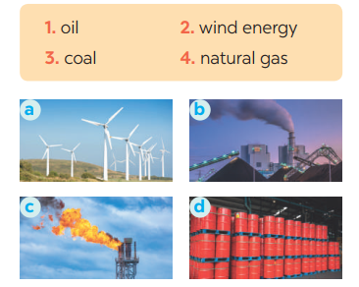
4
Match the words / phrases in the box with the correct pictures.
1. c 2. a 3. b 4. d
2- wind energy
3 - coal
KEY
1 - oil
4 - natural gas

Slide 17
5
Complete each of the sentences with the correct word from the conversation
1. Energy is ___________that we use to provide us with light, heat or electricity.
2. When energy comes from the__________, wind and water, we call it renewable energy.
3. When energy comes from wind, we call it __________energy.
4. We cannot _________ out of renewable energy.
5. Some types of energy are _________and easy to use.
Game:
Lucky number

Slide 18
LUCKY NUMBERS
1
2
3
4
5
6
7
8
A
2
4
6
8
10
12
14
B
2
4
6
8
10
12
14

Slide 19
5
Complete each of the sentences with the correct word from the conversation
power
1. Energy is ___________that we use to provide us with light, heat or electricity.

Slide 20
5
Complete each of the sentences with the correct word from the conversation
2. When energy comes from the__________, wind and water, we call it renewable energy.
sun

Slide 21
5
Complete each of the sentences with the correct word from the conversation
wind
3. When energy comes from wind, we call it ________energy.

Slide 22
5
Complete each of the sentences with the correct word from the conversation
run
4. We cannot ________ out of renewable energy.

Slide 23
5
Complete each of the sentences with the correct word from the conversation
cheap
5. Some types of energy are _________and easy to use.

Slide 24

UNLUCKY NUMBER

Slide 25



Slide 27
5
Complete each of the sentences with the correct word from the conversation
bicycle
1. Energy is ___________that we use to provide us with light, heat or electricity.
2. When energy comes from the_________, wind and water, we call it renewable energy.
3. When energy comes from wind, we call it __________energy.
4. We cannot _________ out of renewable energy.
5. Some types of energy are _______and easy to use.
* Answers
1. power
2. sun
3. wind
4. run
5. cheap

Slide 28

* PRODUCTION
Group discussion
1. What is the best source of energy?
2. Why do you think it is the best one?
→ I think renewable energy (such as the sun, wind, water) is the best because Some types of energy are cheap , safe and easy to use.

Slide 29
* CONSOLIDATION
ENERGY SOURCES
TYPES OF ENERGY
SOURCES OF ENERGY
Topic of the unit
Vocabulary

Slide 30
* HOMEWORK
Exercises in your workbook
Prepare the vocabulary for the next lesson:
A closer look 1.

Slide 31

Thanks for your atendance!
Goodbye. See you again
Notes:
31

