Slide 1

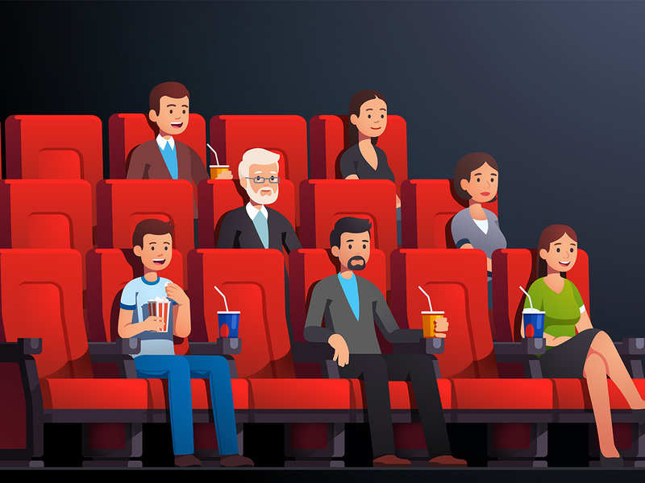
WARM-UP
Matching:
Film posters

Slide 2
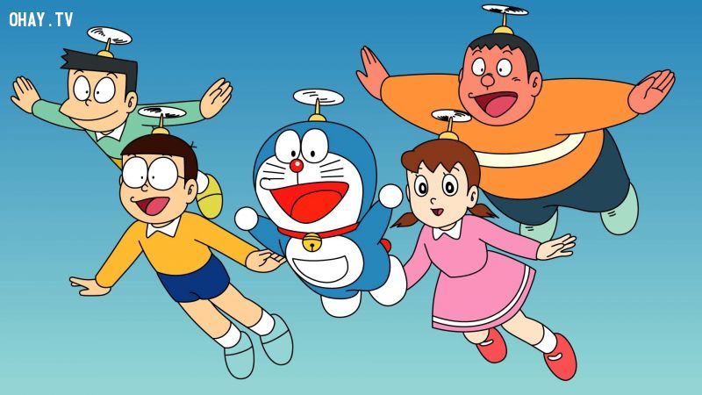


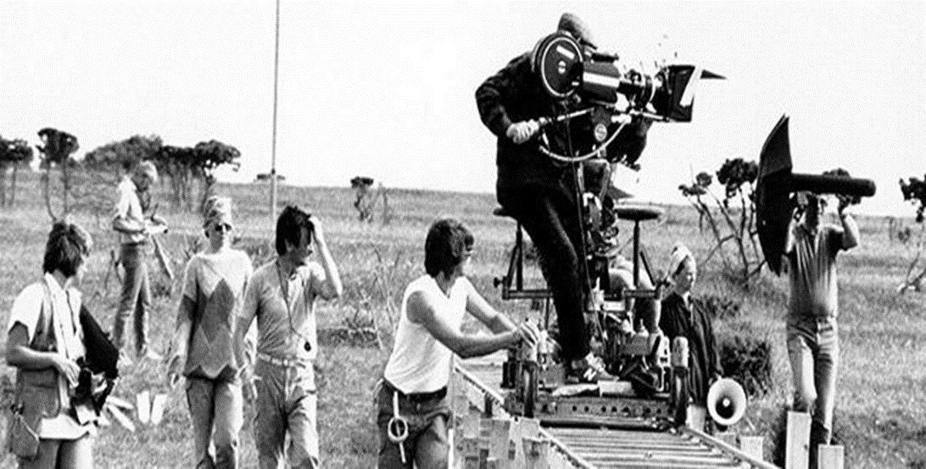
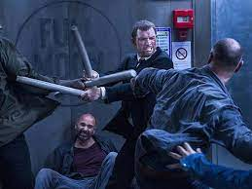


Matching:
Film posters
fantasy
comedy
violent film
cartoon
horror film
documentary

Slide 3


Unit
8
FILMS
LESSON 2: A CLOSER LOOK 1
  Adjectives to describe films
Vocabulary
  /ɪə/ and /eə/
Pronunciation

Slide 4

* VOCABULARY
violent (adj):
hung dữ; bạo lực, mãnh liệt
/'vaiələnt/

Slide 5
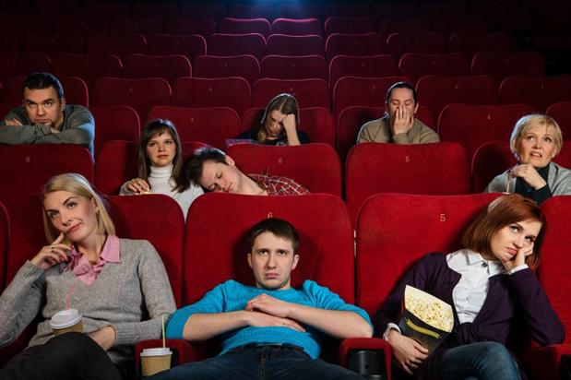
* VOCABULARY
dull (adj):
buồn tẻ, chán, đơn điệu
/dʌl/

Slide 6

* VOCABULARY
confusing (adj):
khó hiểu, gây bối rối
/kən'fju:ziŋ/

Slide 7
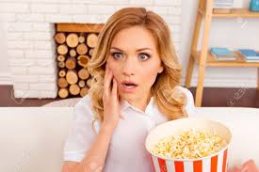
* VOCABULARY
shocking (adj):
gây choáng váng, làm sửng sốt
/'∫ɒkiŋ/

Slide 8
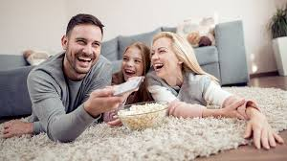
* VOCABULARY
enjoyable (adj):
thú vị, thích thú
/in'dʒɔiəbl/

Slide 9
* VOCABULARY
New words | Pronunciation | Meaning
1. dull (adj) | /dʌl/ | buồn tẻ, chán; đơn điệu
2. violent (adj) | /'vaiələnt/ | hung dữ; bạo lực, mãnh liệt
3. confusing (adj) | /kən'fju:ziŋ/ | khó hiểu, gây bối rối
4. enjoyable (adj) | /in'dʒɔiəbl/ | thú vị, thích thú
5. shocking (adj) | /'∫ɒkiŋ/ | gây choáng váng, làm sửng sốt

Slide 10

* Checking vocab
What and Where
dull
shocking
confusing
enjoyable
violent

Slide 11
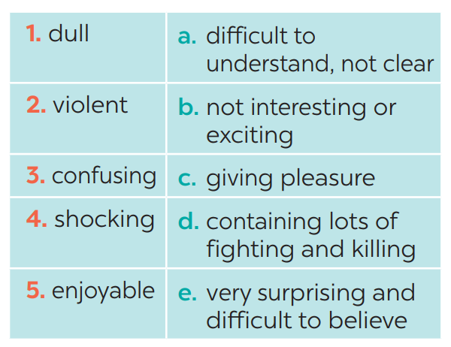
1
Match the following adjectives with their meanings.
1. b
2. d
3. a
4. e
5. c

Slide 12
2
1
Complete the following sentences, using the adjectives in
1. I found the film A Polluted Planet hard to believe. It’s a very _________ documentary.
2. The film was so _________ that we almost fell asleep.
3. I think you will enjoy Our Holiday. It’s quite _________ .
4. There were too many fights in the film. It was too _________ .
5. I didn’t really understand the film. It was very _________ .

Slide 13


LUCKY NUMBERS
1
2
3
4
5
6
A
2
4
6
8
10
12
14
B
2
4
6
8
10
12
14

Slide 14
2
1
Complete the following sentences, using the adjectives in
1. I found the film A Polluted Planet hard to believe. It’s a very _________ documentary.
shocking

Slide 15
2
1
Complete the following sentences, using the adjectives in
2. The film was so _________ that we almost fell asleep.
dull

Slide 16
2
1
Complete the following sentences, using the adjectives in
3. I think you will enjoy Our Holiday. It’s quite _________ .
enjoyable

Slide 17


LUCKY NUMBER!
you get 2 plus points

Slide 18
2
1
Complete the following sentences, using the adjectives in
4. There were too many fights in the film. It was too _________ .
violent

Slide 19
2
1
Complete the following sentences, using the adjectives in
5. I didn’t really understand the film. It was very _________ .
confusing

Slide 20
2
1
Complete the following sentences, using the adjectives in
1. I found the film A Polluted Planet hard to believe. It’s a very _________ documentary.
2. The film was so _________ that we almost fell asleep.
3. I think you will enjoy Our Holiday. It’s quite _________ .
4. There were too many fights in the film. It was too _________ .
5. I didn’t really understand the film. It was very _________ .
shocking
dull
enjoyable
violent
confusing

Slide 21
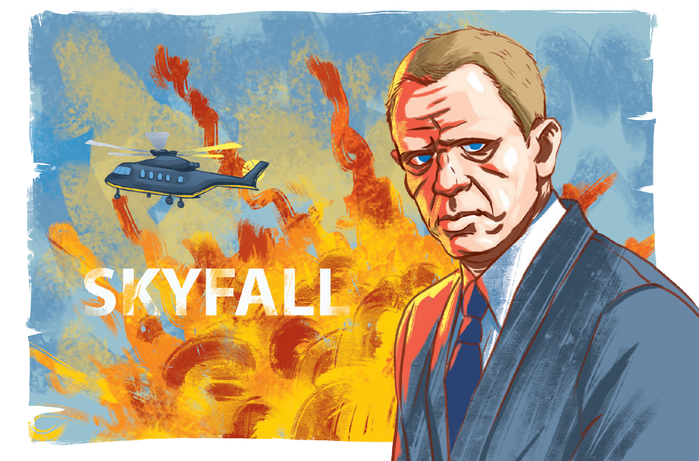
3
Work in pairs. Ask and answer questions about a film you saw recently.
Example:
A: What film did you see recently?
B: Skyfall.
A: What do you think of it?
B: It’s too violent.

Slide 22
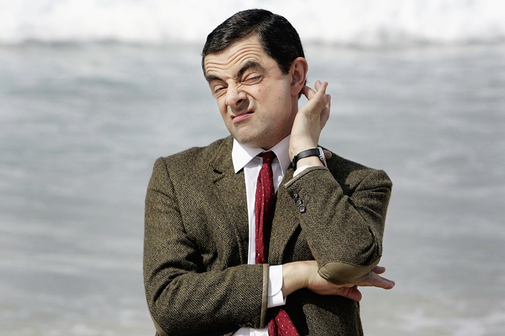
3
Work in pairs. Ask and answer questions about a film you saw recently.
A: What film did you see recently?
B:
A: What do you think of it?
B:
Mr. Bean.
It's too funny.

Slide 23

* PRONUNCIATION
/ɪə/ and /eə/

Slide 24

How to pronounce /ɪə/

Slide 25

How to pronounce /eə/

Slide 26
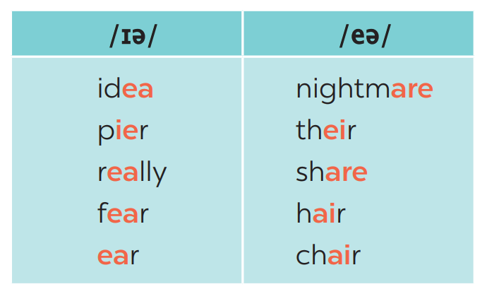
4
Listen and repeat the words. Pay attention to the sounds /ɪə/ and /eə/.

Slide 27
4
Listen and repeat the words. Pay attention to the sounds /ɪə/ and /eə/.
/ɪə/ | /eə/
idea/aɪˈdɪə/ pier /pɪər really /ˈrɪə.li/ fear /fɪər/ ear /ɪər/ | nightmare /ˈnaɪt.meər/ their /ðeər/ share/ʃeər/ hair /heər/ chair /tʃeər/

Slide 28

5
Listen and repeat, paying attention to the underlined words.
Game: Broken telephone
/ɪə/ and /eə/
1. Is there a cinema near here?
2. There’s a chair under the stairs.
3. Put your earphones near here.
4. I don’t care about your idea.
5. Our airplane is up there, in the air.

Slide 29
* CONSOLIDATION
  Adjectives to describe films
Vocabulary
  /ɪə/ and /eə/
Pronunciation

Slide 30

2
HOMEWORK
Write some sentences to describe your favourite types of films. You can use the adjectives that you have learnt in this lesson.

Slide 31

Goodbye.
See you again

Slide 32


* PRONUNCIATION
/ɪə/ and /eə/
- Listen and repeat the following words. Pay attention to the underlined parts.
chair
here
- Can you recognize the sounds in the underlined parts?
chair
here
/eə/
/ɪə/

Slide 33
