Slide 1


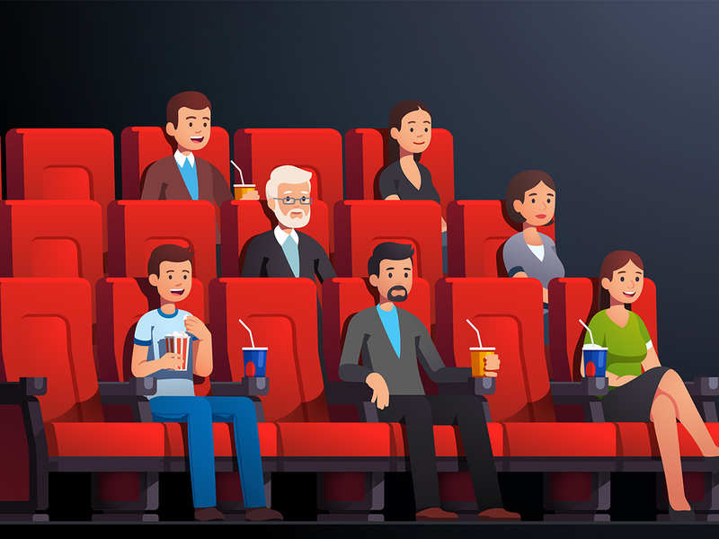
WARM-UP
Chatting
Look at the picture and answer the questions
- What are they doing?
- Do you like watching films?
- What kind of film do you like watching?
- Have you ever watched a movie at the cinema?
Unit
HOBBIES

Slide 2



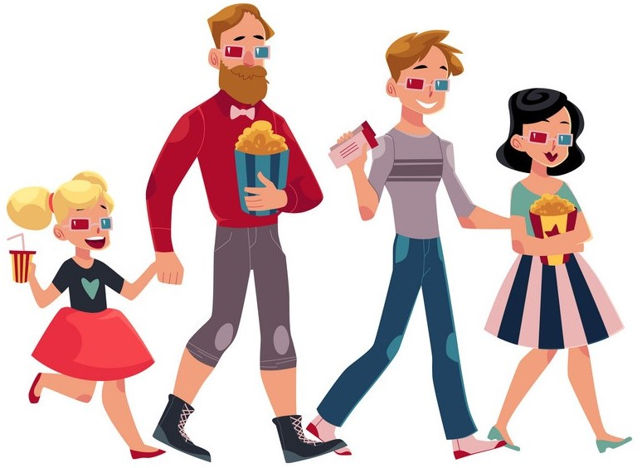
Unit
8
FILMS
LESSON 1: GETTING STARTED
Let’s go to the cinema tonight!

Slide 3



Slide 4

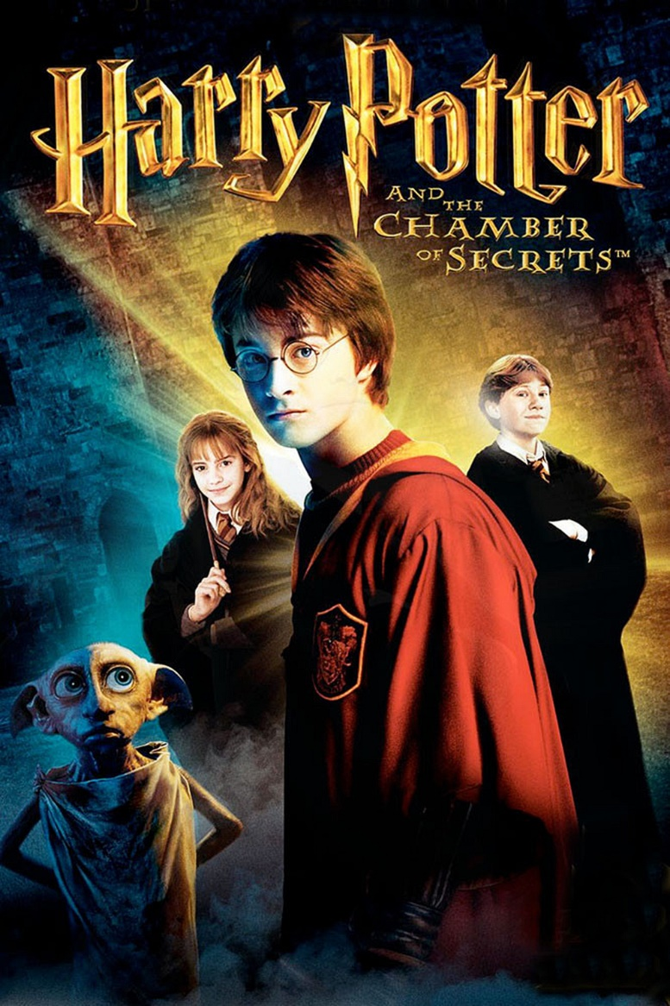
* VOCABULARY
- fantasy (n):
/ˈfæntəsi /
phim viễn tưởng

Slide 5
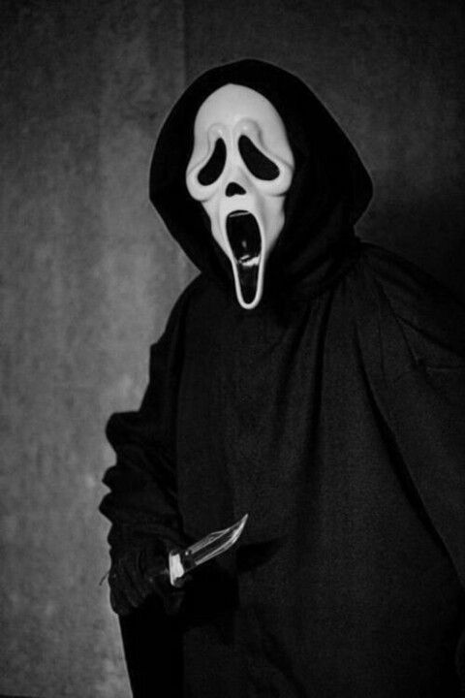
* VOCABULARY
- horror film (n)
phim kinh dị
/'hɒrə fɪlm/

Slide 6
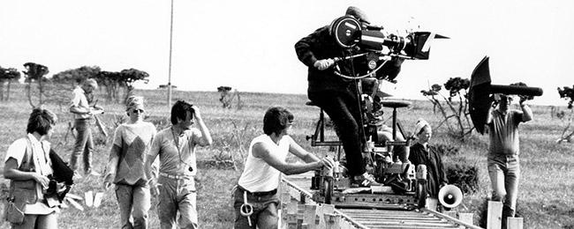
* VOCABULARY
- documentary (n)
phim tài liệu
/dɒkjʊˈmentəri/

Slide 7
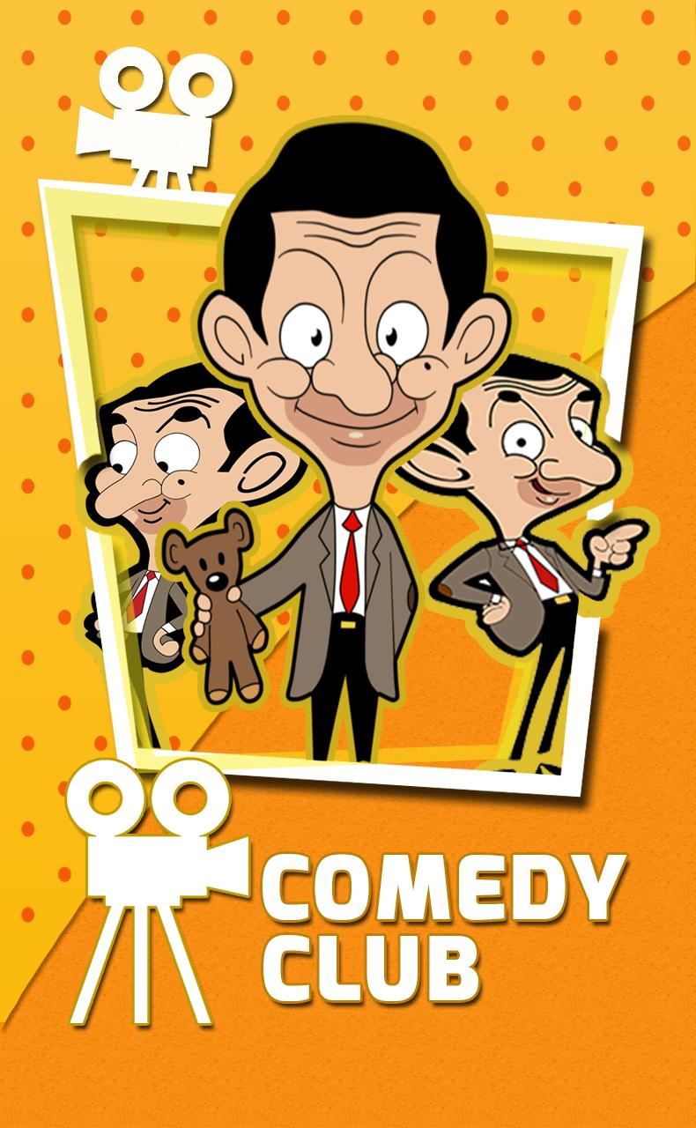
* VOCABULARY
-comedy (n)
/ˈkɒmədi/
phim hài

Slide 8
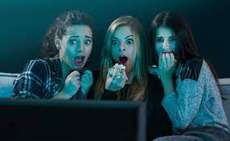
* VOCABULARY
- frightening (adj)
/ˈfraɪtnɪŋ/
sợ = scary

Slide 9

* VOCABULARY
- review (n) :
/rɪˈvjuː/
bình luận

Slide 10
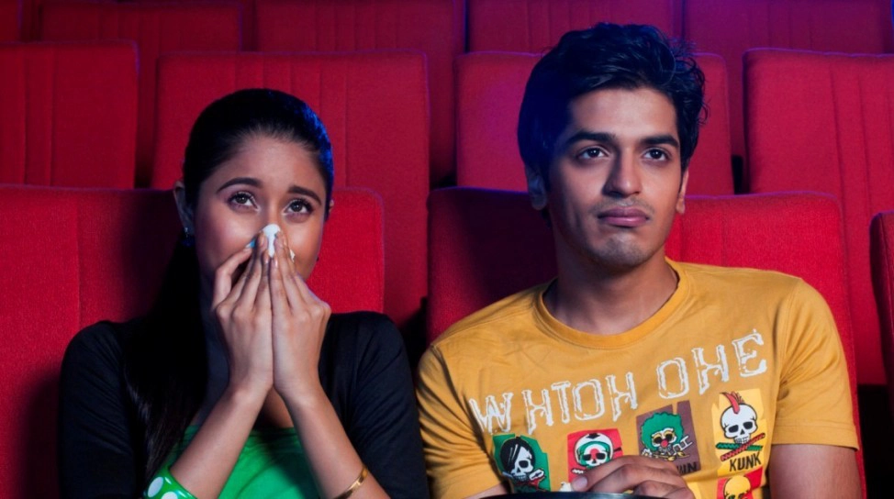
* VOCABULARY
- moving (adj):
/ˈmuːvɪŋ/
xúc động

Slide 11
* VOCABULARY
New words | Pronunciation | Meaning
-horror film (n) | /'hɒrə fɪlm/ | phim kinh dị
-Documentary (n) | /dɒkjuˈmentri/ | phim tài liệu
-Comedy (n) | /ˈkɒmədi/ | phim hài
-Fantasy (n) | /ˈfæntəsi / | phim viễn tưởng
-frightening (adj) | /ˈfraɪtnɪŋ/ | sợ hãi
- review (n) | /rɪˈvjuː/ | bình luận
- moving (adj): | /ˈmuːvɪŋ/ | Xúc động

Slide 12
* VOCABULARY
New words | Meaning
 | phim kinh dị
 | phim tài liệu
 | phim hài
 | phim viễn tưởng
 | sợ hãi
 | bình luận
 | Xúc động
-horror film (n)
-documentary (n)
-comedy (n)
-fantasy (n)
-frightening (adj)
- review (n)
- moving (adj)

Slide 13
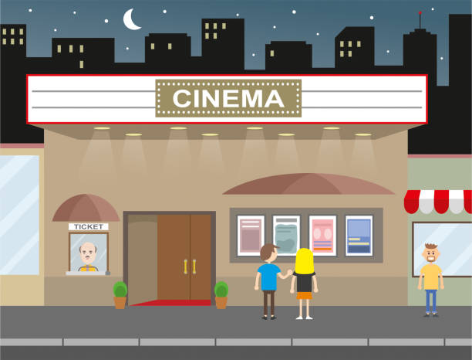
* PRACTICE
1
Listen and read.
Mark: Let's go to the cinema tonight!
Mi: Good idea! What shall we see?
Mark: A Nightmare is on at Sao Mai Cinema tonight.
Mi: Is it a fantasy?
Mark: No, it's a horror film.
Mi: That's too scary for me. Look! An Old Pier is on at Town Cinema. It's a documentary.
Mark: I don't really like documentaries. They're often boring. What about Our Holiday?
Mi: What kind of film is it?
Mark: It's a comedy.
Mi: And who stars in it?
Mark: Kate Harrison and Lily Collins.
Mi: Um, they're pretty good. What's it about?
Mark: It's about two women living in different countries and they decide to exchange houses.
Mi: What are the reviews like?
Mark: Well, although a few people say it's a bit silly, most say it's funny and interesting.

Slide 14
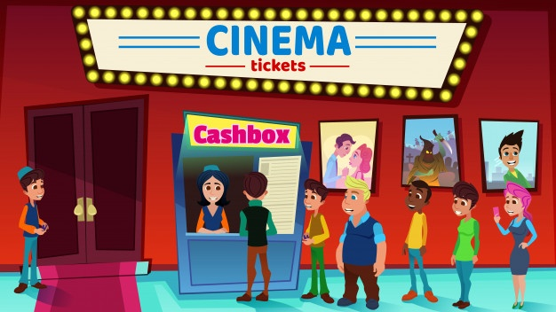
*PRACTICE
2
Read the conversation again and choose the correct answer to each question.

Slide 15



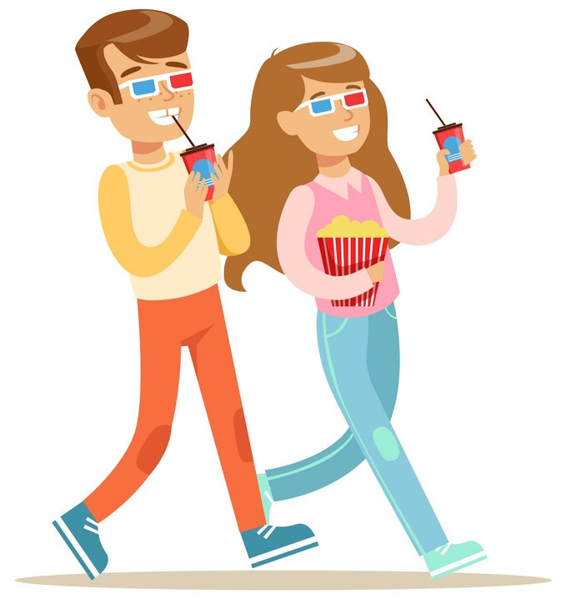
5
4
1
1. What does Mark suggest doing tonight?
3
2
a. Watching a TV show.
b. Watching a film.
c. Staying at home
Mark: Let’s go to the cinema tonight!
Hoa: Good idea! What shall we see?

Slide 16
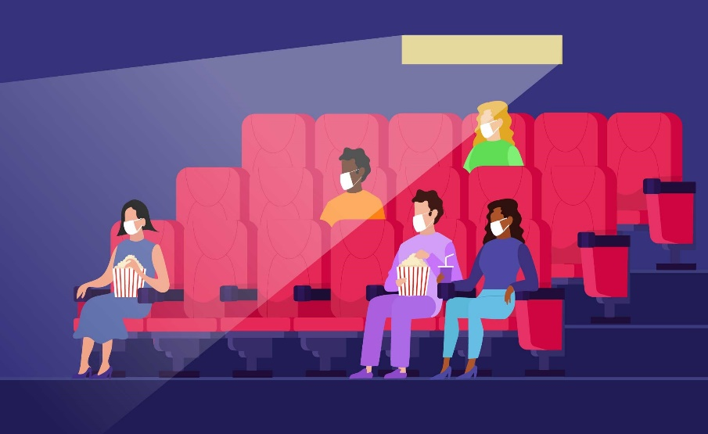
5
4
1
2. Why doesn’t Mark want to see An Old Pier?
3
2
a. He doesn’t like that type of film.
b. It’s not on at a convenient time
c. He saw it last week.
Hoa: That’s too frightening for me. Look! An Old Pier is on at the Town Cinema. It’s a documentary.
Mark: I don’t really like documentaries. They’re often boring. What about Our Holiday?

Slide 17

5
4
1
3. The word “reviews” in the conversation mostly means.
3
2
a. people’s opinions about the film
b. interesting scenes in the film
c. what people don’t like about the film

Slide 18
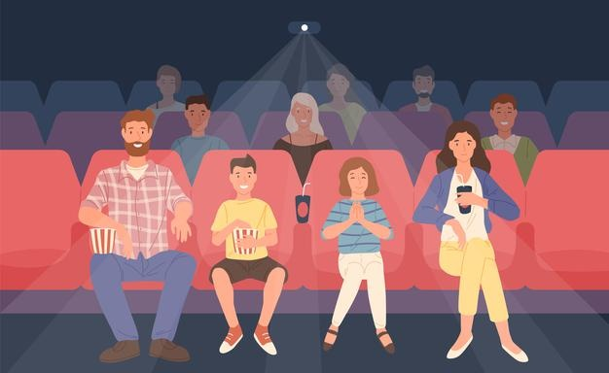
5
4. What do people think of Our Holiday?
4
1
3
2
a. Everyone likes it.
b. No one likes it.
c. Most people like it.
Hoa: What are the reviews like?
Mark: Well, although a few people say it’s a bit silly, most say it’s funny and interesting.

Slide 19
* PRACTICE
3
Choose the correct word or phrase to complete each of
the following sentences.
comedy
Game: Who is faster?
fantasy
science fiction film
Types of films
1. A film that tries to make the audience laugh is a ………………
horror film
docu-mentary
comedy
cartoon

Slide 20
* PRACTICE
3
Choose the correct word or phrase to complete each of
the following sentences.
Game: Who is faster?
comedy
fantasy
science fiction film
Types of films
2. A film that is based only on
imagination, not on real facts, is a …………………
horror film
docu-mentary
fantasy
cartoon

Slide 21
* PRACTICE
3
Choose the correct word or phrase to complete each of
the following sentences.
comedy
Game: Who is faster?
fantasy
science fiction film
Types of films
3. A film that shows real life events or stories is a ……………….
horror film
docu-mentary
documentary
cartoon

Slide 22
* PRACTICE
3
Choose the correct word or phrase to complete each of
the following sentences.
comedy
Game: Who is faster?
fantasy
science fiction film
Types of films
4. A film that is set in the future, often about science, is a
………………………..
horror film
docu-mentary
science fiction film
cartoon

Slide 23
* PRACTICE
3
Choose the correct word or phrase to complete each of
the following sentences.
comedy
Game: Who is faster?
fantasy
science fiction film
Types of films
5. A film in which strange and frightening things happen is a
……………….
horror film
docu-mentary
horror film
cartoon

Slide 24
4
Complete the following sentences with the words in the box.
funny
interesting
frightening
moving
boring
1. Going to the hospital can be _________________ for a child.
2. The film was so _______________ that the audience couldn’t stop laughing.
3. Many people cried when they saw the _______________ scenes of the film.
4. The film last night was so _______________ that we fell asleep.
5. This book is ________________. I got a lot of useful information from it.
frightening
funny
moving
boring
interesting

Slide 25

* PRODUCTION
5
Work in pairs. ask and answer about a type of film. Use some of the adjectives in Task 4.
Example:
A: Do you like documentaries?
B: No, I don’t.
A: Why not?
B: I think they’re boring.

Slide 26
* CONSOLIDATION
Topic of the unit
FILMS
Vocabulary
Types of films
Adjectives describing films

Slide 27
Homework
Think about your favourite film.
Use at least 3 adjectives to describe it.

Slide 28
2
Homework
Think about your favourite film.
Use at least 3 adjectives to describe it.

Slide 29

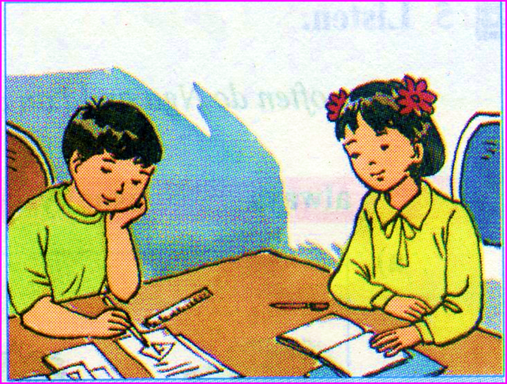
homework
Think about your favourite film.
Use at least 3 adjectives to describe it.

Slide 30

Thanks for your atendance!
Goodbye. See you again
Notes:
30

