Slide 1
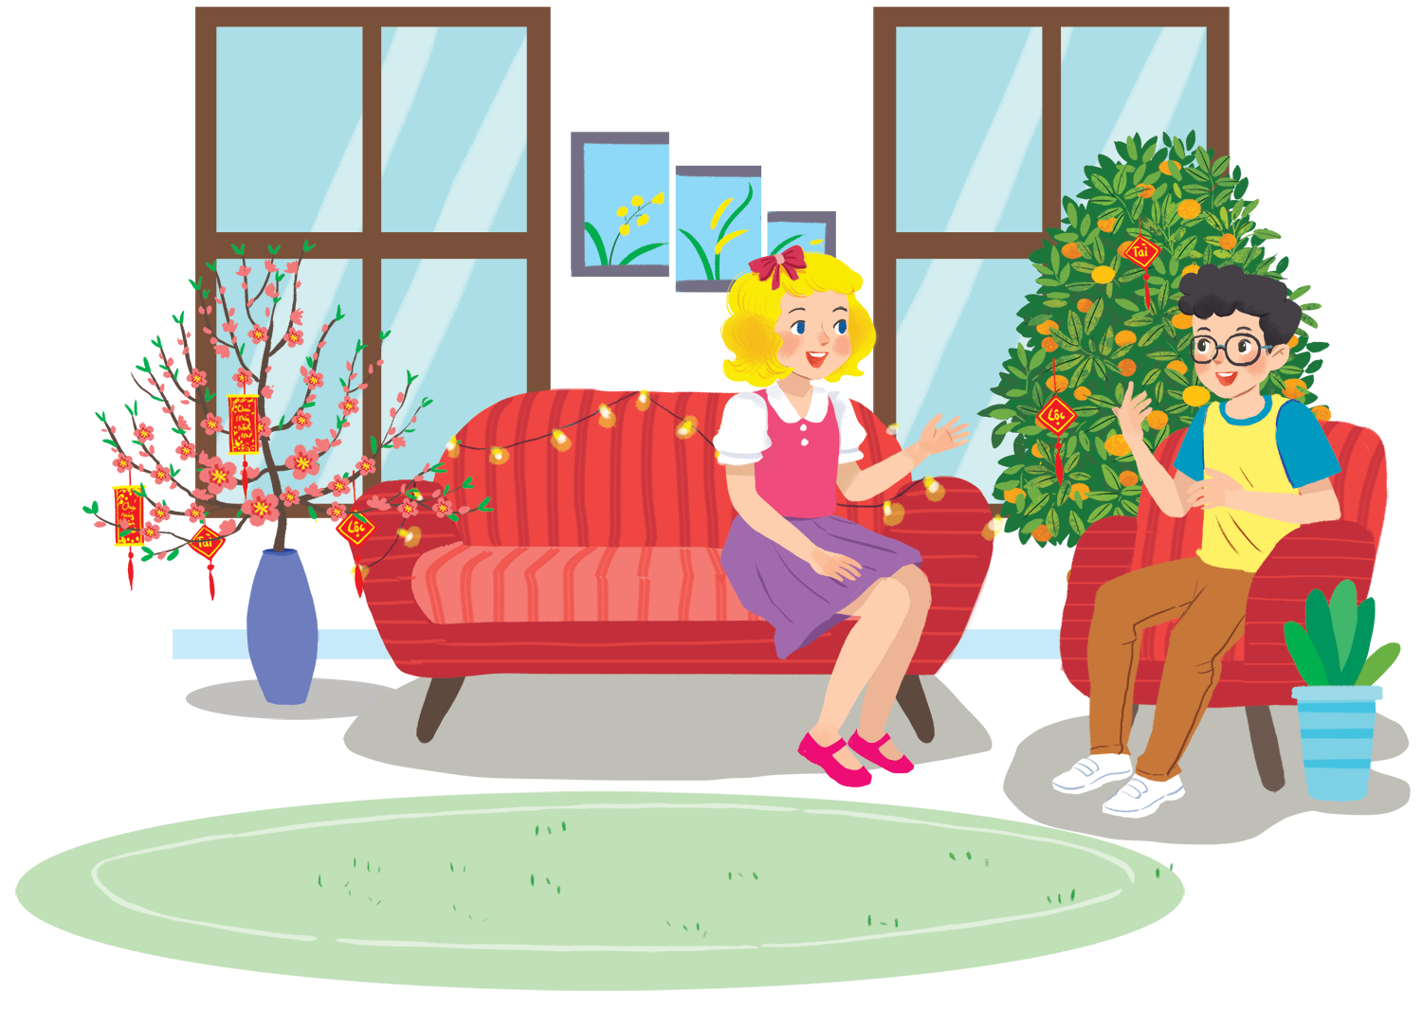
UNIT 6: OUT TET HOLIDAY
LESSON 7: LOOKING BACK - PROJECT
English 6

Slide 2



Vocabulary
1
Match the verbs on the left with the nouns on the right.
2
Complete the sentences with the words / phrases in the box.
Grammar
3
Write full sentences using the cues given, and should or shouldn’t.
4
Read the passage and fill the blanks with some or any.

Slide 3

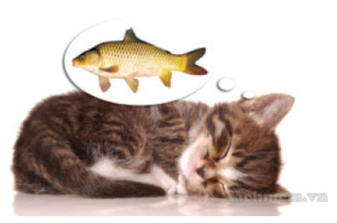
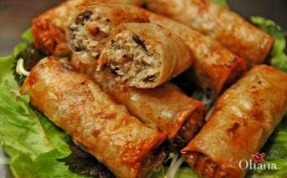
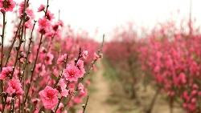

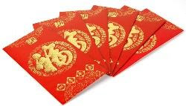

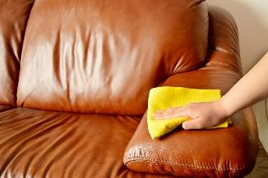
 | P |  |  |  |  |  |  |  |  |  |  |  |  |  | F
 | E |  |  |  |  |  |  |  |  |  |  |  |  |  | I
 | A |  |  |  |  |  |  |  |  |  |  |  |  |  | R
 | C |  |  |  |  |  |  |  |  |  |  |  |  |  | E
 | H |  |  |  |  |  |  |  |  |  |  |  |  |  | W
 | F |  |  |  |  |  |  |  | L |  |  | W |  |  | O
C | L | E | A | N | T | H | E | F | U | R | N | I | T | U | R | E
 | O |  |  |  |  |  |  |  | C |  |  | S |  |  | K
 | W |  |  |  |  |  |  |  | K |  |  | H |  |  | S | H | O | P | P | I | N | G
 | E |  |  |  |  |  |  |  | Y
 | R |  |  |  |  |  |  |  | M
 | S | P | E | C | I | A | L | F | O | O | D
 |  |  |  |  |  |  |  |  | N
 |  |  |  |  |  |  |  |  | E
 |  |  |  |  |  |  |  |  | Y
1
2
HINTS
1. peach flowers
2. fireworks
3. lucky money
4. wish
5. clean the furniture
6. shopping
7. special food
3
4
5
6
7

Slide 4
Vocabulary

Slide 5
1
Match the verbs on the left with the nouns on the right.
1.
give
a.
a wish
2.
cook
b.
fireworks
3.
plant
c.
special food
4.
make
d.
lucky number
5.
watch
e.
trees
6.
break
f.
things

Slide 6
2
Complete the sentences with the words / phrases in the box.
gathering
cleaning
lucky money
banh chung
peach
lucky money into red envelopes.
1.
At Tet, my mother puts
into red envelopes.
2.
What are you doing?
I’m
cleaning my bedroom.
my bedroom.
Banh chung is special for Tet.
3.
is special for Tet.
peach
4.
We have flowers only at Tet.
5.
When everybody is at home together,
we call it a family
gathering.
.

Slide 7
Grammar

Slide 8
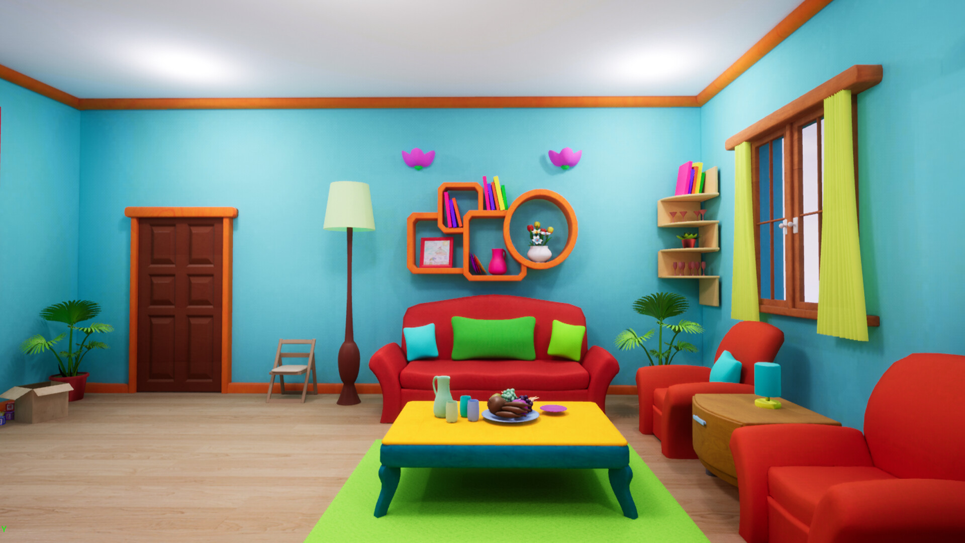

She should ask for permission before entering a room.
Ask for permission before entering a room
Should
Shouldn’t

Slide 9
She shouldn’t run about the house
.
Run about the house
Should
Shouldn’t

Slide 10

She shouldn’t take things from a shelf
.
Take things from a shelf
Should
Shouldn’t

Slide 11
She shouldn’t make a lot of noise
.
Make a lot of noise
Should
Shouldn’t

Slide 12

She should ask for some water if she feels thirsty
.
Ask for some water if she feels
Should
Shouldn’t

Slide 13
3
Write full sentences using the cues given, and should or shouldn’t.
1.
Ask for permission before entering a room
He / She
should ask for permission before entering a room.
2.
Run about the house
He / She
shouldn’t run about the home.
3.
Take things from a shelf
He / She
shouldn’t take things from a shelf.
4.
Make a lot of noise
He / She
shouldn’t make a lot of noise.
5.
Ask for some water if he / she feels
He / She
should ask for some water if he / she feels thirsty.

Slide 14
4
Read the passage and fill the blanks with some or any.
My room is ready for Tet. By the window are (1) balloons. There is a picture I made from (2) old magazines. It’s colourful, but I didn’t use (3) paint or colour pencils. I love flowers, but I don’t have (4) yet. Oh, look at this new plant. It needs (5) water, but it doesn’t need (6) sunlight. It can live in a room.
some
some
any
any
some
any

Slide 15

Game:
1. It’s good if children help their parents with the housework.
→ Children should ………………………………………………
2. It’s not a good idea when you eat a lot of sweets and candies.
→ You shouldn’t ……………………………………………..
3. I’m not happy when children lie to their parents.
→ Children shouldn’t ………………………………………………
4. She doesn’t have any new books in the bag
→ There ………………………………………….........................

Slide 16


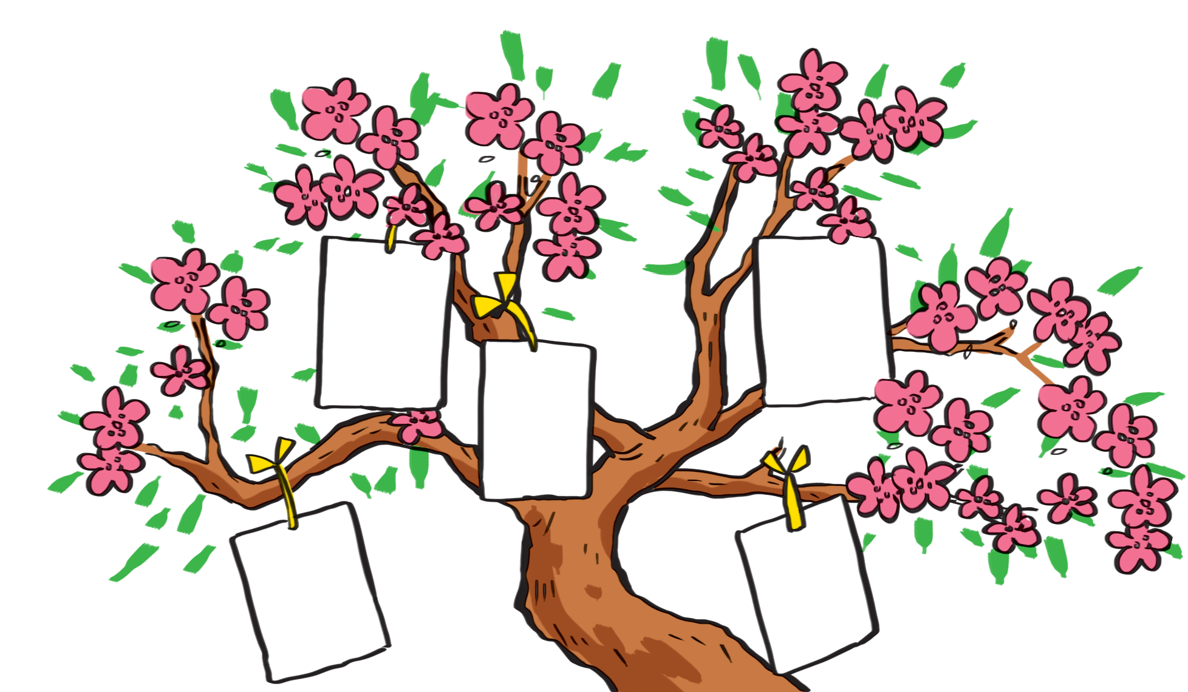
I want to have a brother.
I want to visit Singapore
I want to live in a tree house.

Slide 17


I wish
1.
Each student gets a small piece of paper and writes his / her wishes on it.
2.
He / She hangs it on a tree.
3.
Other students take turns to come up, get a piece of paper and read aloud the wish.
4.
The class guess whose wish it is.

Slide 18
Now I can … |  |  | 
use the words related to things and activities at Tet.
pronounce the sounds /s/ and /ʃ/ correctly.
use should / shouldn’t for advice.
use some / any for amount.
say New Year’s wishes.
read about New Year’s practices.
talk about what children should / shouldn’t do at Tet.
listen about preparations for Tet.
write an email about what children should / shouldn’t do at Tet.

Slide 19

Homework
Learn vocabulary and the structure by heart.
Do exercise in your work book
Prepare the next lesson: Review 2 Language focus

