Slide 1








Warm-up
Look and say

Slide 2

LOOK AND SAY
educational programme

Slide 3
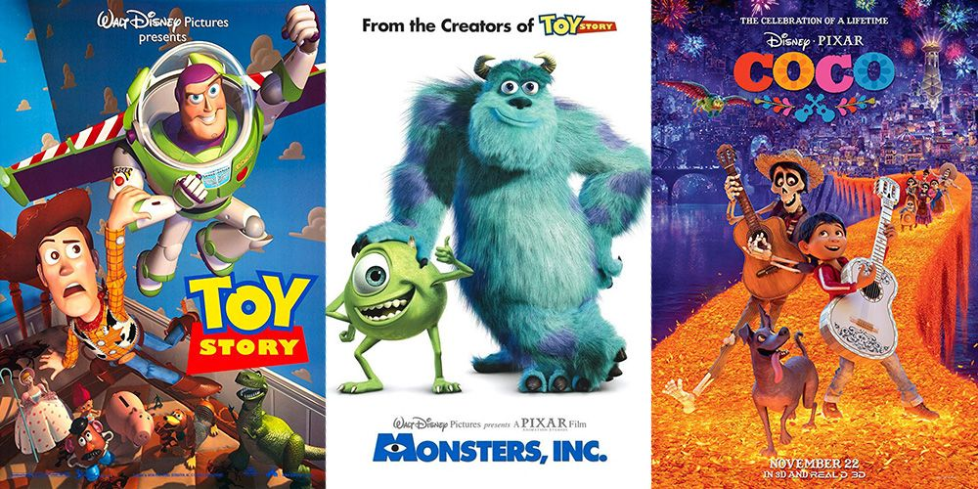
LOOK AND SAY
animated films

Slide 4

LOOK AND SAY
channels

Slide 5
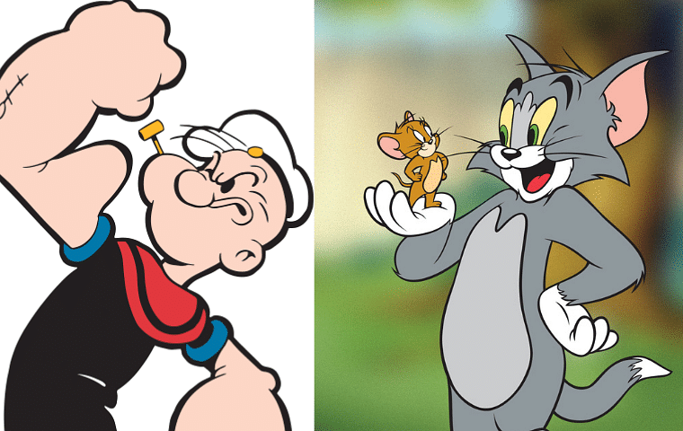
LOOK AND SAY
cartoons

Slide 6
CAN YOU ADD MORE TV PROGRAMMES?

Slide 7











UNIT 7:
TELEVISION
Lesson 2: A closer look 1

Slide 8
Objectives
OBJECTIVES
By the end of this lesson, student will be able to:

use the words about TV programmes and people

pronounce the sounds /θ/ and /ð/ correctly

Slide 9






01
VOCABULARY

Slide 10
Ex 1. Write the words / phrases in the box next to the definition. (P.8)
talent show
comedy
educational programme
viewer
character
1. an animal or person in a film
2. a programme which teaches maths, English, etc.
3. a film / show which makes people laugh
4. a competition to choose the best performer
5. a person who watches TV

Slide 11

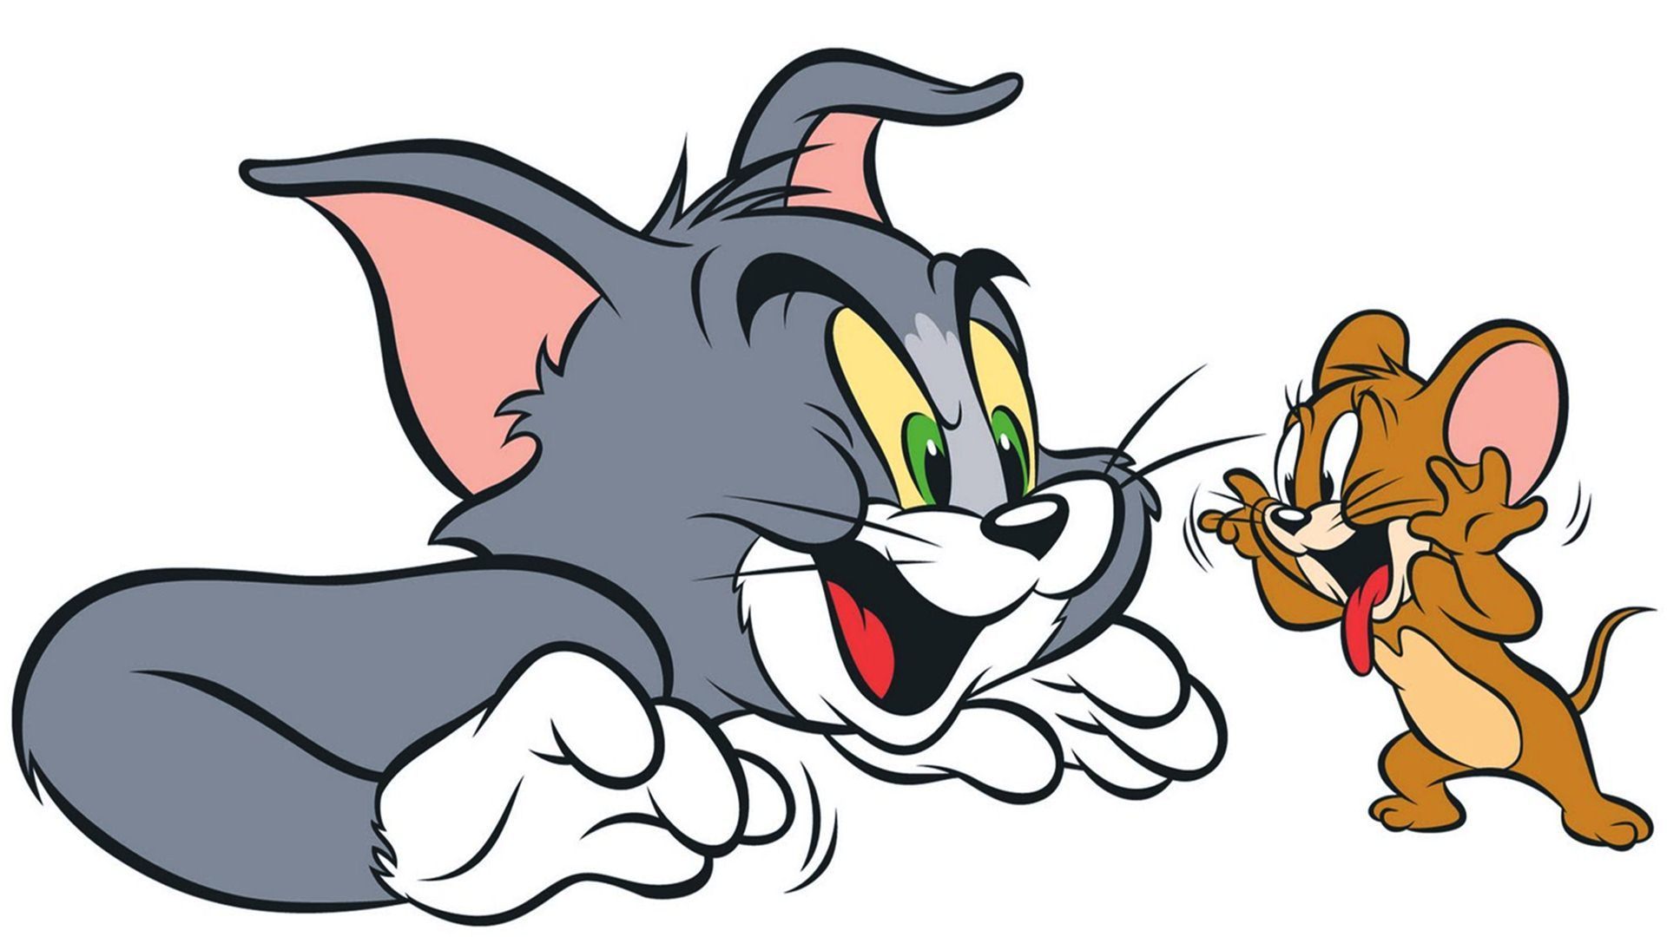

Vocabulary
1. an animal or person in a film
character
/ˈkær.ək.tər/
nhân vật

Slide 12

Vocabulary
2. a programme which teaches maths, English, etc.
educational programme

Slide 13

Vocabulary
3. a film / show which makes people laugh
comedy
/ˈkɒm.ə.di/
chương trình hài

Slide 14

Vocabulary
4. a competition to choose the best performer
talent show
/ˈtæl.ənt ˌʃəʊ/
chương trình tìm kiếm tài năng

Slide 15
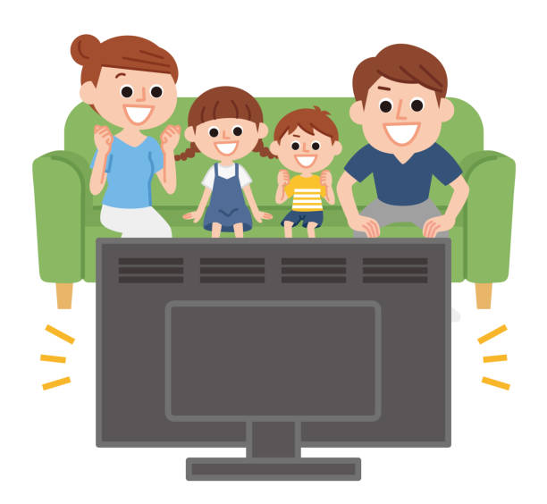
Vocabulary
5. a person who watches TV
viewer
/ˈvjuː.ər/
người xem qua màn hình

Slide 16
Ex 1. Write the words / phrases in the box next to the definition. (P.8)
1. an animal or person in a film
character
educational programme
2. a programme which teaches maths, English, etc.
3. a film / show which makes people laugh
comedy
4. a competition to choose the best performer
talent show
5. a person who watches TV
viewer

Slide 17


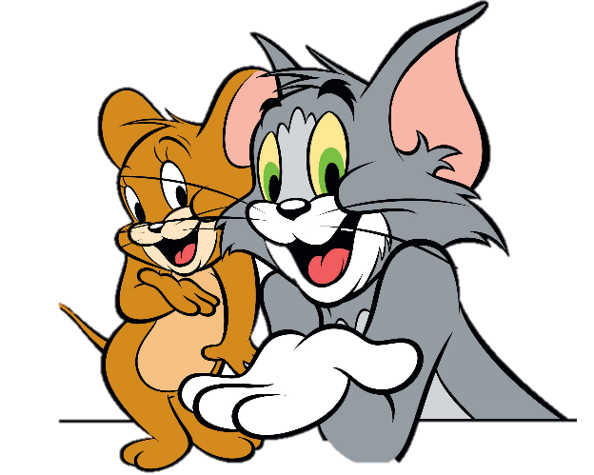

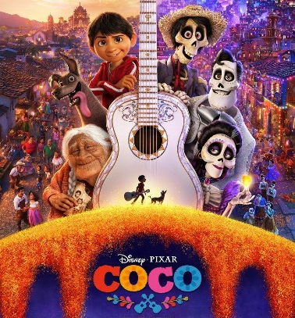
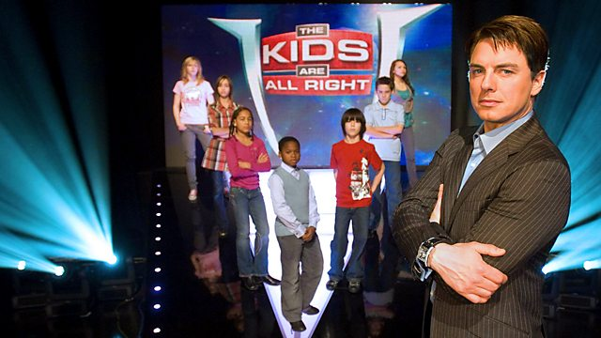
Ex 2. Complete the sentences with the words/ phrases in the box.
animated films
viewers
comedies
character
game show
channel
1. Do you watch Bibi, the popular _________ for children?
2. Which _________ do you prefer: Jerry the mouse or Tom the cat?
3. I love ____________ like Happy Feet and Coco.
4. I love Children are Always Right, a _________ for kids.
5. My father often watches _________. They're so funny.
6. A popular programme has a lot of _________.
channel
character
animated films
game show
comedies
viewers

Slide 18


Ex 3. Complete the sentences with the adjectives in the box.
popular
cute
live
educational
boring
funny
1. The most _________ channel for children is the Cartoon Network.
2. This film is very _________. I don't want to watch it.
3. Cat Kitty is a very _________ character. Children love her.
4. You can watch this programme at the same time it happens. It's _________.
5. Comedies are _________. People laugh a lot when they watch them.
6. We learn a lot from Discovery Channel. This channel is _________
popular
boring
cute
live
funny
educational

Slide 19




02
PRONUNCIATION

Slide 20




How can you pronounce?
thank
mother
/θ/
/ð/

Slide 21

How to pronounce /θ/ & /ð/

Slide 22



Ex 4. Listen and repeat the words.
/θ/ | /ð/
theatre earth anything both through | there them neither weather than

Slide 23

Ex 5. Tongue Twister
Take turns to read the sentences quickly and correctly.
1. They are thinking about the weather there.
2. The new theatre opens on Thursday the third.
/ð/
/θ/
/ð/
/ð/
/ð/
/ð/
/θ/
/θ/
/θ/

Slide 24





Wrap-up
Vocabulary
Pronunciation
How to pronounce /θ/ & /ð/
TV programmes and some adjectives to describe them

Slide 25






Thank you!

