Slide 1


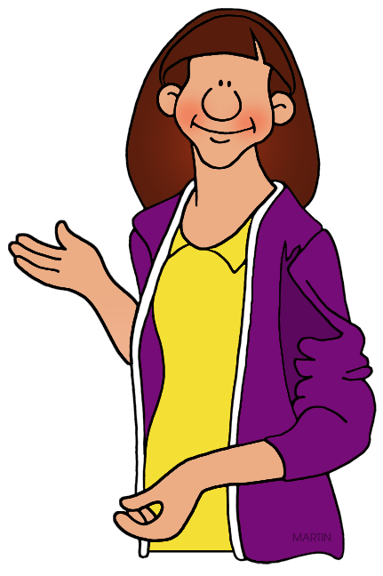
REVIEW 2
( UNITS 4 – 5 – 6)
Pronunciation
Vocabulary
Grammar

Slide 2
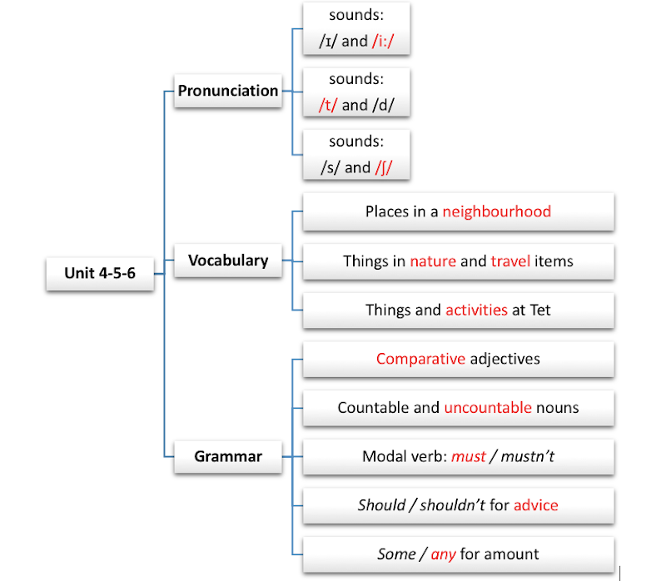

Slide 3

Pronunciation
Listen and circle the word with the different underlined sound.

Slide 4

1
Listen and circle the word with the different underlined sound.
1.
A.
seat
B.
wonders
C.
desert
2.
A.
cheap
B.
teach
C.
bread
3.
A.
sugar
B.
some
C.
sure
4.
A.
excuse
B.
between
C.
cathedral
5.
A.
modern
B.
crowded
C.
celebrate
Notes:
Thiếu tên bài đọc.

Slide 5


Vocabulary
Write the words in the box (a – h) next to their opposites (1 – 8).
Choose the correct word / phrase for each definition.

Slide 6
2
Write the words in the box (a – h) next to their opposites (1 – 8).
a. short
b. noisy
c. low
d. small
e. boring
f. hot
g. sad
h. cheap
1.
big
d. small
5.
long
a. short
2.
happy
g. sad
6.
expensive
h. cheap
3.
cold
f. hot
7.
high
c. low
4.
quiet
b. noisy
8.
interesting
e. boring

Slide 7
3
Choose the correct word / phrase for each definition.
1.
A place where a large amount of water falls from a high place. waterfall / lake
2.
A thing which helps you to ﬁnd directions.
backpack / compass
3.
A building where people go and see valuable art or old things. theatre / museum
4.
To tell someone you want them to be happy or successful. wish / hope
5.
Children receive it in red envelopes at Tet. lucky money / new clothes

Slide 8


Grammar
Complete the sentences with the correct answer A, B, or C.
Complete the sentences with should or shouldn’t.

Slide 9
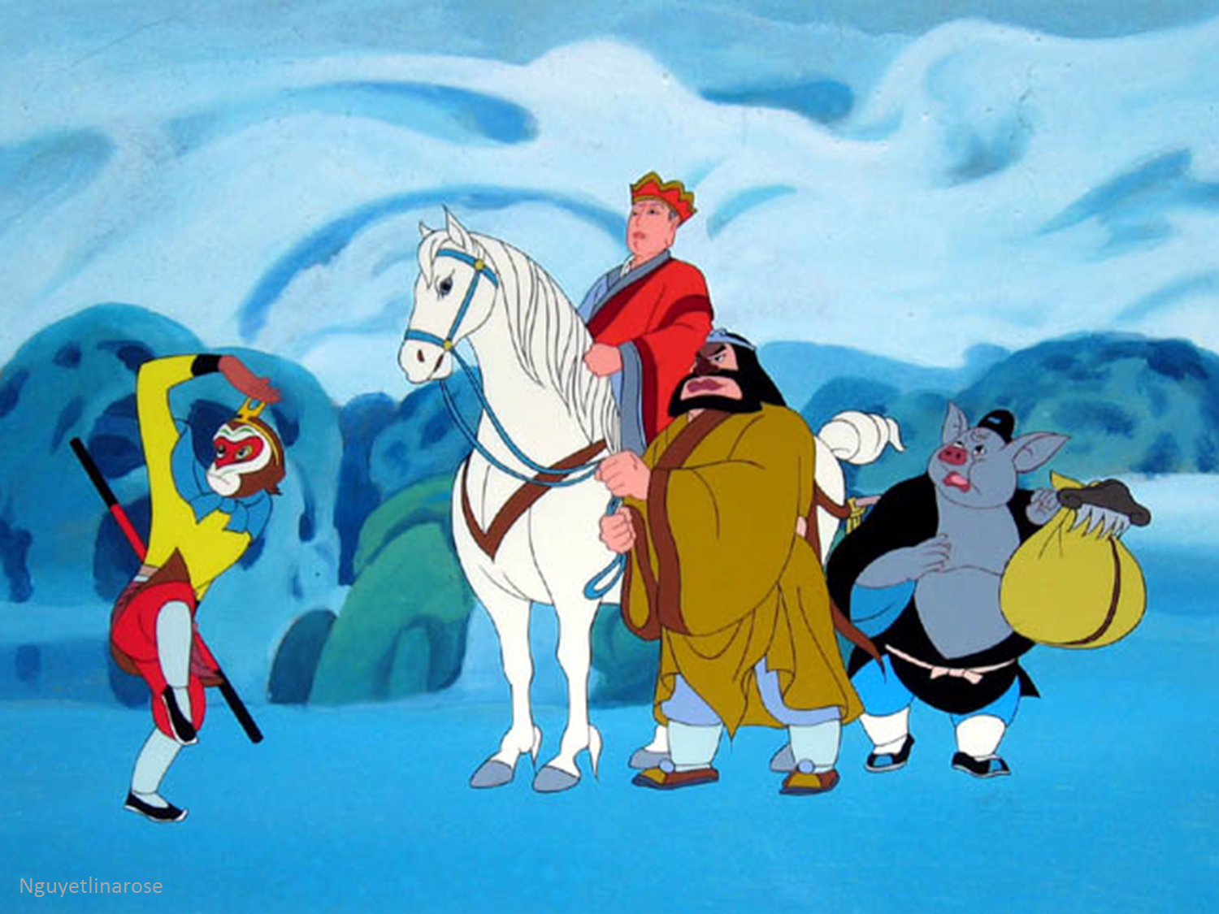

JOURNEY TO THE WEST

Slide 10

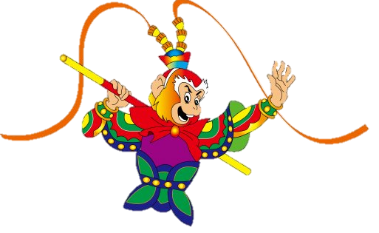
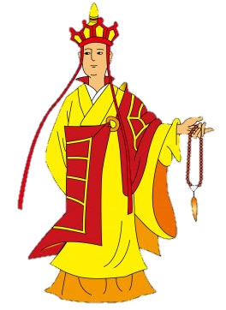
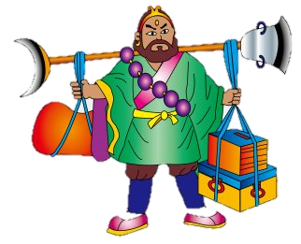
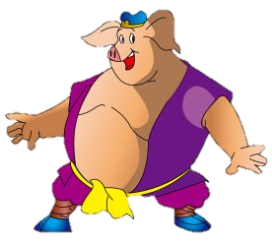

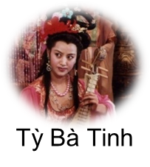
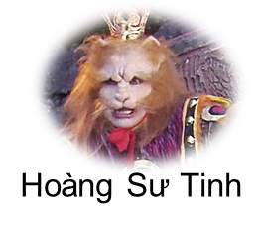
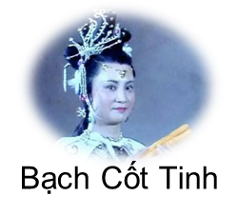
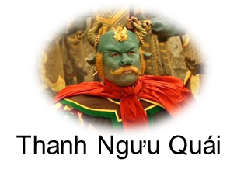
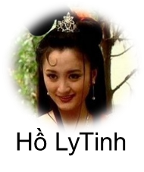
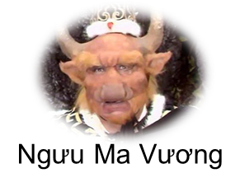
Notes:
Rule: Divide the class into 2 groups. Each group has 3 questions which should be answered.
The question can be chosen randomly. The point will be gotten when the answer is correct.
Note: Each character has different point.

Slide 11
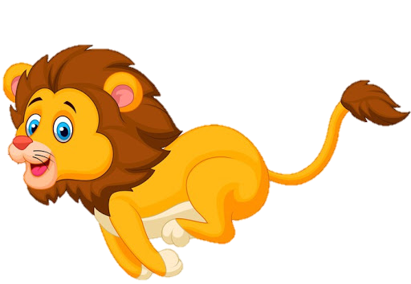
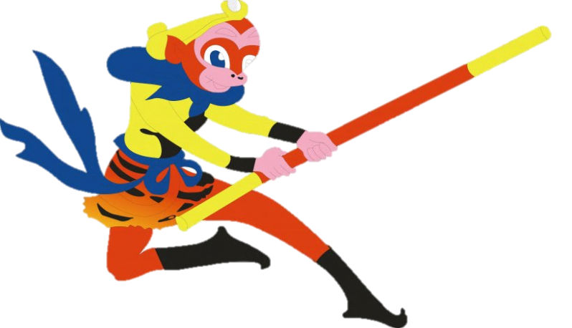
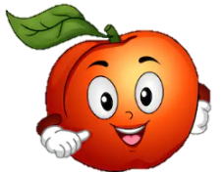
_______ long rivers of the world begin from the Himalayas.
+5
A. any
B. some
C. A

Slide 12

Sue’s drawings are more colourful ________ her teacher’s.
+3
A. most
B. as
C. than

Slide 13
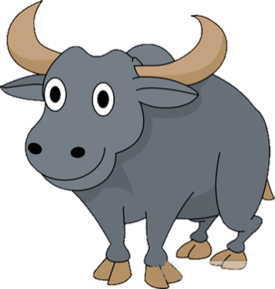
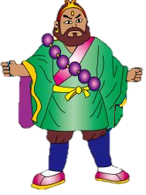

You ________ buy a ticket to enter the zoo. It’s not free.
+10
A. mustn’t
B. don’t
C. must

Slide 14
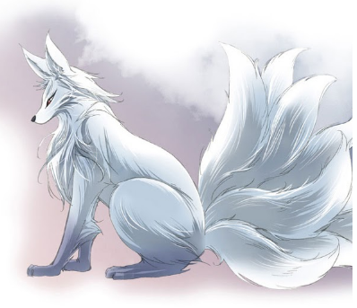
Do you know ______ English songs for children?
+9
A. any
B. a few
C. some

Slide 15
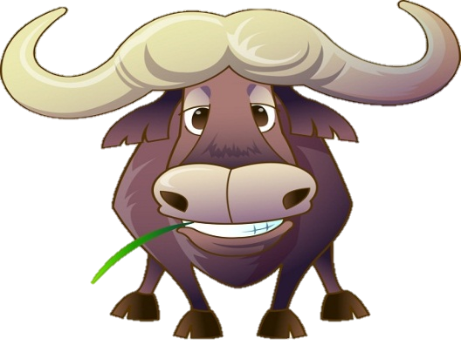
The USA has _______ natural wonders.
+7
A. many
B. much
C. a little

Slide 16

Hoa doesn't have _______ friends in Ha Noi.
+3
A. lots
B. any
C. lot

Slide 17
4
Complete the sentences with the correct answer A, B, or C.
1.
long rivers of the world begin from the Himalayas.
A.
B.
Some
C.
A
Any
2.
Sue’s drawings are more colourful her teacher’s.
A.
most
B.
as
C.
than
3.
You buy a ticket to enter the zoo. It’s not free.
B.
C.
must
A.
mustn’t
don’t
4.
Do you know English songs for children?
A.
B.
a few
C.
some
any
5.
The USA has natural wonders.
A.
B.
much
C.
a little
many

Slide 18
5
Complete the sentences with should or shouldn’t.
should
1.
When you get help from somebody, you
say “Thank you!”.
You ask people for lucky money. It’s not good behavior.
2.
shouldn’t
shouldn’t
3.
You make noise when you are eating.
Before you visit a natural wonder, you
learn about it.
4.
should
5.
What I do if I get lost?
should

Slide 19

Homework
  Learn vocabulary and the structure by heart.
  Do exercise in your work book
  Prepare the next lesson

